Slide 1
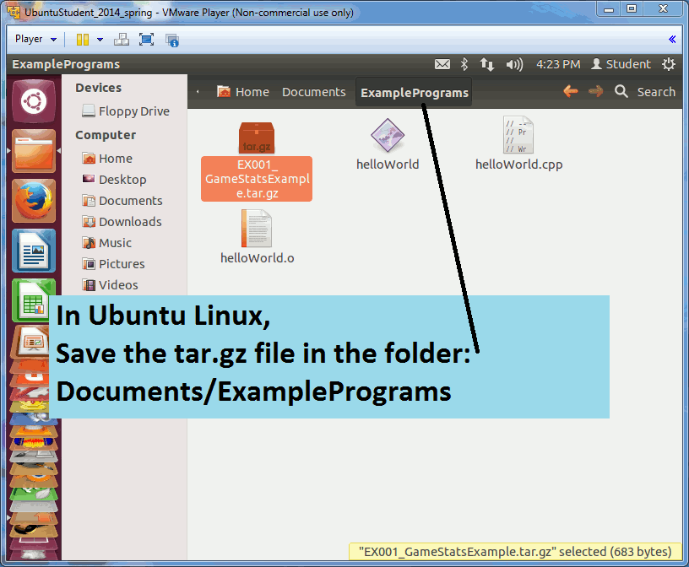
GameStats.cpp
CS 244 – Data Structures and Algorithms
Brent M. Dingle, Ph.D.
Department of Mathematics, Statistics, and Computer Science
University of Wisconsin – Stout
Based on the book: Data Structures and Algorithms in C++ (Goodrich, Tamassia, Mount)
Some content derived/taken from: http://www.stroustrup.com/Programming/

Slide 23
End
End

