Slide 1
C++ and Ubuntu Linux Review and Practice
CS 244
Brent M. Dingle, Ph.D.
Game Design and Development Program
Department of Mathematics, Statistics, and Computer Science
University of Wisconsin – Stout
2014

Slide 2
From Last Time
Installed VMware Player and Ubuntu Linux
Is there anyone who missed that?
Is there anyone who it is not working for yet?
If you missed the first class then you want to speak with me after this class

Slide 3
Things to Note
Some Class Activities will require you to drop box things into D2L
These typically are the graded activities
Other class Activities are for your own benefit
Such as installing Ubuntu Linux

Slide 4
Also Note
Your first homework is already posted online
Do NOT wait to the due date to start it
There will be a test (soon) on your C++ knowledge
Start reviewing as soon as possible

Slide 5
Today’s Plan
Set up some foundational groundwork stuff
Review some C++ and programming
Get some practice using Ubuntu Linux and g++

Slide 6
Start Marker
General questions about the course?
Next up
What is programming?
Object Oriented versus Structured
C++ Review and Intro to Ubuntu

Slide 7
Class Activity
What is programming?
Helper Questions:
Why do you write a program?
What are you trying to do? How?
Perhaps identify a simple example?

Slide 8
End Class Activity
Take a survey of answers
Write them on the board
Go to next slide and continue

Slide 9
Something You Already Know
What is programming?
Programming is taking
A problem
A set of data
A set of functions
Then
Finding a way to apply those functions to the data to get an answer to the problem
.
Check board
Does this equate?

Slide 10
Something You Already Know
What is programming?
Programming is taking
A problem
Find the area of a rectangle
A set of data
length and width
A set of functions
multiplication, addition, subtraction, division
Then
Finding a way to apply those functions to the data to get an answer to the problem
area = length * width
Example

Slide 11
Some New-ish Things
A Data Structure is a way of organizing and accessing data
Need to store a list of numbers?
Use an array of doubles
An Abstract Data Type (ADT) is
A set of data
A set of operations that can be performed on the data
An Algorithm is a step-by-step procedure for performing some task
Need to find the minimum number?
Use an algorithm

Slide 12
Back to What You Already Knew
Programming is taking
A problem
Find the area of a rectangle
A set of data
length and width
A set of functions
multiplication, addition, subtraction, division
Then
Finding a way to apply those functions to the data to get an answer to the problem
area = length * width
- An Abstract Data Type (ADT)
A set of Data
length and width
A set of operations
multiplication, addition, subtraction, division
Use an Algorithm with the ADT to get an answer to the problem
area = length * width

Slide 13
What is Programming – Summary
Programming is
Taking a given problem
Selecting an appropriate Abstract Data Type
Select the right tool
Applying the correct algorithm (using the selected ADT) to solve the problem
Use the tool in an efficient and appropriate manner

Slide 14
Marker Slide
Questions on:
What is programming?
Next up
Object Oriented versus Structured
C++ Review and Intro to Ubuntu

Slide 15
More Stuff You Already Know
Many ways to approach programming
Two popular ways
Procedural (aka structured)
Object Oriented
Guesses anyone?

Slide 16
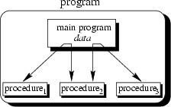
Procedural (basic concept)
The main program coordinates calls to procedures sending appropriate data as parameters
Example Languages:
BASIC, Pascal, C, FORTRAN
Data and functions are contained in procedures

Slide 17
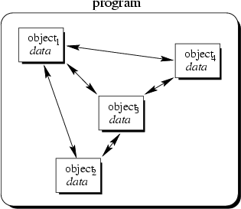
Object Oriented (basic concept)
Objects in the program interact
Conceptually by sending “messages” to each other
Objects contain both data and operations to act on that data
Example Languages:
Java, C++, Simula, Objective C, Smalltalk, Python

Slide 18
Object Oriented (characteristics)
Encapsulation
Classes hold and can hide data and functions
Nobody else needs to know how they work
Outsiders only get the interface
Inheritance
Objects can be derived from other objects
class Truck is derived from class Vehicle
Polymorphism
Ability to assume different forms
Pointers to a base class can point at derived classes
A pointer to SimplePerson can point to an Instructor or Student or SimplePerson

Slide 19
Object Oriented Supports
Modular programming
E.Z.(er) development
Maintainability

Slide 20
Object Oriented (implementation)
How languages have chosen to approach/allow object oriented design varies
C++
Supports both procedural and object oriented
Good for flexibility and usability
Why both?
Derived from C

Slide 21
Object Oriented (implementation)
How languages have chosen to approach/allow object oriented design varies
C++
Supports both procedural and object oriented
Good for flexibility and usability
Why both?
Derived from C

Slide 22
Marker Slide
Questions on:
What is programming?
Object Oriented versus Structured
Next up
C++ Review and Intro to Ubuntu

Slide 23
Recall Details of C++
So we now move on to details
How is an executable file created?
Write a C++ program
Remember C++

Slide 24
Executable Files
The file you run to launch a program is an executable file
In Windows executables are typically named someProgName.exe
In Linux the executable name used by g++ is a.out but can be specified to be almost any name and extension

Slide 25
Steps to an Executable
Using an editor a programmer (you) write C++ source code saving it as a file or files
After the source code is saved the programmer invokes a C++ compiler
an application that reads source code and translates it into an object file (.o or .obj)
A linker then links the object file to external files as necessary (like library files) and creates the executable file (.exe in Windows)

Slide 26
Steps to an Executable
Using an editor a programmer (you) write C++ source code saving it as a file or files
After the source code is saved the programmer invokes a C++ compiler
an application that reads source code and translates it into an object file (.o or .obj)
A linker then links the object file to external files as necessary (like library files) and creates the executable file (.exe in Windows)

Slide 27
Steps to an Executable
Using an editor a programmer (you) write C++ source code saving it as a file or files
After the source code is saved the programmer invokes a C++ compiler
an application that reads source code and translates it into an object file (.o or .obj)
A linker then links the object file to external files as necessary (like library files) and creates the executable file (.exe in Windows)

Slide 28
Steps to an Executable
Using an editor a programmer (you) write C++ source code saving it as a file or files
After the source code is saved the programmer invokes a C++ compiler
an application that reads source code and translates it into an object file (.o or .obj)
A linker then links the object file to external files as necessary (like library files) and creates the executable file (.exe in Windows)

Slide 29
Integrated Development Environment
To assist in the creation of executables a programmer often uses an Integrated Development Environment (IDE)
An IDE typically combines
an editor
a compiler
a linker
sometimes debugging and other tools
Examples:
Visual Studio, Eclipse, Xcode, etc.
g++ acts as both
a compiler
and a linker

Slide 30
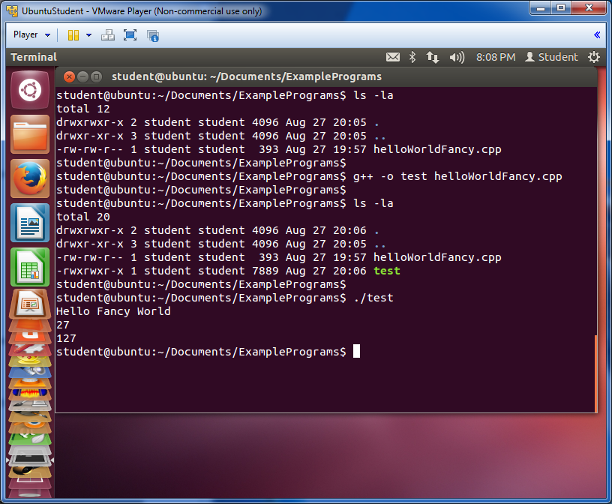
Command Line (Terminal Window)
Another way to invoke the compiler and linker is from the command line
This is usually done when
there is no graphical environment available
many engineering environments are NOT Windows/graphical
and/or when the program is only composed of one or two source files
Notes:
There is a helper document on D2L: HowTo_CompileCPP_viaCommandLine, that offers details on this for Ubuntu Linux and g++

Slide 31
Command Line (Terminal Window)
Another way to invoke the compiler and linker is from the command line
This is usually done when
there is no graphical environment available
many engineering environments are NOT Windows/graphical
and/or when the program is only composed of one or two source files
Notes:
There is a helper document on D2L: HowTo_CompileCPP_viaCommandLine, that offers details on this for Ubuntu Linux and g++

Slide 32
For this class
Our early projects will be command line compiled and linked
We will then look at how to create a Makefile
Then we will start using a very primitive IDE

Slide 33
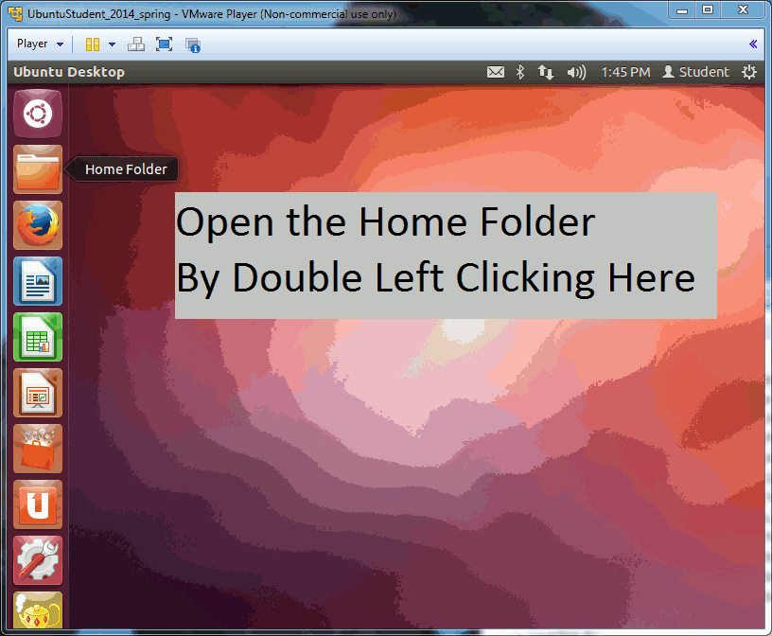
In Class Assignment – Hello
Take 10 to 20 minutes to
Create a HelloGameOver.cpp program
Use whatever text editor you like
This time using gedit may be the easiest
Use command line to invoke g++ to compile and link into an executable
Submit the source code and resulting executable (tarred together) to D2L
Each individual must submit something, but you may work together
There may exist a document on D2L to help you
Check the In Class Assignment Folder, for file: ICA001_HelloGameOver.pptx
Additional help may be found on D2L in the Helper Section
HowTo_CompileCPP_viaCommandLine.pdf

Slide 34
End In Class Assignment Hello
You have now completed your first C++ program for this course
AND know how tar and gzip the results
Most of the time you will only need to submit the source code
the executable will be re-created for grading
Be certain you submitted something to D2L

Slide 35
So far so good
Now you should practice and explore
Trivial Practice
ica002_DieRoller
More challenging
ica003_WordJumble
ica004_SimplePerson

Slide 36
The End
Or is it?

