Slide 1
Software Engineering Review
Chapter 1
CS 244
Brent M. Dingle, Ph.D.
Game Design and Development Program
Department of Mathematics, Statistics, and Computer Science
University of Wisconsin – Stout
2014

Slide 2
From Previous
Installed VMware Player and Ubuntu Linux
Turned in Graded In-Class assignment
Took Test ZERO
See me after class if you missed any of that

Slide 3
Outline Marker Slide
Go over Test Zero
Summary Review of Software Engineering
Chapter 1 highlights
Algorithm Analysis
Big-Oh

Slide 4
Test Zero
Present Solutions to Test Zero
Leave here
Give back tests
Go over general data on scores
Go over solution key
Come back here

Slide 5
Software Engineering
Chapter 1 Stuff
Ready
Set
Next Slide

Slide 6
Objectives of Chapter 1
Things you should
already know/review
Learn about software engineering principles
Discover what an algorithm is and explore problem-solving techniques
Become aware of structured design and object-oriented design programming methodologies
Learn about classes
Become aware of private, protected, and public members of a class

Slide 7
Objectives of Chapter 1
Things you should
already know/review
Explore how classes are implemented
Become aware of Unified Modeling Language (UML) notation
Examine constructors and destructors
Become aware of an abstract data type (ADT)
Explore how classes are used to implement ADTs

Slide 8
Software Life Cycle
Program life cycle
The phases between program conception and retirement
Three fundamental stages
Development, Use, and Maintenance
Program retirement occurs when
Program too expensive to maintain
No new version released
Our focus is on this stage

Slide 9
Program Life Cycle: Development
Development Stage
“First” and most important stage of the software life cycle
Four phases of Development
Analysis
Design
Implementation (and debugging)
Testing (and debugging)

Slide 10
Software Development: Analysis
Analysis (of problem)
First and most important step of development
Analysis requirements
Thoroughly understand the problem
Understand the problem requirements
Divide problem into subproblems (if complex)

Slide 11
Software Development: Design
Design
Design an algorithm to solve the problem or subproblem
Algorithm
Step-by-step problem-solving process
Solution obtained in finite amount of time
We will get back to design and analysis of algorithms shortly

Slide 12
Software Development: Design (cont)
Design
Structured design
Dividing problem into smaller subproblems
Also known as: top-down design, stepwise refinement, and modular programming

Slide 13
Software Development: Design (cont)
Design
Object-oriented design (OOD)
Identifies components called objects
Determines how objects interact with one another
Object specifications: relevant data; possible operations performed on that data
Object-oriented programming (OOP) language
Programming language implementing OOD
Object-oriented design principles
Encapsulation, inheritance, and polymorphism
Very popular topic for job interviews

Slide 14
Software Development: Implementation
Implementation
Write and compile programming code
Implement classes and functions discovered in the design phase
Final program consists of several functions
Each accomplishes a specific goal
Precondition
Statement specifying condition(s)
Must be true before function called
Postcondition
Statement specifying true items after function call completed
Debugging while implementing
typically means
fixing coding errors
syntax, initializations,
data assignments…

Slide 15
Software Development: Testing
Debugging while testing
typically means
fixing errors in logical design
boundaries and user interfacing
and meeting specifications
Testing
Testing
Testing program correctness
Verifying program works properly
Increase program reliability
Discover and fix errors before releasing to user
Test case
Set of inputs, user actions, other initial conditions, and the expected output
Document properly
Black-box testing and white-box testing
Implementation and
Testing are generally
iterative:
Implement, test,
implement, test…
Black box – inputs yield output expected
White box – test all code paths

Slide 16
Review Summary: Program Life Cycle
Program Life Cycle has 3 stages
Development, Use, and Maintenance
Development stage has 4 main phases
Analysis
Design
Implementation
Testing

Slide 17
Outline Marker Slide
Questions on:
Review of Software Engineering
Next Up:
Algorithm Analysis
Big-Oh

Slide 18
Algorithm
Algorithm:
step-by-step problem-solving process
solution obtained in finite amount of time
Created/selected in design phase of software development

Slide 19
Algorithm Analysis: Big-Oh
Analyze algorithm after design
Example
50 packages delivered to 50 different houses
50 houses one mile apart, in the same area
FIGURE 1-1 Gift shop and each dot representing a house

Slide 20
Algorithm Analysis: Big-Oh
Example (cont’d.)
Driver picks up all 50 packages
Drives one mile to first house, delivers first package
Drives another mile, delivers second package
Drives another mile, delivers third package, and so on
Distance driven to deliver packages
1+1+1+… +1 = 50 miles
Total distance traveled: 50 + 50 = 100 miles
Solution scheme 1
FIGURE 1-2 Package delivering scheme

Slide 21
Algorithm Analysis: Big-Oh
Example (cont’d.)
Similar route to deliver another set of 50 packages
Driver picks up first package, drives one mile to the first house, delivers package, returns to the shop
Driver picks up second package, drives two miles, delivers second package, returns to the shop
Total distance traveled
2 * (1+2+3+…+50) = 2550 miles
Solution scheme 2
FIGURE 1-3 Another package delivery scheme

Slide 22
Algorithm Analysis: Big-Oh
Example (cont’d.)
n packages to deliver to n houses, each one mile apart
First scheme: total distance traveled
1+1+1+… +n = 2n miles
Function of n
Second scheme: total distance traveled
2 * (1+2+3+…+n) = 2*(n(n+1) / 2) = n²+n
Function of n²
Which scheme is better?

Slide 23
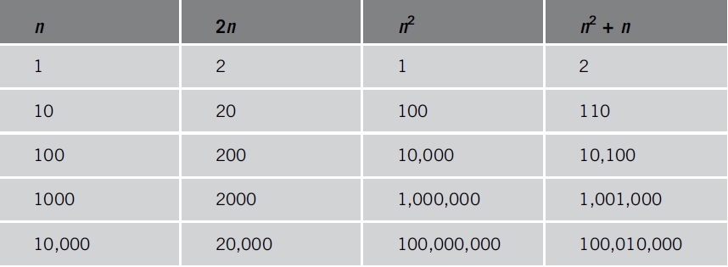
Algorithm Analysis: Big-Oh
Analyzing an algorithm
Count number of operations performed
Not affected by computer speed
TABLE 1-1 Various values of n, 2n, n², and n² + n

Slide 24
Algorithm Analysis: Big-Oh
Example 1-1
Illustrates fixed number of executed operations
1 op

Slide 25
Algorithm Analysis: Big-Oh
Example 1-1
Illustrates fixed number of executed operations
1 op
1 op

Slide 26
Algorithm Analysis: Big-Oh
Example 1-1
Illustrates fixed number of executed operations
1 op
1 op
1 op

Slide 27
Algorithm Analysis: Big-Oh
Example 1-1
Illustrates fixed number of executed operations
1 op
1 op
1 op
1 op

Slide 28
Algorithm Analysis: Big-Oh
Example 1-1
Illustrates fixed number of executed operations
1 op
1 op
1 op
1 op
1 op

Slide 29
Algorithm Analysis: Big-Oh
Example 1-1
Illustrates fixed number of executed operations
1 op
1 op
1 op
1 op
1 op
1 op

Slide 30
Algorithm Analysis: Big-Oh
Example 1-1
Illustrates fixed number of executed operations
1 op
1 op
1 op
1 op
1 op
1 op
1 op

Slide 31
Algorithm Analysis: Big-Oh
Example 1-1
Illustrates fixed number of executed operations
1 op
1 op
1 op
1 op
1 op
1 op
1 op
Constant number of operations
Aside: O(1)

Slide 32
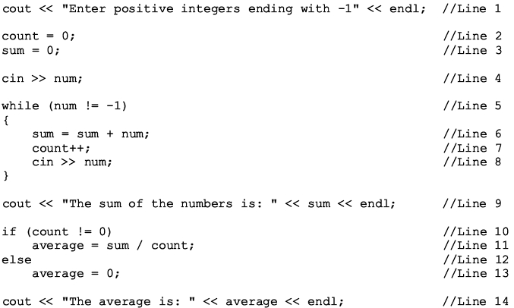
Algorithm Analysis: Big-Oh
Example 1-2
Illustrates dominant operations
1 op

Slide 33
Algorithm Analysis: Big-Oh
Example 1-2
Illustrates dominant operations
1 op
1 op

Slide 34
Algorithm Analysis: Big-Oh
Example 1-2
Illustrates dominant operations
1 op
1 op
1 op

Slide 35
Algorithm Analysis: Big-Oh
Example 1-2
Illustrates dominant operations
1 op
1 op
1 op
1 op

Slide 36
Algorithm Analysis: Big-Oh
Example 1-2
Illustrates dominant operations
1 op
1 op
1 op
1 op

Slide 37
Algorithm Analysis: Big-Oh
Example 1-2
Illustrates dominant operations
1 op
1 op
1 op
1 op
1 op

Slide 38
Algorithm Analysis: Big-Oh
Example 1-2
Illustrates dominant operations
1 op
1 op
1 op
1 op
1 op
1 op

Slide 39
Algorithm Analysis: Big-Oh
Example 1-2
Illustrates dominant operations
1 op
1 op
1 op
1 op
1 op
1 op
1 op

Slide 40
Algorithm Analysis: Big-Oh
Example 1-2
Illustrates dominant operations
1 op
1 op
1 op
1 op
1 op
1 op
1 op
1 op

Slide 41
Algorithm Analysis: Big-Oh
Example 1-2
Illustrates dominant operations
1 op
1 op
1 op
1 op
1 op
1 op
1 op
1 op
1 op

Slide 42
Algorithm Analysis: Big-Oh
Example 1-2
Illustrates dominant operations
1 op
1 op
1 op
1 op
1 op
1 op
1 op
1 op
1 op
1 op

Slide 43
Algorithm Analysis: Big-Oh
Example 1-2
Illustrates dominant operations
1 op
1 op
1 op
1 op
Constant except for here
Depends on User Input Size
This while-loop dominates the runtime
Input size is usually represented by: n
1 op
1 op
1 op
Aside: yielding O(n) for this code
1 op
1 op
1 op

Slide 44
Algorithm Analysis: Big-Oh
Notation notes related to Big-Oh
n: represents “input” size
f(n): number of basic operations
c: units of computer time to execute one operation
cf(n): computer time to execute f(n) operations
Constant c depends on computer speed (varies)
Goal: Determine algorithm efficiency
Knowing how function f(n) grows as problem size grows

Slide 45
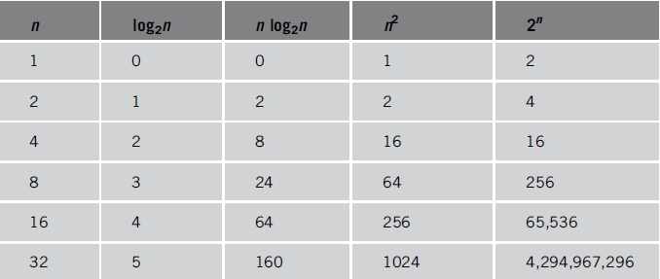
Algorithm Analysis: Big-Oh
TABLE 1-2 Growth rates of various functions

Slide 46
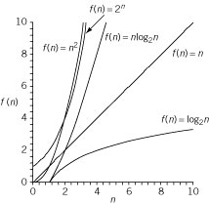
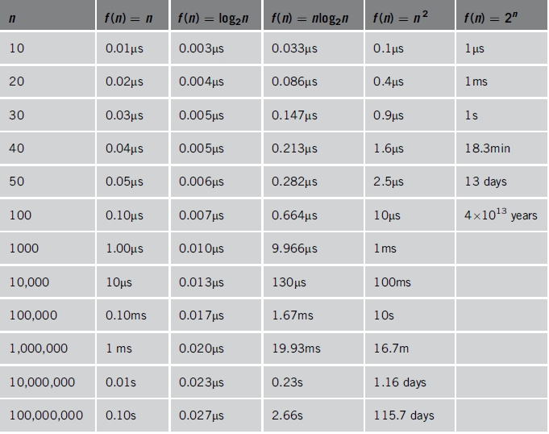
Algorithm Analysis: Big-Oh
TABLE 1-3 Time for f(n) instructions on a computer that executes 1 billion instructions per second
Figure 1-4 Growth rate
of functions in Table 1-3

Slide 47
Algorithm Analysis: Big-Oh
Notation useful in describing algorithm behavior
Shows how a function f(n) grows as n increases without bound
Analysis is
Asymptotic in nature
Study of the function f as n becomes larger and larger
Examples of functions
g(n)=n² (no linear term)
f(n)=n² + 4n + 20

Slide 48
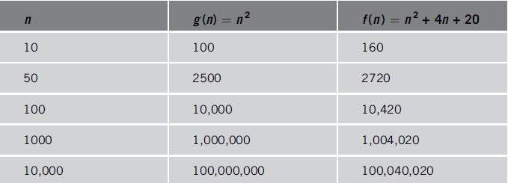
Algorithm Analysis: Big-Oh
Consider f(n) = n² + 4n + 20
As n becomes larger and larger
Term 4n + 20 in f(n) becomes insignificant
Term n² becomes dominant term
TABLE 1-4 Growth rate of n² and n² + 4n + 20n
60 versus 100
similar “size”

Slide 49
Algorithm Analysis: Big-Oh
Consider f(n) = n² + 4n + 20
As n becomes larger and larger
Term 4n + 20 in f(n) becomes insignificant
Term n² becomes dominant term
TABLE 1-4 Growth rate of n² and n² + 4n + 20n
220 versus 2500
similar
but 2500 is ‘bigger’ than 220

Slide 50
Algorithm Analysis: Big-Oh
Consider f(n) = n² + 4n + 20
As n becomes larger and larger
Term 4n + 20 in f(n) becomes insignificant
Term n² becomes dominant term
TABLE 1-4 Growth rate of n² and n² + 4n + 20n
420 versus 10,000… the 420 seems “small”

Slide 51
Algorithm Analysis: Big-Oh
Consider f(n) = n² + 4n + 20
As n becomes larger and larger
Term 4n + 20 in f(n) becomes insignificant
Term n² becomes dominant term
TABLE 1-4 Growth rate of n² and n² + 4n + 20n
4020 versus 1,000,000… the 4020 seems “very small”

Slide 52
Algorithm Analysis: Big-Oh
Consider f(n) = n² + 4n + 20
As n becomes larger and larger
Term 4n + 20 in f(n) becomes insignificant
Term n² becomes dominant term
We conclude: f(n) = n² + 4n + 20
is O(n²)
TABLE 1-4 Growth rate of n² and n² + 4n + 20n
40,020 versus 100,000,000… the 40,020 is “insignificant”

Slide 53
Algorithm Analysis: Big-Oh
Definition
Let f and g be real-valued functions
Assume f and g nonnegative
For all real numbers n, f(n) >= 0 and g(n) >= 0
f(n) is Big-Oh of g(n): written f(n) = O(g(n))
If there exists positive constants c and n₀ such that f(n) <= cg(n) for all n >= n₀

Slide 54
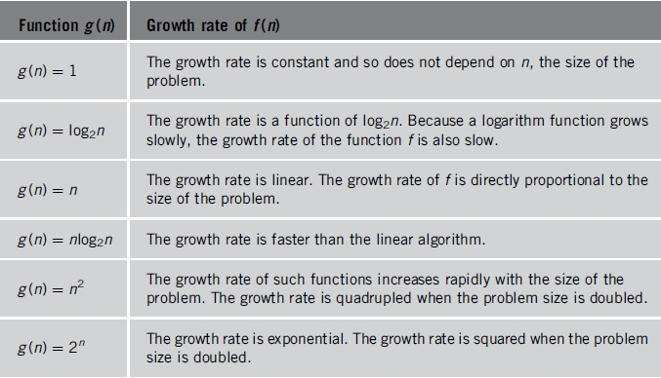
Algorithm Analysis: Big-Oh
TABLE 1-5 Some Big-O functions that appear in algorithm analysis

Slide 55
Presentation Summary
Program life cycle software development phases
Analysis, Design, Implementation, and Testing
Object-oriented design principles
Encapsulation, Inheritance, and Polymorphism
Algorithm: step-by-step problem-solving process
Solution obtained in finite amount of time
Big-Oh
Used to analyze and compare algorithms

Slide 56
Next Time
More on Big-Oh

Slide 57
Actions Items for Today
Homework 1
Due Sept 18
Check D2L for details
Homework 2
Due Sept 25
Check D2L for details

Slide 58
The End
Or is it?

