Slide 1
Big Oh
CS 244
Brent M. Dingle, Ph.D.
Game Design and Development Program
Department of Mathematics, Statistics, and Computer Science
University of Wisconsin – Stout
2014

Slide 2
Things to Note
Homework 1 is Due
  Before now (8 AM, Sep 18)
  If you have not yet turned it in, do so now
  Peer Review will be towards end of class
Homework 2 is Posted on D2L
  Do NOT delay in starting it

Slide 3
Notes on Homework
Some comments on Homework 2 follow
Offering clarification on interpretation of a couple questions
  If these additions are not already in there

Slide 4
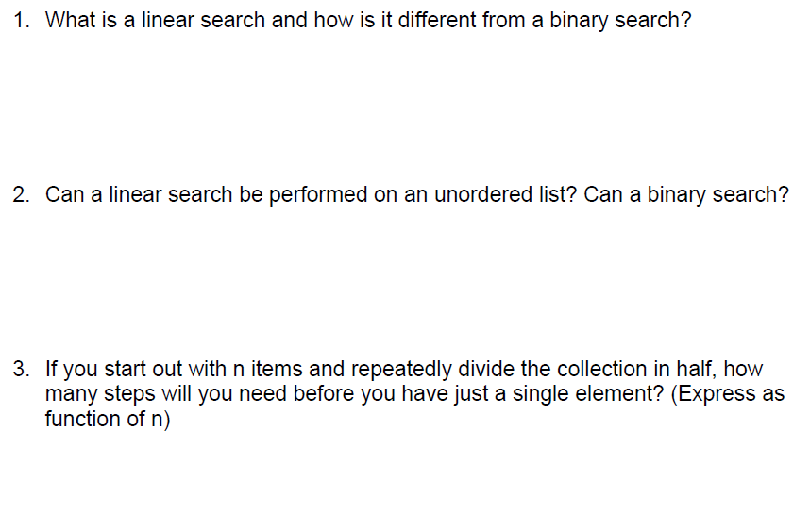
Linear Search vs. Binary Search
^ successfully performed

Slide 5
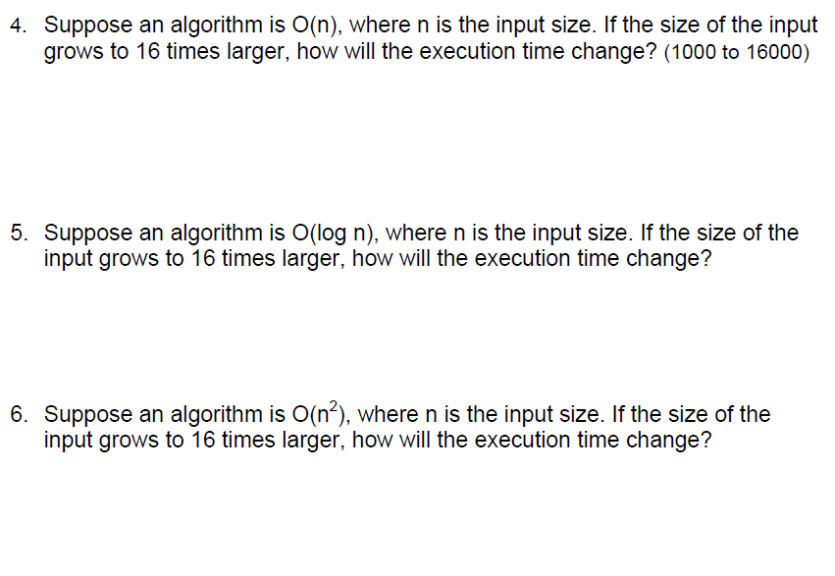
Running Time Comparisons
log n here means “log Base 2 of n”

Slide 6
From Last Time
  Software Engineering
  Introduction to Big-Oh

Slide 7
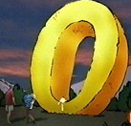
For Today
Algorithms
Big-Oh

Slide 8
Marker Slide
Any General Questions ?
Next up
  Algorithms
  Big-Oh

Slide 9

Algorithm Introduction
An algorithm is a set of instructions used to solve a specific problem.
  A sequence of steps to solve the problem
  A step by step set of instructions to solve the problem
  Synonyms
    Process
    Method
    Procedure
    Routine
    Recipe
Yeah, let’s cook something.

Slide 10
Properties of Algorithms
Algorithm design focusses on
  Input
  Definition
  Correctness
  Result Specification
  Termination

Slide 11





Pieces So far
Algorithm design focusses on
  Input
  Definition
  Correctness
  Result Specification
  Termination
Definition
Input
Correctness
Specification
Time
All these can be done in
‘consistent’ fashion for any algorithm

Slide 12
Pieces So far
Algorithm design focusses on
  Input
  Definition
  Correctness
  Result Specification
  Termination
Definition
Input
Correctness
Specification
Time
How long does it take
the Algorithm to run to completion?
Assume we only use/create algorithms
that do indeed finish (i.e. no infinite loops)
How do we answer this question?

Slide 13
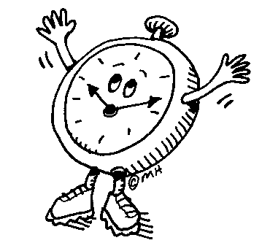
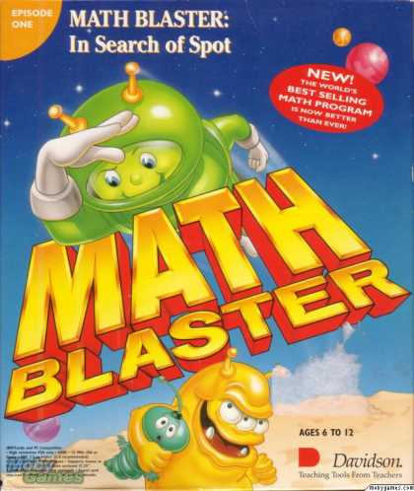
Measuring Execution Time: 2 ways
Physically Time the Implementation
    Wall-clock time
    Benchmarks
    Experimental Studies
Theoretical Analysis
  Asymptotic Analysis
    Use Math

Slide 14
Experimental Studies
Write a program implementing the algorithm
Run the program with inputs of varying size and composition
Use a method like clock() to get an accurate measure of the actual running time
Plot the results

Slide 15
Limitations of Experiments
It is necessary to implement the algorithm, which may be difficult
Results may not be indicative of the running time on other inputs not included in the experiment.
In order to compare two algorithms, the same hardware and software environments must be used

Slide 16
Pieces So far
Algorithm design focusses on
  Input
  Definition
  Correctness
  Result Specification
  Termination
Definition
Input
Correctness
Specification
Time
How long does it take
the Algorithm to run to completion?
Assume we only use/create algorithms
that do indeed finish (i.e. no infinite loops)
So physically timing the execution
has some issues
Try option 2: Math

Slide 17
The Problem to Solve
for those that
may have drifted off
Algorithms take time to run.
  We want to measure the time relative to data input size (i.e. n )
  Using a physical timer has lots of complications
    Does not allow for easy comparison of algorithms
  Most interested in “worst case” time

Slide 18
Measuring Running Time
emphasis point
Running time of an algorithm grows with the input size
Average case time is often difficult to determine
We focus on the worst case running time
  Crucial to applications such as games, finance and robotics
  Easier to analyze
worst case
5ms
4ms
Running Time
3ms
best case
2ms
1ms
A
B
C
D
E
F
G
Input Instance

Slide 19
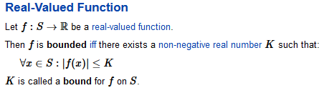
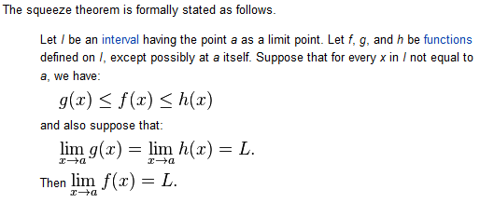
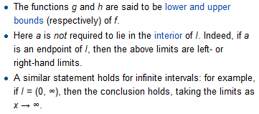

Bounding Functions
Long ago in a galaxy called Calculus
  Functions were bounded
    Not only could they be bound by constants
    But by other limiting functions
It was a dark and mysterious place
  Let’s go there =)

Slide 20
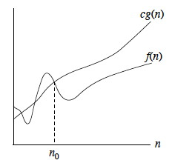
What We Want
Assume: our algorithm can be characterized to run in f(n) time
  where n = input size
We want a function g(n)
  that at some value
  of n = n0
  becomes greater than f(n) and stays greater
  and it is okay if we have to multiply g(n) by some constant c to get this

Slide 21
O( mathFunction )
if we can find such a g(n) then we will say
  our algorithm runs in
  O( g(n) ) time
More Formally:
a function f(n) is O(g(n))
if f(n) is bounded above by some constant multiple of g(n) for all large n.
So, f(n) ≤ cg(n) for all n > n_{o} .

Slide 22
What do we get?
Math: Asymptotic Analysis
  Uses a high-level description of the algorithm
  instead of an implementation
  Characterizes running time as a function
  of the input size, n.
  Takes into account all possible inputs
  Allows us to evaluate the speed of an algorithm independent of the hardware/software environment

Slide 23
Marker Slide
Any Questions On:
  Algorithms
    General
    Execution Time: Physically Timing
    Execution Time: Asymptotic Analysis: Big-Oh
Next up
  Big-Oh: Motivation
    Linear Search
    Binary Search

Slide 24
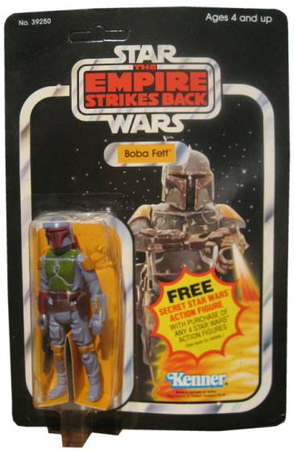
Motivation: Linear Search
Say you have 1,000 action figures
  You keep them in an unorganized (but very cool) looking pile on your otherwise unused bed
A friend comes over and wants
to see the super rare and totally
awesome Boba Fett
In the worst case how many action figures will you have to look at before you are guaranteed to have found the specified Boba Fett?

Slide 25

Motivation: Linear Search (cont)
Worst case: 1000
If there were 10,000 action figures?
  Worst case is 10,000
If there were 100,000?
  Worst case is 100,000
So the input size (1000, 10000, 100000) is directly proportional to the worst case search time
  This is described as O(n)
for k = 1 to 1000
look at action figure number k
stop if it is Boba Fett
for k = 1 to 10,000
look at action figure number k
stop if it is Boba Fett
for k = 1 to 100,000
look at action figure number k
stop if it is Boba Fett
for k = 1 to n
look at action figure number k
stop if it is Boba Fett

Slide 26
Marker Slide
Any Questions On:
  Algorithms
    General
    Execution Time: Physically Timing
    Execution Time: Asymptotic Analysis: Big-Oh
  Big-Oh: Motivation
    Linear Search
Next up
  Big-Oh: Motivation
    Binary Search

Slide 27

More Examples – More Motivation
Why do we care how long an algorithm will take to run?
  So we can
    Generalize
    Re-apply
    Improve
    Compare
    Determine if we are using the RIGHT TOOL for the job
Consider Dictionaries…

Slide 28
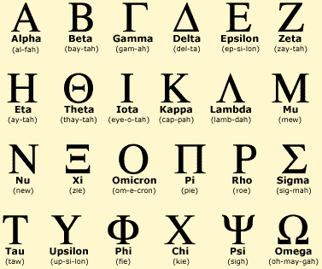

Dictionaries – Motivation
Why are dictionaries alphabetized?
  [ pause for student participation ]

Slide 29

Dictionaries – Motivation
Why are dictionaries alphabetized?
  To speed up looking for things.

Slide 30

Dictionaries – Motivation
Why are dictionaries alphabetized?
  To speed up looking for things.
Why does alphabetizing
them help?
  [ Yet Another Pause ]
    YAP…. YAP…. YAP

Slide 31

Dictionaries – Motivation
Why are dictionaries alphabetized?
  To speed up looking for things.
Why does alphabetizing
them help?
  We can find things faster.
  Using an Ordered List.

Slide 32
Dictionaries – Find Things Faster
Using an ordered list
helps us find things faster
  How does that work?
  [ YAP ]
    Describe processes of using dictionary

Slide 33

























How to Use a Dictionary
Keep cutting the search area in half
Open dictionary to the middle
  Then to ¼ or ¾ mark
    Then (1/8 or 3/8 mark) or (5/8 or 7/8)
      Then …
Find Happiness

Slide 34
Discovered: Binary Search
By investigating dictionaries
  We discovered an ordering
  allows us to perform a binary search
    more on that search method later
For now we will claim a Binary Search is
  O(log n)
    to be shown later

Slide 35
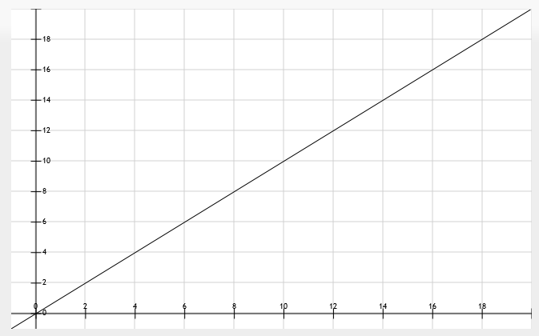
More Examples – More Motivation
Why do we care how long an algorithm will take to run?
    Compare
  Linear: O(n)
  Binary: O(lg n)
  Which is faster?
    Consider the graphs of each
lg(n) < n, for all n > 0
Binary Search is thus faster

Slide 36
Marker Slide
Any Questions on:
  Algorithms
    General
    Execution Time: Physically Timing
    Execution Time: Asymptotic Analysis: Big-Oh
  Big-Oh: Motivation
    Linear Search
    Binary Search
Next up
  Peer Review of hw01

Slide 37
Graded: Peer Review
Perform Peer Review on HW #1
Form into groups of 4 to 6 people
  Give copy of your solution to person on your right
    Rightmost person circle around: give to leftmost person
Locate PeerReviewSheet on D2L
  Fill it out based on your evaluation of the code you have been given
When done
  Submit PeerReviewSheet to D2L
Repeat once (so you do a total of 2 reviews)

Slide 38

The End
Or is it?

