Slide 1
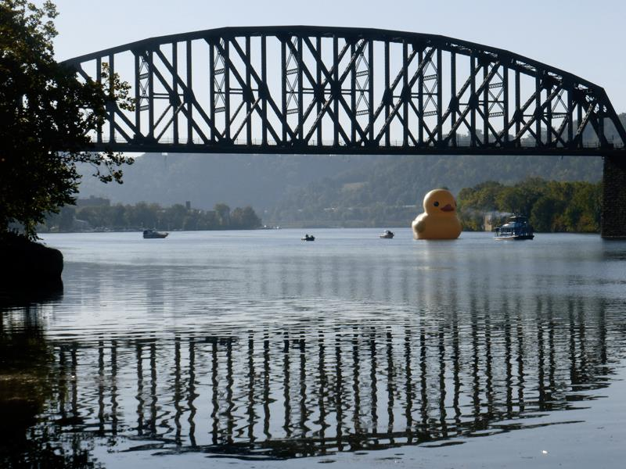

Big Oh – part 2
CS 244
This presentation
requires Sound Enabled
Brent M. Dingle, Ph.D.
Game Design and Development Program
Department of Mathematics, Statistics, and Computer Science
University of Wisconsin – Stout
2014
Notes:
This only took 1 hour to present. Suggest: Put more student work in

Slide 2
Things to Note
Homework 2 is Due Soon
Homework 3 is Posted on D2L
  Do NOT delay in starting it

Slide 3
From Last Time
  Algorithms
    Review
  Big-Oh
    Introduction
    Linear Search
    Binary Search

Slide 4
For Today
More on Big-Oh
  This extends beyond that presented in Chapter 1 of your book, but start there
Side Comment
  There are many ways to approach Big-Oh
  You will see several of the possible approaches
  Some are math/logic based, some more ‘human intuition’ based
  Some are faster, less error prone, and better than others
  NONE are randomly guessing

Slide 5
Marker Slide
Any General Questions ?
Next up
  Searching Arrays
    Summary Review from last time
  Big-Oh
    The Math side of things
      Asymptotic Analysis
    The Code side of things
      Examples, how to get the math function

Slide 6
Searching Arrays:
Linear Search and Binary Search
Searching
  Find an element in a large amount of data
    Typically checking if an array contains
    a value matching the sought element’s key value
So far you have seen at least:
  Linear searching (sequential search)
  Binary searching
Action Figures
and Dictionary examples
from Previous lecture

Slide 7
Sequential (Linear) Search
Action Figures
Previous lecture
Begins at the start of the list and continues until the item is found or the entire list has been searched
  Compare each array element with search key
    If search key found, return element index
    If search key not found, return –1 (invalid index)
  Works best for small or unsorted arrays
  Inefficient for larger arrays

Slide 8
Binary Search, on Ordered Lists
Dictionary Happiness
Previous lecture
Uses a divide-and-conquer strategy to find an element in a list (eliminates half for each pass)
  Compare middle array element to search key
    If element equals key, then return array index
    If element is less than key, then repeat search on first half of array
    If element is greater then key, then repeat search on second half of array
    Continue search until
      Element equals search key (success)
  Efficient for large, sorted arrays

Slide 9
Searching: Big-Oh Reference
Linear Search
  O(n)
Binary Search
  O(lg n)
    yet to be proven/shown how
    spoiler:
      (integer-wise) lg n is the number of times n can be divided by 2

Slide 10
Marker Slide
Any Questions On:
  Searching Arrays
    Summary Review from last time
Next up
  Big-Oh
    The Math side of things
      Asymptotic Analysis
      Growth Rate Comparisons (input growth versus time growth)
    The Code side of things
      Examples, how to get the math function

Slide 11
Definitions
An algorithm is a sequence of steps to solve a problem.
  The performance of an algorithm when implemented on a computer may vary depending on the approach used to solve the problem and the actual steps taken.
To compare the performance of algorithms, computer scientists use big-O notation.
  We will study several algorithms during this course and analyze their performance using big-O notation.

Slide 12



Measuring Algorithm Efficiency
There are different mechanisms for measuring efficiency.
  Measure actual system characteristics (practical)
    processor time used,
    memory size used,
    and execution time. (practical)
  Measure Time to develop the program (developer time).
  Analyze the number of operations an algorithm performs
  to measure its complexity. (theoretical)
  You can analyze the space (memory or disk) that the algorithm uses to perform its computation. (theoretical)
    Often, algorithms make a time vs. space trade-off.
    That is, the algorithm may run faster if given more space.
Most of this class will put focus here

Slide 13
Best, Worst, and Average Case
Few algorithms
  have the exact same performance every time
    performance of an algorithm depends on the size of the inputs it processes
The best case performance of the algorithm is the most efficient execution of the algorithm on the "best" data inputs.
The worst case performance of the algorithm is the least efficient execution of the algorithm on the "worst" data inputs.
The average case performance of the algorithm is the average efficiency of the algorithm on the set of all data inputs.
The analysis of all cases typically
  expresses efficiency in terms of the input size, n, of the data.
Most of this class will put focus here – on worst case

Slide 14
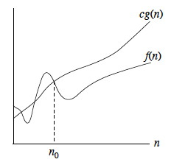

Big-Oh: Used for What (again)
Big-O notation is a mechanism for quickly communicating the efficiency of an algorithm.
  Big-O notation measures the worst case performance of the algorithm by bounding the formula expressing the efficiency.
cg(n) bounds f(n)

Slide 15
Asymptotic Execution Time
Suppose f(n) is a formula describing the exact execution run time of some algorithm for an input size of n.
That algorithm is then O( g(n) )
If there exist constants c and n₀ such that:
    f(n) ≤ c*g(n), for all n > n₀
cg(n) bounds f(n)
For Example…
Searching a dictionary is O( log n )
Searching an unordered list is O( n )

Slide 16
Big-Oh Notation
Given functions f(n) and g(n), we say that
f(n) is O(g(n))
if there are positive constants
c and n₀ such that
f(n) ≤ cg(n) for n ≥ n₀
In other words:
a function f(n) is O(g(n))
if f(n) is bounded above by some constant multiple of g(n) for all large n.
So, f(n) ≤ cg(n) for all n > n_{o} .

Slide 17
Big-Oh Notation
Given functions f(n) and g(n), we say that
f(n) is O(g(n))
if there are positive constants
c and n₀ such that
f(n) ≤ cg(n) for n ≥ n₀
Example: 2n + 10 is O(n)
  2n + 10 ≤ cn
  (c − 2) n ≥ 10
  n ≥ 10/(c − 2)
  Pick c = 3 and n₀ = 10

Slide 18

7 Functions
Seven functions commonly used to examine the complexity of an algorithm are:
  constant, log₂n, n, n log₂n, n², n³, 2^{n}
These are listed in lowest complexity to highest complexity
  More details follow
In this class the subscript 2 may be omitted:
log₂n → log n but in the context of this class log n should be taken to mean log base 2 of n,
unless explicitly stated otherwise.
You may also see log₂n abbreviated lg n
Note your calculator will not understand this
Base Conversion Reminder:
$$\log_{2}(x)= \frac{\log_{10}(x)}{\log_{10}(2)}$$

Slide 19
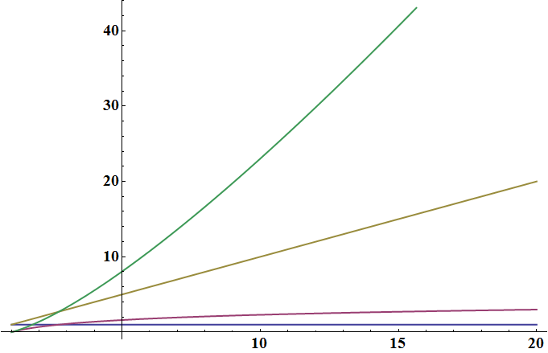
Common Big-Oh Functions
Seven functions that often appear in algorithm analysis:
  Constant ≈ 1
  Logarithmic ≈ log n
  Linear ≈ n
  N-Log-N ≈ n log n
  Quadratic ≈ n²
  Cubic ≈ n³
  Exponential ≈ 2^{n}

Slide 20
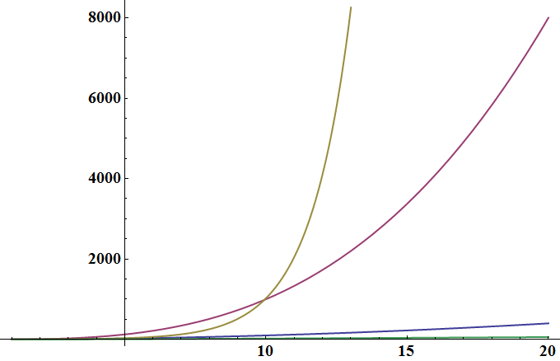
Common Big-Oh Functions
Seven functions that often appear in algorithm analysis:
  Constant ≈ 1
  Logarithmic ≈ log n
  Linear ≈ n
  N-Log-N ≈ n log n
  Quadratic ≈ n²
  Cubic ≈ n³
  Exponential ≈ 2^{n}

Slide 21
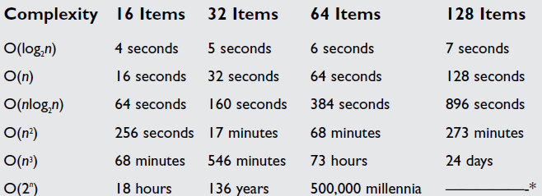
Running Time Comparisons
* just too big of a number to calculate

Slide 22
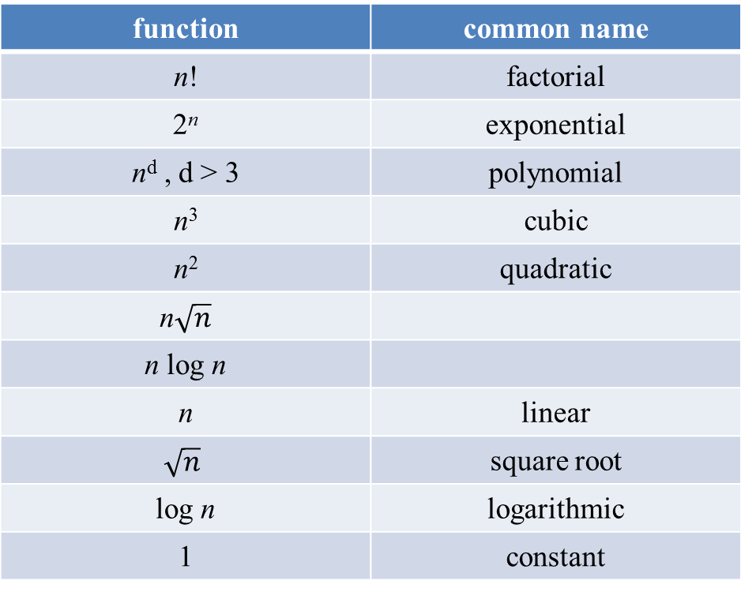
Ranking of Execution Times
function | common name
n! | factorial
2^{n} | exponential
n^{d} , d > 3 | polynomial
n³ | cubic
n² | quadratic
n$\sqrt{n}$
n log n
n | linear
$$\sqrt{n}$$ | square root
log n | logarithmic
1 | constant
fast → ok → kinda slow → way too long

Slide 23
Constant Factors and Big Oh
With regard to Big Oh Analysis
The growth rate is not affected by
  constant factors, c, or
  lower-order terms
Examples
  100 n + 10⁵ is a linear function O(n)
  40 n² + 10⁸n is a quadratic function O(n²)
constant factor
lower order term
constant factors
lower order term

Slide 24
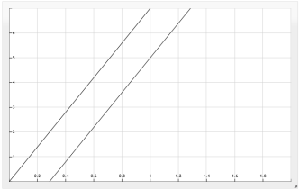
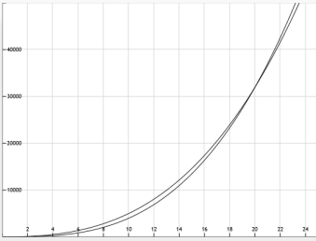
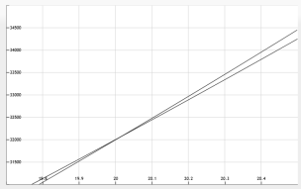
Big Oh Examples: Applying Definition
7n – 2
3n³ + 20n² + 5
3 (log n) + 5
  7n-2 is O(n)
  need c > 0 and n₀ ≥ 1 such that 7n-2 ≤ c•n for n ≥ n₀
  this is true for c = 7 and n₀ = 1
  3n³ + 20n² + 5 is O(n³)
  need c > 0 and n₀ ≥ 1 such that 3n³ + 20n² + 5 ≤ c•n³ for n ≥ n₀
  this is true for c = 4 and n₀ = 21
  3 log n + 5 is O(log n)
  need c > 0 and n₀ ≥ 1 such that 3 log n + 5 ≤ c•log n for n ≥ n₀
  this is true for c = 8 and n₀ = 2

Slide 25
Marker Slide
Any Questions On:
  Searching Arrays
  Big-Oh
    The Math side of things
      Asymptotic Analysis
Next up
  Big-Oh
    The Math side of things
      Growth Rate Comparisons
    The Code side of things
      Nested For-Loops, Sigma Notation
      Practice Exercises
      Book Example

Slide 26
Big-Oh: Relates to Growth Rate
As Big-Oh notation is based on asymptotic analysis
  Big-Oh notation gives an upper bound on the growth rate of a function
  The statement “f(n) is O(g(n))” means that the growth rate of f(n) is no more than the growth rate of g(n) (f(n) ≤ cg(n) for n ≥ n₀ → f’(n) ≤ c g’(n) )
Thus
  We can use the big-Oh notation
  to rank functions according to their growth rate
Are we allowed to use derivatives
in a Computer Science Class?
YES!
 | f(n) is O(g(n)) | g(n) is O(f(n))
g(n) grows more | Yes | No
f(n) grows more | No | Yes
Same growth | Yes | Yes

Slide 27
Summarizing: Why Growth Rate Matters
Aside
c is just a constant
Pretend it is 1
and make it go away
if it helps
if runtime is... | time for n + 1 | time for 2 n | time for 4 n
c lg n | c lg (n + 1) | c (lg n + 1) | c(lg n + 2)
c n | c (n + 1) | 2c n | 4c n
c n lg n | ~ c n lg n + c n | 2c n lg n + 2cn | 4c n lg n + 4cn
c n² | ~ c n² + 2c n | 4 cn² | 16c n²
c n³ | ~ c n³ + 3c n² | 8c n³ | 64c n³
c 2^{n} | c 2 ^{n+1} | c 2 ^{2n} | c 2 ^{4n}
consider
O(n^2)

Slide 28
Summarizing: Why Growth Rate Matters
where input size doubles
Aside
c is just a constant
Pretend it is 1
and make it go away
if it helps
if runtime is... | time for n + 1 | time for 2 n | time for 4 n
c lg n | c lg (n + 1) | c (lg n + 1) | c(lg n + 2)
c n | c (n + 1) | 2c n | 4c n
c n lg n | ~ c n lg n + c n | 2c n lg n + 2cn | 4c n lg n + 4cn
c n² | ~ c n² + 2c n | 4 cn² | 16c n²
c n³ | ~ c n³ + 3c n² | 8c n³ | 64c n³
c 2^{n} | c 2 ^{n+1} | c 2 ^{2n} | c 2 ^{4n}
consider
O(n^2)
then
runtime
quadruples

Slide 29
Summarizing: Why Growth Rate Matters
if runtime is... | time for n + 1 | time for 2 n | time for 4 n
c lg n | c lg (n + 1) | c (lg n + 1) | c(lg n + 2)
c n | c (n + 1) | 2c n | 4c n
c n lg n | ~ c n lg n + c n | 2c n lg n + 2cn | 4c n lg n + 4cn
c n² | ~ c n² + 2c n | 4 cn² | 16c n²
c n³ | ~ c n³ + 3c n² | 8c n³ | 64c n³
c 2^{n} | c 2 ^{n+1} | c 2 ^{2n} | c 2 ^{4n}
consider
O(lg n)

Slide 30
Summarizing: Why Growth Rate Matters
where input size doubles
if runtime is... | time for n + 1 | time for 2 n | time for 4 n
c lg n | c lg (n + 1) | c (lg n + 1) | c(lg n + 2)
c n | c (n + 1) | 2c n | 4c n
c n lg n | ~ c n lg n + c n | 2c n lg n + 2cn | 4c n lg n + 4cn
c n² | ~ c n² + 2c n | 4 cn² | 16c n²
c n³ | ~ c n³ + 3c n² | 8c n³ | 64c n³
c 2^{n} | c 2 ^{n+1} | c 2 ^{2n} | c 2 ^{4n}
then
runtime
increases by
“1 step”
consider
O(lg n)

Slide 31
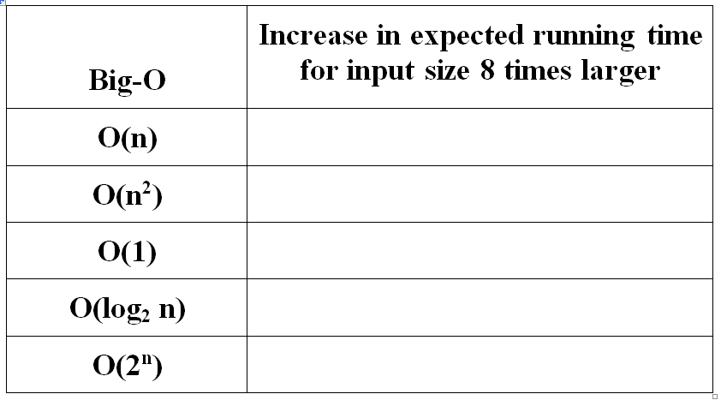

Examples: Running Time Comparisons
i.e. 8n versus n
8 times LONGER
8 times longer = 3*8 = 24 minutes
Say it takes 3 minutes for an input size of 10 (i.e. n = 10)
Now if we had an input size of 80 (i.e. 8n)
How long would it take?
$\frac{10}{8∗10}= \frac{3}{X}$ → X = 3 * 8

Slide 32
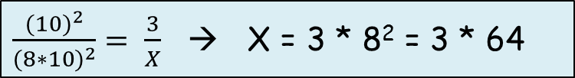
Examples: Running Time Comparisons
i.e. 8n versus n
8 times LONGER
64 times LONGER
64 times longer = 3*64 = 192 minutes
Say it takes 3 minutes for an input size of 10 (i.e. n = 10)
Now if we had an input size of 80 (i.e. 8n)
How long would it take?
$\frac{{(10)}^{2}}{{(8∗10)}^{2}}= \frac{3}{X}$ → X = 3 * 8² = 3 * 64

Slide 33

Examples: Running Time Comparisons
i.e. 8n versus n
8 times LONGER
64 times LONGER
same time
3 * 1 = 3 minutes
Say it takes 3 minutes for an input size of 10 (i.e. n = 10)
Now if we had an input size of 80 (i.e. 8n)
How long would it take?
$\frac{1}{1}= \frac{3}{X}$ → X = 3 * 1 = 3

Slide 34
Examples: Running Time Comparisons
i.e. 8n versus n
8 times LONGER
64 times LONGER
Be careful with this one…
it is not a “times” longer
same time
And these follow in similar fashion
… but rather a “plus steps”

Slide 35
Marker Slide
Any Questions On:
  Searching Arrays
  Big-Oh
    The Math side of things
      Asymptotic Analysis
      Growth Rate Comparisons
Next up
  Big-Oh
    The Code side of things
      Nested For-Loops, Sigma Notation
      Practice Exercises
      Book Example

Slide 36
Big-Oh Example
Determine the performance using big-O notation for the following code based on the number of cout executions:
Determine the number of operations performed:
  1) The inner loop counts from 1 to n => n operations
  2) The outer loop counts from 1 to n => n operations
  3) The outer loop performs the inner loop n times.
  4) Thus, the cout statement is executed n * n times = O(n²).
for (int i =1; i <= n; i++)
for (int j=1; j <= n; j++)
cout << j << endl;

Slide 37
Sigma Summation
To more formally analyze algorithms we typically need to perform mathematical summations.
The summation sign is used to denote the summation of a large series of numbers. The summation sign is the Greek letter sigma.
Example:

Slide 38
Sigma Summation Rules
The sum of numbers from 1 to n has a simple formula:
Multiplied constants can be moved outside the summation:
Added constants can be summed separately:
This would be a good formula to
have memorized

Slide 39
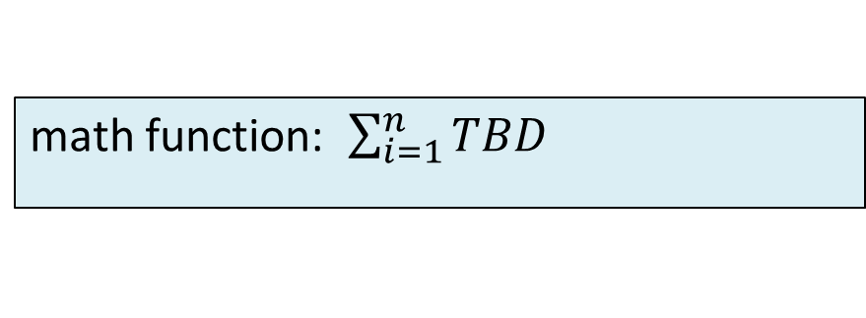
Example: Using the Sum
Using summations determine the Big-Oh
of the following code:
for (int i =1; i <= n; i++)
for (int j=1; j <= n; j++)
cout << j << endl;
n
Executes n times (worst case), Uses n units of time
math function: $\sum_{i=1}^{n}{TBD}$

Slide 40
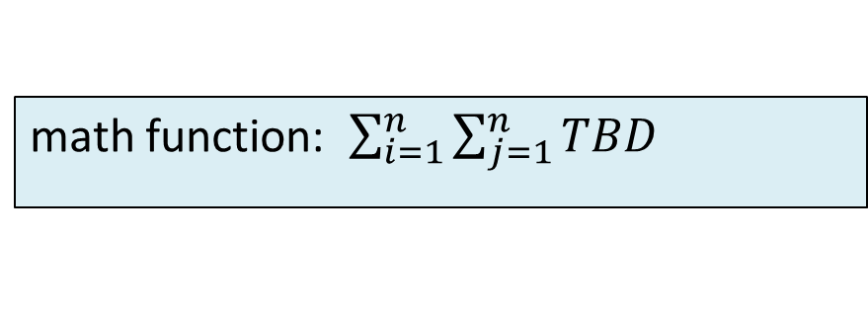
Example: Using the Sum
Using summations determine the Big-Oh
of the following code:
for (int i =1; i <= n; i++)
for (int j=1; j <= n; j++)
cout << j << endl;
n
n
Executes n times (worst case), Uses n units of time
math function: $\sum_{i=1}^{n}{\sum_{j=1}^{n}{TBD}}$

Slide 41
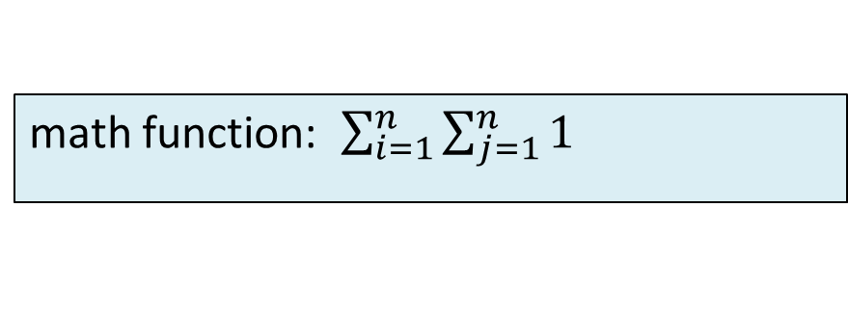
Example: Using the Sum
Using summations determine the Big-Oh
of the following code:
for (int i =1; i <= n; i++)
for (int j=1; j <= n; j++)
cout << j << endl;
n
n
1
Constant time: Mark it as using ONE unit of time
math function: $\sum_{i=1}^{n}{\sum_{j=1}^{n}{1}}$

Slide 42
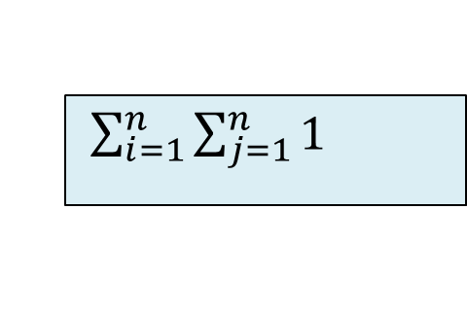
Example: Using the Sum
Using summations determine the Big-Oh
of the following code:
for (int i =1; i <= n; i++)
for (int j=1; j <= n; j++)
cout << j << endl;
$\sum_{i=1}^{n}{\sum_{j=1}^{n}{1}}$
Simplifies to n

Slide 43
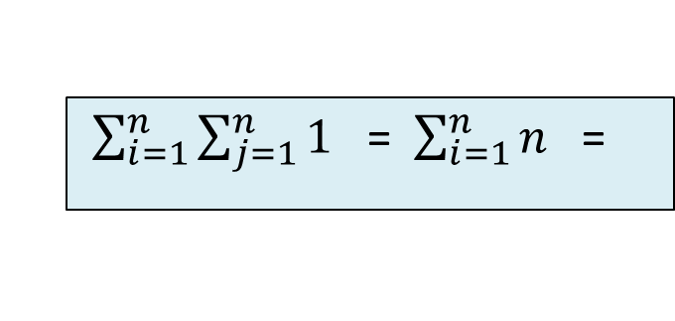
Example: Using the Sum
Using summations determine the Big-Oh
of the following code:
for (int i =1; i <= n; i++)
for (int j=1; j <= n; j++)
cout << j << endl;
$\sum_{i=1}^{n}{\sum_{j=1}^{n}{1}}$ = $\sum_{i=1}^{n}{n}$ =
Simplifies to n

Slide 44
Example: Using the Sum
Using summations determine the Big-Oh
of the following code:
for (int i =1; i <= n; i++)
for (int j=1; j <= n; j++)
cout << j << endl;
$\sum_{i=1}^{n}{\sum_{j=1}^{n}{1}}$ = $\sum_{i=1}^{n}{n}$ =
n is a ‘constant’ take it out of the summation

Slide 45
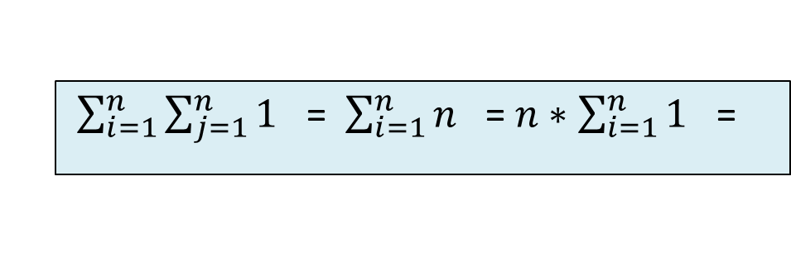
Example: Using the Sum
Using summations determine the Big-Oh
of the following code:
for (int i =1; i <= n; i++)
for (int j=1; j <= n; j++)
cout << j << endl;
$\sum_{i=1}^{n}{\sum_{j=1}^{n}{1}}$ = $\sum_{i=1}^{n}{n}$ = $n∗\sum_{i=1}^{n}{1}$ =
n is a ‘constant’ take it out of the summation

Slide 46
Example: Using the Sum
Using summations determine the Big-Oh
of the following code:
for (int i =1; i <= n; i++)
for (int j=1; j <= n; j++)
cout << j << endl;
$\sum_{i=1}^{n}{\sum_{j=1}^{n}{1}}$ = $\sum_{i=1}^{n}{n}$ = $n∗\sum_{i=1}^{n}{1}$ =
Simplifies to n

Slide 47
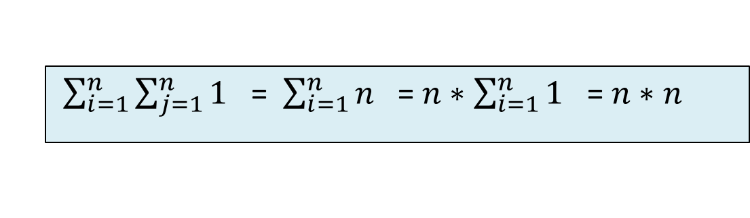
Example: Using the Sum
Using summations determine the Big-Oh
of the following code:
for (int i =1; i <= n; i++)
for (int j=1; j <= n; j++)
cout << j << endl;
$\sum_{i=1}^{n}{\sum_{j=1}^{n}{1}}$ = $\sum_{i=1}^{n}{n}$ = $n∗\sum_{i=1}^{n}{1}$ = $n∗n$
Simplifies to n

Slide 48
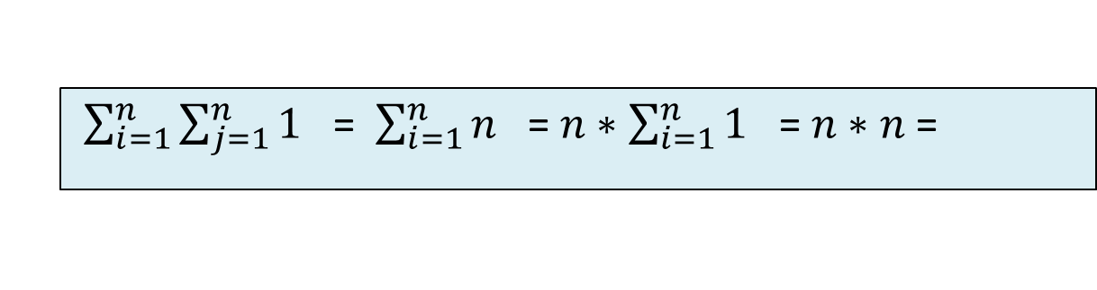
Example: Using the Sum
Using summations determine the Big-Oh
of the following code:
for (int i =1; i <= n; i++)
for (int j=1; j <= n; j++)
cout << j << endl;
$\sum_{i=1}^{n}{\sum_{j=1}^{n}{1}}$ = $\sum_{i=1}^{n}{n}$ = $n∗\sum_{i=1}^{n}{1}$ = $n∗n$ =
Multiply out

Slide 49
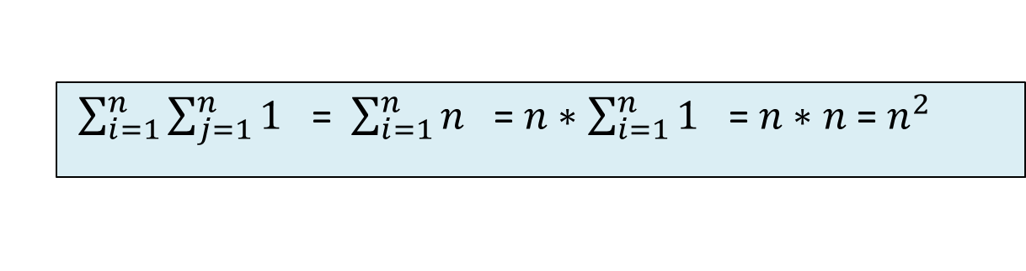
Example: Using the Sum
Using summations determine the Big-Oh
of the following code:
for (int i =1; i <= n; i++)
for (int j=1; j <= n; j++)
cout << j << endl;
$\sum_{i=1}^{n}{\sum_{j=1}^{n}{1}}$ = $\sum_{i=1}^{n}{n}$ = $n∗\sum_{i=1}^{n}{1}$ = $n∗n$ = $n^{2}$
Multiply out

Slide 50
Example: Using the Sum
Using summations determine the Big-Oh
of the following code:
for (int i =1; i <= n; i++)
for (int j=1; j <= n; j++)
cout << j << endl;
$\sum_{i=1}^{n}{\sum_{j=1}^{n}{1}}$ = $\sum_{i=1}^{n}{n}$ = $n∗\sum_{i=1}^{n}{1}$ = $n∗n$ = $n^{2}$
Math function for this is: n²
Algorithm is O(n²)

Slide 51
Marker Slide
Any Questions On:
  Searching Arrays
  Big-Oh
    The Math side of things
      Asymptotic Analysis
      Growth Rate Comparisons
    The Code side of things
      Nested For-Loops, Sigma Notation
Next up
  Big-Oh
    The Code side of things
      Practice Exercises
      Book Example

Slide 52
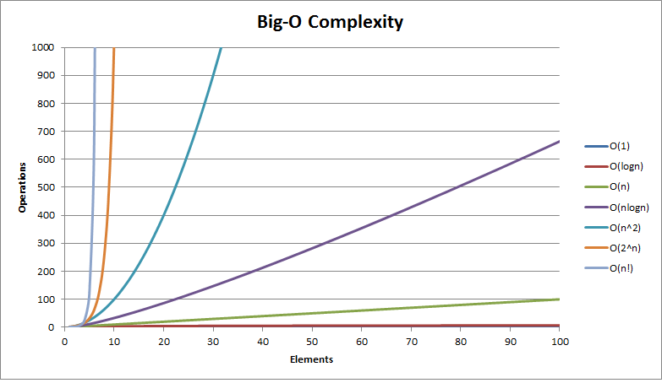
Big-O Exercises: Warm Up
What is the Big-Oh for the following formula?
Remove lower order terms
4n³ + 3n² + 6n
Eliminate constants
O(n³)
Notes:
Answer:
1) O(n³) 2) O(n*log(n))
3) a) 1+2+3+…+n = Σk=1 to n
=n/2(n+1)
Ο(n²)

Slide 53
Big-O Exercises: Warm Up
What is the Big-Oh for the following formula?
Remove lower order terms
n + n * (log n)
Eliminate constants
O(n log n)
Notes:
Answer:
1) O(n³) 2) O(n*log(n))
3) a) 1+2+3+…+n = Σk=1 to n
=n/2(n+1)
Ο(n²)

Slide 54


Big-O Exercises: Code
Analyze using Big-Oh and Summations
(count number of cout calls)
for (int i =1; i <= n; i++)
for (int j=1; j <= i; j++)
cout << j << endl;
i = 1 → inner loops runs 1 time
i = 2 → inner loops runs 2 times
i = 3 → inner loops runs 3 times
i = 4 → inner loops runs 4 times
: :
i = n → inner loops runs n times
1 + 2 + 3 + 4 + … + n
Eliminate constants
Remove lower order terms
$$\sum_{i=1}^{n}{i}=$$
$$\frac{n(n+1)}{2}$$
O(n²)
½ n² + ½ n
Notes:
Answer:
1) O(n³) 2) O(n*log(n))
3) a) 1+2+3+…+n = Σk=1 to n
=n/2(n+1)
Ο(n²)

Slide 55
Big-O Exercises: Code
Assume n = 8
Outer loop runs 16 times
Inner loop runs 4 times each time
16*4 = 64 → 8²
Analyze using Big-Oh
and Summations
Wait a minute…
Assume n = n
Outer loop runs 2n times
Inner loop runs n/2 times each time
2n * n/2 = n²
int i=1, j=1;
while (i <= 2*n)
{
cout << i << endl;
j=1;
while (j <= n/2)
{
cout << j;
cout << j*2 << endl;
j++;
}
i++;
}
Assume n = 9
Outer loop runs 18 times
Inner loop runs 4 times each time
18*4 = 72 → 9*8 < 81 = 9²
O(n²)
Assume n = 10
Outer loop runs 20 times
Inner loop runs 5 times each time
20*5 = 100 → 10²
Assume n = 1024
Outer loop runs 2048 times
Inner loop runs 512 times each time
2048*512 = 1048675 = 1024²
Notes:
Answer:
1) O(n³) 2) O(n*log(n))
3) a) 1+2+3+…+n = Σk=1 to n
=n/2(n+1)
Ο(n²)

Slide 56
Marker Slide
Any Questions On:
  Searching Arrays
  Big-Oh
    The Math side of things
      Asymptotic Analysis
      Growth Rate Comparisons
    The Code side of things
      Nested For-Loops, Sigma Notation
      Practice Exercises
Next up
  Big-Oh
    The Code side of things
      Book Example
    More Examples

Slide 57
Big-Oh Rules (yet another refresher)
If f(n) is a polynomial of degree d, then f(n) is O(n^{d}), i.e.,
  Drop lower-order terms
Use the smallest possible class of functions
  Say “2n is O(n)” instead of “2n is O(n²)”

Slide 58
Big-Oh Rules (yet another refresher)
If f(n) is a polynomial of degree d, then f(n) is O(n^{d}), i.e.,
  Drop lower-order terms
  Drop constant factors
Use the smallest possible class of functions
  Say “2n is O(n)” instead of “2n is O(n²)”
Use the simplest expression of the class
  Say “3n + 5 is O(n)” instead of “3n + 5 is O(3n)”

Slide 59
Big-Oh Constant Time: O(1)
We assume most primitive operations
  addition, multiplication, assignment ops, etc
Can be performed in constant time, c
  The exact number does not really matter
    Constants get knocked out during Big-Oh analysis

Slide 60
Constant Time Loops
A loop that performs a constant number of iterations is still considered a constant
// Initialize a deck by creating all 52 cards
Deck::Deck()
{
topCard = 0;
for (int i = 1; i <= 13; i++)
{
Card c1(diamond, i), c2(spade, i), c3(heart, i), c4(club, i);
cards[topCard++] = c1;
cards[topCard++] = c2;
cards[topCard++] = c3;
cards[topCard++] = c4;
}
}
Everything is constant in the loop
And the loop runs from 1 to 13, always

Slide 61
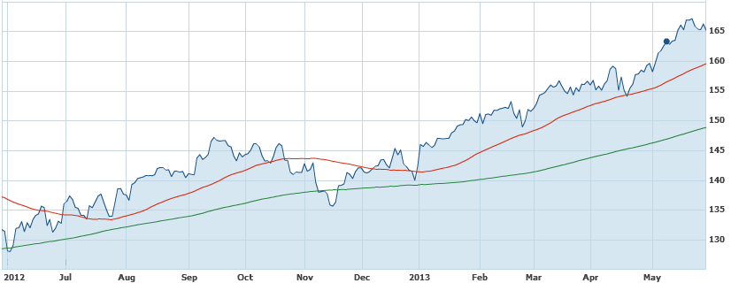
Computing Prefix Averages
We further illustrate asymptotic analysis with two algorithms for prefix averages
Define:
  The i-th prefix average of an array X is the
  average of the first (i + 1) elements of X:
A[i] = (X[0] + X[1] + … + X[i]) / (i + 1)

Slide 62
Prefix Averages (Quadratic)
The following algorithm computes prefix averages in quadratic time by applying the definition
Yet another way of looking at things:
Count the operations
Algorithm prefixAverages1(X, n)
Input array X of n integers
Output array A of prefix averages of X #operations
A ← new array of n integers n
for i ← 0 to n − 1 do
s ← X[0]
for j ← 1 to i do
s ← s + X[j]
A[i] ← s / (i + 1)
return A
This initializes n elements
This will take a total of n operations

Slide 63
Prefix Averages (Quadratic)
The following algorithm computes prefix averages in quadratic time by applying the definition
Algorithm prefixAverages1(X, n)
Input array X of n integers
Output array A of prefix averages of X #operations
A ← new array of n integers n
for i ← 0 to n − 1 do n
s ← X[0]
for j ← 1 to i do
s ← s + X[j]
A[i] ← s / (i + 1)
return A
This loop runs n times
This will take a total of n operations

Slide 64
Prefix Averages (Quadratic)
The following algorithm computes prefix averages in quadratic time by applying the definition
Algorithm prefixAverages1(X, n)
Input array X of n integers
Output array A of prefix averages of X #operations
A ← new array of n integers n
for i ← 0 to n − 1 do n
s ← X[0] n
for j ← 1 to i do
s ← s + X[j]
A[i] ← s / (i + 1)
return A
This line executes once for each iteration
of the outer loop (i.e. n times)
So this will take a total of n operations

Slide 65
Prefix Averages (Quadratic)
The following algorithm computes prefix averages in quadratic time by applying the definition
Algorithm prefixAverages1(X, n)
Input array X of n integers
Output array A of prefix averages of X #operations
A ← new array of n integers n
for i ← 0 to n − 1 do n
s ← X[0] n
for j ← 1 to i do 1 + 2 + 3 +…+ (n − 1)
s ← s + X[j]
A[i] ← s / (i + 1)
return A
This line executes once for the first iteration of the outer loop (i == 1)
Thus using 1 operation

Slide 66
Prefix Averages (Quadratic)
The following algorithm computes prefix averages in quadratic time by applying the definition
Algorithm prefixAverages1(X, n)
Input array X of n integers
Output array A of prefix averages of X #operations
A ← new array of n integers n
for i ← 0 to n − 1 do n
s ← X[0] n
for j ← 1 to i do 1 + 2 + 3 +…+ (n − 1)
s ← s + X[j]
A[i] ← s / (i + 1)
return A
This line executes twice for the second iteration of the outer loop (i == 2)
Thus using 2 more operations

Slide 67
Prefix Averages (Quadratic)
The following algorithm computes prefix averages in quadratic time by applying the definition
Algorithm prefixAverages1(X, n)
Input array X of n integers
Output array A of prefix averages of X #operations
A ← new array of n integers n
for i ← 0 to n − 1 do n
s ← X[0] n
for j ← 1 to i do 1 + 2 + 3 +…+ (n − 1)
s ← s + X[j]
A[i] ← s / (i + 1)
return A
This line executes 3 times for the third iteration of the outer loop (i == 3)
Thus using 3 more operations

Slide 68
Prefix Averages (Quadratic)
The following algorithm computes prefix averages in quadratic time by applying the definition
Algorithm prefixAverages1(X, n)
Input array X of n integers
Output array A of prefix averages of X #operations
A ← new array of n integers n
for i ← 0 to n − 1 do n
s ← X[0] n
for j ← 1 to i do 1 + 2 + 3 +…+ (n − 1)
s ← s + X[j]
A[i] ← s / (i + 1)
return A
This line executes (n-1) times for the last iteration of the outer loop (i == n-1)
Thus using (n-1) more operations

Slide 69
Prefix Averages (Quadratic)
The following algorithm computes prefix averages in quadratic time by applying the definition
Algorithm prefixAverages1(X, n)
Input array X of n integers
Output array A of prefix averages of X #operations
A ← new array of n integers n
for i ← 0 to n − 1 do n
s ← X[0] n
for j ← 1 to i do 1 + 2 + 3 +…+ (n − 1)
s ← s + X[j] 1 + 2 + 3 +…+ (n − 1)
A[i] ← s / (i + 1)
return A
This line is just like the for-j loop it first uses 1, then 2 more, then 3 more, …
and eventually uses (n-1) more operations

Slide 70
Prefix Averages (Quadratic)
The following algorithm computes prefix averages in quadratic time by applying the definition
Algorithm prefixAverages1(X, n)
Input array X of n integers
Output array A of prefix averages of X #operations
A ← new array of n integers n
for i ← 0 to n − 1 do n
s ← X[0] n
for j ← 1 to i do 1 + 2 + 3 +…+ (n − 1)
s ← s + X[j] 1 + 2 + 3 +…+ (n − 1)
A[i] ← s / (i + 1) n
return A
This line executes once for each iteration
of the outer loop (i.e. n times)
So this will take a total of n operations

Slide 71
Prefix Averages (Quadratic)
The following algorithm computes prefix averages in quadratic time by applying the definition
Algorithm prefixAverages1(X, n)
Input array X of n integers
Output array A of prefix averages of X #operations
A ← new array of n integers n
for i ← 0 to n − 1 do n
s ← X[0] n
for j ← 1 to i do 1 + 2 + 3 +…+ (n − 1)
s ← s + X[j] 1 + 2 + 3 +…+ (n − 1)
A[i] ← s / (i + 1) n
return A 1
This line executes only one time
It is outside both loops
So this will take a total of 1 operation

Slide 72
Prefix Averages (Quadratic)
The following algorithm computes prefix averages in quadratic time by applying the definition
Algorithm prefixAverages1(X, n)
Input array X of n integers
Output array A of prefix averages of X #operations
A ← new array of n integers n
for i ← 0 to n − 1 do n
s ← X[0] n
for j ← 1 to i do 1 + 2 + 3 +…+ (n − 1)
s ← s + X[j] 1 + 2 + 3 +…+ (n − 1)
A[i] ← s / (i + 1) n
return A 1
Clearly either of these can be taken
as the LARGEST number of operations.
So we will use 1 + 2 + 3 + …+ (n-1)
to characterize the runtime of this algorithm… see next page
Notes:
Aside: This selection is valid because we are throwing away lower order terms (and removing constants)
The total number of operations would be:
n + n + n + (sum 1 to n-1) + (sum 1 to n-1) + n + 1

Slide 73
Prefix Averages: End of 1st Method
The running time of prefixAverages1 is
O(1 + 2 + …+ n)
The sum of the first n integers is n(n + 1) / 2
Thus, algorithm prefixAverages1 runs in O(n²) time
This is from the formula
you memorized:
Algorithm prefixAverages1(X, n)
Input array X of n integers
Output array A of prefix averages of X #operations
A ← new array of n integers n
for i ← 0 to n − 1 do n
s ← X[0] n
for j ← 1 to i do 1 + 2 + 3 +…+ (n − 1)
s ← s + X[j] 1 + 2 + 3 +…+ (n − 1)
A[i] ← s / (i + 1) n
return A 1

Slide 74
Prefix Averages: 2nd Implementation
This is a transition slide
Do you feel things transitioning?
Move onto the 2nd implementation of the Prefix Averages Code

Slide 75
Prefix Averages (Linear)
The following algorithm computes prefix averages in linear time by keeping a running sum
Algorithm prefixAverages2(X, n)
Input array X of n integers
Output array A of prefix averages of X #operations
A ← new array of n integers
s ← 0
for i ← 0 to n − 1 do
s ← s + X[i]
A[i] ← s / (i + 1)
return A

Slide 76
Prefix Averages (Linear)
The following algorithm computes prefix averages in linear time by keeping a running sum
Algorithm prefixAverages2(X, n)
Input array X of n integers
Output array A of prefix averages of X #operations
A ← new array of n integers n
s ← 0
for i ← 0 to n − 1 do
s ← s + X[i]
A[i] ← s / (i + 1)
return A

Slide 77
Prefix Averages (Linear)
The following algorithm computes prefix averages in linear time by keeping a running sum
Algorithm prefixAverages2(X, n)
Input array X of n integers
Output array A of prefix averages of X #operations
A ← new array of n integers n
s ← 0 1
for i ← 0 to n − 1 do
s ← s + X[i]
A[i] ← s / (i + 1)
return A

Slide 78
Prefix Averages (Linear)
The following algorithm computes prefix averages in linear time by keeping a running sum
Algorithm prefixAverages2(X, n)
Input array X of n integers
Output array A of prefix averages of X #operations
A ← new array of n integers n
s ← 0 1
for i ← 0 to n − 1 do n
s ← s + X[i]
A[i] ← s / (i + 1)
return A

Slide 79
Prefix Averages (Linear)
The following algorithm computes prefix averages in linear time by keeping a running sum
Algorithm prefixAverages2(X, n)
Input array X of n integers
Output array A of prefix averages of X #operations
A ← new array of n integers n
s ← 0 1
for i ← 0 to n − 1 do n
s ← s + X[i] n
A[i] ← s / (i + 1)
return A

Slide 80
Prefix Averages (Linear)
The following algorithm computes prefix averages in linear time by keeping a running sum
Algorithm prefixAverages2(X, n)
Input array X of n integers
Output array A of prefix averages of X #operations
A ← new array of n integers n
s ← 0 1
for i ← 0 to n − 1 do n
s ← s + X[i] n
A[i] ← s / (i + 1) n
return A

Slide 81
Prefix Averages (Linear)
The following algorithm computes prefix averages in linear time by keeping a running sum
Algorithm prefixAverages2(X, n)
Input array X of n integers
Output array A of prefix averages of X #operations
A ← new array of n integers n
s ← 0 1
for i ← 0 to n − 1 do n
s ← s + X[i] n
A[i] ← s / (i + 1) n
return A 1

Slide 82
Prefix Averages (Linear)
The following algorithm computes prefix averages in linear time by keeping a running sum
Algorithm prefixAverages2(X, n)
Input array X of n integers
Output array A of prefix averages of X #operations
A ← new array of n integers n
s ← 0 1
for i ← 0 to n − 1 do n
s ← s + X[i] n
A[i] ← s / (i + 1) n
return A 1
Largest of all these is n

Slide 83
Prefix Averages (Linear)
The following algorithm computes prefix averages in linear time by keeping a running sum
Algorithm prefixAverages2(X, n)
Input array X of n integers
Output array A of prefix averages of X #operations
A ← new array of n integers n
s ← 0 1
for i ← 0 to n − 1 do n
s ← s + X[i] n
A[i] ← s / (i + 1) n
return A 1
Largest of all these is n
Algorithm prefixAverages2 runs in O(n) time

Slide 84
So Many Ways to Big-Oh?
You have now seen a variety of ways to approach calculating Big-Oh for various algorithms and source code.
Why so many ways?
  Are they really different?
  Or just different implementations of the same process?
  Think of it as a “meta” example of algorithm implementation
  And hopefully at least one of the ways makes
  “the most sense” to you

Slide 85
Marker Slide
Any Questions On:
  Searching Arrays
  Big-Oh
    The Math side of things
      Asymptotic Analysis
      Growth Rate Comparisons
    The Code side of things
      Nested For-Loops, Sigma Notation
      Practice Exercises
      Book Example
Next up
  Big-Oh
    More Examples

Slide 86
Coding example #1
Operations
for ( i=0; i < n; i++ )
m += i;

Slide 87
Coding example #1
Operations
n
for ( i=0; i < n; i++ )
m += i;

Slide 88
Coding example #1
Operations
n
n
for ( i=0; i < n; i++ )
m += i;

Slide 89
Coding example #1
Operations
n
n
for ( i=0; i < n; i++ )
m += i;
Answer: O(n)

Slide 90
Coding example #2
Operations
for ( i=0; i < n; i++ )
for( j=0; j < n; j++ )
sum[i] += entry[i][j];

Slide 91
Coding example #2
Operations
n
for ( i=0; i < n; i++ )
for( j=0; j < n; j++ )
sum[i] += entry[i][j];

Slide 92
Coding example #2
Operations
n
n²
for ( i=0; i < n; i++ )
for( j=0; j < n; j++ )
sum[i] += entry[i][j];

Slide 93
Coding example #2
Operations
n
n²
n²
for ( i=0; i < n; i++ )
for( j=0; j < n; j++ )
sum[i] += entry[i][j];

Slide 94
Coding example #2
Operations
n
n²
n²
for ( i=0; i < n; i++ )
for( j=0; j < n; j++ )
sum[i] += entry[i][j];
Answer: O(n²)

Slide 95
Coding example #3
Operations
for ( i=0; i < n; i++ )
for( j=0; j < i; j++ )
m += j;
Notes:
1 + 2 + 3 + … + (n-1) → ( (n-1)*n ) / 2 ← by induction

Slide 96
Coding example #3
Operations
n
for ( i=0; i < n; i++ )
for( j=0; j < i; j++ )
m += j;
Notes:
1 + 2 + 3 + … + (n-1) → ( (n-1)*n ) / 2 ← by induction

Slide 97

Coding example #3
Operations
n
1+2+..+n-1
for ( i=0; i < n; i++ )
for( j=0; j < i; j++ )
m += j;
i = 1…. j-loop goes 1
i = 2…. j-loop goes 2
i = 3…. j-loop goes 3
: :
i = (n-1) …. j-loop goes (n-1)
1
+2
+3
:
+ (n-1)
$$\sum_{i=1}^{n−1}{i}=\frac{\left(n−1\right)n}{2}$$
Notes:
1 + 2 + 3 + … + (n-1) → ( (n-1)*n ) / 2 ← by induction

Slide 98
Coding example #3
Operations
n
1+2+..+n-1
1+2+..+n-1
for ( i=0; i < n; i++ )
for( j=0; j < i; j++ )
m += j;
Notes:
1 + 2 + 3 + … + (n-1) → ( (n-1)*n ) / 2 ← by induction

Slide 99
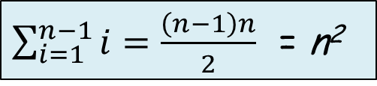
Coding example #3
Operations
n
1+2+..+n-1
1+2+..+n-1
for ( i=0; i < n; i++ )
for( j=0; j < i; j++ )
m += j;
$\sum_{i=1}^{n−1}{i}=\frac{\left(n−1\right)n}{2}$ = n²
Answer: O(n²)
Notes:
1 + 2 + 3 + … + (n-1) → ( (n-1)*n ) / 2 ← by induction

Slide 100
Coding example #4
int i = n;
while (i > 0)
{
tot += i;
i = i / 2;
}
This looks tricky
Assume positive integers
so 1 / 2 = 0.5 => 0

Slide 101
Coding example #4
int i = n;
while (i > 0)
{
tot += i;
i = i / 2;
}
i starts equal to n
We divide by 2 until i <= 0
So the real question is:
How many times can n be divided by 2 ?
Assume positive integers
so 1 / 2 = 0.5 => 0

Slide 102
Coding example #4
int i = n;
while (i > 0)
{
tot += i;
i = i / 2;
}
How many times can n be divided by 2 ?
Or rather: Find k such that n - 2^{k} <= 0
and k+1 will be the number of times this
loop executes
the +1 is by experiment:
n = 1, n – 2⁰ = 0, loop executes 1 time
n = 2, n – 2¹ = 0, loop executes 2 times
It really does not matter though -it will not change the asymptotic bound
Assume positive integers
so 1 / 2 = 0.5 => 0

Slide 103
Coding example #4
int i = n;
while (i > 0)
{
tot += i;
i = i / 2;
}
Find k such that
n - 2^{k} <= 0
n <= 2^{k}
lg n <= k
k >= lg n
Pick the minimum k value = lg n
Loop executes (lg n) + 1 times
Answer: O(lg n)
Assume positive integers
so 1 / 2 = 0.5 => 0

Slide 104
Equivalent of Coding example #4
i = 1;
while (i < n)
{
tot += i;
i = i * 2;
}
Find k such that
2^{k} >= n
k >= lg n
Pick the minimum k value = lg n
Loop executes (lg n) times
Answer: O(lg n)

Slide 105
Coding example #5
Operations
for ( i=0; i < n; i++ )
for( j=0; j < n; j++ )
for( k=0; k < n; k++ )
sum[i][j] += entry[i][j][k];

Slide 106
Coding example #5
Operations
n
for ( i=0; i < n; i++ )
for( j=0; j < n; j++ )
for( k=0; k < n; k++ )
sum[i][j] += entry[i][j][k];

Slide 107
Coding example #5
Operations
n
n^2
for ( i=0; i < n; i++ )
for( j=0; j < n; j++ )
for( k=0; k < n; k++ )
sum[i][j] += entry[i][j][k];

Slide 108
Coding example #5
Operations
n
n^2
n^3
for ( i=0; i < n; i++ )
for( j=0; j < n; j++ )
for( k=0; k < n; k++ )
sum[i][j] += entry[i][j][k];

Slide 109
Coding example #5
Operations
n
n^2
n^3
n^3
for ( i=0; i < n; i++ )
for( j=0; j < n; j++ )
for( k=0; k < n; k++ )
sum[i][j] += entry[i][j][k];

Slide 110
Coding example #5
Operations
n
n^2
n^3
n^3
for ( i=0; i < n; i++ )
for( j=0; j < n; j++ )
for( k=0; k < n; k++ )
sum[i][j] += entry[i][j][k];
Answer: O(n³)

Slide 111
Coding example #6
Calculate the total
These 4 for-loops
are the function.
Operations
n
for ( i=0; i < n; i++ )
for( j=0; j < n; j++ )
sum[i] += entry[i][j][0];
for ( i=0; i < n; i++ )
for( k=0; k < n; k++ )
sum[i] += entry[i][0][k];

Slide 112
Coding example #6
Calculate the total
These 4 for-loops
are the function.
Operations
n
n²
for ( i=0; i < n; i++ )
for( j=0; j < n; j++ )
sum[i] += entry[i][j][0];
for ( i=0; i < n; i++ )
for( k=0; k < n; k++ )
sum[i] += entry[i][0][k];

Slide 113
Coding example #6
Calculate the total
These 4 for-loops
are the function.
Operations
n
n²
n²
for ( i=0; i < n; i++ )
for( j=0; j < n; j++ )
sum[i] += entry[i][j][0];
for ( i=0; i < n; i++ )
for( k=0; k < n; k++ )
sum[i] += entry[i][0][k];

Slide 114
Coding example #6
Calculate the total
These 4 for-loops
are the function.
Operations
n
n²
n²
n
for ( i=0; i < n; i++ )
for( j=0; j < n; j++ )
sum[i] += entry[i][j][0];
for ( i=0; i < n; i++ )
for( k=0; k < n; k++ )
sum[i] += entry[i][0][k];

Slide 115
Coding example #6
Calculate the total
These 4 for-loops
are the function.
Operations
n
n²
n²
n
n²
for ( i=0; i < n; i++ )
for( j=0; j < n; j++ )
sum[i] += entry[i][j][0];
for ( i=0; i < n; i++ )
for( k=0; k < n; k++ )
sum[i] += entry[i][0][k];

Slide 116
Coding example #6
Calculate the total
These 4 for-loops
are the function.
Operations
n
n²
n²
n
n²
n²
for ( i=0; i < n; i++ )
for( j=0; j < n; j++ )
sum[i] += entry[i][j][0];
for ( i=0; i < n; i++ )
for( k=0; k < n; k++ )
sum[i] += entry[i][0][k];

Slide 117
Coding example #6
Calculate the total
These 4 for-loops
are the function.
Operations
n
n²
n²
n
n²
n²
for ( i=0; i < n; i++ )
for( j=0; j < n; j++ )
sum[i] += entry[i][j][0];
for ( i=0; i < n; i++ )
for( k=0; k < n; k++ )
sum[i] += entry[i][0][k];
Answer: n + n² + n² + n + n² + n²
4n² + 2n
4n²
O(n²)
Showing more of the implied steps for illustration

Slide 118
Coding example #7
Operations
for ( i=0; i < n; i++ )
for( j=0; j < sqrt(n); j++ )
m += j;

Slide 119
Coding example #7
Operations
n
for ( i=0; i < n; i++ )
for( j=0; j < sqrt(n); j++ )
m += j;

Slide 120
Coding example #7
Operations
n
n^{3/2}
for ( i=0; i < n; i++ )
for( j=0; j < sqrt(n); j++ )
m += j;

Slide 121
Coding example #7
Operations
n
n^{3/2}
n^{3/2}
for ( i=0; i < n; i++ )
for( j=0; j < sqrt(n); j++ )
m += j;

Slide 122
Coding example #7
Operations
n
n^{3/2}
n^{3/2}
for ( i=0; i < n; i++ )
for( j=0; j < sqrt(n); j++ )
m += j;
Answer: O(n^{3/2})

Slide 123
Coding example #8
Operations
for ( i=0; i < n; i++ )
for( j=0; j < sqrt(995); j++ )
m += j;

Slide 124
Coding example #8
Operations
n
for ( i=0; i < n; i++ )
for( j=0; j < sqrt(995); j++ )
m += j;

Slide 125
Coding example #8
Operations
n
31n
for ( i=0; i < n; i++ )
for( j=0; j < sqrt(995); j++ )
m += j;

Slide 126
Coding example #8
Operations
n
31n
31n
for ( i=0; i < n; i++ )
for( j=0; j < sqrt(995); j++ )
m += j;

Slide 127
Coding example #8
Operations
n
31n
31n
for ( i=0; i < n; i++ )
for( j=0; j < sqrt(995); j++ )
m += j;
Answer: O(n)

Slide 128
Coding example #8 : Equivalent code
Operations
n
n
n
n
n
for ( i=0; i < n; i++ )
{
m += j;
m += j;
m += j;
…
m += j; // 31 times
}
Answer: O(n)

Slide 129
Coding example #9
int total(int n )
{
int subtotal = 0;
for( i=0; i < n; i++)
subtotal += i;
return subtotal;
}
main()
{
int tot = 0;
for ( i=0; i < n; i++ )
tot += total(i);
}
First rearrange
the function to be after main
- cosmetic reasons

Slide 130
Coding example #9
main()
{
int tot = 0;
for ( i=0; i < n; i++ )
tot += total(i);
}
int total(int n )
{
int subtotal = 0;
for( i=0; i < n; i++)
subtotal += i;
return subtotal;
}
Change the parameter name
used in the total() function
m
m;

Slide 131
Coding example #9
main()
{
int tot = 0;
for ( i=0; i < n; i++ )
tot += total(i);
}
int total(int m )
{
int subtotal = 0;
for( i=0; i < m; i++)
subtotal += i;
return subtotal;
}
Change the loop variable
used in the total function
k
k
k
k

Slide 132
Coding example #9
main()
{
int tot = 0;
for ( i=0; i < n; i++ )
tot += total(i);
}
Next
inline the total function
m becomes i
main()
{
int tot = 0;
for ( i=0; i < n; i++ )
{
int subtotal = 0;
for( k=0; k < i; k++)
subtotal += k;
tot += subtotal;
}
}
m;
int total(int m )
{
int subtotal = 0;
for( k=0; k < m; k++)
subtotal += k;
return subtotal;
}

Slide 133
Coding example #9
main()
{
int tot = 0;
for ( i=0; i < n; i++ )
{
int subtotal = 0;
for( k=0; k < i; k++)
subtotal += k;
tot += subtotal;
}
}
Operations

Slide 134
Coding example #9
main()
{
int tot = 0;
for ( i=0; i < n; i++ )
{
int subtotal = 0;
for( k=0; k < i; k++)
subtotal += k;
tot += subtotal;
}
}
Operations
1

Slide 135
Coding example #9
main()
{
int tot = 0;
for ( i=0; i < n; i++ )
{
int subtotal = 0;
for( k=0; k < i; k++)
subtotal += k;
tot += subtotal;
}
}
Operations
1
n

Slide 136
Coding example #9
main()
{
int tot = 0;
for ( i=0; i < n; i++ )
{
int subtotal = 0;
for( k=0; k < i; k++)
subtotal += k;
tot += subtotal;
}
}
Operations
1
n
n

Slide 137
Coding example #9
main()
{
int tot = 0;
for ( i=0; i < n; i++ )
{
int subtotal = 0;
for( k=0; k < i; k++)
subtotal += k;
tot += subtotal;
}
}
Operations
1
n
n
1 + 2 + 3 + … + (n-1)

Slide 138
Coding example #9
main()
{
int tot = 0;
for ( i=0; i < n; i++ )
{
int subtotal = 0;
for( k=0; k < i; k++)
subtotal += k;
tot += subtotal;
}
}
Operations
1
n
n
1 + 2 + 3 + … + (n-1)
1 + 2 + 3 + … + (n-1)

Slide 139
Coding example #9
main()
{
int tot = 0;
for ( i=0; i < n; i++ )
{
int subtotal = 0;
for( k=0; k < i; k++)
subtotal += k;
tot += subtotal;
}
}
Operations
1
n
n
1 + 2 + 3 + … + (n-1)
1 + 2 + 3 + … + (n-1)
n

Slide 140
Graded In-Class Activity: BigOhEx09
main()
{
int tot = 0;
for ( i=0; i < n; i++ )
{
int subtotal = 0;
for( k=0; k < i; k++)
subtotal += k;
tot += subtotal;
}
}
Operations
1
n
n
1 + 2 + 3 + … + (n-1)
1 + 2 + 3 + … + (n-1)
n
Create a MS-Word document, named BigOhEx09.docx. Copy the above code and operations table into it. Complete the exercise by including the corresponding Sigma Summation, its simplification, and the final Big-Oh runtime for this code.
Submit the document to the appropriate D2L dropbox, before class ends
Notes:
To check your work the solution to this is given on a hidden slide following this one

Slide 141
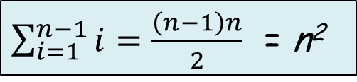
Coding example #9
main()
{
int tot = 0;
for ( i=0; i < n; i++ )
{
int subtotal = 0;
for( k=0; k < i; k++)
subtotal += k;
tot += subtotal;
}
}
Operations
1
n
n
1 + 2 + 3 + … + (n-1)
1 + 2 + 3 + … + (n-1)
n
$\sum_{i=1}^{n−1}{i}=\frac{\left(n−1\right)n}{2}$ = n²
Answer: O(n²)

Slide 142
Marker Slide
Any Questions on:
  Searching Arrays
  Big-Oh
    The Math side of things
      Asymptotic Analysis
      Growth Rate Comparisons
    The Code side of things
      Nested For-Loops, Sigma Notation
      Practice Exercises
      Book Example
    More Examples
Next up
  Free Play

Slide 143
Free Play – Things to Work On
Homework 2
Homework 3

Slide 144

The End
Or is it?

