Slide 1
Big Oh, part 3
This presentation
requires Sound Enabled
CS 244
Brent M. Dingle, Ph.D.
Game Design and Development Program
Department of Mathematics, Statistics, and Computer Science
University of Wisconsin – Stout
2014

Slide 2
Things to Note
Homework 2: Big-Oh is due today
  like now
  please submit something if you have not already done so
Homework 3 is Posted on D2L
  Do NOT delay in starting it

Slide 3
From Last Time
Big-Oh
  Lots of information
  Many Examples

Slide 4
For Today
Finish out Big-Oh
Move onto other stuff
  in other presentation files

Slide 5
Marker Slide
Any General Questions ?
Next up
  Big-Oh
    Some Formulas
    Examples

Slide 6


Long Term: Suggest Knowing
1 + 2 + 3 + 4 + … + n
$$\sum_{i=1}^{n}{i}=$$
$$\frac{n(n+1)}{2}$$
O(n²)
½ n² + ½ n

Slide 7
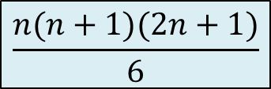


Long Term: Suggest Knowing
1 + 4 + 9 + 16 + … + n²
$$\sum_{i=1}^{n}{i^{2}}=$$
$$\frac{n(n+1)(2n+1)}{6}$$
$$\frac{1}{3}n^{3} + \frac{1}{2}n^{2}+ \frac{1}{6}n$$
O(n³)

Slide 8
Marker Slide
Any Questions On:
  Big-Oh
    Some Formulas
Next up
  Big-Oh
    Examples

Slide 9
Note: Not all C++
Some of the following examples
  and some in your homework
  and some on your quizzes and tests
will NOT be C++
  consider it pseudo-code
  with some of it looking a lot like Java
Why?
  Because Big-Oh Analysis is NOT C++ specific
  It applies to all algorithms implemented in any language

Slide 10
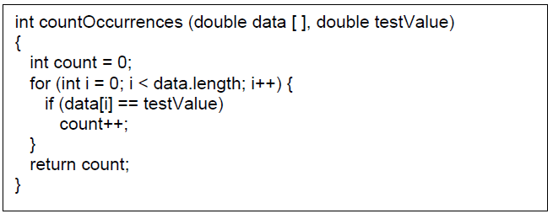



Q1
$$\sum_{i=0}^{n−1}{1}=$$
$$\sum_{i=1}^{n}{1}$$
$$=n$$
n
O(n)

Slide 11
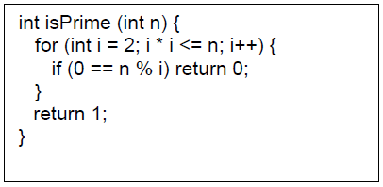
Q2

Slide 12
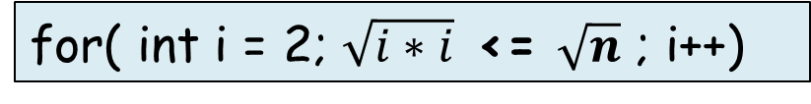
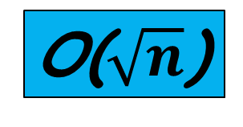
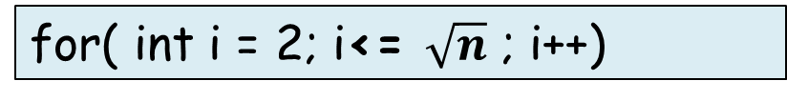
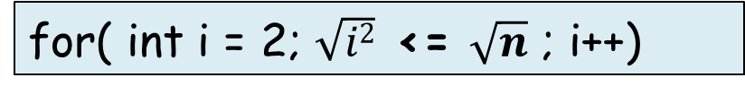
Q2 – the faster way
Simplify
for( int i = 2; $\sqrt{i∗i}$ <= $\sqrt{n}$ ; i++)
for( int i = 2; $\sqrt{i2}$ <= $\sqrt{n}$ ; i++)
O($\sqrt{n}$)
for( int i = 2; i<= $\sqrt{n}$ ; i++)
Thinking WORST
case execution time w.r.t n
So assume
n is never evenly divisible by i
Or rather Assume:
we never short-circuit return out of the for loop
we always loop from 2 until i*i > n

Slide 13
Marker Slide
Any Questions On:
  Big-Oh
    Some Formulas
    First couple examples
Next up
  Big-Oh
    More Examples

Slide 14
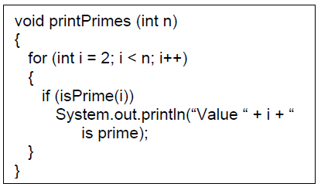
Q3: Lengthy Way
By Q2 we know the function isPrime is characterized by
sqrt(i)
Recall:
Big-Oh notation gives an upper bound
on the growth rate of a function
Notes:
f(n) is in O(n sqrt(n)):
n n
Sum (sqrt(i)) <= Sum (sqrt(n)) = n sqrt(n) is in O(n sqrt(n)) by choosing
i=1 i=1
c = 1 and N = any constant.

Slide 15




Q3: Lengthy Way
By Q2 we know the function isPrime is characterized by
sqrt(i)
So Maybe MATH can help us
$$\sum_{i=2}^{n−1}{\sqrt{i}}$$
$$≤1+\sqrt{n}+\sum_{i=2}^{n−1}{\sqrt{i}}$$
$$=\sum_{i=1}^{n}{\sqrt{i}}$$
$$≤\sum_{i=1}^{n}{\sqrt{n}}$$
We prefer the sigma bounds to be
i=1 to n
It allows easier application of sigma rules
So we can change the sigma bounds
by adding 2 values. Note the ≤ also
Simplify to something we can solve
Note the ≤
Allowed because Big-Oh is upper bound oriented
Recall:
Big-Oh notation gives an upper bound
on the growth rate of a function
Notes:
f(n) is in O(n sqrt(n)):
n n
Sum (sqrt(i)) <= Sum (sqrt(n)) = n sqrt(n) is in O(n sqrt(n)) by choosing
i=1 i=1
c = 1 and N = any constant.

Slide 16



Q3: Lengthy Way
By Q2 we know the function isPrime is characterized by
sqrt(i)
$$\sum_{i=2}^{n−1}{\sqrt{i}}$$
$$≤\sum_{i=1}^{n}{\sqrt{n}}$$
$$≤\sum_{i=1}^{n}{\sqrt{n}}$$
Recall:
Big-Oh notation gives an upper bound
on the growth rate of a function
Notes:
f(n) is in O(n sqrt(n)):
n n
Sum (sqrt(i)) <= Sum (sqrt(n)) = n sqrt(n) is in O(n sqrt(n)) by choosing
i=1 i=1
c = 1 and N = any constant.

Slide 17



Q3: Lengthy Way
By Q2 we know the function isPrime is characterized by
sqrt(i)
O($n\sqrt{n}$)
$$\sum_{i=2}^{n−1}{\sqrt{i}}$$
$$≤\sum_{i=1}^{n}{\sqrt{n}}$$
$$=\sqrt{n}\sum_{i=1}^{n}{1}$$
$$=n\sqrt{n}$$
Remove lower order terms – N/A
Recall:
Big-Oh notation gives an upper bound
on the growth rate of a function
Eliminate constants – N/A
Notes:
f(n) is in O(n sqrt(n)):
n n
Sum (sqrt(i)) <= Sum (sqrt(n)) = n sqrt(n) is in O(n sqrt(n)) by choosing
i=1 i=1
c = 1 and N = any constant.

Slide 18
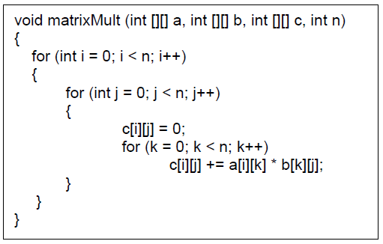



Q4
$$\sum_{i=0}^{n−1}{}\sum_{j=0}^{n−1}{}\sum_{k=0}^{n−1}{1}$$
$$\sum_{j=0}^{n−1}{}\sum_{k=0}^{n−1}{1}$$
$$\sum_{k=0}^{n−1}{1}$$

Slide 19




Q4: Lengthy Way Justifies Op Count Way
O(n³)
$$\sum_{i=0}^{n−1}{}\sum_{j=0}^{n−1}{}\sum_{k=0}^{n−1}{1}$$
$$=\sum_{i=0}^{n−1}{}\sum_{j=0}^{n−1}{n}$$
$$=\sum_{i=0}^{n−1}{n2}$$
$$=n3$$
Remove lower order terms – N/A
Eliminate constants – N/A

Slide 20
Q4: Operation Count
Operations
n
$$\sum_{i=0}^{n−1}{}\sum_{j=0}^{n−1}{}\sum_{k=0}^{n−1}{1}$$
$$=\sum_{i=0}^{n−1}{}\sum_{j=0}^{n−1}{n}$$
$$=\sum_{i=0}^{n−1}{n2}$$
$$=n3$$

Slide 21
Q4: Operation Count
Operations
n
n²
$$\sum_{i=0}^{n−1}{}\sum_{j=0}^{n−1}{}\sum_{k=0}^{n−1}{1}$$
$$=\sum_{i=0}^{n−1}{}\sum_{j=0}^{n−1}{n}$$
$$=\sum_{i=0}^{n−1}{n2}$$
$$=n3$$

Slide 22
Q4: Operation Count
Operations
n
n²
n²
$$\sum_{i=0}^{n−1}{}\sum_{j=0}^{n−1}{}\sum_{k=0}^{n−1}{1}$$
$$=\sum_{i=0}^{n−1}{}\sum_{j=0}^{n−1}{n}$$
$$=\sum_{i=0}^{n−1}{n2}$$
$$=n3$$

Slide 23
Q4: Operation Count
Operations
n
n²
n²
n³
$$\sum_{i=0}^{n−1}{}\sum_{j=0}^{n−1}{}\sum_{k=0}^{n−1}{1}$$
$$=\sum_{i=0}^{n−1}{}\sum_{j=0}^{n−1}{n}$$
$$=\sum_{i=0}^{n−1}{n2}$$
$$=n3$$

Slide 24
Q4: Operation Count
Operations
n
n²
n²
n³
n³
$$\sum_{i=0}^{n−1}{}\sum_{j=0}^{n−1}{}\sum_{k=0}^{n−1}{1}$$
$$=\sum_{i=0}^{n−1}{}\sum_{j=0}^{n−1}{n}$$
$$=\sum_{i=0}^{n−1}{n2}$$
$$=n3$$

Slide 25
Q4: Operation Count
Operations
n
n²
n²
n³
n³
O(n³)
$$\sum_{i=0}^{n−1}{}\sum_{j=0}^{n−1}{}\sum_{k=0}^{n−1}{1}$$
$$=\sum_{i=0}^{n−1}{}\sum_{j=0}^{n−1}{n}$$
$$=\sum_{i=0}^{n−1}{n2}$$
$$=n3$$

Slide 26
Marker Slide
Any Questions On:
  Big-Oh
    Some Formulas
    First 4 examples or so
Next up
  Big-Oh
    More Examples

Slide 27
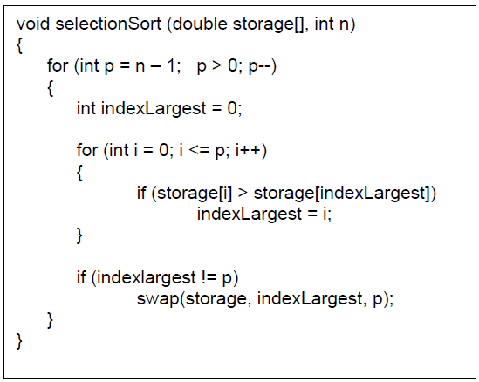
Q5
So what remains? …
void selectionSort(double storage[], int n)
{
for (int p = n-1; p > 0; p--)
for (int i=0; i <= p; i++)
Do something taking
constant time
}
Considered Constant
Considered Constant
Considered Constant
Considered Constant
Considered Constant

Slide 28



Q5
So what remains? …
void selectionSort(double storage[], int n)
{
for (int p = n-1; p > 0; p--)
for (int i=0; i <= p; i++)
Do something taking
constant time
}
p = n-1 → inner loops runs n times
p = n-2 → inner loops runs n-1 times
p = n-3 → inner loops runs n-2 times
p = n-4 → inner loops runs n-3 times
: :
p = 1 → inner loops runs 2 times
2 + 3 + 4 + … + n
O(n²)
$$\sum_{i=2}^{n}{i}$$
$$≤\sum_{i=1}^{n}{i}$$
$$=\frac{n(n+1)}{2}$$
= ½ n² + ½ n
Eliminate constants
Remove lower order terms

Slide 29
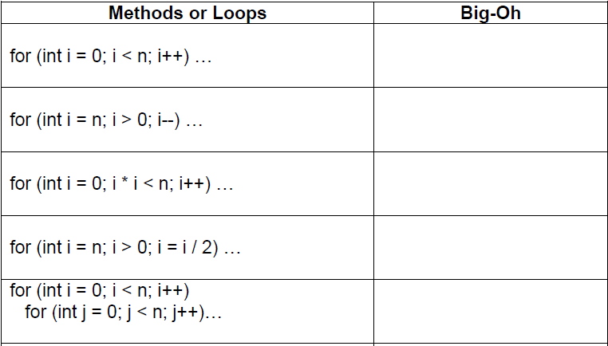


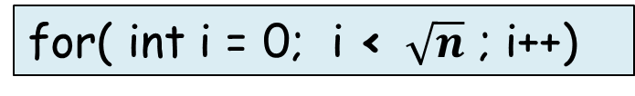
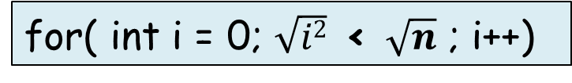
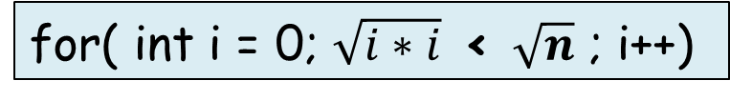
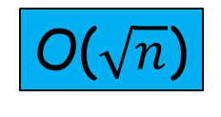

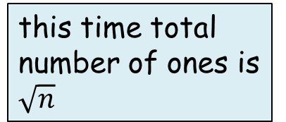
Q6a
$$\sum_{i=0}^{n−1}{1}$$
= 1 + 1 + … + 1
= n
O(n)
$$\sum_{i=1}^{n}{1}$$
= 1 + 1 + … + 1
= n
O(n)
$$\sum_{i=1}^{\sqrt{n}}{1}$$
= 1 + 1 + … + 1
O($\sqrt{n}$)
for( int i = 0; $\sqrt{i∗i}$ < $\sqrt{n}$ ; i++)
this time total number of ones is $\sqrt{n}$
for( int i = 0; $\sqrt{i2}$ < $\sqrt{n}$ ; i++)
for( int i = 0; i < $\sqrt{n}$ ; i++)

Slide 30
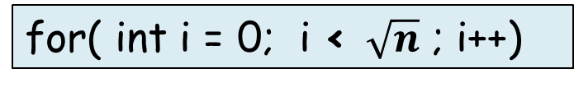
Q6a
n |  | number of iterations
257 | 128,64,32,16,8,4,2,1,0 | 9
256 | 128,64,32,16,8,4,2,1,0 | 9
255 | 127, 63, 31, 15, 7,3,1,0 | 8
129 | 64, 32, 16, 8, 4, 2, 1,0 | 8
128 | 64, 32, 16, 8, 4, 2, 1,0 | 8
127 | 63, 31, 15, 7, 3, 1, 0 | 7
65 | 32, 16, 8, 4, 2, 1, 0 | 7
64 | 32, 16, 8, 4, 2, 1, 0 | 7
63 | 31, 15, 7, 3, 1, 0 | 6
n |  | number of iterations
33 | 16, 8, 4, 2, 1, 0 | 6
32 | 16, 8, 4, 2, 1, 0 | 6
31 | 15, 7, 3, 1, 0 | 5
17 | 8, 4, 2, 1, 0 | 5
16 | 8, 4, 2, 1, 0 | 5
15 | 7, 3, 1, 0 | 4
9 | 4, 2, 1, 0 | 4
8 | 4, 2, 1, 0 | 4
7 | 3, 1, 0 | 3
lg 256 = lg 2⁸ = 8 lg 2 = 8
O(n)
lg 32 = lg 2⁵ = 5 lg 2 = 5
O(n)
lg 128 = lg 2⁷ = 7 lg 2 = 7
lg 16 = lg 2⁴ = 4 lg 2 = 4
for( int i = 0; i < $\sqrt{n}$ ; i++)
O($\sqrt{n}$)
lg 64 = lg 2⁶ = 6 lg 2 = 6
lg 8 = lg 2³ = 3 lg 2 = 3
Effectively this is counting
the number of times n can be divided in half (integer-wise)

Slide 31
Q6a
We seem to be off by 1
each time with the lg n
So let’s add 1
and characterize this for loop by the function
n |  | number of iterations
257 | 128,64,32,16,8,4,2,1,0 | 9
256 | 128,64,32,16,8,4,2,1,0 | 9
255 | 127, 63, 31, 15, 7,3,1,0 | 8
129 | 64, 32, 16, 8, 4, 2, 1,0 | 8
128 | 64, 32, 16, 8, 4, 2, 1,0 | 8
127 | 63, 31, 15, 7, 3, 1, 0 | 7
65 | 32, 16, 8, 4, 2, 1, 0 | 7
64 | 32, 16, 8, 4, 2, 1, 0 | 7
63 | 31, 15, 7, 3, 1, 0 | 6
n |  | number of iterations
33 | 16, 8, 4, 2, 1, 0 | 6
32 | 16, 8, 4, 2, 1, 0 | 6
31 | 15, 7, 3, 1, 0 | 5
17 | 8, 4, 2, 1, 0 | 5
16 | 8, 4, 2, 1, 0 | 5
15 | 7, 3, 1, 0 | 4
9 | 4, 2, 1, 0 | 4
8 | 4, 2, 1, 0 | 4
7 | 3, 1, 0 | 3
lg 256 = lg 2⁸ = 8 lg 2 = 8
O(n)
lg 32 = lg 2⁵ = 5 lg 2 = 5
1 + lg n
O(lg n)
Remove lower order terms
O(n)
lg 128 = lg 2⁷ = 7 lg 2 = 7
lg 16 = lg 2⁴ = 4 lg 2 = 4
Eliminate constants – N/A
for( int i = 0; i < $\sqrt{n}$ ; i++)
O($\sqrt{n}$)
lg 64 = lg 2⁶ = 6 lg 2 = 6
lg 8 = lg 2³ = 3 lg 2 = 3
O(lg n)

Slide 32




Q6a
O(n)
O(n)
Remove lower order terms – N/A
O($\sqrt{n}$)
Eliminate constants – N/A
$$\sum_{i=0}^{n−1}{}\sum_{j=0}^{n−1}{1}$$
$$=\sum_{i=0}^{n−1}{n}$$
$$=n\sum_{i=0}^{n−1}{1}$$
$$=n2$$
O(lg n)
O(n²)

Slide 33
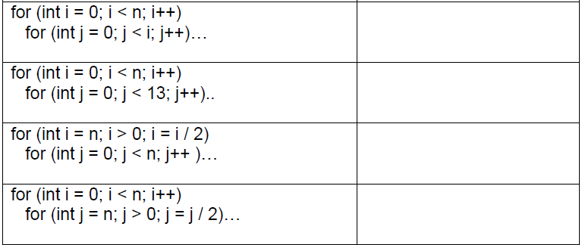


Q6b
O(n²)
Eliminate constants
Remove lower order terms
$$\sum_{i=1}^{n}{i}=$$
$$\frac{n(n+1)}{2}$$
½ n² + ½ n

Slide 34




Q6b
O(n²)
O(n)
Remove lower order terms – N/A
Eliminate constants
$$\sum_{i=0}^{n−1}{}\sum_{j=0}^{13}{1}$$
$$=\sum_{i=0}^{n−1}{13}$$
$$=13\sum_{i=0}^{n−1}{1}$$
$$=13n$$

Slide 35


Q6b
for (int i = n; i > 0; i = i/2)
for (int j = 0; j < n; j++ ) …
$$Let^{′}s make a table$$
n | i values | outer loop iters | for each outer loop inner loop iters | total iters
1 | 1, 0 | 1 | 1 | 1
2 | 2, 1, 0 | 2 | 2 | 4
3 | 3, 1, 0 | 2 | 3 | 6
4 | 4, 2, 1, 0 | 3 | 4 | 12
5 | 5, 2, 1, 0 | 3 | 5 | 15
6 | 6, 3, 1, 0 | 3 | 6 | 18
7 | 7, 3, 1, 0 | 3 | 7 | 21
8 | 8, 4, 2, 1, 0 | 4 | 8 | 32
9 | 9, 4, 2, 1, 0 | 4 | 9 | 36
: | : | : | : | :
32 | 32,16,8,4,2,1,0 | 6 | 32 | 192
O(n²)
O(n)
$$Let^{′}s make a table$$

Slide 36
Q6b
for (int i = n; i > 0; i = i/2)
for (int j = 0; j < n; j++ ) …
$$Let^{′}s make a table$$
And this is just n
We’ve seen this before
it was ( 1 + lg n )
n | i values | outer loop iters | for each outer loop inner loop iters | total iters
1 | 1, 0 | 1 | 1 | 1
2 | 2, 1, 0 | 2 | 2 | 4
3 | 3, 1, 0 | 2 | 3 | 6
4 | 4, 2, 1, 0 | 3 | 4 | 12
5 | 5, 2, 1, 0 | 3 | 5 | 15
6 | 6, 3, 1, 0 | 3 | 6 | 18
7 | 7, 3, 1, 0 | 3 | 7 | 21
8 | 8, 4, 2, 1, 0 | 4 | 8 | 32
9 | 9, 4, 2, 1, 0 | 4 | 9 | 36
: | : | : | : | :
32 | 32,16,8,4,2,1,0 | 6 | 32 | 192
(1 + lg n)
n
O(n²)
O(n)

Slide 37
Q6b
for (int i = n; i > 0; i = i/2)
for (int j = 0; j < n; j++ ) …
n | i values | outer loop iters | for each outer loop inner loop iters | total iters
1 | 1, 0 | 1 | 1 | 1
2 | 2, 1, 0 | 2 | 2 | 4
3 | 3, 1, 0 | 2 | 3 | 6
4 | 4, 2, 1, 0 | 3 | 4 | 12
5 | 5, 2, 1, 0 | 3 | 5 | 15
6 | 6, 3, 1, 0 | 3 | 6 | 18
7 | 7, 3, 1, 0 | 3 | 7 | 21
8 | 8, 4, 2, 1, 0 | 4 | 8 | 32
9 | 9, 4, 2, 1, 0 | 4 | 9 | 36
: | : | : | : | :
32 | 32,16,8,4,2,1,0 | 6 | 32 | 192
And we have
( 1 + lg n ) * n = n + n(lg n)
(1 + lg n)
n
O(n²)
O(n)
Remove lower order terms
Eliminate constants – N/A
O(n lg n)

Slide 38
Q6b
O(n²)
O(n)
O(n lg n)
By Similar we arrive at:
O(n lg n)

Slide 39

HINTS: Polynomial Classifications

Slide 40
HINTS: Polynomial Classifications
= 15n + 5 n lg n

Slide 41

HINTS: Polynomial Classifications
= $\frac{5}{6}n+\frac{4}{6}$

Slide 42

HINTS: Polynomial Classifications
$$=\sum_{i=1}^{n}{i}$$

Slide 43
HINTS: Polynomial Classifications
= n⁴ + lesser terms

Slide 44

HINTS: Polynomial Classifications

Slide 45
HINTS: Polynomial Classifications

Slide 46
Other Questions
Come see me
if you have additional questions
on Big-Oh
or the related homework

Slide 47
Marker Slide
Any other questions on:
  Big-Oh
    Some Formulas
    Examples
Next up
  New stuff

Slide 48

The End
Or is it?
  Continue to next presentation

