Slide 1
Pointer and Array Lists Chapter 3, Summary
Review-ish of stuff
from previous lecture
Different perspective
CS 244
Brent M. Dingle, Ph.D.
Game Design and Development Program
Department of Mathematics, Statistics, and Computer Science
University of Wisconsin – Stout
2014
Some content based on Book: Data Structures Using C++ 2nd Ed. by D.S. Malik

Slide 2
Objectives
Learn about the pointer data type and pointer variables
Explore how to declare and manipulate pointer variables
Learn about the address of operator and dereferencing operator
Discover dynamic variables
Examine how to use the new and delete operators to manipulate dynamic variables
Learn about pointer arithmetic

Slide 3
Objectives (cont’d.)
Discover dynamic arrays
Become aware of the shallow and deep copies of data
Discover the peculiarities of classes with pointer data members
Explore how dynamic arrays are used to process lists
Learn about virtual functions
Become aware of abstract classes

Slide 4
The Pointer Data Type and Pointer Variables
Pointer data types
Values are computer memory addresses
No associated name
Domain consists of addresses (memory locations)
Pointer variable
Contains an address (memory address)

Slide 5
The Pointer Data Type and Pointer Variables (cont’d.)
Declaring pointer variables
Specify data type of value stored in the memory location that pointer variable points to
General syntax
dataType *identifier;
Asterisk symbol (*)
Between data type and variable name
Can appear anywhere between the two
Preference: attach * to variable name
Examples: int *p; and char *ch;

Slide 6
The Pointer Data Type and Pointer Variables (cont’d.)
Address of operator (&)
Unary operator
Returns address of its operand
Dereferencing operator (*)
Unary operator
Different from binary multiplication operator
Also known as indirection operator
Refers to object where the pointer points (operand of the *)

Slide 7
The Pointer Data Type and Pointer Variables (cont’d.)
Pointers and classes
Dot operator (.)
Higher precedence than dereferencing operator (*)
Member access operator arrow ( ->)
Simplifies access of class or struct components via a pointer
Consists of two consecutive symbols: hyphen and ‘‘greater than’’ symbol
Syntax
pointerVariableName -> classMemberName

Slide 8
The Pointer Data Type and Pointer Variables (cont’d.)
Initializing pointer variables
No automatic variable initialization in C++
Pointer variables must be initialized
If not initialized, they do not point to anything
Initialized using
Constant value 0 (null pointer)
Named constant NULL
Number 0
Only number directly assignable to a pointer variable

Slide 9
The Pointer Data Type and Pointer Variables (cont’d.)
Dynamic variables
Variables created during program execution
Real power of pointers
Two operators
new: creates dynamic variables
delete: destroys dynamic variables
Reserved words

Slide 10
The Pointer Data Type and Pointer Variables (cont’d.)
Operator new
Allocates single variable
Allocates array of variables
Syntax
new dataType;
new dataType[intExp];
Allocates memory (variable) of designated type
Returns pointer to the memory (allocated memory address)
Allocated memory: uninitialized

Slide 11
The Pointer Data Type and Pointer Variables (cont’d.)
Operator delete
Destroys dynamic variables
Syntax
delete pointerVariable;
delete [ ] pointerVariable;
Memory leak
Memory space that cannot be reallocated
Dangling pointers
Pointer variables containing addresses of deallocated memory spaces
Avoid by setting deleted pointers to NULL after delete

Slide 12
The Pointer Data Type and Pointer Variables (cont’d.)
Operations on pointer variables
Operations allowed
Assignment, relational operations; some limited arithmetic operations
Can assign value of one pointer variable to another pointer variable of the same type
Can compare two pointer variables for equality
Can add and subtract integer values from pointer variable
Danger
Accidentally accessing other variables’ memory locations and changing content without warning

Slide 13
The Pointer Data Type and Pointer Variables (cont’d.)
Dynamic arrays
Static array limitation
Fixed size
Not possible for same array to process different data sets of the same type
Solution
Declare array large enough to process a variety of data sets
Problem: potential memory waste
Dynamic array solution
Prompt for array size during program execution

Slide 14
The Pointer Data Type and Pointer Variables (cont’d.)
Dynamic arrays (cont’d.)
Dynamic array
An array created during program execution
Dynamic array creation
Use new operator
Example
p=new int[10];

Slide 15
The Pointer Data Type and Pointer Variables (cont’d.)
Array name: a constant pointer
Array name value: constant
Increment, decrement operations cannot be applied
FIGURE 3-14 list and array list
FIGURE 3-15 Array list after the execution
of the statements list[0] = 25; and list[2] = 78;

Slide 16
The Pointer Data Type and Pointer Variables (cont’d.)
Shallow vs. deep copy and pointers
Pointer arithmetic may create unsuspected or erroneous results
Shallow copy
Two or more pointers of same type
Points to same memory
Points to same data

Slide 17
The Pointer Data Type and Pointer Variables (cont’d.)
Shallow copy
FIGURE 3-16 Pointer first and its array
FIGURE 3-17 first and second after the statement
second = first; executes
FIGURE 3-18 first and second after the statement
delete [] second; executes

Slide 18
The Pointer Data Type and Pointer Variables (cont’d.)
Deep copy
Two or more pointers have their own data
FIGURE 3-19 first and second both pointing to their own data

Slide 19
Classes and Pointers: Some Peculiarities
Class can have pointer member variables
Peculiarities of such classes exist
FIGURE 3-20 Objects objectOne and objectTwo

Slide 20
Classes and Pointers: Some Peculiarities (cont’d.)
Destructor
Could be used to prevent an array from staying marked as allocated
Even though it cannot be accessed
If a class has a destructor
Destructor automatically executes whenever a class object goes out of scope
Put code in destructor to deallocate memory
FIGURE 3-21 Object objectOne and its data

Slide 21
Classes and Pointers: Some Peculiarities (cont’d.)
Assignment operator
Built-in assignment operators for classes with pointer member variables may lead to shallow copying of data
FIGURE 3-22 Objects objectOne and objectTwo
FIGURE 3-23 Objects objectOne and objectTwo after the statement objectTwo = objectOne; executes

Slide 22
Classes and Pointers: Some Peculiarities (cont’d.)
Assignment operator (cont’d.)
Overloading the assignment operator
Avoids shallow copying of data for classes with a pointer member variable
FIGURE 3-24 Objects objectOne and objectTwo

Slide 23
Abstract Classes and Pure Virtual Functions
Virtual functions enforce run-time binding of functions
Inheritance
Allows deriving of new classes without designing them from scratch
Derived classes
Inherit existing members of base class
Can add their own members
Can redefine or override public and protected base class member functions
Base class can contain functions each derived class can implement

Slide 24
Abstract Classes and Pure Virtual Functions (cont’d.)
Virtual functions enforce run-time binding of functions (cont’d.)
Pure virtual functions
Abstract class
Class contains one or more pure virtual functions
Not a complete class: cannot create objects of that class.
Can contain instance variables, constructors, functions not pure virtual

Slide 25
Marker Slide
Questions on
Pointers?
Next Up
Array Lists

Slide 26
Array-Based Lists
List
Collection of elements of same type
Length of a list
Number of elements in the list
Many operations may be performed on a list
Store a list in the computer’s memory
Using an array

Slide 27
Array-Based Lists (cont’d.)
Three variables needed to maintain and process a list in an array
The array holding the list elements
A variable to store the length of the list
Number of list elements currently in the array
A variable to store array size
Maximum number of elements that can be stored in the array
Desirable to develop generic code
Used to implement any type of list in a program
Make use of templates

Slide 28
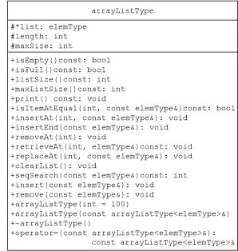
Array-Based Lists (cont’d.)
Define class implementing list as an abstract data type (ADT)
FIGURE 3-29 UML class diagram
of the class arrayListType

Slide 29
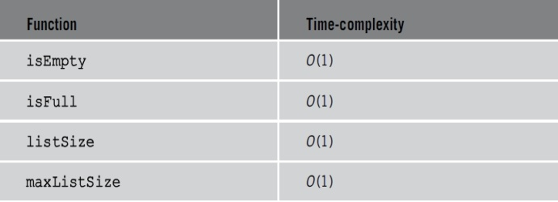
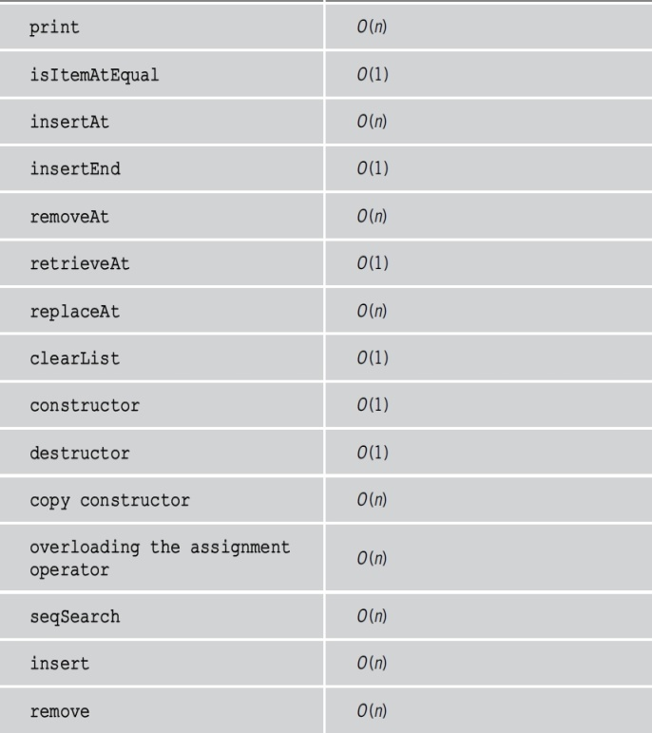
Array-Based Lists (cont’d.)
TABLE 3-1 Time complexity of list operations

Slide 30
Summary
Pointers contain memory addresses
All pointers must be initialized
Static and dynamic variables
Several operators allowed
Static and dynamic arrays
Virtual functions
Enforce run-time binding of functions
Array-based lists
Several operations allowed
Use generic code

Slide 31
The End
Or is it?
Go to next presentation

