Slide 1
Makefiles, Geany
CS 244
Brent M. Dingle, Ph.D.
Game Design and Development Program
Department of Mathematics, Statistics, and Computer Science
University of Wisconsin – Stout
2014

Slide 2
From Last Time
Standard Template Library
Containers
For example, std:: vector
Iterators
Algorithms

Slide 3
Things to Note
Homework 3 is Due Soon
Like now
Please turn something in if you have not already
Homework 4 and 5 are Posted on D2L
Do NOT delay in starting

Slide 4
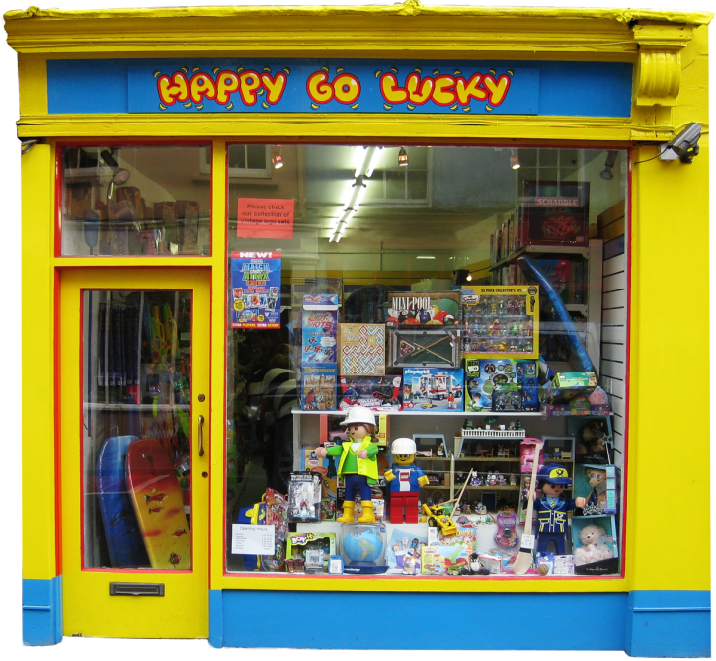
For Today
Makefiles
compiling multiple files
Geany
a primitive IDE
Then more

Slide 5
Marker Slide
Any General Questions
Next up
makefiles
geany

Slide 6
Multiple File Compiles and Builds
Many programs in this class will have multiple files.
To compile and build multiple files is done from the command prompt (terminal window):
g++ file01.cpp file02.cpp file03.cpp

Slide 7
Class Activity – Using Makefiles
In D2L locate:
Making_Makefiles_Example.pdf
Open that file and follow along with the next few slides
ASIDE:
Command:
dos2unix myfile.txt
may be helpful if copying text
between windows and linux

Slide 8
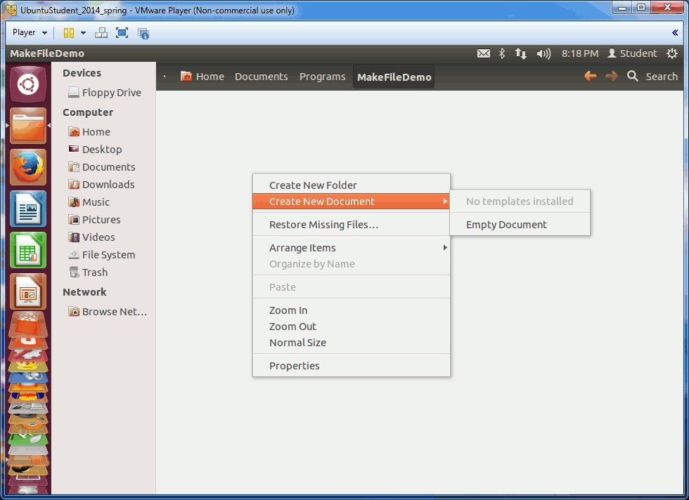
Class Activity Demo – Create Source
Animated GIF
Create the 3 files (use editor of choice)
HelloMain.cpp
HelloFunction.cpp
HelloFunction.h
HelloMain.cpp | HelloFunction.cpp | HelloFunction.h
#include "HelloFunction.h" int main() { HelloFunction(); return 0; } | #include "HelloFunction.h" void HelloFunction() { cout << "Hello there\n"; } | // include standard stuff void HelloFunction();

Slide 9
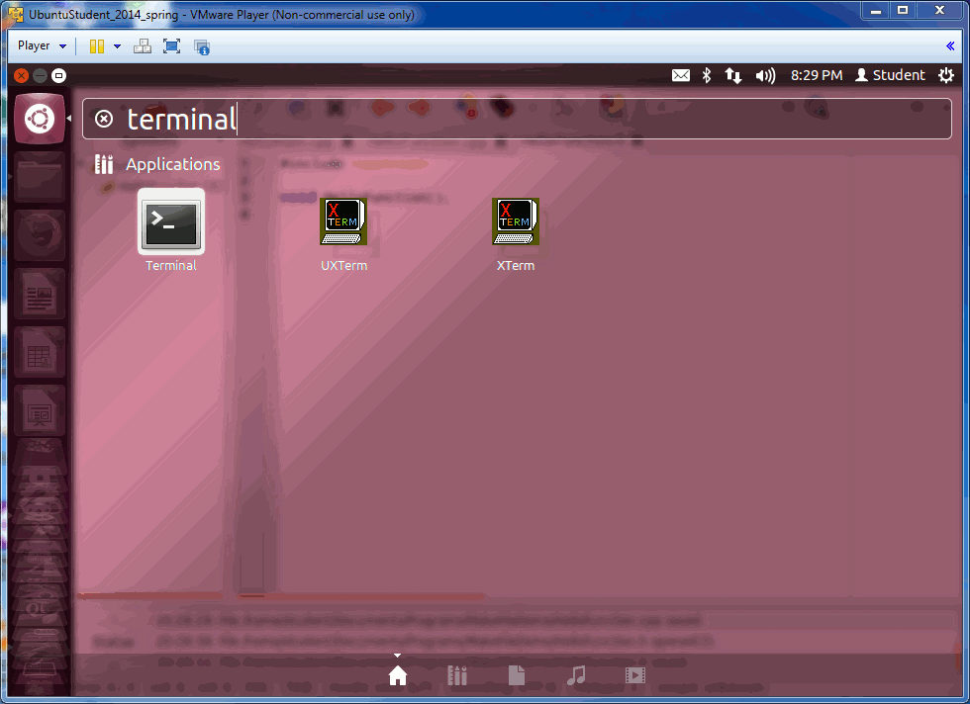
Class Activity Demo: g++ Compile/Build
Compile and build from Terminal Window
g++ -o hello HelloMain.cpp HelloFunction.cpp
Run the resulting executable
./hello
Remove the hello file
rm hello
Animated GIF

Slide 10
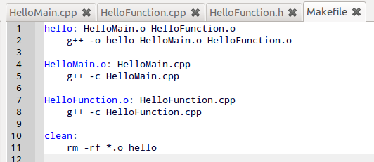
Class Activity Demo – Create makefile
Create a makefile
The lines that start with g++ (and rm) must begin with a TAB
spaces will not work
makefile
hello: HelloMain.o HelloFunction.o g++ -o hello HelloMain.o HelloFunction.o HelloMain.o: HelloMain.cpp g++ -c HelloMain.cpp HelloFunction.o: HelloFunction.cpp g++ -c HelloFunction.cpp clean: rm -rf *.o hello

Slide 11
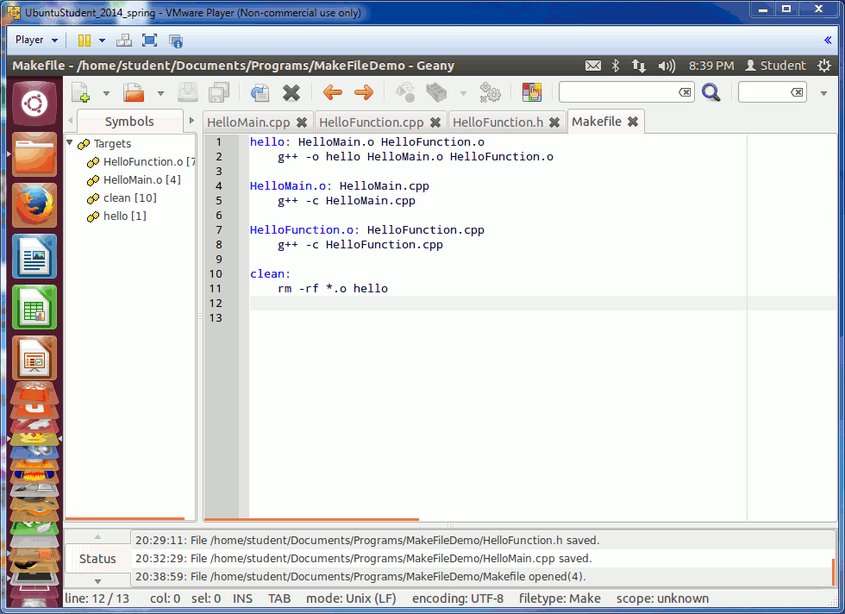
Class Activity Demo – use makefile
Compile and build from Terminal Window
make
Run the resulting executable
./hello
Remove the .o files and hello
make clean
Animated GIF (run the powerpoint and wait a second or two)

Slide 12
Marker Slide
Any questions on
makefiles
Next up
geany

Slide 13
Using Geany
Geany is a very primitive IDE
But is better than command line =)
Geany by “default” only compiles and builds a single cpp file
whatever the “active” one is
This demo will show you how to use a makefile with Geany
The makefile must be in the same folder as your source code
The executable specified by the makefile must be the same name as the file that has your main() function in it

Slide 14
Class Activity – Geany Makefiles
You may want to follow along with the next few slides
It will make things easier for you in the future

Slide 15
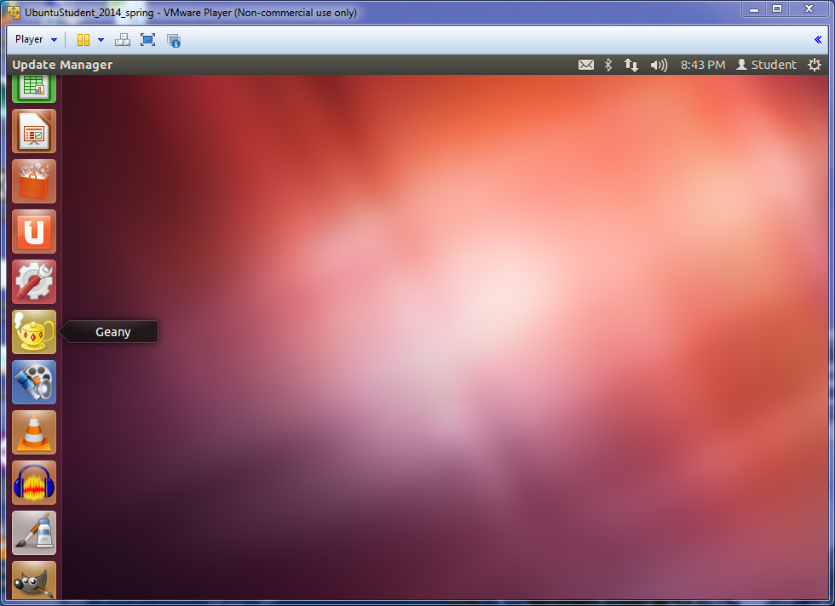
Class Activity Demo – Open Geany

Slide 16
Class Activity Demo – Geany
Open all the files in Geany
HelloMain.cpp HelloFunction.cpp HelloFunction.h
and makefile
Reiterating
to use makefiles with Geany
the executable name in the makefile must be the same as the filename that has main()

Slide 17
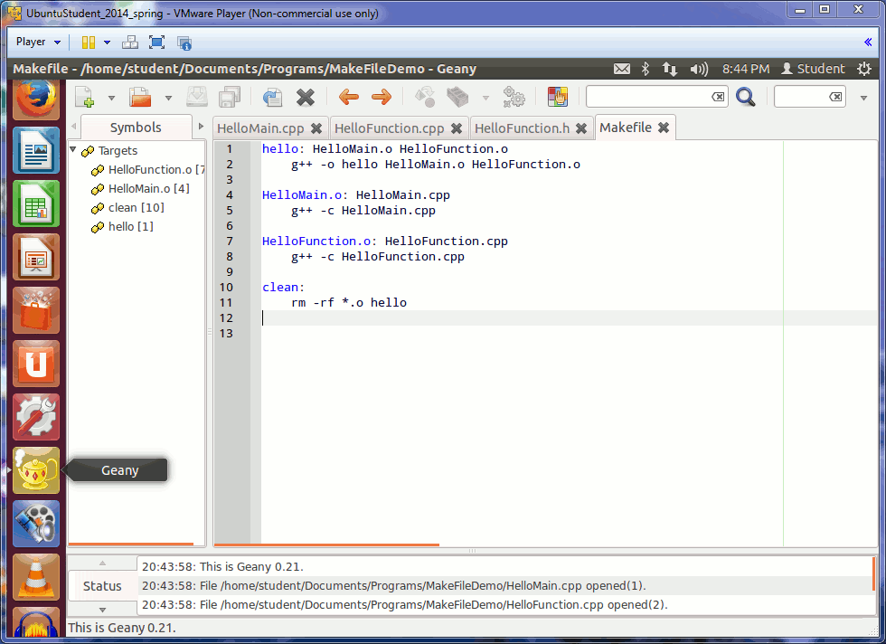
Class Activity Demo – Geany Adapt 1
Change the makefile slightly:
Change the
hello executable
name to be
HelloMain
makefile
hello: HelloMain.o HelloFunction.o g++ -o hello HelloMain.o HelloFunction.o HelloMain.o: HelloMain.cpp g++ -c HelloMain.cpp HelloFunction.o: HelloFunction.cpp g++ -c HelloFunction.cpp clean: rm -rf *.o hello
Animated GIF

Slide 18
Class Activity Demo – Geany Adapt 1
Change the makefile slightly:
Change the
hello executable
name to be
HelloMain
makefile
HelloMain: HelloMain.o HelloFunction.o g++ -o HelloMain HelloMain.o HelloFunction.o HelloMain.o: HelloMain.cpp g++ -c HelloMain.cpp HelloFunction.o: HelloFunction.cpp g++ -c HelloFunction.cpp clean: rm -rf *.o HelloMain
Animated GIF

Slide 19
Class Activity Demo – Geany
Now, if you open the file with the main() function in it
In this case HelloMain.cpp
You can select the dropdown “make all” option in Geany
to compile and build all the files
as described in the makefile
[ shown on next slides ]

Slide 20
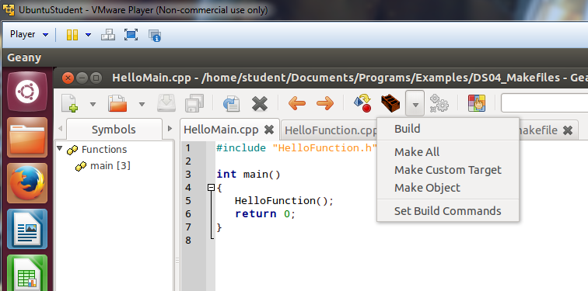
Class Activity Demo – Geany Make All
Press this down
arrow button
to get the drop
down menu
Be sure the file with your main()
function is the
“current tab”

Slide 21
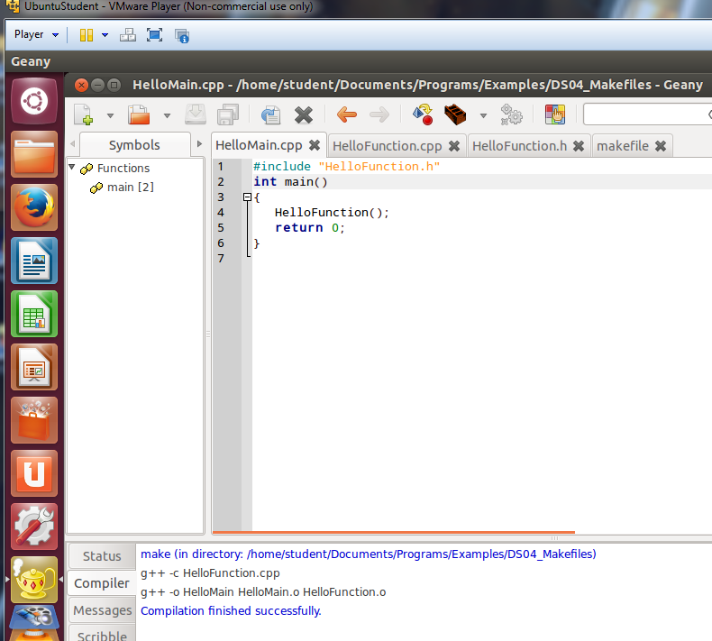
Class Activity Demo – Geany Make Success

Slide 22
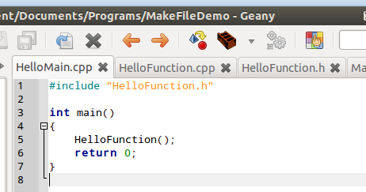
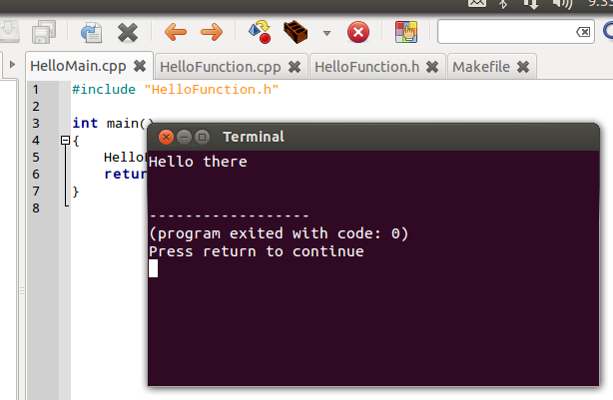
Class Activity Demo – Geany Run
Run the program
Press the ‘gray’ gears button
or on the keyboard press F5
Be sure the .cpp file with main() is still the “current tab” in Geany
In this case HelloMain.cpp

Slide 23
Class Activity Demo – Geany Make Clean
After running the program
If you make any changes to your files you will need to do a
make clean
before the next make all

Slide 24
Class Activity Demo – Mantra
Make Clean
then
Make All
Repeat

Slide 25
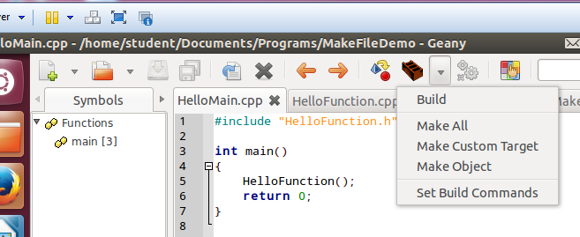
Class Activity Demo – Make Clean Geany
Select: Make Custom Target
Press this down
arrow button
to get the drop
down menu

Slide 26
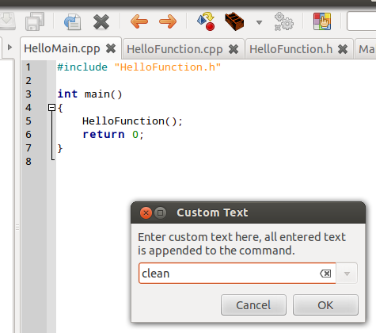
Class Activity Demo – Make Clean Geany
Type: clean
and press OK

Slide 27
Class Activity Demo – Make Clean Geany
Near the bottom of the screen you should see a message like this (if it succeeds)

Slide 28
Marker Slide
Any questions on
makefiles
geany
Next up
another presentation file

Slide 29
The End
Or is it?
Go to next presentation

