Slide 1

Linked Lists part 2
Chapter 5-ish
CS 244
Brent M. Dingle, Ph.D.
Game Design and Development Program
Department of Mathematics, Statistics, and Computer Science
University of Wisconsin – Stout
2014

Slide 2
Previously
Standard Template Library
Makefiles and Geany
Singly Linked Lists
  Class Fun
  Definition and Description
  Implementation Examples
may have skipped this
It will be reviewed today

Slide 3
Marker Slide
Any General Questions ?
Next up
  Singly Linked Lists
    Implementation Examples
  Doubly Linked Lists
  Circularly Linked Lists

Slide 4
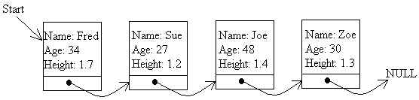
Linked List – Definition
A linked list is a data structure which is built from nodes and pointers.
A list forms a “chain of nodes”
  With pointers representing the links of the chain and holding the entire list together.

Slide 5
Linked List – Example
This linked list has four nodes in it
  Each with a link to the next node in the series.
  The last node has a link to the value NULL
There is also another special pointer, called Start which points to the first link in the chain so that we can keep track of it.

Slide 6
Linked List – Implementation
Key part of a linked list is the node structure
  Which holds the data for each node
    name, age, height, pointer to next node
class Node
{
public:
string m_name;
int m_age; // age in years
double m_height; // height in meters
Node* mp_next; // pointer to next node
};
Node* startPtr = NULL; // global variable to keep track
// of beginning of the list
Others may
call startPtr
start,
head, headPtr
root, rootPtr

Slide 7
Adding a Node
To the End of the List
First
  Create a new node
  Ask user for information to fill
  in the node’s data
Bob
22
Bob
Bob
22
1.8
tempPtr
Node *tempPtr = new Node;
NULL
???
cout << "Please enter the name of the person -> ";
cin >> tempPtr->m_name;
cout << “Enter the age of the person -> “;
cin >> tempPtr->m_age;
cout << "Enter the height of the person → ";
cin >> tempPtr->height;
tempPtr->mp_next = NULL;
A class constructor would likely do this last line for us

Slide 8
Initialize the Start Pointer
Assuming that was the first node in the list
  How would we initialize the global variable startPtr ?
Node *startPtr = NULL;
tempPtr
startPtr
NULL
?????
startPtr = tempPtr;
NULL

Slide 9
Moving Through a List
It is common to use a currentPtr
  To keep track of what node is “currently” being examined
  It too, usually begins at the beginning
startPtr = tempPtr;
startPtr
currentPtr
NULL
?????
Node* currentPtr = startPtr;
NULL

Slide 10
Moving Example
Assume we have a list with more than 1 node
Node* currentPtr = startPtr;
startPtr
NULL
currentPtr
currentPtr
currentPtr
currentPtr
This will move the currentPtr to point to the last node in the list
while (currentPtr->next != NULL )
{
currentPtr = currentPtr->next
}
Useful for outputting a list
Useful for appending to a list

Slide 11

Removing the Head
How to remove the first element
startPtr
startPtr
NULL
oldHeadPtr
Calling this repeatedly until startPtr == NULL
will delete the entire list.
Useful for de-constructors
removeFront()
{
Node* oldHeadPtr = startPtr;
startPtr = oldHeadPtr->mp_next;
delete oldHeadPtr;
}

Slide 12
Example: Linked List Class
class Node
{
public:
string m_name;
int m_age; // age in years
Node* mp_next; // pointer to next node
};
class MyLinkedList
{
public:
MyLinkedList(); // constructor
~MyLinkedList(); // destructor
bool isEmpty() const; // returns true if list is empty
Node* findNode(string findName); // returns null or node w/ match
void addNode(const Node& newNode); // add node to list
void removeFront(); // remove first node of list
private:
Node* mp_startPtr; // pointer to head of list
};

Slide 13
Summary Review
Linked Lists are similar to arrays
When compared to arrays Linked Lists have
  The bad:
    You cannot access the i-th element unless you walk to it through the i-1 elements that come before it
  The good:
    You can INSERT an element into a list WITHOUT moving/shifting all the other elements

Slide 14
Marker Slide
Any Questions On:
  Singly Linked Lists
    Class Fun
    Definition and Description
    Implementation Examples
Next up
  Doubly Linked Lists
  Circularly Linked Lists

Slide 15







Doubly Linked Lists
You can also create linked lists that have pointers in both directions
  Pointer to NEXT
  Pointer to PREVIOUS
Doubly Linked lists are sometimes more useful than singly linked
  The cost is maintaining 2 pointers (and using more memory to do so)
NULL
NULL
NULL
NULL

Slide 16
Marker Slide
Any Questions On:
  Singly Linked Lists
    Class Fun
    Definition and Description
    Implementation Examples
  Doubly Linked Lists
Next up
  Circularly Linked Lists

Slide 17

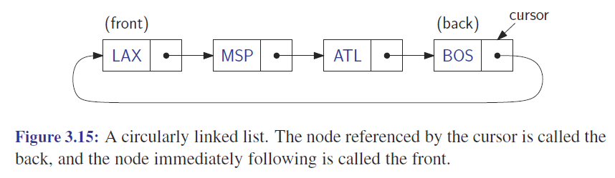
Circularly Linked Lists
So…
Ummm…
Always keep track of your pointers
and
What they *should* be pointing to
You can also create lists that go in circles
  They have nodes that can be referred to as
    front node (start)
    back node (end)
  And a cursor (current) pointer

Slide 18
So Ends the Listing of Lists
Three Linked List Data Types
  Singly Linked
  Doubly Linked
  Circularly Linked
Each with its own features and uses
  Each can be SORTED and SEARCHED
    Just as arrays can
    Lists have advantages and disadvantages compared to arrays
      See previous summary of lists slide

Slide 19
Marker Slide
Any Questions On:
  Singly Linked Lists
    Class Fun
    Definition and Description
    Implementation Examples
  Doubly Linked Lists
  Circularly Linked Lists
Next up
  Bonus Extras

Slide 20
Group Class Activity
Look on D2L for starter code GCA202
Suggest distribute work
1 write header (.h)
1 write main() for testing
1 write constructor/destructor/isEmpty
1 write addNode/Insert
1 write findName
1 write displayList
and so on, or something like that
Find way to combine at end
Only 1 submission needed per team
Form into groups
  Create a linked list class
    Based mostly on the above
    Nodes are people with
    first name and age
  Class be able to
    add nodes (to front)
    remove nodes by name
    sort list alphabetically by name
    print the entire list (readable)
    allocate and de-allocate memory
    correctly using constructors
    and destructors
    Suggest do sort() last and discuss
    as a group – draw pictures
Put ALL group member names at beginning of EVERY source file.
When done, or out of time Submit to correct D2L dropbox
Check Next Slide too

Slide 21
Insertion Sort – Code for Linked List
struct LIST
{
struct LIST * pNext;
int iValue;
};
struct LIST * SortList1(struct LIST * pList)
{
// zero or one element in list
if(!pList || !pList->pNext)
return pList;
// head is the first element of resulting sorted list
LIST * head = 0;
while(pList != 0)
{
LIST * current = pList;
pList = pList->pNext;
if(!head || current->iValue < head->iValue)
{
// insert into the head of the sorted list
// or as the first element into an empty
// sorted list
current->pNext = head;
head = current;
}
// the else-codeblock on the right goes here
}
return head;
}
else
{
// insert current element into proper position in non-empty sorted list
LIST * p = head;
while(p)
{
// p->pNext == NULL if last element of sorted list
// current->iValue < p->pNext->iValue // means in middle
if ( !p->pNext ||
current->iValue < p->pNext->iValue)
{
// insert into middle of sorted list or as last element
current->pNext = p->pNext;
p->pNext = current;
break; // done, exit while loop
}
p = p->pNext;
}
}

Slide 22
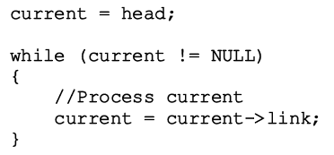
Traversing a List
Suppose head points to a linked list of numbers
Code to move through each node of the list
Code to output data stored in each node

Slide 23

Insertion: In The Middle
p is pointing at a location in the list
we create a new node named newnode
and insert the node after p’s node
Aside:
book circa page 270

Slide 24
Insertion: In The Middle
p is pointing at a location in the list
we create a new node named newnode
and insert the node after p’s node
Aside:
book circa page 270

Slide 25

Insertion: In The Middle
p is pointing at a location in the list
we create a new node named newnode
and insert the node after p’s node
Aside:
book circa page 270

Slide 26
Insertion: In The Middle
p is pointing at a location in the list
we create a new node named newnode
and insert the node after p’s node
Aside:
book circa page 270

Slide 27
Insertion: In The Middle
p is pointing at a location in the list
we create a new node named newnode
and insert the node after p’s node
Aside:
book circa page 270

Slide 28
Deletion: In The Middle
Moving pointers around does not delete the memory allocated.
  The below is incomplete and causes memory leaks
  Exercise: On your own review how to fix/do properly
FIGURE 5-10 List after the statement
p->link = p->link->link; executes

Slide 29
STL has a list container
TABLE 5-9 Various ways to declare a list object

Slide 30
TABLE 5-10 Operations specific to a list container

Slide 31
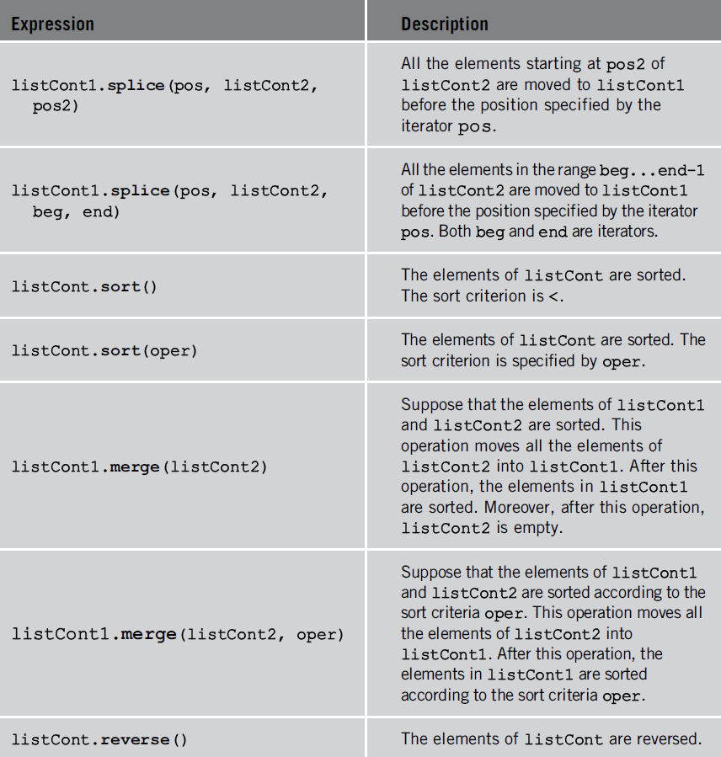
TABLE 5-10 Operations specific to a list container (cont’d.)

Slide 32
Free Play – Things to Work On
Homework 4
Homework 5

Slide 33

The End
Or is it?
  Go to next presentation
    Hanoi Intro
    Useful for homework 5

