Slide 1
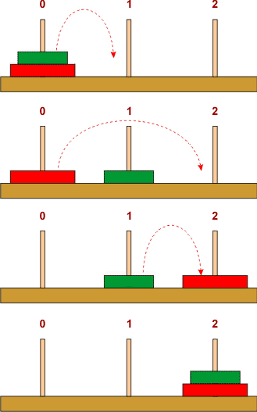
Hanoi Towers part 1
CS 244
Brent M. Dingle, Ph.D.
Game Design and Development Program
Department of Mathematics, Statistics, and Computer Science
University of Wisconsin – Stout
2014

Slide 2
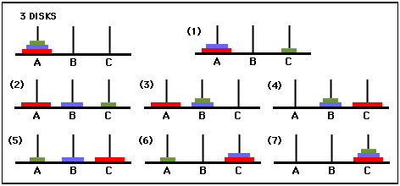
Towers of Hanoi
7 moves

Slide 3
Human Way
while true:
if n is odd:
move disk1 one peg left (first peg wraps around to last peg)
else:
move disk1 one peg right (last peg wraps around to first peg)
if done:
break
else:
make the only legal move not involving disk1

Slide 4
Computer Way
Tower of Hanoi & Big Oh
Pseudocode
:
FUNCTION
MoveTower(n, source,dest, spare):
IF n == 1, THEN:
move disk 1 from source to dest //base case
ELSE:
MoveTower(n - 1, source, spare, dest) // Step 1
move disk n from source to dest // Step 2
MoveTower(n - 1, spare, dest, source) // Step 3
END IF
aside:
1 is smallest disk and n is the largest disk
How did we get this code?
Think on it =)
See also Homework 5

Slide 5
Free Play – Things to Work On
Homework 4
Homework 5

Slide 6
The End
Or is it?

