Slide 1
Recursion
Chapter 6-ish
CS 244
Brent M. Dingle, Ph.D.
Game Design and Development Program
Department of Mathematics, Statistics, and Computer Science
University of Wisconsin – Stout
2014

Slide 2
Things of Note
Homework 4 is due – today
Like now
Turn in something if you have not already done so
Peer Review will follow shortly
Also note
Homework 5 is due next class

Slide 3
Previously
Linked Lists

Slide 4
Marker Slide
Any General Questions ?
Next up
Recursion Introduction
Factorial Example

Slide 5
Objectives
Learn about recursive definitions
Explore the base case and the general case of a recursive definition
Learn about recursive algorithms
Learn about recursive functions

Slide 6
Recursive Definitions
Recursion
Process of solving a problem by reducing it to smaller versions of itself
Example: factorial problem
5!
5 * 4 * 3 * 2 * 1 =120
If n is a nonnegative
Factorial of n is denoted as: n!
and defined as follows:
for n = 0: 0! = 1 Equation 6-1
for n > 0: n! = n * (n-1)! Equation 6-2

Slide 7
Recursive Definitions
for n = 0: 0! = 1 Equation 6-1
for n > 0: n! = n * (n-1)! Equation 6-2
for n = 0: 0! = 1 Equation 6-1
for n > 0: n! = n * (n-1)! Equation 6-2

Slide 8
Recursive Definitions
for n = 0: 0! = 1 Equation 6-1
This case has
no factorial on the
right hand side
This is commonly called
the BASE CASE
for n > 0: n! = n * (n-1)! Equation 6-2
It provides a Direct Solution
i.e. if n == 0 then answer is 1

Slide 9
Recursive Definitions
for n = 0: 0! = 1 Equation 6-1
This case DOES have
a factorial on the
right hand side
This is called
the GENERAL CASE
for n > 0: n! = n * (n-1)! Equation 6-2
aka Inductive Case
aka Recursive Definition
It REDUCES a problem to another problem
of the SAME FORM but SMALLER inputs
Observation: By reducing a problem to smaller and smaller inputs
Eventually
end up at the base case

Slide 10
Recursive Definitions (cont’d.)
Recursion insight gained from factorial problem
Every recursive definition must have one (or more) base cases
General case must eventually reduce to a base case
Base case stops recursion
Recursive algorithm
Finds problem solution by reducing problem to smaller versions of itself
Recursive function
Function that calls itself

Slide 11
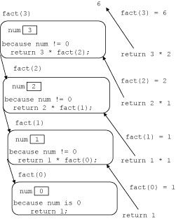
Factorial C++ Code
Recursive function implementing the factorial function
Base Case
FIGURE 6-1 Execution of fact(4)

Slide 12
Factorial C++ Code
Recursive function implementing the factorial function
General Case
Here the function
recursively calls itself
Reducing num by 1
FIGURE 6-1 Execution of fact(4)

Slide 13
Factorial C++ Code
Recursive function implementing the factorial function
FIGURE 6-1 Execution of fact(4)

Slide 14
Factorial C++ Code
Recursive function implementing the factorial function
FIGURE 6-1 Execution of fact(4)

Slide 15
Factorial C++ Code
Recursive function implementing the factorial function
FIGURE 6-1 Execution of fact(4)

Slide 16
Factorial C++ Code
Recursive function implementing the factorial function
FIGURE 6-1 Execution of fact(4)

Slide 17
Factorial C++ Code
Recursive function implementing the factorial function
FIGURE 6-1 Execution of fact(4)

Slide 18
Factorial C++ Code
Recursive function implementing the factorial function
FIGURE 6-1 Execution of fact(4)

Slide 19
Factorial C++ Code
Recursive function implementing the factorial function
FIGURE 6-1 Execution of fact(4)

Slide 20
Factorial C++ Code
Recursive function implementing the factorial function
FIGURE 6-1 Execution of fact(4)

Slide 21
Recursive Definitions (cont’d.)
Recursive function notable comments
Recursive function has unlimited number of copies of itself (logically)
Every call to a recursive function has its own
Code, set of parameters, local variables
After completing a particular recursive call
Control goes back to calling environment (previous call)
Current (recursive) call must execute completely before control goes back to the previous call
Execution in previous call begins from point immediately following the recursive call

Slide 22
Recursive Definitions (cont’d.)
Direct and Indirect recursion
Directly recursive function
Calls itself
Indirectly recursive function
Calls another function, eventually results in original function call
Requires same analysis as direct recursion
Base cases must be identified, appropriate solutions to them provided
Tracing can be tedious
Tail recursive function
Last statement executed: the recursive call

Slide 23
Recursive Definitions (cont’d.)
Infinite recursion
Occurs if every recursive call results in another recursive call
Executes forever (in theory)
Call requirements for recursive functions
System memory for local variables and formal parameters
Saving information for transfer back to right caller
Finite system memory leads to
Execution until system runs out of memory
Abnormal termination of infinite recursive function

Slide 24
Recursive Definitions (cont’d.)
Requirements to design a recursive function
Understand problem requirements
Determine limiting conditions
Identify base cases, providing direct solution to each base case
Identify general cases, providing solution to each general case in terms of smaller versions of itself

Slide 25
Marker Slide
Any questions on:
Recursion Introduction
Factorial Example
Next up
Largest Element in Array Example

Slide 26
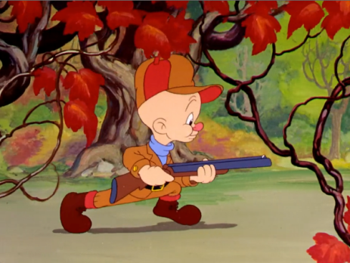
Largest Element in an Array
Assume we have an array of values
It looks something like:
FIGURE 6-2 list with six elements
How can we use recursion to find the largest element in the array?
Can you feel the suspense building?

Slide 27
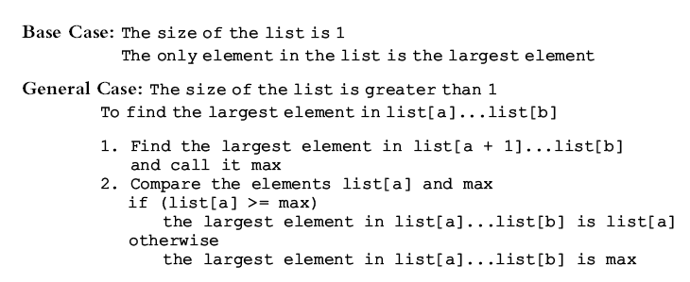
Largest Element in an Array (cont’d.)
Recursive algorithm in pseudocode

Slide 28
Largest Element in an Array (cont’d.)
Recursive algorithm in pseudocode

Slide 29
Largest Element in an Array (cont’d.)
Recursive algorithm as a C++ function

Slide 30
Let’s Test It
Assume the array is:
FIGURE 6-3 list with four elements
Trace execution of the following statement
cout << largest(list, 0, 3) << endl;
Review C++ program on page 362
Determines largest element in a list
I’m really looking for a Wabbit
But maybe this will help

Slide 31
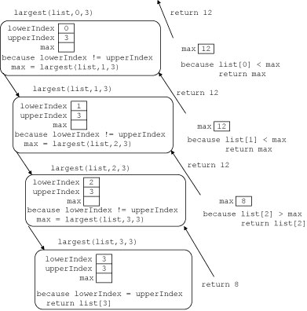
Largest Element in an Array (cont’d.)
FIGURE 6-4
Execution of largest(list, 0, 3)
where
list is:
int largest(const in list[],
int lowerIndex,
int upperIndex)
{
int max;
if (lowerIndex == upperIndex)
return list[lowerIndex]
else
{
max = largest(list,
lowerIndex+1,
upperIndex);
if (list[lowerIndex] > max)
return list[lowerIndex];
else
return max;
}
}

Slide 32
Largest Element in an Array (cont’d.)
FIGURE 6-4
Execution of largest(list, 0, 3)
where
list is:
int largest(const in list[],
int lowerIndex,
int upperIndex)
{
int max;
if (lowerIndex == upperIndex)
return list[lowerIndex]
else
{
max = largest(list,
lowerIndex+1,
upperIndex);
if (list[lowerIndex] > max)
return list[lowerIndex];
else
return max;
}
}

Slide 33
Largest Element in an Array (cont’d.)
FIGURE 6-4
Execution of largest(list, 0, 3)
where
list is:
int largest(const in list[],
int lowerIndex,
int upperIndex)
{
int max;
if (lowerIndex == upperIndex)
return list[lowerIndex]
else
{
max = largest(list,
lowerIndex+1,
upperIndex);
if (list[lowerIndex] > max)
return list[lowerIndex];
else
return max;
}
}

Slide 34
Largest Element in an Array (cont’d.)
FIGURE 6-4
Execution of largest(list, 0, 3)
where
list is:
int largest(const in list[],
int lowerIndex,
int upperIndex)
{
int max;
if (lowerIndex == upperIndex)
return list[lowerIndex]
else
{
max = largest(list,
lowerIndex+1,
upperIndex);
if (list[lowerIndex] > max)
return list[lowerIndex];
else
return max;
}
}

Slide 35
Largest Element in an Array (cont’d.)
FIGURE 6-4
Execution of largest(list, 0, 3)
where
list is:
int largest(const in list[],
int lowerIndex,
int upperIndex)
{
int max;
if (lowerIndex == upperIndex)
return list[lowerIndex]
else
{
max = largest(list,
lowerIndex+1,
upperIndex);
if (list[lowerIndex] > max)
return list[lowerIndex];
else
return max;
}
}

Slide 36
Largest Element in an Array (cont’d.)
FIGURE 6-4
Execution of largest(list, 0, 3)
where
list is:
int largest(const in list[],
int lowerIndex,
int upperIndex)
{
int max;
if (lowerIndex == upperIndex)
return list[lowerIndex]
else
{
max = largest(list,
lowerIndex+1,
upperIndex);
if (list[lowerIndex] > max)
return list[lowerIndex];
else
return max;
}
}

Slide 37
Largest Element in an Array (cont’d.)
FIGURE 6-4
Execution of largest(list, 0, 3)
where
list is:
int largest(const in list[],
int lowerIndex,
int upperIndex)
{
int max;
if (lowerIndex == upperIndex)
return list[lowerIndex]
else
{
max = largest(list,
lowerIndex+1,
upperIndex);
if (list[lowerIndex] > max)
return list[lowerIndex];
else
return max;
}
}

Slide 38
Largest Element in an Array (cont’d.)
FIGURE 6-4
Execution of largest(list, 0, 3)
where
list is:
int largest(const in list[],
int lowerIndex,
int upperIndex)
{
int max;
if (lowerIndex == upperIndex)
return list[lowerIndex]
else
{
max = largest(list,
lowerIndex+1,
upperIndex);
if (list[lowerIndex] > max)
return list[lowerIndex];
else
return max;
}
}

Slide 39
Marker Slide
Any questions on:
Recursion Introduction
Factorial Example
Largest Element in Array Example
Next up
Independent Explorations

Slide 40
Book examples
Printing a Linked List in Reverse Order
Circa Figure 6-5 Example
Fibonacci Numbers
Circa Figure 6-7 Example
Converting a number from Decimal to Binary
Circa Figure 6-10
Tower of Hanoi
Example in the book
More on this follows
Check out your homework too!

Slide 41
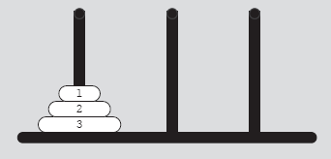
Tower of Hanoi
Object
Move 64 disks from first needle to third needle
Rules
Only one disk can be moved at a time
Removed disk must be placed on one of the needles
A larger disk cannot be placed on top of a smaller disk
64 is arbitrary
FIGURE 6-8 Tower of Hanoi problem with three disks

Slide 42
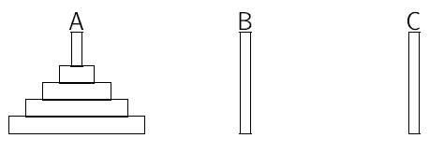
Finding the Solution
Book has additional details
Let’s think about it…
At beginning
Only 2 possible choices
But which is the correct one?
This sounds like
that wascally Wabbit

Slide 43
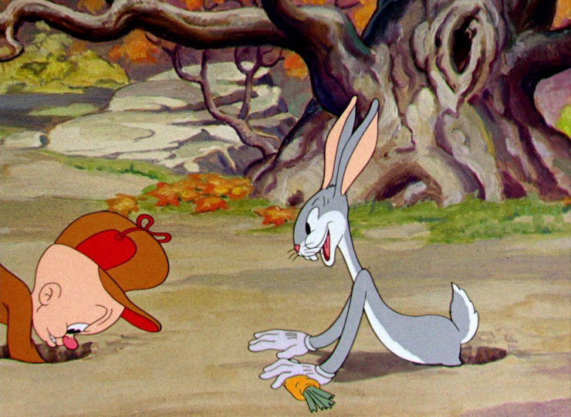
Things to Try
Two possible problem solving approaches
Determine the first step, then go on
i.e. stepwise refinement
produces a series of sequential steps
Break down into cases
i.e. handle each case separately
produces a conditional statement
Neither seem to apply
How about starting in the Middle,
and working both forward and backward

Slide 44
Pretend You Already Solved It Some
red needle A
blue needle B
green needle C
Here we have moved 3 disks from needle A to needle C using needle B
Notice 3 = 4 minus 1 from original start picture
We can now move 1 disk from needle A to needle B
Then we move 3 disks from needle C to needle B using needle A

Slide 45
Generalize
red needle A
blue needle B
green needle C
Move N-1 disks from needle A to needle C using needle B
Move 1 disk from needle A to needle B
Move N-1 disks from needle C to needle B using needle A

Slide 46
Code It
red needle A
blue needle B
green needle C
Anyone see a problem with this?
// Move N disks from A to B using C.
void Hanoi (int N, char A , char B, char C) { // move all but last disk to C Hanoi(N-1, A , C, B); // move one disk from A to B cout << “move disk from needle " << A << " to " << B << endl; // move all disks from C back to B Hanoi(N-1, C, B, A ); }
Hey! This never terminates!
N just becomes negative and it keeps going!

Slide 47
Code It
red needle A
blue needle B
green needle C
FIX: just move the smallest disk directly
From A to B… don’t need C
void Hanoi (int N, char A , char B, char C) { if (N == 1) { cout << "move disk from needle " << A << " to " << B << endl; } else { // move all but last disk to C Hanoi(N-1, A , C, B); // move one disk from A to B cout << "move disk from needle " << A << " to " << B << endl; // move all disks from C back to B Hanoi(N-1, C, B, A ); } }
Notice the function call (in main)
if you wanted to move 4 disks from Red to Green would be:
Hanoi(4, ‘R’, ‘G’, ‘B’); //assume ‘R’ for red, ‘G’ for green, ‘B’ for blue

Slide 48
Tower of Hanoi (cont’d.)
Case: first needle contains only one disk
Move disk directly from needle 1 to needle 3
Case: first needle contains only two disks
Move first disk from needle 1 to needle 2
Move second disk from needle 1 to needle 3
Move first disk from needle 2 to needle 3
Case: first needle contains three disks

Slide 49
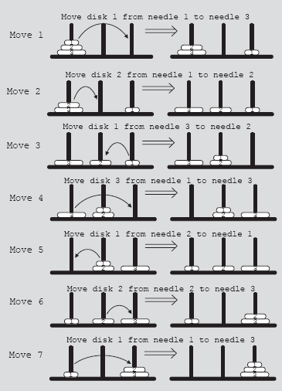
Tower of Hanoi (cont’d.)
FIGURE 6-9 Solution to Tower of Hanoi problem with three disks

Slide 50
Tower of Hanoi (cont’d.)
Generalize problem to the case of 64 disks
Recursive algorithm in pseudocode

Slide 51
Tower of Hanoi (cont’d.)
Generalize problem to the case of 64 disks
Recursive algorithm in C++

Slide 52
Tower of Hanoi (cont’d.)
Without showing the math (yet)
Consider
Analysis of Tower of Hanoi (gives O(2^{n}) )
Time necessary to move all 64 disks from needle 1 to needle 3
Manually: roughly 5 x 10¹¹ years
Universe is about 15 billion years old (1.5 x 10¹⁰)
Computer: 500 years
To generate 2⁶⁴ moves at the rate of 1 billion moves per second

Slide 53
Recursion or Iteration?
Dependent upon nature of the solution and efficiency
Efficiency
Overhead of recursive function: execution time and memory usage
Given speed memory of today’s computers, we can depend more on how programmer envisions solution
Use of programmer’s time
Any program that can be written recursively can also be written iteratively

Slide 54
Summary Review
Recursion is a useful programming tool
Recursion relates rather directly to Math Induction
Sometimes recursive solutions can be envisioned faster and coded faster
However
they may cause issues at runtime for “large N” by consuming all the computers cycles and memory
i.e. crash the program
Iterative solutions will take roughly the same amount of computer runtime
should never crash the computer
may take longer to envision and code correctly

Slide 55
For Your Hanoi Homework
The homework specifies you are to use the following cases in your solution.
Doing or not doing this will likely affect the recursion count you return. So use these cases.
Base Case: first needle contains only one disk
Move disk directly from needle 1 to needle 3
Base Case: first needle contains only two disks
Move first disk from needle 1 to needle 2
Move second disk from needle 1 to needle 3
Move first disk from needle 2 to needle 3
General Case: first needle contains three or more disks
Make recursive calls as needed
This 2nd base case was
NOT accounted for in
the code just presented

Slide 56
Free Play – Things to Work On
Peer Review for Homework 4
Homework 5
Also have the Induction Presentation if Time allows

Slide 57
The End
Or is it?
Also have the Induction Presentation if Time allows

