Slide 1
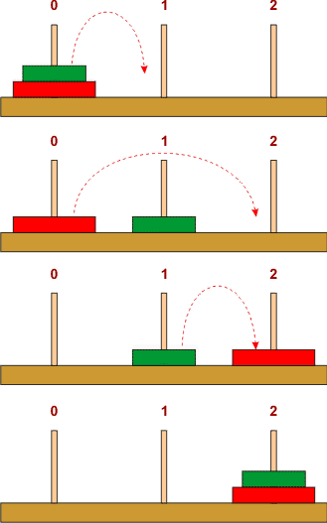
Hanoi Towers Big Oh Recursion
Data Structures and Algorithms
CS 244
Brent M. Dingle, Ph.D.
Department of Mathematics, Statistics, and Computer Science
University of Wisconsin – Stout
Based on the book: Data Structures and Algorithms in C++ (Goodrich, Tamassia, Mount)

Slide 2
First: Math Example
Do the sum(i) i=1 to n example
Prove: $\sum_{i=1}^{n}{i}=\frac{n(n+1)}{2}$

Slide 3
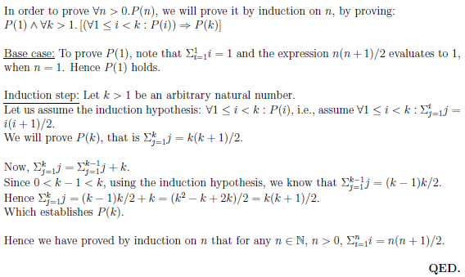
Prove: $\sum_{i=1}^{n}{i}=\frac{n(n+1)}{2}$

Slide 4
Moving On
That was basic math version of an induction proof
Next let’s apply it to Towers of Hanoi Problem

Slide 5
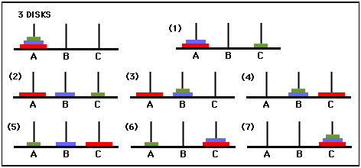
Towers of Hanoi
7 moves

Slide 6
Human Way
while true:
if n is odd:
move disk1 one peg left (first peg wraps around to last peg)
else:
move disk1 one peg right (last peg wraps around to first peg)
if done:
break
else:
make the only legal move not involving disk1

Slide 7
Computer Way
Tower of Hanoi & Big Oh
Pseudocode
:
FUNCTION
MoveTower(n, source,dest, spare):
IF n == 1, THEN:
move disk 1 from source to dest //base case
ELSE:
MoveTower(n - 1, source, spare, dest) // Step 1
move disk n from source to dest // Step 2
MoveTower(n - 1, spare, dest, source) // Step 3
END IF
aside:
1 is smallest disk and n is the largest disk
How did we get this code?
we start in the “middle”
See next slides

Slide 8
Notice Something
Tower of Hanoi & Big Oh
Pseudocode
:
FUNCTION
MoveTower(n, source,dest, spare):
IF n == 1, THEN:
move disk 1 from source to dest //base case
ELSE:
MoveTower(n - 1, source, spare, dest) // Step 1
move disk n from source to dest // Step 2
MoveTower(n - 1, spare, dest, source) // Step 3
END IF
aside:
1 is smallest disk and n is the largest disk
At the start we have 3 disks (n=3)
As of Move 3, shown below,
We have moved the (n-1) tower i.e. the tower of 2 disks
to the Middle Peg

Slide 9
Notice Something
Tower of Hanoi & Big Oh
Pseudocode
:
FUNCTION
MoveTower(n, source,dest, spare):
IF n == 1, THEN:
move disk 1 from source to dest //base case
ELSE:
MoveTower(n - 1, source, spare, dest) // Step 1
move disk n from source to dest // Step 2
MoveTower(n - 1, spare, dest, source) // Step 3
END IF
aside:
1 is smallest disk and n is the largest disk
At the start we have 3 disks (n=3)
As of Move 3, shown below,
We have moved the (n-1) tower i.e. the tower of 2 disks
to the Middle Peg
On Move 4 we move the largest disk to the Rightmost Peg

Slide 10
Notice Something
Tower of Hanoi & Big Oh
Pseudocode
:
FUNCTION
MoveTower(n, source,dest, spare):
IF n == 1, THEN:
move disk 1 from source to dest //base case
ELSE:
MoveTower(n - 1, source, spare, dest) // Step 1
move disk n from source to dest // Step 2
MoveTower(n - 1, spare, dest, source) // Step 3
END IF
aside:
1 is smallest disk and n is the largest disk
At the start we have 3 disks (n=3)
As of Move 3, shown below,
We have moved the (n-1) tower i.e. the tower of 2 disks
to the Middle Peg
On Move 4 we move the largest disk to the Rightmost Peg
On Move 7 we have moved the (n-1) tower
to the Rightmost Peg as well

Slide 11
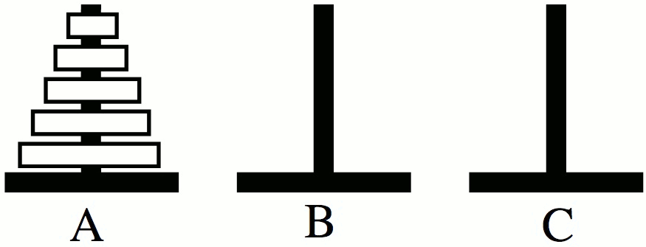
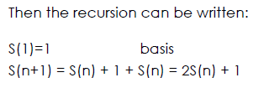
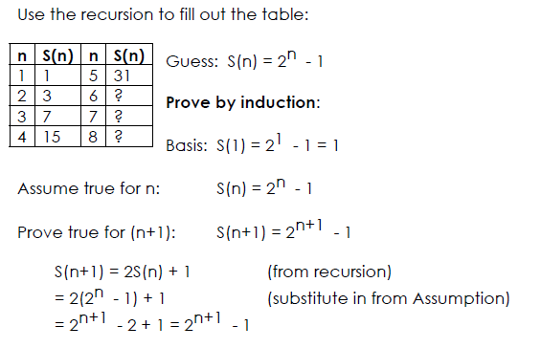
Analysis

Slide 12
Analysis

Slide 13
Analysis
Base Case of 1 disk is easy to prove
Claim: S(1) = 2^1 – 1 = 1
Proof:
Move the one disk from
the left peg to the right peg
and done taking only 1 Move

Slide 14
Analysis

Slide 15
Analysis

Slide 16
Analysis

Slide 17
Analysis

Slide 18
Analysis

Slide 19
The End
Or is it?

