Slide 1

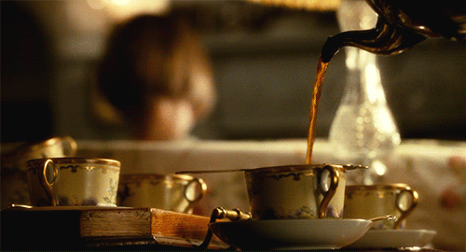
Dynamic Arrays
CS 244
Brent M. Dingle, Ph.D.
Game Design and Development Program
Department of Mathematics, Statistics, and Computer Science
University of Wisconsin – Stout
Content derived from: Data Structures Using C++ (D.S. Malik)
and Data Structures and Algorithms in C++ (Goodrich, Tamassia, Mount)

Slide 2
Points of Note
Assignment 6 is posted
  Due: November 4
        Check D2L to confirm all due dates

Slide 3
Previously
Previous to Test discussion was on
  Linked Lists
    Single, Double, Circular
  Recursion
More recently
  Stacks in general from the book

Slide 4

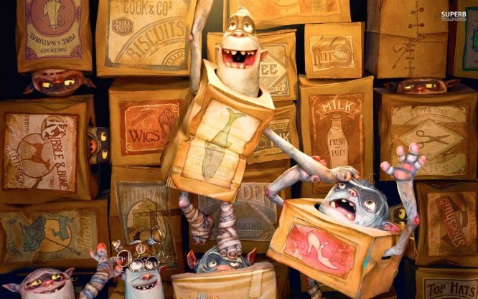
Today
Taking a step back
Will get back to the Stacks soon
Dynamic Arrays
  Establishes a setting to talk about how to implement stacks
    transitions to Stack ADT
Suggest
  In the background download example:
    DS214_Pitcher from D2L

Slide 5
Marker Slide
Any General Questions ?
Next up
  Dynamic Arrays
    Setup
    Pitcher Pour
    Pitcher Class
    Ice Cube Tea

Slide 6
Dynamic Arrays
A
Dynamic Array
  An array that can grow in size
  Has a Capacity
    The maximum number of things it can hold
    Number of cells
    Number chairs in the room
  Has a Size
    The current number of things it holds
    Number of cells used
    Number of chairs being used (students in the room)
Standard Template Library example
  std::vector in STL
    is a “dynamic array”
B
C
D
E

Slide 7
Dynamic Array Example in STL
C++ Vector in STL
  Recall the Standard Template Library is a collection
  of data types (and algorithms)
  std::vector is one of these data types
    Allows random access
      i.e. A[5], A[231], A[59], … ← not ordered (‘random’ indices)
    Similar to Java’s ArrayList (but a different API)
  Some functions of std::vector include
    size()
    capacity()
    push_back()
    empty()
    there are more…

Slide 8
Words
“Dynamic array” is too wordy
  also called growable arrays and expandable arrays
    and a variety of other [synonym for dynamic] arrays
SO Many CS types have taken to using
VECTOR
to mean
Dynamic Array
    and “array” means “static array”
    be aware of who you are talking with and how they use the words
Vector however
is a very well defined
math-physics-engineering word
ALSO used by CS types

Slide 9
Adding elements to a vector
Vectors, like static arrays can become full
  when the vector’s size == the vector’s capacity
However
  unlike static arrays (which just throw errors)
Vectors can allocate more memory to hold more elements
  hence “dynamic array”
  Note this allocation of more memory is hidden from the person “using” the vector
    It just happens automatically and behind the scenes
  But we are concerned and interested programmers and must understand HOW this automation happens

Slide 10
Marker Slide
Any Questions On:
  Dynamic Arrays
    Setup
Next up
  Dynamic Arrays
    Pitcher Pour
    Pitcher Class
    Ice Cube Tea

Slide 11
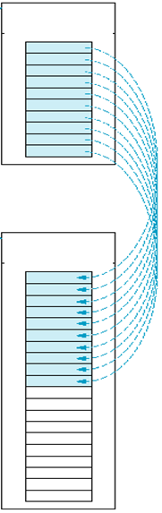
Picture Pour?
This is a picture to illustrate:
  A vector has become full
    A pitcher has become full
  More memory has been allocated (double the size)
    New pitcher twice the size
  All the old data is copied (poured) into the newly allocated memory space
    Contents of small pitcher poured into larger
  And viola there is now plenty of space to add more elements

Slide 12
Picture Pour?
This is a picture to illustrate:
  A vector has become full
    A pitcher has become full
  More memory has been allocated (double the size)
    New pitcher twice the size
  All the old data is copied (poured) into the newly allocated memory space
    Contents of small pitcher poured into larger
  And viola there is now plenty of space to add more elements

Slide 13
Picture Pour?
This is a picture to illustrate:
  A vector has become full
    A pitcher has become full
  More memory has been allocated (double the size)
    New pitcher twice the size
  All the old data is copied (poured) into the newly allocated memory space
    Contents of small pitcher poured into larger
  And viola there is now plenty of space to add more elements

Slide 14
Dynamic Array Towards an Example
Let’s go with the idea of Pitcher…

Slide 15

Motivation / Analogy
For a get together – we have a pitcher of tea
  It can only hold enough for 4 drinks
We invite 3 friends to come over
  so all is good
.

Slide 16

Motivation / Analogy
Say we have a pitcher
  it can only hold enough water for 4 drinks
We invite 3 friends to come over
  so all is good
At the last minute
  Someone decides to
  bring their roommate with them
Now we have to make more tea
AND need a bigger pitcher

Slide 17
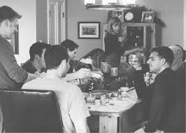
Motivation / Analogy
We could select
a pitcher that can hold enough for 5 drinks
  But what if we get another last minute addition?
    Then we would have to do this whole thing again for each new addition

Slide 18
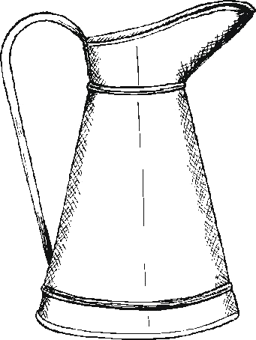
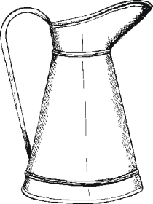
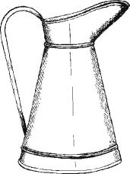
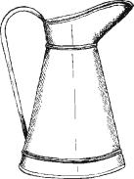

Motivation / Analogy
Perhaps a pitcher that holds 6 drinks (2 more than original would be better)
  Then we only need to do this for each 2 new additions…
+ =
+ =
+ =

Slide 19
Motivation / Analogy
Perhaps a pitcher that holds 6 drinks (2 more than original would be better)
  Then we only need to do this for each 2 new additions…
Or maybe getting a pitcher that can hold
twice as much would be better
+ =
+ =
+ =
* 2 =
* 2 =

Slide 20
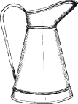

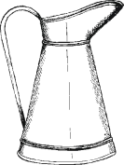
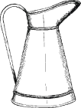
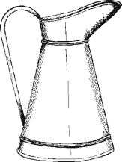
Group In-Class Exercise
Assume it takes 10 minutes of preparation time each time we have to get a new pitcher (and 1 minute to prepare/place out things for each guest)
    4 minutes originally, 5+10 minutes with late addition, 6+10 minutes if another…
Which solution will be the better option for saving time as the number of guests (n) increases?
  Increasing the pitcher size by 2 each as needed
  or Doubling the pitcher size as needed
  Assume n increments by 1 for an undetermined amount of time.
  Assume our party size could get huge (to unknown large maximum)
  Cannot use a pitcher size of infinity or 5 million or whatever without a need for it
Discuss in groups of 3 or 4
  Elect someone to write it up (.txt file) for discussion
+ =
* 2 =

Slide 21
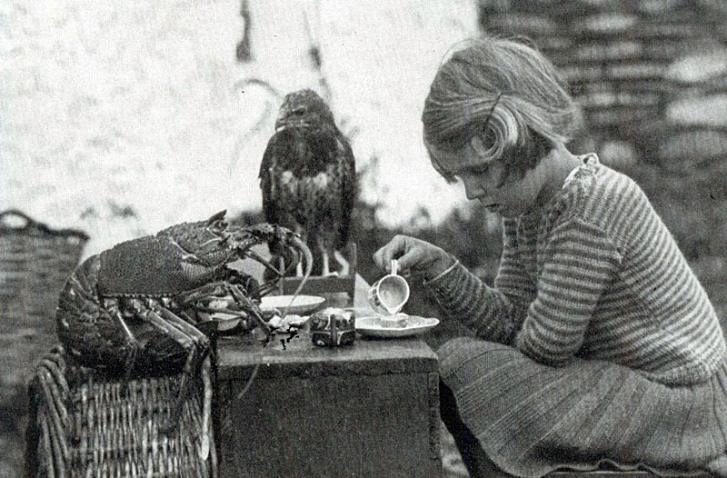
Discuss Some
Discuss some of the solutions proposed

Slide 22
Marker Slide
Any Questions On:
  Dynamic Arrays
    Setup
    Pitcher Pour
Next up
  Dynamic Arrays
    Pitcher Class
    Ice Cube Tea

Slide 23
“Official” Solution
See next presentation (mostly)
Now let’s think about some code
We want to make a Pitcher class
  sort of a dynamic array class
  but no array (to start with)

Slide 24
class Pitcher
Our pitcher needs to have
  Capacity
    Max number of drinks
    it can hold
    Member variable
      int m_capacity
    Default initial capacity is 4
  Size
    Some tea in it
    The amount used
      Number of drinks currently held
    Member variable
      int m_size
class Pitcher
{
private:
int m_capacity;
int m_size;
:
public:
Pitcher(int capacity = 4);
:
};

Slide 25
class Pitcher
Our pitcher needs to have
  Capacity
    Max number of drinks
    it can hold
    Member variable
      int m_capacity
    Default initial capacity is 4
  Size
    Some tea in it
    The amount used
      Number of drinks currently held
    Member variable
      int m_size
class Pitcher
{
private:
int m_capacity;
int m_size;
:
public:
Pitcher(int capacity = 4);
:
};

Slide 26
class Pitcher – header file stuff
Our pitcher needs to have
  Capacity
    Max number of drinks
    it can hold
    Member variable
      int m_capacity
    Default initial capacity is 4
  Size
    Some tea in it
    The amount used
      Number of drinks currently held
    Member variable
      int m_size
class Pitcher
{
private:
int m_capacity;
int m_size;
:
public:
Pitcher(int capacity = 4);
:
};

Slide 27
class Pitcher – constructor (cpp)
Recall header file was like so:
class Pitcher
{
private:
int m_capacity;
int m_size;
:
public:
Pitcher(int capacity = 4);
:
};
Pitcher constructor
Initializes the private
member variables
Pitcher::Pitcher(int capacity)
{
what goes here ?
}

Slide 28
class Pitcher – constructor (cpp)
Recall header file was like so:
class Pitcher
{
private:
int m_capacity;
int m_size;
:
public:
Pitcher(int capacity = 4);
:
};
Pitcher constructor
Initializes the private
member variables
Pitcher::Pitcher(int capacity)
{
m_capacity = capacity;
m_size = 0; //init size to 0
}

Slide 29
class Pitcher – addTea
// Pitcher .h file
class Pitcher
{
private:
:
:
:
public:
Pitcher(int capacity = 4);
void addTea();
:
};
We need to be able to add tea to the pitcher
Because we have a Keurig we make our tea one serving at a time
So we add one serving at a time to our pitcher
void Pitcher::addTea()
{
++m_size;
}
// Pitcher.cpp file

Slide 30
class Pitcher – addTea
// Pitcher .h file
class Pitcher
{
private:
int m_capacity;
int m_size;
:
public:
Pitcher(int capacity = 4);
void addTea();
:
};
We need to be able to add tea to the pitcher
Because we have a Keurig we make our tea one serving at a time
So we add one serving at a time to our pitcher
WAIT!
There is something missing!
void Pitcher::addTea()
{
++m_size;
}
// Pitcher.cpp file

Slide 31
class Pitcher – addTea
// Pitcher .h file
class Pitcher
{
private:
int m_capacity;
int m_size;
:
public:
Pitcher(int capacity = 4);
void addTea();
:
};
We need to be able to add tea to the pitcher
Because we have a Keurig we make our tea one serving at a time
So we add one serving at a time to our pitcher
WAIT!
There is something missing!
void Pitcher::addTea()
{
++m_size;
}
// Pitcher.cpp file

Slide 32
class Pitcher – addTea
void Pitcher::addTea()
{
Corrections needed here ….
}
void Pitcher::addTea()
{
++m_size;
}

Slide 33
class Pitcher – addTea
void Pitcher::addTea()
{
Corrections needed here ….
}
void Pitcher::addTea()
{
if ( (m_size + 1) > m_capacity )
{
m_capacity = m_capacity * 2; // go with doubling idea here
}
++m_size;
}

Slide 34
class Pitcher – getters
class Pitcher
{
private:
int m_capacity;
int m_size;
:
public:
Pitcher(int capacity = 4);
void addTea();
int getCapacity();
int getSize();
:
};
// Pitcher .h file

Slide 35
class Pitcher – getters
// Pitcher.cpp file
// Pitcher.cpp file
int Pitcher::getCapacity()
{
what goes here ?
}
int Pitcher::getSize()
{
what goes here ?
}
// Pitcher .h file
class Pitcher
{
:
public:
Pitcher(int capacity = 4);
void addTea();
int getCapacity();
int getSize();
:
};

Slide 36
class Pitcher – getters
// Pitcher.cpp file
// Pitcher.cpp file
int Pitcher::getCapacity()
{
return m_capacity;
}
int Pitcher::getSize()
{
what goes here ?
}
// Pitcher .h file
class Pitcher
{
:
public:
Pitcher(int capacity = 4);
void addTea();
int getCapacity();
int getSize();
:
};

Slide 37
class Pitcher – getters
// Pitcher.cpp file
// Pitcher.cpp file
int Pitcher::getCapacity()
{
return m_capacity;
}
int Pitcher::getSize()
{
return m_size;
}
// Pitcher .h file
class Pitcher
{
:
public:
Pitcher(int capacity = 4);
void addTea();
int getCapacity();
int getSize();
:
};

Slide 38
class Pitcher – copy constructor
// Pitcher .h file
// Pitcher.cpp file
class Pitcher
{
:
public:
Pitcher(int capacity = 4);
Pitcher(Pitcher& copyMe);
:
};
Pitcher::Pitcher(Pitcher& copyMe)
{
what goes here ?
}

Slide 39
class Pitcher – copy constructor
// Pitcher .h file
// Pitcher.cpp file
class Pitcher
{
:
public:
Pitcher(int capacity = 4);
Pitcher(Pitcher& copyMe);
:
};
Pitcher::Pitcher(Pitcher& copyMe)
{
m_capacity = copyMe.m_capacity;
m_size = copyMe.m_size;
}

Slide 40
class pitcher – assignment operator
// Pitcher .h file
class Pitcher
{
:
public:
Pitcher& operator= (const Pitcher& rhs);
:
};
// Pitcher.cpp file
Pitcher& Pitcher::operator= (const Pitcher& rhs)
{
what goes here ?
}

Slide 41
class pitcher – assignment operator
class Pitcher
{
:
public:
Pitcher& operator= (const Pitcher& rhs);
:
};
// Pitcher .h file
// Pitcher.cpp file
Pitcher& Pitcher::operator= (const Pitcher& rhs)
{
m_capacity = rhs.m_capacity;
m_size = rhs.m_size;
}

Slide 42
class Pitcher – operator ==
class Pitcher
{
:
public:
friend bool operator== (const Pitcher& lhs, const Pitcher& rhs);
:
};
// Pitcher .h file
bool operator== (const Pitcher& lhs, const Pitcher& rhs)
{
what goes here ?
}
// Pitcher.cpp file

Slide 43
class Pitcher – operator ==
class Pitcher
{
:
public:
friend bool operator== (const Pitcher& lhs, const Pitcher& rhs);
:
};
// Pitcher .h file
bool operator== (const Pitcher& lhs, const Pitcher& rhs)
{
bool retVal = false;
if (lhs.m_size == rhs.m_size)
retVal = true;
return retVal;
}
// Pitcher.cpp file
Note size (contents) matters for equality
Capacity does not

Slide 44
Marker Slide
Any Questions On:
  Dynamic Arrays
    Setup
    Pitcher Pour
    Pitcher Class
Next up
  Dynamic Arrays
    Ice Cube Tea

Slide 45
Adding a Twist
So because we want to see an example of a dynamic array…
We need to change the story a little…

Slide 46

What about the array?
This requires some creative thought…
  because pitchers hold liquid normally…
It is pretty cold here…
  I think our tea has frozen
  So each serving is now an ice cube
To make it interesting
  Let’s say each ice cube has a flavor

Slide 47
Enumerated Flavors
In the header let’s add a line
// Pitcher .h file
enum Flavor { noFlavorSet = -1,
raspberry, peach, lemon, grape, strawberry };
class Pitcher
{
private:
int m_capacity;
int m_size;
:
public:
Pitcher(int capacity = 4);
:
};

Slide 48
class Pitcher – with an array
// Pitcher .h file
Our pitcher already has
  Capacity
  Size
Let’s make an array to keep track of each flavor of each serving (each ice cube)
So add another member variable:
  mp_serving
  of type Flavor*
enum Flavor { noFlavorSet = -1,
raspberry, peach, lemon,
grape, strawberry };
class Pitcher
{
private:
int m_capacity;
int m_size;
Flavor* mp_serving;
:
public:
Pitcher(int capacity = 4);
:
};
// Pitcher .h file

Slide 49
class Pitcher – memory allocation
So we need to modify some functions now
First create a function to allocate memory and “save things” when more memory is needed.

Slide 50
Pitcher::growPitcher
void Pitcher::growPitcher(int n, bool copy)
{
Flavor* newArr = new Flavor[n]; // alloc memory
// if copy is true, loop to copy elements in mp_array to newArr array
if (true == copy)
{
for(int i=0; i < m_size; i++)
{
newArr[i] = mp_serving[i];
}
}
delete [] mp_serving; // free memory used
// Assign newArr to mp_serving and Update capacity to n
mp_serving = newArr;
m_capacity = n;
}
// Pitcher.cpp file

Slide 51
Pitcher::growPitcher
void Pitcher::growPitcher(int n, bool copy)
{
Flavor* newArr = new Flavor[n]; // alloc memory
// if copy is true, loop to copy elements in mp_array to newArr array
if (true == copy)
{
for(int i=0; i < m_size; i++)
{
newArr[i] = mp_serving[i];
}
}
delete [] mp_serving; // free memory used
// Assign newArr to mp_serving and Update capacity to n
mp_serving = newArr;
m_capacity = n;
}
// Pitcher.cpp file

Slide 52
Pitcher::growPitcher
void Pitcher::growPitcher(int n, bool copy)
{
Flavor* newArr = new Flavor[n]; // alloc memory
// if copy is true, loop to copy elements in mp_array to newArr array
if (true == copy)
{
for(int i=0; i < m_size; i++)
{
newArr[i] = mp_serving[i];
}
}
delete [] mp_serving; // free memory used
// Assign newArr to mp_serving and Update capacity to n
mp_serving = newArr;
m_capacity = n;
}
// Pitcher.cpp file

Slide 53
Pitcher::growPitcher
// should also initialize all elements
// to invalid state – as a safety
for(int i=0; i < m_n; i++)
{
newArr[i] = noFlavorSet;
}
void Pitcher::growPitcher(int n, bool copy)
{
Flavor* newArr = new Flavor[n]; // alloc memory
// if copy is true, loop to copy elements in mp_array to newArr array
if (true == copy)
{
for(int i=0; i < m_size; i++)
{
newArr[i] = mp_serving[i];
}
}
delete [] mp_serving; // free memory used
// Assign newArr to mp_serving and Update capacity to n
mp_serving = newArr;
m_capacity = n;
}
// Pitcher.cpp file

Slide 54
Pitcher – constructor, Revised
Need to allocate memory now
Pitcher::Pitcher(int capacity)
{
m_capacity = capacity;
m_size = 0; //init size to 0
}
Pitcher::Pitcher(int capacity)
{
mp_serving = NULL; // always init ptrs
growPitcher(capacity, false);
m_size = 0; // init size to 0
// init all servings to notSet
for (int j=0;j <m_capacity; j++)
{
mp_serving[j] = noFlavorSet;
}
}
// OLD Pitcher.cpp file
// New Pitcher.cpp file

Slide 55
Pitcher – addTea, Revised
// Old Pitcher .h file
class Pitcher
{
private:
:
:
:
public:
void addTea();
:
};
We need to be able to add tea to the pitcher
Because we have a Keurig we make our tea one serving at a time
So we add one serving at a time to our pitcher
Now allow a flavor to be specified

Slide 56
Pitcher – addTea, Revised
// New Pitcher .h file
class Pitcher
{
private:
:
:
:
public:
void addTea(Flavor flav);
:
};
We need to be able to add tea to the pitcher
Because we have a Keurig we make our tea one serving at a time
So we add one serving at a time to our pitcher
Now allow a flavor to be specified

Slide 57
Pitcher – addTea, Revised
void Pitcher::addTea()
{
if ( (m_size + 1) > m_capacity )
{
m_capacity = m_capacity * 2; // go with doubling idea here
}
++m_size;
}
// Old Pitcher.cpp file
void Pitcher::addTea(Flavor flav)
{
if ( (m_size + 1) > m_capacity )
{
growPitcher(m_capacity * 2, true); // go with doubling idea here
}
mp_serving[m_size] = flav; // set the new serving flavor
++m_size; // add 1 to serving count
}
// New Pitcher.cpp file

Slide 58
Pitcher – copy constructor, Revised
Pitcher::Pitcher(Pitcher& copyMe)
{
m_capacity = copyMe.m_capacity;
m_size = copyMe.m_size;
}
// Old Pitcher.cpp file
Pitcher::Pitcher(Pitcher& copyMe)
{
mp_serving = NULL; // always init ptrs
growPitcher(copyMe.m_capacity, false);
for (int j=0; j < copyMe.m_capacity; j++)
{
mp_serving[j] = copyMe.mp_serving[j];
}
m_size = copyMe.m_size;
}
// New Pitcher.cpp file

Slide 59
Pitcher – assignment operator, Revised
Pitcher& Pitcher::operator= (const Pitcher& rhs)
{
m_capacity = rhs.m_capacity;
m_size = rhs.m_size;
}
// Old Pitcher.cpp file
Pitcher& Pitcher::operator= (const Pitcher& rhs)
{
if (m_capacity < rhs.m_capacity)
{
growPitcher(rhs.m_capacity, false);
}
for (int j=0; j < rhs.m_capacity; j++)
{
mp_serving[j] = rhs.mp_serving[j];
}
m_size = rhs.m_size;
}
An oddity could happen here
if this->m_capacity was originally
greater than rhs.m_capacity
All will work… but…
what if this->size was initially
greater than rhs.m_size too ?
// New Pitcher.cpp file

Slide 60
Revised Pitcher – operator ==
bool operator== (const Pitcher& lhs, const Pitcher& rhs)
{
bool retVal = false;
if (lhs.m_size == rhs.m_size)
retVal = true;
return retVal;
}
// Old Pitcher.cpp file
bool operator== (const Pitcher& lhs, const Pitcher& rhs)
{
bool retVal = false;
if (lhs.m_size == rhs.m_size)
{
retVal = true;
int j = 0;
while ( (j < lhs.m_size) && (true == retVal))
{
if ( lhs.mp_serving[j] != rhs.mp_serving[j]) { retVal = false; }
++j;
}
}
return retVal;
}
// New Pitcher.cpp file

Slide 61
End of Revisions
So that should mostly work
Probably want one more function to output stuff

Slide 62
class Pitcher operator <<
ostream& operator<< (ostream& ostr, const Pitcher& pi)
{
if ( pi.m_size <= 0) { ostr << "pitcher is empty"; }
for(int i=0; i < pi.m_size; i++)
{
switch (pi.mp_serving[i])
{
case raspberry:
ostr << "raspberry";
break;
case peach:
ostr << "peach";
break;
: // lines skipped here
default:
ostr << "oops spilled one";
break;
} // end switch
ostr << " ";
} // end for
return ostr;
}

Slide 63
So Ends Class Pitcher
Details of this class may be found on D2L
  Ask if you cannot locate them
    Check In-Class Assignments, Unit 2, Examples
    or similar

Slide 64
Marker Slide
Any Questions On:
  Dynamic Arrays
    Setup
    Pitcher Pour
    Pitcher Class
    Ice Cube Tea
Next up
  End of Part 1

Slide 65
The End
The end of part 1, presentation 16
Go to next part

