Slide 1
Searching
CS 244
Brent M. Dingle, Ph.D.
Game Design and Development Program
Department of Mathematics, Statistics, and Computer Science
University of Wisconsin – Stout
Content derived from: Data Structures Using C++ (D.S. Malik)
and Data Structures and Algorithms in C++ (Goodrich, Tamassia, Mount)

Slide 2
In the Past
Priority Queues
Unordered List implementation
Ordered List implementation

Slide 3
Now and Future
Searching
Sequential
Binary

Slide 4
Objectives (chapter 9)
Learn various search algorithms
Explore how to implement
sequential and binary search algorithms
Discover how sequential and binary search algorithms perform
Be aware of lower bound on comparison-based search algorithms

Slide 5
Marker Slide
General Questions?
Next
Searching
General
Sequential (Linear)
Binary

Slide 6
Search Algorithms
Item Key
Unique member of the item
Used in searching, sorting, insertion, deletion
Number of key comparisons
Comparing the key of the search item with the key of an item in the list
Book reference:
Can use class arrayListType from Chapter 3
Implements a list and basic operations in an array

Slide 7
Marker Slide
Questions On:
Searching
General
Next
Searching
Sequential (Linear)
Binary

Slide 8
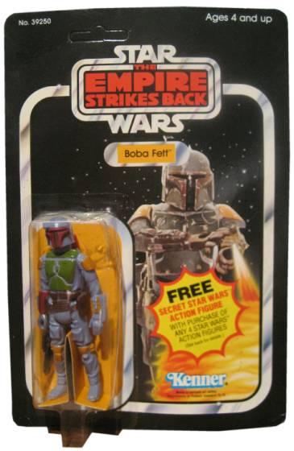
Motivation: Linear Search
Review
Say you have 1,000 action figures
You keep them in an unorganized (but very cool) looking pile on your otherwise unused bed
A friend comes over and wants to see the super rare and totally awesome Boba Fett
In the worst case how many action figures will you have to look at before you are guaranteed to have found the specified Boba Fett?

Slide 9
Motivation: Linear Search (cont)
Review
Worst case: 1000
If there were 10,000 action figures?
Worst case is 10,000
If there were 100,000?
Worst case is 100,000
So the input size (1000, 10000, 100000) is directly proportional to the worst case search time
This is described as O(n)
for k = 1 to 1000
look at action figure number k
stop if it is Boba Fett
for k = 1 to 10,000
look at action figure number k
stop if it is Boba Fett
for k = 1 to 100,000
look at action figure number k
stop if it is Boba Fett
for k = 1 to n
look at action figure number k
stop if it is Boba Fett

Slide 10
Sequential Search
POINT IS
You have seen sequential searches (A LOT)
More book refs:
Array-based lists
See Chapter 3
Linked Lists
See Chapter 5
Code for Sequential Search works the same for array based lists and linked list
See code circa page 499
AND
You were always using something as a
UNIQUE key
to find the item being searched for

Slide 11
Analysis of Sequential Search
template <class elemType>
int arrayListType<elemType>::seqSearch(const elemType& item) const
{
int loc;
bool found = false;
for (loc = 0; loc < length; loc++)
{
if (list[loc] == item)
{
found = true;
break;
}
}
if (found)
return loc;
else
return -1;
} //end seqSearch
Count number of comparisons
Note list and length are member variables of class arrayListType
N = length
Worst case results in N comparisons
O(N)
Aside:
Best case takes 1 compare
O(1)
Average case (consider all cases, divide by N)
(1+2+3+…+N) / N = (N^2 + N) / 2N = (N + 1) / 2 = O(N)
Code from book, circa page 499

Slide 12
Marker Slide
Questions on:
Searching
General
Sequential (Linear)
Next
Searching
Binary

Slide 13
Recall: Using a Dictionary
Review
Keep cutting the search area in half
Open dictionary to the middle
Then to ¼ or ¾ mark
Then (1/8 or 3/8 mark) or (5/8 or 7/8)
Then …
Find Happiness

Slide 14
Recall: Binary Search
Review
By investigating dictionaries
We discovered an ordering allows us to perform a binary search
Binary Search
REQUIRES an ORDERED List
Binary Search is
O(log n)
Uses a Divide and Conquer Strategy

Slide 15
C++ Code
int BinarySearchForInteger(vector<int> v, int from, int to, int val)
{
if (from > to) return -1; // val not found
int mid = (from + to)/2;
if (v[mid] == val)
return mid;
else if (val > v[mid])
return search(v, mid+1, to, val);
else
return search(v, from, mid-1,val);
}
Count number of comparisons
Note list and length are member variables of class orderedArrayListType
N = length
Worst case results in N comparisons
O(lg N)
See also Code from book circa page 503

Slide 16
C++ Code
template<class elemType>
int orderedArrayListType<elemType>::binarySearch(const elemType& item) const
{
int first = 0;
int last = length - 1;
int mid;
bool found = false;
while ( (first <= last) && (!found) )
{
mid = (first + last) / 2;
if (list[mid] == item)
found = true;
else if (list[mid] > item)
last = mid - 1;
else
first = mid + 1;
}
if (found)
return mid;
else
return -1;
}//end binarySearch
Count number of comparisons
Note list and length are member variables of class orderedArrayListType
N = length
Worst case results in N comparisons
O(lg N)
Code from book circa page 503

Slide 17
Marker Slide
Questions on:
Searching
General
Sequential (Linear)
Binary
Next
Searching
Closing Comments
Lower bound on Comparison Based Search Algorithms

Slide 18
Comparison Based Searches
Sequential (linear) and Binary Searches
Are Comparison Based Searches
Sequential is O(N)
Binary is O(lg N)
A linear search checks each element one at a time, starting from the beginning of the list
A binary search repeatedly divides the search space in half until it finds the value
This assumes the list is sorted
Requires a data structure that supports immediate O(1) look-up
e.g. std::vector

Slide 19
Book Gives Theorem
Thus for a search algorithm to be (worst-case) faster than O(lg N)
It cannot be comparison based
Knowing this result is good thing
Math helps CS again
Implication is:
To do a search faster will require something more than just comparisons

Slide 20
The End (of This Part)
End
Check for more
Peek into future
Hash Tables do Searches
in the worst case O(n)
but average case O(1)
O(n) is NOT better than O(lg n)
but on average it can be faster
O(1) is faster than O(lg n)
This “average” case analysis will
show up in later classes

