Slide 1
Hashing Plus Quick Review
CS 244
Brent M. Dingle, Ph.D.
Game Design and Development Program
Department of Mathematics, Statistics, and Computer Science
University of Wisconsin – Stout
Content derived from: Data Structures Using C++ (D.S. Malik)
and Data Structures and Algorithms in C++ (Goodrich, Tamassia, Mount)

Slide 2
In the Past
Priority Queues
  Unordered List implementation
  Ordered List implementation
Hashing and Hash Tables

Slide 3
Now and Future
Review Hash Tables (Hashing)
Some Searching

Slide 4
Marker Slide
General Questions?
Next
  Review Hashing
    Open Addressing: Double Hashing
  Review Stacks
  Review Queues
  Review PQs

Slide 5
Hashing Concept
REVIEW
A Hash Table is a fixed size list of records organized to a unique key
The key is usually one of the data fields in the record
Each cell in the hash table is called a bucket
  Buckets may be empty – wasting memory
The hash function maps the record’s key to an integer called the hash index
  This indicates into which bucket to put the record
  … …
If every key maps to a unique hash index
Then the hash table operations are fast
  Search, Insert, and Delete are all O(1)
 | 1 Yoda | 2 Darth |  |  | 5 R2D2 | 6 Leia
0 | 1 | 2 | 3 | 4 | 5 | 6
443 Han |  | 445 Luke | 446 Chewie
443 | 444 | 445 | 446 | 447
499

Slide 6
Collisions and Chaining
REVIEW
A collision occurs when two keys map to the same hash index
Chaining is one way to solve this problem
Let k = max # of records stored in one bucket
If using vectors then
  Search and Delete are O(k)
  Insert is O(1)
0 | 1 | 2 | 3 | 4 | 5 | 6
 | 1 Yoda | 2 Darth |  |  | 5 R2D2 | 6 Leia
Total collisions = 4
k = 3
2 Qui-Gon
5 Obi Wan
6 Lando
6 Ahsoka

Slide 7
Collisions: Open Addressing
REVIEW
Another category of handling collisions is
  Open Addressing
This includes
  Linear Probing
  Quadratic Probing
  Double Hashing
    Example follows

Slide 8
Open Addressing:
Double Hashing
REVIEW
Double hashing uses a secondary hash function d(k) and handles collisions by placing an item in the first available cell of the series
h(k,i) =(h(k) + i*d(k)) mod N
for i = 0, 1, … , N − 1
The secondary hash function d(k) cannot have zero values
The table size N must be a prime to allow probing of all the cells
Common choice of compression map for the secondary hash function: d(k) = q − (k mod q)
where
  q < N
  q is a prime
The possible values for d(k) are
1, 2, … , q

Slide 9
Class Exercise: Double Hashing
Assume you have a hash table H with N=11 slots (H[0,10]) and let the hash functions for double hashing be
  h(k,i)=( h(k) + i*d(k) ) mod N
  h(k) = k mod N
  d(k) = 5 - (k mod 5)
Demonstrate (by picture) the insertion of the following keys into H
  10, 22, 31, 4, 15, 26
Double hashing uses a secondary hash
function d(k) and handles collisions
by placing an item in the first
available cell of the series:
h(k,i) =(h(k) + i*d(k)) mod N
for i = 0, 1, … , N - 1
Next Slide is Start Slide

Slide 10
Example of Double Hashing
Consider a hash table storing integer keys that handles collision with double hashing
  N = 11
  h(k) = k mod 11
  d(k) = 5 − (k mod 5)
Insert keys
  10, 22, 31, 21, 15, 26
k | h(k) | d(k) | Probes
10
22
31
21
15
26
h(k,i) =(h(k) + i*d(k)) mod N
d(k) = q − (k mod q)
Pause for student work
0
1
2
3
4
5
6
7
8
9
10

Slide 11
Example of Double Hashing
N = 11
h(k) = k mod 11
d(k) = 5 − (k mod 5)
k | h(k) | d(k) | Probes
10 | 10 | 5 | 10
22
31
21
15
26
h(k,i) =(h(k) + i*d(k)) mod N
for i = 0, 1, … , N – 1
i is the probe attempt number
h(10) = 10 mod 11 = 10
d(10) = 5 – (10 mod 5)
= 5 – 0 = 5
h(10, 0) = (10 + 0) mod 11 = 10
h(10, 1) = (10 + 1*5) mod 11 = 4
h(10, 2) = (10 + 2*5) mod 11 = 9
10
0
1
2
3
4
5
6
7
8
9
10

Slide 12
Example of Double Hashing
N = 11
h(k) = k mod 11
d(k) = 5 − (k mod 5)
k | h(k) | d(k) | Probes
10 | 10 | 5 | 10
22 | 0 | 3 | 0
31
21
15
26
h(k,i) =(h(k) + i*d(k)) mod N
for i = 0, 1, … , N – 1
i is the probe attempt number
h(22) = 22 mod 11 = 0
d(22) = 5 – (22 mod 5)
= 5 – 2 = 3
h(22, 0) = (0 + 0) mod 11 = 0
h(22, 1) = (0 + 1*3) mod 11 = 3
h(22, 2) = (0 + 2*3) mod 11 = 4
22
10
0
1
2
3
4
5
6
7
8
9
10

Slide 13
Example of Double Hashing
N = 11
h(k) = k mod 11
d(k) = 5 − (k mod 5)
k | h(k) | d(k) | Probes
10 | 10 | 5 | 10
22 | 0 | 3 | 0
31 | 9 | 4 | 9
21
15
26
h(k,i) =(h(k) + i*d(k)) mod N
for i = 0, 1, … , N – 1
i is the probe attempt number
h(31) = 31 mod 11 = 9
d(31) = 5 – (31 mod 5)
= 5 – 1 = 4
h(31, 0) = (9 + 0) mod 11 = 9
h(31, 1) = (9 + 1*4) mod 11 = 2
h(31, 2) = (9 + 2*4) mod 11 = 6
22
31
10
0
1
2
3
4
5
6
7
8
9
10

Slide 14
Example of Double Hashing
N = 11
h(k) = k mod 11
d(k) = 5 − (k mod 5)
k | h(k) | d(k) | Probes
10 | 10 | 5 | 10
22 | 0 | 3 | 0
31 | 9 | 4 | 9
21 | 10 | 4 | 10
15
26
h(k,i) =(h(k) + i*d(k)) mod N
for i = 0, 1, … , N – 1
i is the probe attempt number
h(21) = 21 mod 11 = 10
d(21) = 5 – (21 mod 5)
= 5 – 1 = 4
h(21, 0) = (10 + 0) mod 11 = 10
h(21, 1) = (10 + 1*4) mod 11 = 3
h(21, 2) = (10 + 2*4) mod 11 = 7
22
31
10
0
1
2
3
4
5
6
7
8
9
10

Slide 15
Example of Double Hashing
N = 11
h(k) = k mod 11
d(k) = 5 − (k mod 5)
k | h(k) | d(k) | Probes
10 | 10 | 5 | 10
22 | 0 | 3 | 0
31 | 9 | 4 | 9
21 | 10 | 4 | 10 | 3
15
26
h(k,i) =(h(k) + i*d(k)) mod N
for i = 0, 1, … , N – 1
i is the probe attempt number
h(21) = 21 mod 11 = 10
d(21) = 5 – (21 mod 5)
= 5 – 1 = 4
h(21, 0) = (10 + 0) mod 11 = 10
h(21, 1) = (10 + 1*4) mod 11 = 3
h(21, 2) = (10 + 2*4) mod 11 = 7
22
21
31
10
0
1
2
3
4
5
6
7
8
9
10

Slide 16
Example of Double Hashing
N = 11
h(k) = k mod 11
d(k) = 5 − (k mod 5)
k | h(k) | d(k) | Probes
10 | 10 | 5 | 10
22 | 0 | 3 | 0
31 | 9 | 4 | 9
21 | 10 | 4 | 10 | 3
15 | 4 | 5 | 4
26
h(k,i) =(h(k) + i*d(k)) mod N
for i = 0, 1, … , N – 1
i is the probe attempt number
h(15) = 15 mod 11 = 4
d(15) = 5 – (15 mod 5)
= 5 – 0 = 5
h(15, 0) = (4 + 0) mod 11 = 4
h(15, 1) = (4 + 1*5) mod 11 = 9
h(15, 2) = (4 + 2*5) mod 11 = 3
22
21
15
31
10
0
1
2
3
4
5
6
7
8
9
10

Slide 17
Example of Double Hashing
N = 11
h(k) = k mod 11
d(k) = 5 − (k mod 5)
k | h(k) | d(k) | Probes
10 | 10 | 5 | 10
22 | 0 | 3 | 0
31 | 9 | 4 | 9
21 | 10 | 4 | 10 | 3
15 | 4 | 5 | 4
26 | 4 | 4 | 4
h(k,i) =(h(k) + i*d(k)) mod N
for i = 0, 1, … , N – 1
i is the probe attempt number
h(26) = 26 mod 11 = 4
d(26) = 5 – (26 mod 5)
= 5 – 1 = 4
h(26, 0) = (4 + 0) mod 11 = 4
h(26, 1) = (4 + 1*4) mod 11 = 8
h(26, 2) = (4 + 2*4) mod 11 = 1
22
21
15
31
10
0
1
2
3
4
5
6
7
8
9
10

Slide 18
Example of Double Hashing
N = 11
h(k) = k mod 11
d(k) = 5 − (k mod 5)
k | h(k) | d(k) | Probes
10 | 10 | 5 | 10
22 | 0 | 3 | 0
31 | 9 | 4 | 9
21 | 10 | 4 | 10 | 3
15 | 4 | 5 | 4
26 | 4 | 4 | 4 | 8
h(k,i) =(h(k) + i*d(k)) mod N
for i = 0, 1, … , N – 1
i is the probe attempt number
h(26) = 26 mod 11 = 4
d(26) = 5 – (26 mod 5)
= 5 – 1 = 4
h(26, 0) = (4 + 0) mod 11 = 4
h(26, 1) = (4 + 1*4) mod 11 = 8
h(26, 2) = (4 + 2*4) mod 11 = 1
22
21
15
26
31
10
0
1
2
3
4
5
6
7
8
9
10

Slide 19
Marker Slide
Questions on:
  Review Hashing
    Open Addressing: Double Hashing
Next
  Review Stacks
  Review Queues
  Review PQs

Slide 20
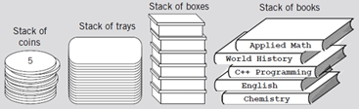
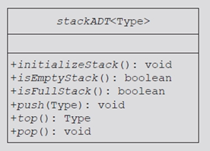
Stacks
Stack operations
  push, pop, top… all O(1)
  LIFO
Implement a stack as an array
  Both statically and dynamically allocated
  Amortization
Implement a stack as a linked list
  Implement a class stack and its functions
  using a linked list member variable
  and its linked list functions
Discover stack applications
  Homework: balancing symbols, palindromes
  Book: other examples
stackADT<Type>
+ push(Type Item) : void + pop() : void + top() : Type + size() : int + empty() : bool

Slide 21
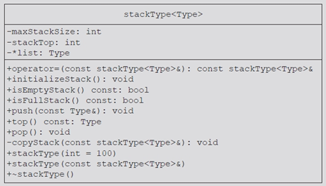
Stacks
Stack operations
  push, pop, top… all O(1)
  LIFO
Implement a stack as an array
  Both statically and dynamically allocated
  Amortization
Implement a stack as a linked list
  Implement a class stack and its functions
  using a linked list member variable
  and its linked list functions
Discover stack applications
  Homework: balancing symbols, palindromes
  Book: other examples

Slide 22
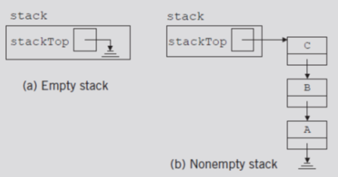
Stacks
Stack operations
  push, pop, top… all O(1)
  LIFO
Implement a stack as an array
  Both statically and dynamically allocated
  Amortization
Implement a stack as a linked list
  Implement a class stack and its funcs
  using a linked list member variable
  and its linked list functions
Discover stack applications
  Homework: balancing symbols, palindromes
  Book: other examples

Slide 23
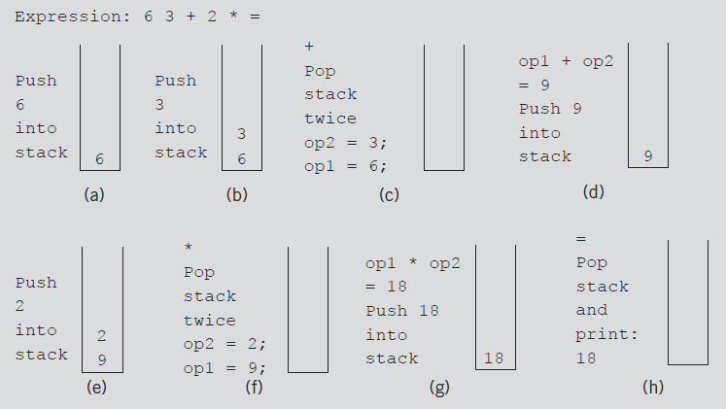
Stacks
Stack operations
  push, pop, top… all O(1)
  LIFO
Implement a stack as an array
  Both statically and dynamically allocated
  Amortization
Implement a stack as a linked list
  Implement a class stack and its functions
  using a linked list member variable
  and its linked list functions
Discover stack applications
  Homework: balancing symbols, palindromes
  Book: other examples
FIGURE 7-15 Evaluating the postfix expression: 6 3 + 2 * =

Slide 24
Marker Slide
Questions on:
  Review Hashing
    Open Addressing: Double Hashing
  Review Stacks
Next
  Review Queues
  Review PQs

Slide 25
Queues
Queue operations
  enqueue, dequeue, front… all O(1)
  FIFO
Implement a queue as an array
  Statically and dynamically allocated
  Linear and Circular
Implement a queue as a linked list
Discover queue applications
  Homework: palindromes
  Book: other examples
queueADT<Type>
+ enqueue(Type Item) + dequeue() + front() :Type + rear() :Type

Slide 26

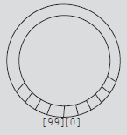
Queues
Queue operations
  enqueue, dequeue, front… all O(1)
  FIFO
Implement a queue as an array
  Statically and dynamically allocated
  Linear and Circular
Implement a queue as a linked list
Discover queue applications
  Homework: palindromes
  Book: other examples

Slide 27

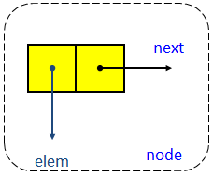
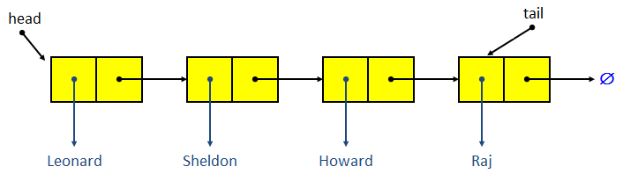
Queues
Queue operations
  enqueue, dequeue, front… all O(1)
  FIFO
Implement a queue as an array
  Statically and dynamically allocated
  Linear and Circular
Implement queue as a linked list
Discover queue applications
  Homework: palindromes
  Book: other examples

Slide 28
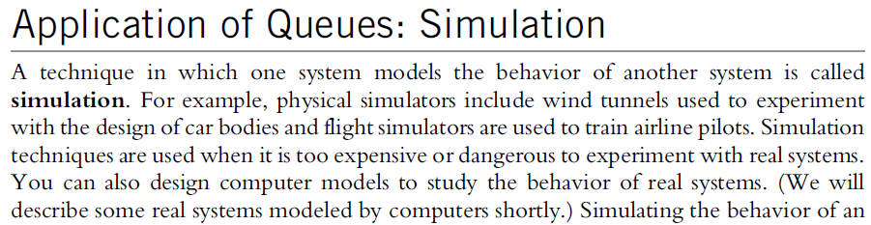
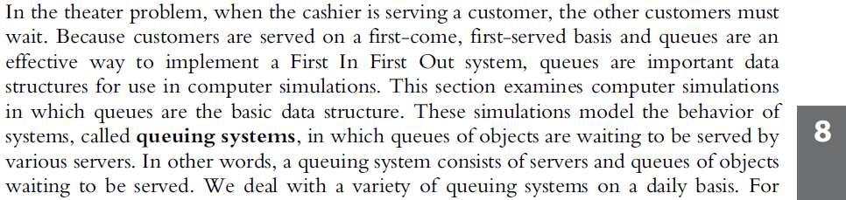
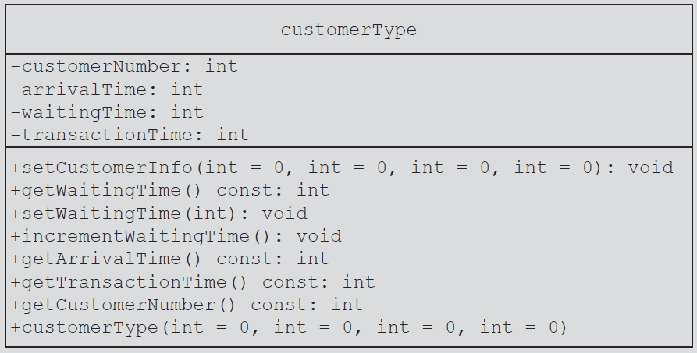
Queues
Queue operations
  enqueue, dequeue, front… all O(1)
  FIFO
Implement a queue as an array
  Statically and dynamically allocated
  Linear and Circular
Implement a queue as a linked list
Discover queue applications
  Homework: palindromes
  Book: other examples

Slide 29
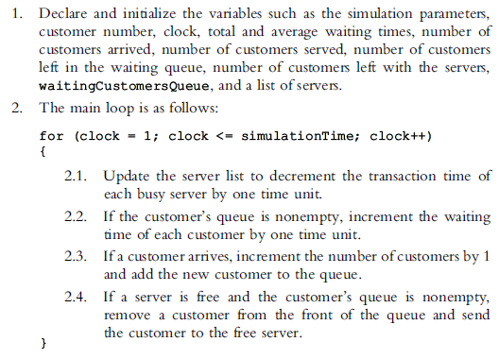
Queues
Queue operations
  enqueue, dequeue, front… all O(1)
  FIFO
Implement a queue as an array
  Statically and dynamically allocated
  Linear and Circular
Implement a queue as a linked list
Discover queue applications
  Homework: palindromes
  Book: other examples

Slide 30
Marker Slide
Questions on:
  Review Hashing
    Open Addressing: Double Hashing
  Review Stacks
  Review Queues
Next
  Review PQs

Slide 31

The Priority Queue ADT
A priority queue (PQ) is a restricted form of a list
  items are arranged according to their priorities (or keys)
    keys may or may not be unique
  Unlike a queue which is FIFO
  A priority queue removes items based on priority
Each item in a PQ is a composition of 2 objects
  the key (priority)
  and the data
    Thus we have the pair (key, data)
  So we can implement this using a linked list

Slide 32
Additional PQ Info
Two Types:
  min PQ
    minimum key value is the highest priority
  max PQ
    maximum key value is the highest priority
Either way must hold a Total Order Relation
  Reflexive, Antisymmetric, Transitive
Implemented as
  Ordered or Unordered linked list
  Implementation Determines which functions are O(1) and O(n)
    Review: insertItem and removeItem

Slide 33
Marker Slide
Questions on:
  Review Hashing
    Open Addressing: Double Hashing
  Review Stacks
  Review Queues
  Review PQs
Next
  More on PQs
    AND SImulations
  Application Practice
    Hash Tables, Non-numeric Keys

Slide 34
Priority Queues
Contrast:
  Queue
    structure ensures items processed in the order received
  Priority queues
    Customers (jobs) with higher priority pushed to the front of the queue

Slide 35
Priority Queues
Implementation
  Ordinary linked list
    Keeps items in order from the highest to lowest priority
  Treelike structure
    Very effective
    Chapter 10

Slide 36
STL class priority_queue
class template priority_queue<elemType>
  Queue element data type specified by elemType
  Contained in the STL header file queue
Specifying element priority
  Default priority criteria for the queue elements
    Less-than operator (<)
  Overloading the less-than operator (<)
    Compare the elements
  Defining a comparison function to specify the priority

Slide 37
Application of Queues: Simulation
Simulation
  Technique in which one system models the behavior of another system
Computer simulation
  Represents objects being studied as data
  Actions implemented with algorithms
    Programming language implements algorithms with functions
    Functions implement object actions

Slide 38
Application of Queues: Simulation (cont’d.)
Computer simulation (cont’d.)
  C++ combines data, data operations into a single unit using classes
    Objects represented as classes
    Class member variables describe object properties
    Function members describe actions on data
  Change in simulation results occurs if change in data value or modification of function definitions occurs
  Main goal
    Generate results showing the performance of an existing system
    Predict performance of a proposed system

Slide 39
Application of Queues: Simulation (cont’d.)
Queuing systems
  Computer simulations
    Queues represent the basic data structure
  Queues of objects
    Waiting to be served by various servers
  Consist of servers and queues of objects waiting to be served

Slide 40
Designing a Queuing System
Server
  Object that provides the service
Customer
  Object receiving the service
Transaction time (service time)
  Time required to serve a customer
Queuing system consists of servers, queue of waiting objects
  Model system consisting of a list of servers; waiting queue holding the customers to be served

Slide 41
Designing a Queuing System (cont’d.)
Modeling a queuing system: requirements
  Number of servers, expected customer arrival time, time between customer arrivals, number of events affecting system
Time-driven simulation
  Clock implemented as a counter
  Passage of time
    Implemented by incrementing counter by one
Run simulation for fixed amount of time
  Example: run for 100 minutes
    Counter starts at one and goes up to 100 using a loop

Slide 42
Customer
Has a customer number, arrival time, waiting time, transaction time, departure time
  With known arrival time, waiting time, transaction time
    Can determine departure time (add these three times)
See class customerType code on pages 475-476
  Implements customer as an ADT
Member function definitions
  Functions setWaitingTime, getArrivalTime, getTransactionTime, getCustomerNumber
    Left as exercises

Slide 43
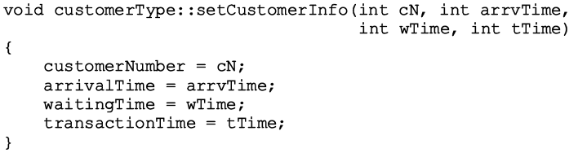

Slide 44
Server
At any given time unit
  Server either busy serving a customer or free
String variable sets server status
Every server has a timer
Program might need to know which customer served by which server
  Server stores information of the customer being served
Three member variables associated with a server
  status, transactionTime, currentCustomer

Slide 45
Server (cont’d.)
Basic operations performed on a server
  Check if server free
  Set server as free
  Set server as busy
  Set transaction time
  Return remaining transaction time
  If server busy after each time unit
    Decrement transaction time by one time unit
See class serverType code on page 477
  Implements server as an ADT
Member function definitions

Slide 46
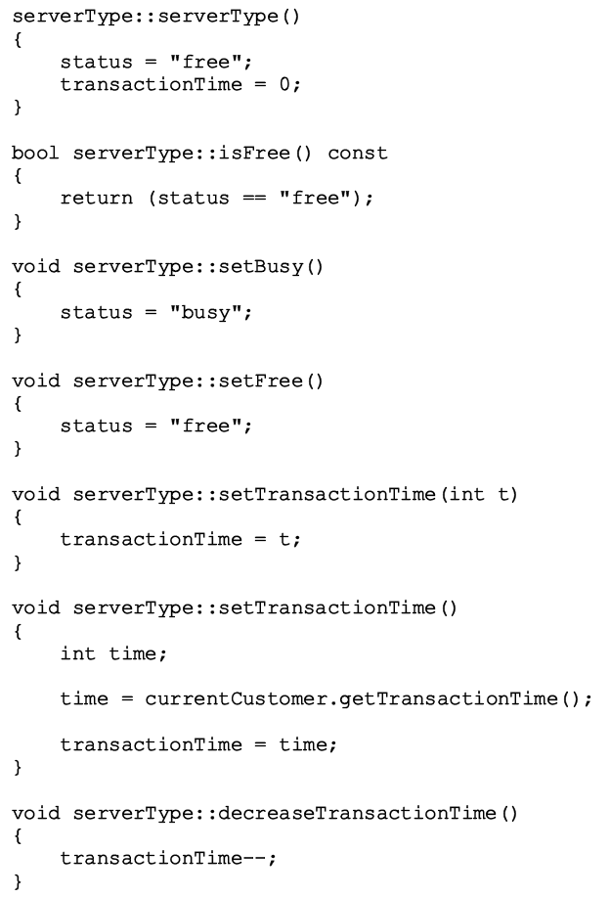

Slide 47
Server List
Set of servers
class serverListType
  Two member variables
    Store number of servers
    Maintain a list of servers
  List of servers created during program execution
  Several operations must be performed on a server list
  See class serverListType code on page 481
    Implements the list of servers as an ADT
  Definitions of member functions

Slide 48
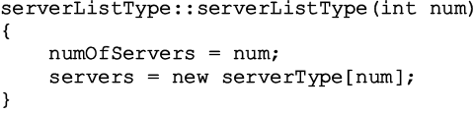

Slide 50
Waiting Customers Queue
Upon arrival, customer goes to end of queue
  When server available
    Customer at front of queue leaves to conduct transaction
  After each time unit, waiting time incremented by one
Derive class waitingCustomerQueueType from class queueType
  Add additional operations to implement the customer queue
  See code on page 485

Slide 51
Main Program
Run the simulation
  Need information (simulation parameters)
    Number of time units the simulation should run
    The number of servers
    Transaction time
    Approximate time between customer arrivals
  Function setSimulationParameters
    Prompts user for these values
    See code on page 487

Slide 52
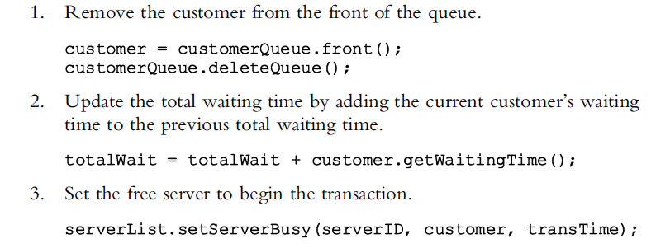
Main Program (cont’d.)
General algorithm to start the transaction

Slide 53
Main Program (cont’d.)
Use the Poisson distribution from statistics
  Probability of y events occurring at a given time
    Where λ is the expected value that y events occur at that time
Function runSimulation implements the simulation
  Function main is simple and straightforward
    Calls only the function runSimulation

Slide 54
Summary of Queues, PQs, Sims
Queue
  First In First Out (FIFO) data structure
  Implemented as array or linked list
  Linked lists: queue never full
Standard Template Library (STL)
  Provides a class to implement a queue in a program
Priority Queue
  Customers with higher priority pushed to the front
Simulation
  Common application for queues

Slide 55
Marker Slide
Questions on:
  Review Hashing
    Open Addressing: Double Hashing
  Review Stacks
  Review Queues
  Review PQs
  More on PQs
    AND SImulations
Next
  Application Practice
    Hash Tables, Non-numeric Keys

Slide 56
Hash Tables – Non-numeric Keys
Given the following hash function and hash table of size 6
  Draw the result after hashing the following values into the table.
  Use the buckets/chaining approach to resolve any collisions.
  The table should not be resized
HASH = number of characters in the key * 2
a. heap
b. bst
c. dynarr
d. queue
e. stack
f. deque
g. bag
h. linkedlist
i. avl
j. iterator
0
1
2
3
4
5

Slide 57
Hash Tables – Non-numeric Keys
Given the following hash function and hash table of size 6
  Draw the result after hashing the following values into the table.
  Use the buckets/chaining approach to resolve any collisions.
  The table should not be resized
HASH = number of characters in the key * 2
a. heap
b. bst
c. dynarr
d. queue
e. stack
f. deque
g. bag
h. linkedlist
i. avl
j. iterator
0
1
2 | heap
3
4
5
heap → 4*2 = 8 mod 6 = 2

Slide 58
Hash Tables – Non-numeric Keys
Given the following hash function and hash table of size 6
  Draw the result after hashing the following values into the table.
  Use the buckets/chaining approach to resolve any collisions.
  The table should not be resized
HASH = number of characters in the key * 2
a. heap
b. bst
c. dynarr
d. queue
e. stack
f. deque
g. bag
h. linkedlist
i. avl
j. iterator
0 | bst
1
2 | heap
3
4
5
bst→ 3*2 = 6 mod 6 = 0

Slide 59
Hash Tables – Non-numeric Keys
Given the following hash function and hash table of size 6
  Draw the result after hashing the following values into the table.
  Use the buckets/chaining approach to resolve any collisions.
  The table should not be resized
HASH = number of characters in the key * 2
a. heap
b. bst
c. dynarr
d. queue
e. stack
f. deque
g. bag
h. linkedlist
i. avl
j. iterator
0 | bst | dynarr
1
2 | heap
3
4
5
dynarr→ 6*2 = 12 mod 6 = 0

Slide 60
Hash Tables – Non-numeric Keys
Given the following hash function and hash table of size 6
  Draw the result after hashing the following values into the table.
  Use the buckets/chaining approach to resolve any collisions.
  The table should not be resized
HASH = number of characters in the key * 2
a. heap
b. bst
c. dynarr
d. queue
e. stack
f. deque
g. bag
h. linkedlist
i. avl
j. iterator
0 | bst | dynarr
1
2 | heap
3
4 | queue
5
queue→ 5*2 = 10 mod 6 = 4

Slide 61
Hash Tables – Non-numeric Keys
Given the following hash function and hash table of size 6
  Draw the result after hashing the following values into the table.
  Use the buckets/chaining approach to resolve any collisions.
  The table should not be resized
HASH = number of characters in the key * 2
a. heap
b. bst
c. dynarr
d. queue
e. stack
f. deque
g. bag
h. linkedlist
i. avl
j. iterator
0 | bst | dynarr
1
2 | heap
3
4 | queue | stack
5
stack→ 5*2 = 10 mod 6 = 4

Slide 62
Hash Tables – Non-numeric Keys
Given the following hash function and hash table of size 6
  Draw the result after hashing the following values into the table.
  Use the buckets/chaining approach to resolve any collisions.
  The table should not be resized
HASH = number of characters in the key * 2
a. heap
b. bst
c. dynarr
d. queue
e. stack
f. deque
g. bag
h. linkedlist
i. avl
j. iterator
0 | bst | dynarr
1
2 | heap
3
4 | queue | stack | deque
5
deque→ 5*2 = 10 mod 6 = 4

Slide 63
Hash Tables – Non-numeric Keys
Given the following hash function and hash table of size 6
  Draw the result after hashing the following values into the table.
  Use the buckets/chaining approach to resolve any collisions.
  The table should not be resized
HASH = number of characters in the key * 2
a. heap
b. bst
c. dynarr
d. queue
e. stack
f. deque
g. bag
h. linkedlist
i. avl
j. iterator
0 | bst | dynarr | bag
1
2 | heap
3
4 | queue | stack | deque
5
bag→ 3*2 = 6 mod 6 = 0

Slide 64
Hash Tables – Non-numeric Keys
Given the following hash function and hash table of size 6
  Draw the result after hashing the following values into the table.
  Use the buckets/chaining approach to resolve any collisions.
  The table should not be resized
HASH = number of characters in the key * 2
a. heap
b. bst
c. dynarr
d. queue
e. stack
f. deque
g. bag
h. linkedlist
i. avl
j. iterator
0 | bst | dynarr | bag
1
2 | heap | linkedlist
3
4 | queue | stack | deque
5
linkedlist→ 10*2 = 20 mod 6 = 2

Slide 65
Hash Tables – Non-numeric Keys
Given the following hash function and hash table of size 6
  Draw the result after hashing the following values into the table.
  Use the buckets/chaining approach to resolve any collisions.
  The table should not be resized
HASH = number of characters in the key * 2
a. heap
b. bst
c. dynarr
d. queue
e. stack
f. deque
g. bag
h. linkedlist
i. avl
j. iterator
0 | bst | dynarr | bag | avl
1
2 | heap | linkedlist
3
4 | queue | stack | deque
5
avl→ 3*2 = 6 mod 6 = 0

Slide 66
Hash Tables – Non-numeric Keys
Given the following hash function and hash table of size 6
  Draw the result after hashing the following values into the table.
  Use the buckets/chaining approach to resolve any collisions.
  The table should not be resized
HASH = number of characters in the key * 2
a. heap
b. bst
c. dynarr
d. queue
e. stack
f. deque
g. bag
h. linkedlist
i. avl
j. iterator
0 | bst | dynarr | bag | avl
1
2 | heap | linkedlist
3
4 | queue | stack | deque | iterator
5
iterator→ 8*2 = 16 mod 6 = 4

Slide 67
Hash Tables – Non-numeric Keys
Given the following hash function and hash table of size 6
  Draw the result after hashing the following values into the table.
  Use the buckets/chaining approach to resolve any collisions.
  The table should not be resized
What is the load factor for the HashTable?
HASH = number of characters in the key * 2
a. heap
b. bst
c. dynarr
d. queue
e. stack
f. deque
g. bag
h. linkedlist
i. avl
j. iterator
0 | bst | dynarr | bag | avl
1
2 | heap | linkedlist
3
4 | queue | stack | deque | iterator
5

Slide 68
Hash Tables – Non-numeric Keys
Given the following hash function and hash table of size 6
  Draw the result after hashing the following values into the table.
  Use the buckets/chaining approach to resolve any collisions.
  The table should not be resized
What is the load factor for the HashTable?
HASH = number of characters in the key * 2
a. heap
b. bst
c. dynarr
d. queue
e. stack
f. deque
g. bag
h. linkedlist
i. avl
j. iterator
0 | bst | dynarr | bag | avl
1
2 | heap | linkedlist
3
4 | queue | stack | deque | iterator
5
(num items) / (table size) = 10 / 6 ~= 1.6666

Slide 69
Hash Tables – Non-numeric Keys
Given the following hash function and hash table of size 6
  Draw the result after hashing the following values into the table.
  Use the buckets/chaining approach to resolve any collisions.
  The table should not be resized
On average, how many comparisons are made to determine whether an item is in the list ?
HASH = number of characters in the key * 2
a. heap
b. bst
c. dynarr
d. queue
e. stack
f. deque
g. bag
h. linkedlist
i. avl
j. iterator
Load Factor = α = 10 / 6 ~= 1.6666
0 | bst | dynarr | bag | avl
1
2 | heap | linkedlist
3
4 | queue | stack | deque | iterator
5

Slide 70
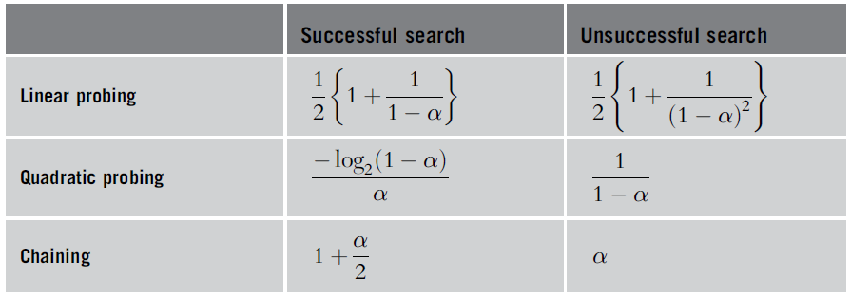
Hash Tables – Non-numeric Keys
Given the following hash function and hash table of size 6
  Draw the result after hashing the following values into the table.
  Use the buckets/chaining approach to resolve any collisions.
  The table should not be resized
On average, how many comparisons are made to determine whether an item is in the list ?
HASH = number of characters in the key * 2
a. heap
b. bst
c. dynarr
d. queue
e. stack
f. deque
g. bag
h. linkedlist
i. avl
j. iterator
Load Factor = α = 10 / 6 ~= 1.6666
0 | bst | dynarr | bag | avl
1
2 | heap | linkedlist
3
4 | queue | stack | deque | iterator
5
Table 9-5 from the book

Slide 71
Hash Tables – Non-numeric Keys
Given the following hash function and hash table of size 6
  Draw the result after hashing the following values into the table.
  Use the buckets/chaining approach to resolve any collisions.
  The table should not be resized
On average, how many comparisons are made to determine whether an item is in the list ?
HASH = number of characters in the key * 2
a. heap
b. bst
c. dynarr
d. queue
e. stack
f. deque
g. bag
h. linkedlist
i. avl
j. iterator
Load Factor = α = 10 / 6 ~= 1.6666
0 | bst | dynarr | bag | avl
1
2 | heap | linkedlist
3
4 | queue | stack | deque | iterator
5
Assume Success → 1 + (10/6) *(1/2) = 1 + (10/12) ~= 1.833
Table 9-5 from the book

Slide 72
Hash Tables – Non-numeric Keys
Given the following hash function and hash table of size 6
  Draw the result after hashing the following values into the table.
  Use the buckets/chaining approach to resolve any collisions.
  The table should not be resized
On average, how many comparisons are made to determine whether an item is in the list ?
HASH = number of characters in the key * 2
a. heap
b. bst
c. dynarr
d. queue
e. stack
f. deque
g. bag
h. linkedlist
i. avl
j. iterator
Load Factor = α = 10 / 6 ~= 1.6666
0 | bst | dynarr | bag | avl
1
2 | heap | linkedlist
3
4 | queue | stack | deque | iterator
5
Assume Unsuccessful → (10/6)
Table 9-5 from the book

Slide 73
Marker Slide
Questions on:
  Review Hashing
    Open Addressing: Double Hashing
  Review Stacks
  Review Queues
  Review PQs
  Application Practice
    Hash Tables, Non-numeric Keys
Next
  Application Practice
    Queues

Slide 74
Queues
Assume a queue of size 5 with the following values inserted sequentially:
  30, 40, 10, 50, 21
Describe or illustrate the resulting queue
30
End
Front

Slide 75
Queues
Assume a queue of size 5 with the following values inserted sequentially:
  30, 40, 10, 50, 21
Describe or illustrate the resulting queue
40 30
End
Front

Slide 76
Queues
Assume a queue of size 5 with the following values inserted sequentially:
  30, 40, 10, 50, 21
Describe or illustrate the resulting queue
10 40 30
End
Front

Slide 77
Queues
Assume a queue of size 5 with the following values inserted sequentially:
  30, 40, 10, 50, 21
Describe or illustrate the resulting queue
50 10 40 30
End
Front

Slide 78
Queues
Assume a queue of size 5 with the following values inserted sequentially:
  30, 40, 10, 50, 21
Describe or illustrate the resulting queue
21 50 10 40 30
End
Front

Slide 79
Marker Slide
Questions on:
  Review Hashing
  Review Stacks
  Review Queues
  Review PQs
  Application Practice
    Hash Tables, Non-numeric Keys
    Queues
Next
  Application Practice
    Making Dequeus using Doubly Linked Lists
      One data type created using another

Slide 80
Double-Ended Queues & Doubly Linked Lists
Enhanced Version
Main deque operations:
  insertFirst(object o): inserts element o at the beginning of the deque
  insertLast(object o): inserts element o at the end of the deque
  removeFirst(): removes and returns the element at the front of the deque
  removeLast(): removes and returns the element at the end of the deque
  first(): returns the element at the front without removing it
  last(): returns the element at the front without removing it
  size(): returns the number of elements stored
  isEmpty(): returns a Boolean value indicating whether no elements are stored
Doubly linked list operations
  insertFront(e): inserts an element on the front of the list
  removeFront(): returns and removes the element at the front of the list
  insertBack(e): inserts an element on the back of the list
  removeBack(): returns and removes the element at the end of the list

Slide 81
Double-Ended Queues & Doubly Linked Lists
Enhanced Version
Main deque operations:
  insertFirst(object o): inserts element o at the beginning of the deque
  insertLast(object o): inserts element o at the end of the deque
  removeFirst(): removes and returns the element at the front of the deque
  removeLast(): removes and returns the element at the end of the deque
  first(): returns the element at the front without removing it
  last(): returns the element at the front without removing it
  size(): returns the number of elements stored
  isEmpty(): returns a Boolean value indicating whether no elements are stored
Doubly linked list operations
  insertFront(e): inserts an element on the front of the list
  removeFront(): returns and removes the element at the front of the list
  insertBack(e): inserts an element on the back of the list
  removeBack(): returns and removes the element at the end of the list

Slide 82
Double-Ended Queues & Doubly Linked Lists
Enhanced Version
Main deque operations:
  insertFirst(object o): inserts element o at the beginning of the deque
  insertLast(object o): inserts element o at the end of the deque
  removeFirst(): removes and returns the element at the front of the deque
  removeLast(): removes and returns the element at the end of the deque
  first(): returns the element at the front without removing it
  last(): returns the element at the front without removing it
  size(): returns the number of elements stored
  isEmpty(): returns a Boolean value indicating whether no elements are stored
Doubly linked list operations
  insertFront(e): inserts an element on the front of the list
  removeFront(): returns and removes the element at the front of the list
  insertBack(e): inserts an element on the back of the list
  removeBack(): returns and removes the element at the end of the list

Slide 83
Double-Ended Queues & Doubly Linked Lists
Enhanced Version
Main deque operations:
  insertFirst(object o): inserts element o at the beginning of the deque
  insertLast(object o): inserts element o at the end of the deque
  removeFirst(): removes and returns the element at the front of the deque
  removeLast(): removes and returns the element at the end of the deque
  first(): returns the element at the front without removing it
  last(): returns the element at the front without removing it
  size(): returns the number of elements stored
  isEmpty(): returns a Boolean value indicating whether no elements are stored
Doubly linked list operations
  insertFront(e): inserts an element on the front of the list
  removeFront(): returns and removes the element at the front of the list
  insertBack(e): inserts an element on the back of the list
  removeBack(): returns and removes the element at the end of the list

Slide 84
Double-Ended Queues & Doubly Linked Lists
Enhanced Version
Main deque operations:
  insertFirst(object o): inserts element o at the beginning of the deque
  insertLast(object o): inserts element o at the end of the deque
  removeFirst(): removes and returns the element at the front of the deque
  removeLast(): removes and returns the element at the end of the deque
  first(): returns the element at the front without removing it
  last(): returns the element at the front without removing it
  size(): returns the number of elements stored
  isEmpty(): returns a Boolean value indicating whether no elements are stored
Doubly linked list operations
  insertFront(e): inserts an element on the front of the list
  removeFront(): returns and removes the element at the front of the list
  insertBack(e): inserts an element on the back of the list
  removeBack(): returns and removes the element at the end of the list

Slide 85
Double-Ended Queues & Doubly Linked Lists
Enhanced Version
Main deque operations:
  insertFirst(object o): inserts element o at the beginning of the deque
  insertLast(object o): inserts element o at the end of the deque
  removeFirst(): removes and returns the element at the front of the deque
  removeLast(): removes and returns the element at the end of the deque
  first(): returns the element at the front without removing it
  last(): returns the element at the front without removing it
  size(): returns the number of elements stored
  isEmpty(): returns a Boolean value indicating whether no elements are stored
Doubly linked list operations
  insertFront(e): inserts an element on the front of the list
  removeFront(): returns and removes the element at the front of the list
  insertBack(e): inserts an element on the back of the list
  removeBack(): returns and removes the element at the end of the list
first() would require a minor
alteration or addition to LinkedList
very similar to removeFront()

Slide 86
Double-Ended Queues & Doubly Linked Lists
Enhanced Version
Main deque operations:
  insertFirst(object o): inserts element o at the beginning of the deque
  insertLast(object o): inserts element o at the end of the deque
  removeFirst(): removes and returns the element at the front of the deque
  removeLast(): removes and returns the element at the end of the deque
  first(): returns the element at the front without removing it
  last(): returns the element at the front without removing it
  size(): returns the number of elements stored
  isEmpty(): returns a Boolean value indicating whether no elements are stored
Doubly linked list operations
  insertFront(e): inserts an element on the front of the list
  removeFront(): returns and removes the element at the front of the list
  insertBack(e): inserts an element on the back of the list
  removeBack(): returns and removes the element at the end of the list
last() would require a minor
alteration or addition to LinkedList
very similar to removeBack()

Slide 87
Double-Ended Queues & Doubly Linked Lists
Enhanced Version
Main deque operations:
  insertFirst(object o): inserts element o at the beginning of the deque
  insertLast(object o): inserts element o at the end of the deque
  removeFirst(): removes and returns the element at the front of the deque
  removeLast(): removes and returns the element at the end of the deque
  first(): returns the element at the front without removing it
  last(): returns the element at the front without removing it
  size(): returns the number of elements stored
  isEmpty(): returns a Boolean value indicating whether no elements are stored
Doubly linked list operations
  insertFront(e): inserts an element on the front of the list
  removeFront(): returns and removes the element at the front of the list
  insertBack(e): inserts an element on the back of the list
  removeBack(): returns and removes the element at the end of the list
size() and isEmpty() would require
the addition of a counter that increments
each time enqueue() is called and
decrements when dequeue() is called

Slide 88
The End (of This Part)
End
Check for more
Else work on homework
Prep for test

