Slide 1




Trees and Traversal
On a Tree Fallen Across the Road
by Robert Frost
(To hear us talk)
The tree the tempest with a crash of wood
Throws down in front of us is not bar
Our passage to our journey's end for good,
But just to ask us who we think we are
Insisting always on our own way so.
She likes to halt us in our runner tracks,
And make us get down in a foot of snow
Debating what to do without an ax.
And yet she knows obstruction is in vain:
We will not be put off the final goal
We have it hidden in us to attain,
Not though we have to seize earth by the pole
And, tired of aimless circling in one place,
Steer straight off after something into space.
Data Structures and Algorithms
CS 244
Brent M. Dingle, Ph.D.
Department of Mathematics, Statistics, and Computer Science
University of Wisconsin – Stout
Based on the book: Data Structures and Algorithms in C++ (Goodrich, Tamassia, Mount)
Some content derived/taken from: http://www.stroustrup.com/Programming/

Slide 2
Previously
Sorting
  Merge Sort (chapter 11.1)
Introduction to Trees
  General and Binary

Slide 3
Today
Traversals

Slide 4
Continuing with Trees
Tree Definitions and ADT (§7.1)
Tree Traversal Algorithms for General Trees (preorder and postorder) (§7.2)
BinaryTrees (§7.3)
  Data structures for trees (§7.1.4 and §7.3.4)
  Traversals of Binary Trees
    (preorder, inorder, postorder) (§7.3.6)
  Euler Tours (§7.3.7)
Location
in the book

Slide 5
What is a Tree
Review
In Computer Science, a tree is an abstract model of a hierarchical structure
A tree consists of nodes with a parent-child relation
Applications:
  Organization charts
  File systems
  Many others
Computers”R”Us
Sales
Manufacturing
R&D
US
International
Laptops
Desktops
Europe
Asia
Canada

Slide 6
Binary Tree
Review
A binary tree is a tree with the following properties:
  Each internal node has two children
  The children of a node are an ordered pair
We call the children of an internal node left child and right child
A
B
C
D
E
F
G
H
I

Slide 7

Exercise: Trees
Review
Take 5 minutes (or less) to answer the following.
You will be randomly selected to share your answers shortly.
Be prepared.
A
Answer the following questions about the tree shown on the right:
  What is the size of the tree to the right?
  What nodes are leaves?
  What node is the root?
  What nodes are internal nodes?
  List the ancestors of node F.
  List the descendants of node B.
  What is the depth of A?
  What is the height of the tree?
  How many leaves does a tree with exactly 1 node have?
B
C
D
E
F
G
H
I
J
K
Recall Definitions: Leaf : node without children
Internal node: node with at least one child

Slide 8
Tree Traversals
Types of Traversals
  Pre-Order ( trees in general )
  Post-Order ( trees in general )
  In-Order ( Binary Tree specific )

Slide 9
Preorder Traversal
A traversal visits the nodes of a tree in a systematic manner
In a preorder traversal, a node is visited before its descendants
Application: print a structured document
Algorithm preOrder(v)
  visit(v)
  for each child w of v
  preOrder(w)
1
Data Structures & Algorithms
2
5
9
1. A C++ Primer
2. Object-Oriented Design
Bibliography
3
4
6
7
8
1.1 Basic C++
Programming Elements
1.2 Expressions
2.1 Goals, Principles,
and Patterns
2.2 Inheritance and
Polymorphism
2.3 Templates

Slide 10
Preorder Traversal
A traversal visits the nodes of a tree in a systematic manner
In a preorder traversal, a node is visited before its descendants
Application: print a structured document
Algorithm preOrder(v)
  visit(v)
  for each child w of v
  preOrder(w)
1
Data Structures & Algorithms
2
5
9
1. A C++ Primer
2. Object-Oriented Design
Bibliography
3
4
6
7
8
1.1 Basic C++
Programming Elements
1.2 Expressions
2.1 Goals, Principles,
and Patterns
2.2 Inheritance and
Polymorphism
2.3 Templates

Slide 11
Preorder Traversal
A traversal visits the nodes of a tree in a systematic manner
In a preorder traversal, a node is visited before its descendants
Application: print a structured document
Algorithm preOrder(v)
  visit(v)
  for each child w of v
  preOrder(w)
1
Data Structures & Algorithms
2
5
9
1. A C++ Primer
2. Object-Oriented Design
Bibliography
3
4
6
7
8
1.1 Basic C++
Programming Elements
1.2 Expressions
2.1 Goals, Principles,
and Patterns
2.2 Inheritance and
Polymorphism
2.3 Templates

Slide 12
Preorder Traversal
A traversal visits the nodes of a tree in a systematic manner
In a preorder traversal, a node is visited before its descendants
Application: print a structured document
Algorithm preOrder(v)
  visit(v)
  for each child w of v
  preOrder(w)
1
Data Structures & Algorithms
2
5
9
1. A C++ Primer
2. Object-Oriented Design
Bibliography
3
4
6
7
8
1.1 Basic C++
Programming Elements
1.2 Expressions
2.1 Goals, Principles,
and Patterns
2.2 Inheritance and
Polymorphism
2.3 Templates

Slide 13
Preorder Traversal
A traversal visits the nodes of a tree in a systematic manner
In a preorder traversal, a node is visited before its descendants
Application: print a structured document
Algorithm preOrder(v)
  visit(v)
  for each child w of v
  preOrder(w)
1
Data Structures & Algorithms
2
5
9
1. A C++ Primer
2. Object-Oriented Design
Bibliography
3
4
6
7
8
1.1 Basic C++
Programming Elements
1.2 Expressions
2.1 Goals, Principles,
and Patterns
2.2 Inheritance and
Polymorphism
2.3 Templates

Slide 14
Preorder Traversal
A traversal visits the nodes of a tree in a systematic manner
In a preorder traversal, a node is visited before its descendants
Application: print a structured document
Algorithm preOrder(v)
  visit(v)
  for each child w of v
  preOrder(w)
1
Data Structures & Algorithms
2
5
9
1. A C++ Primer
2. Object-Oriented Design
Bibliography
3
4
6
7
8
1.1 Basic C++
Programming Elements
1.2 Expressions
2.1 Goals, Principles,
and Patterns
2.2 Inheritance and
Polymorphism
2.3 Templates

Slide 15
Preorder Traversal
A traversal visits the nodes of a tree in a systematic manner
In a preorder traversal, a node is visited before its descendants
Application: print a structured document
Algorithm preOrder(v)
  visit(v)
  for each child w of v
  preOrder(w)
1
Data Structures & Algorithms
2
5
9
1. A C++ Primer
2. Object-Oriented Design
Bibliography
3
4
6
7
8
1.1 Basic C++
Programming Elements
1.2 Expressions
2.1 Goals, Principles,
and Patterns
2.2 Inheritance and
Polymorphism
2.3 Templates

Slide 16
Preorder Traversal
A traversal visits the nodes of a tree in a systematic manner
In a preorder traversal, a node is visited before its descendants
Application: print a structured document
Algorithm preOrder(v)
  visit(v)
  for each child w of v
  preOrder(w)
1
Data Structures & Algorithms
2
5
9
1. A C++ Primer
2. Object-Oriented Design
Bibliography
3
4
6
7
8
1.1 Basic C++
Programming Elements
1.2 Expressions
2.1 Goals, Principles,
and Patterns
2.2 Inheritance and
Polymorphism
2.3 Templates

Slide 17
Preorder Traversal
A traversal visits the nodes of a tree in a systematic manner
In a preorder traversal, a node is visited before its descendants
Application: print a structured document
Algorithm preOrder(v)
  visit(v)
  for each child w of v
  preOrder(w)
1
Data Structures & Algorithms
2
5
9
1. A C++ Primer
2. Object-Oriented Design
Bibliography
3
4
6
7
8
1.1 Basic C++
Programming Elements
1.2 Expressions
2.1 Goals, Principles,
and Patterns
2.2 Inheritance and
Polymorphism
2.3 Templates

Slide 18
Preorder Traversal
A traversal visits the nodes of a tree in a systematic manner
In a preorder traversal, a node is visited before its descendants
Application: print a structured document
Algorithm preOrder(v)
  visit(v)
  for each child w of v
  preOrder(w)
1
Data Structures & Algorithms
2
5
9
1. A C++ Primer
2. Object-Oriented Design
Bibliography
3
4
6
7
8
1.1 Basic C++
Programming Elements
1.2 Expressions
2.1 Goals, Principles,
and Patterns
2.2 Inheritance and
Polymorphism
2.3 Templates

Slide 19
Postorder Traversal
In a postorder traversal, a node is visited after its descendants
Application: compute space used by files in a directory and its subdirectories
Algorithm postOrder(v)
  for each child w of v
  postOrder(w)
  visit(v)
9
cs16/
8
3
7
homeworks/
programs/
todo.txt
1K
1
2
4
5
6
h1c.doc
3K
h1nc.doc
2K
DDR.java
10K
Stocks.java
25K
Robot.java
20K

Slide 20
Postorder Traversal
In a postorder traversal, a node is visited after its descendants
Application: compute space used by files in a directory and its subdirectories
Algorithm postOrder(v)
  for each child w of v
  postOrder(w)
  visit(v)
9
cs16/
8
3
7
homeworks/
programs/
todo.txt
1K
1
2
4
5
6
h1c.doc
3K
h1nc.doc
2K
DDR.java
10K
Stocks.java
25K
Robot.java
20K

Slide 21
Postorder Traversal
In a postorder traversal, a node is visited after its descendants
Application: compute space used by files in a directory and its subdirectories
Algorithm postOrder(v)
  for each child w of v
  postOrder(w)
  visit(v)
9
cs16/
8
3
7
homeworks/
programs/
todo.txt
1K
1
2
4
5
6
h1c.doc
3K
h1nc.doc
2K
DDR.java
10K
Stocks.java
25K
Robot.java
20K

Slide 22
Postorder Traversal
In a postorder traversal, a node is visited after its descendants
Application: compute space used by files in a directory and its subdirectories
Algorithm postOrder(v)
  for each child w of v
  postOrder(w)
  visit(v)
9
cs16/
8
3
7
homeworks/
programs/
todo.txt
1K
1
2
4
5
6
h1c.doc
3K
h1nc.doc
2K
DDR.java
10K
Stocks.java
25K
Robot.java
20K

Slide 23
Postorder Traversal
In a postorder traversal, a node is visited after its descendants
Application: compute space used by files in a directory and its subdirectories
Algorithm postOrder(v)
  for each child w of v
  postOrder(w)
  visit(v)
9
cs16/
8
3
7
homeworks/
programs/
todo.txt
1K
1
2
4
5
6
h1c.doc
3K
h1nc.doc
2K
DDR.java
10K
Stocks.java
25K
Robot.java
20K

Slide 24
Postorder Traversal
In a postorder traversal, a node is visited after its descendants
Application: compute space used by files in a directory and its subdirectories
Algorithm postOrder(v)
  for each child w of v
  postOrder(w)
  visit(v)
9
cs16/
8
3
7
homeworks/
programs/
todo.txt
1K
1
2
4
5
6
h1c.doc
3K
h1nc.doc
2K
DDR.java
10K
Stocks.java
25K
Robot.java
20K

Slide 25
Postorder Traversal
In a postorder traversal, a node is visited after its descendants
Application: compute space used by files in a directory and its subdirectories
Algorithm postOrder(v)
  for each child w of v
  postOrder(w)
  visit(v)
9
cs16/
8
3
7
homeworks/
programs/
todo.txt
1K
1
2
4
5
6
h1c.doc
3K
h1nc.doc
2K
DDR.java
10K
Stocks.java
25K
Robot.java
20K

Slide 26
Postorder Traversal
In a postorder traversal, a node is visited after its descendants
Application: compute space used by files in a directory and its subdirectories
Algorithm postOrder(v)
  for each child w of v
  postOrder(w)
  visit(v)
9
cs16/
8
3
7
homeworks/
programs/
todo.txt
1K
1
2
4
5
6
h1c.doc
3K
h1nc.doc
2K
DDR.java
10K
Stocks.java
25K
Robot.java
20K

Slide 27
Postorder Traversal
In a postorder traversal, a node is visited after its descendants
Application: compute space used by files in a directory and its subdirectories
Algorithm postOrder(v)
  for each child w of v
  postOrder(w)
  visit(v)
9
cs16/
8
3
7
homeworks/
programs/
todo.txt
1K
1
2
4
5
6
h1c.doc
3K
h1nc.doc
2K
DDR.java
10K
Stocks.java
25K
Robot.java
20K

Slide 28
Postorder Traversal
In a postorder traversal, a node is visited after its descendants
Application: compute space used by files in a directory and its subdirectories
Algorithm postOrder(v)
  for each child w of v
  postOrder(w)
  visit(v)
9
cs16/
8
3
7
homeworks/
programs/
todo.txt
1K
1
2
4
5
6
h1c.doc
3K
h1nc.doc
2K
DDR.java
10K
Stocks.java
25K
Robot.java
20K

Slide 29
Inorder Traversal
In an inorder traversal a node is visited after its left subtree and before its right subtree
Application: draw a binary tree
  x(v) = inorder rank of v
  y(v) = depth of v
Algorithm inOrder(v)
  if isInternal(v)
    inOrder(leftChild(v))
  visit(v)
  if isInternal(v)
    inOrder(rightChild(v))

Slide 30
Inorder Traversal
In an inorder traversal a node is visited after its left subtree and before its right subtree
Application: draw a binary tree
  x(v) = inorder rank of v
  y(v) = depth of v
Algorithm inOrder(v)
  if isInternal(v)
    inOrder(leftChild(v))
  visit(v)
  if isInternal(v)
    inOrder(rightChild(v))
1

Slide 31
Inorder Traversal
In an inorder traversal a node is visited after its left subtree and before its right subtree
Application: draw a binary tree
  x(v) = inorder rank of v
  y(v) = depth of v
Algorithm inOrder(v)
  if isInternal(v)
    inOrder(leftChild(v))
  visit(v)
  if isInternal(v)
    inOrder(rightChild(v))
2
1

Slide 32
Inorder Traversal
In an inorder traversal a node is visited after its left subtree and before its right subtree
Application: draw a binary tree
  x(v) = inorder rank of v
  y(v) = depth of v
Algorithm inOrder(v)
  if isInternal(v)
    inOrder(leftChild(v))
  visit(v)
  if isInternal(v)
    inOrder(rightChild(v))
2
1
3

Slide 33
Inorder Traversal
In an inorder traversal a node is visited after its left subtree and before its right subtree
Application: draw a binary tree
  x(v) = inorder rank of v
  y(v) = depth of v
Algorithm inOrder(v)
  if isInternal(v)
    inOrder(leftChild(v))
  visit(v)
  if isInternal(v)
    inOrder(rightChild(v))
2
1
4
3

Slide 34
Inorder Traversal
In an inorder traversal a node is visited after its left subtree and before its right subtree
Application: draw a binary tree
  x(v) = inorder rank of v
  y(v) = depth of v
Algorithm inOrder(v)
  if isInternal(v)
    inOrder(leftChild(v))
  visit(v)
  if isInternal(v)
    inOrder(rightChild(v))
2
1
4
3
5

Slide 35
Inorder Traversal
In an inorder traversal a node is visited after its left subtree and before its right subtree
Application: draw a binary tree
  x(v) = inorder rank of v
  y(v) = depth of v
Algorithm inOrder(v)
  if isInternal(v)
    inOrder(leftChild(v))
  visit(v)
  if isInternal(v)
    inOrder(rightChild(v))
6
2
1
4
3
5

Slide 36
Inorder Traversal
In an inorder traversal a node is visited after its left subtree and before its right subtree
Application: draw a binary tree
  x(v) = inorder rank of v
  y(v) = depth of v
Algorithm inOrder(v)
  if isInternal(v)
    inOrder(leftChild(v))
  visit(v)
  if isInternal(v)
    inOrder(rightChild(v))
6
2
1
4
7
3
5

Slide 37
Inorder Traversal
In an inorder traversal a node is visited after its left subtree and before its right subtree
Application: draw a binary tree
  x(v) = inorder rank of v
  y(v) = depth of v
Algorithm inOrder(v)
  if isInternal(v)
    inOrder(leftChild(v))
  visit(v)
  if isInternal(v)
    inOrder(rightChild(v))
6
2
8
1
4
7
3
5

Slide 38
Inorder Traversal
In an inorder traversal a node is visited after its left subtree and before its right subtree
Application: draw a binary tree
  x(v) = inorder rank of v
  y(v) = depth of v
Algorithm inOrder(v)
  if isInternal(v)
    inOrder(leftChild(v))
  visit(v)
  if isInternal(v)
    inOrder(rightChild(v))
6
2
8
1
4
7
9
3
5

Slide 39
Generalizing Traversals
The 3 tree traversals you have just seen should all seem very similar in how they work
You may wonder if there is a way to generalize this methodology
The answer is YES

Slide 40
Tree Traversal Notes
Pre-Order, In-Order, Post-Order
  All “visit” each node in a tree exactly once
Pretend the tree is
an overhead view
of a wall
  Maybe the nodes are
  towers (doesn’t matter)
We want to walk all the
way around the wall structure
  We begin above the root node, facing towards it
  We then place our left hand against the node
  and walk all the way around the wall structure
  so that our left hand never leaves the wall
+
×
×
2
−
3
2
5
1

Slide 41
Tree Traversal Notes
Pre-Order, In-Order, Post-Order
  All “visit” each node in a tree exactly once
Pretend the tree is
an overhead view
of a wall
  Maybe the nodes are
  towers (doesn’t matter)
We want to walk all the
way around the wall structure
  We begin above the root node, facing towards it
  We then place our left hand against the node
  and walk all the way around the wall structure
  so that our left hand never leaves the wall
+
×
×
2
−
3
2
5
1

Slide 42
Tree Traversal Notes
Pre-Order, In-Order, Post-Order
  All “visit” each node in a tree exactly once
Pretend the tree is
an overhead view
of a wall
  Maybe the nodes are
  towers (doesn’t matter)
We want to walk all the
way around the wall structure
  We begin above the root node, facing towards it
  We then place our left hand against the node
  and walk all the way around the wall structure
  so that our left hand never leaves the wall
+
×
×
2
−
3
2
5
1

Slide 43
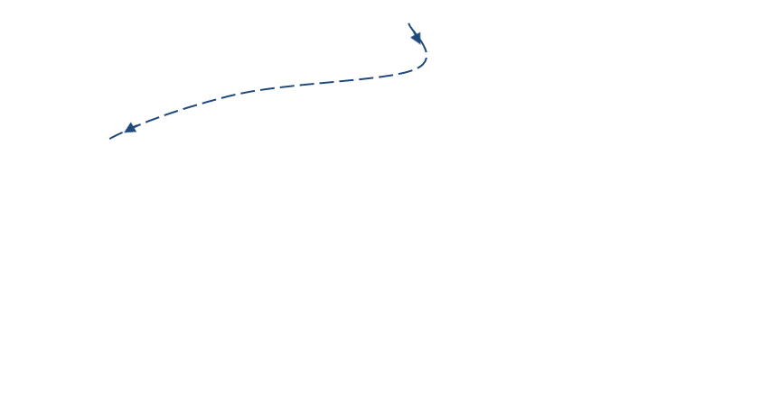
Tree Traversal Notes
Pre-Order, In-Order, Post-Order
  All “visit” each node in a tree exactly once
Pretend the tree is
an overhead view
of a wall
  Maybe the nodes are
  towers (doesn’t matter)
We want to walk all the
way around the wall structure
  We begin above the root node, facing towards it
  We then place our left hand against the node
  and walk all the way around the wall structure
  so that our left hand never leaves the wall
+
×
×
2
−
3
2
5
1

Slide 44
Generalizing
We will now encounter
each node 3 times
  Once on the ‘left’ side
    with respect to the paper
  Once on the ‘bottom’ side
    with respect to the paper
  Once on the right side
    with respect to the paper
+
L
×
×
2
−
3
2
5
1

Slide 45
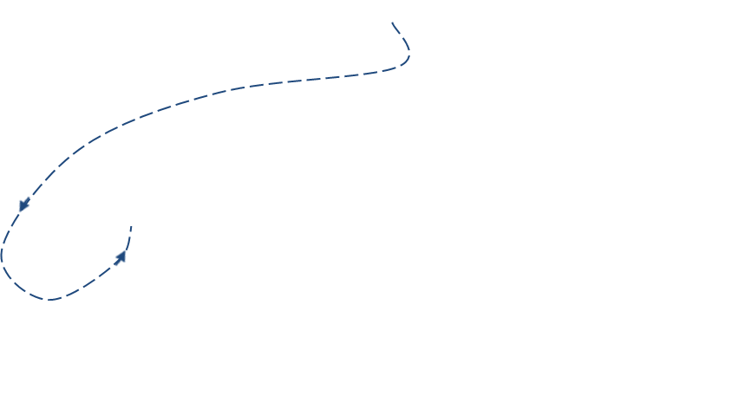
Generalizing
Pre-Order, In-Order, Post-Order
  All “visit” each node in a tree exactly once
We will now encounter
each node 3 times
  Once on the ‘left’ side
    with respect to the paper
  Once on the ‘bottom’ side
    with respect to the paper
  Once on the right side
    with respect to the paper
+
L
×
×
B
2
−
3
2
5
1

Slide 46
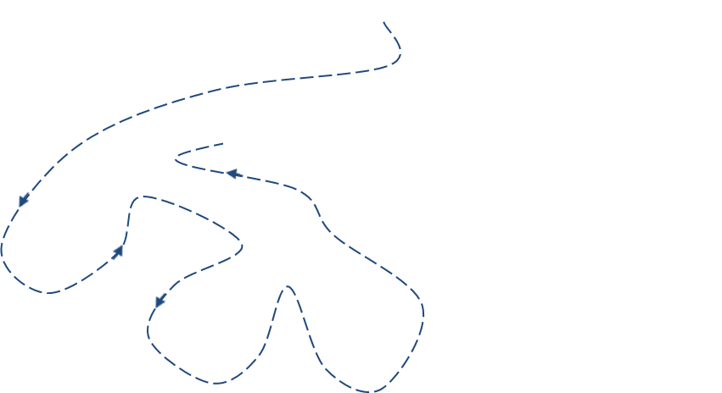
Generalizing
We will now encounter
each node 3 times
  Once on the ‘left’ side
    with respect to the paper
  Once on the ‘bottom’ side
    with respect to the paper
  Once on the ‘right’ side
    with respect to the paper
+
L
×
R
×
B
2
−
3
2
5
1

Slide 47
Euler Tour
This is an Euler Tour
  Generic traversal of a binary tree
  Includes as special cases
  the pre-order,
  post-order
  and in-order
  traversals
  Walk around the tree
  and visit each node three times:
    on the left (pre-order)
    from below (in-order)
    on the right (post-order)
+
L
×
R
×
B
2
−
3
2
5
1

Slide 48
Euler Tour Traversal
Algorithm eulerTour(p)
left-visit-action(p)
if isInternal(p)
    eulerTour(p.left())
  bottom-visit-action(p)
  if isInternal(p)
    eulerTour(p.right())
  right-visit-action(p)
End Algorithm
Notice leaf nodes all three visits
happen one right after the other
(effectively all at the same “time” )
+
L
×
R
×
B
2
−
3
2
5
1

Slide 49
Application Example
Arithmetic Expression Tree
Binary tree associated with an arithmetic expression
  internal nodes: operators
  leaves: operands
Example: arithmetic expression tree for the expression (2 × (a − 1) + (3 × b))
Next slide shows how
+
×
×
2
−
3
b
a
1

Slide 50
Print Arithmetic Expressions
Algorithm printExpression(v)
  if isInternal(v)
  print(“(’’)
    printExpression(leftChild(v))
  print(v.element())
  if isInternal(v)
    printExpression(rightChild(v))
  print (“)’’)
Specialization of an inorder traversal
  print operand or operator when visiting node
  print “(“ before traversing left subtree
  print “)“ after traversing right subtree
+
Expect to get: ((2 × (a − 1)) + (3 × b))
×
×
2
−
3
b
Instructor:
WORK THIS OUT ON THE BOARD
a
1

Slide 51
Bonus Euler Tour Application:
Print Arithmetic Expressions
Specialization of an Euler Tour traversal
  Left-visit-action: if node is internal, print “(“
  Bottom-visit-action: print value or operator stored at node
  Right-visit-action: if node is internal, print “)”
Algorithm printExpression(p)
  if isExternal(p) then
  print value stored at p
  Else
    print “(“
    printExpression(p.left())
    Print the operator stored at p
    printExpression(p.right())
  print “)”
  Endif
End Algorithm
+
×
×
2
−
3
b
((2 × (a − 1)) + (3 × b))
a
1

Slide 52
Class Activity: Arithmetic Expressions
Algorithm evalExpr(v)
  if isLeaf(v)
    return v.element()
  else
  x ← evalExpr(leftChild(v))
  y ← evalExpr(rightChild(v))
  ◊ ← operator stored at v
    return x ◊ y
Specialization of a postorder traversal
  recursive method returning the value of a subtree
  when visiting an internal node, combine the values of the subtrees
Students:
Write out the terms as they would be
visited in post-order traversal: x y ◊
Work this out on paper
You will be randomly selected to
present your answer
pause, circa 5 minutes
+
×
×
2
−
3
b
a
1

Slide 53
Evaluate Arithmetic Expressions
Enhanced Version
Algorithm evalExpr(v)
  if isLeaf(v)
    return v.element()
  else
  x ← evalExpr(leftChild(v))
  y ← evalExpr(rightChild(v))
  ◊ ← operator stored at v
    return x ◊ y
Specialization of a postorder traversal
  recursive method returning the value of a subtree
  when visiting an internal node, combine the values of the subtrees
+
2a1-*3b*+
ASIDE: Postfix Notation
Read from left to right
When you encounter an operator
apply it to the previous 2 operands
So 2, a, 1, -
apply minus and get (a - 1)
Next *
apply times and get 2 * (a – 1)
Continue and get: ((2 × (a − 1)) + (3 × b))
∗
∗
2
−
3
b
a
1

Slide 54

Example: Arithmetic Expressions
Draw an expression tree that has
  Four leaves, storing the values 2, 4, 8, and 8
  3 internal nodes, storing operations +, -, *, / (operators can be used more than once, but each internal node stores only one)
  The value of the root is 24
continues on next slide
so keep going

Slide 55
Example: Arithmetic Expressions
Draw an expression tree that has
  Four leaves, storing the values 2, 4, 8, and 8
  3 internal nodes, storing operations +, -, *, / (operators can be used more than once, but each internal node stores only one)
  The value of the root is 24
This order does not seem to help…
4+8 = 12, 2+8 = 10,
4*8 = 32, 2* 8 = 16
4
8
2
8
continues on next slide

Slide 56
Example: Arithmetic Expressions
Draw an expression tree that has
  Four leaves, storing the values 2, 4, 8, and 8
  3 internal nodes, storing operations +, -, *, / (operators can be used more than once, but each internal node stores only one)
  The value of the root is 24
This order seems better
8 * 8 = 64, 2*4 = 8
8 + 8 = 16, 2+4 = 6
8
8
2
4
complete solution next slide

Slide 57
Example: Arithmetic Expressions
Draw an expression tree that has
  Four leaves, storing the values 2, 4, 8, and 8
  3 internal nodes, storing operations +, -, *, / (operators can be used more than once, but each internal node stores only one)
  The value of the root is 24
+
+
×
8
8
2
4

Slide 58
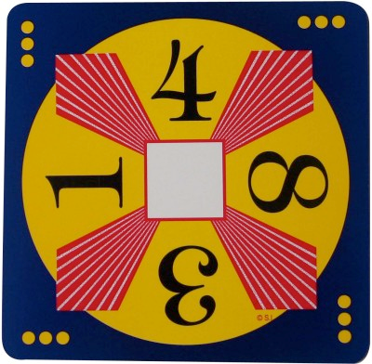
Class Exercise 2:
Arithmetic Expressions
Draw an expression tree that has
  Four leaves, storing the values 1, 3, 4, and 8
  3 internal nodes, storing operations +, -, *, / (operators can be used more than once, but each internal node stores only one)
  The value of the root is 24
Let students do this one
Pause… 5 minutes or so

Slide 59
Class Exercise 2:
Arithmetic Expressions
Enhanced Version
Draw an expression tree that has
  Four leaves, storing the values 1, 3, 4, and 8
  3 internal nodes, storing operations +, -, *, / (operators can be used more than once, but each internal node stores only one)
  The value of the root is 24
+
×
8
+
4
1
3

Slide 60
Ok so what about coding stuff?
Pictures are nice
But what about coding it?
How might you create a binary tree to actually represent this kind of stuff using C++?

Slide 61

Classwork: Infix into Tree How?
Say the input was: ((2 ∗ (a − 1)) + (3 ∗ b))
How would you make a binary tree to represent it?
  So that an in-order traversal
  would give back what you input.
What algorithm would you use?
  Assume you can ignore spaces (if that helps)
Assume you MUST have “outer parens”
So for x + y
it must be entered as ( x + y )
Hints may appear here from time to time
Assume all parentheses are matched
+
Start with something easy: (a - 1)
The desired tree
Students – Group
10 minutes or until solved
whichever is faster
Hint use small trees and a stack
to make a bigger tree
if ‘a’ was a tree
and ‘-’ was a tree
and ‘1’ was a tree
then when you found a ‘)’
you could make a bigger tree
×
×
2
−
3
b
a
1
( 2 * (a - 1) ) → 2 is a tree (bottom of stack)
* is a tree (above 2’s tree)
“a-1 is a tree with root –” ( above *’s tree)… hit another ‘)’ … hmmm

Slide 62
Classwork: Infix into Tree How?
To go from infix
to postfix we will use a Binary Tree
and a Stack
createExpressionTree(ExpTree):
Input: A fully-parenthesized arithmetic
expression E=e₀e₁...e_{n-1}
where each e_{i} is either an operator (+,-,*,/)
or a constant (55.2) or brackets.
Output: A binary tree T representing E.
S = new Stack()
for each e_{i}
if e_{i} is constant or operator then
T = new BinaryTree()
T.addRoot(e_{i})
S.push(T)
else if e_{i} is '('
continue looping
else { e_{i} is ')'}
T₂ = S.pop()
T = S.pop()
T₁ = S.pop()
T.attach(T.root(), T₁, T₂)
S.push(T)
return S.pop()
You will find something
very similar to this in the code example we are going to work on in the very (2 or 3 slides) near future
Test it:
((2 * (a − 1)) + (3 * b))
+
The desired tree
+
×
×
×
×
2
−
3
b
2
−
3
b
a
1
a
1

Slide 63
PreWork for In-Class Programming
Students: Start Ubuntu up if not already going
Objective of next activity:
  Explore actual code using a binary tree to store a binary arithmetic expression (as in previous slides)
  To test the code we will assume the input is entered in “infix” notation
    parentheses and such like we usually write equations
  We will output the code using postfix notation
    no parentheses, single space separating operands and operators

Slide 64
Class Exercise – Groups of 1, 2, or 3
D2L
Using a binary tree
  Convert an entered infix arithmetic expression to a postfix expression
    Output the infix expression
    Output the postfix expression
  Evaluate the expression
    Assume all operands are (non-negative) integers
    i.e. perform the operations as specified and output the result
  Test with
    ((2 * (6 − 1)) + (3 ∗ 12)) Result should be 2 6 1 - * 3 12 * + = 46
Starter Code may be available on D2L
  On an INDIVIDUAL basis turn in resulting code for possible bonus points on an assignment
  May work as group – but each individual must turn in
    Identify any one else you worked with in the code comments
Bonus Points
Notes:
About 30 maybe 40 minutes to get to here
30 minutes – 20 for work and 10 for solution, or similar

Slide 65
The End
For next time
  Read Chapter 7
    Trees and such
  Do the homework
If time left…
work on it here and now… I might help.
=)

