Slide 1
Review and Prepare for Test 2
Data Structures and Algorithms
CS 244
Brent M. Dingle, Ph.D.
Department of Mathematics, Statistics, and Computer Science
University of Wisconsin – Stout
Based on the book: Data Structures and Algorithms in C++ (Goodrich, Tamassia, Mount)
Some content from Data Structures Using C++ (D.S. Malik)

Slide 2
Points of Note
Next class, there is a Test
More on this shortly

Slide 3
Previously
Take Home Online Quiz
Time to take it ended right before this class
Go over answers

Slide 4
Big Oh – Again
Because you can never get enough

Slide 5
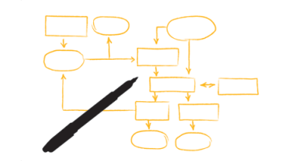
Linked Lists
How are they implemented in C++
Node and pointer
Singly and Doubly Linked
Be able to read code
Use pointers
Allocate and De-allocate nodes

Slide 6
Summary of Sorting Algorithms (so far)
Algorithm | Time | Notes
Selection Sort | O(n²) | Slow, in-place For small data sets
Insertion Sort | O(n²) | Slow, in-place For small data sets
Bubble Sort | O(n²) | Slow, in-place For small data sets
Heap Sort | O(nlog n) | Fast, in-place For large data sets
Merge Sort | O(nlogn) | Fast, sequential data access For huge data sets
Quick Sort | O(nlogn) | Assumes key values are random and uniformly distributed
Place holder for others we have not yet seen

Slide 7
Improv
Go through previous lectures and highlight additional things
Take Questions

Slide 8
Questions
Any questions
that have not yet been asked
and or answered

Slide 9
The End
It says, The End
Go Study
Do Well

