Slide 1
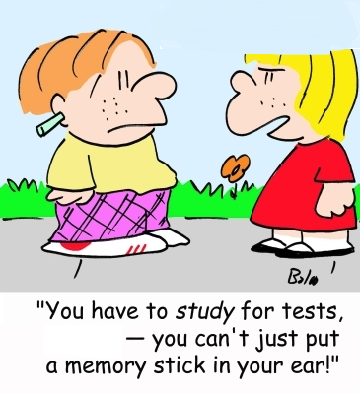

Take the Test
Data Structures and Algorithms
CS 244
Brent M. Dingle, Ph.D.
Department of Mathematics, Statistics, and Computer Science
University of Wisconsin – Stout
Based on the book: Data Structures and Algorithms in C++ (Goodrich, Tamassia, Mount)
Some content from Data Structures Using C++ (D.S. Malik)

Slide 2
Points of Note
You should be taking the test
  Not reading this

Slide 3
The End
It says, The End
Good day. =)

