Slide 1
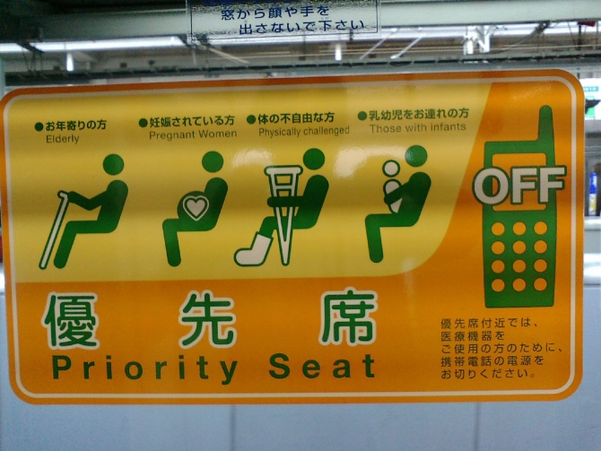

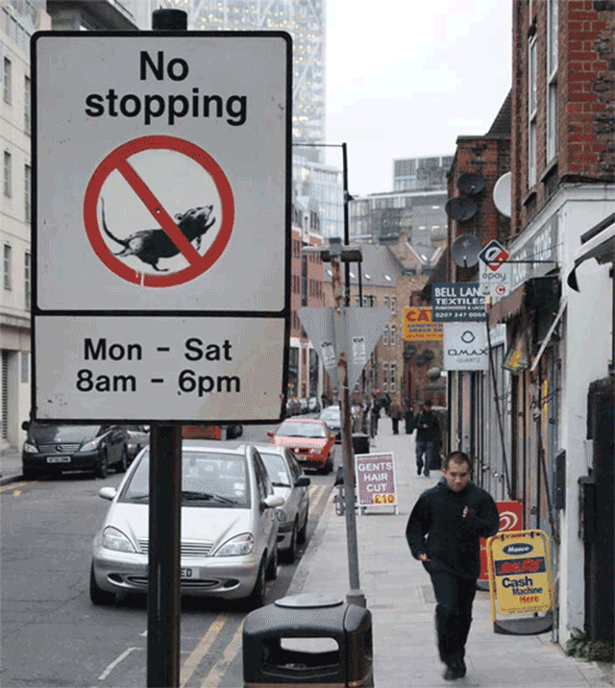
Binary Trees
Priority Queues, and Heaps
CS 244
Brent M. Dingle, Ph.D.
Game Design and Development Program
Department of Mathematics, Statistics, and Computer Science
University of Wisconsin – Stout
Content derived from: Data Structures Using C++ (D.S. Malik)
and Data Structures and Algorithms in C++ (Goodrich, Tamassia, Mount)c

Slide 2
Previously
Various Sorting
Some Tree Stuff

Slide 3
Things to Note
Homework 8 is due
  like today
  turn it in if you have not already done so
Homework 9
  do not delay in starting it

Slide 4
For Today
Review some Tree stuff
Move on to new stuff

Slide 5
Where are we headed?
Have seen
  Sorting (chapter 10)
  Trees (chapter 11)
  Priority Queues (chapter 8) – but more is coming
Will soon see
  Priority Queues
    nodes have keys and data
  Heaps
    Thought of as a binary tree (pile of stuff = heap)
    but implemented using a vector array
  PQ Sorting
    Implemented using an unsorted list (selection sort)
    Implemented using a sorted list (insertion sort)
    Implemented using a Heap (heap sort)

Slide 6
Marker Slide
General Questions?
Next:
  Trees
    Review Some Definitions of Binary Trees
    Applications of Binary Trees
    Tree Traversals
  Priority Queues

Slide 7
Definitions and Examples
A Complete Binary Tree with height h, is a tree such that
  All 2^{h-1} nodes exist at height h-1
  Nodes at level h fill up left to right
A Full (or Proper) Binary Tree is a tree such that
  Every non-leaf node has 2 children
∅
Complete Binary Tree
(also is FULL)
Complete Binary Tree
(but is NOT full)

Slide 8
Definitions and Examples
A Complete Binary Tree with height h, is a tree such that
  All 2^{h-1} nodes exist at height h-1
  Nodes at level h fill up left to right
A Full (or Proper) Binary Tree is a tree such that
  Every non-leaf node has 2 children
∅
∅
NOT a Complete Binary Tree
(also not full)
NOT a Complete Binary Tree
(also not full)

Slide 9
Definitions and Examples: Balance
a
a
b
c
b
c
e
d
e
f
g
d
f
h
i
j
g
h
A balanced binary tree
i
j
An unbalanced binary tree
A binary tree is balanced if every level above the lowest is “full” (contains 2^{n} nodes)
In most applications, a reasonably balanced binary tree is desirable

Slide 10
Marker Slide
Questions on:
  Trees
    Review Some Definitions of Binary Trees
Next:
  Trees
    Applications of Binary Trees
    Tree Traversals
  Priority Queues

Slide 11
Application Example
Arithmetic Expression Tree
Binary tree associated with an arithmetic expression
  internal nodes: operators
  leaves: operands
Example: arithmetic expression tree for the expression (2 × (a − 1) + (3 × b))
+
×
×
2
−
3
b
a
1

Slide 12
Application Example
Decision Tree
Binary tree associated with a decision process
  internal nodes: questions with yes/no answer
  leaves: decisions
Example: dining decision
Want a fast meal?
Yes
No
How about coffee?
On expense account?
Yes
No
Yes
No
Starbucks
Antonio’s
Veritas
Chili’s

Slide 13
Marker Slide
Questions on:
  Trees
    Review Some Definitions of Binary Trees
    Applications of Binary Trees
Next:
  Trees
    Tree Traversals
  Priority Queues

Slide 14
Generalizing Traversals
The 3 tree traversals methods:
  preorder, inorder, and postorder
  are all very similar in nature
There is a way to generalize this methodology

Slide 15
Tree Traversal Notes
Pre-Order, In-Order, Post-Order
  All “visit” each node in a tree exactly once
Pretend the tree is
an overhead view
of a wall
  Maybe the nodes are
  towers (doesn’t matter)
We want to walk all the
way around the wall structure
  We begin above the root node, facing towards it
  We then place our left hand against the node
  and walk all the way around the wall structure
  so that our left hand never leaves the wall
+
×
×
2
−
3
2
5
1

Slide 16
Tree Traversal Notes
Pre-Order, In-Order, Post-Order
  All “visit” each node in a tree exactly once
Pretend the tree is
an overhead view
of a wall
  Maybe the nodes are
  towers (doesn’t matter)
We want to walk all the
way around the wall structure
  We begin above the root node, facing towards it
  We then place our left hand against the node
  and walk all the way around the wall structure
  so that our left hand never leaves the wall
+
×
×
2
−
3
2
5
1

Slide 17
Tree Traversal Notes
Pre-Order, In-Order, Post-Order
  All “visit” each node in a tree exactly once
Pretend the tree is
an overhead view
of a wall
  Maybe the nodes are
  towers (doesn’t matter)
We want to walk all the
way around the wall structure
  We begin above the root node, facing towards it
  We then place our left hand against the node
  and walk all the way around the wall structure
  so that our left hand never leaves the wall
+
×
×
2
−
3
2
5
1

Slide 18
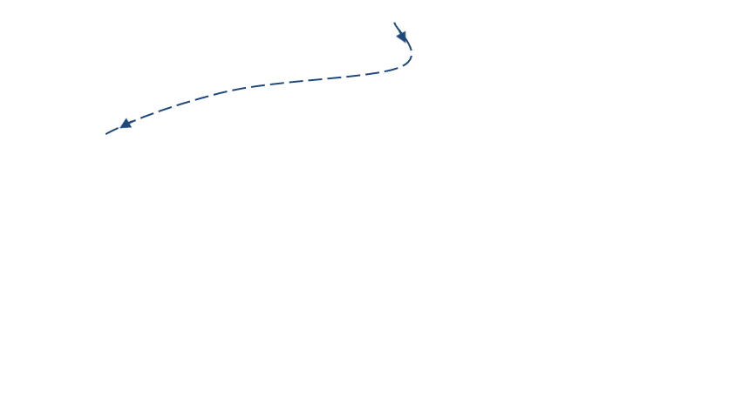
Tree Traversal Notes
Pre-Order, In-Order, Post-Order
  All “visit” each node in a tree exactly once
Pretend the tree is
an overhead view
of a wall
  Maybe the nodes are
  towers (doesn’t matter)
We want to walk all the
way around the wall structure
  We begin above the root node, facing towards it
  We then place our left hand against the node
  and walk all the way around the wall structure
  so that our left hand never leaves the wall
+
×
×
2
−
3
2
5
1

Slide 19
Generalizing
We will now encounter
each node 3 times
  Once on the ‘left’ side
    with respect to the paper
  Once on the ‘bottom’ side
    with respect to the paper
  Once on the right side
    with respect to the paper
+
L
×
×
2
−
3
2
5
1

Slide 20
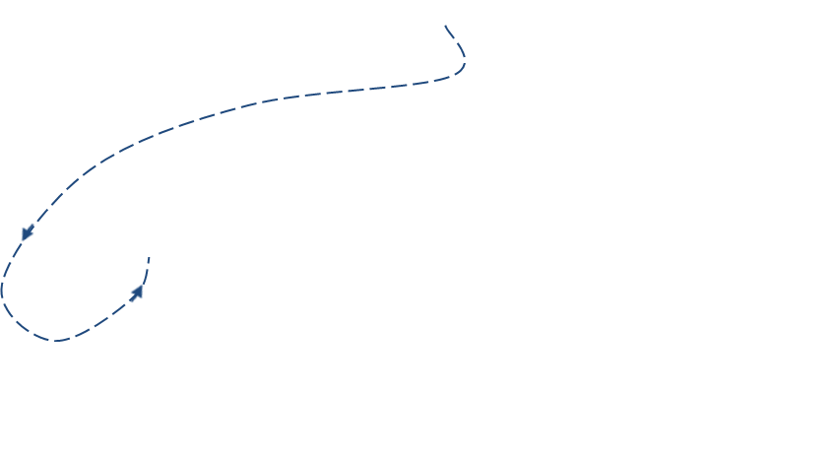
Generalizing
Pre-Order, In-Order, Post-Order
  All “visit” each node in a tree exactly once
We will now encounter
each node 3 times
  Once on the ‘left’ side
    with respect to the paper
  Once on the ‘bottom’ side
    with respect to the paper
  Once on the right side
    with respect to the paper
+
L
×
×
B
2
−
3
2
5
1

Slide 21
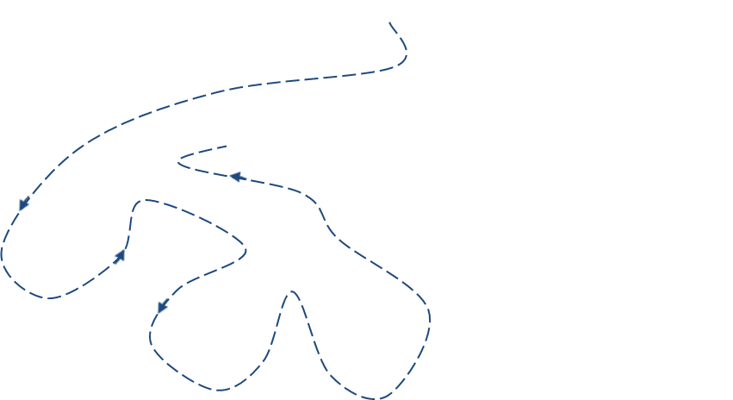
Generalizing
We will now encounter
each node 3 times
  Once on the ‘left’ side
    with respect to the paper
  Once on the ‘bottom’ side
    with respect to the paper
  Once on the ‘right’ side
    with respect to the paper
+
L
×
R
×
B
2
−
3
2
5
1

Slide 22
Euler Tour
This is an Euler Tour
  Generic traversal of a binary tree
  Includes as special cases
  the pre-order,
  post-order
  and in-order
  traversals
  Walk around the tree
  and visit each node three times:
    on the left (pre-order)
    from below (in-order)
    on the right (post-order)
+
L
×
R
×
B
2
−
3
2
5
1

Slide 23
Euler Tour Traversal
Algorithm eulerTour(p)
left-visit-action(p)
if isInternal(p)
    eulerTour(p.left())
  bottom-visit-action(p)
  if isInternal(p)
    eulerTour(p.right())
  right-visit-action(p)
End Algorithm
Notice leaf nodes all three visits
happen one right after the other
(effectively all at the same “time” )
+
L
×
R
×
B
2
−
3
2
5
1

Slide 24
In-Class Activity:
ICA305_ExamFun
Draw a (single) binary tree T, such that
  Each internal node of T stores a single character
  A preorder traversal of T yields EXAMFUN
  An inorder traversal of T yields MAFXUEN
Might Try:
E
/ \
X F
/ \ / \
A M U N
Solves preorder, but fails inorder. Must satisfy both with ONE tree.
Keep looking.
Submit your work to
correct D2L dropbox
before class ends

Slide 25
Marker Slide
Questions on:
  Trees
Next:
  Priority Queues
    Definitions and relation to Sorting
      Setting up for ‘generic’ sorting algorithm
        Where performance depends on the data structure being used

Slide 26
Relation of what is coming to the Book
PriorityQueue ADT (Chapter 8 and 10)
  Sorting with a Priority Queue (Chapter 10)
  Implementing a PQ with a list (Chapter 8)
    Selection-sort and Insertion Sort (Chapter 10)
Heaps (Chapter 10)
  Complete Binary Trees (Chapter 11)
  Implementing a PQ with a heap (Chapter 10-ish)
  Heapsort (Chapter 10)

Slide 27
Claim about Sorting
Possible to create a generic algorithm
  PQ-Sort
Where the data structure used to implement it
Affects the runtime of the algorithm

Slide 28
Going MORE general
We have seen some sorting methods.
  Selection, Insertion, etc…
Can we abstract them even more?
Consider Priority Queues
  Think like how some airlines have you board
    Special Access, Group 1, Group 2, …

Slide 29

The Priority Queue ADT
A priority queue (PQ) is a restricted form of a list
  items are arranged according to their priorities (or keys)
    keys may or may not be unique
  Unlike a queue which is FIFO
  A priority queue removes items based on priority

Slide 30
PQ – Total Order Relation
A priority queue must hold a total order relation (example <= )
A Total Order Relation has the following properties:
  Reflexive
    k <= k
  Antisymmetric
    if x <= y and y <= x then x = y
  Transitive
    if a <= b and b <= c then a <= c

Slide 31
2 ‘types’ of PQ
Priority Queues may be viewed as:
min PQ
  minimum key value is the highest priority
max PQ
  maximum key value is the highest priority

Slide 32
Priority Queue ADT Operations
Main Methods of PQs
insertItem(key, data)
  aka enqueue(key, data)
  inserts data into the PQ according to key
removeItem()
  removes the item with the smallest (largest) key
    depending if using a min PQ or max PQ
size()
  returns number of elements in PQ
empty()
  returns true if zero elements in PQ
minItem() / maxItem()
  returns item with smallest/largest key
minKey() / maxKey()
  returns smallest/largest key
removeItem() may also be named
removeMin() or removeMax()
or dequeue()
Additional Methods of PQs

Slide 33





Sorting Using a Priority Queue
Given a sequence of N items
  a PQ can be used to sort the sequence:
  Step 1
    Insert N items into the PQ via insertItem(key, data)
  Step 2
    Remove the items by calling removeItem() N times
      The first remove removes the largest item, the second call the second largest, … the last removes the smallest item

Slide 34
Sorting Using a Priority Queue
Given a sequence of N items
  a PQ can be used to sort the sequence:
  Step 1
    Insert N items into the PQ via insertItem(key, data)
  Step 2
    Remove the items by calling removeItem() N times
      The first remove removes the largest item, the second call the second largest, … the last removes the smallest item
S

Slide 35
Sorting Using a Priority Queue
Given a sequence of N items
  a PQ can be used to sort the sequence:
  Step 1
    Insert N items into the PQ via insertItem(key, data)
  Step 2
    Remove the items by calling removeItem() N times
      The first remove removes the largest item, the second call the second largest, … the last removes the smallest item

Slide 36
Sorting Using a PQ
Given a sequence of N items
  a PQ can be used to sort the sequence:
  Step 1
    Insert N items into the PQ via insertItem(key, data)
  Step 2
    Remove the items by calling removeItem() N times
      The first remove removes the largest item, the second call the second largest, … the last removes the smallest item
Algorithm PriorityQueueSort (S, PQ):
Input: Sequence, S, of n items, and empty priority queue, PQ.
Output: Sequence S sorted by the total order relation.
while ! S.empty() do
item := S.removeFirst()
PQ.insertItem(item.key, item.data)
while ! PQ.empty do
item := PQ.removeItem()
S.insertLast(item)

Slide 37
Marker Slide
Questions on:
  Trees
  Priority Queues
    From the Book: Comparisons and Comparator Operator and ADT
    From the Book: Definitions and relation to Sorting
    Reboot: back to selection sort and insertion sort
    Setting up for ‘generic’ sorting algorithm
      Where performance depends on the data structure being used
Next:
  Priority Queues
    Implementations
      Unordered List
      Ordered List
      Binary Tree (Heap)

Slide 38
PQ Implementation
Priority Queues can be implemented using
  Unordered List
  Ordered List
  Binary Tree (Heap)

Slide 39
Implementing PQ as an Unordered List
Each item in a PQ is a composition of 2 objects
  the key (priority)
  and the data
    Thus we have the pair (key, data)
  So we could implement this using a linked list
    see next slide

Slide 40
Recall Doubly Linked List
template <typename T>
class Item {
public:
T elem;
Item<T> *prev, *next;
};
prev
next
elem
node
But for our priority queue we split elem into TWO things
  key (of type int)
  data (of type T)

Slide 41
Recall Doubly Linked List
template <typename T>
class Item {
public:
int key;
T data;
Item<T> *prev, *next;
};
prev
next
key
data
node
But for our priority queue we split elem into TWO things
  key (of type int)
  data (of type T)

Slide 42
Implementing a PQ as Unordered list
So if we have a list of unordered stuff
To make it a PQ we need the functions
  insertItem(key, data)
  removeItem()
    assume a Min PQ so this removes the item with the smallest key

Slide 43
PQ as Unordered list
PQ::insertItem(key, data)
  This is just an insertFront() call for the list
    like m_list.insertFront(…)
  Recall this is an O(1) operation

Slide 44
PQ as Unordered list
So if we have a list of unordered stuff
To make it a PQ we need the functions
  insertItem(key, data)
    Can be done in O(1)
  What about…
  removeItem()
    assume a Min PQ so this removes the item with the smallest key

Slide 45
PQ as Unordered list
So if we have a list of unordered stuff
To make it a PQ we need the functions
  insertItem(key, data)
    Can be done in O(1)
  removeItem()
    Requires O(n)

Slide 46
Marker Slide
Questions on:
  Trees
  Priority Queues
    Setting up for ‘generic’ sorting algorithm
      Where performance depends on the data structure being used
    Implementations
      Unordered List
Next:
  Priority Queues
    Implementations
      Ordered List
      Binary Tree (Heap)

Slide 47
Implementing a PQ as an Ordered list
Let’s say we have a list of Ordered stuff
To make it a PQ we still need the functions
  insertItem(key, data)
  removeItem()
    assume a Min PQ so this removes the item with the smallest key

Slide 48
PQ as an Ordered list
PQ::removeItem() is now easy
  This is just a removeFront() call for the list
    like m_list.removeFront(…)
  Recall this is an O(1) operation

Slide 49
PQ as an Ordered list
Let’s say we have a list of Ordered stuff
To make it a PQ we need the functions
  removeItem()
    Can be done in O(1)
  What about…
  insertItem(key, data)
    note this must maintain the ordering
    so we have to find the correct place to insert it

Slide 50
PQ as an Ordered list
Let’s say we have a list of Ordered stuff
To make it a PQ we need the functions
  removeItem()
    Can be done in O(1)
  insertItem(key, data)
    Requires O(n)

Slide 51
Summary: List-based Priority Queue
Unsorted list implementation
  Store the items of the priority queue in a list-based sequence, in arbitrary order
Performance:
  insertItem takes O(1) time since we can insert the item at the beginning or end of the sequence
  removeMin, minKey and minElement take O(n) time since we have to traverse the entire sequence to find the smallest key
Sorted list implementation
  Store the items of the priority queue in a sequence, sorted by key
Performance:
  insertItem takes O(n) time since we have to find the place where to insert the item
  removeMin, minKey and minElement take O(1) time since the smallest key is at the beginning of the sequence
4
5
2
3
1
1
2
3
4
5

Slide 52
Marker Slide
Questions on:
  Trees
  Priority Queues
    Setting up for ‘generic’ sorting algorithm
      Where performance depends on the data structure being used
    Implementations
      Unordered List
      Ordered List
Next:
  Priority Queue Sorts
    Selection Sort
    Insertion Sort
  Heap

Slide 53
Selection and Insertion Sort
Selection and Insertion Sort are
  two different implementations of PQ-sort
Selection sort uses data structure of
  Unsorted List
Insertion sort uses a data structure of
  Sorted List

Slide 54
Sorting Using a PQ
Recall
  a PQ can be used to sort the sequence:
  Step 1
    Insert N items into the PQ via insertItem(key, data)
  Step 2
    Remove the items by calling removeItem() N times
      The first remove removes the largest item, the second call the second largest, … the last removes the smallest item
Algorithm PriorityQueueSort (S, PQ):
Input: Sequence, S, of n items, and empty priority queue, PQ.
Output: Sequence S sorted by the total order relation.
while ! S.empty() do
item := S.removeFirst()
PQ.insertItem(item.key, item.data)
while ! PQ.empty do
item := PQ.removeItem() // e.g. PQ.removeMin()
S.insertLast(item)

Slide 55
Selection Sort
Recall:
  Selection-sort is the variation of PQ-sort where the priority queue is implemented with an unsorted sequence
    first n insertItems, then n removeMins
4
5
2
3
1
Algorithm PriorityQueueSort (S, PQ):
while ! S.empty() do
item := S.removeFirst()
PQ.insertItem(item.key, item.data)
while ! PQ.empty do
item := PQ.removeItem() // e.g. PQ.removeMin()
S.insertLast(item)

Slide 56

Selection Sort
Recall:
  Selection-sort is the variation of PQ-sort where the priority queue is implemented with an unsorted sequence
    first n insertItems, then n removeMins
4
5
2
3
1
Algorithm PriorityQueueSort (S, PQ):
while ! S.empty() do
item := S.removeFirst()
PQ.insertItem(item.key, item.data)
while ! PQ.empty do
item := PQ.removeItem() // e.g. PQ.removeMin()
S.insertLast(item)
$$n$$

Slide 57

Selection Sort
Recall:
  Selection-sort is the variation of PQ-sort where the priority queue is implemented with an unsorted sequence
    first n insertItems, then n removeMins
4
5
2
3
1
Algorithm PriorityQueueSort (S, PQ):
while ! S.empty() do
item := S.removeFirst()
PQ.insertItem(item.key, item.data)
while ! PQ.empty do
item := PQ.removeItem() // e.g. PQ.removeMin()
S.insertLast(item)
$$n$$
$$n$$

Slide 58

Selection Sort
Recall:
  Selection-sort is the variation of PQ-sort where the priority queue is implemented with an unsorted sequence
    first n insertItems, then n removeMins
4
5
2
3
1
Algorithm PriorityQueueSort (S, PQ):
while ! S.empty() do
item := S.removeFirst()
PQ.insertItem(item.key, item.data)
while ! PQ.empty do
item := PQ.removeItem() // e.g. PQ.removeMin()
S.insertLast(item)
$$n$$
$$n$$
$$n$$

Slide 59

Selection Sort
Recall:
  Selection-sort is the variation of PQ-sort where the priority queue is implemented with an unsorted sequence
    first n insertItems, then n removeMins
4
5
2
3
1
Algorithm PriorityQueueSort (S, PQ):
while ! S.empty() do
item := S.removeFirst()
PQ.insertItem(item.key, item.data)
while ! PQ.empty do
item := PQ.removeItem() // e.g. PQ.removeMin()
S.insertLast(item)
$$n$$
$$n$$
$$n$$
$$n$$

Slide 60

Selection Sort
Recall:
  Selection-sort is the variation of PQ-sort where the priority queue is implemented with an unsorted sequence
    first n insertItems, then n removeMins
4
5
2
3
1
Algorithm PriorityQueueSort (S, PQ):
while ! S.empty() do
item := S.removeFirst()
PQ.insertItem(item.key, item.data)
while ! PQ.empty do
item := PQ.removeItem() // e.g. PQ.removeMin()
S.insertLast(item)
$$n$$
$$n$$
$$n$$
$$n$$
$$n\text{2}$$

Slide 61

Selection Sort
Recall:
  Selection-sort is the variation of PQ-sort where the priority queue is implemented with an unsorted sequence
    first n insertItems, then n removeMins
4
5
2
3
1
Algorithm PriorityQueueSort (S, PQ):
while ! S.empty() do
item := S.removeFirst()
PQ.insertItem(item.key, item.data)
while ! PQ.empty do
item := PQ.removeItem() // e.g. PQ.removeMin()
S.insertLast(item)
$$n$$
$$n$$
$$n$$
$$n$$
$$n\text{2}$$
$$n$$

Slide 62
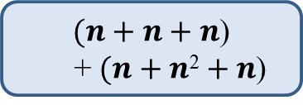
Selection Sort
Recall:
  Selection-sort is the variation of PQ-sort where the priority queue is implemented with an unsorted sequence
    first n insertItems, then n removeMins
4
5
2
3
1
Algorithm PriorityQueueSort (S, PQ):
while ! S.empty() do
item := S.removeFirst()
PQ.insertItem(item.key, item.data)
while ! PQ.empty do
item := PQ.removeItem() // e.g. PQ.removeMin()
S.insertLast(item)
$(n+n+n$)
+ $(n+n\text{2}+n$)

Slide 63

Selection Sort
Recall:
  Selection-sort is the variation of PQ-sort where the priority queue is implemented with an unsorted sequence
    first n insertItems, then n removeMins
4
5
2
3
1
Algorithm PriorityQueueSort (S, PQ):
while ! S.empty() do
item := S.removeFirst()
PQ.insertItem(item.key, item.data)
while ! PQ.empty do
item := PQ.removeItem() // e.g. PQ.removeMin()
S.insertLast(item)
$5n+n$²

Slide 64
Selection Sort
Recall:
  Selection-sort is the variation of PQ-sort where the priority queue is implemented with an unsorted sequence
    first n insertItems, then n removeMins
4
5
2
3
1
Algorithm PriorityQueueSort (S, PQ):
while ! S.empty() do
item := S.removeFirst()
PQ.insertItem(item.key, item.data)
while ! PQ.empty do
item := PQ.removeItem() // e.g. PQ.removeMin()
S.insertLast(item)
$5n+n$²
O(n²)

Slide 65
Marker Slide
Questions on:
  Trees
  Priority Queues
    Setting up for ‘generic’ sorting algorithm
      Where performance depends on the data structure being used
    Implementations
      Unordered List
      Ordered List
  Priority Queue Sorts
    Selection Sort
Next:
  Priority Queue Sorts
    Insertion Sort
  Heap

Slide 66
Insertion Sort
Similar can be seen with Insertion Sort
Recall:
  Insertion-sort is the variation of PQ-sort where the priority queue is implemented with a sorted sequence
1
2
3
4
5
Algorithm PriorityQueueSort (S, PQ):
while ! S.empty() do
item := S.removeFirst()
PQ.insertItem(item.key, item.data)
while ! PQ.empty do
item := PQ.removeItem() // e.g. PQ.removeMin()
S.insertLast(item)

Slide 67
Insertion Sort
Similar can be seen with Insertion Sort
Recall:
  Insertion-sort is the variation of PQ-sort where the priority queue is implemented with a sorted sequence
1
2
3
4
5
Algorithm PriorityQueueSort (S, PQ):
while ! S.empty() do
item := S.removeFirst()
PQ.insertItem(item.key, item.data)
while ! PQ.empty do
item := PQ.removeItem() // e.g. PQ.removeMin()
S.insertLast(item)
$$n$$

Slide 68
Insertion Sort
Similar can be seen with Insertion Sort
Recall:
  Insertion-sort is the variation of PQ-sort where the priority queue is implemented with a sorted sequence
1
2
3
4
5
Algorithm PriorityQueueSort (S, PQ):
while ! S.empty() do
item := S.removeFirst()
PQ.insertItem(item.key, item.data)
while ! PQ.empty do
item := PQ.removeItem() // e.g. PQ.removeMin()
S.insertLast(item)
$$n$$
$$n$$

Slide 69

Insertion Sort
Similar can be seen with Insertion Sort
Recall:
  Insertion-sort is the variation of PQ-sort where the priority queue is implemented with a sorted sequence
1
2
3
4
5
Algorithm PriorityQueueSort (S, PQ):
while ! S.empty() do
item := S.removeFirst()
PQ.insertItem(item.key, item.data)
while ! PQ.empty do
item := PQ.removeItem() // e.g. PQ.removeMin()
S.insertLast(item)
$$n$$
$$n$$
$n$²

Slide 70
Insertion Sort
Similar can be seen with Insertion Sort
Recall:
  Insertion-sort is the variation of PQ-sort where the priority queue is implemented with a sorted sequence
1
2
3
4
5
Algorithm PriorityQueueSort (S, PQ):
while ! S.empty() do
item := S.removeFirst()
PQ.insertItem(item.key, item.data)
while ! PQ.empty do
item := PQ.removeItem() // e.g. PQ.removeMin()
S.insertLast(item)
$$n$$
$$n$$
$n$²
$$n$$

Slide 71

Insertion Sort
Similar can be seen with Insertion Sort
Recall:
  Insertion-sort is the variation of PQ-sort where the priority queue is implemented with a sorted sequence
1
2
3
4
5
Algorithm PriorityQueueSort (S, PQ):
while ! S.empty() do
item := S.removeFirst()
PQ.insertItem(item.key, item.data)
while ! PQ.empty do
item := PQ.removeItem() // e.g. PQ.removeMin()
S.insertLast(item)
$$n$$
$$n$$
$n$²
$$n$$
$$n$$

Slide 72
Insertion Sort
Similar can be seen with Insertion Sort
Recall:
  Insertion-sort is the variation of PQ-sort where the priority queue is implemented with a sorted sequence
1
2
3
4
5
Algorithm PriorityQueueSort (S, PQ):
while ! S.empty() do
item := S.removeFirst()
PQ.insertItem(item.key, item.data)
while ! PQ.empty do
item := PQ.removeItem() // e.g. PQ.removeMin()
S.insertLast(item)
$$n$$
$$n$$
$n$²
$$n$$
$$n$$
$$n$$

Slide 73
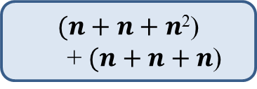
Insertion Sort
Similar can be seen with Insertion Sort
Recall:
  Insertion-sort is the variation of PQ-sort where the priority queue is implemented with a sorted sequence
1
2
3
4
5
Algorithm PriorityQueueSort (S, PQ):
while ! S.empty() do
item := S.removeFirst()
PQ.insertItem(item.key, item.data)
while ! PQ.empty do
item := PQ.removeItem() // e.g. PQ.removeMin()
S.insertLast(item)
$(n+n+n$²)
+ $(n+n+n$)

Slide 74
Insertion Sort
Similar can be seen with Insertion Sort
Recall:
  Insertion-sort is the variation of PQ-sort where the priority queue is implemented with a sorted sequence
1
2
3
4
5
Algorithm PriorityQueueSort (S, PQ):
while ! S.empty() do
item := S.removeFirst()
PQ.insertItem(item.key, item.data)
while ! PQ.empty do
item := PQ.removeItem() // e.g. PQ.removeMin()
S.insertLast(item)
$5n+n$²

Slide 75
Insertion Sort
Similar can be seen with Insertion Sort
Recall:
  Insertion-sort is the variation of PQ-sort where the priority queue is implemented with a sorted sequence
1
2
3
4
5
Algorithm PriorityQueueSort (S, PQ):
while ! S.empty() do
item := S.removeFirst()
PQ.insertItem(item.key, item.data)
while ! PQ.empty do
item := PQ.removeItem() // e.g. PQ.removeMin()
S.insertLast(item)
$5n+n$²
O(n²)

Slide 76

Marker Slide
Questions on:
  Trees
  Priority Queues
    Setting up for ‘generic’ sorting algorithm
      Where performance depends on the data structure being used
    Implementations
      Unordered List and Selection Sort
      Ordered List and Insertion Sort
      Heap very soon (and Heap Sort← In the Future)
Next:
  Heap
  Implementing a Heap

Slide 77
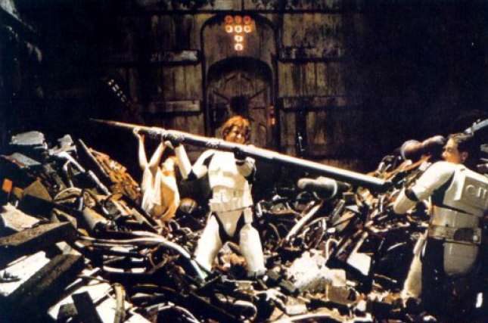
A Better Implementation of PQs
Priority Queues can be implemented using
a Binary Heap (or just Heap for now)
A Heap is a binary tree with two properties
  Structure Property
  Heap-Order Property
    Max Heap
    Min Heap

Slide 78
Structure Property
A Heap
is a complete
binary tree
Root
When a complete
binary tree is built,
its first node must be
the root.

Slide 79
Structure Property
A Heap
is a complete
binary tree
Left child
of the
root
The second node is
always the left child
of the root.

Slide 80
Structure Property
A Heap
is a complete
binary tree
Right child
of the
root
The third node is
always the right child
of the root.

Slide 81
Structure Property
A Heap
is a complete
binary tree
The next nodes
always fill the next
level from left-to-right.

Slide 82
Structure Property
A Heap
is a complete
binary tree
The next nodes
always fill the next
level from left-to-right.

Slide 83
Structure Property
A Heap
is a complete
binary tree
The next nodes
always fill the next
level from left-to-right.

Slide 84
Structure Property
A Heap
is a complete
binary tree
The next nodes
always fill the next
level from left-to-right.

Slide 85
Structure Property
A Heap
is a complete
binary tree

Slide 86
Structure Property
A Heap
is a complete
binary tree
45
35
23
27
21
22
4
19
Each node in a heap
contains a key that
can be compared to
other nodes' keys.

Slide 87
Heap Order Property
45
For a “MaxHeap”
The key value of each node is at least as large as the key value of its children.
The root of the heap is the largest value in the tree
35
23
27
21
22
4
19
The “max heap property"
requires that each
node's key is >= the
keys of its children

Slide 88
Heap Order Property
4
For a “MinHeap”
The key value of each node is the same or smaller than the key value of its children.
The root of the heap is the smallest value in the tree
19
22
27
21
23
45
35
The “min heap property"
requires that each
node's key is <= the
keys of its children

Slide 89
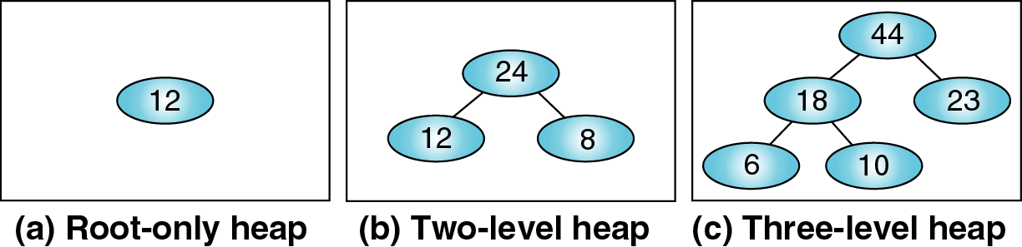
Max Heap Examples

Slide 90
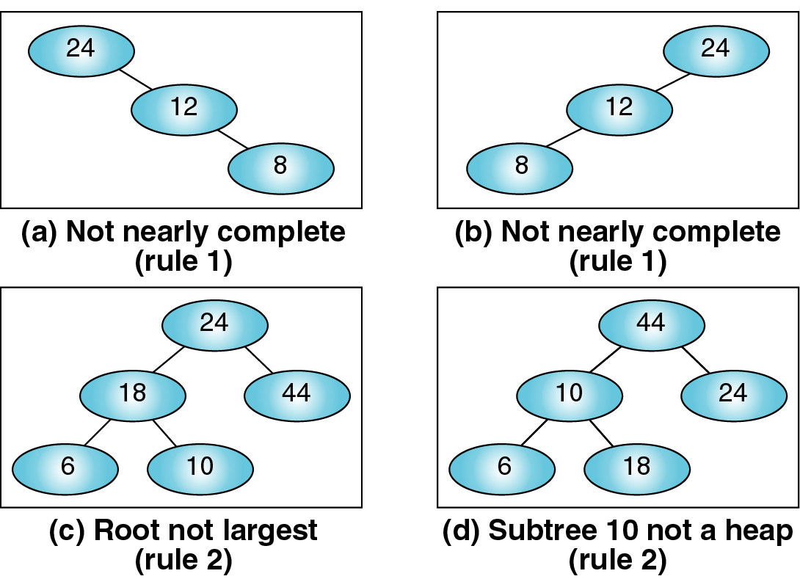
Not Max Heaps
Not complete
Not complete
Root NOT largest
Sub-tree 10 not a heap

Slide 91
Heaps Can Implement PQs
So how does one implement a heap?

Slide 92
Marker Slide
Questions on:
  Trees
  Priority Queues
    Generic Sorting Setup
    Implementations
      Unordered List and Selection Sort
      Ordered List and Insertion Sort
  Heap
Next:
  Implementing a Heap

Slide 93
Heap Implementation
A heap could be implemented using a regular binary tree (left and right child pointers)
However a heap is a complete binary tree
  So we can use an array or vector instead
Class Exercise:
Draw a complete binary tree
with 5 to 9 nodes
Pause for class to
draw a complete binary tree
with 5 to 9 nodes…
Hint: I’m going to go with 6

Slide 94
Heap Implementation
A heap could be implemented using a regular binary tree (left and right child pointers)
However a heap is a complete binary tree
  So we can use an array or vector instead
Class Exercise:
Draw a complete binary tree
with 5 to 9 nodes

Slide 95
Heap Implementation
A heap could be implemented using a regular binary tree (left and right child pointers)
However a heap is a complete binary tree
  So we can use an array or vector instead
Class Exercise:
Number the nodes
Start with 0 for the root
Its left child is 1
Its right child is 2
And keep going
numbering Left to Right
0
1
2
3
4
5

Slide 96
Heap Implementation
A heap could be implemented using a regular binary tree (left and right child pointers)
However a heap is a complete binary tree
  So we can use an array or vector instead
Class Exercise:
Notice any node with index i
its parent node is at (i-1)/2
its left child is at 2i + 1
its right child is at 2i + 2
0
1
2
3
4
5

Slide 97
Heap Implementation
A heap could be implemented using a regular binary tree (left and right child pointers)
However a heap is a complete binary tree
  So we can use an array or vector instead
Class Exercise:
Notice for any node with index i
its parent node is at (i-1)/2
its left child is at 2i + 1
its right child is at 2i + 2
Parent
⎣(i-1)/2⎦
i
Optional:
Draw a NON-complete binary
tree with 5 to 9 nodes
Show this index relation fails to hold
2i+1
Left Child
2i+2
Right Child

Slide 98
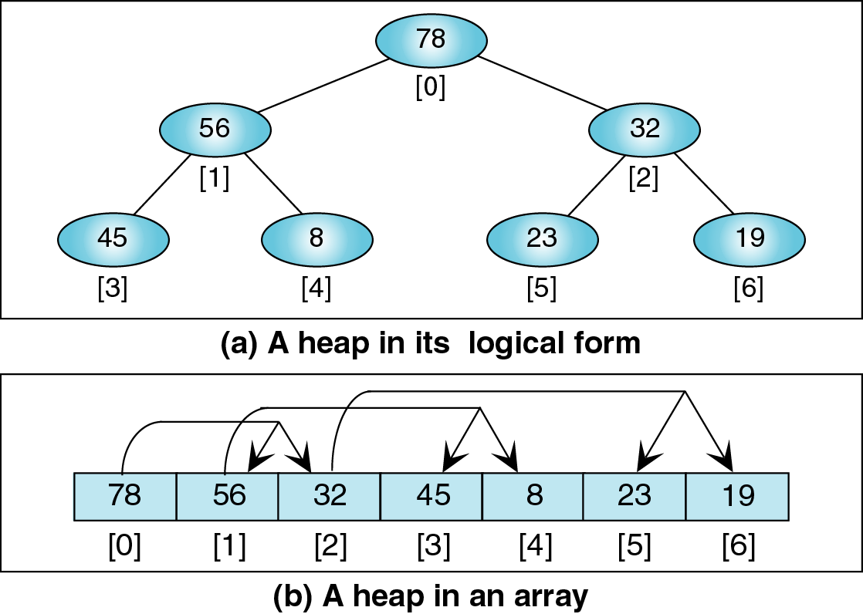
Using a Vector to Implement a Heap

Slide 99
Using a Vector to Implement a Heap

Slide 100
Using a Vector to Implement a Heap

Slide 101
Using a Vector to Implement a Heap

Slide 102
Using a Vector to Implement a Heap

Slide 103
Using a Vector to Implement a Heap

Slide 104
Using a Vector to Implement a Heap

Slide 105
Using a Vector to Implement a Heap

Slide 106
The End of This Part
End

