Slide 1
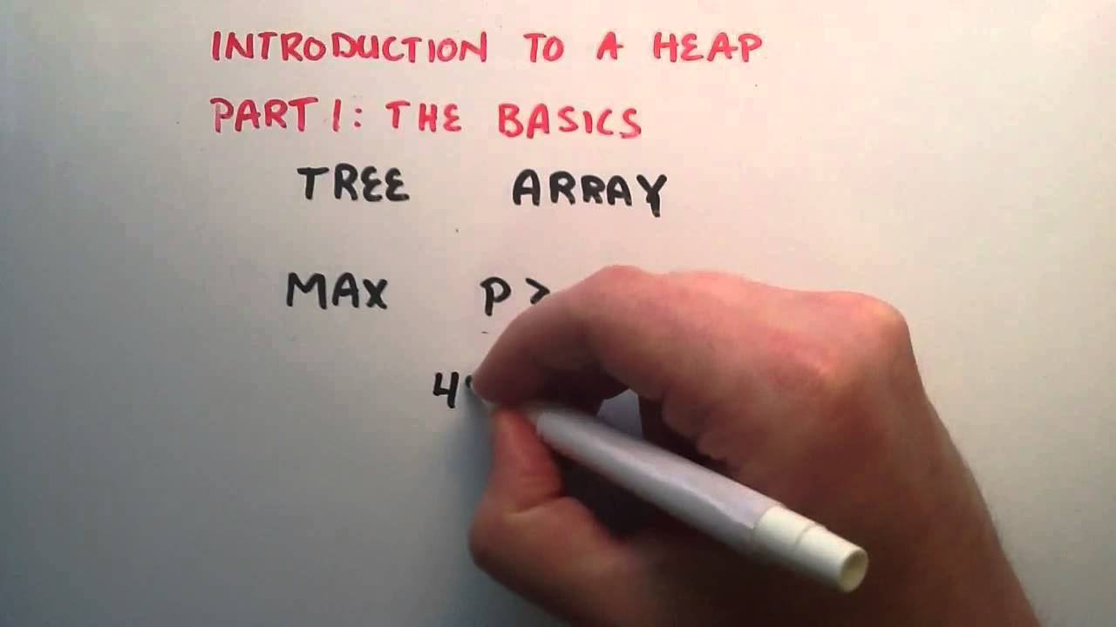
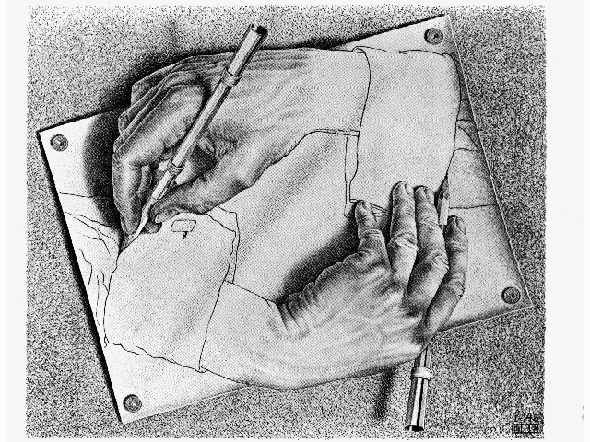
Priority Queues and Heaps
CS 244
Brent M. Dingle, Ph.D.
Game Design and Development Program
Department of Mathematics, Statistics, and Computer Science
University of Wisconsin – Stout
Content derived from: Data Structures Using C++ (D.S. Malik)
and Data Structures and Algorithms in C++ (Goodrich, Tamassia, Mount)c

Slide 2
Previously
Priority Queues
Implemented as Unordered List
Ordered List
Heap ← waiting for this
Heap Description

Slide 3
Marker Slide
General Questions?
Next:
Heap Review
What is a heap
How to implement a Heap
Priority Queue Implementation
Using a Heap

Slide 4
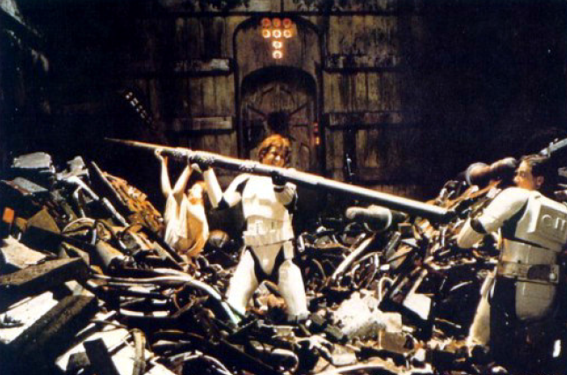
A Better Implementation of PQs
Priority Queues can be implemented using a Binary Heap (or just Heap for now)
A Heap is a binary tree with two properties
Structure Property
Heap-Order Property
Max Heap
Min Heap

Slide 5
Structure Property
A Heap is a complete binary tree
Root
When a complete
binary tree is built,
its first node must be
the root.

Slide 6
Structure Property
A Heap is a complete binary tree
Left child
of the
root
The second node is
always the left child
of the root.

Slide 7
Structure Property
A Heap is a complete binary tree
Right child
of the
root
The third node is
always the right child
of the root.

Slide 8
Structure Property
A Heap is a complete binary tree
The next nodes
always fill the next
level from left-to-right.

Slide 9
Structure Property
A Heap is a complete binary tree
The next nodes
always fill the next
level from left-to-right.

Slide 10
Structure Property
A Heap is a complete binary tree
The next nodes
always fill the next
level from left-to-right.

Slide 11
Structure Property
A Heap is a complete binary tree
The next nodes
always fill the next
level from left-to-right.

Slide 12
Structure Property
A Heap is a complete binary tree

Slide 13
Structure Property
A Heap is a complete binary tree
45
35
23
27
21
22
4
19
Each node in a heap
contains a key that
can be compared to
other nodes' keys.

Slide 14
Heap Order Property
45
For a “MaxHeap”
The key value of each node is at least as large as the key value of its children.
The root of the heap is the largest value in the tree
35
23
27
21
22
4
19
The “max heap property"
requires that each
node's key is >= the
keys of its children

Slide 15
Heap Order Property
4
For a “MinHeap”
The key value of each node is the same or smaller than the key value of its children.
The root of the heap is the smallest value in the tree
19
22
27
21
23
45
35
The “min heap property"
requires that each
node's key is <= the
keys of its children

Slide 16
Max Heap Examples

Slide 17
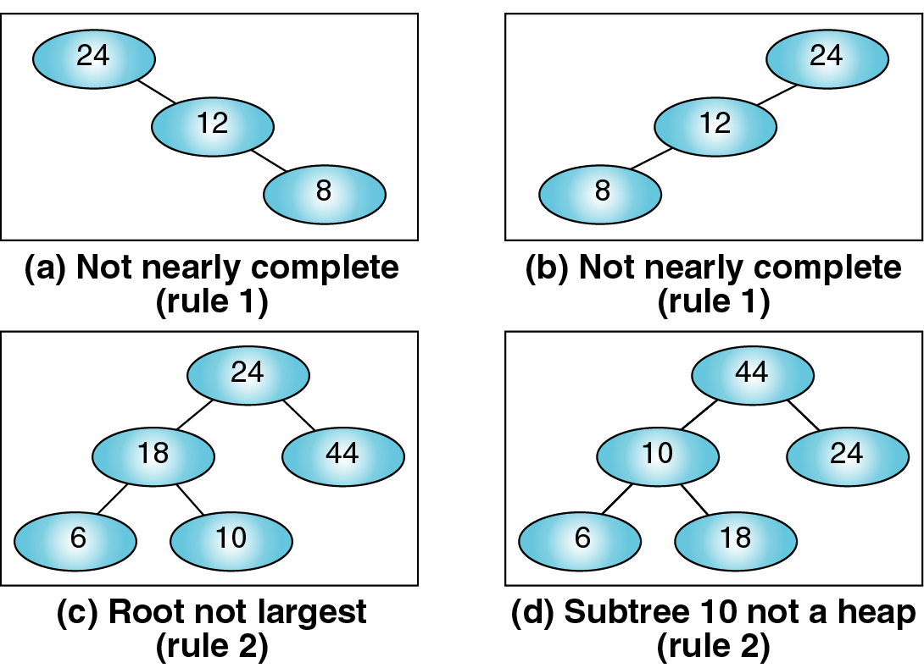
Not Max Heaps
Not complete
Not complete
Root NOT largest
Sub-tree 10 not a heap

Slide 18
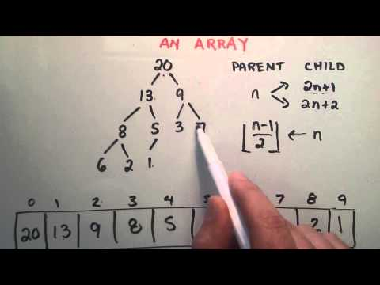
Heaps Can Implement PQs
But first: how does one implement a heap?

Slide 19
Marker Slide
Questions On:
Heap Review
What is a heap
Next:
Heap Review
How to implement a Heap
Priority Queue Implementation
Using a Heap

Slide 20
Heap Implementation
A heap could be implemented using a regular binary tree (left and right child pointers)
However a heap is a complete binary tree
So we can use an array or vector instead
Notice any node with index i
its parent node is at (i-1)/2
its left child is at 2i + 1
its right child is at 2i + 2
0
1
2
3
4
5

Slide 21
Heap Implementation
A heap could be implemented using a regular binary tree (left and right child pointers)
However a heap is a complete binary tree
So we can use an array or vector instead
Parent
⎣(i-1)/2⎦
Notice for any node with index i
its parent node is at (i-1)/2
its left child is at 2i + 1
its right child is at 2i + 2
i
Optional:
Draw a NON-complete binary
tree with 5 to 9 nodes
Show this index relation fails to hold
2i+1
Left Child
2i+2
Right Child

Slide 22
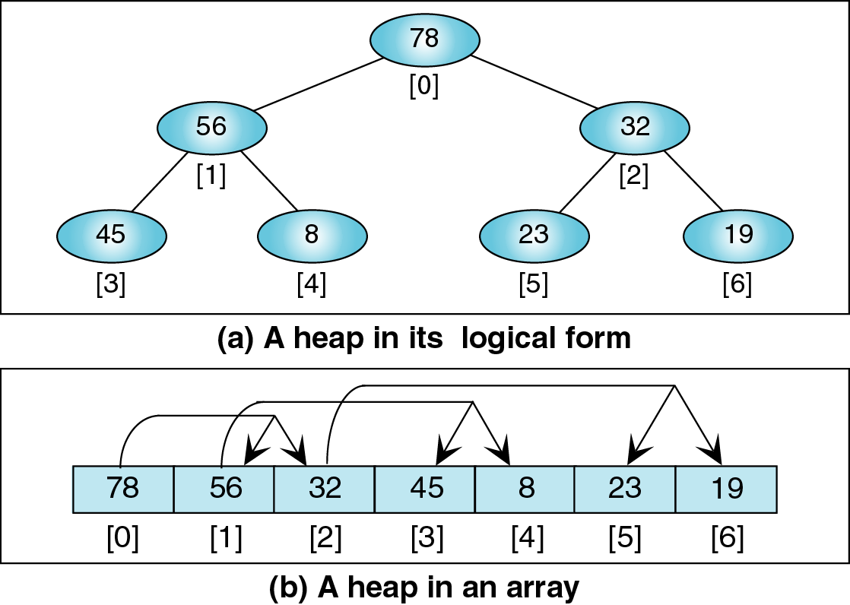
Using a Vector to Implement a Heap

Slide 23
Using a Vector to Implement a Heap

Slide 24
Using a Vector to Implement a Heap

Slide 25
Using a Vector to Implement a Heap

Slide 26
Using a Vector to Implement a Heap

Slide 27
Using a Vector to Implement a Heap

Slide 28
Using a Vector to Implement a Heap

Slide 29
Using a Vector to Implement a Heap

Slide 30
Marker Slide
Questions On:
Heap Review
What is a heap
How to implement a Heap
Next:
Priority Queue Implementation
Using a Heap

Slide 31
A Priority Queue Implemented with a Heap
As mentioned a PQ can be implemented using a Heap.
Each node of the heap contains one item (key and data)
Each node is keyed on priority
So in a max heap the item with the largest key is the root node
For the heap to be a priority queue we must also have 2 functions implemented
insertItem(item)
aka enqueue(entry)
adds item to the heap and readjusts tree as needed
removeItem()
aka dequeue()
removes the highest priority item from the heap (the root) and readjusts the tree as needed

Slide 32
PQ implemented as a Heap
The two PQ functions
insertItem(item)
removeItem()
Really are just inserting and removing a node respectively from the heap
Requires two support functions:
reheapUp
reheapDown
Examples follow

Slide 33
Priority Queue insertItem Algorithm
insertItem(e)
put e at the end of the heap (at index heap.size()-1)
reheapUp(heap.size()-1)
Maintains complete binary tree
Maintains heap order

Slide 34
Priority Queue insertItem Algorithm
insertItem(e)
put e at the end of the heap (at index heap.size()-1)
reheapUp(heap.size()-1)
reheapUp(index)
while e is not in the root && e.key > parent(e).key
swap e with its parent
Notice this swap can occur a maximum number of times equal to the height of the tree
lg N times, where N = number of nodes in the tree
Maintains complete binary tree
Maintains heap order

Slide 35
insertItem Example
Vector Representation
Here is an initial heap.
45
[0]
45
[1]
35
35
23
[2]
23
[3]
27
27
21
22
4
[4]
21
[5]
22
[6]
4
19
5
[7]
19
[8]
5
[9]
??
[10]
??

Slide 36
insertItem Example
Vector Representation
Insert 42 as leaf at back of vector.
45
[0]
45
[1]
35
35
23
[2]
23
[3]
27
27
21
22
4
[4]
21
[5]
22
[6]
4
19
5
42
[7]
19
[8]
5
[9]
42
[10]
??

Slide 37
insertItem Example
Vector Representation
Insert 42 as leaf at back of vector.
45
[0]
45
[1]
35
35
23
[2]
23
[3]
27
27
21
22
4
[4]
21
[5]
22
[6]
4
19
5
42
[7]
19
[8]
5
Fails the heap property
[9]
42
[10]
??

Slide 38
insertItem Example
Vector Representation
Shift 42 up above its parent 21.
45
[0]
45
[1]
35
35
23
[2]
23
[3]
27
27
21
22
4
[4]
21
[5]
22
[6]
4
19
5
42
[7]
19
[8]
5
[9]
42
[10]
??

Slide 39
insertItem Example
Vector Representation
Shift 42 up above its parent 21.
45
[0]
45
[1]
35
35
23
[2]
23
[3]
27
27
42
22
4
[4]
42
[5]
22
[6]
4
19
5
21
[7]
19
[8]
5
Fails the heap property
[9]
21
[10]
??

Slide 40
insertItem Example
Vector Representation
Shift 42 up above its parent 35.
45
[0]
45
[1]
35
35
23
[2]
23
[3]
27
27
42
22
4
[4]
42
[5]
22
[6]
4
19
5
21
[7]
19
[8]
5
[9]
21
[10]
??

Slide 41
insertItem Example
Vector Representation
Shift 42 up above its parent 35.
45
[0]
45
[1]
42
42
23
[2]
23
[3]
27
27
35
22
4
[4]
35
[5]
22
[6]
4
19
5
21
[7]
19
[8]
5
Satisfies the heap property
[9]
21
[10]
??

Slide 42
Priority Queue removeItem() algorithm
removeItem
extract the element from the root
put the element p from the last leaf in its place
i.e. move last element to be the root
remove the last leaf
reheapDown(0, p)
Maintains complete binary tree
Maintains heap order

Slide 43
Priority Queue removeItem() algorithm
removeItem
extract the element from the root
put the element p from the last leaf in its place
i.e. move last element to be the root
remove the last leaf
reheapDown(0, p)
reheapDown(index, p)
while node (p) is not a leaf && p.key < any child’s key
swap p with child that has largest key
Maintains complete binary tree
Maintains heap order

Slide 44
removeItem Example
Vector
Remove and return the largest value 45.
45
[0]
45
[1]
42
42
23
[2]
23
[3]
27
27
35
22
4
[4]
35
[5]
22
[6]
4
19
5
21
[7]
19
[8]
5
[9]
21
[10]
??

Slide 45
removeItem Example
Vector
Put last (back) element 21 in the root node
[0]
[1]
42
42
23
[2]
23
[3]
27
27
35
22
4
[4]
35
[5]
22
[6]
4
19
5
21
[7]
19
[8]
5
[9]
21
[10]
??

Slide 46
removeItem Example
Vector
Put last (back) element 21 in the root node
21
[0]
21
[1]
42
42
23
[2]
23
[3]
27
27
35
22
4
[4]
35
[5]
22
[6]
4
19
5
[7]
19
[8]
5
[9]
??
[10]
??

Slide 47
removeItem Example
Vector
Replace 21 with its largest child 42.
21
[0]
21
[1]
42
42
23
[2]
23
[3]
27
27
35
22
4
[4]
35
[5]
22
[6]
4
19
5
[7]
19
[8]
5
[9]
??
[10]
??

Slide 48
removeItem Example
Vector
Replace 21 with its largest child 42.
42
[0]
42
[1]
21
21
23
[2]
23
[3]
27
27
35
22
4
[4]
35
[5]
22
[6]
4
19
5
[7]
19
[8]
5
[9]
??
[10]
??

Slide 49
removeItem Example
Vector
Replace 21 with its largest child 35.
42
[0]
42
[1]
21
21
23
[2]
23
[3]
27
27
35
22
4
[4]
35
[5]
22
[6]
4
19
5
[7]
19
[8]
5
[9]
??
[10]
??

Slide 50
removeItem Example
Vector
Replace 21 with its largest child 35.
42
[0]
42
[1]
35
35
23
[2]
23
[3]
27
27
21
22
4
[4]
21
[5]
22
[6]
4
19
5
[7]
19
[8]
5
[9]
??
[10]
??

Slide 51
Summary of Heaps
A Max Heap
is a complete binary tree
key value of each node is at least as large as its children
So the root of the heap has the largest value
A heap can be implemented using an array
reheapUp maintains the heap on insertItem
reheapDown maintains the heap on removeItem
A priority queue can be implemented as a heap

Slide 52
Sorting And Priority Queues
Didn’t we mention something about sorting using priority queues there at the beginning…
Must still be in the future…

Slide 53
The End of This Part
End

