Slide 1
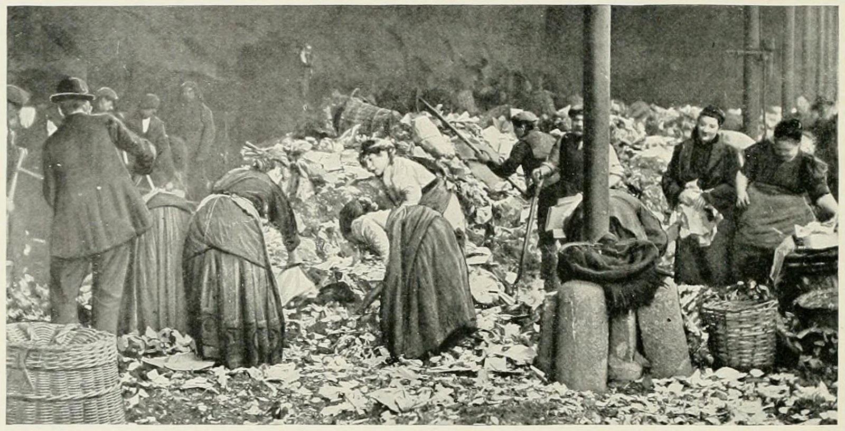
Heap Sorting and Building
CS 244
Brent M. Dingle, Ph.D.
Game Design and Development Program
Department of Mathematics, Statistics, and Computer Science
University of Wisconsin – Stout
Content derived from: Data Structures Using C++ (D.S. Malik)
and Data Structures and Algorithms in C++ (Goodrich, Tamassia, Mount)c

Slide 2
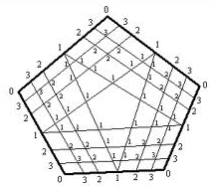
From Last Time
We were talking about Priority Queues (PQs)
Three implementations
unordered list
ordered list
heap (binary tree via vectors)
The associated sorting routines
selection sort
insertion sort
heap sort ← we were almost here
point priority distribution

Slide 3
Marker Slide
General Questions?
Next
Summary Review
PQs
Heaps
PQ Sorting
Unsorted List → Selection Sort
Sorted List → Insertion Sort
Heap Sort

Slide 4
Summary: List-based Priority Queue
Unsorted list implementation
Store the items of the priority queue in a list-based sequence, in arbitrary order
Performance:
insertItem takes O(1) time since we can insert the item at the beginning or end of the sequence
removeMin, minKey and minElement take O(n) time since we have to traverse the entire sequence to find the smallest key
sorted list implementation
Store the items of the priority queue in a sequence, sorted by key
Performance:
insertItem takes O(n) time since we have to find the place where to insert the item
removeMin, minKey and minElement take O(1) time since the smallest key is at the beginning of the sequence
4
5
2
3
1
1
2
3
4
5
Using an unsorted list implementation
and performing a PQ sort with it results
in a SELECTION sort
Using a sorted list implementation
and performing a PQ sort with it results
in a INSERTION sort

Slide 5
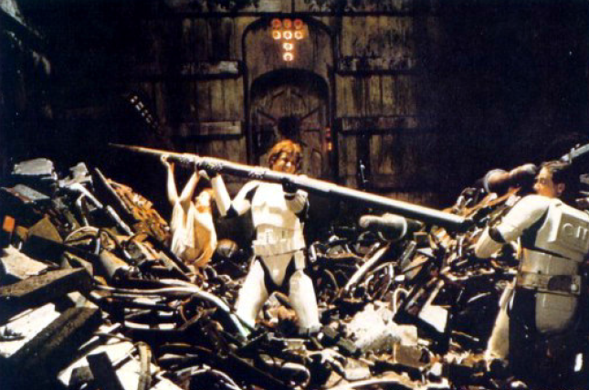
A Better Implementation of PQs
Priority Queues can be implemented using a Binary Heap (or just Heap for now)
A Heap is a binary tree with two properties
Structure Property
Heap-Order Property
Max Heap
Min Heap

Slide 6
Structure Property
45
A Heap is a complete binary tree
35
23
27
21
22
4
19
Each node in a heap
contains a key that
can be compared to
other nodes' keys.

Slide 7
Heap Order Property
45
For a “MaxHeap”
The key value of each node is at least as large as the key value of its children.
The root of the heap is the largest value in the tree
35
23
27
21
22
4
19
The “max heap property"
requires that each
node's key is >= the
keys of its children

Slide 8
Heap Order Property
4
For a “MinHeap”
The key value of each node is the same or smaller than the key value of its children.
The root of the heap is the smallest value in the tree
19
22
27
21
23
45
35
The “min heap property"
requires that each
node's key is <= the
keys of its children

Slide 9
Heap Implemented as a Vector
Because a Heap is a Complete Binary Tree
We can implement a Heap using a vector
i.e. no need for traditional tree nodes with left and right pointers
instead we can use a node’s index to locate its parent and children
Parent
⎣(i-1)/2⎦
i
2i+1
Left Child
2i+2
Right Child

Slide 10
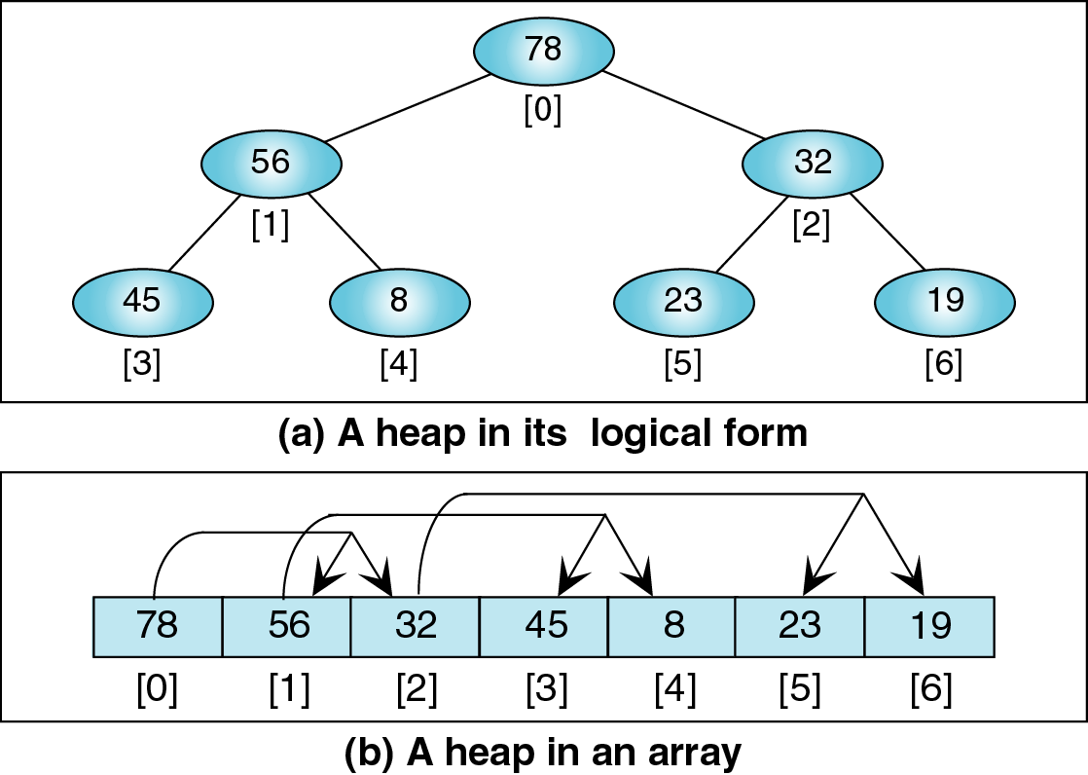
Using a Vector to Implement a Heap

Slide 11
Using a Vector to Implement a Heap

Slide 12
Using a Vector to Implement a Heap

Slide 13
Using a Vector to Implement a Heap

Slide 14
Using a Vector to Implement a Heap

Slide 15
Using a Vector to Implement a Heap

Slide 16
Using a Vector to Implement a Heap

Slide 17
A Priority Queue Implemented with a Heap
As mentioned a PQ can be implemented using a Heap.
Each node of the heap contains one item (key and data)
Each node is keyed on priority
So in a max heap the item with the largest key is the root node
For the heap to be a priority queue we must also have 2 functions implemented
insertItem(item)
aka enqueue(entry) – adds item to the heap and readjusts tree as needed
removeItem()
aka dequeue()
removes the highest priority item from the heap (the root) and readjusts the tree as needed
See previous lecture for examples

Slide 18
Marker Slide
Questions on:
Summary Review
PQs
Heaps
PQ Sorting
Unsorted List → Selection Sort
Sorted List → Insertion Sort
Next
Heap Sort
Example
Analysis
Building Heaps

Slide 19
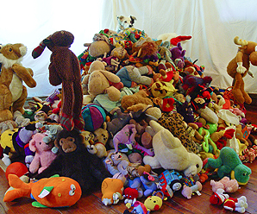
Sorting And Priority Queues
Didn’t we mention something about sorting using priority queues there at the beginning…
NOT Sorted

Slide 20
What did we have to work with?
Priority Queues as
unordered lists
ordered lists
heaps (complete binary trees)
What was the algorithm thing for sorting with Priority Queues…

Slide 21
Sorting Using a PQ
Given a sequence of N items
a PQ can be used to sort the sequence:
Step 1
Insert N items into the PQ via insertItem(key, data)
Step 2
Remove the items by calling removeItem() N times
The first remove removes the largest item, the second call the second largest, … the last removes the smallest item

Slide 22
Sorting Using a PQ
Given a sequence of N items
a PQ can be used to sort the sequence:
Step 1
Insert N items into the PQ via insertItem(key, data)
Step 2
Remove the items by calling removeItem() N times
The first remove removes the largest item, the second call the second largest, … the last removes the smallest item
Algorithm PriorityQueueSort (S, PQ):
Input: Sequence, S, of n items, and empty priority queue, PQ.
Output: Sequence S sorted by the total order relation.
while ! S.empty() do
item := S.removeFirst()
PQ.insertItem(item.key, item.data)
while ! PQ.empty do
item := PQ.removeItem()
S.insertLast(item)

Slide 23
Heap Sort – Perspective
Heap sort is a sorting algorithm that combines the benefits of quick sort and merge sort.
It is O( n * lg n ) in the worse case like merge sort.
It does not need extra space.
Heap sort is like selection sort because it always finds the largest value, then 2nd largest, and so on, but in a much more efficient manner.
First transform the array into a heap
Repeatedly extracting the largest value in the heap
Place it in the correct sorted order at the end of the array.
While useful information the MAJOR take away of this is the runtime
Knowing how it relates to other sorts is also useful.
How it compares to them is even more so.
Notes:
This information is mostly FYI… key take away is the runtime is O(nlgn)

Slide 24
Heap Sort – Verbose Algorithm
Heap sort algorithm:
Treat the unsorted array as a complete binary tree.
Convert the array (complete binary tree) into a heap.
Elements in the heap are unsorted, and as we remove elements from the heap, we will build a sorted array with the largest values at the end of the array.
Keep track of the number of unsorted elements (heap size).
while (unsorted >1)
Remove the top element (data[0]) of the heap.
Swap it with the last unsorted element (data[unsorted-1]).
The heap now has an out-of-place element in the root. Perform reheapDown to rebuild the heap.
Relate this to a PQ Sort
This is a description of Heap Sort
It can be better/also described as a PQ Sort Implemented Using a Heap
Just as Selection Sort is a PQ Sort implemented using an Unordered Sequence
and Insertion Sort is a PQ implemented using an Ordered Sequence
Notes:
This too is mostly FYI. It shows how one *might* describe Heap Sort. The key in this and the next slides is how it really is just a Priority Queue Sort Implemented using a Heap.
Much as Selection Sort was PQ Sort using an Unordered List and Insertion Sort was a PQ sort using an ordered List

Slide 25
Heap Sort Example
We are given a sequence of integer values
They are stored in a vector (or array) as shown to the right
We are to sort the vector using a Heap Sort
Rather we will
Use a Heap
To Implement a PQ Sort
Vector or Array
[0]
5
[1]
10
[2]
3
[3]
4
[4]
7
[5]
5
[6]
1
[7]
6
[8]
8
[9]
2
[10]
9
count

Slide 26
Heap Sort Example
If we used the array “as given” this is the tree we would get:
Vector or Array
5
[0]
5
[1]
10
10
3
[2]
3
[3]
4
4
7
5
1
[4]
7
[5]
5
[6]
1
6
8
2
9
[7]
6
Not a Heap – we must turn it into one
We will now begin adding elements
[8]
8
[9]
2
[10]
9
count

Slide 27
Heap Sort Example
Array Representation
First element is a heap.
5
[0]
5
count
[1]
10
So begins Phase 1
[2]
3
[3]
4
Algorithm PriorityQueueSort (S, PQ):
while ! S.empty() do
item := S.removeFirst()
PQ.insertItem(item.key, item.data)
while ! PQ.empty do
item := PQ.removeItem()
S.insertLast(item)
[4]
7
[5]
5
[6]
1
[7]
6
[8]
8
[9]
2
[10]
9

Slide 28
Heap Sort Example
Array Representation
Add second element.
5
[0]
5
[1]
10
10
count
[2]
3
[3]
4
[4]
7
[5]
5
[6]
1
[7]
6
[8]
8
[9]
2
[10]
9

Slide 29
Heap Sort Example
Array Representation
Perform reheapification upward.
10
[0]
10
[1]
5
count
[2]
3
5
[3]
4
[4]
7
[5]
5
[6]
1
[7]
6
[8]
8
[9]
2
[10]
9

Slide 30
Heap Sort Example
Array Representation
Add 3rd element.
10
[0]
10
[1]
5
5
3
[2]
3
[3]
4
[4]
7
count
[5]
5
[6]
1
[7]
6
[8]
8
[9]
2
[10]
9

Slide 31
Heap Sort Example
Array Representation
Add 4th element.
10
[0]
10
[1]
5
5
3
[2]
3
[3]
4
4
[4]
7
[5]
5
count
[6]
1
[7]
6
[8]
8
[9]
2
[10]
9

Slide 32
Heap Sort Example
Array Representation
Add 5th element.
10
[0]
10
[1]
5
5
3
[2]
3
[3]
4
4
7
[4]
7
count
[5]
5
[6]
1
[7]
6
[8]
8
[9]
2
[10]
9

Slide 33
Heap Sort Example
Array Representation
Perform reheapification upward.
10
[0]
10
[1]
7
7
3
[2]
3
[3]
4
4
5
[4]
5
count
[5]
5
[6]
1
[7]
6
[8]
8
[9]
2
[10]
9

Slide 34
Heap Sort Example
Array Representation
Add 6th element.
10
[0]
10
[1]
7
7
3
[2]
3
[3]
4
4
5
5
[4]
5
[5]
5
count
[6]
1
[7]
6
[8]
8
[9]
2
[10]
9

Slide 35
Heap Sort Example
Array Representation
Perform shift up.
10
[0]
10
[1]
7
7
5
[2]
5
[3]
4
4
5
3
[4]
5
[5]
3
count
[6]
1
[7]
6
[8]
8
[9]
2
[10]
9

Slide 36
Heap Sort Example
Array Representation
Perform shift up.
10
[0]
10
[1]
7
7
5
[2]
5
[3]
4
4
5
3
[4]
5
[5]
3
count
[6]
1
[7]
6
[8]
8
[9]
2
[10]
9

Slide 37
Heap Sort Example
Array Representation
Add 7th element.
10
[0]
10
[1]
7
7
5
[2]
5
[3]
4
4
5
3
1
[4]
5
[5]
3
[6]
1
count
[7]
6
[8]
8
[9]
2
[10]
9

Slide 38
Heap Sort Example
Array Representation
Add 8th element.
10
[0]
10
[1]
7
7
5
[2]
5
[3]
4
4
5
3
1
[4]
5
[5]
3
[6]
1
6
[7]
6
count
[8]
8
[9]
2
[10]
9

Slide 39
Heap Sort Example
Array Representation
Perform shift up.
10
[0]
10
[1]
7
7
5
[2]
5
[3]
6
6
5
3
1
[4]
5
[5]
3
[6]
1
4
[7]
4
count
[8]
8
[9]
2
[10]
9

Slide 40
Heap Sort Example
Array Representation
Add 9th element.
10
[0]
10
[1]
7
7
5
[2]
5
[3]
6
6
5
3
1
[4]
5
[5]
3
[6]
1
4
8
[7]
4
[8]
8
count
[9]
2
[10]
9

Slide 41
Heap Sort Example
Array Representation
Perform shift up.
10
[0]
10
[1]
8
8
5
[2]
5
[3]
7
7
5
3
1
[4]
5
[5]
3
[6]
1
4
6
[7]
4
[8]
6
count
[9]
2
[10]
9

Slide 42
Heap Sort Example
Array Representation
Add 10th element.
10
[0]
10
[1]
8
8
5
[2]
5
[3]
7
7
5
3
1
[4]
5
[5]
3
[6]
1
4
6
2
[7]
4
[8]
6
[9]
2
count
[10]
9

Slide 43
Heap Sort Example
Array Representation
Add last element.
10
[0]
10
[1]
8
8
5
[2]
5
[3]
7
7
5
3
1
[4]
5
[5]
3
[6]
1
4
6
2
9
[7]
4
[8]
6
[9]
2
[10]
9
count

Slide 44
Heap Sort Example
Array Representation
Perform shift up.
10
[0]
10
[1]
9
9
5
[2]
5
[3]
7
7
8
3
1
[4]
8
[5]
3
[6]
1
4
6
2
5
[7]
4
[8]
6
[9]
2
[10]
5
count

Slide 45
Heap Creation Complete
We have created the Heap
Phase 1 is complete
We will now dequeue or rather removeItems and store them at the “end” of the array in order
So ends Phase 1
Algorithm PriorityQueueSort (S, PQ):
while ! S.empty() do
item := S.removeFirst()
PQ.insertItem(item.key, item.data)
while ! PQ.empty do
item := PQ.removeItem()
S.insertLast(item)

Slide 46
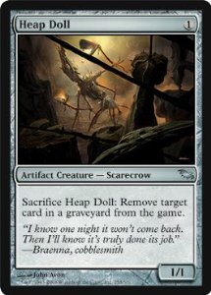
Heap Creation Complete
We have created the Heap
Phase 1 is complete
We will now removeItems and store them at the “end” of the array in order
And Phase 2 will begin
Algorithm PriorityQueueSort (S, PQ):
while ! S.empty() do
item := S.removeFirst()
PQ.insertItem(item.key, item.data)
while ! PQ.empty do
item := PQ.removeItem()
S.insertLast(item)

Slide 47
Heap Sort Example
Array Representation
Dequeue 10
10
[0]
10
[1]
9
9
5
[2]
5
[3]
7
7
8
3
1
[4]
8
[5]
3
[6]
1
4
6
2
5
[7]
4
[8]
6
[9]
2
[10]
5
count

Slide 48
Heap Sort Example
Array Representation
Swap heap top with last unsorted.
5
[0]
5
[1]
9
9
5
[2]
5
[3]
7
7
8
3
1
[4]
8
[5]
3
[6]
1
4
6
2
10
removed from heap
[7]
4
[8]
6
[9]
2
unsorted
[10]
10

Slide 49
Heap Sort Example
Array Representation
Perform reheapification down.
9
[0]
9
[1]
8
8
5
[2]
5
[3]
7
7
5
3
1
[4]
5
[5]
3
[6]
1
4
6
2
[7]
4
[8]
6
unsorted
[9]
2
[10]
10

Slide 50
Heap Sort Example
Array Representation
Swap heap top with last unsorted.
2
[0]
2
[1]
8
8
5
[2]
5
[3]
7
7
5
3
1
[4]
5
[5]
3
[6]
1
4
6
9
[7]
4
[8]
6
unsorted
[9]
9
[10]
10

Slide 51
Heap Sort Example
Array Representation
Perform shift down.
8
[0]
8
[1]
7
7
5
[2]
5
[3]
6
6
5
3
1
[4]
5
[5]
3
[6]
1
4
2
[7]
4
unsorted
[8]
2
[9]
9
[10]
10

Slide 52
Heap Sort Example
Array Representation
Swap heap top with last unsorted.
2
[0]
2
[1]
7
7
5
[2]
5
[3]
6
6
5
3
1
[4]
5
[5]
3
[6]
1
4
8
[7]
4
unsorted
[8]
8
[9]
9
[10]
10

Slide 53
Heap Sort Example
Array Representation
Perform shift-down.
7
[0]
7
[1]
6
6
5
[2]
5
[3]
4
4
5
3
1
[4]
5
[5]
3
[6]
1
2
unsorted
[7]
2
[8]
8
[9]
9
[10]
10

Slide 54
Heap Sort Example
Array Representation
Swap heap top with last unsorted.
2
[0]
2
[1]
6
6
5
[2]
5
[3]
4
4
5
3
1
[4]
5
[5]
3
[6]
1
7
unsorted
[7]
7
[8]
8
[9]
9
[10]
10

Slide 55
Heap Sort Example
Array Representation
Perform shift down.
6
[0]
6
[1]
5
5
5
[2]
5
[3]
4
4
2
3
1
[4]
2
[5]
3
unsorted
[6]
1
[7]
7
[8]
8
[9]
9
[10]
10

Slide 56
Some Steps Skipped
And we cut… fade out to black
… fade back in and we will be on the last step

Slide 57
Heap Sort Example
Array Representation
Last step.
1
unsorted
[0]
1
[1]
2
[2]
3
[3]
4
[4]
5
[5]
5
[6]
6
[7]
7
[8]
8
[9]
9
[10]
10

Slide 58
Marker Slide
Questions on:
Summary Review
PQs
Heaps
PQ Sorting
Unsorted List → Selection Sort
Sorted List → Insertion Sort
Heap Sort
Example
Next
Heap Sort
Analysis
Building Heaps

Slide 59
Heap Sort Analysis
Let n be the number of items given
Algorithm PriorityQueueSort (S, PQ):
while ! S.empty() do
item := S.removeFirst()
PQ.insertItem(item.key, item.data)
while ! PQ.empty do
item := PQ.removeItem()
S.insertLast(item)

Slide 60
Heap Sort Analysis
Let n be the number of items given
Algorithm PriorityQueueSort (S, PQ):
while ! S.empty() do
item := S.removeFirst()
PQ.insertItem(item.key, item.data)
while ! PQ.empty do
item := PQ.removeItem()
S.insertLast(item)
n

Slide 61
Heap Sort Analysis
Let n be the number of items given
Algorithm PriorityQueueSort (S, PQ):
while ! S.empty() do
item := S.removeFirst()
PQ.insertItem(item.key, item.data)
while ! PQ.empty do
item := PQ.removeItem()
S.insertLast(item)
n
1

Slide 62
Heap Sort Analysis
Let n be the number of items given
Algorithm PriorityQueueSort (S, PQ):
while ! S.empty() do
item := S.removeFirst()
PQ.insertItem(item.key, item.data)
while ! PQ.empty do
item := PQ.removeItem()
S.insertLast(item)
n
1
lg n

Slide 63
Heap Sort Analysis
Let n be the number of items given
Algorithm PriorityQueueSort (S, PQ):
while ! S.empty() do
item := S.removeFirst()
PQ.insertItem(item.key, item.data)
while ! PQ.empty do
item := PQ.removeItem()
S.insertLast(item)
n * lg n

Slide 64
Heap Sort Analysis
Let n be the number of items given
Algorithm PriorityQueueSort (S, PQ):
while ! S.empty() do
item := S.removeFirst()
PQ.insertItem(item.key, item.data)
while ! PQ.empty do
item := PQ.removeItem()
S.insertLast(item)
n * lg n
n

Slide 65
Heap Sort Analysis
Let n be the number of items given
Algorithm PriorityQueueSort (S, PQ):
while ! S.empty() do
item := S.removeFirst()
PQ.insertItem(item.key, item.data)
while ! PQ.empty do
item := PQ.removeItem()
S.insertLast(item)
n * lg n
n
lg n

Slide 66
Heap Sort Analysis
Let n be the number of items given
Algorithm PriorityQueueSort (S, PQ):
while ! S.empty() do
item := S.removeFirst()
PQ.insertItem(item.key, item.data)
while ! PQ.empty do
item := PQ.removeItem()
S.insertLast(item)
n * lg n
n
lg n
1

Slide 67
Heap Sort Analysis
Let n be the number of items given
Algorithm PriorityQueueSort (S, PQ):
while ! S.empty() do
item := S.removeFirst()
PQ.insertItem(item.key, item.data)
while ! PQ.empty do
item := PQ.removeItem()
S.insertLast(item)
n * lg n
n * lg n

Slide 68
Heap Sort Analysis
Let n be the number of items given
HeapSort is thus
Algorithm PriorityQueueSort (S, PQ):
while ! S.empty() do
item := S.removeFirst()
PQ.insertItem(item.key, item.data)
while ! PQ.empty do
item := PQ.removeItem()
S.insertLast(item)
O(n * lg n)

Slide 69
Priority Queue Sort Summary
PQ-Sort consists of n insertions followed by n removeItem operations
 | Insert | Remove | PQ-Sort Total
Insertion Sort (ordered sequence) | O(n) | O(1) | O(n²)
Selection Sort (unordered sequence) | O(1) | O(n) | O(n²)
Heap Sort (binary heap, vector-based implementation) | O(logn) | O(logn) | O(n logn)

Slide 70
Marker Slide
Questions on:
Summary Review
PQs
Heaps
PQ Sorting
Unsorted List → Selection Sort
Sorted List → Insertion Sort
Heap Sort
Example
Analysis
Next
Building Heaps – Bottom Up

Slide 71
Building Heaps
So far,
To build a Heap of n items using just insertItems
Requires O(n lg n) time
as just seen
Perhaps there is a faster way…
Computer Science is all about TWOs
We’ve seen dividing things by 2 is useful
Perhaps merging two things will also be useful

Slide 72
Merging Two Min Heaps
We are given two heaps and a key k
3
2
8
5
4
6
7

Slide 73
Merging Two Min Heaps
We are given two heaps and a key k
We create a new heap with the root node storing k and with the two heaps as subtrees
3
2
8
5
4
6
7

Slide 74
Merging Two Min Heaps
We are given two heaps and a key k
We create a new heap with the root node storing k and with the two heaps as subtrees
We perform “Reheapify Down” to restore the heap-order property
7
3
2
7
8
5
4
6

Slide 75
Bottom-up Heap Construction
The Book’s
section 8.3.6
may have this
mixed up a little
h should = lg n
and there may be
other math “errors”
in the book’s version
We can construct a heap storing n given keys using a bottom-up construction with log n phases
In phase i, pairs of heaps with 2^{i} −1 keys are merged into heaps with 2^{i+1}−1 keys
2^{i} −1
2^{i} −1
2^{i+1}−1

Slide 76
Example
You are given the array of 15 elements
16, 25, 10, 12, 11, 9, 23, 27, 15, 7, 8, 20, 5,6, 4
You want to make a heap out of them
Before we had to insert 1 item at a time
We will do something different now… we will start at the bottom
4
5
6
15
7
8
20
16
25
10
12
11
9
23
27
Notes:
This slide: Used to make the animated slides showing steps

Slide 77
Example
You are given the array of 15 elements
16, 25, 10, 12, 11, 9, 23, 27, 15, 7, 8, 20, 5,6, 4
You want to make a heap out of them
Before we had to insert 1 item at a time (see the phase 1 of Heap Sort example)
We will do something different now… we will start at the bottom

Slide 78
Example
You are given the array of 15 elements
16, 25, 10, 12, 11, 9, 23, 27, 15, 7, 8, 20, 5,6, 4
Begin by drawing a binary tree with 15 nodes

Slide 79
Example
You are given the array of 15 elements
16, 25, 10, 12, 11, 9, 23, 27, 15, 7, 8, 20, 5,6, 4
Now fill in the BOTTOM nodes left to right
You are creating EIGHT heaps of size 1
16
25
10
12
11
9
23
27

Slide 80
Example
You are given the array of 15 elements
16, 25, 10, 12, 11, 9, 23, 27, 15, 7, 8, 20, 5,6, 4
Add the 15 element to the leftmost side (above 16 and 25)
And Merge the two heaps below it together (Least element on top so reheapify down changes nothing)
15
16
25
10
12
11
9
23
27

Slide 81
Example
You are given the array of 15 elements
16, 25, 10, 12, 11, 9, 23, 27, 15, 7, 8, 20, 5,6, 4
Add the 7 element to above the 10 and 12
(Least element on top so reheapify down changes nothing)
15
7
16
25
10
12
11
9
23
27

Slide 82
Example
You are given the array of 15 elements
16, 25, 10, 12, 11, 9, 23, 27, 15, 7, 8, 20, 5,6, 4
Add the 8 element to above 11 and 9
(Least element on top so reheapify down changes nothing)
15
7
8
16
25
10
12
11
9
23
27

Slide 83
Example
You are given the array of 15 elements
16, 25, 10, 12, 11, 9, 23, 27, 15, 7, 8, 20, 5,6, 4
Add the 20 element above 23 and 27
(Least element on top so reheapify down changes nothing)
15
7
8
20
16
25
10
12
11
9
23
27

Slide 84
Example
You are given the array of 15 elements
16, 25, 10, 12, 11, 9, 23, 27, 15, 7, 8, 20, 5,6, 4
Add the 5 element to the leftmost side (above 15 and 7)
(Least element on top so reheapify down changes nothing)
5
15
7
8
20
16
25
10
12
11
9
23
27

Slide 85
Example
You are given the array of 15 elements
16, 25, 10, 12, 11, 9, 23, 27, 15, 7, 8, 20, 5,6, 4
Add the 6 element to the leftmost side (above 8 and 20)
(Least element on top so reheapify down changes nothing)
5
6
15
7
8
20
16
25
10
12
11
9
23
27

Slide 86
Example
You are given the array of 15 elements
16, 25, 10, 12, 11, 9, 23, 27, 15, 7, 8, 20, 5,6, 4
Finally Add the 4 element to the top (above 5 and 6)
(Least element on top so reheapify down changes nothing)
4
5
6
15
7
8
20
16
25
10
12
11
9
23
27

Slide 87
Marker Slide
Questions on:
Summary Review
Heap Sort
Example
Analysis
Building Heaps – Bottom Up
Next
Building Heaps – Bottom Up
Analysis

Slide 88
Analysis
At each level we insert nodes
Each node can generate h-i swaps
h = lg(n) (integer-wise)
i = level = 0, 1, 2, 3
= null,
for this example

Slide 89
Analysis
At each level we insert nodes
Each node can generate h-i swaps
h = lg(n) (integer-wise)
i = level = 0, 1, 2, 3
= null,
for this example

Slide 90
Analysis
At each level we insert nodes
Each node can generate h-i swaps
h = lg(n) (integer-wise)
i = level = 0, 1, 2, 3
= null,
for this example

Slide 91
Analysis
At each level we insert nodes
Each node can generate h-i swaps
h = lg(n) (integer-wise)
i = level = 0, 1, 2, 3
= null,
for this example
3 -2 = 1
Putting something here can generate ONE swap

Slide 92
Analysis
At each level we insert nodes
Each node can generate h-i swaps
h = lg(n) (integer-wise)
i = level = 0, 1, 2, 3
= null,
for this example
3 -1 = 2
Putting something here can generate TWO swaps

Slide 93
Analysis
At each level we insert nodes
Each node can generate h-i swaps
h = lg(n) (integer-wise)
i = level = 0, 1, 2, 3
= null,
for this example
3 - 0 = 3
Putting something here can generate THREE swaps

Slide 94
Analysis
At each level we insert nodes
Each node can generate h-i swaps
h = lg(n) (integer-wise)
i = level = 0, 1, 2, 3

Slide 95
Analysis
At each level we insert nodes
Each node can generate h-i swaps
h = lg(n) (integer-wise)
i = level = 0, 1, 2, 3

Slide 96
Analysis
At each level we insert nodes
Each node can generate h-i swaps
Substitute lg(n) back in for h
h = lg(n) (integer-wise)
i = level = 0, 1, 2, 3

Slide 97
Analysis
At each level we insert nodes
Each node can generate h-i swaps
h = lg(n) (integer-wise)
i = level = 0, 1, 2, 3

Slide 98
Analysis
At each level we insert nodes
Each node can generate h-i swaps
h = lg(n) (integer-wise)
i = level = 0, 1, 2, 3
→ O(n)

Slide 99
Analysis
At each level we insert nodes
Each node can generate h-i swaps
Thus, bottom-up heap construction runs in O(n) time
Bottom-up heap construction is faster than n successive insertions and speeds up the first phase of heap-sort
Notes:
i.e. n < n lg n… previously phase 1 was nlgn, bottom up it only takes n time

Slide 100
Marker Slide
Questions on:
Summary Review
Heap Sort
Example
Analysis
Building Heaps – Bottom Up
Analysis
Next
Building Heaps – Bottom Up
Class Example

Slide 101
Class Exercise: Bottom-up Heap
Build a MIN heap from the bottom up on the following input sequence:
(22, 15, 36, 44, 10, 3, 9, 13, 29, 25, 2, 11, 7, 1, 17)
Pause for Students to Complete

Slide 102
Class Exercise: Bottom-up Heap
enhanced version
Build a MIN heap from the bottom up on the following input sequence:
(22, 15, 36, 44, 10, 3, 9, 13, 29, 25, 2, 11, 7, 1, 17)
Step 1
How many items need to be at the bottom?
How many levels will the tree have?
There are 15 items… perhaps 4 levels?
So bottom level will have up to 8 items…
But do we need all 8?

Slide 103
Class Exercise: Bottom-up Heap
enhanced version
Build a MIN heap from the bottom up on the following input sequence:
(22, 15, 36, 44, 10, 3, 9, 13, 29, 25, 2, 11, 7, 1, 17)
25
7
17
29
2
11
1
22
15
36
44
10
3
9
13

Slide 104
Class Exercise: Bottom-up Heap
enhanced version
Build a MIN heap from the bottom up on the following input sequence:
(22, 15, 36, 44, 10, 3, 9, 13, 29, 25, 2, 11, 7, 1, 17)
7
1
17
29
25
2
11
22
15
36
44
10
3
9
13

Slide 105
Class Exercise: Bottom-up Heap
enhanced version
Build a MIN heap from the bottom up on the following input sequence:
(22, 15, 36, 44, 10, 3, 9, 13, 29, 25, 2, 11, 7, 1, 17)
7
1
Reheap Down is needed
17
29
25
2
11
22
15
36
44
10
3
9
13

Slide 106
Class Exercise: Bottom-up Heap
enhanced version
Build a MIN heap from the bottom up on the following input sequence:
(22, 15, 36, 44, 10, 3, 9, 13, 29, 25, 2, 11, 7, 1, 17)
7
1
After Reheap Down
17
15
25
2
9
22
29
36
44
10
3
11
13

Slide 107
Class Exercise: Bottom-up Heap
enhanced version
Build a MIN heap from the bottom up on the following input sequence:
(22, 15, 36, 44, 10, 3, 9, 13, 29, 25, 2, 11, 7, 1, 17)
7
1
17
15
25
2
9
22
29
36
44
10
3
11
13

Slide 108
Class Exercise: Bottom-up Heap
enhanced version
Build a MIN heap from the bottom up on the following input sequence:
(22, 15, 36, 44, 10, 3, 9, 13, 29, 25, 2, 11, 7, 1, 17)
17
7
1
15
25
2
9
22
29
36
44
10
3
11
13

Slide 109
Class Exercise: Bottom-up Heap
enhanced version
Build a MIN heap from the bottom up on the following input sequence:
(22, 15, 36, 44, 10, 3, 9, 13, 29, 25, 2, 11, 7, 1, 17)
17
Reheap Down is needed
7
1
15
25
2
9
22
29
36
44
10
3
11
13

Slide 110
Class Exercise: Bottom-up Heap
enhanced version
Build a MIN heap from the bottom up on the following input sequence:
(22, 15, 36, 44, 10, 3, 9, 13, 29, 25, 2, 11, 7, 1, 17)
1
After Reheap Down 1st iteration
Reheap Down is still needed
7
17
15
25
2
9
22
29
36
44
10
3
11
13

Slide 111
Class Exercise: Bottom-up Heap
enhanced version
Build a MIN heap from the bottom up on the following input sequence:
(22, 15, 36, 44, 10, 3, 9, 13, 29, 25, 2, 11, 7, 1, 17)
1
After Reheap Down, 2nd iteration
Reheap Down is still needed
7
2
15
25
17
9
22
29
36
44
10
3
11
13

Slide 112
Class Exercise: Bottom-up Heap
enhanced version
Build a MIN heap from the bottom up on the following input sequence:
(22, 15, 36, 44, 10, 3, 9, 13, 29, 25, 2, 11, 7, 1, 17)
1
After Reheap Down, 3rd iteration
7
2
15
25
3
9
22
29
36
44
10
17
11
13

Slide 113
Marker Slide
Questions on:
Summary Review
Heap Sort
Example
Analysis
Building Heaps – Bottom Up
Analysis
Class Example
Next
Locators

Slide 114
Locators
Mostly FYI
May show up with respect to other things later
3
a
1
g
4
e

Slide 115
Locators
A locator identifies and tracks an item (key, element) within a data structure
A locator sticks with a specific item, even if that element changes its position in the data structure
Intuitive notion:
claim check
reservation number
Methods of the locator ADT:
key(): returns the key of the item associated with the locator
element(): returns the element of the item associated with the locator

Slide 116
Locator-based Methods
Locator-based priority queue methods:
insert(k, o): inserts the item (k, o) and returns a locator for it
min(): returns the locator of an item with smallest key
remove(l): remove the item with locator l
replaceKey(l, k): replaces the key of the item with locator l
replaceElement(l, o): replaces with o the element of the item with locator l
locators(): returns an iterator over the locators of the items in the priority queue
Locator-based dictionary methods:
insert(k, o): inserts the item (k, o) and returns its locator
find(k): if the dictionary contains an item with key k, returns its locator, else return a special null locator
remove(l): removes the item with locator l and returns its element
locators(), replaceKey(l, k), replaceElement(l, o)

Slide 117
Possible Implementation
The locator is an object storing
key
element
position (or rank) of the item in the underlying structure
In turn, the position (or array cell) stores the locator
Example:
binary search tree with locators
6
d
3
a
9
b
1
g
4
e
8
c

Slide 118
Positions vs. Locators
Position
represents a “place” in a data structure
related to other positions in the data structure (e.g., previous/next or parent/child)
often implemented as a pointer to a node or the index of an array cell
Position-based ADTs (e.g., sequence and tree) are fundamental data storage schemes
Locator
identifies and tracks a (key, element) item
unrelated to other locators in the data structure
often implemented as an object storing the item and its position in the underlying structure
Key-based ADTs (e.g., priority queue and dictionary) can be augmented with locator-based methods

Slide 119
The End ?

