Slide 1
Review and Prepare for Test 3
CS 244
Brent M. Dingle, Ph.D.
Game Design and Development Program
Department of Mathematics, Statistics, and Computer Science
University of Wisconsin – Stout
Content derived from: Data Structures Using C++ (D.S. Malik)
and Data Structures and Algorithms in C++ (Goodrich, Tamassia, Mount)

Slide 2
Stuff to Consider
Sorting
Selection Sort, Insertion Sort, Bubble Sort
Quick Sort, Merge Sort
Trees
General and Binary
Traversals: Pre-, In-, Post-Order
Priority Queues
Heaps
Priority Queue Sorts
Insertion, Selection, Heap
Huffman Encoding/Decoding
Binary Search Trees (AVL trees)
Graphs
Adjacency Matrix/List
Breadth First Traversal

Slide 3
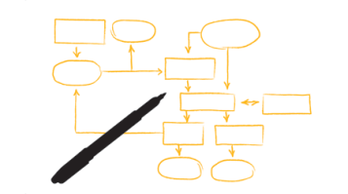
Layout for Test 3
5 to 10 True or False
10 to 15 Multiple Choice
10 to 15 Open Answer Problems
At least 1 of the 10 requires the ability to read code
At least 2 have parts that require coding
Circa 15 lines or less required for each
Some thinking required

Slide 4
The End
End
ANY QUESTIONS ???
Is this thing on?

