Slide 1
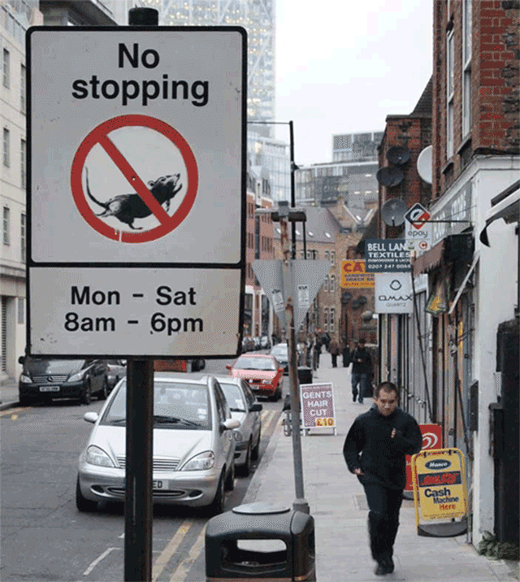
Binary Trees Priority Queues, and Heaps
Data Structures and Algorithms
CS 244
Brent M. Dingle, Ph.D.
Department of Mathematics, Statistics, and Computer Science
University of Wisconsin – Stout
Based on the book: Data Structures and Algorithms in C++ (Goodrich, Tamassia, Mount)
Some content from Data Structures Using C++ (D.S. Malik)

Slide 2
Previously
Took test 2
Grades are posted

Slide 3
Things to Note
Homework 10 is due April 29
It was listed twice on the syllabus
Homework 11 is Due May 6

Slide 4
For Today
Go over test
Review some Tree stuff
Move on to new stuff

Slide 5
Where are we headed?
Have seen
Vector Arrays
Trees
Sorting
Will soon see
Priority Queues
nodes have keys and data
Heaps
Thought of as a binary tree (pile of stuff = heap)
but implemented using a vector array
PQ Sorting
Implemented using an unsorted list (selection sort)
Implemented using a sorted list (insertion sort)
Implemented using a Heap (heap sort)

Slide 6
Marker Slide
General Questions?
Next:
Trees
Review Some Definitions of Binary Trees
Applications of Binary Trees
Tree Traversals
Priority Queues

Slide 7
Definitions and Examples
A Complete Binary Tree with height h, is a tree such that
All 2^{h-1} nodes exist at height h-1
Nodes at level h fill up left to right
A Full (or Proper) Binary Tree is a tree such that
Every non-leaf node has 2 children
∅
Complete Binary Tree
(also is FULL)
Complete Binary Tree
(but is NOT full)

Slide 8
Definitions and Examples
A Complete Binary Tree with height h, is a tree such that
All 2^{h-1} nodes exist at height h-1
Nodes at level h fill up left to right
A Full (or Proper) Binary Tree is a tree such that
Every non-leaf node has 2 children
∅
∅
NOT a Complete Binary Tree
(also not full)
NOT a Complete Binary Tree
(also not full)

Slide 9
Definitions and Examples: Balance
a
a
b
c
b
c
e
d
e
f
g
d
f
h
i
j
g
h
A balanced binary tree
i
j
An unbalanced binary tree
A binary tree is balanced if every level above the lowest is “full” (contains 2^{n} nodes)
In most applications, a reasonably balanced binary tree is desirable

Slide 10
Marker Slide
Questions on:
Trees
Review Some Definitions of Binary Trees
Next:
Trees
Applications of Binary Trees
Tree Traversals
Priority Queues

Slide 11
Application Example Arithmetic Expression Tree
Binary tree associated with an arithmetic expression
internal nodes: operators
leaves: operands
Example: arithmetic expression tree for the expression (2 × (a − 1) + (3 × b))
+
×
×
2
−
3
b
a
1

Slide 12
Application Example Decision Tree
Binary tree associated with a decision process
internal nodes: questions with yes/no answer
leaves: decisions
Example: dining decision
Want a fast meal?
Yes
No
How about coffee?
On expense account?
Yes
No
Yes
No
Starbucks
Antonio’s
Veritas
Chili’s

Slide 13
Marker Slide
Questions on:
Trees
Review Some Definitions of Binary Trees
Applications of Binary Trees
Next:
Trees
Tree Traversals
Priority Queues

Slide 14
Generalizing Traversals
The 3 tree traversals methods:
preorder, inorder, and postorder
are all very similar in nature
There is a way to generalize this methodology

Slide 15
Tree Traversal Notes
Pre-Order, In-Order, Post-Order
All “visit” each node in a tree exactly once
Pretend the tree is an overhead view of a wall
Maybe the nodes are towers (doesn’t matter)
We want to walk all the way around the wall structure
We begin above the root node, facing towards it
We then place our left hand against the node
and walk all the way around the wall structure
so that our left hand never leaves the wall
+
×
×
2
−
3
2
5
1

Slide 16
Tree Traversal Notes
Pre-Order, In-Order, Post-Order
All “visit” each node in a tree exactly once
Pretend the tree is an overhead view of a wall
Maybe the nodes are towers (doesn’t matter)
We want to walk all the way around the wall structure
We begin above the root node, facing towards it
We then place our left hand against the node
and walk all the way around the wall structure
so that our left hand never leaves the wall
+
×
×
2
−
3
2
5
1

Slide 17
Tree Traversal Notes
Pre-Order, In-Order, Post-Order
All “visit” each node in a tree exactly once
Pretend the tree is an overhead view of a wall
Maybe the nodes are towers (doesn’t matter)
We want to walk all the way around the wall structure
We begin above the root node, facing towards it
We then place our left hand against the node
and walk all the way around the wall structure
so that our left hand never leaves the wall
+
×
×
2
−
3
2
5
1

Slide 18
Tree Traversal Notes
Pre-Order, In-Order, Post-Order
All “visit” each node in a tree exactly once
Pretend the tree is an overhead view of a wall
Maybe the nodes are towers (doesn’t matter)
We want to walk all the way around the wall structure
We begin above the root node, facing towards it
We then place our left hand against the node
and walk all the way around the wall structure
so that our left hand never leaves the wall
+
×
×
2
−
3
2
5
1

Slide 19
Generalizing
We will now encounter each node 3 times
Once on the ‘left’ side
with respect to the paper
Once on the ‘bottom’ side
with respect to the paper
Once on the right side
with respect to the paper
+
L
×
×
2
−
3
2
5
1

Slide 20
Generalizing
Pre-Order, In-Order, Post-Order
All “visit” each node in a tree exactly once
We will now encounter each node 3 times
Once on the ‘left’ side
with respect to the paper
Once on the ‘bottom’ side
with respect to the paper
Once on the right side
with respect to the paper
+
L
×
×
B
2
−
3
2
5
1

Slide 21
Generalizing
We will now encounter each node 3 times
Once on the ‘left’ side
with respect to the paper
Once on the ‘bottom’ side
with respect to the paper
Once on the ‘right’ side
with respect to the paper
+
L
×
R
×
B
2
−
3
2
5
1

Slide 22
Euler Tour
This is an Euler Tour
Generic traversal of a binary tree
Includes as special cases the pre-order, post-order and in-order traversals
Walk around the tree and visit each node three times:
on the left (pre-order)
from below (in-order)
on the right (post-order)
+
L
×
R
×
B
2
−
3
2
5
1

Slide 23
Euler Tour Traversal
Algorithm eulerTour(p)
left-visit-action(p)
if isInternal(p)
eulerTour(p.left())
bottom-visit-action(p)
if isInternal(p)
eulerTour(p.right())
right-visit-action(p)
End Algorithm
Notice leaf nodes all three visits
happen one right after the other
(effectively all at the same “time” )
+
L
×
R
×
B
2
−
3
2
5
1

Slide 24
Graded In-Class Activity: ICA305_ExamFun
Draw a (single) binary tree T, such that
Each internal node of T stores a single character
A preorder traversal of T yields EXAMFUN
An inorder traversal of T yields MAFXUEN
Might Try:
E
/ \
X F
/ \ / \
A M U N
Solves preorder, but fails inorder. Must satisfy both with ONE tree.
Keep looking.
Submit your work to
correct D2L dropbox
before class ends

Slide 25
Marker Slide
Questions on:
Trees
Review Some Definitions of Binary Trees
Applications of Binary Trees
Tree Traversals
Next:
Priority Queues
From the Book: Comparisons and Comparator Operator and ADT
From the Book: Definitions and relation to Sorting

Slide 26
Going MORE general
We have seen some sorting methods.
Selection, Insertion, etc…
Can we abstract them even more?
We will create something called a Priority QUEUE
Think like how some airlines have you board
Special Access, Group 1, Group 2, …
But first a little on COMPARISONs

Slide 27
Comparisons
Previously we mentioned comparisons for sorting relations
Example:
C++ allows you to implement Comparators
overloads the operator()
operator parentheses
Algorithm bubbleSort(S, C)
Input sequence S, comparator C
Output sequence S sorted according to C
(take C as typical greater than op>)
for ( i = 0; i < S.size(); i++ )
for ( j = 1; j < S.size() – i; j++ )
if ( S.atIndex ( j – 1 ) > S.atIndex ( j ) )
S.swap ( j-1, j );
return(S)

Slide 28
Comparators in C++
A comparator class overloads the “()” operator with a comparison function.
Example: Compare two points in the plane lexicographically.
class LexCompare { public: int operator()(Point a, Point b) { if (a.x < b.x) return –1; else if (a.x > b.x) return +1; else if (a.y < b.y) return –1; else if (a.y > b.y) return +1; else return 0; } };

Slide 29
Comparators and Us
Why mention comparators now?
The Priority Queue and the generalization of sorting methods is going to refer to them

Slide 30
Definition: Comparator ADT
A comparator encapsulates the action of comparing two objects according to a given total order relation
A generic priority queue will use a comparator as a template argument, to define the comparison function (<,=,>)
The comparator is external to the keys being compared. Thus, the same objects can be sorted in different ways by using different comparators.
When the priority queue needs to compare two keys, it uses its comparator
Comparators allow you to compare things
You will write comparators for your classes
You will send your classes and their comparator
to GENERIC implementations of algorithms
This allows you to write just ONE version of
a ‘global’ algorithm and have it work with
different classes

Slide 31
Recall from Math: Total Order Relation
Mathematical concept of total order relation ≤
Reflexive property: x ≤ x
Antisymmetric property: x ≤ y ∧ y ≤ x ⇒ x = y
Transitive property: x ≤ y ∧ y ≤ z ⇒ x ≤ z
Most comparators
will define a Total Order Relation
This tends to produce predictable results humans
are used to.
Many algorithms assume such
properties of the comparator
Recall:
∧ means AND
⇒ means IMPLIES

Slide 32
Marker Slide
Questions on:
Trees
Review Some Definitions of Binary Trees
Applications of Binary Trees
Tree Traversals
Priority Queues
From the Book: Comparisons and Comparator Operator and ADT
Next:
Priority Queues
From the Book: Definitions and relation to Sorting

Slide 33
Relation of what is coming to the Book
PriorityQueue ADT (§8.1)
Total order relation (§8.1.1)
Comparator ADT (§8.1.2)
Sorting with a Priority Queue (§8.1.5)
Implementing a PQ with a list (§8.2)
Selection-sort and Insertion Sort (§8.2.2)
Heaps (§8.3)
Complete Binary Trees (§8.3.2)
Implementing a PQ with a heap (§8.3.3)
Heapsort (§8.3.5)

Slide 34
Priority Queue ADT
A priority queue stores a collection of items
An item is a pair (key, element)
Main methods of the Priority Queue ADT
insertItem(k, o) inserts an item with key k and element o
removeMin() removes the item with the smallest key
Additional methods
minKey() returns, but does not remove, the smallest key of an item
minElement() returns, but does not remove, the element of an item with smallest key
size(), isEmpty()
Applications:
Standby flyers
Auctions

Slide 35
PQ-Sort: Sorting with a Priority Queue
We can use a priority queue to sort a set of comparable elements
Insert the elements one by one with a series of insertItem(k, o) operations

Slide 36
PQ-Sort: Sorting with a Priority Queue
We can use a priority queue to sort a set of comparable elements
Insert the elements one by one with a series of insertItem(k, o) operations
Remove the elements in sorted order with a series of removeMin() operations

Slide 37
PQ-Sort: Sorting with a Priority Queue
We can use a priority queue to sort a set of comparable elements
Insert the elements one by one with a series of insertItem(k, o) operations
Remove the elements in sorted order with a series of removeMin() operations
Running time depends on the PQ implementation
Algorithm PQ-Sort(S, C)
Input sequence S, comparator C for the elements of S
Output sequence S sorted in increasing order according to C
P ← priority queue with comparator C
while !S.isEmpty ()
e ← S.remove (S.first())
P.insertItem(k, o)
while !P.isEmpty()
e ← P.minElement() P.removeMin()
S.insertLast(e)

Slide 38
PQ-Sort: Sorting with a Priority Queue
We can use a priority queue to sort a set of comparable elements
Insert the elements one by one with a series of insertItem(k, o) operations
Remove the elements in sorted order with a series of removeMin() operations
Running time depends on the PQ implementation
Algorithm PQ-Sort(S, C)
Input sequence S, comparator C for the elements of S
Output sequence S sorted in increasing order according to C
P ← priority queue with comparator C
while !S.isEmpty ()
e ← S.remove (S.first())
P.insertItem(k, o)
while !P.isEmpty()
e ← P.minElement() P.removeMin()
S.insertLast(e)

Slide 39
List-based Priority Queue
Unsorted list implementation
Store the items of the priority queue in a list-based sequence, in arbitrary order
Performance:
insertItem takes O(1) time since we can insert the item at the beginning or end of the sequence
removeMin, minKey and minElement take O(n) time since we have to traverse the entire sequence to find the smallest key
sorted list implementation
Store the items of the priority queue in a sequence, sorted by key
Performance:
insertItem takes O(n) time since we have to find the place where to insert the item
removeMin, minKey and minElement take O(1) time since the smallest key is at the beginning of the sequence
4
5
2
3
1
1
2
3
4
5

Slide 40
Selection-Sort
Selection-sort is the variation of PQ-sort where the priority queue is implemented with an unsorted sequence
Running time of Selection-sort:
Inserting the elements into the priority queue with n insertItem operations takes O(n) time
Removing the elements in sorted order from the priority queue with n removeMin operations takes time proportional to 1 + 2 + …+ n
Selection-sort runs in O(n²) time
4
5
2
3
1

Slide 41
Exercise: Selection-Sort
Selection-sort is the variation of PQ-sort where the priority queue is implemented with an unsorted sequence (first n insertItems, then n removeMins)
Illustrate the performance of selection-sort on the following input sequence:
(22, 15, 36, 44, 10, 3, 9, 13, 29, 25)
4
5
2
3
1
Notes:
see book if stuck

Slide 42
Insertion-Sort
Insertion-sort is the variation of PQ-sort where the priority queue is implemented with a sorted sequence
Running time of Insertion-sort:
Inserting the elements into the priority queue with n insertItem operations takes time proportional to 1 + 2 + …+ n
Removing the elements in sorted order from the priority queue with a series of n removeMin operations takes O(n) time
Insertion-sort runs in O(n²) time
1
2
3
4
5

Slide 43
Exercise: Insertion-Sort
Insertion-sort is the variation of PQ-sort where the priority queue is implemented with a sorted sequence (first n insertItems, then n removeMins)
Illustrate the performance of insertion-sort on the following input sequence:
(22, 15, 36, 44, 10, 3, 9, 13, 29, 25)
1
2
3
4
5
Notes:
see bbook for answer

Slide 44
In-place Insertion-sort
Instead of using an external data structure, we can implement selection-sort and insertion-sort in-place (only O(1) extra storage)
A portion of the input sequence itself serves as the priority queue
For in-place insertion-sort
We keep sorted the initial portion of the sequence
We can use swapElements instead of modifying the sequence
5
4
2
3
1
5
4
2
3
1
4
5
2
3
1
2
4
5
3
1
2
3
4
5
1
1
2
3
4
5
1
2
3
4
5

Slide 45
Marker Slide
Questions on:
Trees
Review Some Definitions of Binary Trees
Applications of Binary Trees
Tree Traversals
Priority Queues
From the Book: Comparisons and Comparator Operator and ADT
From the Book: Definitions and relation to Sorting
Next:
Priority Queues
Reboot: back to selection sort and insertion sort

Slide 46
Beginnings
Long ago we saw a selection sort algorithm
It looked a lot like that to the right:
void selectionSort(int data[], int n)
{
int smallestIndex;
int smallest, saved;
for (int i=0; i < n-1; i++)
{
// Find smallest element
smallest = data[i];
smallestIndex = i;
for (int j=i+1; j < n; j++)
{
if (data[j] < smallest)
{
smallest = data[j];
smallestIndex = j;
}
}
// Swap with smallest element
saved = data[i];
data[i] = data[smallestIndex];
data[smallestIndex] = saved;
}
}

Slide 47
Class Activity
Let data[] be defined to hold:
22, 15, 44, 10, 3, 9, 13, 25
And thus n = 8
Execute the function on that input data
For each iteration of the outer for-loop write the contents of data[] plus one line before entry
8 lines of output
void selectionSort(int data[], int n)
{
int smallestIndex;
int smallest, saved;
for (int i=0; i < n-1; i++)
{
// Find smallest element
smallest = data[i];
smallestIndex = i;
for (int j=i+1; j < n; j++)
{
if (data[j] < smallest)
{
smallest = data[j];
smallestIndex = j;
}
}
// Swap with smallest element
saved = data[i];
data[i] = data[smallestIndex];
data[smallestIndex] = saved;
}
}
Notes:
Final line should be: 3 9 10 13 15 22 25 44

Slide 48
Class Activity
Let data[] be:
22, 15, 44, 10, 3, 9, 13, 25
And thus n = 8
Execute the function on that input data
For each iteration of the outer for-loop write the contents of data[]
8 lines of output
void selectionSort(int data[], int n)
{
int smallestIndex;
int smallest, saved;
for (int i=0; i < n-1; i++)
{
// Find smallest element
smallest = data[i];
smallestIndex = i;
for (int j=i+1; j < n; j++)
{
if (data[j] < smallest)
{
smallest = data[j];
smallestIndex = j;
}
}
// Swap with smallest element
saved = data[i];
data[i] = data[smallestIndex];
data[smallestIndex] = saved;
}
}
22 15 44 10 3 9 13 25
3 15 44 10 22 9 13 25
Recall Selection Sort
SELECTs the smallest
value and then swaps it
to the current position
Notes:
Final line should be: 3 9 10 13 15 22 25 44

Slide 49
Class Activity
Let data[] be:
22, 15, 44, 10, 3, 9, 13, 25
And thus n = 8
Execute the function on that input data
For each iteration of the outer for-loop write the contents of data[]
8 lines of output
void selectionSort(int data[], int n)
{
int smallestIndex;
int smallest, saved;
for (int i=0; i < n-1; i++)
{
// Find smallest element
smallest = data[i];
smallestIndex = i;
for (int j=i+1; j < n; j++)
{
if (data[j] < smallest)
{
smallest = data[j];
smallestIndex = j;
}
}
// Swap with smallest element
saved = data[i];
data[i] = data[smallestIndex];
data[smallestIndex] = saved;
}
}
22 15 44 10 3 9 13 25
3 15 44 10 22 9 13 25
We have completed the
for j (with i=0) and identified the
smallest element as 3
Now we swap the
3 with whatever is
at index i = 0
Notes:
Final line should be: 3 9 10 13 15 22 25 44

Slide 50
Class Activity
Let data[] be:
22, 15, 44, 10, 3, 9, 13, 25
And thus n = 8
Execute the function on that input data
For each iteration of the outer for-loop write the contents of data[]
8 lines of output
void selectionSort(int data[], int n)
{
int smallestIndex;
int smallest, saved;
for (int i=0; i < n-1; i++)
{
// Find smallest element
smallest = data[i];
smallestIndex = i;
for (int j=i+1; j < n; j++)
{
if (data[j] < smallest)
{
smallest = data[j];
smallestIndex = j;
}
}
// Swap with smallest element
saved = data[i];
data[i] = data[smallestIndex];
data[smallestIndex] = saved;
}
}
22 15 44 10 3 9 13 25
3 15 44 10 22 9 13 25
3 9 44 10 22 15 13 25
Class Participation
9 is selected
what happens next?
Notes:
Final line should be: 3 9 10 13 15 22 25 44

Slide 51
Class Activity
Let data[] be:
22, 15, 44, 10, 3, 9, 13, 25
And thus n = 8
Execute the function on that input data
For each iteration of the outer for-loop write the contents of data[]
8 lines of output
void selectionSort(int data[], int n)
{
int smallestIndex;
int smallest, saved;
for (int i=0; i < n-1; i++)
{
// Find smallest element
smallest = data[i];
smallestIndex = i;
for (int j=i+1; j < n; j++)
{
if (data[j] < smallest)
{
smallest = data[j];
smallestIndex = j;
}
}
// Swap with smallest element
saved = data[i];
data[i] = data[smallestIndex];
data[smallestIndex] = saved;
}
}
22 15 44 10 3 9 13 25
3 15 44 10 22 9 13 25
3 9 44 10 22 15 13 25
3 9 10 44 22 15 13 25
Class Participation
10 is selected
what happens next?
Notes:
Final line should be: 3 9 10 13 15 22 25 44

Slide 52
Class Activity
Let data[] be:
22, 15, 44, 10, 3, 9, 13, 25
And thus n = 8
Execute the function on that input data
For each iteration of the outer for-loop write the contents of data[]
8 lines of output
void selectionSort(int data[], int n)
{
int smallestIndex;
int smallest, saved;
for (int i=0; i < n-1; i++)
{
// Find smallest element
smallest = data[i];
smallestIndex = i;
for (int j=i+1; j < n; j++)
{
if (data[j] < smallest)
{
smallest = data[j];
smallestIndex = j;
}
}
// Swap with smallest element
saved = data[i];
data[i] = data[smallestIndex];
data[smallestIndex] = saved;
}
}
22 15 44 10 3 9 13 25
3 15 44 10 22 9 13 25
3 9 44 10 22 15 13 25
3 9 10 44 22 15 13 25
3 9 10 13 22 15 44 25
Class Participation
13 is selected
what happens next?
Notes:
Final line should be: 3 9 10 13 15 22 25 44

Slide 53
Class Activity
Let data[] be:
22, 15, 44, 10, 3, 9, 13, 25
And thus n = 8
Execute the function on that input data
For each iteration of the outer for-loop write the contents of data[]
8 lines of output
void selectionSort(int data[], int n)
{
int smallestIndex;
int smallest, saved;
for (int i=0; i < n-1; i++)
{
// Find smallest element
smallest = data[i];
smallestIndex = i;
for (int j=i+1; j < n; j++)
{
if (data[j] < smallest)
{
smallest = data[j];
smallestIndex = j;
}
}
// Swap with smallest element
saved = data[i];
data[i] = data[smallestIndex];
data[smallestIndex] = saved;
}
}
22 15 44 10 3 9 13 25
3 15 44 10 22 9 13 25
3 9 44 10 22 15 13 25
3 9 10 44 22 15 13 25
3 9 10 13 22 15 44 25
3 9 10 13 15 22 44 25
Class Participation
15 is selected
what happens next?
Notes:
Final line should be: 3 9 10 13 15 22 25 44

Slide 54
Class Activity
Let data[] be:
22, 15, 44, 10, 3, 9, 13, 25
And thus n = 8
Execute the function on that input data
For each iteration of the outer for-loop write the contents of data[]
8 lines of output
void selectionSort(int data[], int n)
{
int smallestIndex;
int smallest, saved;
for (int i=0; i < n-1; i++)
{
// Find smallest element
smallest = data[i];
smallestIndex = i;
for (int j=i+1; j < n; j++)
{
if (data[j] < smallest)
{
smallest = data[j];
smallestIndex = j;
}
}
// Swap with smallest element
saved = data[i];
data[i] = data[smallestIndex];
data[smallestIndex] = saved;
}
}
22 15 44 10 3 9 13 25
3 15 44 10 22 9 13 25
3 9 44 10 22 15 13 25
3 9 10 44 22 15 13 25
3 9 10 13 22 15 44 25
3 9 10 13 15 22 44 25
3 9 10 13 15 22 44 25
Class Participation
22 is selected
what happens next?
Notes:
Final line should be: 3 9 10 13 15 22 25 44

Slide 55
Class Activity
Let data[] be:
22, 15, 44, 10, 3, 9, 13, 25
And thus n = 8
Execute the function on that input data
For each iteration of the outer for-loop write the contents of data[]
8 lines of output
void selectionSort(int data[], int n)
{
int smallestIndex;
int smallest, saved;
for (int i=0; i < n-1; i++)
{
// Find smallest element
smallest = data[i];
smallestIndex = i;
for (int j=i+1; j < n; j++)
{
if (data[j] < smallest)
{
smallest = data[j];
smallestIndex = j;
}
}
// Swap with smallest element
saved = data[i];
data[i] = data[smallestIndex];
data[smallestIndex] = saved;
}
}
22 15 44 10 3 9 13 25
3 15 44 10 22 9 13 25
3 9 44 10 22 15 13 25
3 9 10 44 22 15 13 25
3 9 10 13 22 15 44 25
3 9 10 13 15 22 44 25
3 9 10 13 15 22 44 25
3 9 10 13 15 22 25 44
Class Participation
25 is selected
what happens next?
Notes:
Final line should be: 3 9 10 13 15 22 25 44

Slide 56
Class Activity
Let data[] be:
22, 15, 44, 10, 3, 9, 13, 25
And thus n = 8
Execute the function on that input data
For each iteration of the outer for-loop write the contents of data[]
8 lines of output
void selectionSort(int data[], int n)
{
int smallestIndex;
int smallest, saved;
for (int i=0; i < n-1; i++)
{
// Find smallest element
smallest = data[i];
smallestIndex = i;
for (int j=i+1; j < n; j++)
{
if (data[j] < smallest)
{
smallest = data[j];
smallestIndex = j;
}
}
// Swap with smallest element
saved = data[i];
data[i] = data[smallestIndex];
data[smallestIndex] = saved;
}
}
22 15 44 10 3 9 13 25
3 15 44 10 22 9 13 25
3 9 44 10 22 15 13 25
3 9 10 44 22 15 13 25
3 9 10 13 22 15 44 25
3 9 10 13 15 22 44 25
3 9 10 13 15 22 44 25
3 9 10 13 15 22 25 44
and there it is. done.
Notes:
Final line should be: 3 9 10 13 15 22 25 44

Slide 57
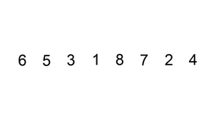
Beginnings 2
Long ago we saw an insertion sort algorithm
It looked a lot like that to the right:
void insertion_sort(int x[],int N)
{
int key,i;
for(int j=1; j < N; j++)
{
key = x[j];
i = j - 1;
while ( (x[i] > key) && (i >= 0) )
{
x[i+1] = x[i];
i--;
}
x[i+1] = key;
}
}

Slide 58
Class Activity
Let data[] be defined to hold:
6, 5, 3, 1, 8, 7, 2, 4
And thus N = 8
Execute the function on that input data
For each iteration of the outer for-loop write the contents of data[] plus one line before entry
8 lines of output
void insertion_sort(int x[],int N)
{
int key,i;
for(int j=1; j < N; j++)
{
key = x[j];
i = j - 1;
while ( (x[i] > key) && (i >= 0) )
{
x[i+1] = x[i];
i--;
}
x[i+1] = key;
}
}

Slide 59
Class Activity
Let data[] be:
6, 5, 3, 1, 8, 7, 2, 4
And thus n = 8
Execute the function on that input data
For each iteration of the outer for-loop write the contents of data[]
8 lines of output
void insertion_sort(int x[],int N)
{
int key,i;
for(int j=1; j < N; j++)
{
key = x[j];
i = j - 1;
while ( (x[i] > key) && (i >= 0) )
{
x[i+1] = x[i];
i--;
}
x[i+1] = key;
}
}
6 5 3 1 8 7 2 4
5 6 3 1 8 7 2 4
3 5 6 1 8 7 2 4
1 3 5 6 8 7 2 4
1 3 5 6 8 7 2 4
1 3 5 6 7 8 2 4
1 2 3 5 6 7 8 4
1 2 3 4 5 6 7 8
Recall: Insertion Sort
looks at each item in the list
in order and INSERTs it into
the location it is supposed to go
(with respect to everything already examined)

Slide 60
Class Activity
Let data[] be:
6, 5, 3, 1, 8, 7, 2, 4
And thus n = 8
Execute the function on that input data
For each iteration of the outer for-loop write the contents of data[]
8 lines of output
void insertion_sort(int x[],int N)
{
int key,i;
for(int j=1; j < N; j++)
{
key = x[j];
i = j - 1;
while ( (x[i] > key) && (i >= 0) )
{
x[i+1] = x[i];
i--;
}
x[i+1] = key;
}
}
6 5 3 1 8 7 2 4
5 6 3 1 8 7 2 4
3 5 6 1 8 7 2 4
1 3 5 6 8 7 2 4
1 3 5 6 8 7 2 4
1 3 5 6 7 8 2 4
1 2 3 5 6 7 8 4
1 2 3 4 5 6 7 8
j starts out at index 1
So key has the value of 5

Slide 61
Class Activity
Let data[] be:
6, 5, 3, 1, 8, 7, 2, 4
And thus n = 8
Execute the function on that input data
For each iteration of the outer for-loop write the contents of data[]
8 lines of output
void insertion_sort(int x[],int N)
{
int key,i;
for(int j=1; j < N; j++)
{
key = x[j];
i = j - 1;
while ( (x[i] > key) && (i >= 0) )
{
x[i+1] = x[i];
i--;
}
x[i+1] = key;
}
}
6 5 3 1 8 7 2 4
5 6 3 1 8 7 2 4
3 5 6 1 8 7 2 4
1 3 5 6 8 7 2 4
1 3 5 6 8 7 2 4
1 3 5 6 7 8 2 4
1 2 3 5 6 7 8 4
1 2 3 4 5 6 7 8
j starts out at index 1
So key has the value of 5
The while loop will now insert
the 5 into the correct location
for indices >= 0 and <= j-1
(j is 1 so only index 0 gets checked this time)

Slide 62
Class Activity
Let data[] be:
6, 5, 3, 1, 8, 7, 2, 4
And thus n = 8
Execute the function on that input data
For each iteration of the outer for-loop write the contents of data[]
8 lines of output
void insertion_sort(int x[],int N)
{
int key,i;
for(int j=1; j < N; j++)
{
key = x[j];
i = j - 1;
while ( (x[i] > key) && (i >= 0) )
{
x[i+1] = x[i];
i--;
}
x[i+1] = key;
}
}
6 5 3 1 8 7 2 4
5 6 3 1 8 7 2 4
3 5 6 1 8 7 2 4
1 3 5 6 8 7 2 4
1 3 5 6 8 7 2 4
1 3 5 6 7 8 2 4
1 2 3 5 6 7 8 4
1 2 3 4 5 6 7 8
Class Participation
3 is current value
Where does it get inserted?

Slide 63
Class Activity
Let data[] be:
6, 5, 3, 1, 8, 7, 2, 4
And thus n = 8
Execute the function on that input data
For each iteration of the outer for-loop write the contents of data[]
8 lines of output
void insertion_sort(int x[],int N)
{
int key,i;
for(int j=1; j < N; j++)
{
key = x[j];
i = j - 1;
while ( (x[i] > key) && (i >= 0) )
{
x[i+1] = x[i];
i--;
}
x[i+1] = key;
}
}
6 5 3 1 8 7 2 4
5 6 3 1 8 7 2 4
3 5 6 1 8 7 2 4
1 3 5 6 8 7 2 4
1 3 5 6 8 7 2 4
1 3 5 6 7 8 2 4
1 2 3 5 6 7 8 4
1 2 3 4 5 6 7 8
Class Participation
1 is current value
Where does it get inserted?

Slide 64
Class Activity
Let data[] be:
6, 5, 3, 1, 8, 7, 2, 4
And thus n = 8
Execute the function on that input data
For each iteration of the outer for-loop write the contents of data[]
8 lines of output
void insertion_sort(int x[],int N)
{
int key,i;
for(int j=1; j < N; j++)
{
key = x[j];
i = j - 1;
while ( (x[i] > key) && (i >= 0) )
{
x[i+1] = x[i];
i--;
}
x[i+1] = key;
}
}
6 5 3 1 8 7 2 4
5 6 3 1 8 7 2 4
3 5 6 1 8 7 2 4
1 3 5 6 8 7 2 4
1 3 5 6 8 7 2 4
1 3 5 6 7 8 2 4
1 2 3 5 6 7 8 4
1 2 3 4 5 6 7 8
Class Participation
8 is current value
Where does it get inserted?

Slide 65
Class Activity
Let data[] be:
6, 5, 3, 1, 8, 7, 2, 4
And thus n = 8
Execute the function on that input data
For each iteration of the outer for-loop write the contents of data[]
8 lines of output
void insertion_sort(int x[],int N)
{
int key,i;
for(int j=1; j < N; j++)
{
key = x[j];
i = j - 1;
while ( (x[i] > key) && (i >= 0) )
{
x[i+1] = x[i];
i--;
}
x[i+1] = key;
}
}
6 5 3 1 8 7 2 4
5 6 3 1 8 7 2 4
3 5 6 1 8 7 2 4
1 3 5 6 8 7 2 4
1 3 5 6 8 7 2 4
1 3 5 6 7 8 2 4
1 2 3 5 6 7 8 4
1 2 3 4 5 6 7 8
Class Participation
7 is current value
Where does it get inserted?

Slide 66
Class Activity
Let data[] be:
6, 5, 3, 1, 8, 7, 2, 4
And thus n = 8
Execute the function on that input data
For each iteration of the outer for-loop write the contents of data[]
8 lines of output
void insertion_sort(int x[],int N)
{
int key,i;
for(int j=1; j < N; j++)
{
key = x[j];
i = j - 1;
while ( (x[i] > key) && (i >= 0) )
{
x[i+1] = x[i];
i--;
}
x[i+1] = key;
}
}
6 5 3 1 8 7 2 4
5 6 3 1 8 7 2 4
3 5 6 1 8 7 2 4
1 3 5 6 8 7 2 4
1 3 5 6 8 7 2 4
1 3 5 6 7 8 2 4
1 2 3 5 6 7 8 4
1 2 3 4 5 6 7 8
Class Participation
2 is current value
Where does it get inserted?

Slide 67
Class Activity
Let data[] be:
6, 5, 3, 1, 8, 7, 2, 4
And thus n = 8
Execute the function on that input data
For each iteration of the outer for-loop write the contents of data[]
8 lines of output
void insertion_sort(int x[],int N)
{
int key,i;
for(int j=1; j < N; j++)
{
key = x[j];
i = j - 1;
while ( (x[i] > key) && (i >= 0) )
{
x[i+1] = x[i];
i--;
}
x[i+1] = key;
}
}
6 5 3 1 8 7 2 4
5 6 3 1 8 7 2 4
3 5 6 1 8 7 2 4
1 3 5 6 8 7 2 4
1 3 5 6 8 7 2 4
1 3 5 6 7 8 2 4
1 2 3 5 6 7 8 4
1 2 3 4 5 6 7 8
Class Participation
4 is current value
Where does it get inserted?

Slide 68
Class Activity
Let data[] be:
6, 5, 3, 1, 8, 7, 2, 4
And thus n = 8
Execute the function on that input data
For each iteration of the outer for-loop write the contents of data[]
8 lines of output
void insertion_sort(int x[],int N)
{
int key,i;
for(int j=1; j < N; j++)
{
key = x[j];
i = j - 1;
while ( (x[i] > key) && (i >= 0) )
{
x[i+1] = x[i];
i--;
}
x[i+1] = key;
}
}
6 5 3 1 8 7 2 4
5 6 3 1 8 7 2 4
3 5 6 1 8 7 2 4
1 3 5 6 8 7 2 4
1 3 5 6 8 7 2 4
1 3 5 6 7 8 2 4
1 2 3 5 6 7 8 4
1 2 3 4 5 6 7 8
and there it is. done.

Slide 69
Enough Fun
Hang on to those results we will get back to them
Now, what was the next important thing that had to be done…

Slide 70
Marker Slide
Questions on:
Trees
Priority Queues
From the Book: Comparisons and Comparator Operator and ADT
From the Book: Definitions and relation to Sorting
Reboot: back to selection sort and insertion sort
Next:
Priority Queues
Setting up for ‘generic’ sorting algorithm
Where performance depends on the data structure being used

Slide 71
Problems of Priority
Print Jobs
Printers get print requests from all over a building. Suppose we want them to print staff jobs before faculty jobs before student jobs, and grad students before undergraduate students, and so on. How do we set this behavior up?
Emergency Room scheduling
Say you are in charge of scheduling patients for treatment in the ER. A gunshot victim would likely get treatment sooner than someone with a sore neck – regardless of arrival time. How do we always choose the most urgent case when new patients continue to arrive?

Slide 72
The Priority Queue ADT
A priority queue (PQ) is a restricted form of a list
items are arranged according to their priorities (or keys)
keys may or may not be unique
Unlike a queue which is FIFO
A priority queue removes items based on priority

Slide 73
PQ – Total Order Relation
A priority queue must hold a total order relation (example <= )
A Total Order Relation has the following properties:
Reflexive
k <= k
Antisymmetric
if x <= y and y <= x then x = y
Transitive
if a <= b and b <= c then a <= c

Slide 74
2 ‘types’ of PQ
Priority Queues may be viewed as:
min PQ
minimum key value is the highest priority
max PQ
maximum key value is the highest priority

Slide 75
Priority Queue ADT Operations
Main Methods of PQs
insertItem(key, data)
aka enqueue(key, data)
inserts data into the PQ according to key
removeItem()
removes the item with the smallest (largest) key
depending if using a min PQ or max PQ
size()
returns number of elements in PQ
empty()
returns true if zero elements in PQ
minItem() / maxItem()
returns item with smallest/largest key
minKey() / maxKey()
returns smallest/largest key
removeItem() may also be named
removeMin() or removeMax()
or dequeue()
Additional Methods of PQs

Slide 76
Sorting Using a Priority Queue
Given a sequence of N items
a PQ can be used to sort the sequence:
Step 1
Insert N items into the PQ via insertItem(key, data)
Step 2
Remove the items by calling removeItem() N times
The first remove removes the largest item, the second call the second largest, … the last removes the smallest item

Slide 77
Sorting Using a Priority Queue
Given a sequence of N items
a PQ can be used to sort the sequence:
Step 1
Insert N items into the PQ via insertItem(key, data)
Step 2
Remove the items by calling removeItem() N times
The first remove removes the largest item, the second call the second largest, … the last removes the smallest item
S

Slide 78
Sorting Using a Priority Queue
Given a sequence of N items
a PQ can be used to sort the sequence:
Step 1
Insert N items into the PQ via insertItem(key, data)
Step 2
Remove the items by calling removeItem() N times
The first remove removes the largest item, the second call the second largest, … the last removes the smallest item

Slide 79
Sorting Using a PQ
Given a sequence of N items
a PQ can be used to sort the sequence:
Step 1
Insert N items into the PQ via insertItem(key, data)
Step 2
Remove the items by calling removeItem() N times
The first remove removes the largest item, the second call the second largest, … the last removes the smallest item
Algorithm PriorityQueueSort (S, PQ):
Input: Sequence, S, of n items, and empty priority queue, PQ.
Output: Sequence S sorted by the total order relation.
while ! S.empty() do
item := S.removeFirst()
PQ.insertItem(item.key, item.data)
while ! PQ.empty do
item := PQ.removeItem()
S.insertLast(item)

Slide 80
Marker Slide
Questions on:
Trees
Priority Queues
From the Book: Comparisons and Comparator Operator and ADT
From the Book: Definitions and relation to Sorting
Reboot: back to selection sort and insertion sort
Setting up for ‘generic’ sorting algorithm
Where performance depends on the data structure being used
Next:
Priority Queues
Implementations
Unordered List
Ordered List
Binary Tree (Heap)

Slide 81
PQ Implementation
Priority Queues can be implemented using
Unordered List
Ordered List
Binary Tree (Heap)

Slide 82
Implementing PQ as an Unordered List
Each item in a PQ is a composition of 2 objects
the key (priority)
and the data
Thus we have the pair (key, data)
So we could implement this using a linked list
details next slide, look at the list’s node structure

Slide 83
Recall Doubly Linked List
template <typename T> class Item { public: T elem;
Item<T> *prev, *next;
};
prev
next
elem
node
But for our priority queue we split elem into TWO things
key (of type int)
data (of type T)

Slide 84
Recall Doubly Linked List
template <typename T> class Item { public: int key; T data;
Item<T> *prev, *next;
};
prev
next
key data
node
But for our priority queue we split elem into TWO things
key (of type int)
data (of type T)

Slide 85
More Code – For Ref If Needed
class Item {
private int key, data;
private Item next, prev;
public Item () {
key = 0;
data = 0;
next = null;
prev = null; }
public Item (int newKey, int newData, Item newNext, Item newPrev) {
key = newKey;
data = newData;
next = newNext;
prev = newPrev; }

Slide 86
Code Continues – If needed
public void setData (int newData) {
data = newData; }
public void setNext (Item newNext) {
next = newNext; }
public void setPrev (Item newPrev) {
prev = newPrev; }
public void displayItem () {
System.out.println ("key: " + key + "; data: " + data);
}
}
public int getKey () {
return key; }
public int getData () {
return data; }
public Item getNext () {
return next; }
public Item getPrev () {
return prev; }
public void setKey (int newKey) {
key = newKey; }

Slide 87
Implementing a PQ as Unordered list
So if we have a list of unordered stuff
To make it a PQ we need the functions
insertItem(key, data)
removeItem()
assume a Min PQ so this removes the item with the smallest key

Slide 88
PQ as Unordered list
PQ::insertItem(key, data)
This is just an insertFront() call for the list
like m_list.insertFront(…)
Recall this is an O(1) operation
Review of this follows

Slide 89
Inserting at the Front
Review
context of PQ::insertItem(key, data)
PQ is implemented using
Unordered list
Allocate a new node
Have new node point to old head
Update head to point to new node
head
tail
∅
12, Leonard
7, Sheldon
98, Howard
54, Raj

Slide 90
Inserting at the Front
Review
context of PQ::insertItem(key, data)
PQ is implemented using
Unordered list
Allocate a new node
Have new node point to old head
Update head to point to new node
head
tail
∅
∅
19, Penny
12, Leonard
7, Sheldon
98, Howard
54, Raj

Slide 91
Inserting at the Front
Review
context of PQ::insertItem(key, data)
PQ is implemented using
Unordered list
Allocate a new node
Have new node point to old head
Update head to point to new node
head
tail
∅
19, Penny
12, Leonard
7, Sheldon
98, Howard
54, Raj

Slide 92
Inserting at the Front
Review
context of PQ::insertItem(key, data)
PQ is implemented using
Unordered list
Allocate a new node
Have new node point to old head
Update head to point to new node
head
tail
∅
19, Penny
12, Leonard
7, Sheldon
98, Howard
54, Raj

Slide 93
PQ as Unordered list
So if we have a list of unordered stuff
To make it a PQ we need the functions
insertItem(key, data)
Can be done in O(1) -- as just seen
What about…
removeItem()
assume a Min PQ so this removes the item with the smallest key

Slide 94
PQ as Unordered list
removeItem() - remove item with minimum key
Whether using a singly or doubly linked list we must start either at the front or the back of the list and walk through the list to find the item
This is O(n)…
First node is assumed to be minimum
until something lower is found
curPtr
MinSoFar
∅
56
89
12
36

Slide 95
PQ as Unordered list
removeItem() - remove item with minimum key
Whether using a singly or doubly linked list we must start either at the front or the back of the list and walk through the list to find the item
This is O(n)…
curPtr
MinSoFar
∅
56
89
12
36

Slide 96
PQ as Unordered list
removeItem() - remove item with minimum key
Whether using a singly or doubly linked list we must start either at the front or the back of the list and walk through the list to find the item
This is O(n)…
Found something < 56
So adjust MinSoFar
curPtr
MinSoFar
∅
56
89
12
36

Slide 97
PQ as Unordered list
removeItem() - remove item with minimum key
Whether using a singly or doubly linked list we must start either at the front or the back of the list and walk through the list to find the item
This is O(n)…
curPtr
MinSoFar
∅
56
89
12
36

Slide 98
PQ as Unordered list
removeItem() - remove item with minimum key
Whether using a singly or doubly linked list we must start either at the front or the back of the list and walk through the list to find the item
This is O(n)…
curPtr
MinSoFar
∅
56
89
12
36

Slide 99
PQ as Unordered list
removeItem() - remove item with minimum key
Whether using a singly or doubly linked list we must start either at the front or the back of the list and walk through the list to find the item
This is O(n)…
curPtr reaches the end of the list
so wherever MinSoFar is pointing at
must be the minimum so remove its node
and adjust pointers as needed
curPtr
MinSoFar
∅
56
89
12
36

Slide 100
PQ as Unordered list
removeItem() - remove item with minimum key
Whether using a singly or doubly linked list we must start either at the front or the back of the list and walk through the list to find the item
This is O(n)…
curPtr reaches the end of the list
so wherever MinSoFar is pointing at
must be the minimum so remove its node
and adjust pointers as needed
curPtr
∅
56
89
36

Slide 101
PQ as Unordered list
So if we have a list of unordered stuff
To make it a PQ we need the functions
insertItem(key, data)
Can be done in O(1)
removeItem()
Requires O(n)
This is no good… we want faster
Maybe if we use an ORDERED list instead…

Slide 102
PQ as Unordered list
So if we have a list of unordered stuff
To make it a PQ we need the functions
insertItem(key, data)
Can be done in O(1)
removeItem()
Requires O(n)
What does the class think?
Will an ordered list help?
This is no good… we want faster
Maybe if we use an ORDERED list instead…

Slide 103
Marker Slide
Questions on:
Trees
Priority Queues
From the Book stuff
Reboot: back to selection sort and insertion sort
Setting up for ‘generic’ sorting algorithm
Where performance depends on the data structure being used
Implementations
Unordered List
Next:
Priority Queues
Implementations
Ordered List
Binary Tree (Heap)

Slide 104
Implementing a PQ as an Ordered list
Let’s say we have a list of Ordered stuff
To make it a PQ we still need the functions
insertItem(key, data)
removeItem()
assume a Min PQ so this removes the item with the smallest key

Slide 105
PQ as an Ordered list
PQ::removeItem() is now easy
This is just a removeFront() call for the list
like m_list.removeFront(…)
Recall this is an O(1) operation
Review of this follows

Slide 106
Removing at the Front
Review
context of PQ::removeItem()
PQ is implemented using Ordered list
Update head to point to next node in the list
Return elem of previous head and delete the node
head
tail
∅
12
36
56
89

Slide 107
Removing at the Front
Review
context of PQ::removeItem()
PQ is implemented using Ordered list
Update head to point to next node in the list
Return elem of previous head and delete the node
head
tail
∅
12
36
56
89

Slide 108
Removing at the Front
Review
context of PQ::removeItem()
PQ is implemented using Ordered list
Update head to point to next node in the list
Return elem of previous head and delete the node
head
tail
∅
12
36
56
89

Slide 109
Removing at the Front
Review
context of PQ::removeItem()
PQ is implemented using Ordered list
Update head to point to next node in the list
Return elem of previous head and delete the node
head
tail
∅
12
36
56
89

Slide 110
Removing at the Front
Review
context of PQ::removeItem()
PQ is implemented using Ordered list
Update head to point to next node in the list
Return elem of previous head and delete the node
head
tail
∅
36
56
89

Slide 111
PQ as an Ordered list
Let’s say we have a list of Ordered stuff
To make it a PQ we need the functions
removeItem()
Can be done in O(1)
What about…
insertItem(key, data)
note this must maintain the ordering
so we have to find the correct place to insert it

Slide 112
PQ as an Ordered list
insertItem(key, data)
Whether using a singly or doubly linked list we must start either at the front or the back of the list and walk through the list to find the correct place for the item
This is O(n)…
∅
56
curPtr
prevPtr
∅
∅
12
36
89

Slide 113
PQ as an Ordered list
insertItem(key, data)
Whether using a singly or doubly linked list we must start either at the front or the back of the list and walk through the list to find the correct place for the item
This is O(n)…
∅
56
curPtr
prevPtr
∅
12
36
89

Slide 114
PQ as an Ordered list
insertItem(key, data)
Whether using a singly or doubly linked list we must start either at the front or the back of the list and walk through the list to find the correct place for the item
This is O(n)…
∅
56
curPtr
prevPtr
∅
12
36
89

Slide 115
PQ as an Ordered list
insertItem(key, data)
Whether using a singly or doubly linked list we must start either at the front or the back of the list and walk through the list to find the correct place for the item
This is O(n)…
∅
56
prevPtr’s key < 56
curPtr’s key > 56
So the place for key = 56 is
between them
Adjust pointers to make it so
curPtr
prevPtr
∅
12
36
89

Slide 116
PQ as an Ordered list
insertItem(key, data)
Whether using a singly or doubly linked list we must start either at the front or the back of the list and walk through the list to find the correct place for the item
This is O(n)…
56
prevPtr’s key < 56
curPtr’s key > 56
So the place for key = 56 is
between them
Adjust pointers to make it so
curPtr
prevPtr
∅
12
36
89

Slide 117
PQ as an Ordered list
insertItem(key, data)
Whether using a singly or doubly linked list we must start either at the front or the back of the list and walk through the list to find the correct place for the item
This is O(n)…
prevPtr’s key < 56
curPtr’s key > 56
So the place for key = 56 is
between them
Adjust pointers to make it so
curPtr
prevPtr
∅
12
36
56
89

Slide 118
PQ as an Ordered list
Let’s say we have a list of Ordered stuff
To make it a PQ we need the functions
removeItem()
Can be done in O(1)
insertItem(key, data)
Requires O(n)
So either way, ordered or unordered
list implementations of Priority Queues
have at least one operation that is O(n)
There must be something better…
… else why would I be saying O(n) is bad =)

Slide 119
Summary: List-based Priority Queue
Unsorted list implementation
Store the items of the priority queue in a list-based sequence, in arbitrary order
Performance:
insertItem takes O(1) time since we can insert the item at the beginning or end of the sequence
removeMin, minKey and minElement take O(n) time since we have to traverse the entire sequence to find the smallest key
Sorted list implementation
Store the items of the priority queue in a sequence, sorted by key
Performance:
insertItem takes O(n) time since we have to find the place where to insert the item
removeMin, minKey and minElement take O(1) time since the smallest key is at the beginning of the sequence
4
5
2
3
1
1
2
3
4
5

Slide 120
A Better Data Structure for PQs?
Does there exist a better implementation?
YES
But first a sidetrack
What if our keys are not integers?
How do we order things by them?
How do we compare them?
template <typename T1, typename T2 > class Item { public: T1 key; T2 data;
Item<T1, T2> *prev, *next;
};
Notes:
Comparator slides are here to go with the book’s presentation
But are mostly a side point in getting to the actual Heap presentation, so probably ok to skip

Slide 121
The Comparator ADT
Typically keys are integers and we can use < or >
But if not
To compare keys, we use comparator objects
These are external to the keys
They define a set of operations that take parameters of the same type as the keys
Thus our keys don’t have to be integers
template <typename T1, typename T2 > class Item { public: T1 key; T2 data;
Item<T1, T2> *prev, *next;
};
Notes:
Comparator slides are here to go with the book’s presentation
But are mostly a side point in getting to the actual Heap presentation, so probably ok to skip

Slide 122
Comparator Operations
Example:
So a min priority queue’s items would
likely be compared with the lessThan(a, b) operator
Comparators allow items to be compared with respect to a specified ordering relationship.
Typical operations of a comparator object include:
lessThan (a,b) Returns true if a is less than b
lessThanOrEqual (a,b) Returns true if a is less than or equal to b
greaterThan (a,b) Returns true if a is greater than b
greaterThanOrEqual (a,b) Returns true if a is greater than or equal to b
equal (a,b) Returns true if a is equal b
comparable (a) Returns true if a can be compared
But
a max priority queue’s items would
likely be compared with the greaterThan(a, b) operator
Only code change needed is specifying
which comparator to use
Notes:
Comparator slides are here to go with the book’s presentation
But are mostly a side point in getting to the actual Heap presentation, so probably ok to skip

Slide 123
Implementing Comparator
It is possible to get “fancy” with comparators in C++.
A common trick is to overload the operator ()
Here the “key”
type would be Point
class LexCompare
{ public: int operator()(Point a, Point b)
{ if (a.x < b.x) return –1; else if (a.x > b.x) return +1; else if (a.y < b.y) return –1; else if (a.y > b.y) return +1; else return 0; } };
Notes:
Comparator slides are here to go with the book’s presentation
But are mostly a side point in getting to the actual Heap presentation, so probably ok to skip

Slide 124
Marker Slide
Questions on:
Trees
Priority Queues
From the Book stuff
Reboot: back to selection sort and insertion sort
Setting up for ‘generic’ sorting algorithm
Where performance depends on the data structure being used
Implementations
Unordered List
Ordered List
Heap ← details of this will come later
Next:
Heap
Implementing a Heap

Slide 125
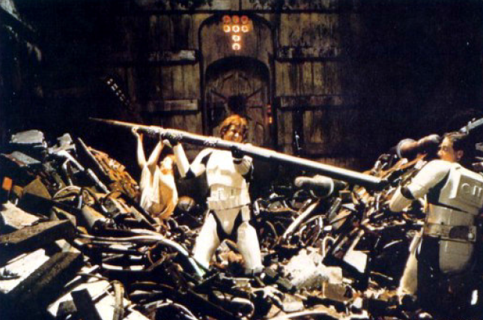
A Better Implementation of PQs
Priority Queues can be implemented using a Binary Heap (or just Heap for now)
A Heap is a binary tree with two properties
Structure Property
Heap-Order Property
Max Heap
Min Heap

Slide 126
Structure Property
A Heap is a complete binary tree
Root
When a complete
binary tree is built,
its first node must be
the root.

Slide 127
Structure Property
A Heap is a complete binary tree
Left child
of the
root
The second node is
always the left child
of the root.

Slide 128
Structure Property
A Heap is a complete binary tree
Right child
of the
root
The third node is
always the right child
of the root.

Slide 129
Structure Property
A Heap is a complete binary tree
The next nodes
always fill the next
level from left-to-right.

Slide 130
Structure Property
A Heap is a complete binary tree
The next nodes
always fill the next
level from left-to-right.

Slide 131
Structure Property
A Heap is a complete binary tree
The next nodes
always fill the next
level from left-to-right.

Slide 132
Structure Property
A Heap is a complete binary tree
The next nodes
always fill the next
level from left-to-right.

Slide 133
Structure Property
A Heap is a complete binary tree

Slide 134
Structure Property
A Heap is a complete binary tree
45
35
23
27
21
22
4
19
Each node in a heap
contains a key that
can be compared to
other nodes' keys.

Slide 135
Heap Order Property
45
For a “MaxHeap”
The key value of each node is at least as large as the key value of its children.
The root of the heap is the largest value in the tree
35
23
27
21
22
4
19
The “max heap property"
requires that each
node's key is >= the
keys of its children

Slide 136
Heap Order Property
4
For a “MinHeap”
The key value of each node is the same or smaller than the key value of its children.
The root of the heap is the smallest value in the tree
19
22
27
21
23
45
35
The “min heap property"
requires that each
node's key is <= the
keys of its children

Slide 137
Max Heap Examples

Slide 138
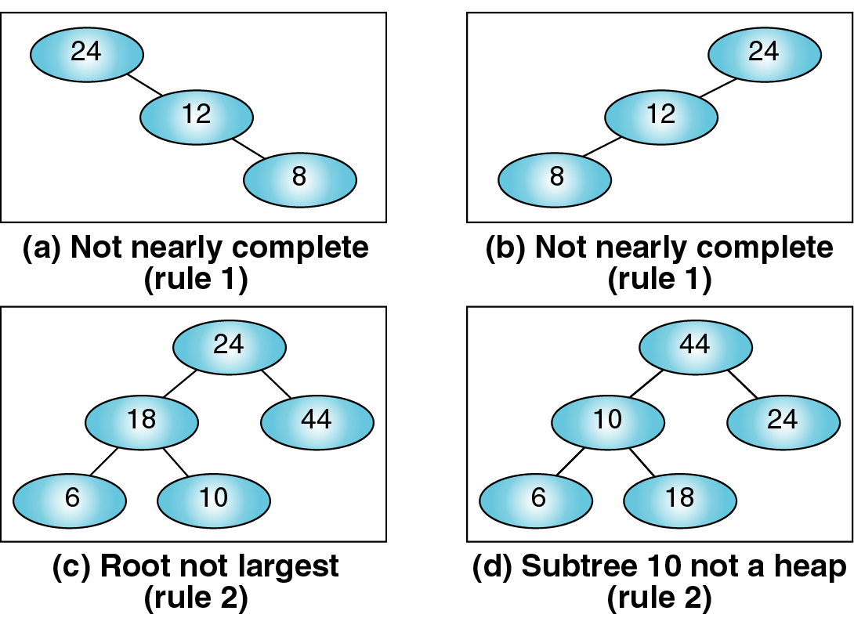
Not Max Heaps
Not complete
Not complete
Root NOT largest
Sub-tree 10 not a heap

Slide 139
Heaps Can Implement PQs
So how does one implement a heap?

Slide 140
Marker Slide
Questions on:
Trees
Priority Queues
Generic Sorting Setup
Implementations
Unordered List
Ordered List
Heap
Next:
Implementing a Heap

Slide 141
Heap Implementation
A heap could be implemented using a regular binary tree (left and right child pointers)
However a heap is a complete binary tree
So we can use an array or vector instead
Class Exercise:
Draw a complete binary tree
with 5 to 9 nodes
Pause for class to
draw a complete binary tree
with 5 to 9 nodes…
Hint: I’m going to go with 6

Slide 142
Heap Implementation
A heap could be implemented using a regular binary tree (left and right child pointers)
However a heap is a complete binary tree
So we can use an array or vector instead
Class Exercise:
Draw a complete binary tree
with 5 to 9 nodes

Slide 143
Heap Implementation
A heap could be implemented using a regular binary tree (left and right child pointers)
However a heap is a complete binary tree
So we can use an array or vector instead
Class Exercise:
Number the nodes
Start with 0 for the root
Its left child is 1
Its right child is 2
And keep going
numbering Left to Right
0
1
2
3
4
5

Slide 144
Heap Implementation
A heap could be implemented using a regular binary tree (left and right child pointers)
However a heap is a complete binary tree
So we can use an array or vector instead
Class Exercise:
Notice any node with index i
its parent node is at (i-1)/2
its left child is at 2i + 1
its right child is at 2i + 2
0
1
2
3
4
5

Slide 145
Heap Implementation
A heap could be implemented using a regular binary tree (left and right child pointers)
However a heap is a complete binary tree
So we can use an array or vector instead
Class Exercise:
Notice for any node with index i
its parent node is at (i-1)/2
its left child is at 2i + 1
its right child is at 2i + 2
Parent
⎣(i-1)/2⎦
i
Optional:
Draw a NON-complete binary
tree with 5 to 9 nodes
Show this index relation fails to hold
2i+1
Left Child
2i+2
Right Child

Slide 146
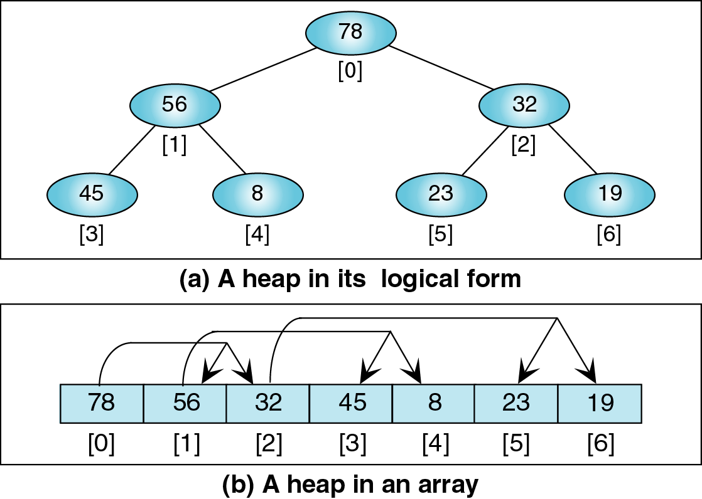
Using a Vector to Implement a Heap

Slide 147
Using a Vector to Implement a Heap

Slide 148
Using a Vector to Implement a Heap

Slide 149
Using a Vector to Implement a Heap

Slide 150
Using a Vector to Implement a Heap

Slide 151
Using a Vector to Implement a Heap

Slide 152
Using a Vector to Implement a Heap

Slide 153
Using a Vector to Implement a Heap

Slide 154
The End of This Part
End

