Slide 1
Priority Queues, Trees, and Huffman Encoding
This presentation requires Audio Enabled
Data Structures and Algorithms
CS 244
Brent M. Dingle, Ph.D.
Department of Mathematics, Statistics, and Computer Science
University of Wisconsin – Stout
Based on the book: Data Structures and Algorithms in C++ (Goodrich, Tamassia, Mount)
Some content from Data Structures Using C++ (D.S. Malik)

Slide 2
Previously
Priority Queues
  nodes have keys and data
  Min PQs and Max PQs
Heaps
  Thought of as a binary tree (pile of stuff = heap)
  but implemented using a vector array
    Top Down Build takes O(n lg n) time
    Bottom Up Build takes O(n) time
  2 Major properties: Structure and Order
    Complete Binary Tree
    Min Heaps and Max Heaps
PQ Sorting
  Implemented using an unsorted list (selection sort)
    O(n²)
  Implemented using a sorted list (insertion sort)
    O(n²)
  Implemented using a Heap (heap sort)
    O(n * lg n)

Slide 3
Priority Queue ADT
A priority queue stores a collection of items
An item is a pair
(key, element)
Main methods of the Priority Queue ADT
  insertItem(k, o)
  inserts an item with key k and element o
  removeMin()
  removes the item with the smallest key
Additional methods
  minKey()
  returns, but does not remove, the smallest key of an item
  minElement()
  returns, but does not remove, the element of an item with smallest key
  size(), isEmpty()
Applications:
  Standby flyers
  Auctions
We will be using these two functions heavily in the very near future

Slide 4
Marker Slide
General Questions?
Next
  Huffman Encoding
    Data Compression

Slide 5
PQs and Trees
What can they be used for?
How about data compression?
  Putting Trees into PQs

Slide 6

PQs and Trees
Putting Trees into PQs
  Mixing Data Structures with Data Structures?
  No good can come from this. =)

Slide 7
Definition: File Compression
Compression: the process of encoding information in fewer bits
  Wasting space is bad, so compression is good
Compression is useful for many things
  storing photos
  reducing email attachment size
  reduction of other media files (mp3s, DVD, Blu-Ray)
  allows voice calls over low band-width connection
    cell phones, Skype, etc
Common compression programs
  WinZip, WinRAR, 7Zip, etc

Slide 8
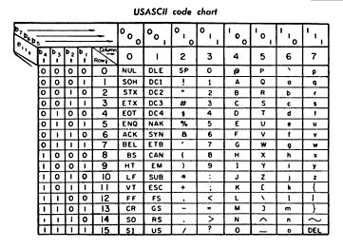
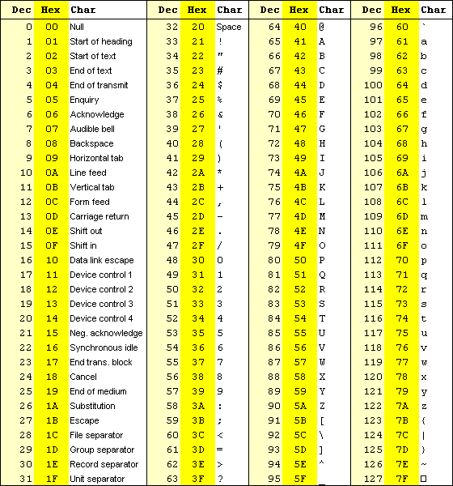
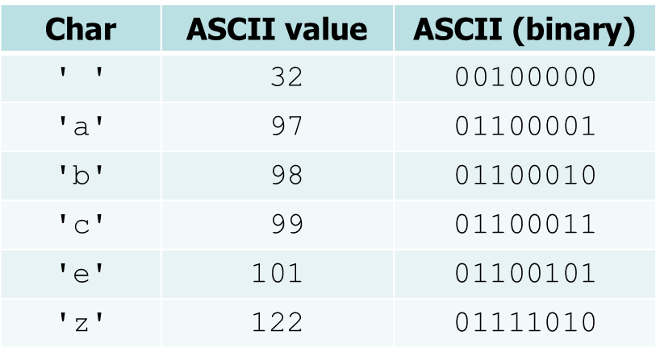
ASCII Encoding
American Standard Code
for Information Interchange
  Encodes 128 characters
    7 bit encoding scheme
      2^7 = 128
    Implemented using 8 bits
      first bit always 0

Slide 9
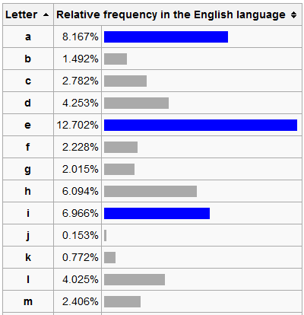
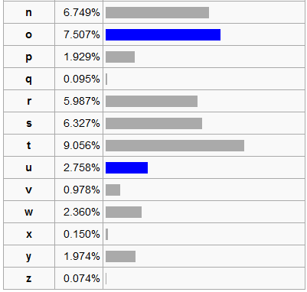
Observation
Some characters in the English alphabet occur more frequently than others
  The table below is based on
  Robert Lewand's Cryptological Mathematics

Slide 10
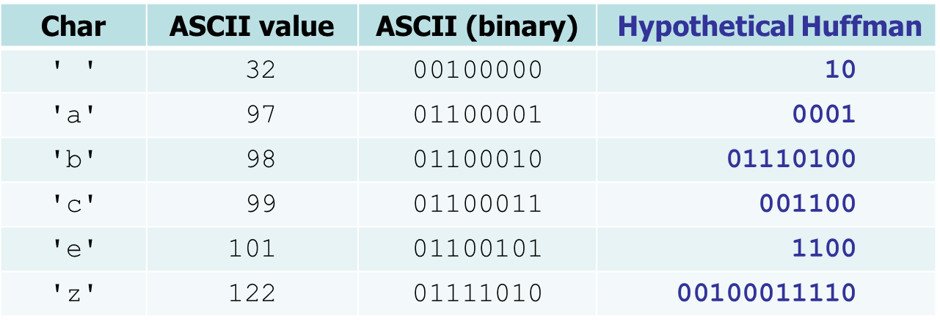
Huffman Encoding
Huffman encoding: Uses variable lengths for different characters to take advantage of their relative frequencies
  Some characters occur more often than others
    If those characters use < 8 bits each, the file will be smaller
  Other characters may need > 8 bits
    but that’s ok → they don’t show up often

Slide 11
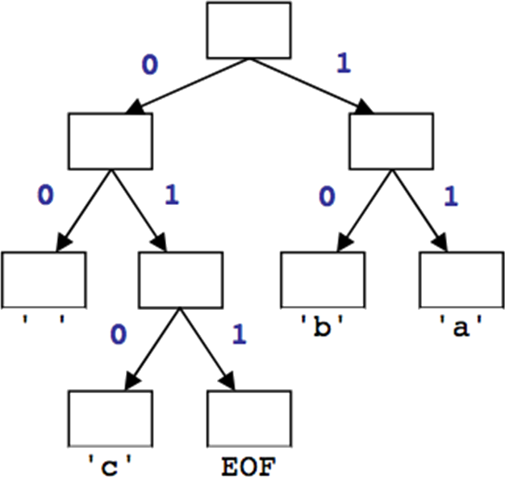
Huffman’s Algorithm
The idea: Create a “Huffman Tree” that will tell us a good binary representation for each character
  Left means 0
  Right means 1
    Example 'b‘ is 10
More frequent characters will be higher in the tree (have a shorter binary value).
To build this tree,
we must do a few steps first
  Count occurrences of each unique character in the file to compress
  Use a priority queue to order them from least to most frequent
  Make a tree and use it

Slide 12
Huffman Compression – Overview
Step 1
  Count characters (frequency of characters in the message)
Step 2
  Create a Priority Queue
Step 3
  Build a Huffman Tree
Step 4
  Traverse the Tree to find the Character to Binary Mapping
Step 5
  Use the mapping to encode the message

Slide 13
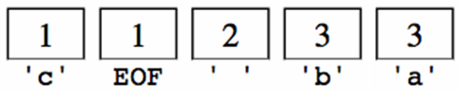
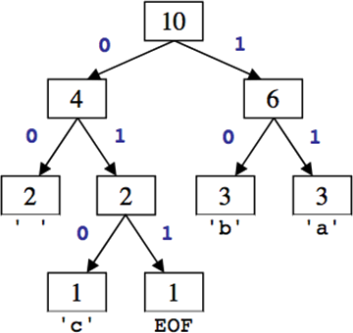
Huffman Compression – Overview
Count the occurrences of each character in the file
  S ay: ' ' = 2, 'a' = 3, 'b' = 3, 'c' = 1, EOF = 1
Place character and counts in a priority queue
Use priority queue to create Huffman tree →
Traverse tree to find (char → binary) map
  ' ' = 00, 'a' = 11, 'b' = 10, 'c' = 010, EOF = 011
For each char in file, convert to compressed binary version
  11 10 00 11 10 00 010 1 1 10 011

Slide 14
Step 1: Count Characters
Example message (input file) contents:
ab ab cab
  counts: { ' ' = 2, 'b'=3, 'a' =3, 'c' =1, EOF=1 }
  File size currently = 10 bytes = 80 bits
file ends with an invisible EOF character
byte | 1 | 2 | 3 | 4 | 5 | 6 | 7 | 8 | 9 | 10
char | 'a' | 'b' | ' ' | 'a' | 'b' | ' ' | 'c' | 'a' | 'b' | EOF
ASCII | 97 | 98 | 32 | 97 | 98 | 32 | 99 | 97 | 98 | 256
binary | 01100001 | 01100010 | 00100000 | 01100001 | 01100010 | 00100000 | 01100011 | 01100001 | 01100010 | N/A

Slide 15

Step 2: Create a Priority Queue
Each node of the PQ is a tree
  The root of the tree is the ‘key’
  The other internal nodes hold ‘subkeys’
  The leaves hold the character values
Insert each into the PQ using the PQ’s function
  insertItem(count, character)
The PQ should organize them into ascending order
  So the largest value is lowest priority
    You can think of this as an ordered list
      But the PQ could be implemented in whatever way works best
        could be a minheap
.
1
These are all
one node trees
front and back used to show priority ordering
i.e. the order things would be removed from the PQ

Slide 16
Step 2: Create a Priority Queue
Each node of the PQ is a tree
  The root of the tree is the ‘key’
  The other internal nodes hold ‘subkeys’
  The leaves hold the character values
Insert each into the PQ using the PQ’s function
  insertItem(count, character)
The PQ should organize them into ascending order
  So the smallest value is highest priority
    We will use an example with the PQ implemented as an ordered list
      But the PQ could be implemented in whatever way works best
        could be a minheap, unordered list, or ‘other’

Slide 17
Step 2: PQ Creation, An Illustration
From step 1 we have
  counts: { ' ' = 2, 'b'=3, 'a'=3, 'c'=1, EOF=1 }
Make these into trees
Add the trees to a Priority Queue
  Assume PQ is implemented as a sorted list

Slide 18
Step 2: PQ Creation, An Illustration
From step 1 we have
  counts: { ' ' = 2, 'b'=3, 'a'=3, 'c'=1, EOF=1 }
Make these into trees
Add the trees to a Priority Queue
  Assume PQ is implemented as a sorted list
2
3
3
1
1
' '
b
a
c
EOF

Slide 19
Step 2: PQ Creation, An Illustration
From step 1 we have
  counts: { ' ' = 2, 'b'=3, 'a'=3, 'c'=1, EOF=1 }
Make these into trees
Add the trees to a Priority Queue
  Assume PQ is implemented as a sorted list
Recall: Each Insert is an O(n) operation
This is done n times. So this is O(n²)
3
2
1
3
1
b
' '
EOF
a
c

Slide 20
Step 3: Build the Huffman Tree
All nodes should be in the PQ
While PQ.size() > 1
  Remove the two highest priority (rarest) nodes
    Nodes removed first time through will be single node trees
    Removal done using PQ’s removeMin() function
  Combine the two nodes into a single node
    First time through this will create a tree of 3 nodes
      root node = sum of the counts of the 2 selected chars
    So the new node is a tree with
      root having key value = sum of keys of nodes removed
      left subtree is the first removed node
      right subtree is the second removed node
Example next slide

Slide 21
Step 3: Build the Huffman Tree
Aside: All nodes should be in the PQ
While PQ.size() > 1
  Remove the two highest priority (rarest) nodes
    Removal done using PQ’s removeMin() function
  Combine the two nodes into a single node
    So the new node is a tree with
      root has key value = sum of keys of nodes being combined
      left subtree is the first removed node
      right subtree is the second removed node
  Insert the combined node back into the PQ
end While
Remove the one node from the PQ
  This is the Huffman Tree
Example next slide

Slide 22
Step 3a: Building Huffman Tree, Illus.
Remove the two highest priority (rarest) nodes
1
1
2
3
3
c
EOF
' '
b
a

Slide 23
Step 3b: Building Huffman Tree, Illus.
Combine the two nodes into a single node
2
3
3
' '
b
a
2
1
1
c
EOF

Slide 24
Step 3c: Building Huffman Tree, Illus.
Insert the combined node back into the PQ
2
3
3
' '
b
a
2
1
1
c
EOF

Slide 25
Step 3d: Building Huffman Tree, Illus.
PQ has 4 nodes still, so repeat
2
2
3
3
' '
b
a
1
1
c
EOF

Slide 26
Step 3a: Building Huffman Tree, Illus.
Remove the two highest priority (rarest) nodes
2
2
3
3
' '
b
a
1
1
c
EOF

Slide 27
Step 3b: Building Huffman Tree, Illus.
Combine the two nodes into a single node
3
3
b
a
4
2
2
' '
1
1
c
EOF

Slide 28
Step 3c: Building Huffman Tree, Illus.
Insert the combined node back into the PQ
3
3
b
a
4
2
2
' '
1
1
c
EOF

Slide 29
Step 3d: Building Huffman Tree, Illus.
3 nodes remain in PQ, repeat again
3
3
4
b
a
2
2
' '
1
1
c
EOF

Slide 30
Step 3a: Building Huffman Tree, Illus.
Remove the two highest priority (rarest) nodes
3
3
4
b
a
2
2
' '
1
1
c
EOF

Slide 31
Step 3b: Building Huffman Tree, Illus.
Combine the two nodes into a single node
4
6
2
2
3
3
' '
b
a
1
1
c
EOF

Slide 32
Step 3c: Building Huffman Tree, Illus.
Insert the combined node back into the PQ
4
6
2
2
3
3
' '
b
a
1
1
c
EOF

Slide 33
Step 3d: Building Huffman Tree, Illus.
2 nodes still in PQ, repeat one more time
4
6
2
2
3
3
' '
b
a
1
1
c
EOF

Slide 34
Step 3a: Building Huffman Tree, Illus.
Remove the two highest priority (rarest) nodes
4
6
2
2
3
3
' '
b
a
1
1
c
EOF

Slide 35
Step 3b: Building Huffman Tree, Illus.
Combine the two nodes into a single node
10
4
6
2
2
3
3
' '
b
a
1
1
c
EOF

Slide 36
Step 3c: Building Huffman Tree, Illus.
Insert the combined node back into the PQ
10
4
6
2
2
3
3
' '
b
a
1
1
c
EOF

Slide 37
Step 3d: Building Huffman Tree, Illus.
Only 1 node remains in the PQ, so while loop ends
10
4
6
2
2
3
3
' '
b
a
1
1
c
EOF

Slide 38
Step 3: Building Huffman Tree, Illus.
Huffman tree is complete
10
4
6
2
2
3
3
' '
b
a
1
1
c
EOF

Slide 39
Huffman Compression – Overview
Count the occurrences of each character in the file
  S ay: ' ' = 2, 'a' = 3, 'b' = 3, 'c' = 1, EOF = 1
Place character and counts in a priority queue
Use priority queue to create Huffman tree →
Traverse tree to find (char → binary) map
  ' ' = 00, 'a' = 11, 'b' = 10, 'c' = 010, EOF = 011
For each char in file, convert to compressed binary version
  11 10 00 11 10 00 010 1 1 10 011

Slide 40
Huffman Compression – Overview
Step 1
  Count characters (frequency of characters in the message)
Step 2
  Create a Priority Queue
Step 3
  Build a Huffman Tree
Step 4
  Traverse the Tree to find the Character to Binary Mapping
Step 5
  Use the mapping to encode the message

Slide 41
Step 4: Traverse Tree to Find the Character to Binary Mapping
' ' =
'c' =
EOF =
'b' =
'a' =
Recall
Left is 0
Right is 1
10
4
6
2
2
3
3
' '
b
a
1
1
c
EOF

Slide 42
Step 4: Traverse Tree to Find the Character to Binary Mapping
' ' =
'c' =
EOF =
'b' =
'a' =
00
Recall
Left is 0
Right is 1
10
0
4
6
0
2
2
3
3
' '
b
a
1
1
c
EOF

Slide 43
Step 4: Traverse Tree to Find the Character to Binary Mapping
' ' =
'c' =
EOF =
'b' =
'a' =
00
010
Recall
Left is 0
Right is 1
10
0
4
6
1
2
2
3
3
0
' '
b
a
1
1
c
EOF

Slide 44
Step 4: Traverse Tree to Find the Character to Binary Mapping
' ' =
'c' =
EOF =
'b' =
'a' =
00
010
Recall
Left is 0
Right is 1
10
011
0
4
6
1
2
2
3
3
1
' '
b
a
1
1
c
EOF

Slide 45
Step 4: Traverse Tree to Find the Character to Binary Mapping
' ' =
'c' =
EOF =
'b' =
'a' =
00
010
Recall
Left is 0
Right is 1
10
011
1
10
4
6
0
2
2
3
3
' '
b
a
1
1
c
EOF

Slide 46
Step 4: Traverse Tree to Find the Character to Binary Mapping
' ' =
'c' =
EOF =
'b' =
'a' =
00
010
Recall
Left is 0
Right is 1
10
011
1
10
11
4
6
1
2
2
3
3
' '
b
a
1
1
c
EOF

Slide 47
Huffman Compression – Overview
Count the occurrences of each character in the file
  S ay: ' ' = 2, 'a' = 3, 'b' = 3, 'c' = 1, EOF = 1
Place character and counts in a priority queue
Use priority queue to create Huffman tree →
Traverse tree to find (char → binary) map
  ' ' = 00, 'a' = 11, 'b' = 10, 'c' = 010, EOF = 011
For each char in file, convert to compressed binary version
  11 10 00 11 10 00 010 1 1 10 011

Slide 48
Huffman Compression – Overview
Step 1
  Count characters (frequency of characters in the message)
Step 2
  Create a Priority Queue
Step 3
  Build a Huffman Tree
Step 4
  Traverse the Tree to find the Character to Binary Mapping
Step 5
  Use the mapping to encode the message

Slide 49
Step 5: Encode the Message
file ends with an invisible EOF character
' ' = 00
'c' = 010
EOF = 011
'b' = 10
'a' = 11
Example message (input file) contents:
ab ab cab
10
4
6
2
2
3
3
' '
b
a
1
1
c
EOF

Slide 50
Graded In Class Assignment: Encode the Message
' ' = 00
'c' = 010
EOF = 011
'b' = 10
'a' = 11
Example message (input file) contents:
ab ab cab
file ends with an invisible EOF character
ICA310_EncodeMessage
Save the encoded message as a text (.txt) file and upload to the appropriate D2L dropbox
  before class ends today

Slide 51
Step 5: Encode the Message
file ends with an invisible EOF character
' ' = 00
'c' = 010
EOF = 011
'b' = 10
'a' = 11
Example message (input file) contents:
ab ab cab
11

Slide 52
Step 5: Encode the Message
file ends with an invisible EOF character
' ' = 00
'c' = 010
EOF = 011
'b' = 10
'a' = 11
Example message (input file) contents:
ab ab cab
1110

Slide 53
Step 5: Encode the Message
file ends with an invisible EOF character
' ' = 00
'c' = 010
EOF = 011
'b' = 10
'a' = 11
Example message (input file) contents:
ab ab cab
111000

Slide 54
Step 5: Encode the Message
file ends with an invisible EOF character
' ' = 00
'c' = 010
EOF = 011
'b' = 10
'a' = 11
Example message (input file) contents:
ab ab cab
11100011

Slide 55
Step 5: Encode the Message
file ends with an invisible EOF character
' ' = 00
'c' = 010
EOF = 011
'b' = 10
'a' = 11
Example message (input file) contents:
ab ab cab
1110001110

Slide 56
Step 5: Encode the Message
file ends with an invisible EOF character
' ' = 00
'c' = 010
EOF = 011
'b' = 10
'a' = 11
Example message (input file) contents:
ab ab cab
111000111000

Slide 57
Step 5: Encode the Message
file ends with an invisible EOF character
' ' = 00
'c' = 010
EOF = 011
'b' = 10
'a' = 11
Example message (input file) contents:
ab ab cab
111000111000010

Slide 58
Step 5: Encode the Message
file ends with an invisible EOF character
' ' = 00
'c' = 010
EOF = 011
'b' = 10
'a' = 11
Example message (input file) contents:
ab ab cab
11100011100001011

Slide 59
Step 5: Encode the Message
file ends with an invisible EOF character
' ' = 00
'c' = 010
EOF = 011
'b' = 10
'a' = 11
Example message (input file) contents:
ab ab cab
1110001110000101110

Slide 60
Step 5: Encode the Message
file ends with an invisible EOF character
' ' = 00
'c' = 010
EOF = 011
'b' = 10
'a' = 11
Example message (input file) contents:
ab ab cab
1110001110000101110011

Slide 61
Step 5: Encode the Message
file ends with an invisible EOF character
' ' = 00
'c' = 010
EOF = 011
'b' = 10
'a' = 11
Example message (input file) contents:
ab ab cab
1110001110000101110011
Count the bits used = 22 bits
versus the 80
  previously needed
File is almost ¼ the size
  lots of savings

Slide 62
Decompression
From the previous tree shown we now have the message characters encoded as:
Which compresses to bytes 3 like so:
How to decompress?
  Hint: Lookup table is not the best answer,
  what is the first symbol?... 1=? or is it 11? or 111? or 1110? or…
char | 'a' | 'b' | ' ' | 'a' | 'b' | ' ' | 'c' | 'a' | 'b' | EOF
binary | 11 | 10 | 00 | 11 | 10 | 00 | 010 | 11 | 10 | 011
byte | 1 | 2 | 3
char | a b a | b c a | b EOF
binary | 11 10 00 11 | 10 00 010 1 | 1 10 011

Slide 63
Decompression via Tree
The tree is known to the recipient of the message
  So use it
To identify symbols we will
Apply the Prefix Property
  No encoding A is the prefix of another encoding B
  Never will have x→011 and y→011100110

Slide 64
Decompression via Tree
Apply the Prefix Property
  No encoding A is the prefix of another encoding B
  Never will have x→011 and y→011100110
the Algorithm
  Read each bit one at a time from the input
  If the bit is 0 go left in the tree
  Else if the bit is 1 go right
  If you reach a leaf node
    output the character at that leaf
    and go back to the tree root

Slide 65
Decompressing Example
Say the encrypted message was:
1011010001101011011
    note: this is NOT the same message as the encryption just done (but the tree the is same)
10
4
6
Read each bit one at a time
If it is 0 go left
If it is 1 go right
If you reach a leaf, output the character there and go back to the tree root
2
2
3
3
' '
b
a
1
1
c
EOF

Slide 66
Class Activity: Decompressing Example
Say the encrypted message was:
1011010001101011011
    note: this is NOT the same message as the encryption just done (but the tree the is same)
10
4
6
Read each bit one at a time
If it is 0 go left
If it is 1 go right
If you reach a leaf, output the character there and go back to the tree root
2
2
3
3
' '
b
a
1
1
Pause for students to complete
c
EOF

Slide 67
Decompressing Example
Say the encrypted message was:
1011010001101011011
10
1
4
6
Read each bit one at a time
If it is 0 go left
If it is 1 go right
If you reach a leaf, output the character there and go back to the tree root
2
2
3
3
' '
b
a
1
1
c
EOF

Slide 68
Decompressing Example
Say the encrypted message was:
1011010001101011011
10
b
1
4
6
0
Read each bit one at a time
If it is 0 go left
If it is 1 go right
If you reach a leaf, output the character there and go back to the tree root
2
2
3
3
' '
b
a
1
1
c
EOF

Slide 69
Decompressing Example
Say the encrypted message was:
1011010001101011011
10
b
1
4
6
Read each bit one at a time
If it is 0 go left
If it is 1 go right
If you reach a leaf, output the character there and go back to the tree root
2
2
3
3
' '
b
a
1
1
c
EOF

Slide 70
Decompressing Example
Say the encrypted message was:
1011010001101011011
10
b
a
1
4
6
1
Read each bit one at a time
If it is 0 go left
If it is 1 go right
If you reach a leaf, output the character there and go back to the tree root
2
2
3
3
' '
b
a
1
1
c
EOF

Slide 71
Decompressing Example
Say the encrypted message was:
1011010001101011011
10
b
a
0
4
6
Read each bit one at a time
If it is 0 go left
If it is 1 go right
If you reach a leaf, output the character there and go back to the tree root
2
2
3
3
' '
b
a
1
1
c
EOF

Slide 72
Decompressing Example
Say the encrypted message was:
1011010001101011011
10
b
a
0
4
6
1
Read each bit one at a time
If it is 0 go left
If it is 1 go right
If you reach a leaf, output the character there and go back to the tree root
2
2
3
3
' '
b
a
1
1
c
EOF

Slide 73
Decompressing Example
Say the encrypted message was:
1011010001101011011
10
b
a
c
0
4
6
1
Read each bit one at a time
If it is 0 go left
If it is 1 go right
If you reach a leaf, output the character there and go back to the tree root
2
2
3
3
0
' '
b
a
1
1
c
EOF

Slide 74
Decompressing Example
Say the encrypted message was:
1011010001101011011
10
b
a
c
0
4
6
Read each bit one at a time
If it is 0 go left
If it is 1 go right
If you reach a leaf, output the character there and go back to the tree root
2
2
3
3
' '
b
a
1
1
c
EOF

Slide 75
Decompressing Example
Say the encrypted message was:
1011010001101011011
10
b
a
c
0
4
6
0
Read each bit one at a time
If it is 0 go left
If it is 1 go right
If you reach a leaf, output the character there and go back to the tree root
2
2
3
3
' '
b
a
1
1
c
EOF

Slide 76
Decompressing Example
Say the encrypted message was:
1011010001101011011
10
b
a
c
1
4
6
Read each bit one at a time
If it is 0 go left
If it is 1 go right
If you reach a leaf, output the character there and go back to the tree root
2
2
3
3
' '
b
a
1
1
c
EOF

Slide 77
Decompressing Example
Say the encrypted message was:
1011010001101011011
10
b
a
c
a
1
4
6
Read each bit one at a time
If it is 0 go left
If it is 1 go right
If you reach a leaf, output the character there and go back to the tree root
1
2
2
3
3
' '
b
a
1
1
c
EOF

Slide 78
Decompressing Example
Say the encrypted message was:
1011010001101011011
10
b
a
c
a
0
4
6
Read each bit one at a time
If it is 0 go left
If it is 1 go right
If you reach a leaf, output the character there and go back to the tree root
2
2
3
3
' '
b
a
1
1
c
EOF

Slide 79
Decompressing Example
Say the encrypted message was:
1011010001101011011
10
b
a
c
a
0
4
6
Read each bit one at a time
If it is 0 go left
If it is 1 go right
If you reach a leaf, output the character there and go back to the tree root
1
2
2
3
3
' '
b
a
1
1
c
EOF

Slide 80
Decompressing Example
Say the encrypted message was:
1011010001101011011
10
b
a
c
a
c
0
4
6
Read each bit one at a time
If it is 0 go left
If it is 1 go right
If you reach a leaf, output the character there and go back to the tree root
1
2
2
3
3
0
' '
b
a
1
1
c
EOF

Slide 81
Decompressing Example
Say the encrypted message was:
1011010001101011011
10
b
b
c
a
c
a
1
a
c
4
6
Read each bit one at a time
If it is 0 go left
If it is 1 go right
If you reach a leaf, output the character there and go back to the tree root
2
2
3
3
' '
b
a
1
1
c
EOF

Slide 82
Decompressing Example
Say the encrypted message was:
1011010001101011011
10
b
a
c
a
c
a
1
4
6
Read each bit one at a time
If it is 0 go left
If it is 1 go right
If you reach a leaf, output the character there and go back to the tree root
1
2
2
3
3
' '
b
a
1
1
c
EOF

Slide 83
Decompressing Example
Say the encrypted message was:
1011010001101011011
10
b
a
c
a
c
a
0
4
6
Read each bit one at a time
If it is 0 go left
If it is 1 go right
If you reach a leaf, output the character there and go back to the tree root
2
2
3
3
' '
b
a
1
1
c
EOF

Slide 84
Decompressing Example
Say the encrypted message was:
1011010001101011011
10
b
a
c
a
c
a
0
4
6
1
Read each bit one at a time
If it is 0 go left
If it is 1 go right
If you reach a leaf, output the character there and go back to the tree root
2
2
3
3
' '
b
a
1
1
c
EOF

Slide 85
Decompressing Example
Say the encrypted message was:
1011010001101011011
10
b
a
c
a
c
a
EOF
0
4
6
1
Read each bit one at a time
If it is 0 go left
If it is 1 go right
If you reach a leaf, output the character there and go back to the tree root
2
2
3
3
1
' '
b
a
1
1
c
EOF

Slide 86
Decompressing Example
Say the encrypted message was:
1011010001101011011
10
b
a
c
a
c
a
EOF
4
6
And the file is now decoded
Read each bit one at a time
If it is 0 go left
If it is 1 go right
If you reach a leaf, output the character there and go back to the tree root
2
2
3
3
' '
b
a
1
1
c
EOF

Slide 87
The End of This Part
End

