Slide 1
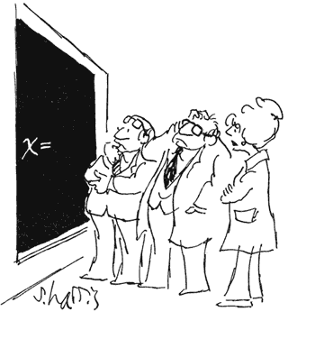
Test 3 Review
Data Structures and Algorithms
CS 244
Brent M. Dingle, Ph.D.
Department of Mathematics, Statistics, and Computer Science
University of Wisconsin – Stout
Based on the book: Data Structures and Algorithms in C++ (Goodrich, Tamassia, Mount)
Some content from Data Structures Using C++ (D.S. Malik)

Slide 2
Test Layout
Same as previous
5 to 10 true/false
5 to 10 multiple choice
10 to 20 short answer or fill in the blank
some coding/algorithm design
lots of problem solving using data structures and algorithms
100 points maximum
but more than 100 points possible
currently looking like 105, maybe 110
select your own “bonus”

Slide 3
Test Topics
Technically test 3 is not cumulative
HOWEVER
Everything builds

Slide 4
Unit 1 Background Stuff
C++
UML
Big-Oh
Misc Other

Slide 5
Unit 2 Background Stuff
Know how each of the following works, common functions, relation of implementation and Big Oh
Arrays (static and dynamic)
Linked Lists (singly linked and doubly linked)
Stacks
Queues
Deques
Misc Other

Slide 6
Example Summary: Stacks
Stacks can be implemented using different data structures
 | Array Fixed-Size | Array Expandable (doubling strategy) | Singly Linked List
Pop() | O(1) | O(1) | O(1)
Push(o) | O(1) | O(1) Average Case | O(1)
Top() | O(1) | O(1) | O(1)
Size(), isEmpty() | O(1) | O(1) | O(1)
Fixed Arrays
maximum number of items can be pushed
Expandable/Dynamic Arrays
push is O(1) only via amortized time analysis, so sometimes it takes longer, but on average is O(1)
Singly Linked list
no maximum, but have to manage memory
Seems all the same…
what’s the real difference between
them if not in run-times?

Slide 7
Example Summary: Queues
Queues can be implemented using different data structures
Queue Ops | Array Fixed-Size | Array Expandable (doubling strategy) | List Singly-Linked
dequeue() | O(1) | O(1) | O(1)
enqueue(o) | O(1) | O(1) Average Case | O(1)
front() | O(1) | O(1) | O(1)
size(), isEmpty() | O(1) | O(1) | O(1)
Fixed Arrays
maximum number of items can be enqueued
Expandable/Dynamic Arrays
enqueue is O(1) only via amortized time analysis, so sometimes it takes longer, but on average is O(1)
Singly Linked list
no maximum, but have to manage memory
Seems all the same…
what’s the real difference between
them if not in run-times?

Slide 8
Example Summary: Deque
Deques can be implemented using different data structures
 | Array Fixed-Size | Array Expandable (doubling strategy) | List Singly-Linked | List Doubly-Linked
removeFirst() | O(1) | O(1) | O(1) | O(1)
removeLast() | O(1) | O(1) | O(n) | O(1)
insertFirst(o), InsertLast(o) | O(1) | O(1) Average Case | O(1) | O(1)
first(), last | O(1) | O(1) | O(1) | O(1)
size(), isEmpty() | O(1) | O(1) | O(1) | O(1)
Fixed Arrays
maximum number of items can be inserted
Expandable/Dynamic Arrays
insert is O(1) only via amortized time analysis, so sometimes it takes longer, but on average is O(1)
Singly and Doubly Linked list
no maximum, but have to manage memory
ALMOST all the same…
what’s the real difference between
them if not in run-times?

Slide 9
Book’s Vector Summary
This is not necessarily same as std::vector,
It is to show the possible consequences of using a vector (dynamic array)
and possible another reason for amortized analysis
 | Array Fixed-Size or Dynamic
RemoveAtRank(r), InsertAtRank(r,o) | O(n) Average Case
elemAtRank(r), ReplaceAtRank(r,o) | O(1)
Size(), isEmpty() | O(1)
NOTE: Vectors generalize arrays

Slide 10
Generalizing Things
We have
Vectors and Lists
We can make other things from them
Stacks, Queues, Deques
Can we generalize/merge vectors and lists into ONE data type?
So stacks, queues, and stuff made out of ONE data type and the details fall into the implementation of that data type

Slide 11
Sequences
Sequence ADT is the union of vectors and lists
Elements are accessed by rank OR position

Slide 12
Sequences
Sequence ADT is the union of vectors and lists
Elements are accessed by rank OR position
Operation | Array | List
size, isEmpty | 1 | 1
atRank, rankOf, elemAtRank | 1 | n
first, last, before, after | 1 | 1
replaceElement, swapElements | 1 | 1
replaceAtRank | 1 | n
insertAtRank, removeAtRank | n | n
insertFirst, insertLast | 1 | 1
insertAfter, insertBefore | n | 1
remove | n | 1
Generic Methods

Slide 13
Sequences
Sequence ADT is the union of vectors and lists
Elements are accessed by rank OR position
Operation | Array | List
size, isEmpty | 1 | 1
atRank, rankOf, elemAtRank | 1 | n
first, last, before, after | 1 | 1
replaceElement, swapElements | 1 | 1
replaceAtRank | 1 | n
insertAtRank, removeAtRank | n | n
insertFirst, insertLast | 1 | 1
insertAfter, insertBefore | n | 1
remove | n | 1
Vector based methods

Slide 14
Sequences
Sequence ADT is the union of vectors and lists
Elements are accessed by rank OR position
Operation | Array | List
size, isEmpty | 1 | 1
atRank, rankOf, elemAtRank | 1 | n
first, last, before, after | 1 | 1
replaceElement, swapElements | 1 | 1
replaceAtRank | 1 | n
insertAtRank, removeAtRank | n | n
insertFirst, insertLast | 1 | 1
insertAfter, insertBefore | n | 1
remove | n | 1
List based methods

Slide 15
Sequences
Sequence ADT is the union of vectors and lists
Elements are accessed by rank OR position
Operation | Array | List
size, isEmpty | 1 | 1
atRank, rankOf, elemAtRank | 1 | n
first, last, before, after | 1 | 1
replaceElement, swapElements | 1 | 1
replaceAtRank | 1 | n
insertAtRank, removeAtRank | n | n
insertFirst, insertLast | 1 | 1
insertAfter, insertBefore | n | 1
remove | n | 1
Bridge methods

Slide 16
Other Data Types in the Background
Standard Template Library stuff
using std namespace
strings, vectors, etc

Slide 17
Other ADT things
Understand and be able to read (use if given) the ADTs of
Iterator
Position
Locator
Comparator
etc

Slide 18
Early Sorting Algorithms
Algorithm | Time | Notes
Selection Sort | O(n²) | Slow, in-place For small data sets
Insertion Sort | O(n²) | Slow, in-place For small data sets
Bubble Sort | O(n²) | Slow, in-place For small data sets
Heap Sort | O(nlog n) | Fast, in-place For large data sets
Merge Sort | O(nlogn) | Fast, sequential data access For huge data sets
All three seem the same, BUT
The Best Case for Insertion and Bubble Sort turns out to be O(n)… average and worst case is O(n^2)
Yet the best case for selection sort remains O(n^2)
Later classes may emphasize these types of differences in greater depth

Slide 19
Then Came Merge Sort
Visualizing Merge Sort used a Tree-Like structure
7 2 ⏐ 9 4 → 2 4 7 9
Its runtime is O(n lg n)
Proving that relied heavily on the fact the number of times N can be divided by two is roughly lg(N)
The algorithm itself is fast, uses sequential data access and works well on huge data sets
7 ⏐ 2 → 2 7
9 ⏐ 4 → 4 9
7 → 7
2 → 2
9 → 9
4 → 4
Algorithm | Time | Notes
Merge Sort | O(n lg n) | Fast, sequential data access For huge data sets

Slide 20
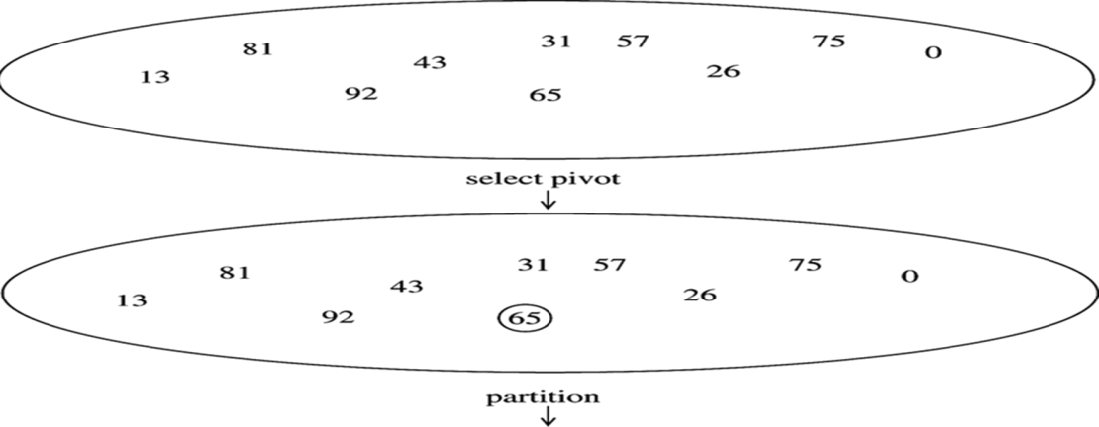
Then Quick Sort
Given an array of n elements (e.g., integers):
If array only contains one element, return
Else
pick one element to use as pivot.
Partition elements into two sub-arrays:
Elements less than or equal to pivot
Elements greater than pivot
Quicksort two sub-arrays
Return results
recursive calls

Slide 21
Quick Sort: Details
There were scenarios quicksort did not do so well in
See lecture DS19_aQuickSort for more information
In sum though:
Algorithm | Time | Notes
Quick Sort | O(nlogn) | Assumes key values are random and uniformly distributed

Slide 22
Next Were Trees
General Trees
and Binary Trees
And Traversal methods

Slide 23
Tree Traversal Notes
Pre-Order, In-Order, Post-Order
All “visit” each node in a tree exactly once
Pretend the tree is an overhead view of a wall
Maybe the nodes are towers (doesn’t matter)
We want to walk all the way around the wall structure
We begin above the root node, facing towards it
We then place our left hand against the node
and walk all the way around the wall structure
so that our left hand never leaves the wall
+
×
×
2
−
3
2
5
1

Slide 24
Tree Traversal Notes
Pre-Order, In-Order, Post-Order
All “visit” each node in a tree exactly once
Pretend the tree is an overhead view of a wall
Maybe the nodes are towers (doesn’t matter)
We want to walk all the way around the wall structure
We begin above the root node, facing towards it
We then place our left hand against the node
and walk all the way around the wall structure
so that our left hand never leaves the wall
+
×
×
2
−
3
2
5
1

Slide 25
Tree Traversal Notes
Pre-Order, In-Order, Post-Order
All “visit” each node in a tree exactly once
Pretend the tree is an overhead view of a wall
Maybe the nodes are towers (doesn’t matter)
We want to walk all the way around the wall structure
We begin above the root node, facing towards it
We then place our left hand against the node
and walk all the way around the wall structure
so that our left hand never leaves the wall
+
×
×
2
−
3
2
5
1

Slide 26
Tree Traversal Notes
Pre-Order, In-Order, Post-Order
All “visit” each node in a tree exactly once
Pretend the tree is an overhead view of a wall
Maybe the nodes are towers (doesn’t matter)
We want to walk all the way around the wall structure
We begin above the root node, facing towards it
We then place our left hand against the node
and walk all the way around the wall structure
so that our left hand never leaves the wall
+
×
×
2
−
3
2
5
1

Slide 27
Generalizing
We will now encounter each node 3 times
Once on the ‘left’ side
with respect to the paper
Once on the ‘bottom’ side
with respect to the paper
Once on the right side
with respect to the paper
+
L
×
×
2
−
3
2
5
1

Slide 28
Generalizing
Pre-Order, In-Order, Post-Order
All “visit” each node in a tree exactly once
We will now encounter each node 3 times
Once on the ‘left’ side
with respect to the paper
Once on the ‘bottom’ side
with respect to the paper
Once on the right side
with respect to the paper
+
L
×
×
B
2
−
3
2
5
1

Slide 29
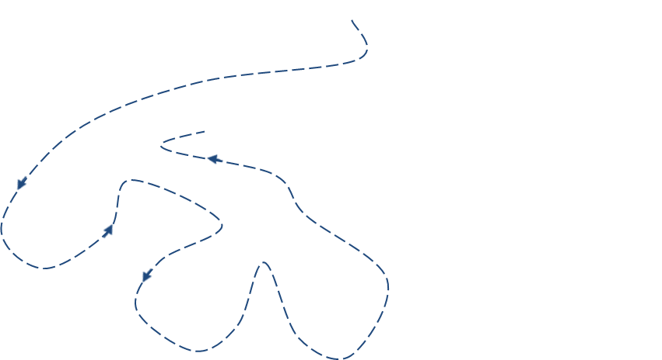
Generalizing
We will now encounter each node 3 times
Once on the ‘left’ side
with respect to the paper
Once on the ‘bottom’ side
with respect to the paper
Once on the ‘right’ side
with respect to the paper
+
L
×
R
×
B
2
−
3
2
5
1

Slide 30
Euler Tour
This is an Euler Tour
Generic traversal of a binary tree
Includes as special cases the pre-order, post-order and in-order traversals
Walk around the tree and visit each node three times:
on the left (pre-order)
from below (in-order)
on the right (post-order)
+
L
×
R
×
B
2
−
3
2
5
1

Slide 31
Euler Tour Traversal
Algorithm eulerTour(p)
left-visit-action(p)
if isInternal(p)
eulerTour(p.left())
bottom-visit-action(p)
if isInternal(p)
eulerTour(p.right())
right-visit-action(p)
End Algorithm
Notice leaf nodes all three visits
happen one right after the other
(effectively all at the same “time” )
+
L
×
R
×
B
2
−
3
2
5
1

Slide 32
Tree Traversal Applications
Be able to apply tree traversal methods to solve various types of problems
Most likely Binary Trees and their traversal will be important

Slide 33
End “in the background”
In sum
Remember the stuff that came before
May have to use it

Slide 34
Unit 3
Began with
trees, binary trees, tree traversals
Next was Priority Queues (PQs)
Two types
Min and Max
Heavy emphasis on PQ Sorting
Insert Items
Remove Items in priority order
Good example of
How the choice of data structure can influence the runtime of an algorithm

Slide 35
Priority Queue Sort Summary
PQ-Sort consists of n insertions followed by n removeItem operations
 | Insert | Remove | PQ-Sort Total
Insertion Sort (ordered sequence) | O(n) | O(1) | O(n²)
Selection Sort (unordered sequence) | O(1) | O(n) | O(n²)
Heap Sort (binary heap, vector-based implementation) | O(logn) | O(logn) | O(n logn)
Of course to do a Heap Sort we presented Heaps first…

Slide 36
Heaps
Heaps
Two major properties
Structure = complete binary tree
Order property = key value of each node is at least as small/large as the key of its children
So also two types: Min and Max
Look like Binary Trees
Usually implemented using vectors
Building top-down: O(n lg n) time
Removing items
Sorting “in-place” with a single array
Reheap up and Reheap down support functions
Building bottom-up
faster than building top-down: O(n) time
but sort still runs in O(n lg n) time
Parent
⎣(i-1)/2⎦
i
2i+1
Left Child
2i+2
Right Child

Slide 37
Application of Data Structures
We side tracked a little to see an application of trees and priority queue sorting in action
Huffman Encoding

Slide 38
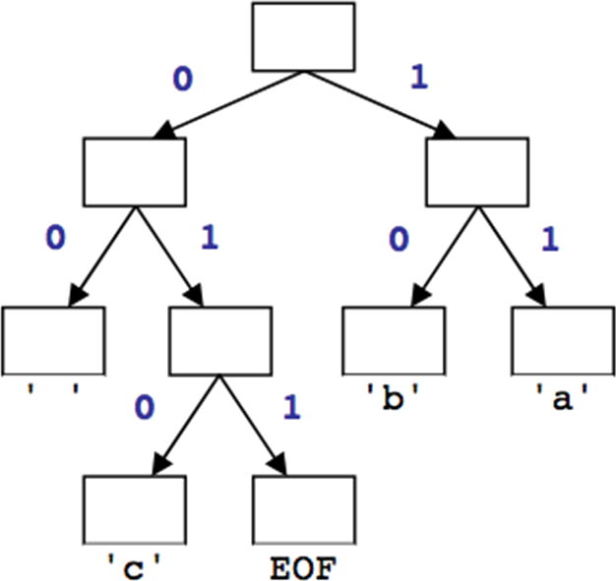
Huffman’s Algorithm
The idea: Create a “Huffman Tree” that will tell us a good binary representation for each character
Left means 0
Right means 1
Example 'b‘ is 10
More frequent characters will be higher in the tree (have a shorter binary value).
To build this tree, we must do a few steps first
Count occurrences of each unique character in the file to compress
Use a priority queue to order them from least to most frequent
Make a tree and use it

Slide 39
Huffman Compression – Overview
Step 1
Count characters (frequency of characters in the message)
Step 2
Create a Priority Queue
Step 3
Build a Huffman Tree
Step 4
Traverse the Tree to find the Character to Binary Mapping
Step 5
Use the mapping to encode the message

Slide 40
Huffman Decompression via Tree
Apply the Prefix Property
No encoding A is the prefix of another encoding B
Never will have x→011 and y→011100110
the Algorithm
Read each bit one at a time from the input
If the bit is 0 go left in the tree
Else if the bit is 1 go right
If you reach a leaf node
output the character at that leaf
and go back to the tree root

Slide 41
Sorting Summary
Sorting discussions (sort of) ended here and we moved onto searching
Sorting Summary (some sorts may be omitted)
check previous lectures, homework, book for others
Algorithm | Time | Notes
Selection Sort | O(n²) | Slow, in-place For small data sets
Insertion Sort | O(n²) | Slow, in-place For small data sets
Bubble Sort | O(n²) | Slow, in-place For small data sets
Heap Sort | O(n lg n) | Fast, in-place For large data sets
Merge Sort | O(n lg n) | Fast, sequential data access For huge data sets
Quick Sort | O(n lg n) | Assumes key values are random and uniformly distributed

Slide 42
Searching Begins
Binary Search Trees (BSTs)
adding nodes
deleting nodes
searching tree for value
Example find: F
D
D
E
B
E
A
G
C
G
F
H
F

Slide 43
Nicely Built Matters
Height Balanced BSTs
Basic idea of AVL Tree
An AVL Tree, or height-balanced tree, is a binary search tree such that
The heights of the left and right subtrees of the root differ by at most 1
The left and right subtrees of the root are AVL trees

Slide 44
AVL Trees
Data structure of nodes
includes balance factor
Inserting Nodes
Deleting Nodes
Rotations used to maintain balance

Slide 45
Decision Trees
Application of binary trees
Relates to BSTs and AVL trees

Slide 46
More ADTs
Maps and Dictionaries
List of keys with data associated to the key
The main difference from a map is that dictionaries allow multiple items with the same key
Again ordered versus unordered sequence implementations
Linear Search versus Binary Search
Example: Direct Address Tables
Problem: Needs too much memory if large number of possible keys

Slide 47
Hash Tables
Improves Direct Address Table idea
Uses a hash function, h: U-> {0, …, m-1} that maps keys to positions in the hash table
Benefit: Reduces memory needed
The size of the table is m, not the size of the universe of keys

Slide 48
Hash Functions
Typically use mod functions with prime numbers
Problem:
Collisions

Slide 49
Resolving Collisions
Chaining
Open Addressing
Linear Probing
Quadratic Probing
Double hashing

Slide 50
Last Major Topic: Graphs
Graph Theory
Definitions needed so we can discuss implementation
Graphs are vertices connected with edges
Trees are a type of graph (with no cycles)
Graph Representation
Adjacency Matrices
Adjacency Lists
Pulls together lots of stuff
vectors, lists, UML, C++ classes,

Slide 51
Breadth First Traversal
Example Algorithm to traverse a graph
Typically the traversal of nodes is listed as they are discovered and marked as visited per the algorithm
For this class can assume adjacent nodes of a given vertex are listed in alphabetical or numerically increasing order (unless specified otherwise)
A, B, C… or 1, 2, 3 order
If given a tree a Breadth First Traversal typically equates to reading the nodes in each level of the tree starting at level zero and going from left node to right node (typewriter style)
May also want to look up Depth First Traversal for contrast
DFS was not shown in class

Slide 52
The End of This Presentation
End
ANY QUESTIONS ???
Is this thing on?

