Slide 1

WELCOME to CS 545
Image Processing
Brent M. Dingle, Ph.D. 2015
Game Design and Development Program
Mathematics, Statistics and Computer Science
University of Wisconsin - Stout

Slide 2
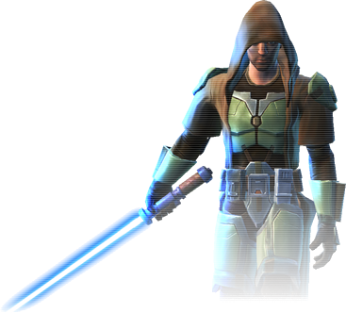

Instructor
Brent Dingle, Ph.D.
  Office: JHSW, Room 219
  Office Hours:
    TBA
  Office Phone: N/A
  Email: dingleb@uwstout.edu
Experience
  2013- : University of Wisconsin - Stout
  2012-2013: Kihon Games
  2007-2012: Raytheon Missile Systems
  1997-2007: Texas A&M University – College Station
  1995-1997: Customer Development Corporation
  1994-1995: Caterpillar
  1990-1995: Bradley University
Course Info: Check online D2L
Syllabus is also online

Slide 3

Welcome
Welcome
to
Image Processing !
We will explore fun and exciting things!
  Learning the mysteries of the digital image world

Slide 4
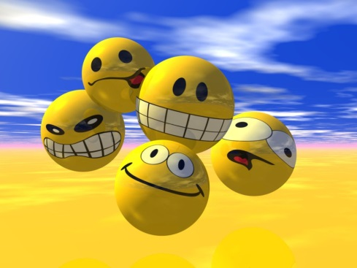
Prerequisites
Officially
  MATH 255 (Differential Eqs)
  MATH 275 (Linear Algebra)
  STAT 332 (Probability and Statistics I)
  CS 244 (Data Structures)
Reality
  Be able to solve math equations
  Understand basics of probability and stats
  General idea of/skills in computer programming
Notes:
Image from: http://mewarnai.us/316222-3d-animated-smiley-face
via http://free-stock-illustration.com/smiley+3d+gratuit

Slide 5
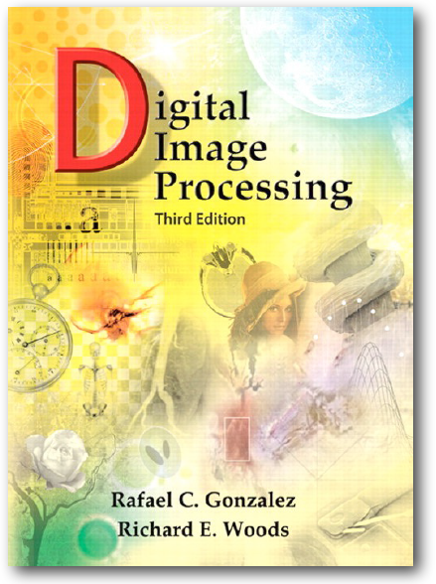
Suggested Book
Digital Image Processing, 3rd Edition
  R.C. Gonzalez and R.E. Woods
  Pearson Prentice Hall
  2008
Notes:
For those interested in using Matlab there is a related book: Digital Image Processing Using MATLAB by Gonzalez, Woods, and Eddins, 2nd Edition, Pearson Prentice Hall, 2008

Slide 6

CS 345 versus CS 545
Long term this is a dual listed class
Currently only have Graduate Students
  So only have CS 545
    and duality is overcome by an instance of singularity

Slide 7
General Info
Work and Grading
  Homework Assignments = 15%
    some may be worked on in-class
    for this semester
      all are graduate students
      most homework will be loosely graded on level of attempt
  Individual semester project = 75%
    3 parts
      proposal = 5%
      midpoint status = 30%
      final status = 40%
        includes a final in-class presentation
  Overall Performance/Quizzes/Other = 10%

Slide 8

Submitting Work
Check online D2L (aka Learn@UW-Stout)
  Dropboxes will be setup there for turn-in of work
    Homework description should detail what is expected
    Ask/email instructor if anything is unclear

Slide 9
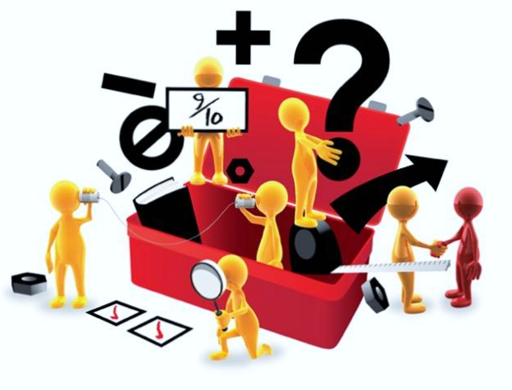
Nature of Work
Expected and Preferred use is
  HTML5 with
    Canvas element, JavaScript, CSS
    Examples will be provided to assist you
  What “can you use”
    Ask instructor
      Some alternate options are:
        C++ and openGL
        Matlab
        WebGL, VRML
      BUT…
        no promises on how much “help”
        the instructor will give on optional tools

Slide 10
Expectations
Summary examples will be shown on how to use HTML5 and JavaScript to do some things
HOWEVER
You will be expected to learn more on your own
  The earlier you start, the better off you will be
  Look through the posted lectures ahead of time
            if you have concerns about this then discuss with the instructor AFTER class

Slide 11
Responsibility
This semester is only Graduate Students
  Much of the initiative rests with you
  Do not expect step-by-step instructions
  You will be pointed in “a” direction
    You should go beyond just “minimal” exploration on your own

Slide 12
Objectives
By semester end, you should
  Understand the mathematical basis for image processing methods
  Be able to implement image processing algorithms
  Be able to select and apply image processing techniques in one or more applicable areas
  Possess a broad understanding of the theoretical basis of image processing *
                * Applies more to CS 545 students

Slide 13

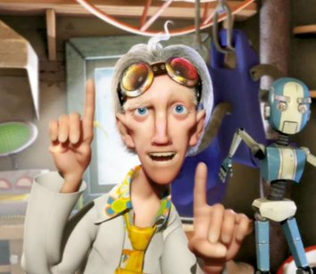
Class Character
Notes:
Image Processing is one of many FUN ways to apply, explore, and experience mathematics
Remember to enjoy this opportunity

Slide 14
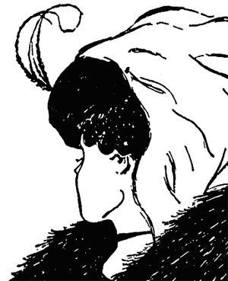

Slide 17
Near Future: Things to Plan

Slide 18
End Course Description
Any questions on the course framework?
Next is actual course material
              continue…

Slide 19


Slide 20

Lecture Objectives
Explore what image processing is about
  Image
  Acquisition and Generation
    Look at some related history
    Consider related fields
    Survey some application areas

Slide 21

Lecture Objectives
Explore what image processing is about
  Image
  Display and Perception
    Examples and Observations

Slide 22
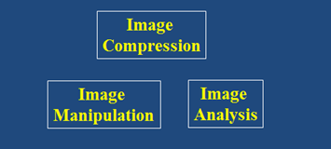
Lecture Objectives
Explore what image processing is about
  All relate to
    Image Compression
    Image Manipulation
    Image Analysis

Slide 23
Digital Image Processing
Digital Image Processing (DIP)
  Is computer manipulation of pictures, or images, that have been converted into numeric form

Slide 24
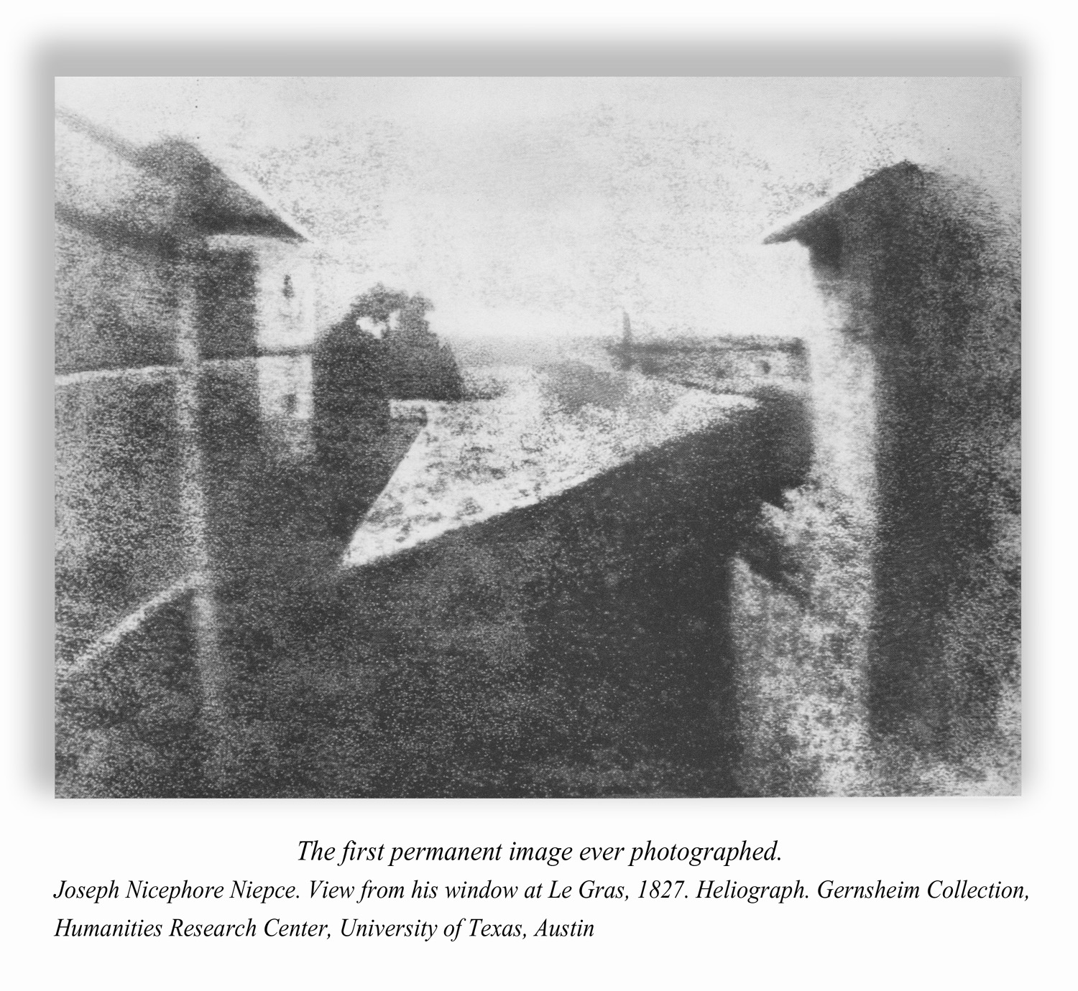
Historical Background 1827
Notes:
http://petapixel.com/2013/10/02/first-photo/ says
Rediscovered in 1952 by photo historians Helmut and Alison Gernsheim, the “First Photograph” was first
depicted in the well-known reproduction that was retouched by Helmut Gernsheim prior to its international
release.
Joseph Nicephore Niepce’s “View from the Window Le Gras” 1826 or 1827. Gernsheim Collection, Harry Ransom Center / The University of Texas at Austin (donated by Swiss photo historian Helmut Gernsheim 1963)

Slide 25
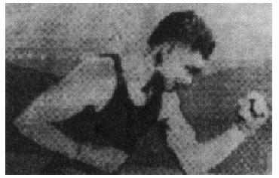
Historical Background 1921
Image transmitted via Telegraph
  using the Bartlane cable picture transmission system
  Printed using a special printer rigged with typefaces simulating halftones

Slide 26
Historical Background 1922
Alternate printing method using tape perforations
  improved tonal quality
  improved resolution
Still limited to 5 levels of grey

Slide 27
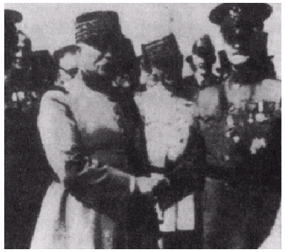
Historical Background – Late 1920s
Improved up to an amazing 15 levels of gray

Slide 28
No Computers
These images were digital in nature
BUT
  did not involve computers
  NOT Digital Image Processing

Slide 29
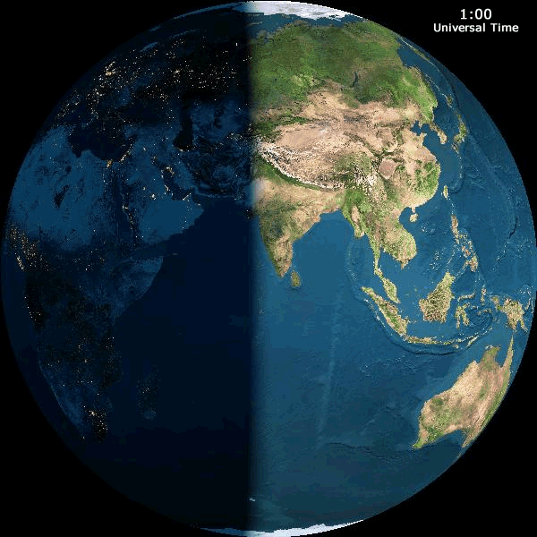
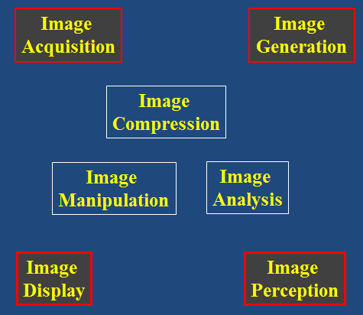
Good Stuff Gets Better
Jumping over some decades of time, improvements made in:
  Acquisition
    Digital cameras, scanners
    MRI and Ultrasound imaging
    Infrared and Microwave imaging
  Transmission
    Internet, satellite, wireless
  Storage
    CD/DVD, Blu-ray
    Flash memory, Phase-change memory
  Display
    GPUs
    Printers, LCD and LED monitors and TVs
    Portable DVD/Blu-ray players (cars), Tablets, Cellphones

Slide 30
Image Processing History 1960-1970
Ranger 7 Image
  Digital with 256 gray levels
  Geometric correction and image enhancement
    Work conducted at the Jet Propulsion Laboratory (Pasadena, CA)
Notes:
The lessons learned from this mission
provided a basis for improved enhancement
and restoration methods for later missions
to the moon, Mars, and beyond

Slide 31
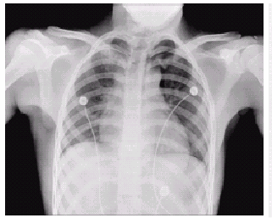
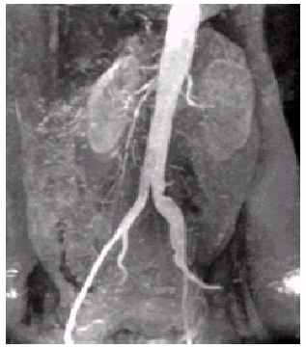
Image Processing History 1970-1980
Emergence of medical imaging
1979 Nobel Peace Prize
for Invention of
Computerized Axial Tomography (CAT)
  Sir Godfrey Housefield
  Professor Allan Cormack

Slide 32
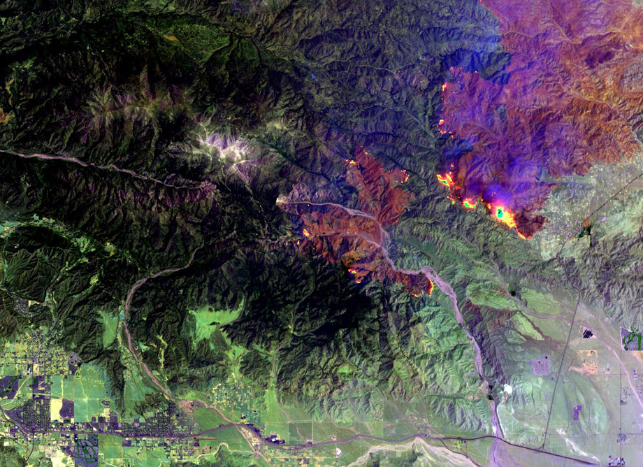
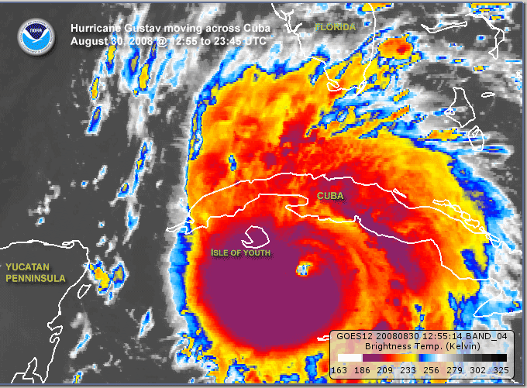
Image Processing History 1980-1990
Satellite and Remote Sensing
  LANDSAT
    8 spectral bands,
    15 to 60 meter spatial resolution,
    16 day temporal resolution
  NOAA GEOS
    satellite sensor array
Image from 2009, courtesy of NASA
Fire San Bernardino National Forest
Multispectral image of Hurricane Gustav
courtesy of NOAA 2008

Slide 33
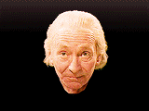
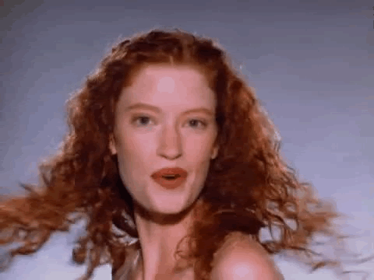
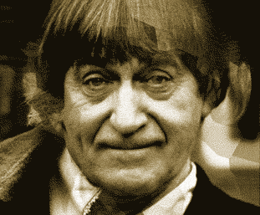
Image Processing History 1990-2000
Morphing and visual effects algorithms
JPEG and MPEG compression
Wavelet Transforms
Image morph from Michael Jackson
Music Video: Black or White
Dr. Who Image morphs
antonybennison.com

Slide 34
Again: Digital Image Processing
Digital Image Processing (DIP)
  Is computer manipulation of pictures, or images, that have been converted into numeric form
  Typical operations include
    Image Compression
    Image Warping
    Contrast Enhancement
    Blur Removal
    Feature Extraction
    Pattern Recognition

Slide 35
Image Processing Goals
Digital image processing is
a subclass of signal processing
specifically concerned with picture images
  Goals
    To improve image quality for
      human perception (subjective)
      computer interpretation (objective)
    Develop methods and applications
      to compress images
      to provide efficient storage and transmission

Slide 36
Related Fields
Computer Graphics
Computer Vision
Artificial Intelligence
… others…

Slide 37
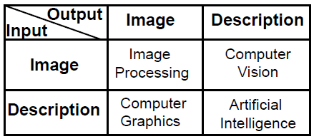
Distinction Between Fields
Image processing is not just image-in/image-out
But it does work to distinguish relational aspects of some fields

Slide 38
Related Fields
Image Processing
Image-In / Image Out
Image
Low
Level
Texture mapping
Antialiasing
Noise reduction
Contrast enhancement
Filtering
Computer Graphics
Computer Vision
Mid
Level
Extract Attributes
Edge Detection
Segmentation
Description In
Image Out
Image In
Features Out
High
Level
Object Recognition
Cognitive Functions
Scene Description
Features In
Description Out
AI

Slide 39
Questions?
Beyond D2L
  Examples and information
  can be found online at:
    http://docdingle.com/teaching/cs.html
    Continue to more stuff as needed

Slide 40
Extra Reference Stuff Follows

Slide 41
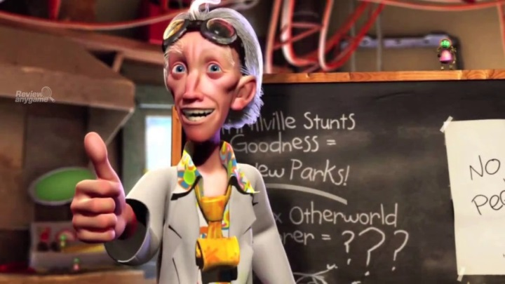
Credits
Much of the content derived/based on slides for use with the book:
  Digital Image Processing, Gonzalez and Woods
Some layout and presentation style derived/based on presentations by
  Donald House, Texas A&M University, 1999
  Bernd Girod, Stanford University, 2007
  Shreekanth Mandayam, Rowan University, 2009
  Igor Aizenberg, TAMUT, 2013
  Xin Li, WVU, 2014
  George Wolberg, City College of New York, 2015
  Yao Wang and Zhu Liu, NYU-Poly, 2015
  Sinisa Todorovic, Oregon State, 2015

