Slide 1
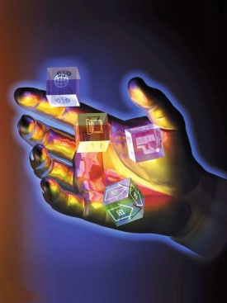
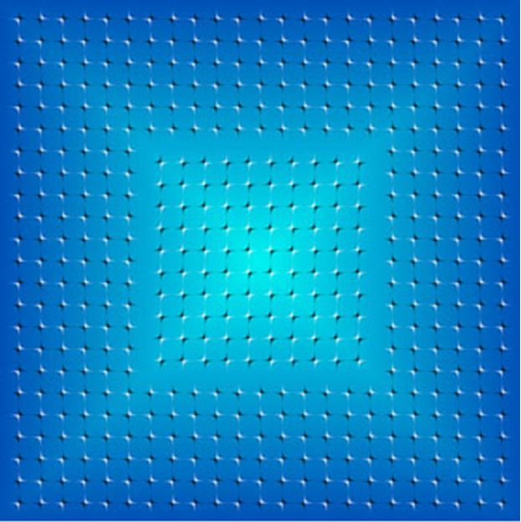

Image
Acquisition, Display, and Perception
Brent M. Dingle, Ph.D. 2015
Game Design and Development Program
Mathematics, Statistics and Computer Science
University of Wisconsin - Stout
Notes:
Background image from Just-Riddles.net

Slide 2

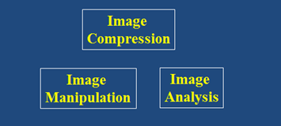

Lecture Objectives
Previously
  History
  Related fields
  Application areas
Today
  Image
    Acquisition
    Display
    and Perception

Slide 3
Recall
Digital Image Processing (DIP)
  Is computer manipulation of pictures, or images, that have been converted into numeric form
  Typical operations include
    Image Compression
    Image Warping
    Contrast Enhancement
    Blur Removal
    Feature Extraction
    Pattern Recognition

Slide 4
Recall: Image Processing Goals
Image processing is
a subclass of signal processing
specifically concerned with picture images
  Goals
    To improve image quality for
      human perception (subjective)
      computer interpretation (objective)
    Develop methods and applications
      to compress images
      to provide efficient storage and transmission

Slide 5
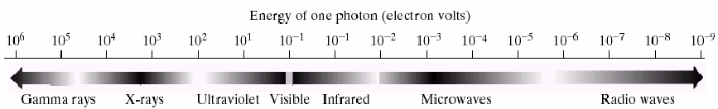
Sources of Images
Principal source of images
is the electromagnetic (EM) energy spectrum
  EM waves are
  stream of massless (proton) particles
  each traveling in a wavelike pattern at the speed of light
    Spectral bands are grouped by energy per photon
      Gamma rays, X-rays, UV, Visible, Infrared, Micro, Radio…

Slide 6
Physical Aspects of Acquisition
Improvements extend beyond human eyes
  From visible spectrum to non-visible EM power spectrum
  From close-distance sensing to remote sensing

Slide 7
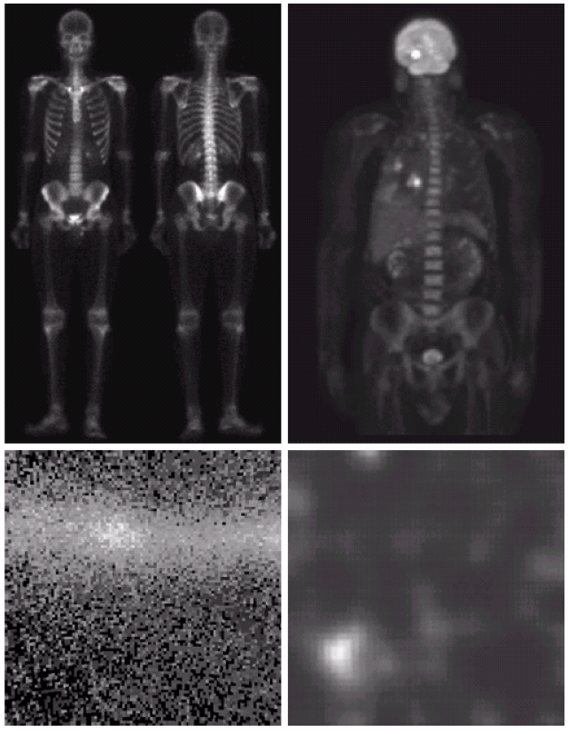
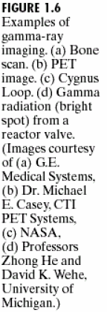
Gamma-Ray Imaging
Used in
  Astronomy and Medicine
Medicine
  Positron Emission Tomography
  Radioactive isotope injected into patient
    Emits gamma rays as it decays
    Allowing creation of medical images via detectors
Cygnus Loop is in the
constellation of Cygnus

Slide 8
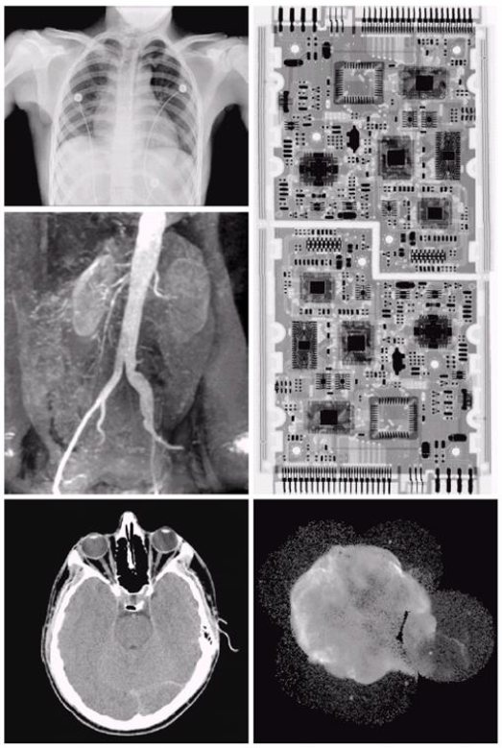

X-Ray Imaging
Oldest source of EM radiation for imaging
  CAT scans
  angiograms
  industrial inspection of circuit boards

Slide 9
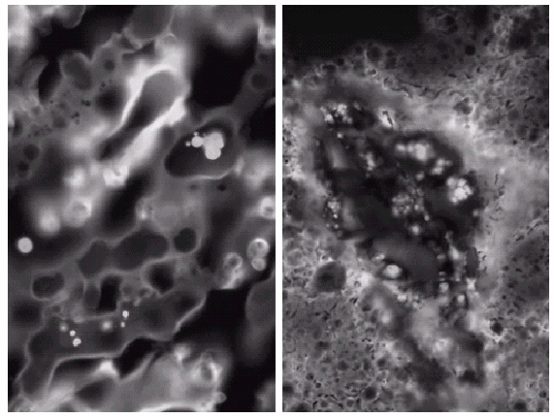
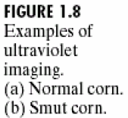
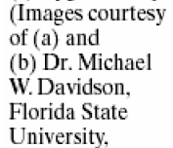
Ultraviolet Imaging
Used for
  lithography
  industrial inspection
  biological imaging
  astronomy
  lasers
  flourescence microscopy
    Shown to the right
    Photon of UV light collides with electron of fluorescent material to elevate its energy
    As energy falls it emits red light

Slide 10



Visible Imaging: Photography

Slide 11

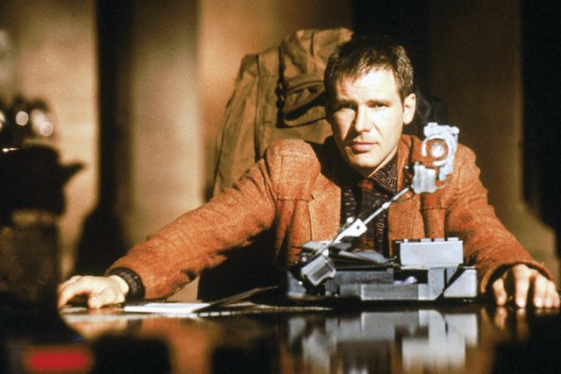
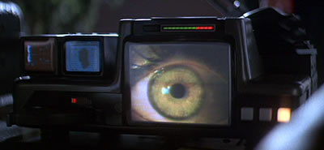
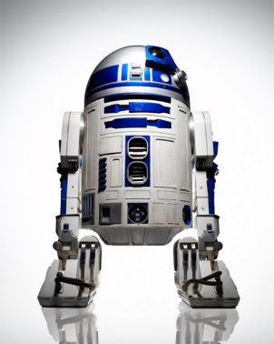
Visible Imaging: Motion Pictures
Notes:
Westworld (1973) was the first feature film to use digital image processing to pixellate photography to simulate an android's point of view

Slide 12
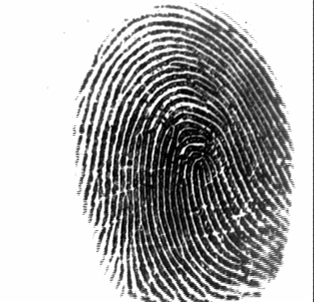
Visible Imaging: Biometrics & Forensics

Slide 13
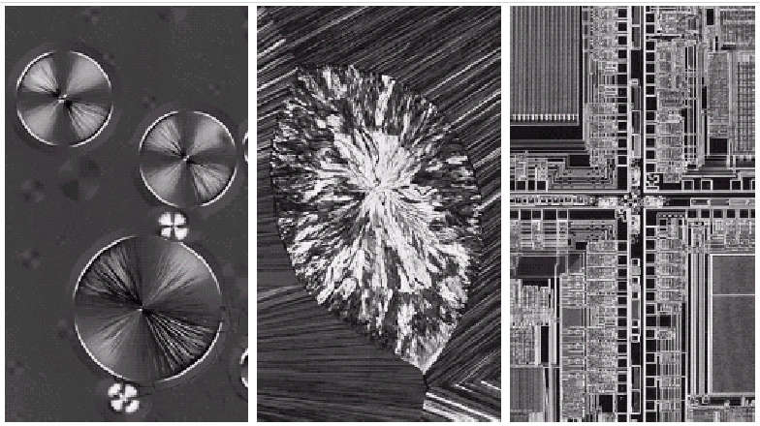
Visible Imaging: Light Microscopy
Taxol (250x)
Cholesterol (40x)
Microprocessor (60x)
Notes:
Taxol (paclitaxel) is a drug used in chemotherapy that interferes with the growth of cancer cells

Slide 14
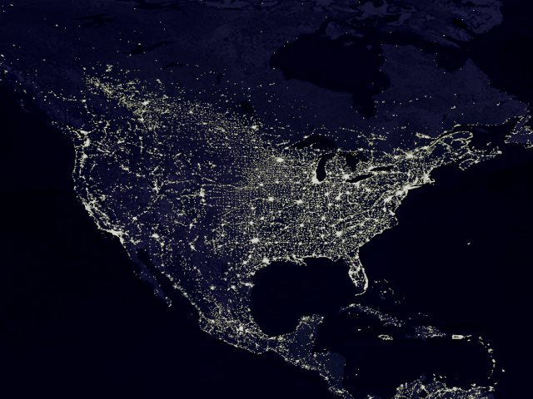
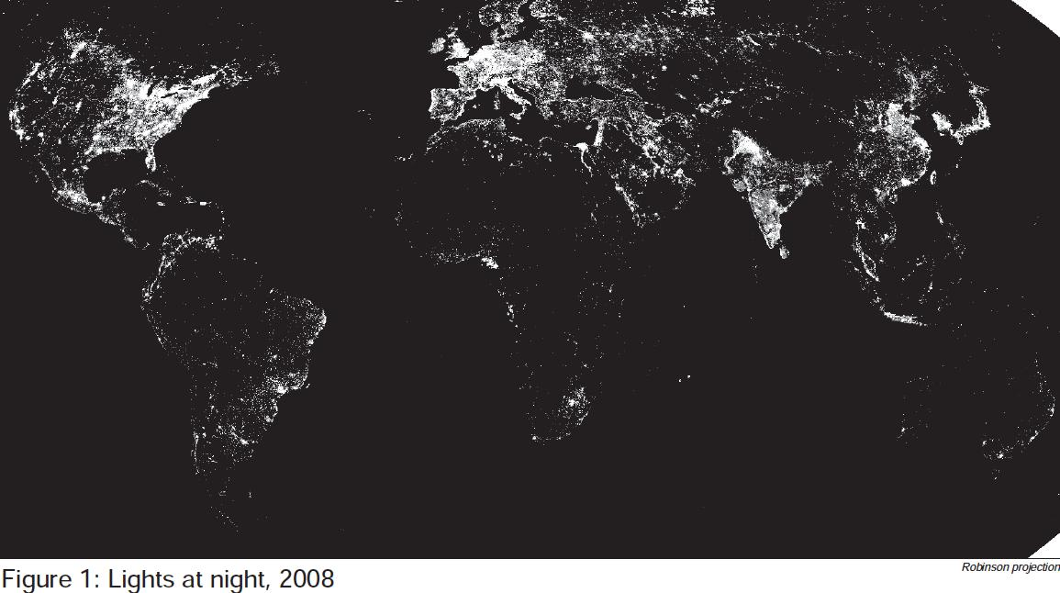
Visible Imaging: Remote Sensing

Slide 15
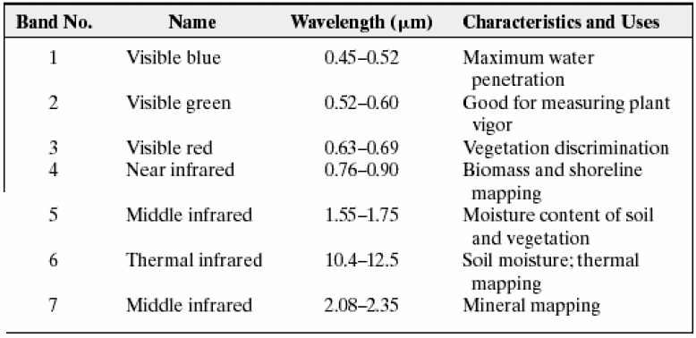
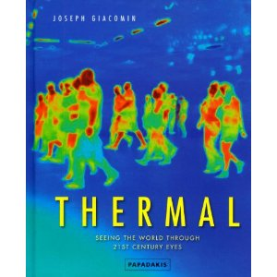
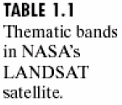
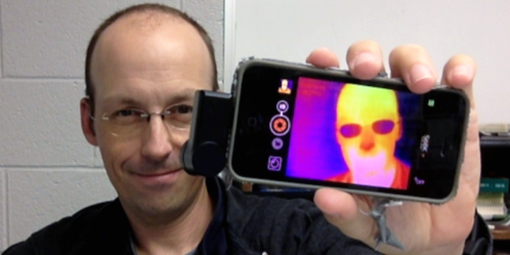
Infrared (thermal) Imaging
Rhett Allain
http://www.wired.com/2014/10/seek-thermal-infrared-camera-iphone-android/

Slide 16

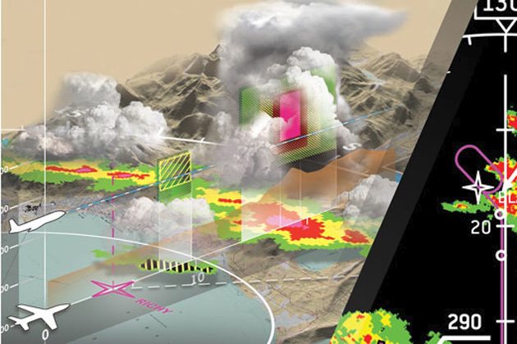
Microwave Imaging: Radar
Rockwell Collins: Weather Radar Threat Tracking System
Notes:
Images from:
https://www.rockwellcollins.com/Products_and_Systems/Radar_and_Surveillance/Weather_Radar.aspx
and
http://www.iawx.net/2013/11/17/severe-thunderstorm-warning-624/

Slide 17
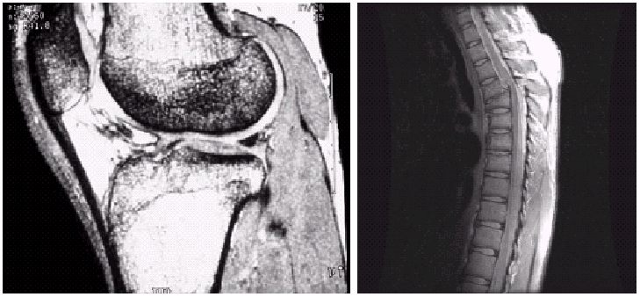
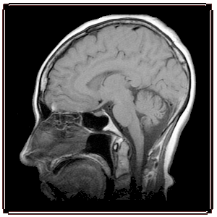
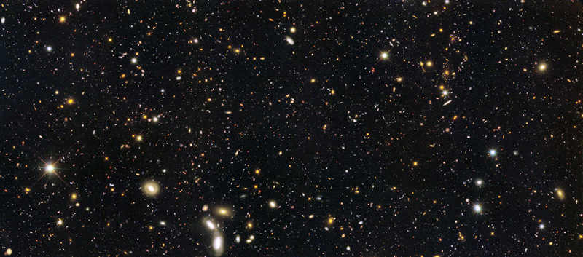
Radio Wave Imaging: MRI and Astronomy

Slide 18
Non-EM Imaging Sources
Acoustic Imaging
  Translate sound waves into image signals
    Ultrasounds, Seismic…
Electron Microscopy
  Shine a beam of electrons through specimen
Synthetic Images in Computer Graphics
  Computer generated
    Non-existent in the real world
    Graphics, Games, Digital Art…
Image
Scene Description

Slide 19
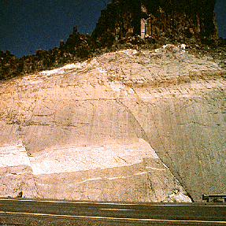
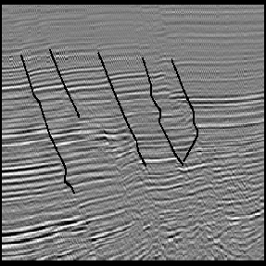
Acoustic Imaging
visible
seismic
potential locations of oil/gas

Slide 20
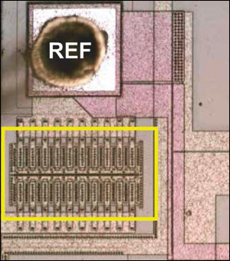
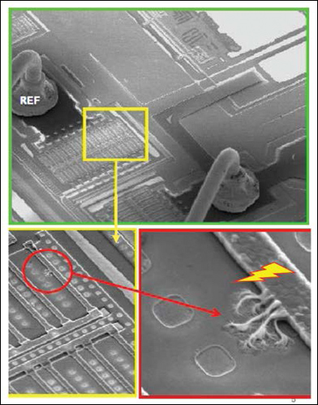
Electron Microscope
visible image
Same circuit under electron microscope
Shows damage from electrical overstress
Images from: http://www.maximintegrated.com/en/app-notes/index.mvp/id/4491
Notes:
Images from: http://www.maximintegrated.com/en/app-notes/index.mvp/id/4491

Slide 21




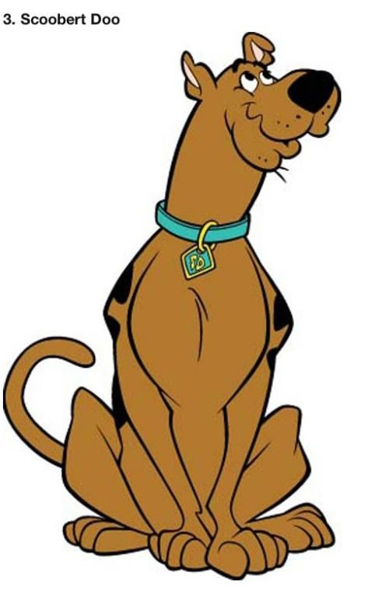
Cartoon Images

Slide 22
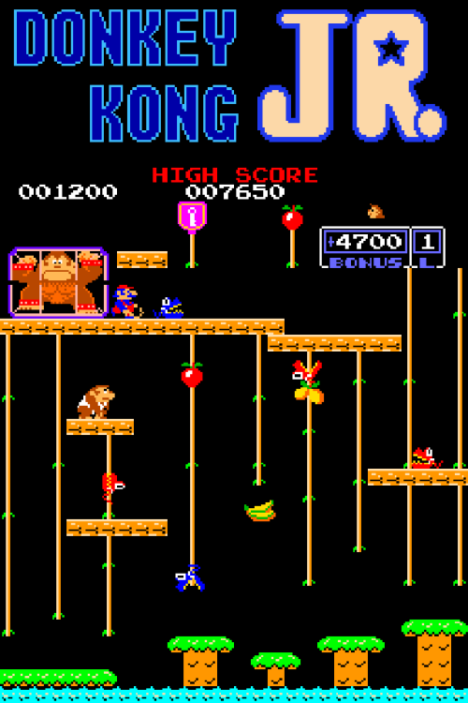

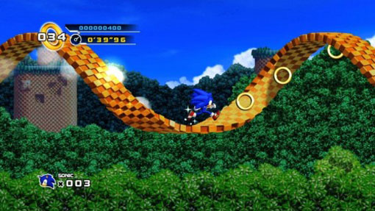
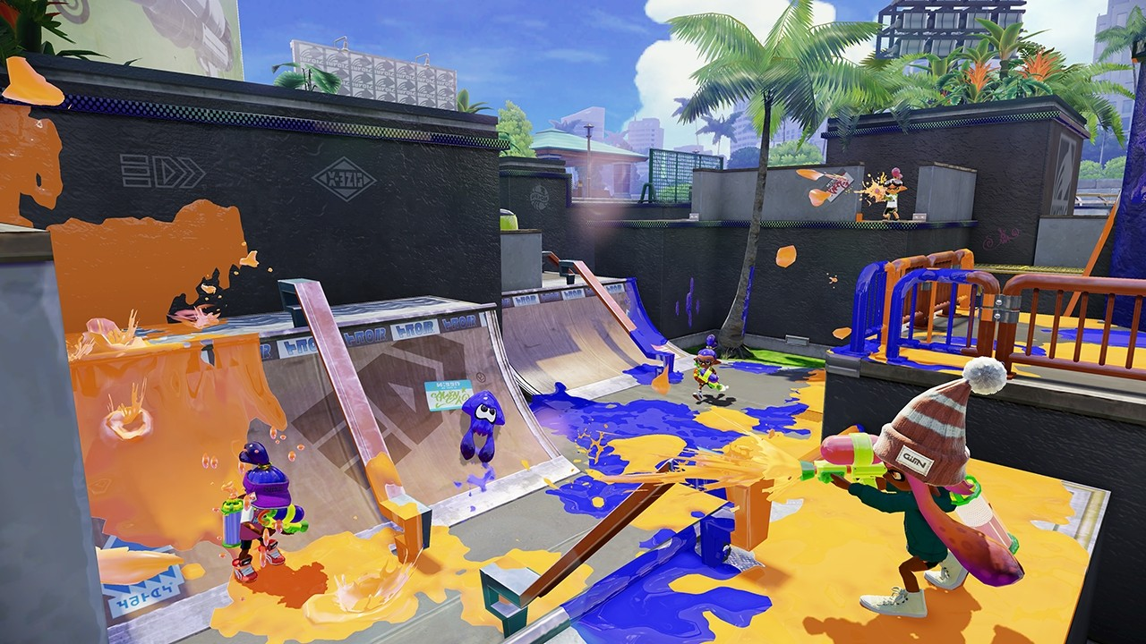

Images from Video Games
Notes:
Donkey Kong Jr, Heroes of the Storm, Sonic the Hedgehog, Splatoon

Slide 23
Summary: Acquisition & Generation
Sources
  Electromagnetic (EM) spectrums
  Acoustic Imaging
    EX: Ultrasounds, Seismic Imaging…
  Electron Microscopy
  Synthetic Images
    Computer Generated
      Graphics, Games, Digital Art…
Image
Scene Description

Slide 24
So Far
Image
Acquisition
Image
Generation
Image
Compression
Image
Manipulation
Image
Analysis
Image
Display
Image
Perception

Slide 25
Moving On
Image
Acquisition
Image
Generation
Image
Compression
Image
Manipulation
Image
Analysis
Now Onto These
Image
Display
Image
Perception

Slide 26
Image Display
Many types of display devices
  For Digital Images
    CRT, Plasma, LCD, LED…
    HDTV, display wall…
    Tablet, Cell phone, Gameboy…
    Stereoscopic 3D

Slide 27
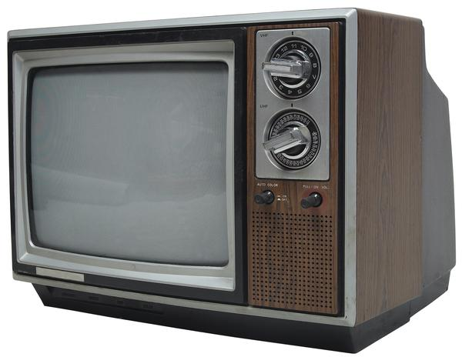
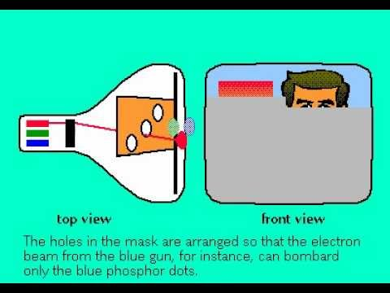
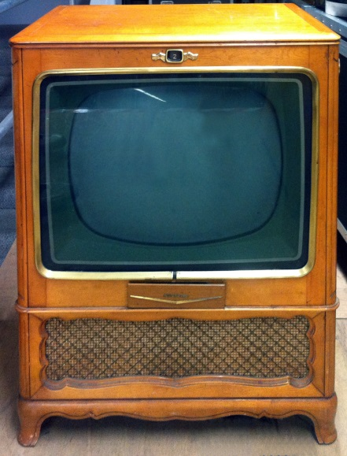
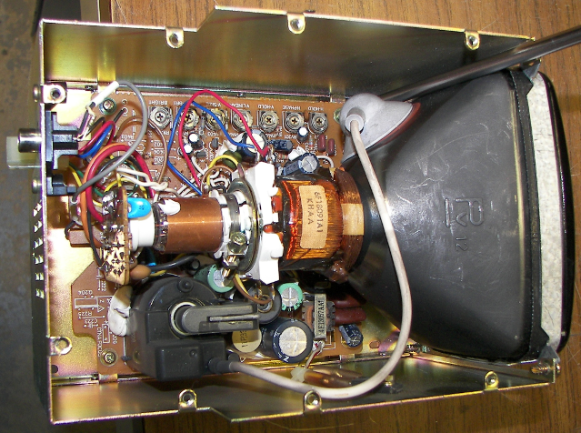
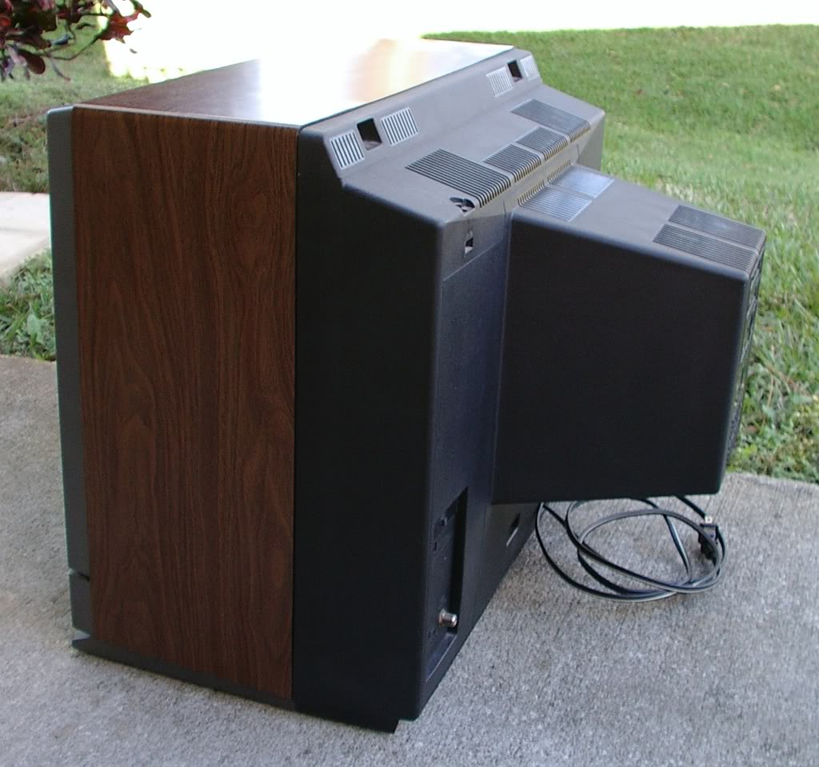
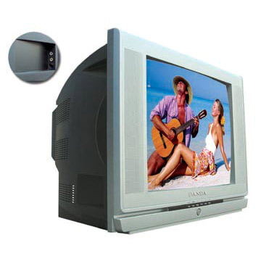
CRT Monitors and TVs

Slide 28
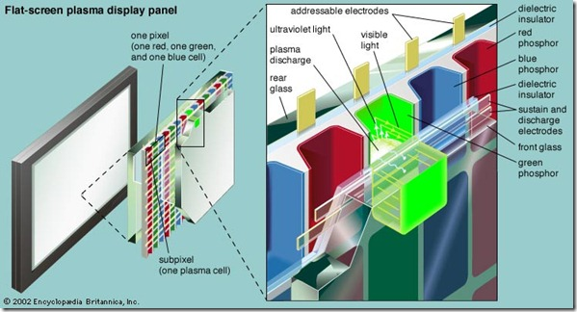
Plasma TVs
Array of light emitting gas cells sandwiched between 2 glass sheets
  Requires a glass panel, but no “external” light source
http://www.guidingtech.com/26940/led-lcd-plasma-difference/

Slide 29

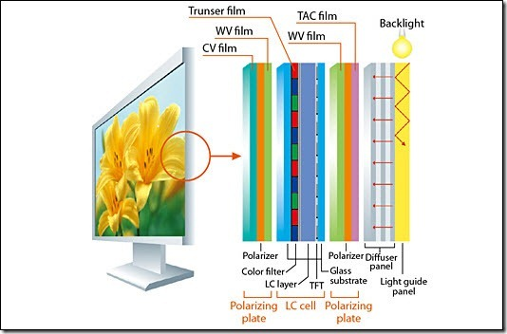
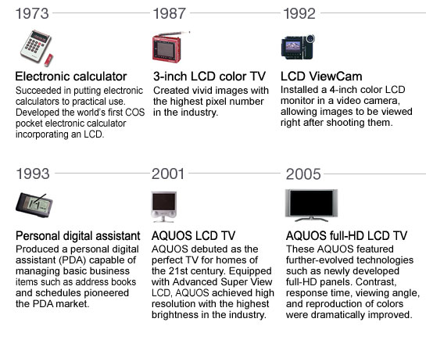
LCD: Liquid Crystal Display
http://mybroadband.co.za/news/gadgets/
59323-cool-tech-deals-this-weekend-4.html/
attachment/lg-32-inch-full-hd-lcd-tv
http://www.guidingtech.com/26940/led-lcd-plasma-difference/
Sharp’s History of LCD development
http://www.sharp.net.au/articles/lcd-televisions/why-sharp-lcd-tv/

Slide 30
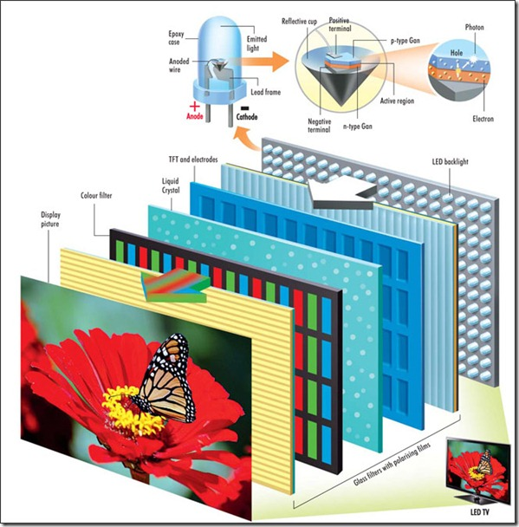
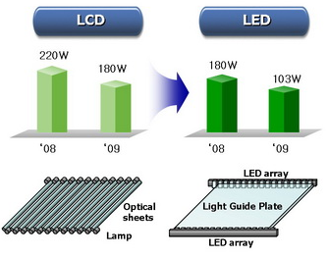
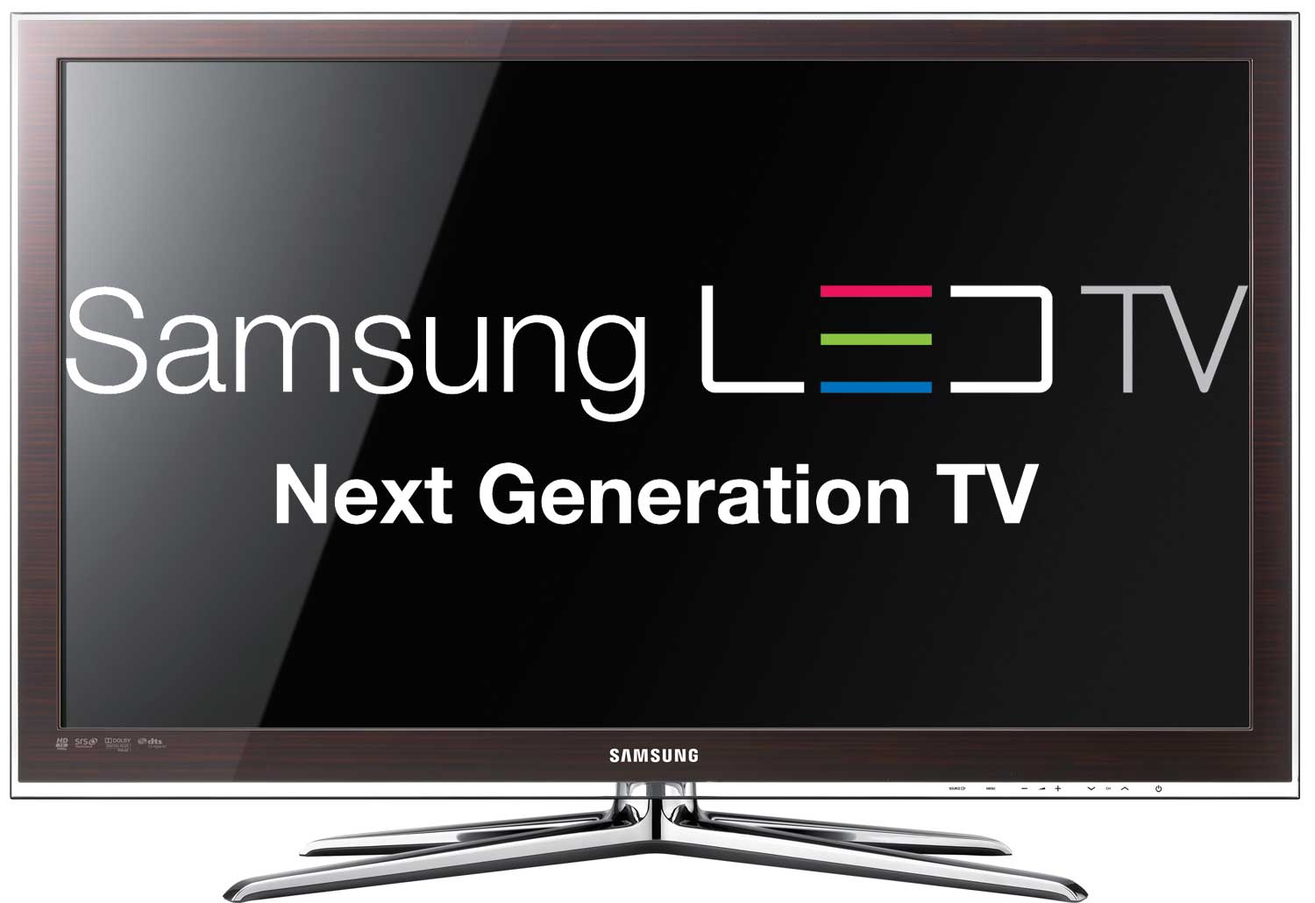
LED: Light Emitting Diode
LED TVs draw much lower current than LCD TVs,
thus resulting in lower power consumption
https://commons.wikimedia.org/wiki/
http://www.guidingtech.com/26940/led-lcd-plasma-difference/

Slide 31
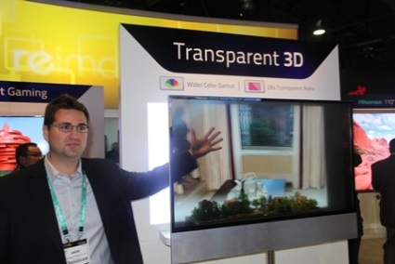
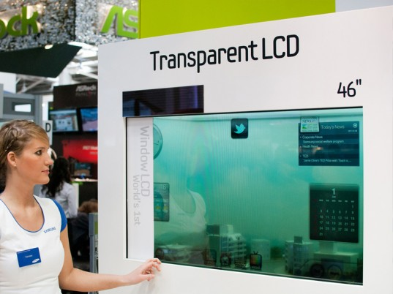

Transparent LCD
Samsung: Solar-Powered
LCD Transparent TV, March 2011
Hisense: Transparent 3D TV, 2013
http://inhabitat.com/samsung-unveils-solar-powered-zero-energy-transparent-tv/
http://www.bbc.com/news/technology-20957845
http://www.applianceretailer.com.au/2013/01/kvvntjtalp/#.VcJkgPmXoXE

Slide 32
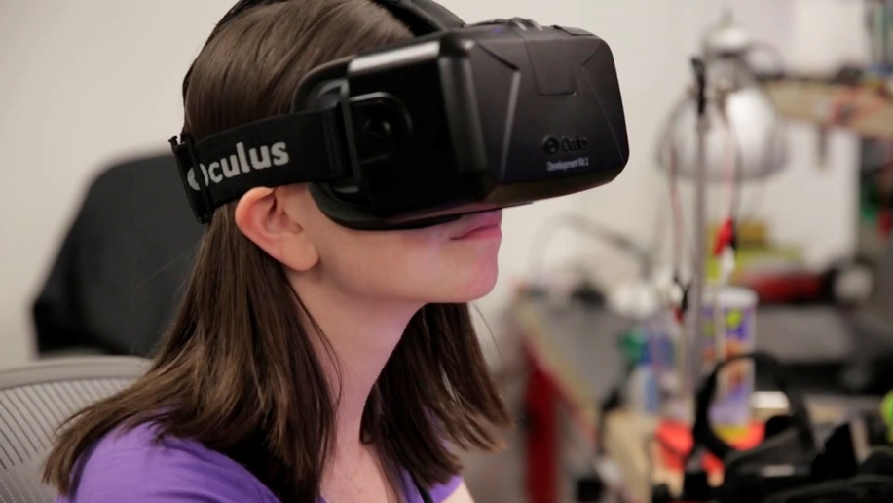
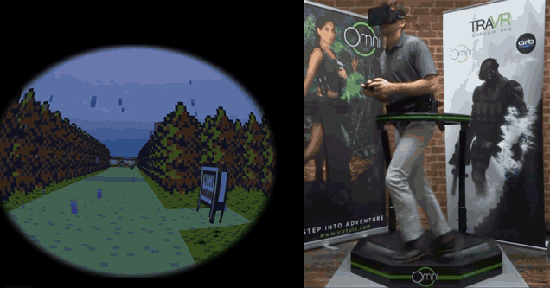
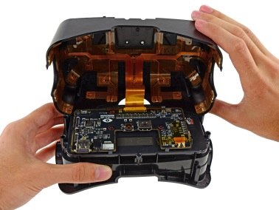



Various VR and 3D Displays

Slide 33


More VR and 3D
http://abcnews.go.com/Technology/
3d-display-physically-touch/story?id=20891750
http://www.firestarters.nl/nl/detail/general_article/9x-haptische-technologie

Slide 34



Virtual Retinal Display
http://vandrico.com/wearables/device/air-scouter
http://www.tested.com/tech/459020-hands-avegants-virtual-retinal-display-prototype/
Virtual Retinal Display
  aka Retinal Scan Display or Retinal Projector
    Draw a raster display directly on the retina of the eye

Slide 35

Images for the Blind
http://blitab.com/

Slide 36

Display Summary
Many types of display devices
  Each has unique features and requirements
Digital Images
must “appear correct”
on all of these
    Standards help
    Yet
      The same image may not inherently display correctly
      Adjustments (image processing) may be required
Human Perception adds complications

Slide 37
Perception and the Human Eye
We use our eyes to observe and evaluate images
We should understand how our eyes work
    What intensity differences can we distinguish?
    What is the spatial resolution of our eye?
    How accurately do we estimate length and area?
    How do we sense colors?
    By which features can we detect/distinguish objects?
Gain in Understanding by Examining “oddities”

Slide 38


Comparative Length
Same Length
  Vertical may appear longer
Table tops are same size

Slide 39
Comparative Length 2
Horizontal Lines are same length
  Upper line may appear longer

Slide 40

Simultaneous Contrast: Light vs Dark

Slide 41

Similar Perception Errors in Color

Slide 42


Ambiguous Images
Seal or Donkey?
Duck or Rabbit?

Slide 43



Thatcher
Eyes and mouth are inverted
  But you don’t notice when the entire image is upside down
    because the mouth and eyes are “correct” then

Slide 44

Rotation Illusion
Rotation occurs in relation to eye motion
Effect stops if you fixate your eyes
Rotation direction depends on polarity of the luminance steps
Asymmetric luminance steps are required to trigger motion detectors
  in eye/brain
Notes:
This is NOT an animated gif

Slide 45

Closer “Look”
Why do these oddities occur?
We have some ideas…

Slide 46
Human Perception
Human Eye
Lightness Perception
Brightness
Contrast
Illusions

Slide 47



Human Eye
Image from:
http://webvision.med.utah.edu/anatomy.html
Three membranes enclose the eye:
Cornea and sclera, Choroid, Retina
ciliary
body
iris
diaphragm
Pupil size: 2-8mm
Eye color: melanin (pigment) in iris

Slide 48
Retina
When the eye is properly focused, light from an outside object is imaged on the retina
Two classes of receptors are located over the surface of retina: cones and rods
  Cone: 6-7 million in each eye, central part of retina (fovea) and highly sensitive to color
  Rod: 75-150 million, all over the retina surface and sensitive to low levels of illumination

Slide 49

Rods and Cones

Slide 50

Image Formation in the Eye

Slide 51

Human Perception
Human Eye
Lightness Perception
Brightness
Contrast
Illusions

Slide 52
Perception of Lightness
Luminance is the amount of visible light that comes to the eye from a surface
Illuminance is the amount of light incident on a surface
Reflectance is the proportion of incident light that is reflected from a surface
  Varies from 0% to 100%
    0% is ideal black
    100% is ideal white.
    In practice,
    average black paint is about 5% and average white paint about 85%.

Slide 53
Math: Image Formation Model
Image Formation Model
  f(x,y) = i(x,y) * r(x,y) + n(x, y)
f(x, y) | 0 < f(x, y) < ∞ | Intensity which is proportional to the energy radiated by a physical source
i(x, y) | 0 < i(x, y) < ∞ | illumination is amount of source illumination incident on the scene being viewed
r(x, y) | 0 < r(x, y) < 1 | reflectance is the amount of illumination reflected by objects in the scene
n(x, y) |  | noise is various measurement errors
nature of i(x, y) is determined by the illumination source (light source)
nature of r(x, y) is determined by the object(s) in the scene

Slide 54

Formation Model: Example
f(x,y)
r(x,y)
i(x,y)
object props
lighting props
Question:
How to separate r(x,y) and i(x,y) from f(x,y)?
For Answer: Google “intrinsic images”
Images from: Deriving intrinsic images from image sequences, Yair Weiss, 2001
Notes:
See also:
H.G. Barrow and J.M. Tenenbaum.
Recovering intrinsic scene characteristics from images.
In A. Hanson and E. Riseman, editors,
Computer Vision Systems.
Academic Press, 1978.

Slide 55

Illustration: Checker-Block
Patches p and q have the same reflectance,
but different luminances.
Patches q and r have different reflectances and different luminances; they share the same illuminance.
90
0.1
Patches p and r happen to have the same luminance, because the lower reflectance of p is counterbalanced by its higher illuminance.
0.9
0.9
10
0.1

Slide 56

Visual Context
Importance of edges
Importance of corners

Slide 57

Lightness Illusion
If we cover the left side and view the right, it appears that the stripes are due to different lighting on the stair steps (illumination).
If we cover the right side of the figure and view the left side, it appears that the stripes are due to paint (reflectance).

Slide 58


More Illusions
Squares A and B --- same value or different?
SAME

Slide 59
Human Perception
Human Eye
Lightness Perception
Brightness
Contrast
Illusions

Slide 60

Brightness Adaptation
The human visual system
cannot operate simultaneously,
over such a high dynamic range
But manages such a large
variation by changing
its overall sensitivity,
a phenomenon called
“brightness adaptation”

Slide 61


Mach Bands
As soon as rectangles touch:
Contrast between them becomes
more exaggerated
i.e. Dark band at top looks more dark
when it touches the middle band
Image: Public Domain from Wikipedia

Slide 62



Brightness Discrimination
Weber ratio = ΔI / I
bright white dots at intersection
when you look directly at them,
black dots when you are not
Weber’s Law
The ratio of the
increment threshold
to the
background intensity
is constant
ΔI / I = K

Slide 63
Human Perception
Human Eye
Lightness Perception
Brightness
Contrast
Illusions

Slide 64
Contrast Effects
A contrast effect is
  the enhancement or diminishment
  relative to the ‘normal’
  of perception or cognition
  as a result of successive or simultaneous exposure
  to a stimulus of lesser or greater value
    ‘normal’ here means
    the perception or cognition that would occur if the other stimulus was not present
      i.e. what it would appear to be “normally”

Slide 65

Example: Simultaneous Contrast
Same luminance but varying brightness (perceived luminance)

Slide 66

Example: Successive Contrast
Stare at the dot in one of the two top circles
Then look at bottom circles
  They will appear different colors/shades (but are the same)

Slide 67
Common Issues with Contrast

Slide 68
Human Perception
Human Eye
Lightness Perception
Brightness
Contrast
Illusions

Slide 69

Optical Illusions

Slide 70

Lastly
What color is this dress ?

Slide 71

Summary: Human Perception
Human Eye
Lightness Perception
Brightness
Contrast
Illusions
Now we understand
the technical details of digital images
AND
how the images are perceived
Next Time:
Let’s start messing with them images =)

Slide 72

Questions?
Beyond D2L
  Examples and information
  can be found online at:
    http://docdingle.com/teaching/cs.html
    Continue to more stuff as needed

Slide 73


Extra Reference Stuff Follows

Slide 74

Credits
Much of the content derived/based on slides for use with the book:
  Digital Image Processing, Gonzalez and Woods
Some layout and presentation style derived/based on presentations by
  Donald House, Texas A&M University, 1999
  Bernd Girod, Stanford University, 2007
  Shreekanth Mandayam, Rowan University, 2009
  Igor Aizenberg, TAMUT, 2013
  Xin Li, WVU, 2014
  George Wolberg, City College of New York, 2015
  Yao Wang and Zhu Liu, NYU-Poly, 2015
  Sinisa Todorovic, Oregon State, 2015

