Slide 1

Image Acquisition and Representation
Some Details
Brent M. Dingle, Ph.D. 2015
Game Design and Development Program
Mathematics, Statistics and Computer Science
University of Wisconsin - Stout

Slide 2
Lecture Objectives
Previously
  Image Acquisition and Generation
  Image Display and Image Perception
  HTML5 and Canvas
Today
  Brief summary of direction of study
  What is a Digital Image?

Slide 3

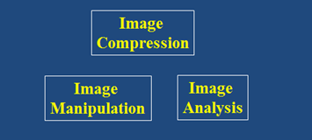

What we will Study
Implicitly: Visual Perception
  Light and EM Spectrum, Image Acquisition, Sampling, Quantization
Image Compression
  General Understanding
Image Manipulation/Enhancement
  in the Spatial Domain
    noise models, noise filtering,
    image sharpening…
  in the Frequency Domain
    Fourier transform, filtering, restoration…
Image Analysis
  Object Identification,
  Image Recognition,
  Edge/corner detection,
  Circle/line/ellipse detection…

Slide 4
What’s useful in this?
Reasons for Compression
  Image data needs to be accessed at different time or location
  Limited storage space and transmission bandwidth
Reasons for Manipulation
  Image data acquisition was non-ideal, transmission was corrupted, or display device is less than optimal
    reasons for restoration, enhancement, interpolation…
  Image data may contain sensitive content
    hide copyright, prevent counterfeit and forgery
Reasons for Analysis
  Reduce burden and error of human operators via automation
  Allow a computer to “see” for various AI tasks

Slide 5
What we will Discover
Digital Image Processing connects many dots
  Linear Algebra, Matrix Theory and Statistics
  Calculus and Fourier Transforms and Wavelets
  AI, Neuroscience, and Psychology

Slide 6
Moving On
How do we get to
DOING
this stuff ?
Must first understand WHAT a digital image is.

Slide 7
What is a Digital Image?
Recall
  Digital Image Processing (DIP)
    Is computer manipulation of pictures, or images, that have been converted into numeric form
Implies a Digital Image
  Is a picture or image converted to numeric form
Let us look at what that really means…

Slide 8
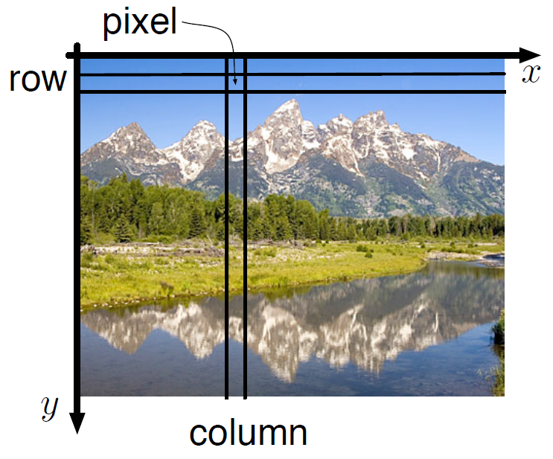
What is a Digital Image?
2D function f(x, y)
or a matrix
  x, y, and f(x, y)
  are discrete and finite
  Image size = (x_{max}) by (y_{max})
    e.g. 1024 x 768
  Pixel Intensity Value = f(x,y)
    bounded by 0 and 255
hmm… how does color fit in?
Think black and white for the moment
spoiler: for color think vector function

Slide 9
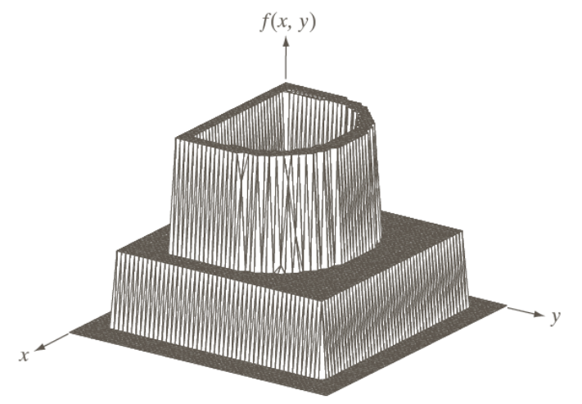
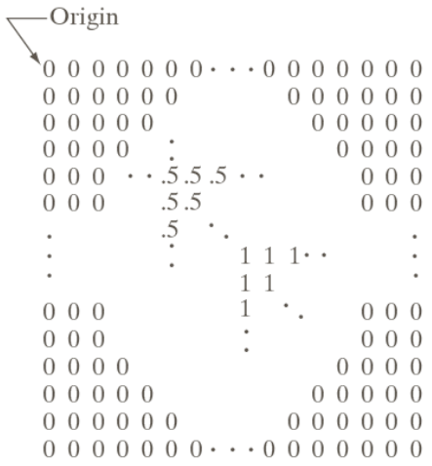
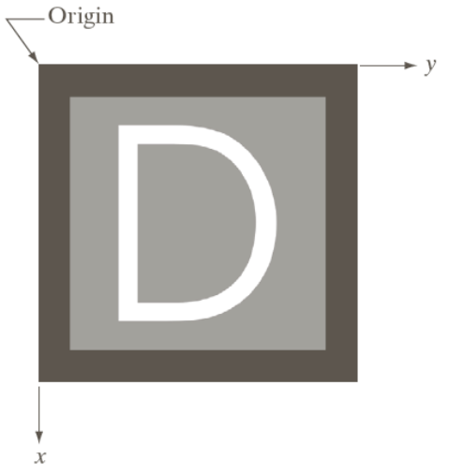
Pixel Values
f(x, y) values
= 0
= 0.5
= 1

Slide 10
How do we get the numbers?
Three principal sensor arrangements

Slide 11
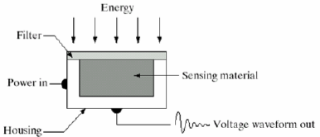
How do we get the numbers?
Three principal sensor arrangements
  Single
  Line
  and Array

Slide 12

How do we get the numbers?
Three principal sensor arrangements
  Single
  Line
  and Array

Slide 13
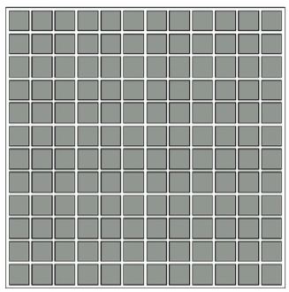
How do we get the numbers?
Three principal sensor arrangements
  Single
  Line
  and Array

Slide 14
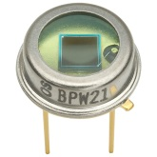
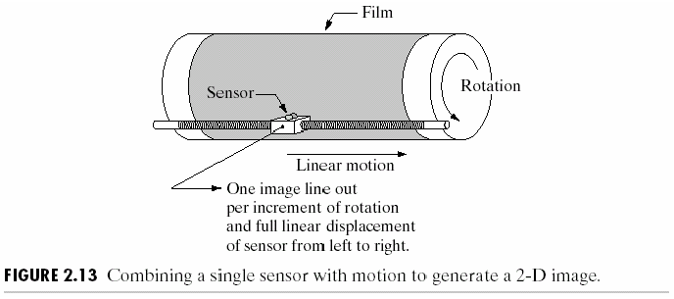
Single Sensor: Moving
Photodiode
  Constructed of silicon materials whose output voltage waveform is proportional to light
  Generating a 2D image using a single sensor requires
  relative displacements in the horizontal and vertical directions
  between the sensor and area to be imaged
Microdensitometers are mechanical digitizers that use a flatbed with the sensor moving in two linear directions

Slide 15
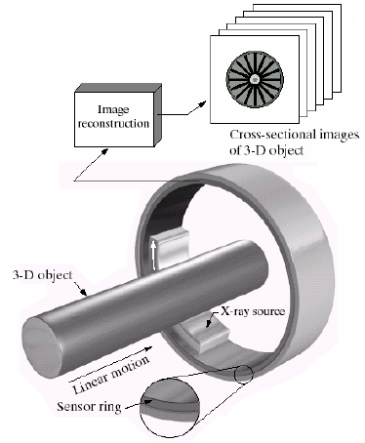
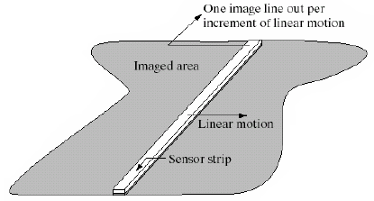
MOVING Sensor Strips
In-line arrangement of sensors
    i.e. a strip of sensors
  Strip provides imaging elements in one direction
    i.e. x direction
  Motion perpendicular to the strip
  images in the other direction
    i.e. y direction
strip moves

Slide 16
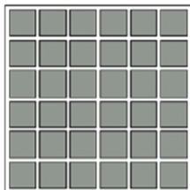
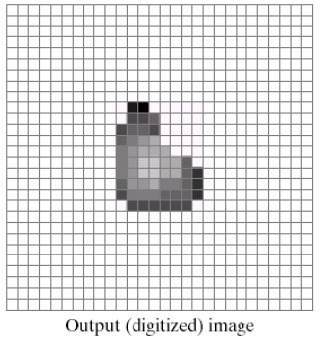
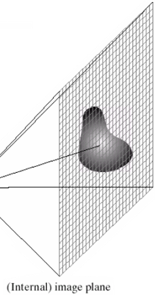

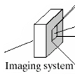
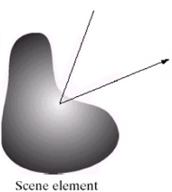
Sensor Arrays
Individual sensors are arranged in a 2D array
  Used in digital cameras
  Entire image formed at once
  No motion necessary

Slide 17
Signals
A signal function conveys information
  1D signal: f(x) waveform
  2D signal: f(x, y) image
  3D signal: f(x, y, z) volumetric data
  or f(x, y, t) animation (spatiotemporal volume)
  4D f(x, y, z, t) volumetric data over time
The dimension of the signal
is equal to its number of indices
In this course we focus on 2D images: f(x, y)

Slide 18
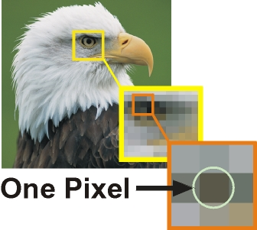
Digital Image
Image produced as an array of picture elements (pixels) in the frame buffer
http://digitalsafari.pbworks.com/w/page/84764749/02%20Pixel%20Art

Slide 19
Image Classification
Images can be classified by
  whether they are defined over all points in the spatial domain
  and whether their image values have finite or infinite precision
  If the position variables (x, y) are continuous
  then the function is defined over all points in the spatial domain
  If (x,y) is discrete
  then the function can be sampled at only a finite set of points (i.e. the integers)
  The value that a function returns can also be classified by its precision, independently of x and y

Slide 20
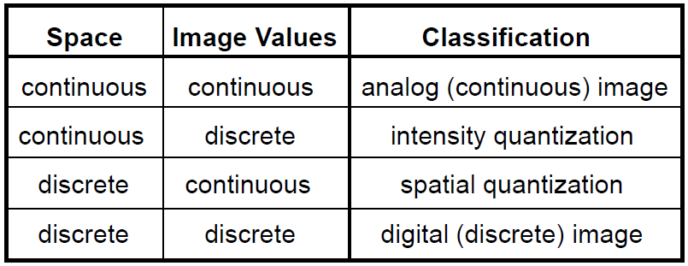
Image Classification
Quantization refers to the mapping of real numbers onto a finite set
  a many-to-one mapping
  similar to casting a double precision to an integer

Slide 21
Digital Image: Summary
Digital Image Processing (DIP)
    Is computer manipulation of pictures, or images, that have been converted into numeric form
A Digital Image
    Is a picture or image converted to numeric form
    In grey-scale the image can be thought of as
      2D function f(x, y) or a matrix
      x, y, and f(x, y) are discrete and finite
      Image size = (x_{max}) by (y_{max}), e.g. 1024 x 768
      Pixel Intensity Value = f(x,y) ∈ [0, 255]

Slide 22

Summary So Far
Digital Image Processing (DIP)
      Is computer manipulation of pictures, or images, that have been converted into numeric form Previously
A Digital Image
      Is a picture or image converted to numeric form
      In grey-scale the image can be thought of as
        2D function f(x, y) or a matrix
        x, y, and f(x, y) are discrete and finite
        Image size = (x_{max}) by (y_{max}),
        Pixel Intensity Value = f(x,y) ∈ [0, 255]
                for color f(x,y) returns a vector
      Digitally created by various physical devices
Next
  Image Acquisition – part 2
  Image Representation

Slide 23
Grayscale (and Color) Imaging
Image Acquisition
  Light and Electromagnetic spectrum
  Charge-Coupled Device (CCD) imaging
  Sampling and Quantization
  Bayer Filter
    a common color filter array (CFA)
Image Representation
  Spatial resolution
  Bit-depth resolution
  Local neighborhood

Slide 24
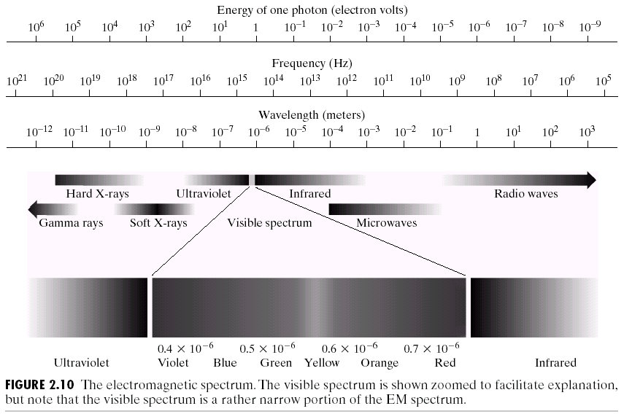
Electromagnetic (EM) Spectrum

Slide 25
Visible Spectrum
Visible range: 0.43µm(violet)-0.78µm(red)
Six bands:
  violet, blue, green, yellow, orange, red
The color of an object is determined by the nature of the light reflected by the object
Monochromatic light (gray level)
Three elements measuring chromatic light
  Radiance, luminance and brightness

Slide 26
Questions so far
Questions on EM spectrum?
Image Acquisition
  Light and Electromagnetic spectrum
  Charge-Coupled Device (CCD) imaging
  Sampling and Quantization
  Bayer Filter
    a common color filter array (CFA)

Slide 27
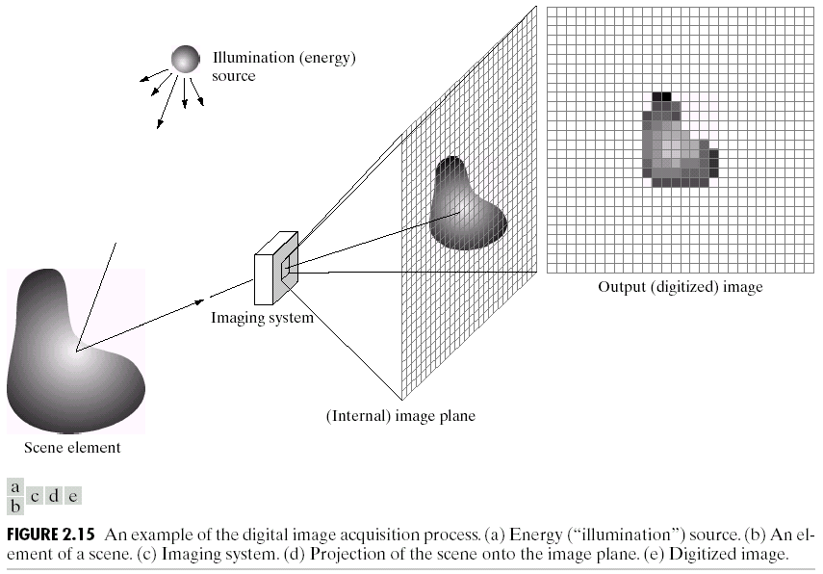
CCD Imaging (Sensor Array)

Slide 28
Charged Coupled Device (CCD)
A CCD is a device for the movement of electrical charge
  usually from within the device to an area where the charge can be manipulated
    often converted into a digital value
  CHARGE into digital value
    where charge is proportional to light exposure

Slide 29
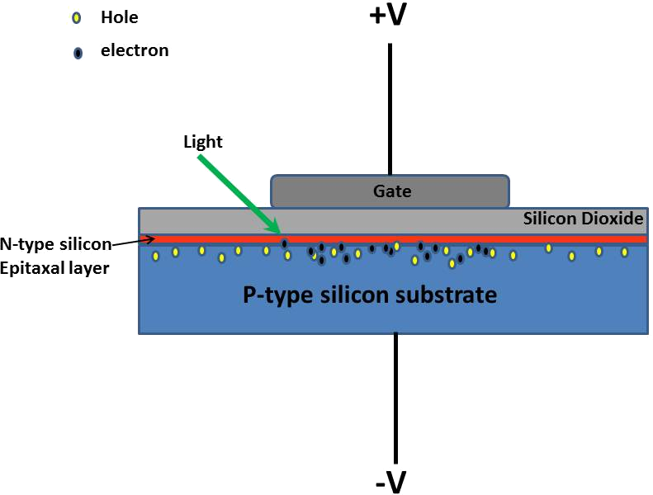
Single Pixel of a CCD Array
The top gate is held at a positive voltage
  gate = metal electrode
Notes:
Reference: http://www.hatiandskoll.com/2013/04/09/secrets-of-charge-coupled-devices-ccd/

Slide 30
Single Pixel of a CCD Array
Below the gate
Silicon Dioxide = SAND
    an insulator carrying no electrons
    keeps electrons away from gate
Notes:
Reference: http://www.hatiandskoll.com/2013/04/09/secrets-of-charge-coupled-devices-ccd/

Slide 31
Single Pixel of a CCD Array
Below the sand
N-type silicon Epitaxal layer
  photosensitive layer
  light can knock electrons off of it
Notes:
Reference: http://www.hatiandskoll.com/2013/04/09/secrets-of-charge-coupled-devices-ccd/

Slide 32
Single Pixel of a CCD Array
Below the Epitaxal layer
P-type silicon layer
  kept at negative voltage
Notes:
Reference: http://www.hatiandskoll.com/2013/04/09/secrets-of-charge-coupled-devices-ccd/

Slide 33
Single Pixel of a CCD Array
Light hits the bottom side of this
  Photoelectrons fill up the holes in the P-Type layer
    longer exposure means more holes filled up
      holes are “wells” to collect electrons
        maximum number of electrons a well can hold = well capacity
Notes:
Reference: http://www.hatiandskoll.com/2013/04/09/secrets-of-charge-coupled-devices-ccd/

Slide 34
Single Pixel of a CCD Array
End result
  Device which stores charge proportional to light exposure
  Make an array of them
Notes:
Reference: http://www.hatiandskoll.com/2013/04/09/secrets-of-charge-coupled-devices-ccd/

Slide 35
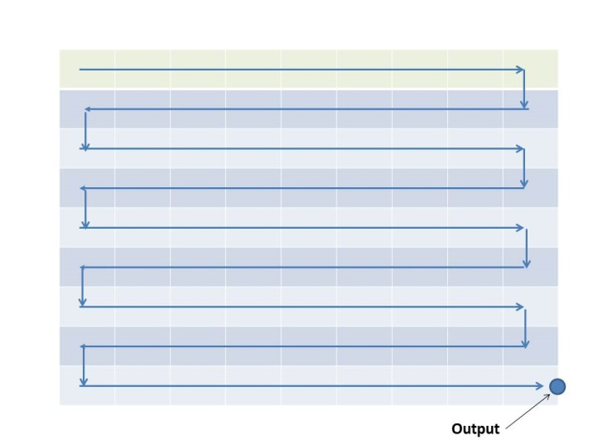
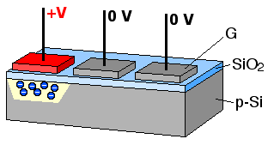
Shift To Get Readout
CCD uses programmed voltages to shift the charge between pixels
  Done by taking a pixel’s voltage to zero
    thus transferring it to adjacent pixel held at voltage V
  Shift continues until it reaches the readout point
Left Image by: Michael Schmid from Wikicommons Creative Commons License,
Right Image: David E. Wolf, http://www.hatiandskoll.com/2013/04/10/more-secrets-of-charge-coupled-devices/
Notes:
Ref: http://www.hatiandskoll.com/2013/04/10/more-secrets-of-charge-coupled-devices/

Slide 36
Shift To Get Readout
At output point
  accumulated charge acts as a voltage
  Analog to Digital (A/D) converter
  converts voltage to digital signal
    Image is now digitized
Left Image by: Michael Schmid from Wikicommons Creative Commons License,
Right Image: David E. Wolf, http://www.hatiandskoll.com/2013/04/10/more-secrets-of-charge-coupled-devices/
Notes:
Ref: http://www.hatiandskoll.com/2013/04/10/more-secrets-of-charge-coupled-devices/

Slide 37
Sloppy Noise
As charge moves from pixel to pixel,
there is spillage
  Which is one cause of “noise” in the signal
    Noise can cause “errors” in readout/display
Image by: Michael Schmid from Wikicommons Creative Commons License,
Notes:
Ref:
http://www.hatiandskoll.com/2013/04/10/more-secrets-of-charge-coupled-devices/
http://www.hatiandskoll.com/2013/04/11/building-a-digital-camera-sensor-from-a-charge-coupled-device/

Slide 38
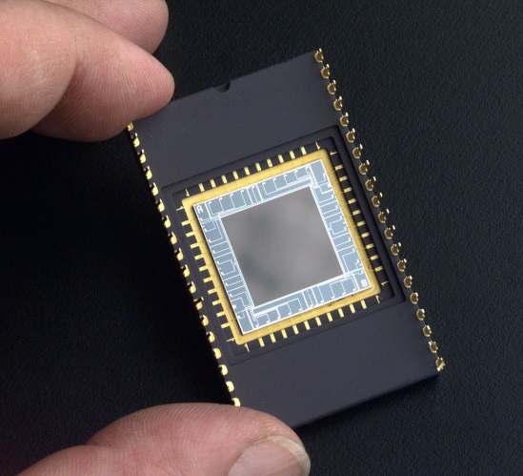
Device Limits: Dynamic Range
Dynamic Range of the Device
  Is the number of grey levels that a device can be divided into
    Is defined by the number of electrons
    This is controlled by the number of electrons in the well (the holes in the P-type silicon layer)
NASA public domain image of CCD sensor array

Slide 39
Questions so far
Questions on
CCD Hardware Aspects of Image Acquisition?
Image Acquisition
  Light and Electromagnetic spectrum
  Charge-Coupled Device (CCD) imaging
  Sampling and Quantization
  Bayer Filter
    a common color filter array (CFA)

Slide 40
Adding Some Math to The Picture
Image Formation Model
  f(x,y) = i(x,y) * r(x,y) + n(x, y)
f(x, y) | 0 < f(x, y) < ∞ | Intensity which is proportional to the energy radiated by a physical source
i(x, y) | 0 < i(x, y) < ∞ | illumination is amount of source illumination incident on the scene being viewed
r(x, y) | 0 < r(x, y) < 1 | reflectance is the amount of illumination reflected by objects in the scene
n(x, y) |  | noise is various measurement errors
nature of i(x, y) is determined by the illumination source (light source)
nature of r(x, y) is determined by the object(s) in the scene

Slide 41
Continuous to Discrete
f(x, y) in the “real” world is continuous
  The sensors provide a continuous voltage waveform whose amplitude and spatial behavior are related to the physical phenomenon being sensed
We must convert the continuous sensed data into digital form
  The A/D converter helps
  Lets look at some of the math behind it

Slide 42
Sampling and Quantization
Sampling
  Digitizing the coordinate values
    this can be thought of as our “pixel” resolution
Quantization
  Digitizing the amplitude
    A/D converter does most of this for us

Slide 43
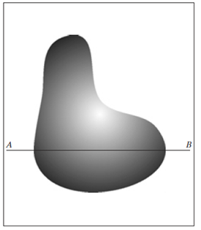
Sampling and Quantization: 1D
Generating a digital image
(a) Continuous Image

Slide 44
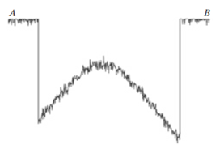
Sampling and Quantization: 1D
Generating a digital image
(a) Continuous Image
(b) A scan line from A to B
in the continuous image

Slide 45
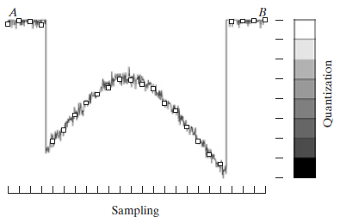
Sampling and Quantization: 1D
Generating a digital image
(b) A scan line from A to B
in the continuous image
(c) Sampling and Quantization

Slide 46
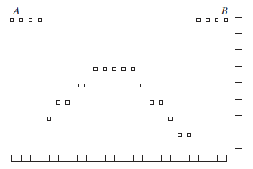
Sampling and Quantization: 1D
Generating a digital image
(d) Digital Scanline
(c) Sampling and Quantization

Slide 47
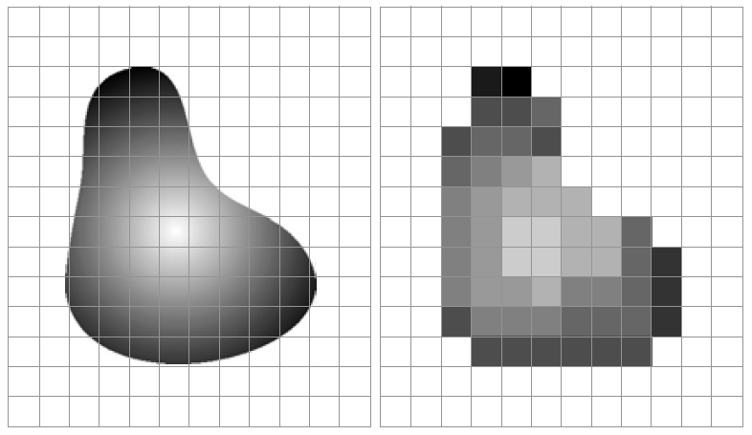
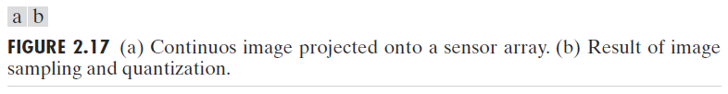
Onto 2D: Sampling and Quantization

Slide 48
Questions so far
Questions on Sampling or Quantization?
Image Acquisition
  Light and Electromagnetic spectrum
  Charge-Coupled Device (CCD) imaging
  Sampling and Quantization
  Bayer Filter
    a common color filter array (CFA)

Slide 49
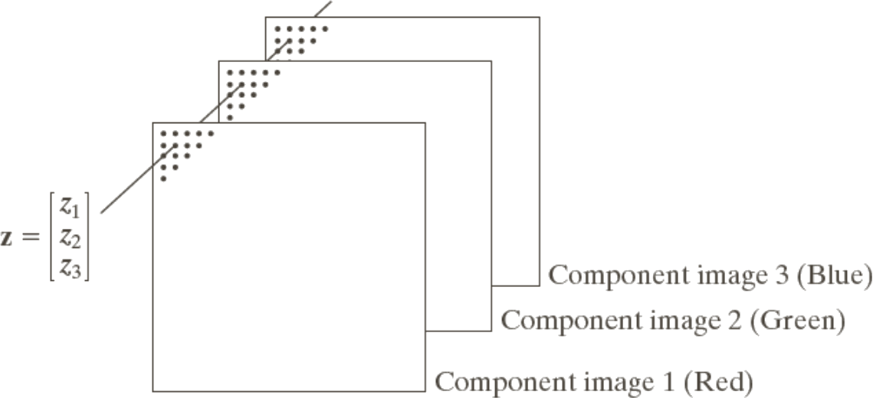
Maxwell: Experiments in Color
How does one use black and white sensors to digitize color?
  Experiments of Colour, James Clerk Maxwell, 1855
Answer (simplified)
  Color Filter Arrays (CFAs)
    Overlay the pixels with a set of
    Red, Green, and Blue filters

Slide 50
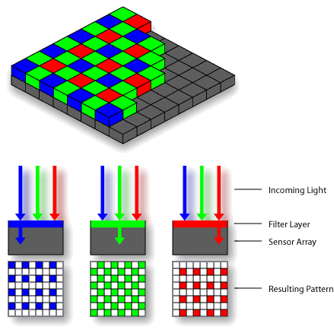
Bayer Filter
Ordering of filter overlays on pixels is important
Bayer Filter
  Is one CFA option
  Note that green has twice as many pixels
    Why?
Bayer Filter overlaid on CCD
Public domain image from WikiCommons
Notes:
Bayer Filter is green biased to account for human eye’s biological bias towards green sensors

Slide 51
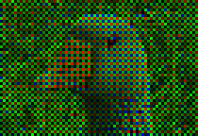
Zoomed in Result
Public Domain image from WikiCommons
Example Image acquired with a CCD chip
using Bayer Filter
  Mosaic Effect leaves something to be desired/fixed

Slide 52
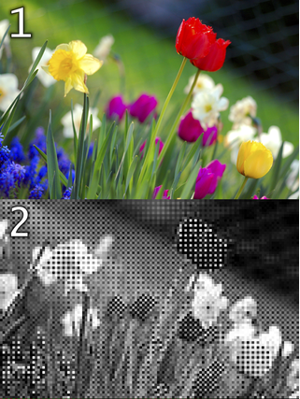
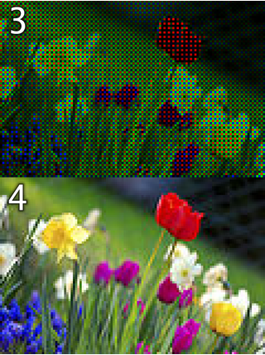
Mosaic Effect
Original scene
Output of a
120-pixel by 80-pixel
sensor with Bayer Filter
3. Output color-coded with Bayer Filter colors
4. Reconstructed Image after interpolating missing
color information

Slide 53


Another Example
Original Scene
What the Camera Sees
Images from: http://www.cambridgeincolour.com/tutorials/camera-sensors.htm

Slide 54
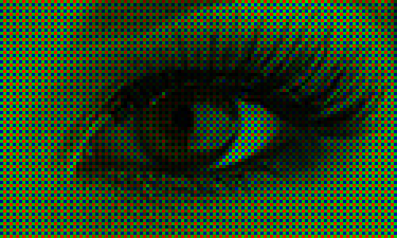
Even More Examples
Bayer Image (400%)
Image from: http://www.red.com/learn/red-101/bayer-sensor-strategy

Slide 55
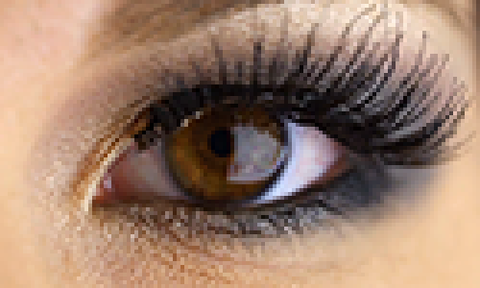
Even More Examples
Full Color Image (400%)
Image from: http://www.red.com/learn/red-101/bayer-sensor-strategy

Slide 56
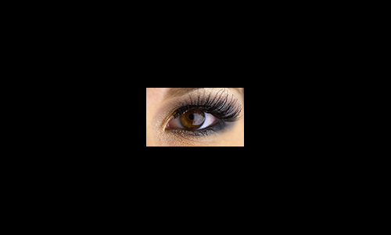
Even More Examples
Full Color Image (100%)
Image from: http://www.red.com/learn/red-101/bayer-sensor-strategy

Slide 57
Mosaic Removal: CFA Interpolation
Bayer de-mosaicking is the process of translating a CFA (Bayer array) of primary colors into a final image that contains full color information
    Interpolation methods
    will be discussed in a later lecture
    The interested may check out various papers online
Paper 1: http://research.microsoft.com/en-us/um/people/lhe/papers/icassp04.demosaicing.pdf
Presentation 1: https://courses.cs.washington.edu/courses/cse467/08au/pdfs/lectures/09-Demosaicing.pdf
Paper 2: http://www.ece.ncsu.edu/imaging/Publications/2002/demosaicking-JEI-02.pdf
Paper 3: http://graphics.cs.williams.edu/papers/BayerJGT09/bayer-jgt09.pdf
Paper 4: https://hal.inria.fr/hal-00683233/PDF/AEIP_SOUMIS.pdf
Paper 5: http://research.microsoft.com/pubs/102068/Demosaicing_ICASSP04.pdf

Slide 58
Questions so far
Questions on Bayer Filters?
  Image Acquisition
    Light and Electromagnetic spectrum
    Charge-Coupled Device (CCD) imaging
    Sampling and Quantization
    Bayer Filter
      a common color filter array (CFA)

Slide 59
Grayscale (and Color) Imaging
Image acquisition
  Light and Electromagnetic spectrum
  Charge-Coupled Device (CCD) imaging
  Bayer Filter
    a common color filter array (CFA)
  Sampling and Quantization
Image representation
  Spatial resolution
  Bit-depth resolution
  Local neighborhood

Slide 60
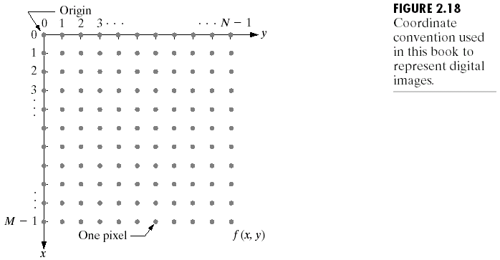
Images as Matrices
Resolution in
Spatial (x, y) coordinates
and
Bit-Depth (pixel values)

Slide 61
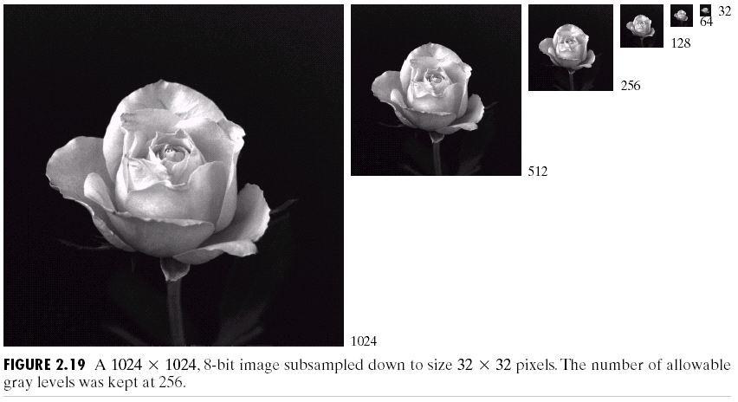
Spatial Resolution: Subsampling
Reducing image size by cutting out every other row/column
… appears mostly ok, w.r.t. appearance
… BUT what if we “zoom in” or keep image size “big”

Slide 62
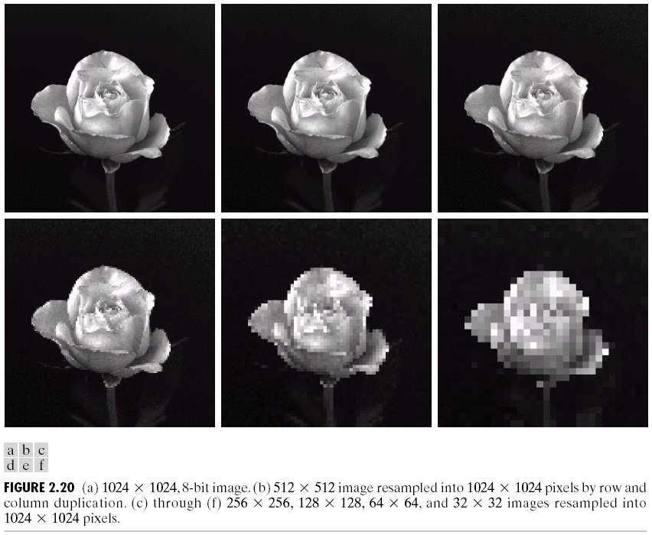
Spatial Resolution: Resampling
Instead of discarding rows and columns (reducing image size) – Resample to 1024x1024
i.e. Duplicate rows and columns with what previously was “kept” (keep image size)

Slide 63
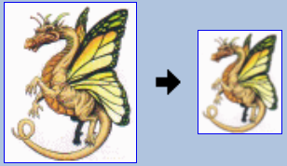
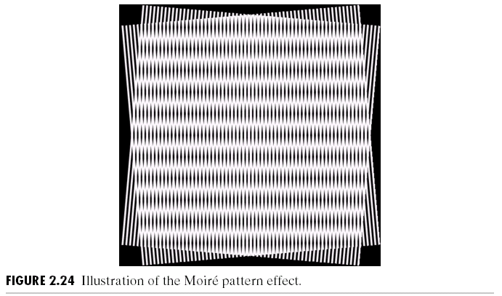
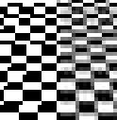

The Message
Use caution when scaling an image
  The obvious methods may have strange effects
Images from: http://www.imagemagick.org/Usage/resize/
Public Domain Image from Wikipedia

Slide 64
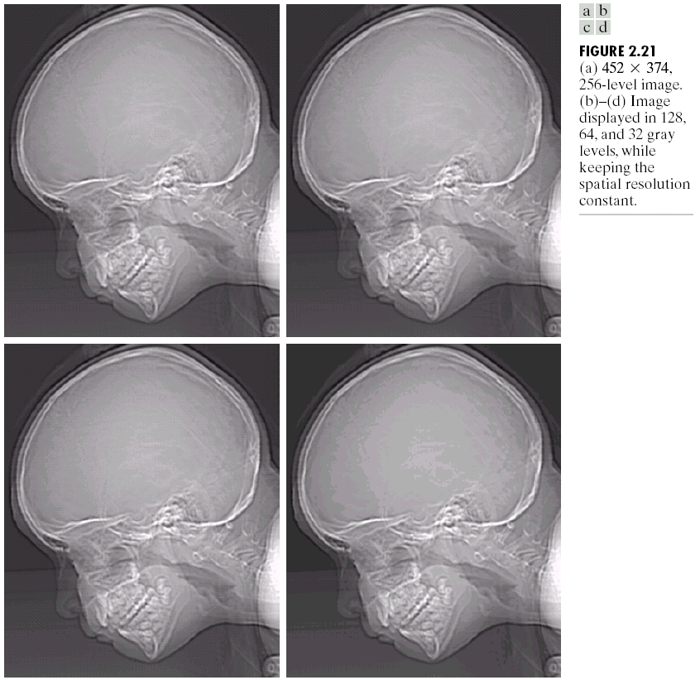
Bit-Depth Resolution

Slide 65
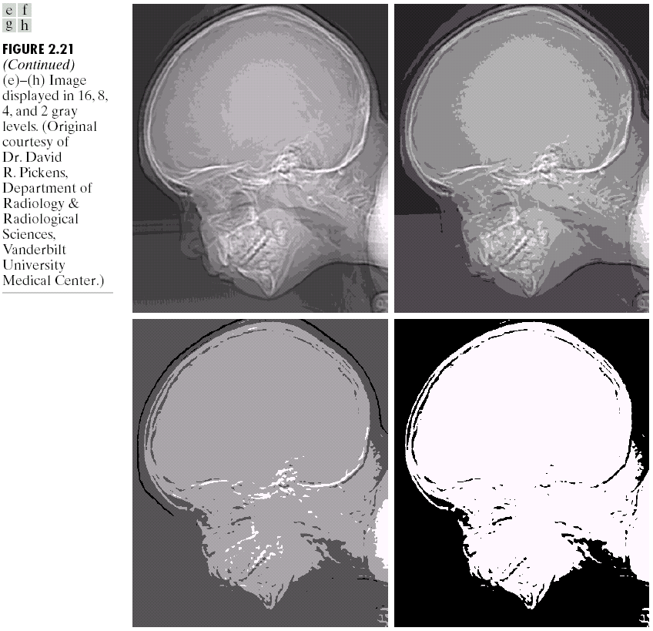
Bit Depth Resolution (fewer bits)

Slide 66
Neighborhoods
Neighbors of a pixel p=(i,j)
N₈(p)={(i-1,j),(i+1,j),(i,j-1),(i,j+1),
(i-1,j-1),(i-1,j+1),(i+1,j-1),(i+1,j+1)}
N₄(p)={(i-1,j),(i+1,j),(i,j-1),(i,j+1)}
Adjacency
4-adjacency: p,q are 4-adjacent if p is in the set N₄(q)
8-adjacency: p,q are 8-adjacent if p is in the set N₈(q)
Note that if p is in N_{4/8}(q), then q must be also in N_{4/8}(p)

Slide 67
Distance Definitions
D₄ distance
(city-block distance)
Euclidean distance
(2-norm)
D₈ distance
(checkboard distance)
4
3
2
3
4
2
3
2
1
2
3
2
2
2
2
2
1
2
1
0
1
2
2
1
1
1
2
2
1
0
1
2
3
2
1
2
3
2
1
0
1
2
1
4
3
2
3
4
2
1
1
1
2
2
2
2
2
2
2

Slide 68
Summary
Image acquisition
  Light and Electromagnetic spectrum
  Charge-Coupled Device (CCD) imaging
  Sampling and Quantization
  Bayer Filter
Image representation
  Spatial resolution
  Bit-depth resolution
  Local neighborhood
We understand digital images!
How and Why!

Slide 69
Questions?
Beyond D2L
  Examples and information
  can be found online at:
    http://docdingle.com/teaching/cs.html
    Continue to more stuff as needed

Slide 70
Extra Reference Stuff Follows

Slide 71
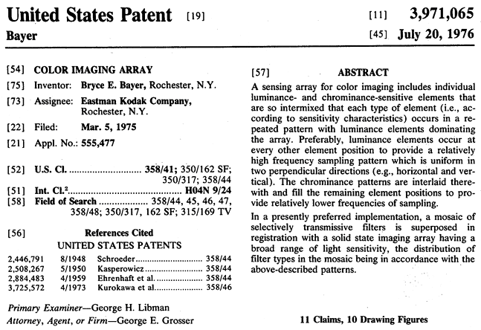
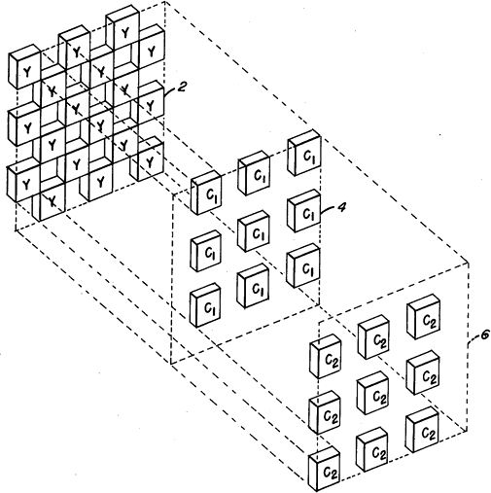
Bryce Bayer’s 1976 patent
  Front Page
  Demonstrates his terminology of luminance and chrominance sensitive elements

Slide 72

Credits
Much of the content derived/based on slides for use with the book:
  Digital Image Processing, Gonzalez and Woods
Some layout and presentation style derived/based on presentations by
  Donald House, Texas A&M University, 1999
  Bernd Girod, Stanford University, 2007
  Shreekanth Mandayam, Rowan University, 2009
  Igor Aizenberg, TAMUT, 2013
  Xin Li, WVU, 2014
  George Wolberg, City College of New York, 2015
  Yao Wang and Zhu Liu, NYU-Poly, 2015
  Sinisa Todorovic, Oregon State, 2015

