Slide 1
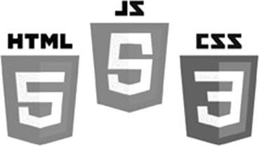

Image Processing
HTML5 – Canvas
JavaScript
Pixels
Brent M. Dingle, Ph.D. 2015
Game Design and Development Program
Mathematics, Statistics and Computer Science
University of Wisconsin - Stout

Slide 2
Lecture Objectives
Provide Examples
  Basic HTML5 canvas
  Pixel Manipulation
  “Loading” Images

Slide 3
What this is Not
To complete your projects
  You must learn more about HTML5 and JavaScript than what is about to be shown
    This is an “on-your-own” activity
      Instructor can help, but you must try on your own
    A prereq to this course is CS 244
      So you have programmed before
      This stuff is “easy” compared to that =)
      Likewise on the math topics
In Sum: The following is just a place to start
  More examples will follow throughout the course

Slide 4
Previously
Digital Image Processing (DIP)
    Is computer manipulation of pictures, or images, that have been converted into numeric form
A Digital Image
    Is a picture or image converted to numeric form
    In grey-scale the image can be thought of as
      2D function f(x, y) or a matrix
      x, y, and f(x, y) are discrete and finite
      Image size = (x_{max}) by (y_{max}), e.g. 1024 x 768
      Pixel Intensity Value = f(x,y) ∈ [0, 255]

Slide 5


HTML5/JS: Direct Pixel Manipulation
Three basic things you can do
  Create an array of empty pixels
  Get an array of pixels from an existing canvas
  Set the pixels of a canvas using a pixel array

Slide 6
Pixel Array
JavaScript arrays work like C/C++/Java
  Use the standard accessors to index into the array
    EX:
      mya[0] is the first element in the array named mya
      mya[k-1] is the k-th element in the array named mya
  Pixels in the array are in row-major order
    with values of 0 to 255
    where each four-integer group represents the four color channels: Red-Green-Blue-Alpha or RGBA
                illustration next slide

Slide 7
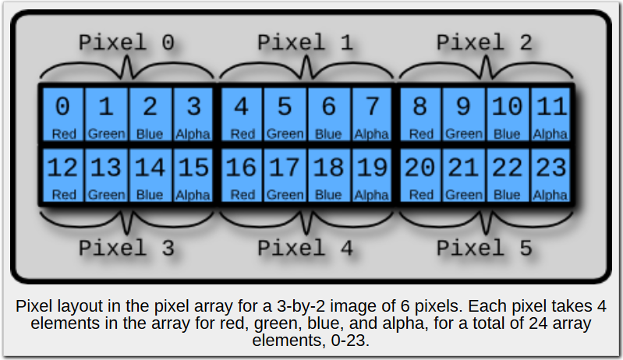
Pixel Order
image from: http://beej.us/blog/data/html5s-canvas-2-pixel/

Slide 8

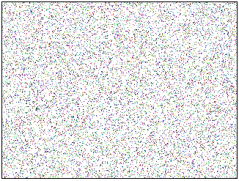
Creating a Noise Image
Use context’s function: createImageData()
Create a new function: SetPixel()
Use context’s function: putImageData()
createImage.html
<!DOCTYPE html>
<html lang="en">
<head>
<script src=“createImage.js" type="text/javascript"></script>
</head>
<body>
<div>
<canvas id="myCanvas" width="320" height="240">
Your browser does NOT support canvas!
</canvas>
</div>
</body>
</html>
Same basic HTML as previous examples
JavaScript filename changed
to createImage.js

Slide 9
Creating a Noise Image
Use context’s function: createImageData()
Create a new function: SetPixel()
Use context’s function: putImageData()
createImage.html
<!DOCTYPE html>
<html lang="en">
<head>
<script src=“createImage.js" type="text/javascript"></script>
</head>
<body>
<div>
<canvas id="myCanvas" width="320" height="240">
Your browser does NOT support canvas!
</canvas>
</div>
</body>
</html>
Questions on the HTML file ?

Slide 10

Creating a Noise Image
Use context’s function: createImageData()
Create a new function: SetPixel()
Use context’s function: putImageData()
createImage.js
var theProgram = {
Main: function() {
theCanvas = document.getElementById("myCanvas");
ctx = theCanvas.getContext("2d");
// Get the size of the canvas as declared in the HTML
var width = theCanvas.width;
var height = theCanvas.height;
// Create an array of pixels the same size as the canvas
imageData = ctx.createImageData(width, height);

Slide 11
Creating a Noise Image
Use context’s function: createImageData()
Create a new function: SetPixel()
Use context’s function: putImageData()
createImage.js
var theProgram = {
Main: function() {
theCanvas = document.getElementById("myCanvas");
ctx = theCanvas.getContext("2d");
// Get the size of the canvas as declared in the HTML
var width = theCanvas.width;
var height = theCanvas.height;
// Create an array of pixels the same size as the canvas
imageData = ctx.createImageData(width, height);
Note the following
imageData.width → width of the image data in PIXELS
imageData.height →height of the image daa in PIXELS
imageData.data → pixel data array of (width * height * 4)
elements

Slide 12
Creating a Noise Image
SetPixel: function(imageData, x, y, r, g, b, a)
{
var index = (x + y * imageData.width) * 4;
imageData.data[index + 0] = r;
imageData.data[index + 1] = g;
imageData.data[index + 2] = b;
imageData.data[index + 3] = a;
},
Use context’s function: createImageData()
Create a new function: SetPixel()
Use context’s function: putImageData()
createImage.js
var theProgram = {
Main: function() {
theCanvas = document.getElementById("myCanvas");
ctx = theCanvas.getContext("2d");
// Get the size of the canvas as declared in the HTML
var width = theCanvas.width;
var height = theCanvas.height;
// Create an array of pixels the same size as the canvas
imageData = ctx.createImageData(width, height);
SetPixel Function
(x, y) is image coordinate
r = red, g = green, b = blue, a = alpha
for alpha --> 255 is opaque and 0 is transparent

Slide 13
Creating a Noise Image
SetPixel: function(imageData, x, y, r, g, b, a)
{
var index = (x + y * imageData.width) * 4;
imageData.data[index + 0] = r;
imageData.data[index + 1] = g;
imageData.data[index + 2] = b;
imageData.data[index + 3] = a;
},
Use context’s function: createImageData()
Create a new function: SetPixel()
Use context’s function: putImageData()
createImage.js
var theProgram = {
Main: function() {
theCanvas = document.getElementById("myCanvas");
ctx = theCanvas.getContext("2d");
// Get the size of the canvas as declared in the HTML
var width = theCanvas.width;
var height = theCanvas.height;
// Create an array of pixels the same size as the canvas
imageData = ctx.createImageData(width, height);
// Draw random dots
for (var i = 0; i < 15000; i++) // 15000 is arbitrary
{
var x = Math.random() * width | 0;
var y = Math.random() * height | 0;
var r = Math.random() * 256 | 0;
var g = Math.random() * 256 | 0;
var b = Math.random() * 256 | 0;
theProgram.SetPixel(imageData, x, y, r, g, b, 255);
}
// Put the image data onto the canvas
ctx.putImageData(imageData, 0, 0);
},

Slide 14
Creating a Noise Image
SetPixel: function(imageData, x, y, r, g, b, a)
{
var index = (x + y * imageData.width) * 4;
imageData.data[index + 0] = r;
imageData.data[index + 1] = g;
imageData.data[index + 2] = b;
imageData.data[index + 3] = a;
},
Use context’s function: createImageData()
Create a new function: SetPixel()
Use context’s function: putImageData()
createImage.js
var theProgram = {
Main: function() {
theCanvas = document.getElementById("myCanvas");
ctx = theCanvas.getContext("2d");
// Get the size of the canvas as declared in the HTML
var width = theCanvas.width;
var height = theCanvas.height;
// Create an array of pixels the same size as the canvas
imageData = ctx.createImageData(width, height);
// Draw random dots
for (var i = 0; i < 15000; i++) // 15000 is arbitrary
{
var x = Math.random() * width | 0;
var y = Math.random() * height | 0;
var r = Math.random() * 256 | 0;
var g = Math.random() * 256 | 0;
var b = Math.random() * 256 | 0;
theProgram.SetPixel(imageData, x, y, r, g, b, 255);
}
// Put the image data onto the canvas
ctx.putImageData(imageData, 0, 0);
},
The “ | 0 ” is to truncate to integer value

Slide 15
Creating a Noise Image
SetPixel: function(imageData, x, y, r, g, b, a)
{
var index = (x + y * imageData.width) * 4;
imageData.data[index + 0] = r;
imageData.data[index + 1] = g;
imageData.data[index + 2] = b;
imageData.data[index + 3] = a;
},
Use context’s function: createImageData()
Create a new function: SetPixel()
Use context’s function: putImageData()
createImage.js
var theProgram = {
Main: function() {
theCanvas = document.getElementById("myCanvas");
ctx = theCanvas.getContext("2d");
// Get the size of the canvas as declared in the HTML
var width = theCanvas.width;
var height = theCanvas.height;
// Create an array of pixels the same size as the canvas
imageData = ctx.createImageData(width, height);
// Draw random dots
for (var i = 0; i < 15000; i++) // 15000 is arbitrary
{
var x = Math.random() * width | 0;
var y = Math.random() * height | 0;
var r = Math.random() * 256 | 0;
var g = Math.random() * 256 | 0;
var b = Math.random() * 256 | 0;
theProgram.SetPixel(imageData, x, y, r, g, b, 255);
}
// Put the image data onto the canvas
ctx.putImageData(imageData, 0, 0);
},
255 is opaque

Slide 16
Creating a Noise Image
SetPixel: function(imageData, x, y, r, g, b, a)
{
var index = (x + y * imageData.width) * 4;
imageData.data[index + 0] = r;
imageData.data[index + 1] = g;
imageData.data[index + 2] = b;
imageData.data[index + 3] = a;
},
Use context’s function: createImageData()
Create a new function: SetPixel()
Use context’s function: putImageData()
createImage.js
var theProgram = {
Main: function() {
theCanvas = document.getElementById("myCanvas");
ctx = theCanvas.getContext("2d");
// Get the size of the canvas as declared in the HTML
var width = theCanvas.width;
var height = theCanvas.height;
// Create an array of pixels the same size as the canvas
imageData = ctx.createImageData(width, height);
// Draw random dots
for (var i = 0; i < 15000; i++) // 15000 is arbitrary
{
var x = Math.random() * width | 0;
var y = Math.random() * height | 0;
var r = Math.random() * 256 | 0;
var g = Math.random() * 256 | 0;
var b = Math.random() * 256 | 0;
theProgram.SetPixel(imageData, x, y, r, g, b, 255);
}
// Put the image data onto the canvas
ctx.putImageData(imageData, 0, 0);
},
place data on the canvas starting at the
upper left corner => (0, 0)

Slide 17
Creating a Noise Image
SetPixel: function(imageData, x, y, r, g, b, a)
{
var index = (x + y * imageData.width) * 4;
imageData.data[index + 0] = r;
imageData.data[index + 1] = g;
imageData.data[index + 2] = b;
imageData.data[index + 3] = a;
},
}; // end theProgram Variable
createImage.js
var theProgram = {
Main: function() {
theCanvas = document.getElementById("myCanvas");
ctx = theCanvas.getContext("2d");
// Get the size of the canvas as declared in the HTML
var width = theCanvas.width;
var height = theCanvas.height;
// Create an array of pixels the same size as the canvas
imageData = ctx.createImageData(width, height);
// Draw random dots
for (var i = 0; i < 15000; i++) // 15000 is arbitrary
{
var x = Math.random() * width | 0;
var y = Math.random() * height | 0;
var r = Math.random() * 256 | 0;
var g = Math.random() * 256 | 0;
var b = Math.random() * 256 | 0;
theProgram.SetPixel(imageData, x, y, r, g, b, 255);
}
// Put the image data onto the canvas
ctx.putImageData(imageData, 0, 0);
},
window.onload = function()
{
theProgram.Main();
};

Slide 18
Creating a Noise Image
createImage.js
var theProgram = {
Main: function() {
theCanvas = document.getElementById("myCanvas");
ctx = theCanvas.getContext("2d");
// Get the size of the canvas as declared in the HTML
var width = theCanvas.width;
var height = theCanvas.height;
// Create an array of pixels the same size as the canvas
imageData = ctx.createImageData(width, height);
Questions on the JavaScript?
SetPixel: function(imageData, x, y, r, g, b, a)
{
var index = (x + y * imageData.width) * 4;
imageData.data[index + 0] = r;
imageData.data[index + 1] = g;
imageData.data[index + 2] = b;
imageData.data[index + 3] = a;
},
}; // end theProgram Variable
// Draw random dots
for (var i = 0; i < 15000; i++) // 15000 is arbitrary
{
var x = Math.random() * width | 0;
var y = Math.random() * height | 0;
var r = Math.random() * 256 | 0;
var g = Math.random() * 256 | 0;
var b = Math.random() * 256 | 0;
theProgram.SetPixel(imageData, x, y, r, g, b, 255);
}
// Put the image data onto the canvas
ctx.putImageData(imageData, 0, 0);
},
window.onload = function()
{
theProgram.Main();
};

Slide 19
Challenge
Modify the previous program to display an image that is not so random
  make it make circles
  or alternating colored lines
  or…

Slide 20
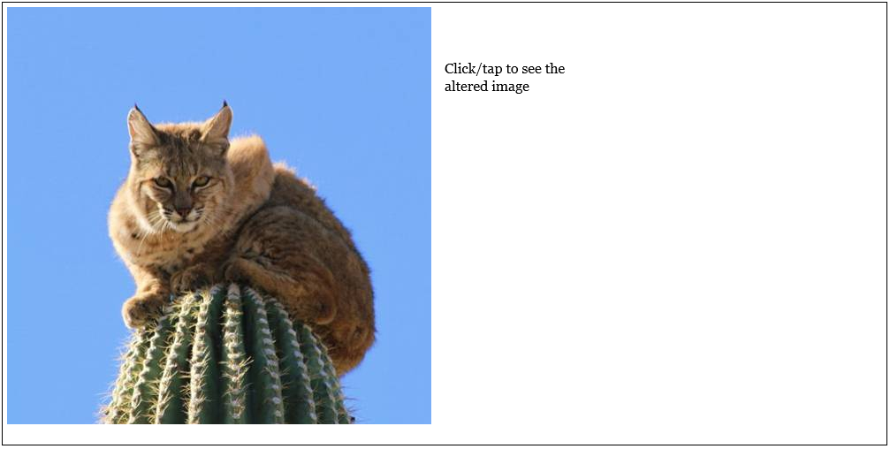
Load Image
We will now walk through a program that starts like:

Slide 21

Turn it Red
And when the user clicks on the right side…

Slide 22
loadImage.html
<!DOCTYPE html>
<html lang="en">
<head>
<meta content="text/html; charset=utf-8" http-equiv="content-type">
<meta name="author" content="Brent Dingle">
<meta name="description" content="Image Data Example in HTML5 and JavaScript by Brent M Dingle">
<title>Example: Load Image Data</title>
<script src="loadImage.js" type="text/javascript"></script>
</head>
<body>
<div>
<canvas id="mainImageCanvas" width="1000" height="500" style="border:1px solid #000000;">
Your browser does not support the HTML5 canvas tag.
</canvas>
</div>
</body>
</html>
Same as previous examples… but using a more detailed id name for the canvas

Slide 23
Questions on the HTML file ?
loadImage.html
<!DOCTYPE html>
<html lang="en">
<head>
<meta content="text/html; charset=utf-8" http-equiv="content-type">
<meta name="author" content="Brent Dingle">
<meta name="description" content="Image Data Example in HTML5 and JavaScript by Brent M Dingle">
<title>Example: Load Image Data</title>
<script src="loadImage.js" type="text/javascript"></script>
</head>
<body>
<div>
<canvas id="mainImageCanvas" width="1000" height="500" style="border:1px solid #000000;">
Your browser does not support the HTML5 canvas tag.
</canvas>
</div>
</body>
</html>

Slide 24
loadImage.js
// ----------------------------------------------------------------------------
// theProgram (singleton) Object
// ----------------------------------------------------------------------------
// ----------------------------------------------------------------------------
var theProgram =
{
// ------------------------------------------------------------------------
// Pseudo-constants
// ------------------------------------------------------------------------
IMAGE_CANVAS_ID: "mainImageCanvas", // canvas id used in html
// ------------------------------------------------------------------------
// Variables
// ------------------------------------------------------------------------
width: 400, // canvas width... likely will be reset
height: 400, // canvas height... likely will be reset
imageObj: null,
xOffset: 5,
yOffset: 5,
Declare and initialize the
Member variables
of the
singleton object theProgram

Slide 25
loadImage.js
// Variables
// ------------------------------------------------------------------------
width: 400, // canvas width... likely will be reset
height: 400, // canvas height... likely will be reset
imageObj: null,
xOffset: 5,
yOffset: 5,
// ------------------------------------------------------------------------
// Functions
// ------------------------------------------------------------------------
// Main
// ------------------------------------------------------------------------
Main: function()
{
var canvas = document.getElementById(this.IMAGE_CANVAS_ID);
canvas.addEventListener('click', theProgram.onClick, false);
canvas.addEventListener('touch', theProgram.onClick, false);
this.imageObj = new Image();
this.imageObj.onload = function()
{
theProgram.drawOrigImage();
};
this.imageObj.src = 'bobcatCactus.png';
},
// ------------------------------------------------------------------------
// EventHandler onClick
Our desired Entry-point function

Slide 26
loadImage.js
// Variables
// ------------------------------------------------------------------------
width: 400, // canvas width... likely will be reset
height: 400, // canvas height... likely will be reset
imageObj: null,
xOffset: 5,
yOffset: 5,
// ------------------------------------------------------------------------
// Functions
// ------------------------------------------------------------------------
// Main
// ------------------------------------------------------------------------
Main: function()
{
var canvas = document.getElementById(this.IMAGE_CANVAS_ID);
canvas.addEventListener('click', theProgram.onClick, false);
canvas.addEventListener('touch', theProgram.onClick, false);
this.imageObj = new Image();
this.imageObj.onload = function()
{
theProgram.drawOrigImage();
};
this.imageObj.src = 'bobcatCactus.png';
},
// ------------------------------------------------------------------------
// EventHandler onClick
Register a call-back function for click and touch events

Slide 27
loadImage.js
// Variables
// ------------------------------------------------------------------------
width: 400, // canvas width... likely will be reset
height: 400, // canvas height... likely will be reset
imageObj: null,
xOffset: 5,
yOffset: 5,
// ------------------------------------------------------------------------
// Functions
// ------------------------------------------------------------------------
// Main
// ------------------------------------------------------------------------
Main: function()
{
var canvas = document.getElementById(this.IMAGE_CANVAS_ID);
canvas.addEventListener('click', theProgram.onClick, false);
canvas.addEventListener('touch', theProgram.onClick, false);
this.imageObj = new Image();
this.imageObj.onload = function()
{
theProgram.drawOrigImage();
};
this.imageObj.src = 'bobcatCactus.png';
},
// ------------------------------------------------------------------------
// EventHandler onClick
Load the image file named:
bobcatCactus.png
Register a callback function
to draw it to the canvas when the file is loaded into the browser
Yes it is important to set the onload function
BEFORE setting the src

Slide 28
loadImage.js
// EventHandler onClick
// ------------------------------------------------------------------------
onClick: function(e)
{
theProgram.drawOrigImage();
theProgram.drawBWimage();
},
// ------------------------------------------------------------------------
// drawOrigImage
// ------------------------------------------------------------------------
drawOrigImage: function()
{
var canvas = document.getElementById(this.IMAGE_CANVAS_ID);
var ctx = canvas.getContext('2d');
ctx.clearRect(0, 0, canvas.width, canvas.height);
ctx.drawImage(this.imageObj, this.xOffset, this.yOffset);
ctx.font="16px Georgia";
ctx.fillText("Click/tap to see the", this.imageObj.width+20, 80);
ctx.fillText("black and white image", this.imageObj.width+20, 100);
},
// ------------------------------------------------------------------------
// drawBWimage -- must call drawOrigImage before this
Function that is called when
the image file named:
bobcatCactus.png
is loaded into the browser

Slide 29
loadImage.js
// EventHandler onClick
// ------------------------------------------------------------------------
onClick: function(e)
{
theProgram.drawOrigImage();
theProgram.drawBWimage();
},
// ------------------------------------------------------------------------
// drawOrigImage
// ------------------------------------------------------------------------
drawOrigImage: function()
{
var canvas = document.getElementById(this.IMAGE_CANVAS_ID);
var ctx = canvas.getContext('2d');
ctx.clearRect(0, 0, canvas.width, canvas.height);
ctx.drawImage(this.imageObj, this.xOffset, this.yOffset);
ctx.font="16px Georgia";
ctx.fillText("Click/tap to see the", this.imageObj.width+20, 80);
ctx.fillText("black and white image", this.imageObj.width+20, 100);
},
// ------------------------------------------------------------------------
// drawBWimage -- must call drawOrigImage before this
Gets the canvas and context

Slide 30
loadImage.js
// EventHandler onClick
// ------------------------------------------------------------------------
onClick: function(e)
{
theProgram.drawOrigImage();
theProgram.drawBWimage();
},
// ------------------------------------------------------------------------
// drawOrigImage
// ------------------------------------------------------------------------
drawOrigImage: function()
{
var canvas = document.getElementById(this.IMAGE_CANVAS_ID);
var ctx = canvas.getContext('2d');
ctx.clearRect(0, 0, canvas.width, canvas.height);
ctx.drawImage(this.imageObj, this.xOffset, this.yOffset);
ctx.font="16px Georgia";
ctx.fillText("Click/tap to see the", this.imageObj.width+20, 80);
ctx.fillText("black and white image", this.imageObj.width+20, 100);
},
// ------------------------------------------------------------------------
// drawBWimage -- must call drawOrigImage before this
Clears the canvas

Slide 31
loadImage.js
// EventHandler onClick
// ------------------------------------------------------------------------
onClick: function(e)
{
theProgram.drawOrigImage();
theProgram.drawBWimage();
},
// ------------------------------------------------------------------------
// drawOrigImage
// ------------------------------------------------------------------------
drawOrigImage: function()
{
var canvas = document.getElementById(this.IMAGE_CANVAS_ID);
var ctx = canvas.getContext('2d');
ctx.clearRect(0, 0, canvas.width, canvas.height);
ctx.drawImage(this.imageObj, this.xOffset, this.yOffset);
ctx.font="16px Georgia";
ctx.fillText("Click/tap to see the", this.imageObj.width+20, 80);
ctx.fillText("black and white image", this.imageObj.width+20, 100);
},
// ------------------------------------------------------------------------
// drawBWimage -- must call drawOrigImage before this
Draws the loaded image

Slide 32
loadImage.js
// EventHandler onClick
// ------------------------------------------------------------------------
onClick: function(e)
{
theProgram.drawOrigImage();
theProgram.drawBWimage();
},
// ------------------------------------------------------------------------
// drawOrigImage
// ------------------------------------------------------------------------
drawOrigImage: function()
{
var canvas = document.getElementById(this.IMAGE_CANVAS_ID);
var ctx = canvas.getContext('2d');
ctx.clearRect(0, 0, canvas.width, canvas.height);
ctx.drawImage(this.imageObj, this.xOffset, this.yOffset);
ctx.font="16px Georgia";
ctx.fillText("Click/tap to see the", this.imageObj.width+20, 80);
ctx.fillText(“altered image", this.imageObj.width+20, 100);
},
// ------------------------------------------------------------------------
// drawBWimage -- must call drawOrigImage before this
Displays message telling user
to click or tap on the area to
see the altered version of the image

Slide 33
loadImage.js
// EventHandler onClick
// ------------------------------------------------------------------------
onClick: function(e)
{
theProgram.drawOrigImage();
theProgram.drawAlteredImage();
},
// ------------------------------------------------------------------------
// drawOrigImage
// ------------------------------------------------------------------------
drawOrigImage: function()
{
var canvas = document.getElementById(this.IMAGE_CANVAS_ID);
var ctx = canvas.getContext('2d');
ctx.clearRect(0, 0, canvas.width, canvas.height);
ctx.drawImage(this.imageObj, this.xOffset, this.yOffset);
ctx.font="16px Georgia";
ctx.fillText("Click/tap to see the", this.imageObj.width+20, 80);
ctx.fillText(“altered image", this.imageObj.width+20, 100);
},
// ------------------------------------------------------------------------
// drawAlteredImage -- must call drawOrigImage before this
This function is called when
the user clicks or taps on the area
It will draw the original image
and then the altered image

Slide 34
loadImage.js
// drawAlteredImage -- must call drawOrigImage before this
// ------------------------------------------------------------------------
drawAlteredImage: function()
{
var canvas = document.getElementById(this.IMAGE_CANVAS_ID);
var ctx = canvas.getContext('2d');
// Get the image data from the canvas context
var imageData = ctx.getImageData(this.xOffset, this.yOffset,
this.imageObj.width, this.imageObj.height);
var data = imageData.data;
// This gives us the image data in RGBA format - one byte for each
// So to iterate over all pixels we would do:
//for(var i = 0, n = data.length; i < n; i += 4)
// {
// var red = data[i];
// var green = data[i + 1];
// var blue = data[i + 2];
// var alpha = data[i + 3];
// }
// We must 'create' a new image
Function to draw the altered image

Slide 35
loadImage.js
// drawAlteredImage -- must call drawOrigImage before this
// ------------------------------------------------------------------------
drawAlteredImage: function()
{
var canvas = document.getElementById(this.IMAGE_CANVAS_ID);
var ctx = canvas.getContext('2d');
// Get the image data from the canvas context
var imageData = ctx.getImageData(this.xOffset, this.yOffset,
this.imageObj.width, this.imageObj.height);
var data = imageData.data;
// This gives us the image data in RGBA format - one byte for each
// So to iterate over all pixels we would do:
//for(var i = 0, n = data.length; i < n; i += 4)
// {
// var red = data[i];
// var green = data[i + 1];
// var blue = data[i + 2];
// var alpha = data[i + 3];
// }
// We must 'create' a new image
Get the original image
pixel data array
CAUTION:
This assumes the image is drawn on the canvas already, at (xOffset, yOffset)
and is size width x height
Hence the need for drawOrigImage to be called before this function
There are other ways to do this and
avoid this assumption

Slide 36
loadImage.js
// drawAlteredImage -- must call drawOrigImage before this
// ------------------------------------------------------------------------
drawAlteredImage: function()
{
var canvas = document.getElementById(this.IMAGE_CANVAS_ID);
var ctx = canvas.getContext('2d');
// Get the image data from the canvas context
var imageData = ctx.getImageData(this.xOffset, this.yOffset,
this.imageObj.width, this.imageObj.height);
var data = imageData.data;
// This gives us the image data in RGBA format - one byte for each
// So to iterate over all pixels we would do:
//for(var i = 0, n = data.length; i < n; i += 4)
// {
// var red = data[i];
// var green = data[i + 1];
// var blue = data[i + 2];
// var alpha = data[i + 3];
// }
// We must 'create' a new image
Recall the ordering of the pixel data

Slide 37
loadImage.js
// var alpha = data[i + 3];
// }
// We must 'create' a new image
var SecondImageData = ctx.createImageData(this.imageObj.width, this.imageObj.height);
for (var pixelIndex=0; pixelIndex < SecondImageData.data.length; pixelIndex += 4)
{
SecondImageData.data[pixelIndex ] = data[pixelIndex] * 3; // More red
SecondImageData.data[pixelIndex + 1] = data[pixelIndex +1] / 2; // Less green
SecondImageData.data[pixelIndex + 2] = data[pixelIndex +2] / 2; // Less blue
SecondImageData.data[pixelIndex + 3] = data[pixelIndex +3]; // alpha unchanged
}
// Want to draw the altered image to the right of original
// Offset gives spacing between
var SecondImageX = 2*this.xOffset + this.imageObj.width;
var SecondImageY = this.yOffset;
ctx.putImageData(SecondImageData, SecondImageX, SecondImageY);
},
}; // end theProgram variable
// ----------------------------------------------------------------------------
// window.ONLOAD
Create a new pixel data array
of the same size as the original

Slide 38
loadImage.js
// var alpha = data[i + 3];
// }
// We must 'create' a new image
var SecondImageData = ctx.createImageData(this.imageObj.width, this.imageObj.height);
for (var pixelIndex=0; pixelIndex < SecondImageData.data.length; pixelIndex += 4)
{
SecondImageData.data[pixelIndex ] = data[pixelIndex] * 3; // More red
SecondImageData.data[pixelIndex + 1] = data[pixelIndex +1] / 2; // Less green
SecondImageData.data[pixelIndex + 2] = data[pixelIndex +2] / 2; // Less blue
SecondImageData.data[pixelIndex + 3] = data[pixelIndex +3]; // alpha unchanged
}
// Want to draw the altered image to the right of original
// Offset gives spacing between
var SecondImageX = 2*this.xOffset + this.imageObj.width;
var SecondImageY = this.yOffset;
ctx.putImageData(SecondImageData, SecondImageX, SecondImageY);
},
}; // end theProgram variable
// ----------------------------------------------------------------------------
// window.ONLOAD
Loop through the pixel data
Increasing the red values
Decreasing the green and blue
Alpha remains the same

Slide 39
loadImage.js
// var alpha = data[i + 3];
// }
// We must 'create' a new image
var SecondImageData = ctx.createImageData(this.imageObj.width, this.imageObj.height);
for (var pixelIndex=0; pixelIndex < SecondImageData.data.length; pixelIndex += 4)
{
SecondImageData.data[pixelIndex ] = data[pixelIndex] * 3; // More red
SecondImageData.data[pixelIndex + 1] = data[pixelIndex +1] / 2; // Less green
SecondImageData.data[pixelIndex + 2] = data[pixelIndex +2] / 2; // Less blue
SecondImageData.data[pixelIndex + 3] = data[pixelIndex +3]; // alpha unchanged
}
// Want to draw the altered image to the right of original
// Offset gives spacing between
var SecondImageX = 2*this.xOffset + this.imageObj.width;
var SecondImageY = this.yOffset;
ctx.putImageData(SecondImageData, SecondImageX, SecondImageY);
},
}; // end theProgram variable
// ----------------------------------------------------------------------------
// window.ONLOAD
Calculate the offset position
to draw the second image
→ calculate where the upper left corner of the new image is to be placed on the canvas
Answer: at position
(secondImageX, secondImageY)
in canvas coordinates

Slide 40
loadImage.js
// var alpha = data[i + 3];
// }
// We must 'create' a new image
var SecondImageData = ctx.createImageData(this.imageObj.width, this.imageObj.height);
for (var pixelIndex=0; pixelIndex < SecondImageData.data.length; pixelIndex += 4)
{
SecondImageData.data[pixelIndex ] = data[pixelIndex] * 3; // More red
SecondImageData.data[pixelIndex + 1] = data[pixelIndex +1] / 2; // Less green
SecondImageData.data[pixelIndex + 2] = data[pixelIndex +2] / 2; // Less blue
SecondImageData.data[pixelIndex + 3] = data[pixelIndex +3]; // alpha unchanged
}
// Want to draw the altered image to the right of original
// Offset gives spacing between
var SecondImageX = 2*this.xOffset + this.imageObj.width;
var SecondImageY = this.yOffset;
ctx.putImageData(SecondImageData, SecondImageX, SecondImageY);
},
}; // end theProgram variable
// ----------------------------------------------------------------------------
// window.ONLOAD
Draw the altered image
on the canvas
at the calculated offset

Slide 41
loadImage.js
SecondImageData.data[pixelIndex + 2] = data[pixelIndex +2] / 2; // Less blue
SecondImageData.data[pixelIndex + 3] = data[pixelIndex +3]; // alpha unchanged
}
// Want to draw the altered image to the right of original
// Offset gives spacing between
var SecondImageX = 2*this.xOffset + this.imageObj.width;
var SecondImageY = this.yOffset;
ctx.putImageData(SecondImageData, SecondImageX, SecondImageY);
},
}; // end theProgram variable
// ----------------------------------------------------------------------------
// window.ONLOAD
// ----------------------------------------------------------------------------
window.onload = function()
{
// Initialize and Start the game
theProgram.Main();
};
// ----------------------------------------------------------------------------
// ----------------------------------------------------------------------------
// end of file
And make sure when all the
contents of the HTML page
are loaded into the browser
that our program begins
i.e. call theProgram.Main()

Slide 42
loadImage.js
SecondImageData.data[pixelIndex + 2] = data[pixelIndex +2] / 2; // Less blue
SecondImageData.data[pixelIndex + 3] = data[pixelIndex +3]; // alpha unchanged
}
// Want to draw the altered image to the right of original
// Offset gives spacing between
var SecondImageX = 2*this.xOffset + this.imageObj.width;
var SecondImageY = this.yOffset;
ctx.putImageData(SecondImageData, SecondImageX, SecondImageY);
},
}; // end theProgram variable
// ----------------------------------------------------------------------------
// window.ONLOAD
// ----------------------------------------------------------------------------
window.onload = function()
{
// Initialize and Start the game
theProgram.Main();
};
// ----------------------------------------------------------------------------
// ----------------------------------------------------------------------------
// end of file
Any questions on the JavaScript?

Slide 43
Challenge
Alter the above program to change the color image into a grey-scale image
Apply a luminance algorithm of:
  0.3*red + 0.59*green + 0.11*blue
  Also, come to the next class with an explanation of why the green would be such a higher weight

Slide 44

Questions?
Beyond D2L
  Examples and information
  can be found online at:
    http://docdingle.com/teaching/cs.html
    Continue to more stuff as needed

Slide 45
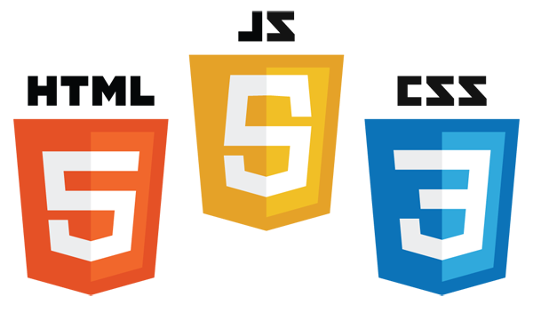

Extra Reference Stuff Follows

Slide 46
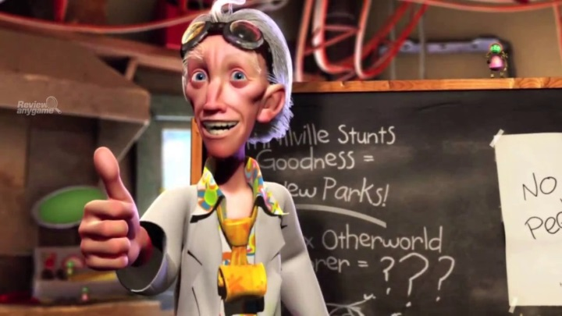
Credits
Much of the content derived/based on slides for use with the book:
  Digital Image Processing, Gonzalez and Woods
Some layout and presentation style derived/based on presentations by
  Donald House, Texas A&M University, 1999
  Bernd Girod, Stanford University, 2007
  Shreekanth Mandayam, Rowan University, 2009
  Igor Aizenberg, TAMUT, 2013
  Xin Li, WVU, 2014
  George Wolberg, City College of New York, 2015
  Yao Wang and Zhu Liu, NYU-Poly, 2015
  Sinisa Todorovic, Oregon State, 2015
  Beej’s Bit Bucket / Tech and Programming Fun
    http://beej.us/blog/
    http://beej.us/blog/data/html5s-canvas-2-pixel/
  w3schools.com

