Slide 1
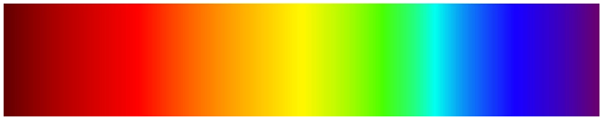

Image Processing
Color
Brent M. Dingle, Ph.D. 2015
Game Design and Development Program
Mathematics, Statistics and Computer Science
University of Wisconsin - Stout
Material in this presentation is largely based on/derived from
presentation(s) and book: The Digital Image by Dr. Donald House at Texas A&M University

Slide 2
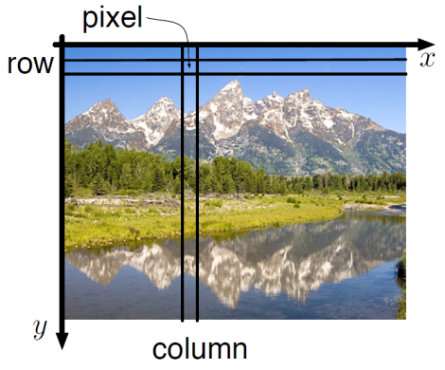
Lecture Objectives
Previously
  Digital Images are Numbers
    2D function f(x, y)
      or a matrix
      f(x, y) = Pixel Intensity Value
        f(x,y) ∈ [0, 255] or f(x,y) ∈ [0, 1]
    Greyscale (scalar)
    Color (3-vector)
Today
  Color
    Perception
    Representation

Slide 3
What is Color?
Who should we ask?
  physicist?
  biologist?
  artist?

Slide 4
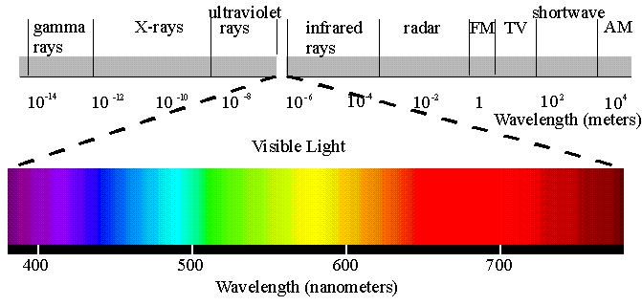
Physical Color
Color is directly related to the physical phenomenon of light
  It is a way of describing distributions of light energy
Electromagnetic Waves

Slide 5
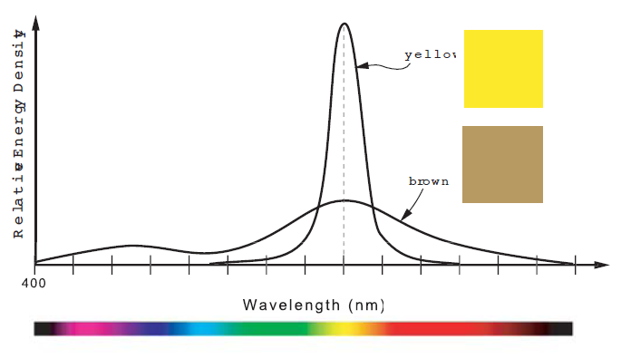
Spectrum Defines Color
Think:
spectral
analysis
speed of light = wavelength * frequency
dominant wavelength
defines hue
total energy (area under curve) are the same
distributions are different… (so things will “appear” different)

Slide 6
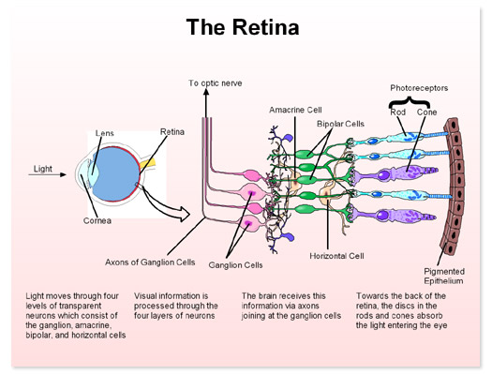
Biology
Rods
and Cones
are
Important
to Color
Perception

Slide 7
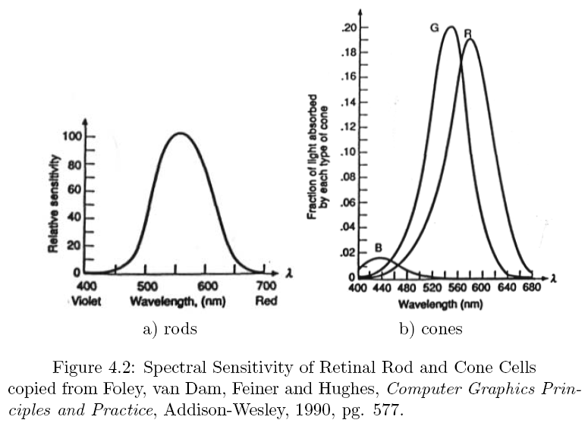
Rod and Cone Response Curves
RODS:
low light
constant luminance
varied wavelength

Slide 8
Rod and Cone Response Curves
CONES:
high light
3 primary types
  roughly R, G, B

Slide 9
Luminous Efficiency Function
By experimental evidence:
(a) is the sum of the 3 curves of (b)
So (a) is often called the Luminous Efficiency Function

Slide 10
Tri-Stimulus Theory of Color
Additive Color Systems
  RGB
  HSV
  CIE xyY
Subtractive Color System
  CMY
    CMYK

Slide 11
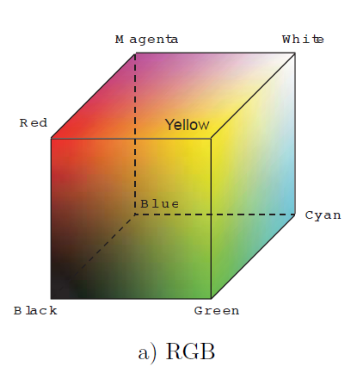
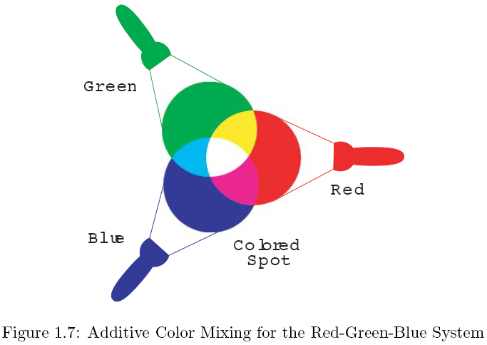
Tri-Stim Theory of Color
light source

Slide 12
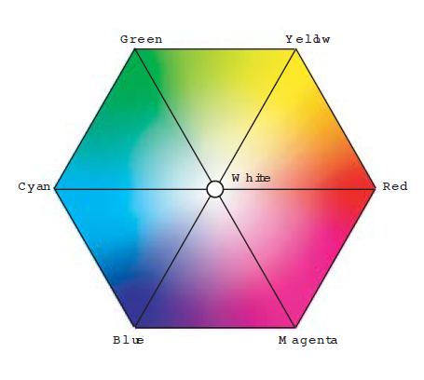
HSV Color Space (Artists)
Hue, Saturation, Value
H
Cross-Section,
so V is constant
S

Slide 13

RGB versus HSV
RGB can be translated to HSV and back
Orient the cube so you are looking down the diagonal from
the white corner to the black corner of the cube

Slide 14
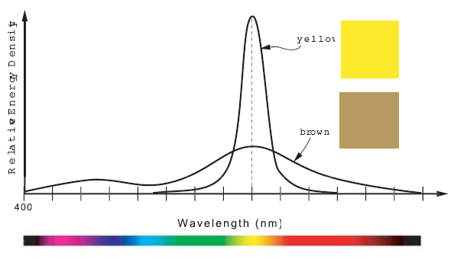
HSV: yellow versus brown
H is same
V is same
S is different
Same Hue ←→ Same dominant wavelength
Same Value ←→Same area under the curves
        different brightness due to response curve of eye
Different Saturation ←→Different Spectral Distribution

Slide 15
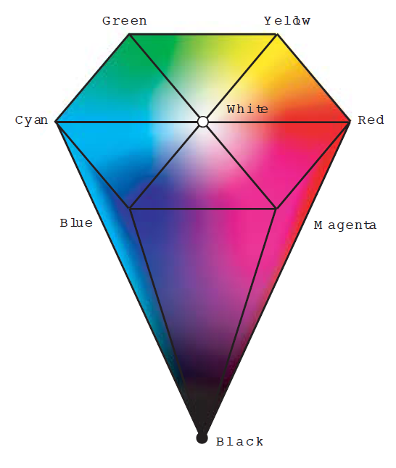
HSV Color Hexcone

Slide 16
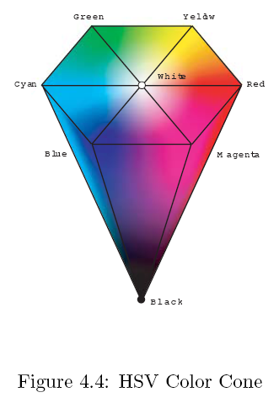
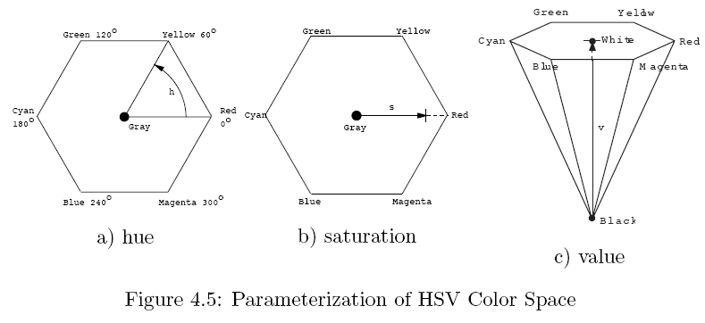
Using the Cone
range here: [0, 360)
range here: [0, 1]
range here: [0, 1]

Slide 17
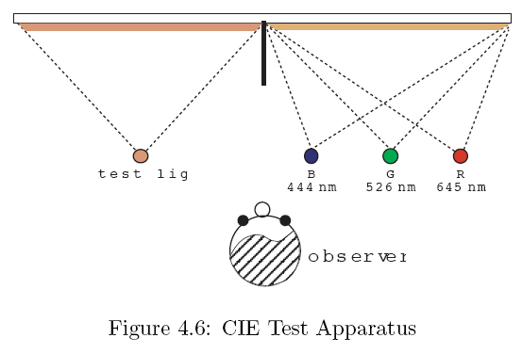
CIE Color Space
CIE: International Commission on Illumination
  Desire to: Specify precise reproducibility
  Developed a color space to reflect desired mathematical properties
    based on experimental results of human eye response/perception
Question to observer: does the left color match the right?

Slide 18


CIE Color Space: A space of desires
CIE intent is to
  Define a colored light using a mixture of 3 primaries
  Three imaginary primaries are denoted: x, y, z
    So each color can be made with positive combinations of x, y, z
  New space is related to CIE RGB space by a linear transformation
    R, G, B and x, y, z can be converted linearly
  Assign Luminous Efficiency Curve to y (Choose y to be luminosity)

Slide 19
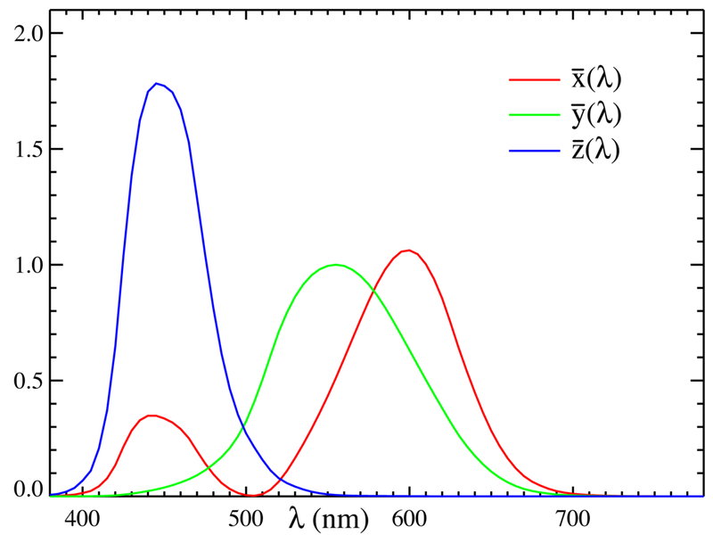
CIE Color Matching Functions
Plots of x, y, z transformed from RGB
  transform is LINEAR

Slide 20
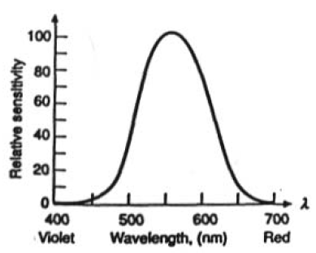
CIE Color Matching Functions
luminous
efficiency curve
By design the y curve is just the luminous efficiency curve of the human eye

Slide 21
CIE xyY color specification
Three imaginary color primaries: x, y, z
  C = Xx + Yy + Zz
Normalizing X, Y, Z yields:
  x = X / (X + Y + Z)
  y = Y / (X + Y + Z)
  z = Z / (X + Y + Z) = 1 – (x + y)
Choose Y to be luminance
i.e. sort of V in HSV
x, y can then represent all colors
i.e. sort of H, S in HSV
Color is then given by (x, y, Y)

Slide 22
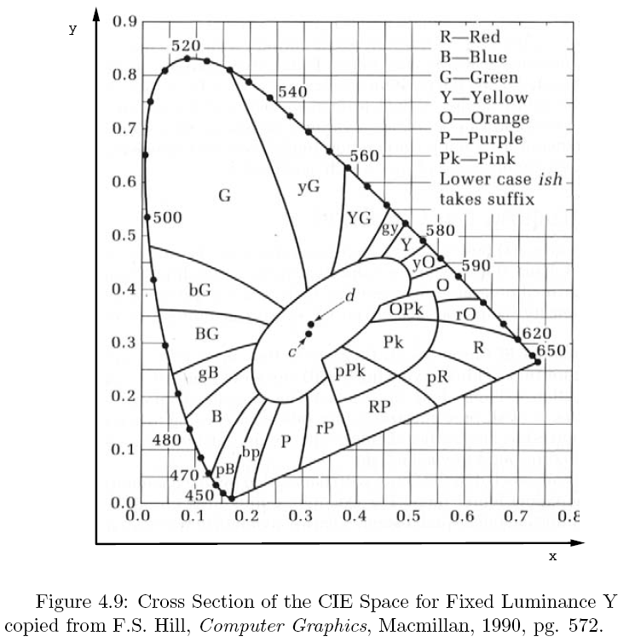
Y is constant in this picture
(x, y) specifies the color

Slide 23
Y is constant in this picture
(x, y) specifies the color
c is white light

Slide 24
Y is constant in this picture
(x, y) specifies the color
d is white light for NSTC

Slide 25
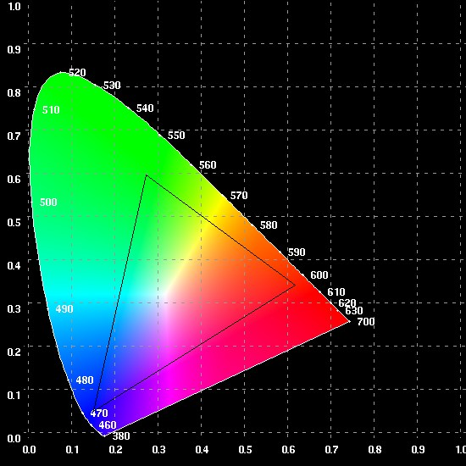
Y is constant in this picture
(x, y) specifies the color
Monitor display
is limited to colors
in this triangle
(approximately)
This is called the
monitor’s GAMUT

Slide 26
Summary
Color
  For humans
    Tri-stimulus based
    Many different color spaces
      Examples: RGB, HSV, CIE xyY
    Translation between them usually linear
      NOTE: HSV, HSL, HSI are NOT the same
        V = value, L = lightness, I = intensity
  Hardware has limitations too
    only a GAMUT of colors can be displayed
            Additional discussion on different color spaces and conversion between them can be found at
              http://www.poynton.com/PDFs/coloureq.pdf
Aside:
Color spaces themselves
tend not be linear
as they try to match
human eye responses
See discussions
on perception

Slide 27
Questions?
Beyond D2L
  Examples and information
  can be found online at:
    http://docdingle.com/teaching/cs.html
    Continue to more stuff as needed

Slide 28
Extra Reference Stuff Follows

Slide 29

Credits
Much of the content derived/based on slides for use with the book:
  Digital Image Processing, Gonzalez and Woods
Some layout and presentation style derived/based on presentations by
  Donald House, Texas A&M University, 1999
  Bernd Girod, Stanford University, 2007
  Shreekanth Mandayam, Rowan University, 2009
  Igor Aizenberg, TAMUT, 2013
  Xin Li, WVU, 2014
  George Wolberg, City College of New York, 2015
  Yao Wang and Zhu Liu, NYU-Poly, 2015
  Sinisa Todorovic, Oregon State, 2015

