Slide 1
Quick Review Summary
Reference Summary List
Brent M. Dingle, Ph.D. 2015
Game Design and Development Program
Mathematics, Statistics and Computer Science
University of Wisconsin - Stout

Slide 2
Lecture Objectives
Quick review of topics covered and direction headed

Slide 3
List Summary
Previously
What a Digital Image is
Acquisition
Human Perception
Representation
Color Spaces
HTML5 and JavaScript Code Examples
Pixel manipulation
Image Loading
Filtering

Slide 4
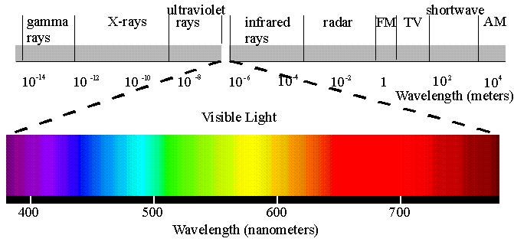
What is a Digital Image?
Acquisition Sources
Electromagnetic (EM) spectrums
Acoustic Imaging
EX: Ultrasounds, Seismic Imaging…
Electron Microscopy
Generation
Synthetic Images
Computer Generated
Graphics, Games, Digital Art…

Slide 5
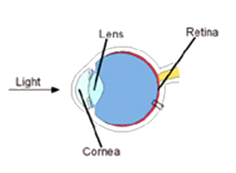
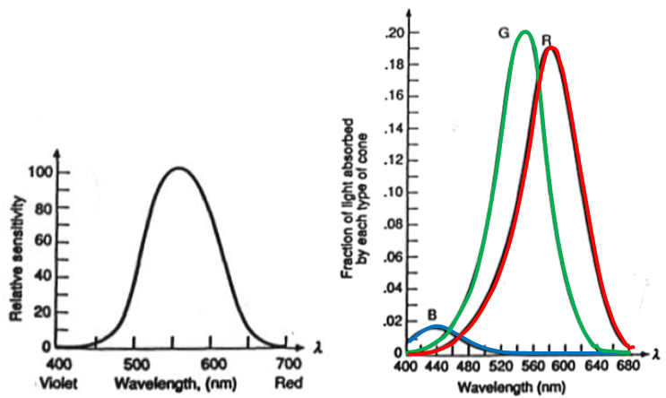
What is a Digital Image?
Human Perception
Human Eye is limited
Rods: 75-150 million, all over the retina surface and sensitive to low levels of illumination
Cones: 6-7 million in each eye, central part of retina (fovea) and highly sensitive to color

Slide 6
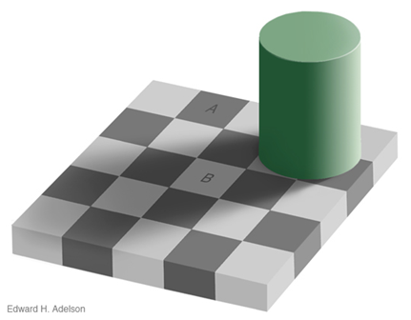
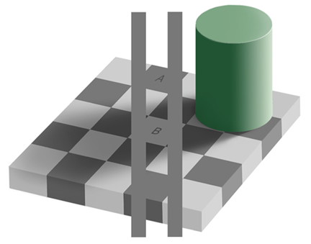
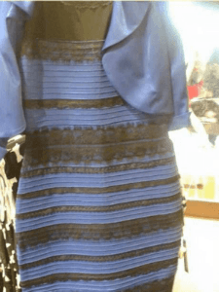
What is a Digital Image?
Human Perception
Human Brain interprets and adjusts

Slide 7
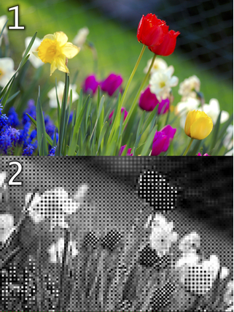
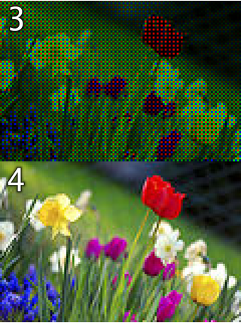
What is a Digital Image?
Representation
Is designed for humans
Red, Green, Blue→ hardware based acquisition

Slide 8
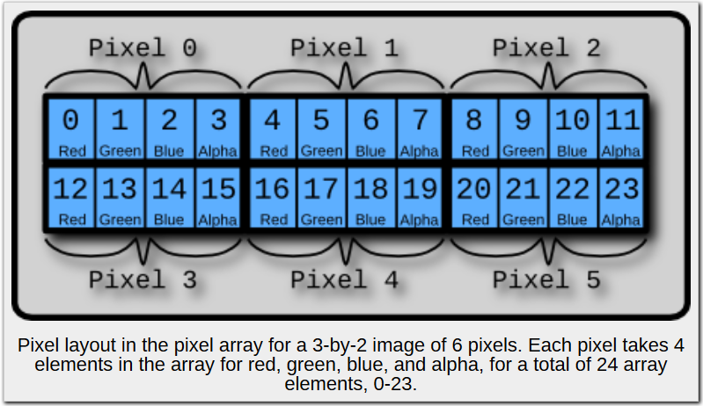
What is a Digital Image?
Representation
Is designed for humans
Red, Green, Blue→ storage

Slide 9
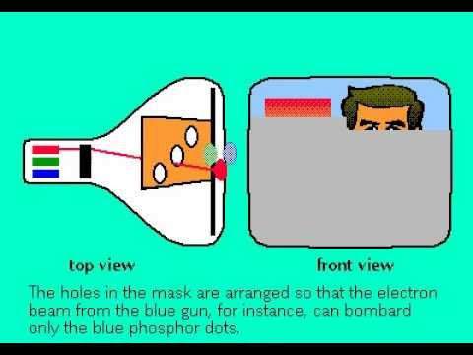
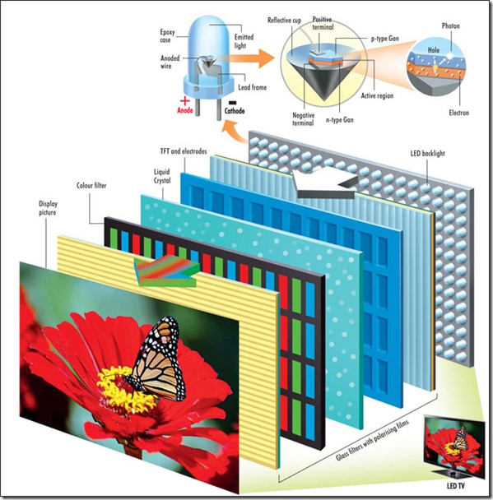
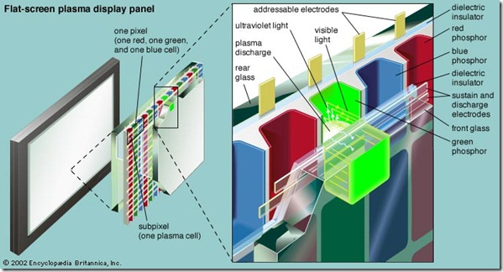
What is a Digital Image?
Representation
Is designed for humans
Red, Green, Blue→ display
http://www.guidingtech.com/26940/led-lcd-plasma-difference/

Slide 10
List Summary
Previously
What a Digital Image is
Acquisition
Human Perception
Representation
Color Spaces
HTML5 and JavaScript Code Examples
Pixel manipulation
Image Loading
Filtering

Slide 11
Color Spaces
Our images are designed for the human eye and the human brain
How does that work?

Slide 12
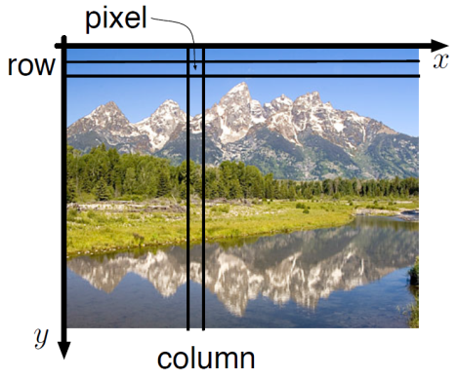
Color Spaces
We have seen
Representation is Red, Green, Blue
Digital Storage is 2D Array of Pixels
Each Pixel with R, G, B values
So…

Slide 13
Color Spaces
What’s the theory?
How is the representation defined?
Tri-Stimulus Theory of Color

Slide 14
Color Spaces: Human Eye
Study the Human Eye
Rods: 75-150 million, all over the retina surface and sensitive to low levels of illumination
Cones: 6-7 million in each eye, central part of retina (fovea) and highly sensitive to color

Slide 15
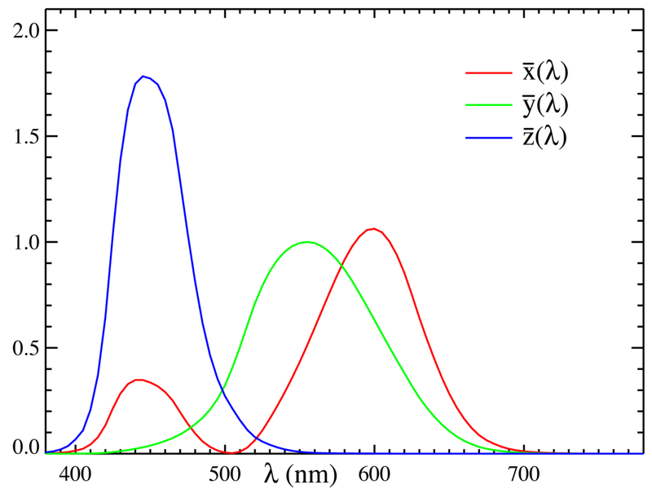
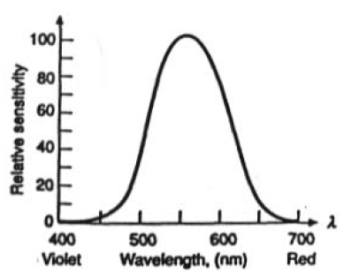
CIE Color Matching Functions
luminous
efficiency curve
DESIGN a model
By design the y curve is just the luminous efficiency curve of the human eye

Slide 16
Tri-Stimulus Theory of Color
Make the model work
Easy to use with hardware and humans
Easy to transition to equivalent models
Experiment results extend across models
So digital image (color) representation, use, perception becomes measurable, comparable, consistent
Additive Color Systems
RGB
HSV
CIE xyY
Subtractive Color System
CMY
CMYK

Slide 17
List Summary
Previously
What a Digital Image is
Acquisition
Human Perception
Representation
Color Spaces
HTML5 and JavaScript Code Examples
Pixel manipulation
Image Loading
Filtering

Slide 18
Math and Programming
Established is a model that is capable of acquiring, storing, and displaying images
It is mathematical in nature and based on experimental results of human perception
This provides a “world” to play in
Mathematical theory and algorithmic exploration is fun
Programming computers based on/using such theory and experimentation is needed to “see” results

Slide 19
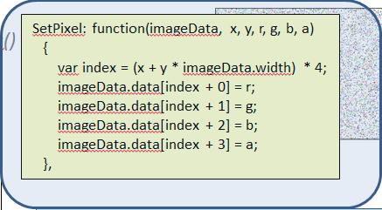
Coding Examples
HTML5 and Javascript support digital image manipulation
Pixel based access to images through arrays

Slide 20
Coding Examples
Loading an Image
Operations exist to decompress and load images via javascript through the browsers
// Setup the listeners
this.dropArea = document.getElementById('theDropArea');
this.dropArea.addEventListener('dragover', this.onDragOver, false);
this.dropArea.addEventListener('drop', this.onDropFileSelect, false);
onDropFileSelect: function (evt)
{
// get array of filenames that were dragged
var files = evt.dataTransfer.files;
// If the "first" file is not an image, do nothing
var curFile = files[0];
// Only process image file
if ( curFile.type.match('image.*') )
{
var img = new Image;
img.onload = function()
{
var canvas = document.getElementById(theProgram.SOURCE_IMG_CANVAS_ID);
var ctx = canvas.getContext('2d');
canvas.style.display = "block";
canvas.width = img.width;
canvas.height = img.height;
canvas.style.width = canvas.width + "px" ;
canvas.style.height = canvas.height + "px";
// Can draw the image on the canvas
ctx.drawImage(img, 0, 0);
// And can store the image data into a data structure
theProgram.srcData = ctx.getImageData(0, 0, img.width, img.height);
}
img.src = URL.createObjectURL(curFile);

Slide 21
Coding Examples
Having stored the image in a data structure we can write code to apply mathematical operations to the image
e.g. convolution filtering
// ------------------------------------------------------------------------
applyConvIdentity: function()
{
// below should do 'nothing' → applies a filter but changes nothing
var destData = theFilter.convolute(theProgram.srcData,
[ 0, 0, 0,
0, 1, 0,
0, 0, 0 ]);
theProgram.displayOutput(destData, theProgram.srcData);
},
theFilter.convolute(f[][], k[][])
for y = 0 to imageHeight
for x = 0 to imageWidth
sum = 0
for i = -1 to 1
for j = -1 to 1
sum = sum + k(j+1, i+1) * f(x – j, y – i)
end for j
end for i
g(x, y) = sum
end for x
end for y
k(j, i) indexes into the convolution filter
i.e. k(j, i) is [[0,0,0],[0,1,0],[0,0,0]]
f(x, y) index into the image
i.e. f(x,y) is referring to theProgram.srcData

Slide 22
List Summary
Previously
What a Digital Image is
Acquisition
Human Perception
Representation
Color Spaces
HTML5 and JavaScript Code Examples
Pixel manipulation
Image Loading
Filtering
Near Future
Image Manipulation
Filtering
Enhancement
Convolutions

Slide 23
Questions?
Beyond D2L
Examples and information can be found online at:
http://docdingle.com/teaching/cs.html
Continue to more stuff as needed

Slide 24
Extra Reference Stuff Follows

Slide 25
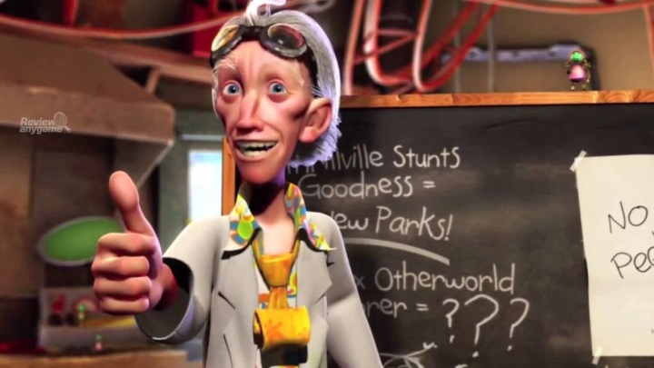
Credits
Much of the content derived/based on slides for use with the book:
Digital Image Processing, Gonzalez and Woods
Some layout and presentation style derived/based on presentations by
Donald House, Texas A&M University, 1999
Bernd Girod, Stanford University, 2007
Shreekanth Mandayam, Rowan University, 2009
Igor Aizenberg, TAMUT, 2013
Xin Li, WVU, 2014
George Wolberg, City College of New York, 2015
Yao Wang and Zhu Liu, NYU-Poly, 2015
Sinisa Todorovic, Oregon State, 2015

