Slide 1

Filtering
Image Enhancement
Spatial and Frequency Based
Brent M. Dingle, Ph.D. 2015
Game Design and Development Program
Mathematics, Statistics and Computer Science
University of Wisconsin - Stout

Slide 2
Lecture Objectives
Previously
  What a Digital Image is
  Acquisition of Digital Images
  Human Perception of Digital Images
  Digital Representation of Images
  Various HTML5 and JavaScript Code
    Pixel manipulation
    Image Loading
    Filtering
Today
  Image Filtering
  Image Enhancement
    Spatial Domain
    Frequency Domain

Slide 3
Lecture Objectives
Previously
  What a Digital Image is
  Acquisition of Digital Images
  Human Perception of Digital Images
  Digital Representation of Images
  Various HTML5 and JavaScript Code
    Pixel manipulation
    Image Loading
    Filtering
Today
  Image Filtering
  Image Enhancement
    Spatial Domain
    Frequency Domain

Slide 4
Outline
Filtering
  Introduction
  Low Pass Filtering
  High Pass Filtering
  Directional Filtering
  Global Filters
    Normalization
    Histogram Equalization
Image Enhancement
  Spatial Domain
  Frequency Domain

Slide 5
Filtering
Filtering
  modify an image based on image color content
  without any intentional change in image geometry
    resulting image essentially has the same size and shape as the original

Slide 6

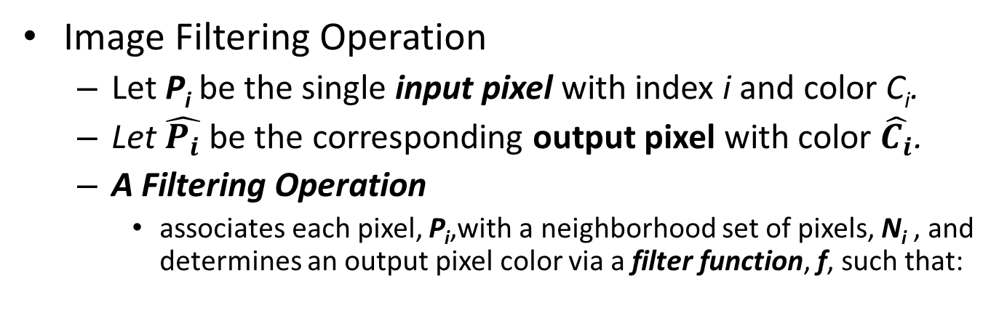
Image Filtering Operation
Image Filtering Operation
  Let P_{i} be the single input pixel with index i and color C_{i}.
  Let $\hat{P_{i}}$ be the corresponding output pixel with color $\hat{C_{i}}$.
  A Filtering Operation
    associates each pixel, P_{i},with a neighborhood set of pixels, N_{i} , and determines an output pixel color via a filter function, f, such that:
$$\hat{C_{i}}=f\left(N_{i}\right)$$

Slide 7
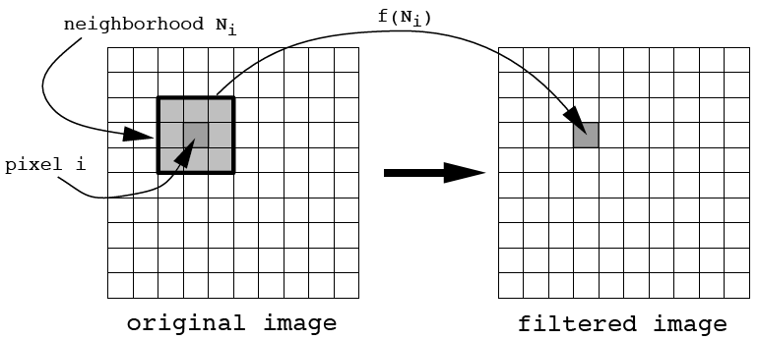


Filtering Operation
$$\hat{C_{i}}=f\left(N_{i}\right)$$
new color = $\hat{C_{i}}$

Slide 8
Moving into Filter Examples
We will see more details on low and high pass filters in later lectures as the course continues
What follows is a brief summary and demonstration

Slide 9
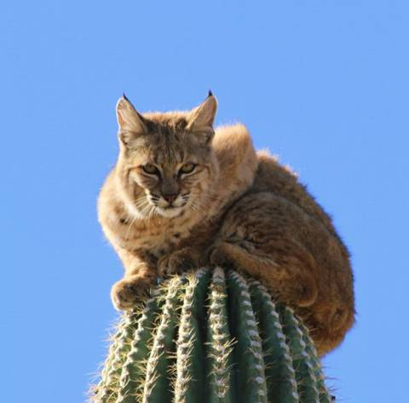

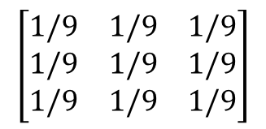
Low Pass Filtering
Low pass filters are useful for smoothing or blurring images
  The intent is to retain low frequency information while reducing high frequency information
Example Kernel:
$$\left[\begin{matrix}1/9 & 1/9 & 1/9 \\ 1/9 & 1/9 & 1/9 \\ 1/9 & 1/9 & 1/9\end{matrix}\right]$$

Slide 10
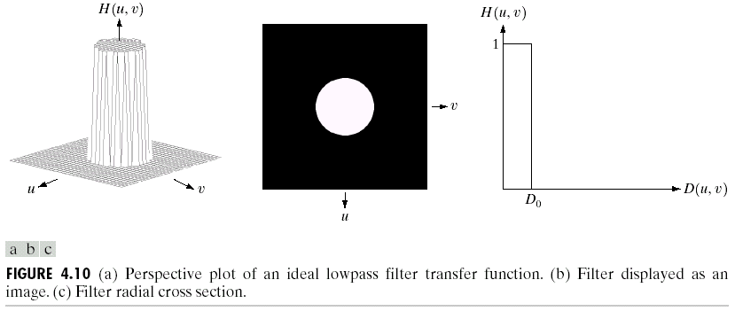
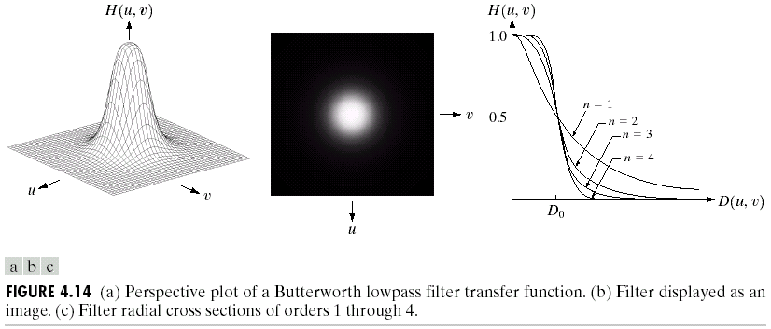
Low Pass Filter – Signal Side
Ideal Filter:
D(u, v): distance from point (u, v) to the origin
cutoff frequency (D0)
nonphysical
radially symmetric about the origin
Butterworth filter:
Gaussian Low Pass filter:

Slide 11
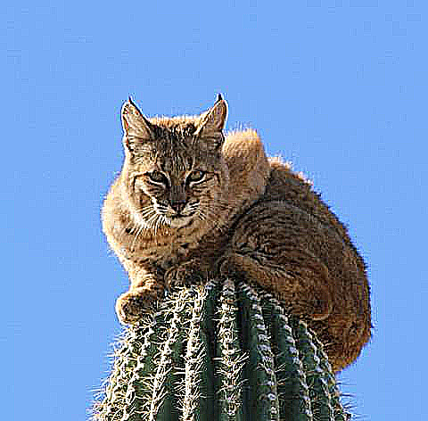
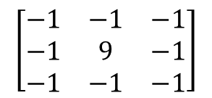
High Pass Filtering
High pass filters are useful for sharpening images (enhancing contrast)
  The intent is to retain high frequency information while reducing low frequency information
Example Kernel:
$$\left[\begin{matrix}−1 & −1 & −1 \\ −1 & 9 & −1 \\ −1 & −1 & −1\end{matrix}\right]$$

Slide 12
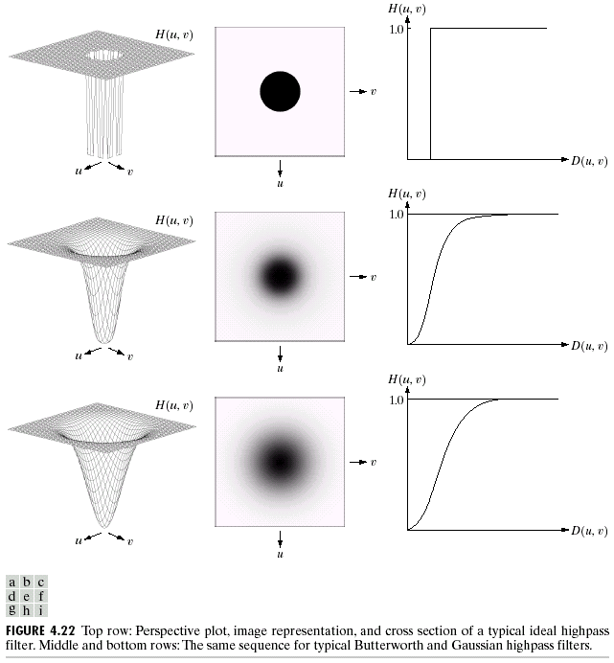
High Pass Filter – Signal Side
Ideal filter:
Butterworth filter:
Gaussian high pass filter:

Slide 13
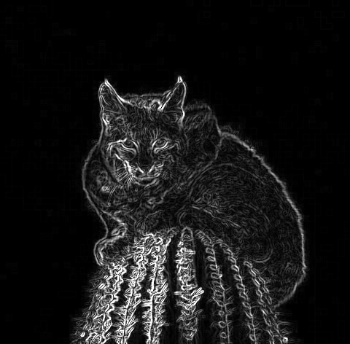
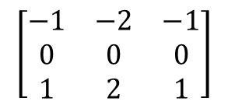
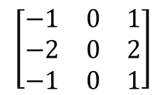
Directional Filtering
Directional filters are useful for edge detection
  Can compute the first derivatives of an image
    Edges are typically visible in images when a large change occurs between adjacent pixels
      a steep gradient, or slope, or rate of change between pixels
Example Kernels:
$$\left[\begin{matrix}−1 & −2 & −1 \\ 0 & 0 & 0 \\ 1 & 2 & 1\end{matrix}\right]$$
$$\left[\begin{matrix}−1 & 0 & 1 \\ −2 & 0 & 2 \\ −1 & 0 & 1\end{matrix}\right]$$

Slide 14
Outline
Filtering
  Introduction
  Low Pass Filtering
  High Pass Filtering
  Directional Filtering
  Global Filters
    Normalization
    Histogram Equalization
Image Enhancement
  Spatial Domain
  Frequency Domain

Slide 15
Global Filters
Global Filters
  Modifies an image’s color values
  by taking the entire image as the neighborhood
  about each pixel
  Two common global filters
    Normalization
    Histogram Equalization

Slide 16
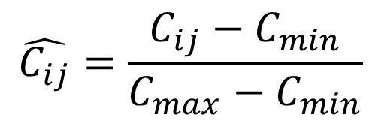
Global Filter: Normalization
Rescale colors to [0, 1]
        or to [0, 255]… same as below just multiply by 255
$$\hat{C_{ij}}=\frac{C_{ij}−C_{min}}{C_{max}−C_{min}}$$
i = pixel index
j = color channel
min and max
are across ALL channels
So max might be in the red channel
while min is in the blue channel

Slide 17
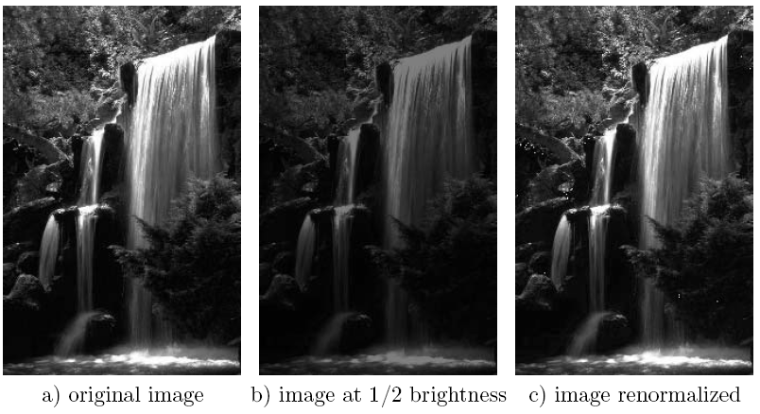
Normalization
aka under-exposed
Normalization recovered
MOST of the value information

Slide 18
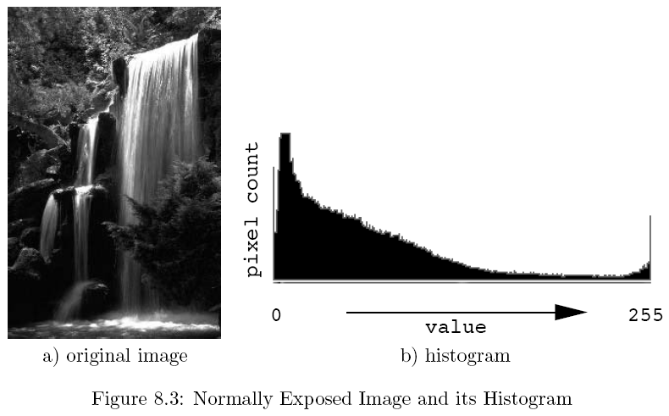
Histogram
An image histogram is a set of tabulations recording how many pixels in the image have particular attributes
Most commonly
  A histogram of an image represents the relative frequency of occurrence of various gray levels in the image

Slide 19
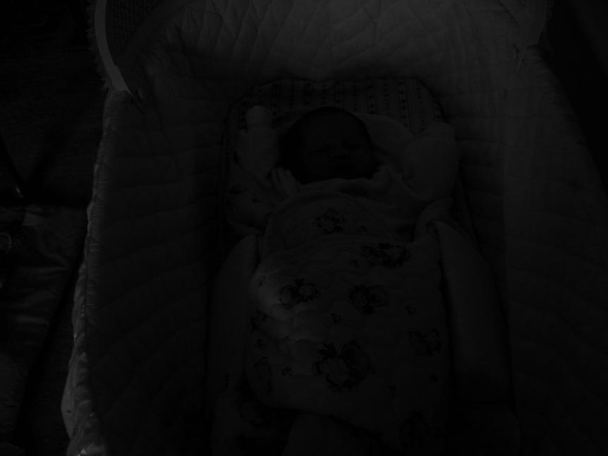
Detecting Exposure Level
Underexposure

Slide 20
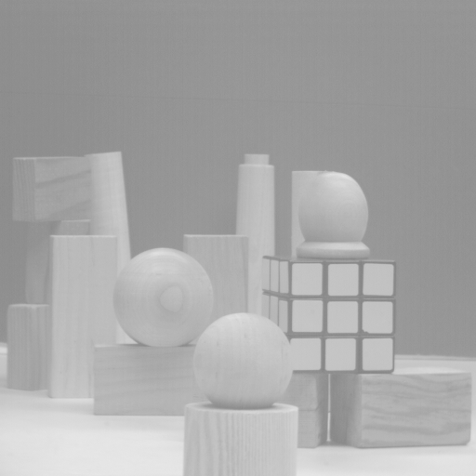
Detecting Exposure Level
Over-Exposed

Slide 21

Construction of Histogram: H
The histogram is constructed based on luminance
  Must select a luminance algorithm
    See HTML5-Pixels presentation and Black-And-White Assignment
Given the normalized R, G, B components of pixel i,
it’s perceived luminance is something like:

Slide 22
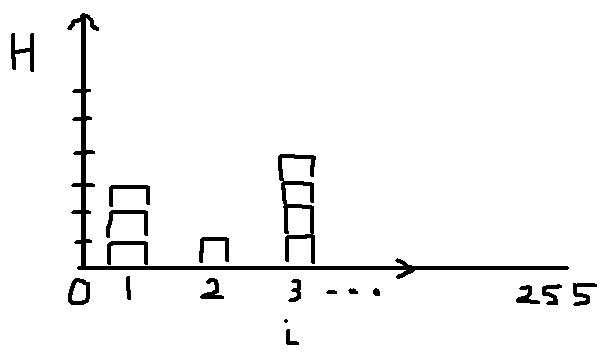
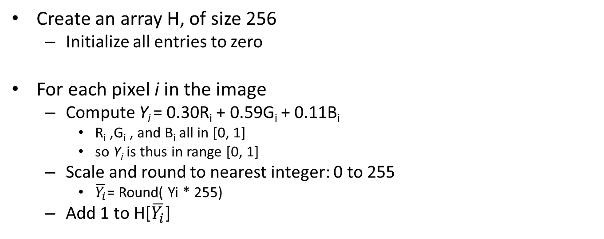

Construction of Histogram: H
Create an array H, of size 256
  Initialize all entries to zero
For each pixel i in the image
  Compute Y_{i} = 0.30R_{i} + 0.59G_{i} + 0.11B_{i}
    R_{i} ,G_{i} , and B_{i} all in [0, 1]
    so Y_{i} is thus in range [0, 1]
  Scale and round to nearest integer: 0 to 255
    $\overline{Y_{i}}$= Round( Yi * 255)
  Add 1 to H[$\overline{Y_{i}}$]
$$\overline{Y_{i}}$$

Slide 23
Goal of Equalization
Goal is not just to use the full range of values, but that the distribution is as uniform as possible
Basic idea:
  Find a map f(x) such that the histogram of the modified (equalized) image is flat (uniform)
    Motivation is to get the cumulative (probability) distribution function (cdf) of a random variable to approximate a uniform distribution
      where H(i)/(number of pixels in image) offers the probability of a pixel to be of a given luminance

Slide 24
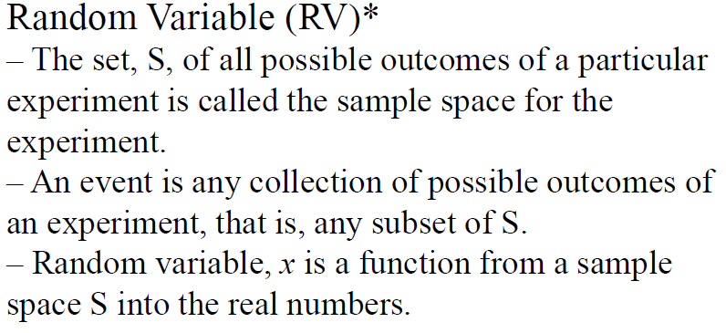
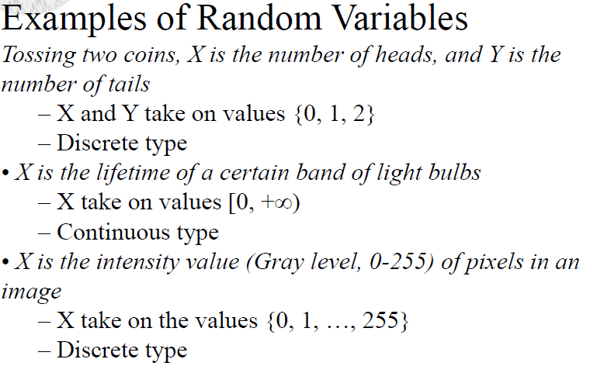
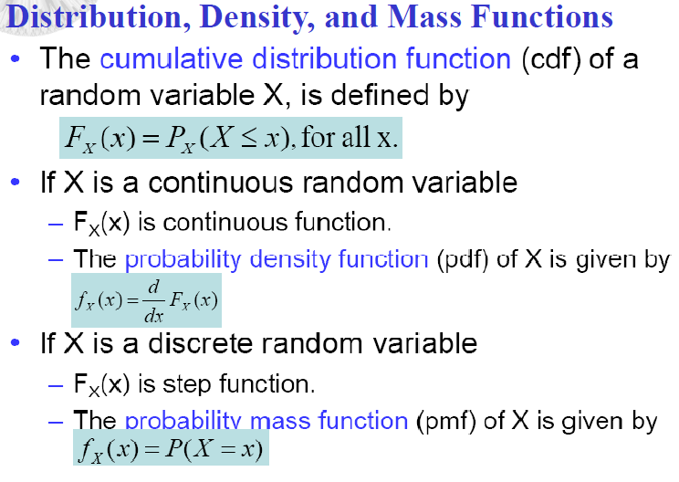
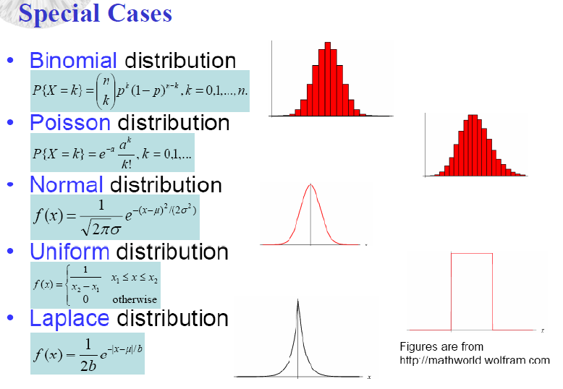
Probability Reference

Slide 25
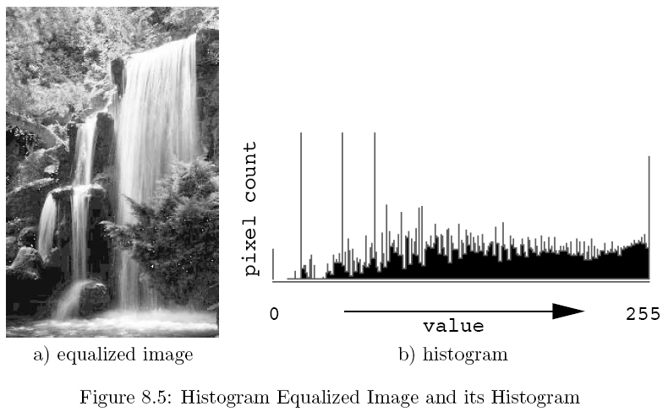
What’s the goal look like
Spread the distribution out

Slide 26
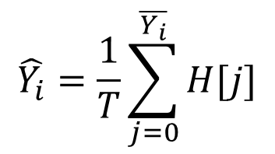

Histogram Equalization: a Global Filter
For each pixel i in the image, compute the target luminance, $\hat{Y_{i}}$
$$\hat{Y_{i}}=\frac{1}{T}\sum_{j=0}^{\overline{Y_{i}}}{H[j]}$$
T = total number of pixels in the image
$\overline{Y_{i}}$ = the discrete luminance value of the pixel i
H is the histogram table array (indices from 0 to 255)

Slide 27
Histogram Equalization: a Global Filter
For each pixel i in the image, compute the target luminance, $\hat{Y_{i}}$
$$\hat{Y_{i}}=\frac{1}{T}\sum_{j=0}^{\overline{Y_{i}}}{H[j]}$$
We want the luminance value
to be proportional to the accumulated count
This sum is the count of pixels that have luminance equal or less than current pixel i
T = total number of pixels in the image
$\overline{Y_{i}}$ = the discrete luminance value of the pixel i
H is the histogram table array (indices from 0 to 255)

Slide 28
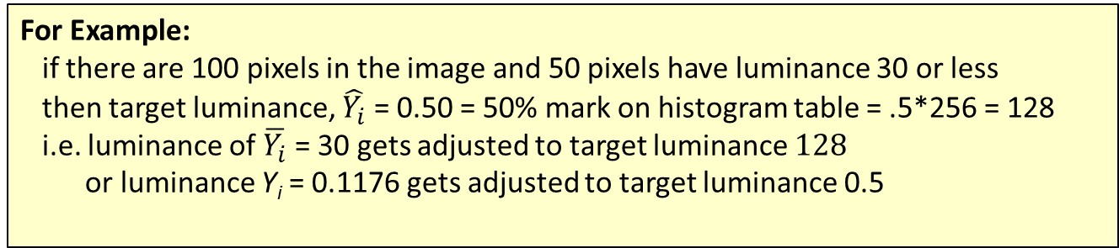
Histogram Equalization: a Global Filter
For each pixel i in the image, compute the target luminance, $\hat{Y_{i}}$
$$\hat{Y_{i}}=\frac{1}{T}\sum_{j=0}^{\overline{Y_{i}}}{H[j]}$$
We want the luminance value
to be proportional to the accumulated count
This sum is the count of pixels that have luminance equal or less than current pixel i
T = total number of pixels in the image
$\overline{Y_{i}}$ = the discrete luminance value of the pixel i
H is the histogram table array (indices from 0 to 255)
For Example:
if there are 100 pixels in the image and 50 pixels have luminance 30 or less
then target luminance, $\hat{Y_{i}}$ = 0.50 = 50% mark on histogram table = .5*256 = 128
i.e. luminance of $\overline{Y_{i}}$ = 30 gets adjusted to target luminance $128$
or luminance Y_{i} = 0.1176 gets adjusted to target luminance 0.5

Slide 29
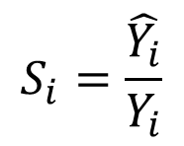
Histogram Equalization
Scale factor
$$S_{i}=\frac{\hat{Y_{i}}}{Y_{i}}$$
= 0.50 = target value
S_{i} = 4.25
= 0.1176 = original value
Use scale factor to rescale the original Red, Green, and Blue
channel values for the given pixel i :
  new R = 4.25 * (old R)
  new G = 4.25 * (old G)
  new B = 4.25 * (old B)
NOTE:
Various rounding/truncating/numerical errors
may cause final values to be outside [0, 1]
Renormalize results by finding min and max
as described earlier in this presentation

Slide 30
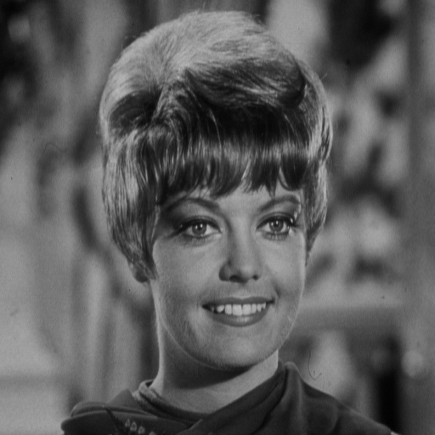
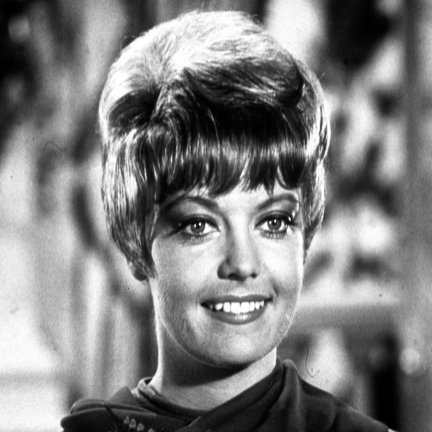
Example Equalization: Images
before
after

Slide 31
Example Equalization: Histograms
before equalization
after equalization

Slide 32
Challenge: Histogram Specification/Matching
Given a target image B
  How would you modify a given image A
  such that the histogram of the modified A
  matches that of target B?
histogram₁
histogram₂
try doing this
S⁻¹*T
just saw
how to
do this
just saw
how to
do this
T
S

Slide 33
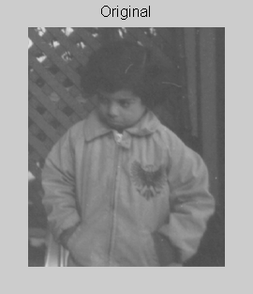
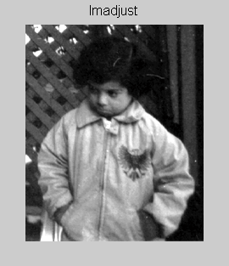
Application: Photography

Slide 34
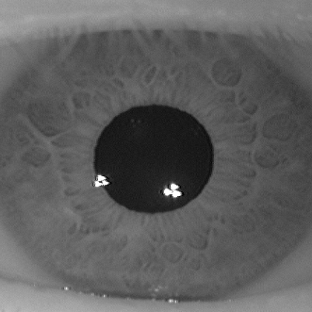
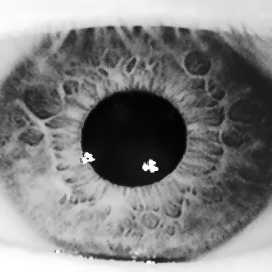
Application: Bioinformatics
before
after

Slide 35

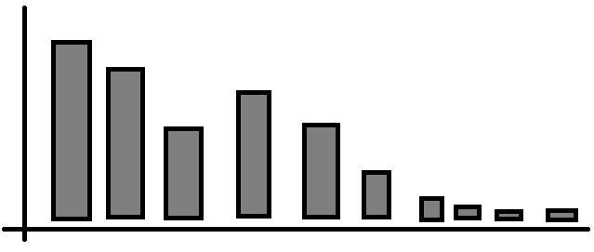
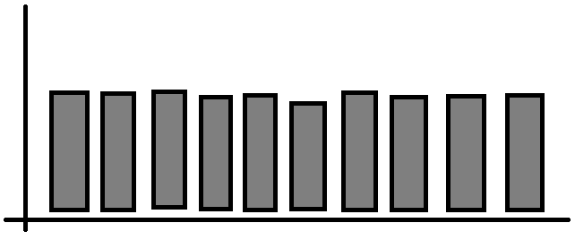
Summary: Normalization vs. Equalization
Normalization: Stretches
Histogram Equalization: Flattens
        And Normalization may be needed after equalization

Slide 36
Questions so far
Any questions on Filtering?
Next: Image Enhancement

Slide 37
Outline
Filtering
  Introduction
  Global Filters
    Normalization
    Histogram Equalization
Image Enhancement
  Spatial Domain
  Frequency Domain

Slide 38
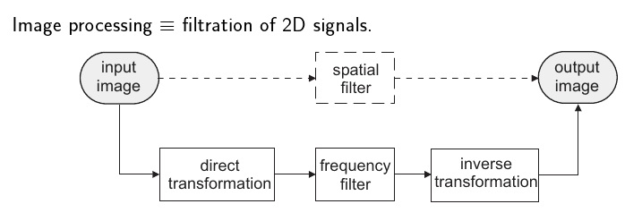
Image Enhancement
Objective of Image Enhancement is to manipulate an image such that the resulting end image is more suitable than the original for a specific application
Two broad categories to due this
  Spatial Domain
    Approaches based on the direct manipulation of pixels in an image
  Frequency Domain
    Approaches based on modifying the Fourier transform of an image

Slide 39
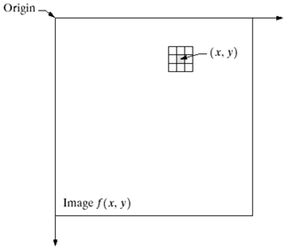
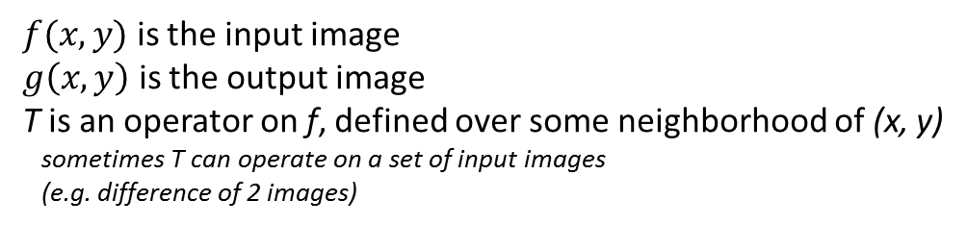

Spatial Domain Methods: Intro
Spatial domain methods
are procedures that operate directly on image pixels
$$g\left(x,y\right)=T\left[f(x,y)\right]$$
$f(x,y)$ is the input image
$g\left(x,y\right)$ is the output image
T is an operator on f, defined over some neighborhood of (x, y)
sometimes T can operate on a set of input images
(e.g. difference of 2 images)

Slide 40
Types of Spatial Methods
Spatial Domain Methods
  Image Normalization
  Histogram Equalization
  Point Operations
We just saw these!

Slide 41
Types of Spatial Methods
Spatial Domain Methods
  Image Normalization
  Histogram Equalization
  Point Operations
Let’s look at some of these

Slide 42
Point Operations: Overview
Point operations are zero-memory operations
  where a given gray level x in [0, L] is mapped to another gray level y in [0, L] as defined by
y
L
x
L
L=255: for grayscale images
ASIDE: 1 is okay for L also,
just keep your abstraction consistent

Slide 43
Trivial Case
y
L
x
L
No influence on visual quality at all
L=255: for grayscale images

Slide 44
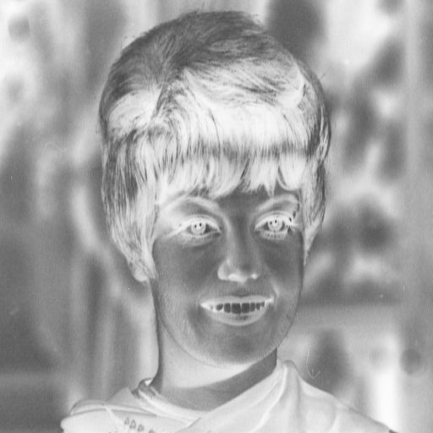
Negative Image
L
x
0
L
L=255: for grayscale images

Slide 45
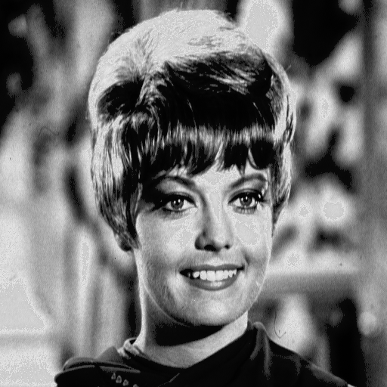
Contrast Stretching
y_{b}
y_{a}
a
b
x
0
L
L=255: for grayscale images

Slide 46
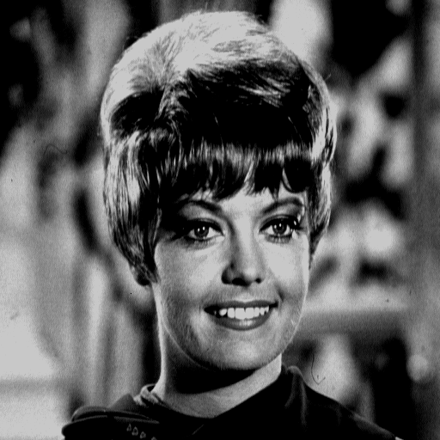
Clipping
a
b
x
0
L
L=255: for grayscale images

Slide 47
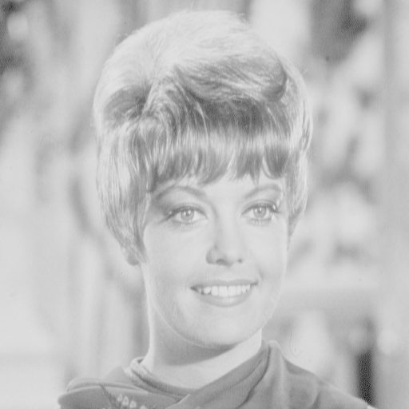
Range Compression
aka Log Transformation
x
0
L
c=100
L=255: for grayscale images

Slide 48
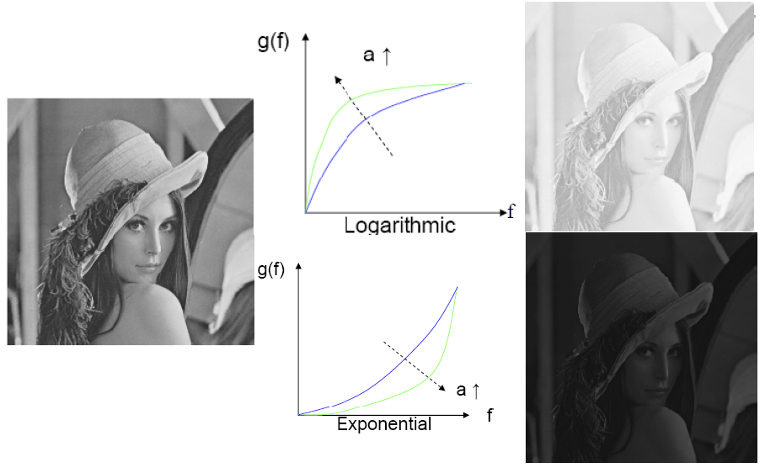

Challenge
Investigate Power-Law Transformations
  HINT: see also gamma correction
$$y=cx^{γ}$$

Slide 49
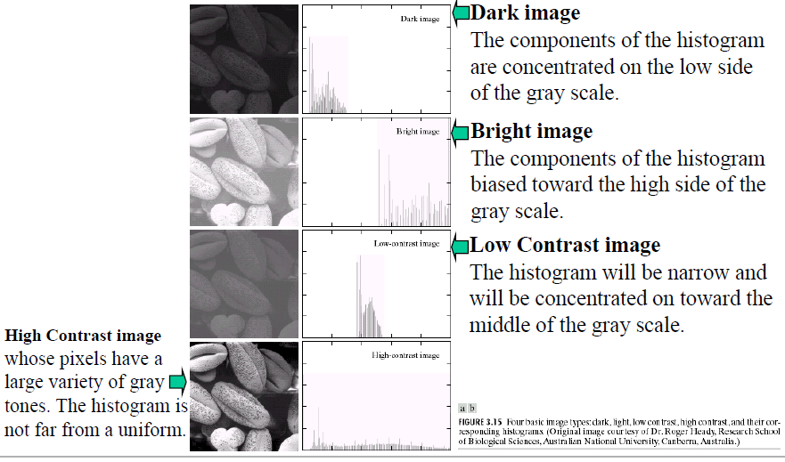
Relation to Histograms
An image’s histogram may help decide what operation may be needed for a desired enhancement

Slide 50
Summary: Spatial Domain Enhancements
Spatial domain methods
are procedures that operate directly on image pixels
Spatial Domain Example Methods
  Image Normalization
  Histogram Equalization
  Point Operations
All can be viewed as a type of filtering
  Point operations have a neighborhood of self
  Normalization and Equalization have a neighborhood of the entire image
Histogram can help “detect” what type of enhancement might be useful

Slide 51
Questions so far
Any questions on
Spatial Domain Image Enhancement ?
Next:
Frequency Domain Image Enhancement

Slide 52
Outline
Filtering
  Introduction
  Global Filters
    Normalization
    Histogram Equalization
Image Enhancement
  Spatial Domain
  Frequency Domain

Slide 53
Unsharp Masking
Unsharp Mask
  can be approached as a spatial filter
  or in the frequency domain
It is mentioned here as a transition
  from spatial to frequency
It would be an advised learning experience to implement and understand this filter in both domains

Slide 54
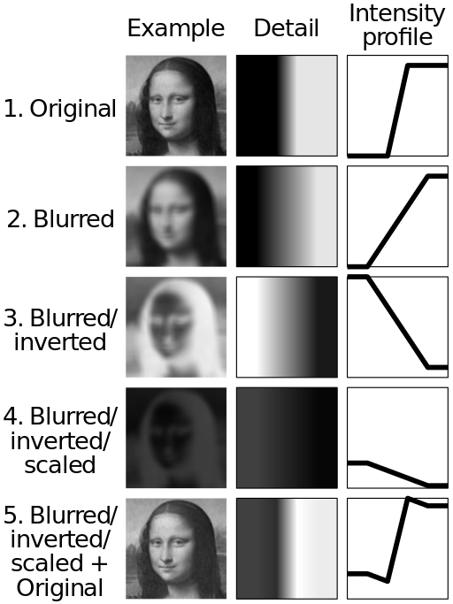
Unsharp Masking
aka high-boost filtering
Image Sharpening Technique
  Unsharp is in the name because image is first blurred
A summary of the method is outlined to the right
In general the method amplifies the high frequency components of the signal image
public domain image from wikipedia

Slide 55
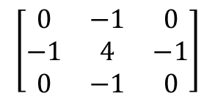
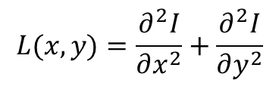
Unsharp Mask: Mathematically
g(m,n) is a high-pass filtered version of x(m,n)
Example using Laplacian operator:
$$g\left(m,n\right)=x\left(m,n\right)−\frac{1}{4}\left[x\left(m−1,n\right)+x\left(m+1,n\right)+x\left(m,n−1\right)+x(m,n+1)\right]$$
Recall:
Laplacian L(x, y) of an image
with pixel intensity values I(x, y) is
The above equation is using a discrete approximation
filter/kernel of the Laplacian:
$$\left[\begin{matrix}0 & −1 & 0 \\ −1 & 4 & −1 \\ 0 & −1 & 0\end{matrix}\right]$$
$$L(x,y)=\frac{∂^{2}I}{∂x^{2}}+\frac{∂^{2}I}{∂y^{2}}$$
This will be highly sensitive to noise
Applying a Gaussian blur and then Laplacian might be a better option

Slide 56
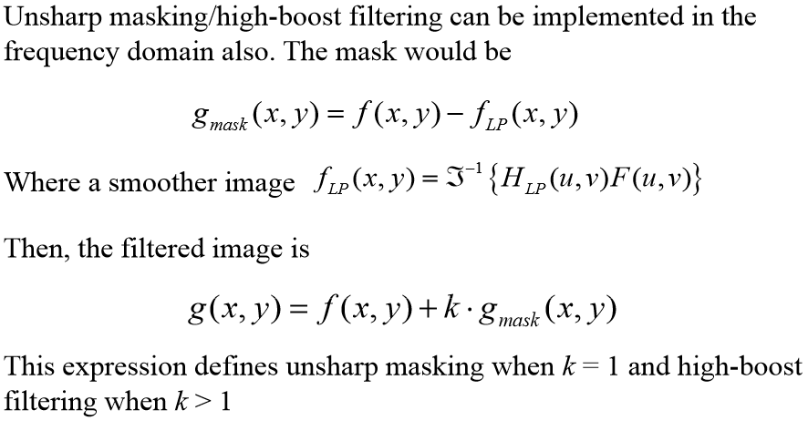
Unsharp Masking: Filler Info
The Fourier Transform and back occurs in the Low-Pass filter
Which is 1 – highpass filter → 1 – laplacian ? (minus might be backwards here)

Slide 57
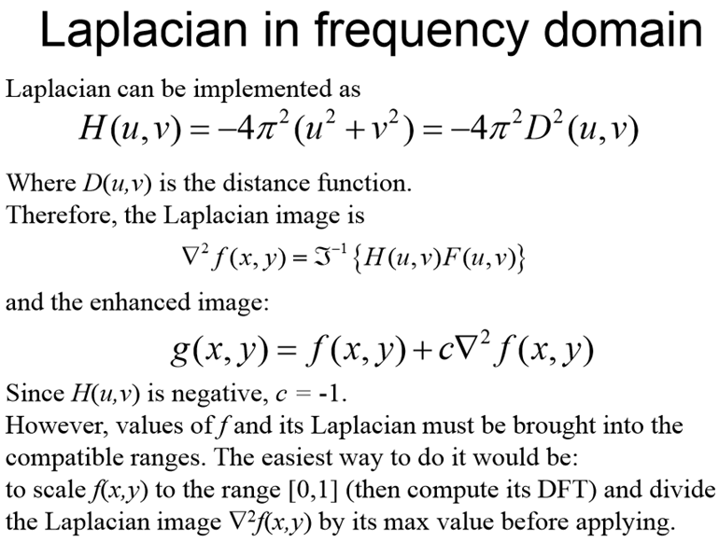
Unsharp – Laplacian Details
Notes:
Slide from: ELEN 4304/5365 DIP Spring 2008

Slide 58




Alternate option
public domain image from wikipedia
Laplacian of Gaussian → LoG
More smoothing reduces number of
edges detected… Do you see the cat?
Discrete Kernel for this
with sigma = 1.4 looks like:

Slide 59
Questions so far?
Questions on Unsharp Frequency Filter?
    Next: Homomorphic Frequency Filter

Slide 60


Noise and Image Abstraction
Noise is usually abstracted as additive:
$$\overline{I}\left(x,y\right)=I\left(x,y\right)+n(x,y)$$
Homomorphic filtering considers noise to be multiplicative:
$$\overline{I}\left(x,y\right)=I\left(x,y\right)n(x,y)$$
Homomorphic filtering is useful in correcting non-uniform illumination in images
→normalizes illumination and increases contrast
→suppresses low frequencies and amplifies high frequencies (in a log-intensity domain)

Slide 61

Homomorphic Frequency Filter: Example
before
after

Slide 62



Homomorphic Filtering: Intro
Illumination varies slowly across the image
  low frequency
  slow spatial variations
Reflectance can change abruptly at object edges
  high frequency
  varies abruptly, particularly at object edges
Homomorphic Filtering begins with a transform of multiplication to addition
  via property of logarithms
Recall previous def of image:
$$I\left(x,y\right)=L\left(x,y\right)R(x,y)$$
I is the image (gray scale),
L is the illumination
R is the reflectance
$$ln⁡(I\left(x,y\right))=ln⁡(L\left(x,y\right)R\left(x,y\right))$$
$$\ln\left(I\left(x,y\right)\right)=\ln\left(L\left(x,y\right)\right)+ln⁡(R\left(x,y\right))$$
0 < L(x,y) < infinity
0 < R(x, y) < 1

Slide 63

Apply High Pass Filter
Once we are in a log-domain
  Remove low-frequency illumination component by applying a high pass filter in the log-domain
    so we keep the high-frequency reflectance component

Slide 64
Apply High Pass Filter
Once we are in a log-domain
  Remove low-frequency illumination component by applying a high pass filter in the log-domain
    so we keep the high-frequency reflectance component
This is an example of Frequency Domain Filtering

Slide 65

Apply High Pass Filter
This is an example of Frequency Domain Filtering

Slide 66



Steps
Step 1: Convert the image into the log domain
$$z\left(x, y\right)= \ln\left(I\left(x,y\right)\right)=\ln\left(L\left(x,y\right)\right)+ln⁡(R\left(x,y\right))$$
Step 2: Apply a High Pass Filter
$$F\left\{z\left(x, y\right)\right\}=F\left\{\ln\left(I\left(x,y\right)\right)\right\}=F\left\{\ln\left(L\left(x,y\right)\right)\right\}+F\left\{ln⁡(R\left(x,y\right))\right\}$$
$$Z\left(u,v\right)=F_{L}\left(u,v\right)+F_{R}\left(u,v\right)$$
$$S\left(u,v\right)=H(u,v)F_{L}\left(u,v\right)+H(u,v)F_{R}\left(u,v\right)$$
$$s\left(x,y\right)=L′\left(x,y\right)+R′\left(x,y\right)$$
Step 3: Apply exponential to return from log domain
$$g\left(x,y\right)=exp\left[s\left(x,y\right)\right]=exp\left[L′\left(x,y\right)\right]+exp\left[R′\left(x,y\right)\right]$$
Notes:
A matlab based example of this can be found at:
http://blogs.mathworks.com/steve/2013/06/25/homomorphic-filtering-part-1/
http://blogs.mathworks.com/steve/2013/07/10/homomorphic-filtering-part-2/

Slide 67
Summary: Filters and Enhancement
Filtering
  Introduction
  Low Pass Filtering
  High Pass Filtering
  Directional Filtering
  Global Filters
    Normalization
    Histogram Equalization
Image Enhancement
  Spatial Domain Methods
    Image Normalization
    Histogram Equalization
    Point Operations
      Image Negatives
      Contrast Stretching
      Clipping
      Range Compression
  Frequency Domain Methods
    Unsharp Filter
    Homomorphic Filter

Slide 68
Questions?
Beyond D2L
  Examples and information
  can be found online at:
    http://docdingle.com/teaching/cs.html
    Continue to more stuff as needed

Slide 69
Extra Reference Stuff Follows

Slide 70

Credits
Much of the content derived/based on slides for use with the book:
  Digital Image Processing, Gonzalez and Woods
Some layout and presentation style derived/based on presentations by
  Donald House, Texas A&M University, 1999
  Bernd Girod, Stanford University, 2007
  Shreekanth Mandayam, Rowan University, 2009
  Igor Aizenberg, TAMUT, 2013
  Xin Li, WVU, 2014
  George Wolberg, City College of New York, 2015
  Yao Wang and Zhu Liu, NYU-Poly, 2015
  Sinisa Todorovic, Oregon State, 2015

