Slide 1
More on Colors
Printing and Compositing
Brent M. Dingle, Ph.D. 2015
Game Design and Development Program
Mathematics, Statistics and Computer Science
University of Wisconsin - Stout

Slide 2
Lecture Objectives
Previously
What a Digital Image is
Acquisition
Human Perception
Representation
HTML5 and JavaScript Code Examples
Pixel manipulation
Image Loading
Filtering
Color Spaces
Image Manipulation
Filtering
Enhancement
Convolutions
Today
Colors for Printing
Colors for Compositing

Slide 3
Lecture Objectives
Previously
What a Digital Image is
Acquisition
Human Perception
Representation
HTML5 and JavaScript Code Examples
Pixel manipulation
Image Loading
Filtering
Color Spaces
Image Manipulation
Filtering
Enhancement
Convolutions
Today
Colors for Printing
Colors for Compositing

Slide 4
Outline
Color
Subtractive Color Spaces CMY and CMYK
Compositing
Example operations
Associated Images
Bluescreening

Slide 5
Color Review
Tri-Stimulus Theory of Color
Additive Color Systems (light emitting)
RGB
HSV
CIE xyY
Subtractive Color Systems (pigment/light reflecting)
CMY
CMYK

Slide 6
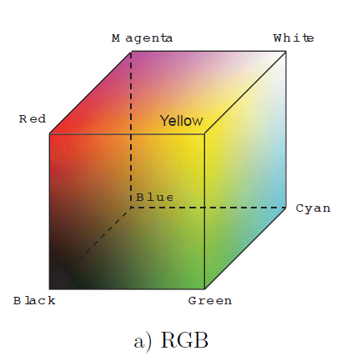
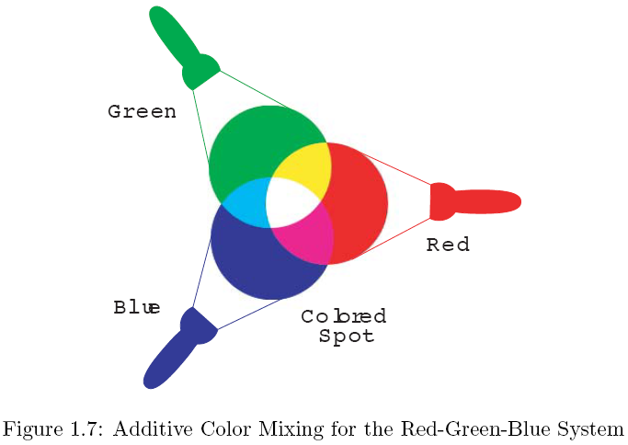
Additive Was Discussed Before
light source
Began with RGB then into HSV then into CIE xyY
→ skipped subtractive… saved it for now

Slide 7
Motivation
We want to PRINT our nice color images
But RGB doesn’t seem to work
Not directly anyway
How do we solve this problem?

Slide 8
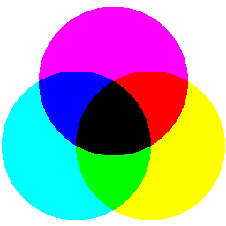
Subtractive Color Systems
CMY and CMYK (think printers/ink/pigment)
Cyan, Magenta, and Yellow (and Black)
M
light is additive
White = R + G + B
Yellow (R + G)
C
Y
Assume:
the surface here Absorbs all Blue light
(reflects no blue light, just red and green)
Y = white – blue
= 1 - B
Conclusion: A surface (pigment) that appears yellow absorbs all blue light

Slide 9
Subtractive Color Systems
Magenta
M
light is additive
White = R + G + B
Magenta (R + B)
C
Y
Assume:
the surface here absorbs all GREEN light
(reflects only red and blue)
M = white – green
= 1 - G
Conclusion: A surface (pigment) that appears magenta absorbs all green light

Slide 10
Subtractive Color Systems
Cyan
M
light is additive
White = R + G + B
Cyan (G + B)
C
Y
Assume:
the surface here absorbs all RED light
(reflects only green and blue)
C = white – red
= 1 - R
Conclusion: A surface (pigment) that appears Cyan absorbs all Red light

Slide 11
Given RGB calculate CMY
$$\left[\begin{matrix}C \\ M \\ Y\end{matrix}\right]=\left[\begin{matrix}1 \\ 1 \\ 1\end{matrix}\right]−\left[\begin{matrix}R \\ G \\ B\end{matrix}\right]$$
Specifically assume we have R = 1, G = 1, and B = 0
Then the equivalent in CMY would be C = 0, M = 0, Y = 1
$$\left[\begin{matrix}C \\ M \\ Y\end{matrix}\right]=\left[\begin{matrix}1 \\ 1 \\ 1\end{matrix}\right]−\left[\begin{matrix}1 \\ 1 \\ 0\end{matrix}\right]=\left[\begin{matrix}0 \\ 0 \\ 1\end{matrix}\right]$$

Slide 12
Given RGB calculate CMY
$$\left[\begin{matrix}C \\ M \\ Y\end{matrix}\right]=\left[\begin{matrix}1 \\ 1 \\ 1\end{matrix}\right]−\left[\begin{matrix}R \\ G \\ B\end{matrix}\right]$$
Specifically assume we have R = 1, G = 1, and B = 0
Then the equivalent in CMY would be C = 0, M = 0, Y = 1
$$\left[\begin{matrix}C \\ M \\ Y\end{matrix}\right]=\left[\begin{matrix}1 \\ 1 \\ 1\end{matrix}\right]−\left[\begin{matrix}1 \\ 1 \\ 0\end{matrix}\right]=\left[\begin{matrix}0 \\ 0 \\ 1\end{matrix}\right]$$
Also note
$$\left[\begin{matrix}R \\ G \\ B\end{matrix}\right]=\left[\begin{matrix}1 \\ 1 \\ 1\end{matrix}\right]−\left[\begin{matrix}C \\ M \\ Y\end{matrix}\right]$$

Slide 13
CMY
How then do we get a Red color to print?
i.e. we have an image with red in it, what CMY do we send to the printer to get it to be printed “correctly”

Slide 14
CMY
How then do we get a Red color to print?
i.e. we have an image with red in it, what CMY do we send to the printer to get it to be printed “correctly”
White = R + G + B
Red ← desired
G+B must be absorbed

Slide 15
CMY
How then do we get a Red color to print?
i.e. we have an image with red in it, what CMY do we send to the printer to get it to be printed “correctly”
$$\left[\begin{matrix}R \\ G \\ B\end{matrix}\right]=\left[\begin{matrix}1 \\ 1 \\ 1\end{matrix}\right]−\left[\begin{matrix}C \\ M \\ Y\end{matrix}\right]$$
White = R + G + B
Red ← desired
G+B must be absorbed

Slide 16
CMY
How then do we get a Red color to print?
i.e. we have an image with red in it, what CMY do we send to the printer to get it to be printed “correctly”
$$\left[\begin{matrix}R \\ G \\ B\end{matrix}\right]=\left[\begin{matrix}1 \\ 1 \\ 1\end{matrix}\right]−\left[\begin{matrix}C \\ M \\ Y\end{matrix}\right]$$
White = R + G + B
Red ← desired
$$\left[\begin{matrix}1 \\ 0 \\ 0\end{matrix}\right]=\left[\begin{matrix}1 \\ 1 \\ 1\end{matrix}\right]−\left[\begin{matrix}C \\ M \\ Y\end{matrix}\right]$$
G+B must be absorbed

Slide 17
CMY
How then do we get a Red color to print?
i.e. we have an image with red in it, what CMY do we send to the printer to get it to be printed “correctly”
$$\left[\begin{matrix}R \\ G \\ B\end{matrix}\right]=\left[\begin{matrix}1 \\ 1 \\ 1\end{matrix}\right]−\left[\begin{matrix}C \\ M \\ Y\end{matrix}\right]$$
White = R + G + B
Red ← desired
$$\left[\begin{matrix}1 \\ 0 \\ 0\end{matrix}\right]=\left[\begin{matrix}1 \\ 1 \\ 1\end{matrix}\right]−\left[\begin{matrix}C \\ M \\ Y\end{matrix}\right]$$
$$\left[\begin{matrix}0 \\ 1 \\ 1\end{matrix}\right]=\left[\begin{matrix}C \\ M \\ Y\end{matrix}\right]$$
G+B must be absorbed

Slide 18
CMY
How then do we get a Red color to print?
i.e. we have an image with red in it, what CMY do we send to the printer to get it to be printed “correctly”
$$\left[\begin{matrix}R \\ G \\ B\end{matrix}\right]=\left[\begin{matrix}1 \\ 1 \\ 1\end{matrix}\right]−\left[\begin{matrix}C \\ M \\ Y\end{matrix}\right]$$
White = R + G + B
Red ← desired
$$\left[\begin{matrix}1 \\ 0 \\ 0\end{matrix}\right]=\left[\begin{matrix}1 \\ 1 \\ 1\end{matrix}\right]−\left[\begin{matrix}C \\ M \\ Y\end{matrix}\right]$$
$$\left[\begin{matrix}0 \\ 1 \\ 1\end{matrix}\right]=\left[\begin{matrix}C \\ M \\ Y\end{matrix}\right]$$
G+B must be absorbed
Solution:
Use M and Y ink
to absorb G and B
i.e. Mix M and Y ink to get Red

Slide 19
CMYK
How do we get BLACK to print?

Slide 20
CMYK
How do we get BLACK to print?
$$\left[\begin{matrix}R \\ G \\ B\end{matrix}\right]=\left[\begin{matrix}1 \\ 1 \\ 1\end{matrix}\right]−\left[\begin{matrix}C \\ M \\ Y\end{matrix}\right]$$
$$\left[\begin{matrix}0 \\ 0 \\ 0\end{matrix}\right]=\left[\begin{matrix}1 \\ 1 \\ 1\end{matrix}\right]−\left[\begin{matrix}C \\ M \\ Y\end{matrix}\right]$$
$$\left[\begin{matrix}C \\ M \\ Y\end{matrix}\right]=\left[\begin{matrix}1 \\ 1 \\ 1\end{matrix}\right]$$
In theory this is true
But in practice it only makes a dark grey
and so in practice a black ink is used
→ CMYK, where K is the measure of black ink
Why? the CMY inks are not pure enough to make black
It is too expensive to make them. Black in is cheaper to make.

Slide 21
CMYK
Common practice for calculating K
First calculate the CMY
Identity which is smallest in value and set K to be that minimum
Then adjust to C’M’Y’
K = min(C, M, Y)
$$\left[\begin{matrix}C′ \\ M′ \\ Y′\end{matrix}\right]=\left[\begin{matrix}C \\ M \\ Y\end{matrix}\right]−\left[\begin{matrix}K \\ K \\ K\end{matrix}\right]$$
And printing is done with 4 inks
in the amounts of C’ M’ Y’ and K

Slide 22
Outline
Color
Subtractive Color Spaces CMY and CMYK
Compositing
Example operations
Associated Color Images
Bluescreening

Slide 23
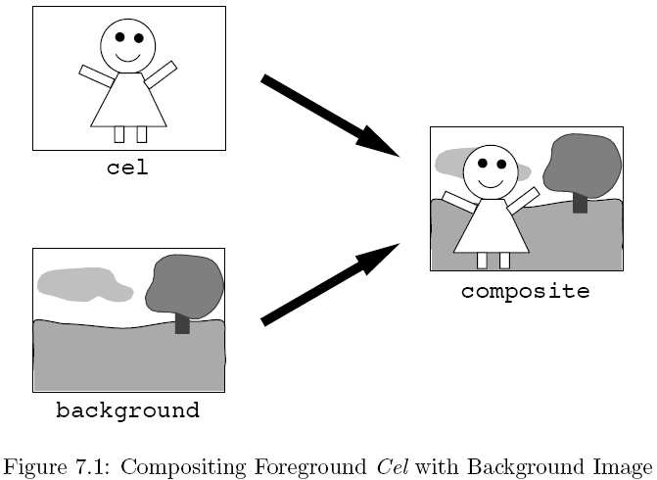
Compositing
Transparent film
Opaque Ink for character
Assume multiple cel layers for compositing
Single background for entire animated sequence
Examples from: Donald House, Texas A&M University, 1999

Slide 24
Use of Compositing
Film Special Effects
Morphing (turning one image into another)
Integrating animated images with live action film
… but how/why can it be done digitally?

Slide 25
Alpha
As already discussed we typically store an ALPHA value along with our RGB
Alpha is the pixel’s opacity
Typically on a [0, 1] scale
0 means completely transparent
1 means fully opaque

Slide 26
Over Operator
The OVER operator takes two images as input and composites them together
Foreground Image = F
Background Image = G
Resulting Composite Image = P
P = F over G
This is a pixel by pixel operation

Slide 27
OVER operator: definition
Assume F is transparent and G opaque
$$C_{P}=α_{F}C_{F}+(1−α_{F})C_{G}$$
$C_{P}$ is composite color channel value
$α_{F}$ is the Foreground pixel alpha
$C_{F}$ is the Foreground pixel color channel value
$C_{G}$ is the backGround pixel color channel value
color channel = R or G or B
equation is same for each

Slide 28
Associativity Challenge
The process is repeatable
Composite each foreground image into the background image, one at a time
BUT
It is desirable to composite multiple foreground images together then composite the result with a background
i.e. the OVER operator needs to be associative
can group the compositing operations in any way and still get the same result
as with addition: (A+B)+C = A+(B+C)

Slide 29
Associative: Explicit Example
How to define over operator such that the following is true

Slide 30
Tasks at Hand
Reformulate over operator to use 2 alpha values in the foreground images to composite the color values into the intermediate foreground image, and
extend the over operator to combine alpha values from two foreground images to provide a single alpha value for the intermediate image

Slide 31
Case of: A over B
Solution for
Combined alpha is
$α_{H}=α_{A}+(1−α_{A})α_{B}$
Solution for
Color Channel is
$C_{H}=\frac{α_{A}}{α_{H}}C_{A}+\frac{{(1−α}_{A})α_{B}}{α_{H}}C_{B}$
ASIDE:
While designed for cases where both A and B are transparent
this will work for all cases of A and B alpha values
For example, say alpha of image A is 0.5 and B is fully opaque
The resulting alpha of combined images is 0.5 + (1-0.5)*0.25 = 0.625
Finish this and observe the resulting C_{H} is as C_{P} was in the earlier ‘simple case’ definition

Slide 32
Subtle Detail
If we ASSUME each pixel color value is given to us as pre-multiplied with its associative value
Then some simplifications can occur
$$C_{H}=\frac{α_{A}}{α_{H}}C_{A}+\frac{{(1−α}_{A})α_{B}}{α_{H}}C_{B}$$

Slide 33
Subtle Detail
If we ASSUME each pixel color value is given to us as pre-multiplied with its associative value
Then some simplifications can occur
$$C_{H}=\frac{α_{A}}{α_{H}}C_{A}+\frac{{(1−α}_{A})α_{B}}{α_{H}}C_{B}$$
$${α_{H}C}_{H}=α_{A}C_{A}+{(1−α}_{A})α_{B}C_{B}$$

Slide 34
Subtle Detail
If we ASSUME each pixel color value is given to us as pre-multiplied with its associative value
Then some simplifications can occur
$$C_{H}=\frac{α_{A}}{α_{H}}C_{A}+\frac{{(1−α}_{A})α_{B}}{α_{H}}C_{B}$$
$${α_{H}C}_{H}=α_{A}C_{A}+{(1−α}_{A})α_{B}C_{B}$$
$$Assume: C_{\hat{H}}={α_{H}C}_{H}$$
$$Assume: C_{\hat{A}}={α_{A}C}_{A}$$
$$Assume: C_{\hat{B}}={α_{B}C}_{B}$$
$$C_{\hat{H}}=C_{\hat{A}}+{(1−α}_{\hat{A}}) C_{\hat{B}}$$

Slide 35
OVER: Nice, Simple, Definition
$$C_{\hat{H}}=C_{\hat{A}}+{(1−α}_{\hat{A}}) C_{\hat{B}}$$
Important: Many images may have an alpha value.
This does NOT always mean
the alpha values have been pre-applied to their color channels (RGB)
--> context of where the image came from may help
So, if you use the above equation, you may need to apply the alpha values to your
initial images (i.e. perform the pre-multiplication on the initial images
before you begin your compositing)

Slide 36
Outline
Color
Subtractive Color Spaces CMY and CMYK
Compositing
Example operations
Associated Color Images
Bluescreening

Slide 37
Associated Color Images
When an image is stored with associated color pixels it is called an Associated Color Image
Associated color:
Instead of storing color and alpha in the frame buffer as
(1, 0, 0, 0.5)
We store them as
(0.5, 0, 0, 0.5)
or colors pre-multiplied with alpha

Slide 38
Why Use Associated Color Images?
Simplifies and generalizes
Useful in compositing
It makes the associative law work for image operations
IMPORTANT:
Most file formats do NOT do this
BUT
It might be useful to do this immediately on images if you plan
on doing operations such as compositing

Slide 39
Other Compositing Operations
image operation | per pixel operation
A over B | $$C_{\hat{H}}=C_{\hat{A}}+{(1−α}_{\hat{A}}) C_{\hat{B}}$$
A in B | $$C_{\hat{H}}=α_{\hat{B}}C_{\hat{A}}$$
A out B | $$C_{\hat{H}}={(1−α}_{\hat{B}}) C_{\hat{A}}$$
A atop B | $$C_{\hat{H}}={α_{\hat{B}}C_{\hat{A}}+(1−α}_{\hat{A}}) C_{\hat{B}}$$
A xor B | $$C_{\hat{H}}={(1−α}_{\hat{B}})C_{\hat{A}}+{(1−α}_{\hat{A}}) C_{\hat{B}}$$
Examples from: Donald House, Texas A&M University, 1999

Slide 40
Outline
Color
Subtractive Color Spaces CMY and CMYK
Compositing
Example operations
Associated Color Images
Bluescreening

Slide 41
Bluescreening
Bluescreening Filmmaking technique
Uses an evenly-lit monochromatic background for the purpose of replacing it with a different image or scene
Invented by Petro Vlahos
Technical Academy Award 1964
Related terms
Luma keying
Chroma keying

Slide 42
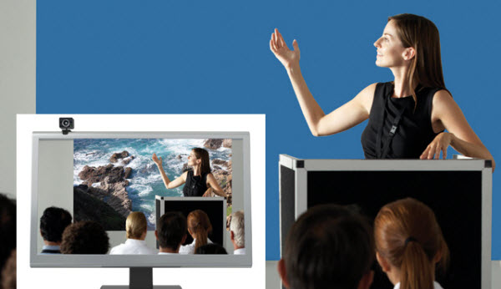
Algorithm
Capture the foreground image against a blue background
Image from advertisement at: http://www.telepresencecatalog.com/draper-vc/

Slide 43
Algorithm
Capture the foreground image against a blue background
Set the α = 0 for the blue pixels
Image from advertisement at: http://www.telepresencecatalog.com/draper-vc/

Slide 44
Algorithm
Capture the foreground image against a blue background
Set the α = 0 for the blue pixels
Set the α = 1 otherwise
Image from advertisement at: http://www.telepresencecatalog.com/draper-vc/

Slide 45
Algorithm
Capture the foreground image against a blue background
Set the α = 0 for the blue pixels
Set the α = 1 otherwise
Composite with desired background
Image from advertisement at: http://www.telepresencecatalog.com/draper-vc/

Slide 46
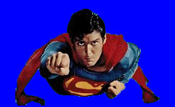
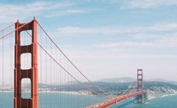
Bluescreening Algorithm
=
x
+
x
C = α × F + ( 1 - α ) × B
unassociated color images, and × means times
$\hat{C}$ = $\hat{F}$+ ( 1 - α ) × $\hat{B}$
if using associated color images

Slide 47
Blue Screening: An Issue
Keep the edges looking smooth in composite
How?
1
0.7
0.2
0
Along edges of
the alpha mask
we use
0 < α < 1
to reduce jaggies
1
1
0.8
0
1
1
1
0.4
1
1
1
0.8
alpha channel

Slide 48
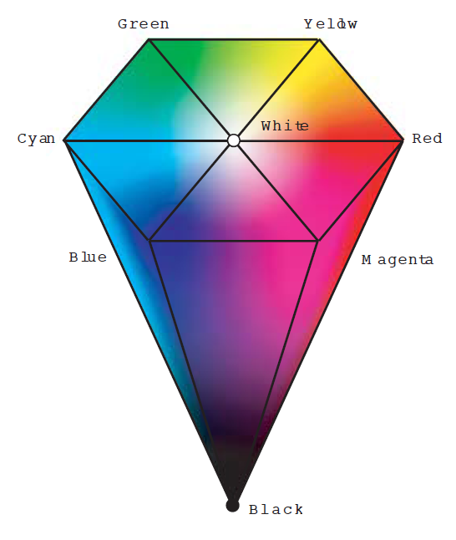
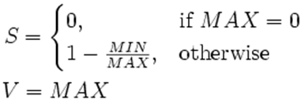
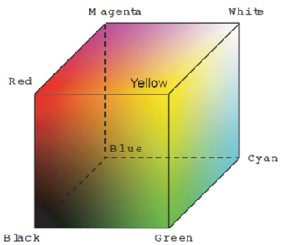
Creating the Alpha Mask
Keying Using Chroma (H) and Luma (V)
First: Convert RGB to HSV
Recall
Let
MAX = maximum(R, G, B); MIN = minimum(R, G, B);
S and V are straightforward
S
H
HSV
RGB
Notes:
Do not have to use HSV… could also use xyY or YUV or…
S: greater diff between MIN and MAX → the more saturation
V: greater MAX is → brighter the color

Slide 49
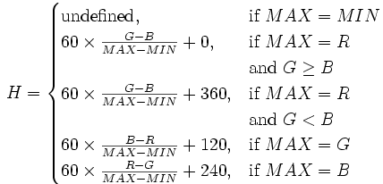
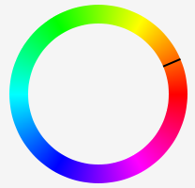
Creating the Alpha Mask
Keying Using Chroma (H) and Luma (V)
First: Convert RGB to HSV → now the H
Recall
Let
MAX = maximum(R, G, B); MIN = minimum(R, G, B);
“perfect” green at 120
“perfect” blue at 240
Notes:
Example H:
If MAX = B, then H is Blue (240 degrees).
If R=G, then it is perfect Blue (240)
else must move towards green or red whichever is larger (bound the move to 60 degrees or less)

Slide 50
Creating the Alpha Mask
Example H:
If MAX = B, then H is Blue (240 degrees).
If R=G, then it is perfect Blue (240)
else must move towards green or red whichever is larger
(bound the move to 60 degrees or less)
MAX = maximum(R, G, B); MIN = minimum(R, G, B);
“perfect” green at 120
“perfect” blue at 240
Notes:
Example H:
If MAX = B, then H is Blue (240 degrees).
If R=G, then it is perfect Blue (240)
else must move towards green or red whichever is larger (bound the move to 60 degrees or less)

Slide 51
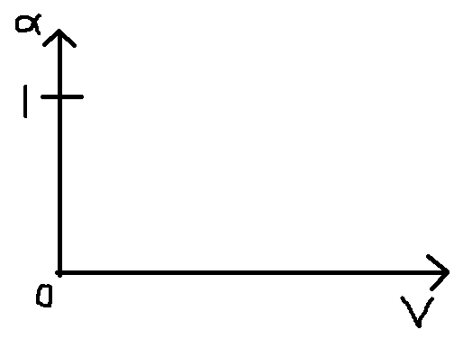
Option: Luma Keying
Use Value (V) in HSV for keying
works for well lit scene and dark background
Method 1
(may cause jaggies)
$$α=\left\{\begin{matrix}1, & V>T \\ 0, & else\end{matrix}\right.$$

Slide 52
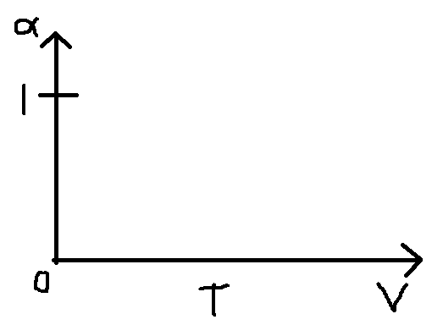
Option: Luma Keying
Use Value (V) in HSV for keying
works for well lit scene and dark background
Method 1
(may cause jaggies)
Method 2
$$α=\left\{\begin{matrix}1 & V>T+ε \\ \frac{V−(T−ε)}{2ε} & T−ε<V≤T+ε \\ 0 & else\end{matrix}\right.$$
$$α=\left\{\begin{matrix}1, & V>T \\ 0, & else\end{matrix}\right.$$
T+ε
Notes:
It is possible to also just use H
or to use all three H,S, and V

Slide 53
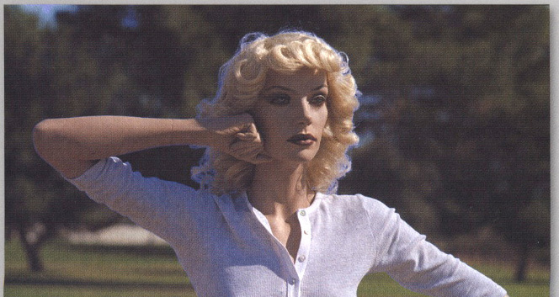
More Problems: Blue Spilling
Color Spill
Describes areas of the foreground subject that have absorbed or reflected color from the background
Commonly happens during shooting and is fixed in post-shooting
blue spill
Source: The Art & Science of Digital Compositing, by Ron Brinkmann

Slide 54
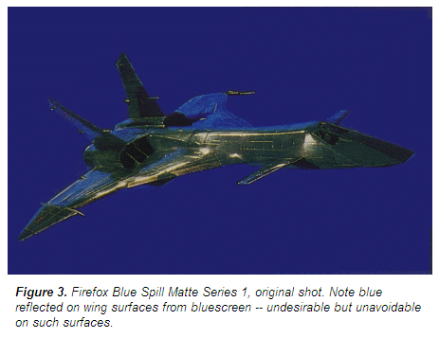
Reflection Blue Spill
blue spill
http://www.digitalgreenscreen.com/figure3.html

Slide 55
Suppression of Spill
Modify the blue channel on associated color image
if ( B > G) then B = G
this will set B=0 on bluescreen and reduces blue otherwise
Problem?
a blue shirt can become green
if this is not done carefully
Can also try
if (B > R) then B = R
Trick is to do this on the associated color image made from the foreground input image
Do not do this to the original input image – can try and see what problems occur =)

Slide 56
Difference Matte
Can be used for non-even blue screens or natural scene screens
non-even screen
overemphasized
clean plate
A
B
$$α=\left\{\begin{matrix}1, & \left|A−B\right|>ε \\ 0, & else\end{matrix}\right.$$

Slide 57
Garbage Matte
Garbage matte
manual method to exclude parts of an image that a bluescreen would not remove
or include parts it did remove
such as reflective blue spill
For example:
Exclude parts outside of
the dashed lasso region

Slide 58
Challenge
Composite your own set of images
i.e. Try doing this
=
x
+
x
C = α × F + ( 1 - α ) × B
unassociated color images, and × means times
Suggest input of: 1 background image,
and 2 or more images taken in front of a bluescreen
(or green screen if easier)
output 2 or more composited images

Slide 59
Trivia
Bluescreening was used “long” ago as blue was useful to film
As movies have become more “digital” Green screens are more common
BECAUSE
image sensors in digital video cameras are most sensitive to green
Bayer pattern allocates more pixels to the green channel
Green channel thus has least amount of noise for cleanest mask
Also requires less light because hardware sensors are more sensitive to green light

Slide 60
Extra Research
Compositing Digital Images SIGGRAPH paper by Porter and Duff, 1984
http://keithp.com/~keithp/porterduff/
Look into Shapes from Silhouettes
Good presentation at:
http://www.sci.utah.edu/~gerig/CS6320-S2015/Materials/CS6320-S2015-Shape-from-Silhouttes-I.pdf
Investigate Active Contour Models
Computer Vision
Relates to Blue Screening (Chroma Keying)
Other (maybe) useful papers
https://www.cs.princeton.edu/courses/archive/fall00/cs426/papers/smith95a.pdf
Smith, A. R., AND Blinn, J. F. 1996. Blue screen matting. In Proceedings of ACM SIGGRAPH 1996, 259–268.
A. Blake & M. Isard (1998). Active Contours. Springer-Verlag.
M. Kass, A. Witkin & D. Terzopoulos (1988). Snakes: active contour models. In International Journal of Computer Vision (1988), pp. 321-331.

Slide 61
Summary: Color and Compositing
Colors for Printing
Subtractive Color Spaces CMY and CMYK
Colors for Compositing
Example operations
Associated Images
Bluescreening

Slide 62
Questions?
Beyond D2L
Examples and information can be found online at:
http://docdingle.com/teaching/cs.html
Continue to more stuff as needed

Slide 63
Extra Reference Stuff Follows

Slide 64
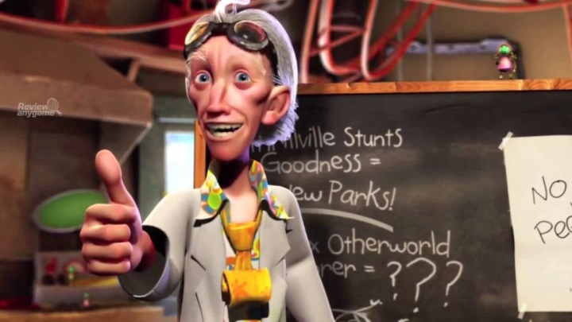
Credits
Much of the content derived/based on slides for use with the book:
Digital Image Processing, Gonzalez and Woods
Some layout and presentation style derived/based on presentations by
Donald House, Texas A&M University, 1999
Bernd Girod, Stanford University, 2007
Shreekanth Mandayam, Rowan University, 2009
Igor Aizenberg, TAMUT, 2013
Xin Li, WVU, 2014
George Wolberg, City College of New York, 2015
Yao Wang and Zhu Liu, NYU-Poly, 2015
Sinisa Todorovic, Oregon State, 2015

