Slide 1
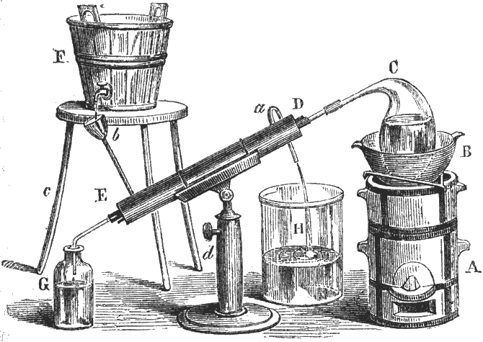
Filtering
Back to Basics
http://nodewebstore.blogspot.com/
Brent M. Dingle, Ph.D. 2015
Game Design and Development Program
Mathematics, Statistics and Computer Science
University of Wisconsin - Stout
Material in this presentation is largely based on/derived from
presentation(s) and book: The Digital Image by Dr. Donald House at Texas A&M University

Slide 2
Previously
Image Filtering
Examples
Low Pass
High Pass
Directional
Global
Normalization and Histogram Equalization
Relation to Image Enhancement
Spatial Domain
not so much the frequency domain

Slide 3
Outline
Filters and Convolutions
General Definitions
Working around the Edges
Low Pass Examples
High Pass Examples

Slide 4
Filtering
Filtering
modify an image based on image color content without any intentional change in image geometry
resulting image essentially has the same size and shape as the original

Slide 5
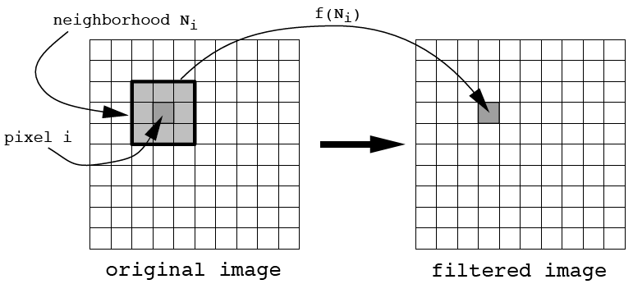
Image Filtering Operation
Image Filtering Operation
Let P_{i} be the single input pixel with index i and color C_{i}.
Let $\hat{P_{i}}$ be the corresponding output pixel with color $\hat{C_{i}}$.
A Filtering Operation
associates each pixel, P_{i},with a neighborhood set of pixels, N_{i} , and determines an output pixel color via a filter function, f, such that:
$$\hat{C_{i}}=f\left(N_{i}\right)$$
new color = $\hat{C_{i}}$

Slide 6
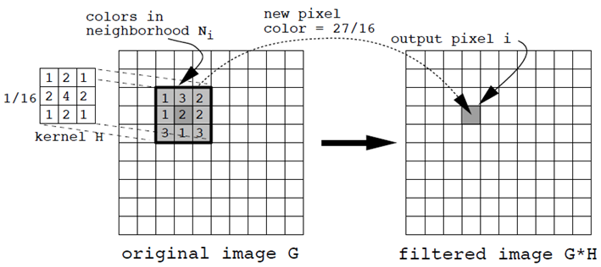
Convolution Filtering
Effectively this is doing a weighted sum
Weighted Sum = ( (1*1) + (2*3) + (1*2)
+ (2*1) + (4*2) + (2*2)
+ (1*3) + (2*1) + (1*3) ) * (1/16) = 27/16

Slide 7
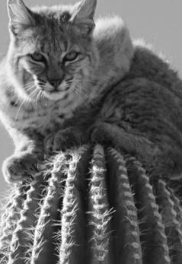
Tricky Around the Edges
Neighborhood
Needed
for some pixels
is out of the image
Many options… let’s look at a good choice

Slide 8
Expand the Input Image: Tiling
This orientation may have problems
Do the pixels at the edges
“match” from one side to the other?
→ NO

Slide 9
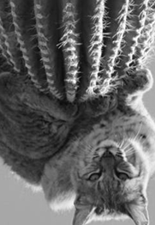
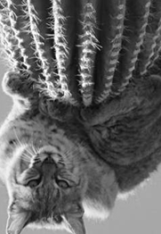
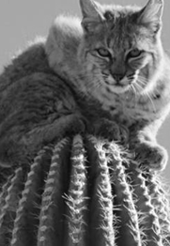
Expand the Input Image: Tiling
Flipping/Reflecting the image
Then Tiling
Usually works
and
Is a GOOD Strategy

Slide 10
Convolution in 1D
output image
input image
Weighted Sum
kernel
pixel at index i
pixel at index j

Slide 11
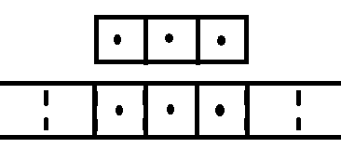
Convolution in 1D
set j from (i-n) to (i+n)
H from n to -n
reflected or flipped
H
sliding
As drawn kernel H has
a width, w = 3 so n = 1
H
-n
0
n
G …. with N elements
i-n
i
i+n

Slide 12
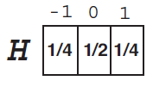
1D Example: Convolution G*H
width of H = 3, so n = 1
and N here is 7 pixels, indexed 0 to 6
original
flipped
Example from: The Digital Image by Dr. Donald House at Texas A&M University, Figure 8.11

Slide 13
1D Example: Convolution G*H
original
flipped
Example for i = 3
$\sum_{j=3−1}^{3+1}{G\left(j\right)H(3−j)}=$ G(2)H(1) + G(3)H(0) + G(4)H(-1)
= (4*1/4) + (2*1/2) + (1*1/4)
= 9/4
Example from: The Digital Image by Dr. Donald House at Texas A&M University, Figure 8.11

Slide 14
Why Flip the Kernel?
Example with no flip:
H
G
G*H
2 1 0
3 4 5
3 10 13
3 4 5
2 1 0
13 10 3
H*G
G*H does NOT equal H*G
Example from: The Digital Image by Dr. Donald House at Texas A&M University, Figure 8.11
Notes:
To see how to get answer start on the no flip first row:
Pad sides of G with zeros as needed… multiply and add up the sum
H is the moving window… so 10 and 14 are easy to calc… no padding of zeros needed

Slide 15
Why Flip the Kernel?
Example with no flip:
H
G
G*H
2 1 0
3 4 5
3 10 13
3 4 5
2 1 0
13 10 3
H*G
Example with flipped kernel:
H
G
G*H
0 1 2
3 4 5
11 14 5
G*H == H*G
5 4 3
2 1 0
11 14 5
H*G
Example from: The Digital Image by Dr. Donald House at Texas A&M University, Figure 8.11
Notes:
To see how to get answer start on the no flip first row:
Pad sides of G with zeros as needed… multiply and add up the sum
H is the moving window… so 10 and 14 are easy to calc… no padding of zeros needed

Slide 16
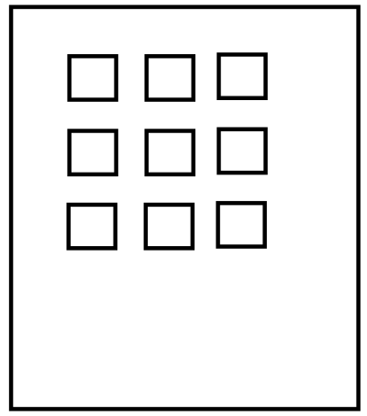
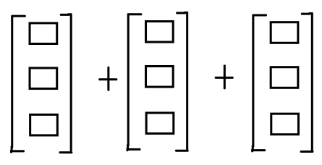
Convolution: 1D to 2D
Convolution extends to 2D in straightforward fashion
Assume kernel H is rectangular array of width, w=2n+1 and height, h=2m+1
Assume image G is of width M and height N
Then…
i is column
j is row
M
i, j
j+n
j
+
+
+
+
+
+
N
j-n
i-m
i+m
As drawn
w = 3 and h = 3
Thus n = 1 and m = 1
i

Slide 17
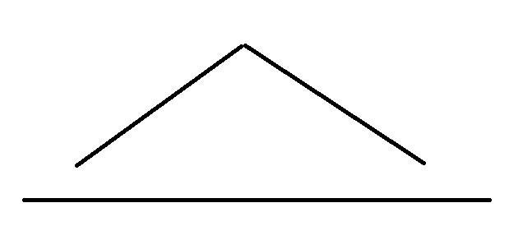
2D kernel from a 1D kernel
H₂ = H₁ H^{t}₁
1 2 1
tent
$$\left[\begin{matrix}1 \\ 2 \\ 1\end{matrix}\right]\left[\begin{matrix}1 & 2 & 1\end{matrix}\right]=\left[\begin{matrix}1 & 2 & 1 \\ 2 & 4 & 2 \\ 1 & 2 & 1\end{matrix}\right]$$
2D kernel
that yields results
similar to 1D kernel

Slide 18
2D Kernel Separability
2D kernels can be separated
Apply filtering twice using the 1D filter
once “horizontally”
once “vertically”
Get same results as applying the 2D filter once
Efficiency increase when W large
multiplications per pixel = 2W < W²
e.g. 2*3 < 3² .

Slide 19
Outline
Filters and Convolutions
General Definitions
Working around the Edges
Low Pass Examples
High Pass Examples

Slide 20
Low Pass Filters
A filter that retains low frequencies and reduces high frequencies
Example: box, or pulse, kernel
1D:
1 1 1
$$\left[\begin{matrix}1 \\ 1 \\ 1\end{matrix}\right]\left[\begin{matrix}1 & 1 & 1\end{matrix}\right]=\left[\begin{matrix}1 & 1 & 1 \\ 1 & 1 & 1 \\ 1 & 1 & 1\end{matrix}\right]$$
2D:

Slide 21
Box * Box = Tent
Convolution of box kernel with itself
Gives a tent filter
0 1 1 1 0
* 1 1 1
= 1 2 3 2 1
*

Slide 22
Low Pass Filter: 2D Tent
1D:
1 2 3 2 1
2D:
$$\left[\begin{matrix}1 \\ 2 \\ \begin{matrix}3 \\ \begin{matrix}2 \\ 1\end{matrix}\end{matrix}\end{matrix}\right]\left[\begin{matrix}1 & 2 & \begin{matrix}3 & 2 & 1\end{matrix}\end{matrix}\right]=\left[\begin{matrix}1 & 2 & \begin{matrix}3 & 2 & 1\end{matrix} \\ 2 & 4 & \begin{matrix}6 & 4 & 2\end{matrix} \\ \begin{matrix}3 \\ 2 \\ 1\end{matrix} & \begin{matrix}6 \\ 4 \\ 2\end{matrix} & \begin{matrix}\begin{matrix}9 & 6 & 3\end{matrix} \\ \begin{matrix}6 & 4 & 2\end{matrix} \\ \begin{matrix}3 & 2 & 1\end{matrix}\end{matrix}\end{matrix}\right]$$

Slide 23
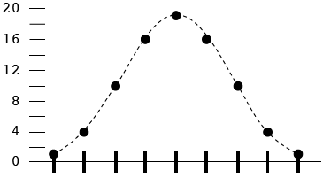
Tent * Tent = Bell
Convolution of tent kernel with itself
Gives a Bell filter
0 0 1 2 3 2 1 0 0 *
1 2 3 2 1
=
1 4 10 16 19 16 10 4 1

Slide 24
Low Pass Filters
The more convolutions with self
The better smoothing you achieve
continue
towards Gaussian
1 1 1
1 2 3 2 1
1 4 10 16 19 16 10 4 1

Slide 25
Example Results
Note:
Tent and Bell
have better quality
than just a “bigger” box
They more cleanly
blur the edges…
…less muddy in appearance
Big Box
Tent
Original Image
1 1 1 1 1
1 2 3 2 1
1 1 1
1 1 1 1 1 1 1 1 1
1 4 10 16 19 16 10 4 1
Box
Bigger Box
Bell
Example from: The Digital Image by Dr. Donald House at Texas A&M University, Figure 8.11

Slide 26
Example Results
Note:
Tent and Bell
have better quality
than just a “bigger” box
They more cleanly
blur the edges…
…less muddy in appearance
Big Box
Tent
Original Image
1 1 1 1 1
1 2 3 2 1
1 1 1
1 1 1 1 1 1 1 1 1
1 4 10 16 19 16 10 4 1
Box
Bigger Box
Bell
Example from: The Digital Image by Dr. Donald House at Texas A&M University, Figure 8.11

Slide 27
Outline
Filters and Convolutions
General Definitions
Working around the Edges
Low Pass Examples
High Pass Examples

Slide 28
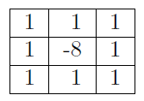
High Pass Filters
A filter that retains high frequencies and reduces low frequencies
Example:
This example suppresses large areas of uniform or smoothly varying color
It will emphasize edges (and other steep changes in color)
Why?
The sum of the kernel weights is zero
So an area of ‘constant’ color will result in a filtered output of zero

Slide 29
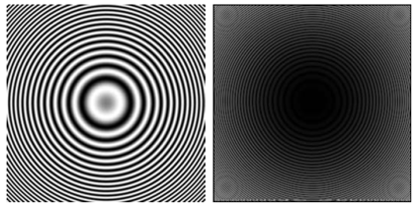
Example Results
low frequency suppressed – yet high frequency remains

Slide 30
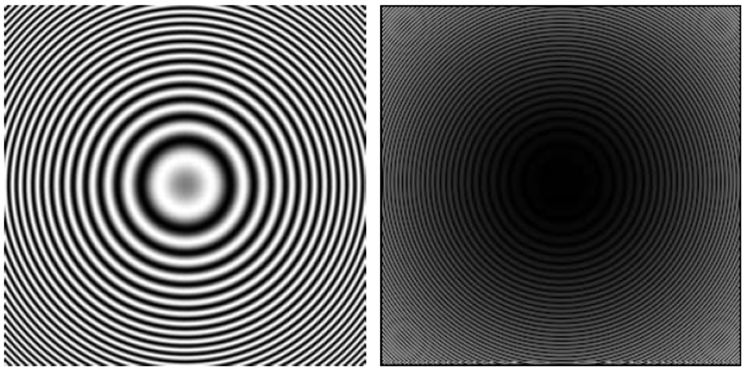
High Pass: Examples Continue
low
frequency
removed
high frequency
remains
Yes you are seeing smaller circles
Why? Remember Moire Patterns?
Aliasing Artifacts?

Slide 31
Summary
More Details provided on
Filters and Convolutions
General Definitions
Working around the Edges
Low Pass Examples
High Pass Examples
Should help in implementation and detailed understanding
Go try doing these things! =)

Slide 32
Questions?
Beyond D2L
Examples and information can be found online at:
http://docdingle.com/teaching/cs.html
Continue to more stuff as needed

Slide 33
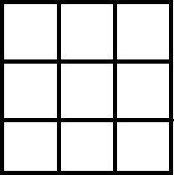
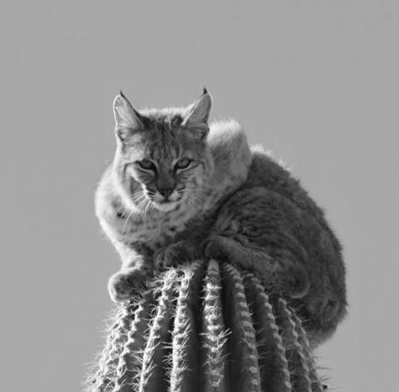
Extra Reference Stuff Follows

Slide 34
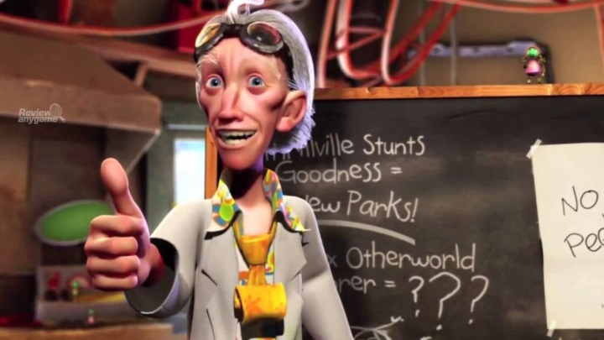
Credits
Much of the content derived/based on slides for use with the book:
Digital Image Processing, Gonzalez and Woods
Some layout and presentation style derived/based on presentations by
Donald House, Texas A&M University, 1999
Bernd Girod, Stanford University, 2007
Shreekanth Mandayam, Rowan University, 2009
Igor Aizenberg, TAMUT, 2013
Xin Li, WVU, 2014
George Wolberg, City College of New York, 2015
Yao Wang and Zhu Liu, NYU-Poly, 2015
Sinisa Todorovic, Oregon State, 2015

