Slide 1
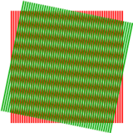

Image Interpolation
Image Processing
Brent M. Dingle, Ph.D. 2015
Game Design and Development Program
Mathematics, Statistics and Computer Science
University of Wisconsin - Stout
public domain image from wikipedia

Slide 2
Lecture Objectives
Previously
  What a Digital Image is
  Acquisition of Digital Images
  Human Perception of Digital Images
  Digital Representation of Images
  Various HTML5 and JavaScript Code
    Pixel manipulation
    Image Loading
    Filtering
Today
  Image Interpolation
    Sub-Sampling
      Aliasing
      Gaussian Blur Fix
    Up-Sampling
      Interpolation
  Examples of Using Interpolation

Slide 3
Lecture Objectives
Previously
  What a Digital Image is
  Acquisition of Digital Images
  Human Perception of Digital Images
  Digital Representation of Images
  Various HTML5 and JavaScript Code
    Pixel manipulation
    Image Loading
    Filtering
Today
  Image Interpolation
    Sub-Sampling
      Aliasing
      Pre-Filtering
    Up-Sampling
      Interpolation
  Examples of Using Interpolation

Slide 4
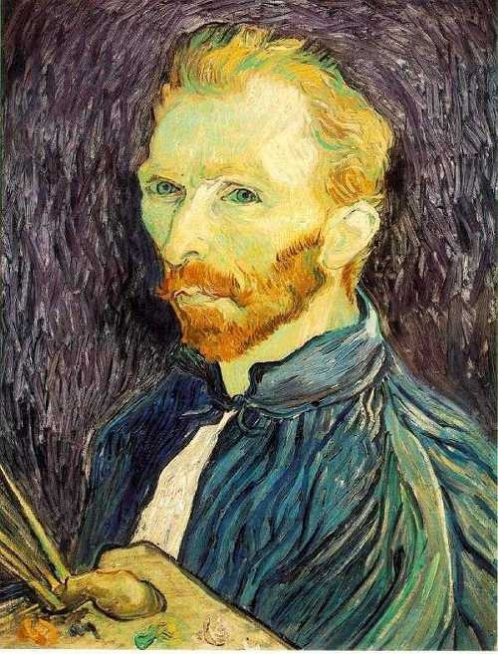
Image Scaling
This image is too big to fit on the screen. How can we generate a half-sized version?
Slide from: Noah Snavely, 2012, Cornell
Source: S. Seitz

Slide 5

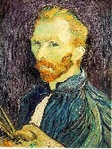

Image sub-sampling
Why do these reduced sizes look bad?
scaled to ½ size
scaled to ¼ size
(2x zoom)
scaled to 1/8 size
(4x zoom)
Slide from: Noah Snavely, 2012, Cornell
Source: S. Seitz

Slide 6
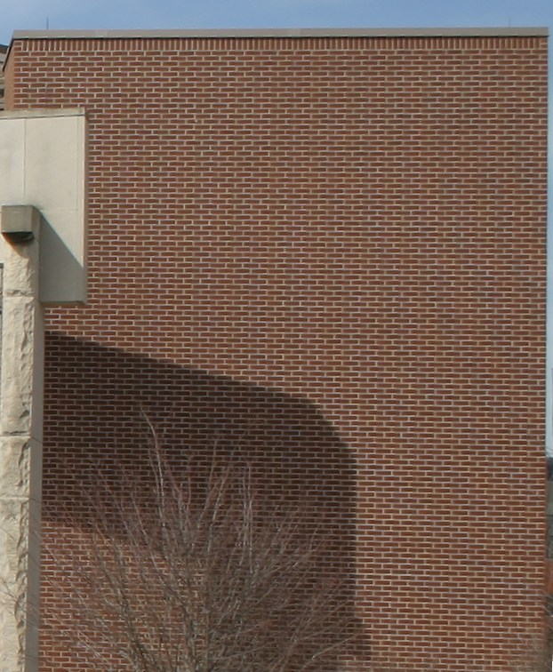
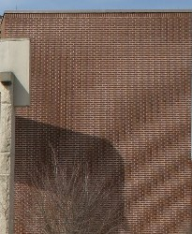
Image sub-sampling
What happened here?
public domain images from wikipedia

Slide 7
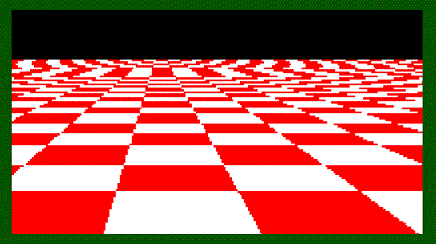
Even worse for synthetic images
And what happened here?
Source: L. Zhang

Slide 8
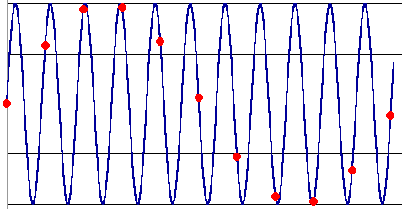
Aliasing
Occurs when your sampling rate is not high enough to capture the amount of detail in your image
  Can give you the wrong signal/image—an alias
To do sampling right,
need to understand the structure of your signal/image
  Hello Fourier!
To avoid aliasing:
  sampling rate ≥ 2 * max frequency in the image
    said another way: ≥ two samples per cycle
  This minimum sampling rate is called the Nyquist rate
Source: L. Zhang

Slide 9
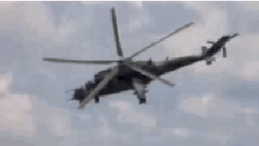
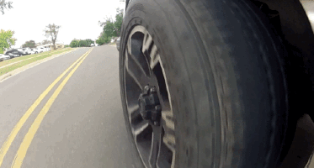
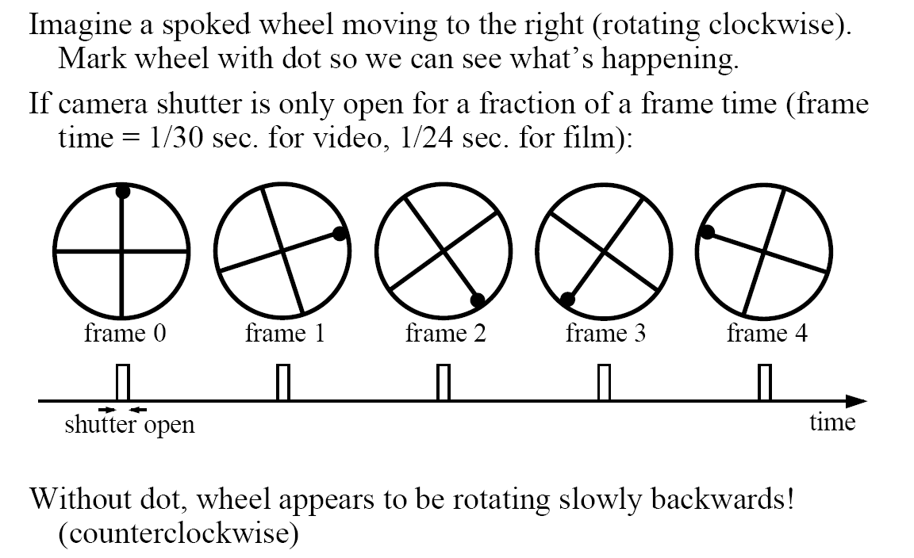
Wagon-wheel effect
(See http://www.michaelbach.de/ot/mot_wagonWheel/index.html)
Source: L. Zhang

Slide 10
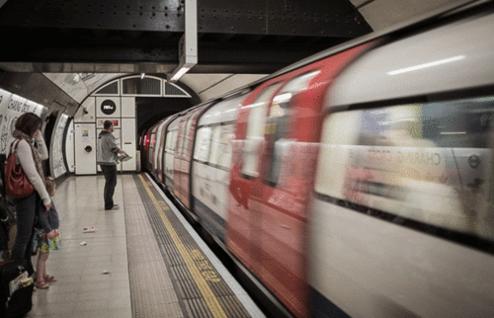
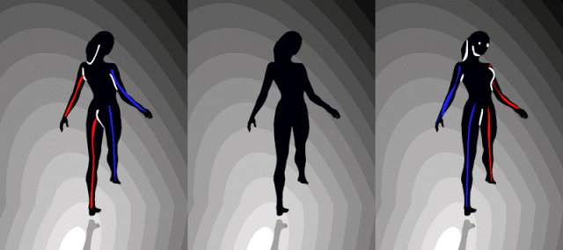
Wagon Wheel Variations
Which way does the middle dancer spin?
Focus on the left – middle matches
Focus on the right – middle matches
Which way is the train going?
Images from: http://stanleykemp.blogspot.com/2015/06/lets-start-weekend-with-couple-of_6.html

Slide 11
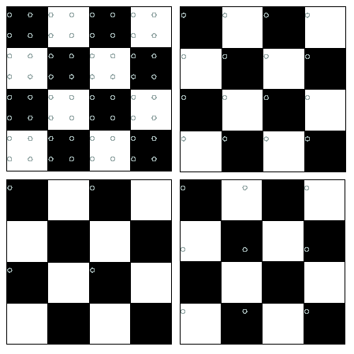
Nyquist limit – 2D example
Good sampling
Bad sampling
sampling rate < 2*(max freq)

Slide 12
Aliasing
When downsampling by a factor of two
  Original image has frequencies that are too high
How can we fix this?

Slide 13



Gaussian pre-filtering
G 1/8
G 1/4
Gaussian 1/2
Solution: filter the image, then subsample
Source: S. Seitz

Slide 14
Subsampling with Gaussian pre-filtering
Gaussian 1/2
G 1/4
G 1/8
Solution: filter the image, then subsample
Source: S. Seitz

Slide 15
Compare with...
1/2
1/4 (2x zoom)
1/8 (4x zoom)
Source: S. Seitz

Slide 16
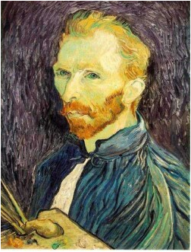







Gaussian pre-filtering
Solution: filter the image, then subsample
F₀
F₁
F₂
…
blur
subsample
blur
subsample
F₀ H
F₁ H
*
*

Slide 17
{
Gaussian pyramid
F₀
F₁
F₂
…
blur
subsample
blur
subsample
F₀ H
F₁ H
*
*

Slide 18
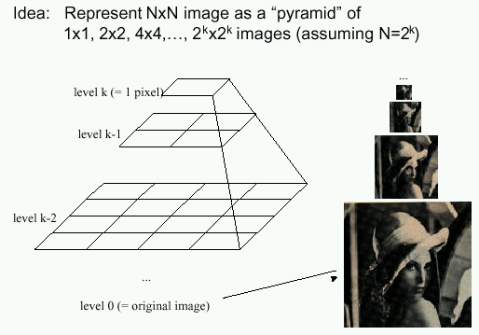
Gaussian pyramids
[Burt and Adelson, 1983]
In computer graphics, a mip map [Williams, 1983]
A precursor to wavelet transform
Gaussian Pyramids have all sorts of applications in computer graphics, vision, imaging…
Source: S. Seitz

Slide 19
Gaussian pyramids
[Burt and Adelson, 1983]
How much space does a Gaussian pyramid take compared to the original image?
Source: S. Seitz

Slide 20
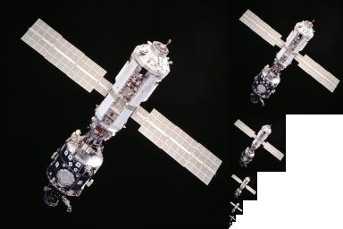
Gaussian Pyramid

Slide 21
Questions so far?
Questions on Sub-Sampling
  Aliasing?
  Gaussian pre-filter?

Slide 22
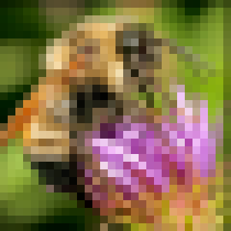
Upsampling
This image is too small for this screen:
How can we make it 10 times as big?
Simplest approach:
repeat each row
and column 10 times
(“Nearest neighbor
interpolation”)
Slide from: Noah Snavely, 2012, Cornell

Slide 23


Image interpolation
d = 1 in this
example
1
2
3
4
5
Recall how a digital image is formed
  It is a discrete point-sampling of a continuous function
  If we could somehow reconstruct the original function, any new image could be generated, at any resolution and scale
Slide from: Noah Snavely, 2012, Cornell
Adapted from: S. Seitz

Slide 24
Image interpolation
d = 1 in this
example
1
2
3
4
5
Recall how a digital image is formed
  It is a discrete point-sampling of a continuous function
  If we could somehow reconstruct the original function, any new image could be generated, at any resolution and scale
Slide from: Noah Snavely, 2012, Cornell
Adapted from: S. Seitz

Slide 25




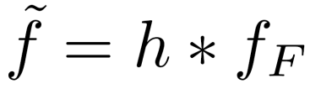
Image interpolation
1
d = 1 in this
example
1
2
2.5
3
4
5
What if we don’t know ?
  Guess an approximation:
  Can be done in a principled way: filtering
  Convert to a continuous function:
  Reconstruct by convolution with a reconstruction filter, h
Slide from: Noah Snavely, 2012, Cornell
Adapted from: S. Seitz

Slide 26
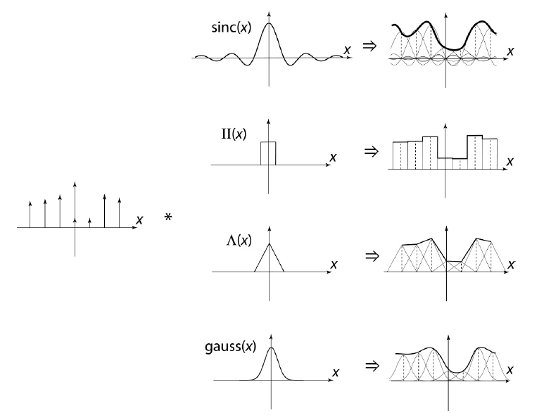
Image interpolation
“Ideal” reconstruction
Nearest-neighbor interpolation
Linear interpolation
Gaussian reconstruction
Slide from: Noah Snavely, 2012, Cornell
Source: B. Curless

Slide 27
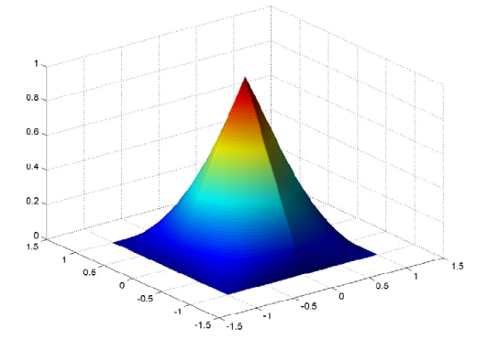


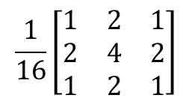
Reconstruction filters
What does the 2D version of this hat function look like?
performs
linear interpolation
(tent function) performs
bilinear interpolation
3x3 Matrix for 2D tent filter might look like:
$$\frac{1}{16}\left[\begin{matrix}1 & 2 & 1 \\ 2 & 4 & 2 \\ 1 & 2 & 1\end{matrix}\right]$$
Derived from: Noah Snavely, 2012, Cornell

Slide 28

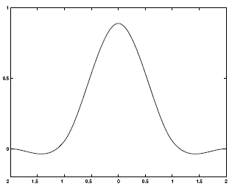
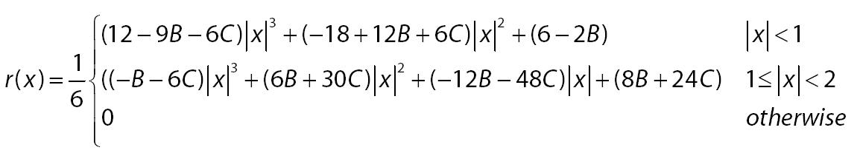
Reconstruction filters
What does the 2D version of this hat function look like?
performs
linear interpolation
(tent function) performs
bilinear interpolation
More information, start at:
  http://en.wikipedia.org/wiki/Bilinear_interpolation
Better filters give better resampled images
  Bicubic is common choice
Cubic reconstruction filter
Slide from: Noah Snavely, 2012, Cornell

Slide 29


Image interpolation
Original image: x 10
Nearest-neighbor interpolation
Bilinear interpolation
Bicubic interpolation
Slide from: Noah Snavely, 2012, Cornell

Slide 30
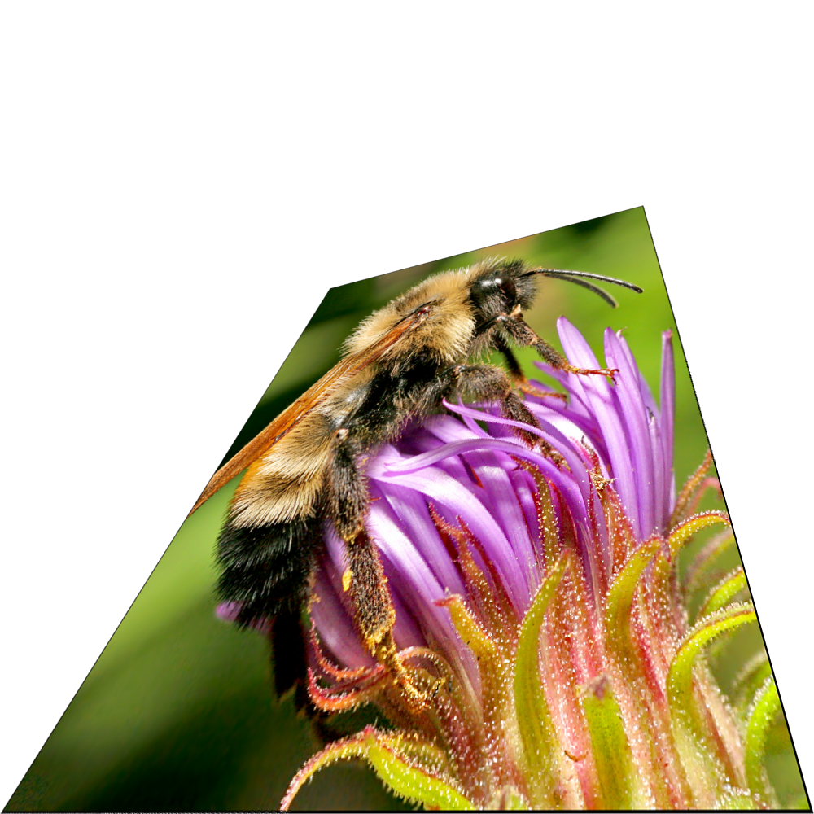
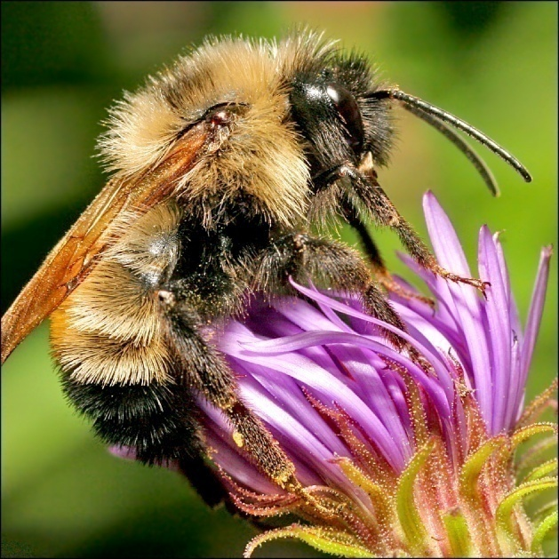
Image interpolation
Also used for resampling
Slide from: Noah Snavely, 2012, Cornell

Slide 31
Examples of Interpolation Usage
Image Bayer De-mosaicking
Image Error Correction/Fill
Image Reconstruction/Inpainting
Merging/Mosaicking/Panoramic Splicing

Slide 32
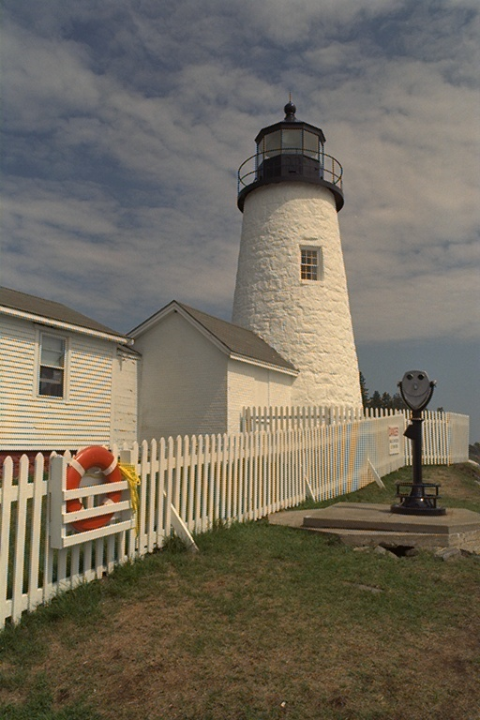

Demosaicing Image Example
Ad-hoc CFA Interpolation
Advanced CFA Interpolation

Slide 33
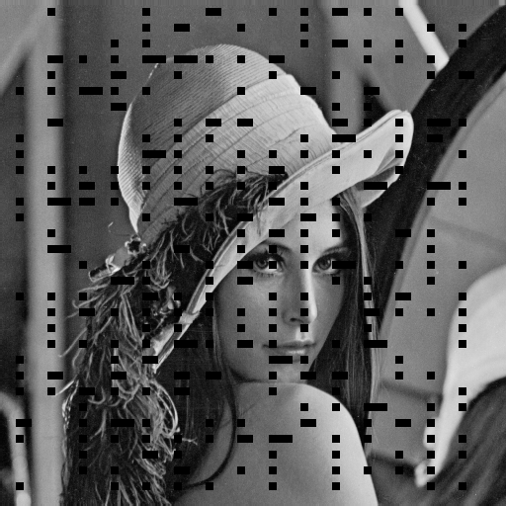
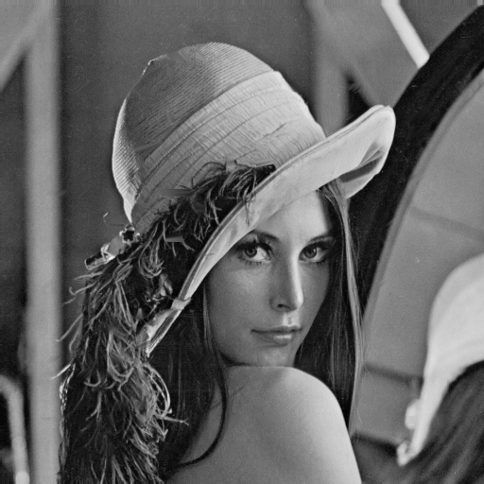
Error Correction/Fill
damaged
interpolated

Slide 34
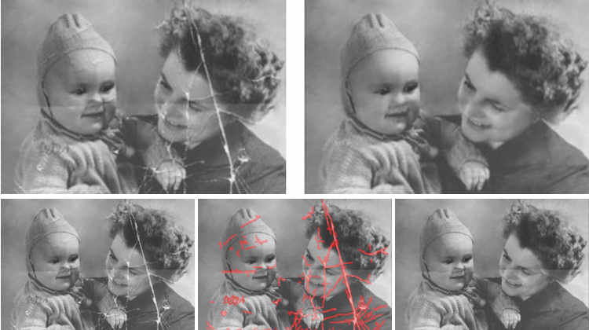
Image Inpainting/Restoration

Slide 35
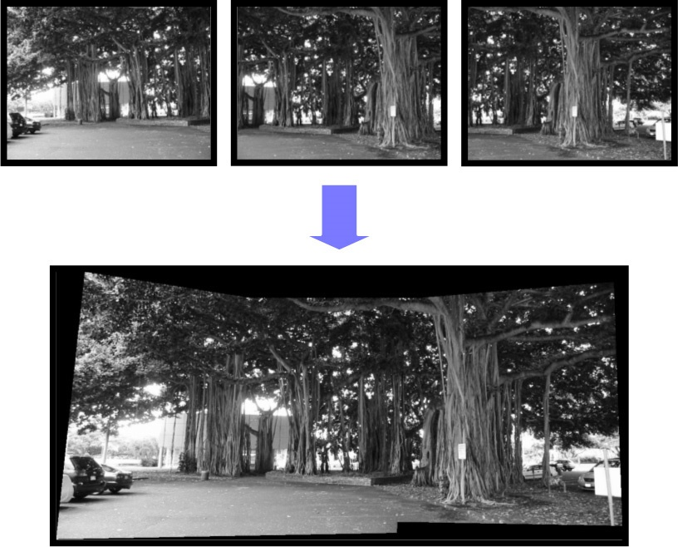
Image Mosaicing/Merging

Slide 36
Summary: Image Interpolation
Image Interpolation
  Fundamental tool in digital processing of images
    bridges the continuous world and the discrete world
  Wide range of application use

Slide 37
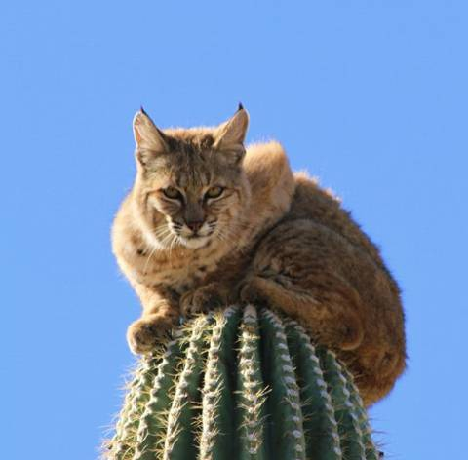
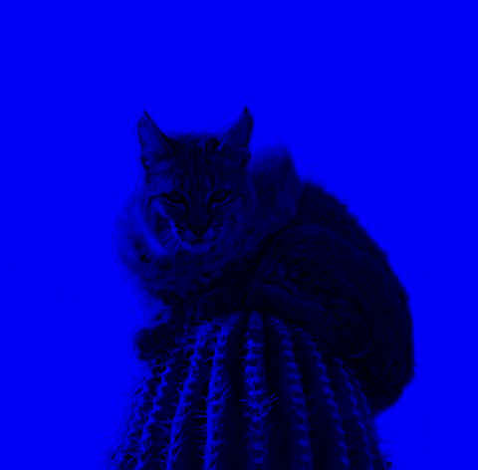
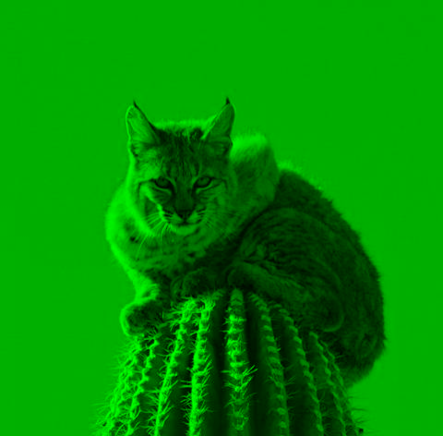
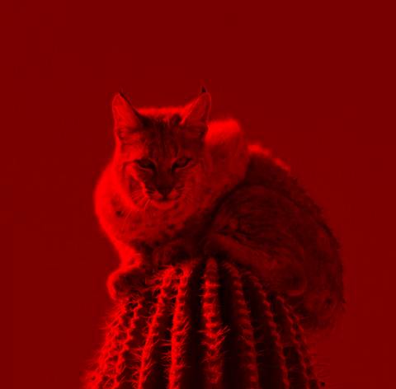
Challenge: Bayer De-Mosaicking
Separate an image into its color planes (RGB)

Slide 38
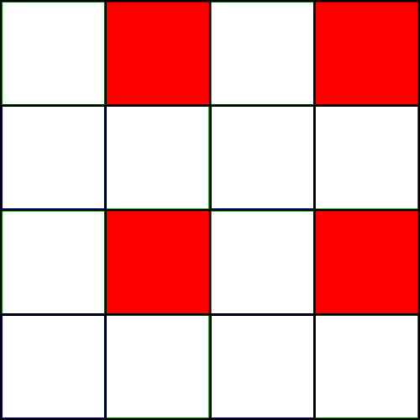
Challenge: Bayer De-Mosaicking
Reduce panes to Bayer Pattern Equivalent

Slide 39
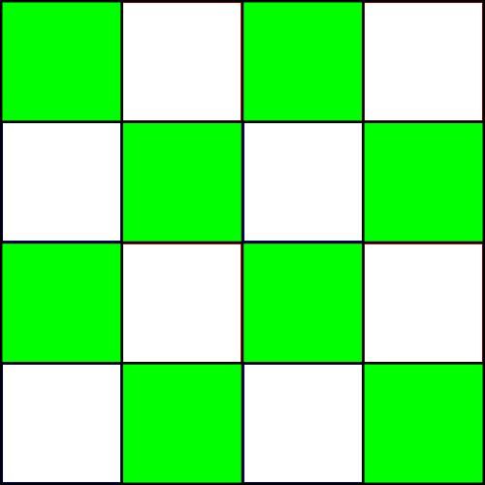
Challenge: Bayer De-Mosaicking
Reduce panes to Bayer Pattern Equivalent

Slide 40
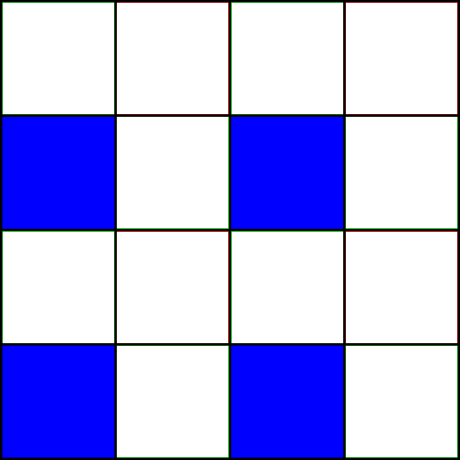
Challenge: Bayer De-Mosaicking
Reduce panes to Bayer Pattern Equivalent

Slide 41
Challenge: Bayer De-Mosaicking
Interpolate each pane and re-composite

Slide 42
Questions?
Beyond D2L
  Examples and information
  can be found online at:
    http://docdingle.com/teaching/cs.html
    Continue to more stuff as needed

Slide 43
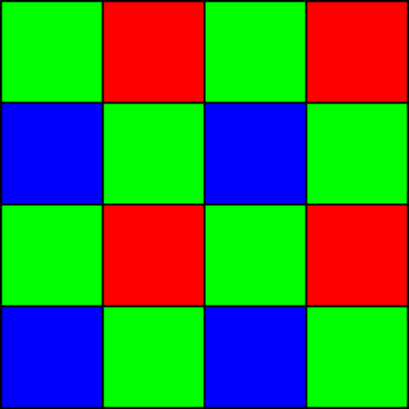
Extra Reference Stuff Follows

Slide 44
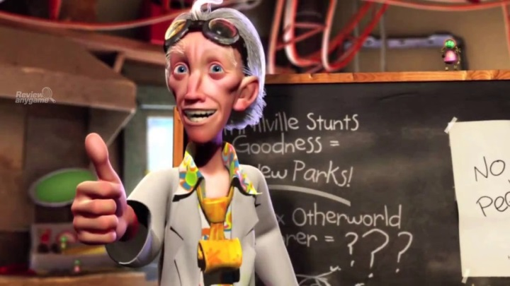
Credits
Much of the content derived/based on slides for use with the book:
  Digital Image Processing, Gonzalez and Woods
Some layout and presentation style derived/based on presentations by
  Donald House, Texas A&M University, 1999
  Bernd Girod, Stanford University, 2007
  Shreekanth Mandayam, Rowan University, 2009
  Noah Snavely, Cornell University, 2012
  Igor Aizenberg, TAMUT, 2013
  Xin Li, WVU, 2014
  George Wolberg, City College of New York, 2015
  Yao Wang and Zhu Liu, NYU-Poly, 2015
  Sinisa Todorovic, Oregon State, 2015

