Slide 1
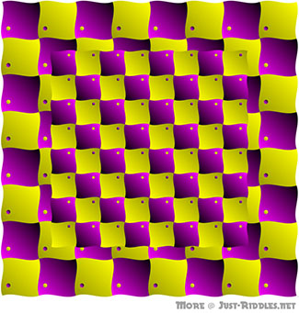
Image Warping (Geometric Transforms)
Image Processing
Brent M. Dingle, Ph.D. 2015
Game Design and Development Program
Mathematics, Statistics and Computer Science
University of Wisconsin - Stout
Material in this presentation is largely based on/derived from
presentation(s) and book: The Digital Image by Dr. Donald House at Texas A&M University

Slide 2
Lecture Objectives
Previously
Image Interpolation
Today
Image Warping (Geometric Transforms)

Slide 3
Outline
Warping (Geometric Transforms)
General Image Warps
Forward and Inverse Mapping

Slide 4
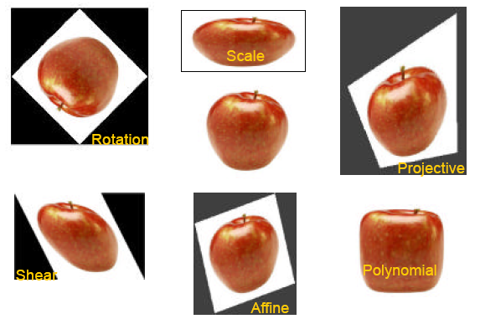
Apples of All Shapes and Sizes

Slide 5
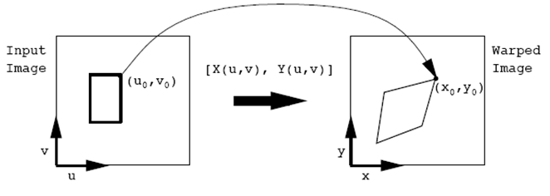
Image Warps
Mapping and functions
X() and Y() map (u, v) to (x, y)
in vector notation:

Slide 6
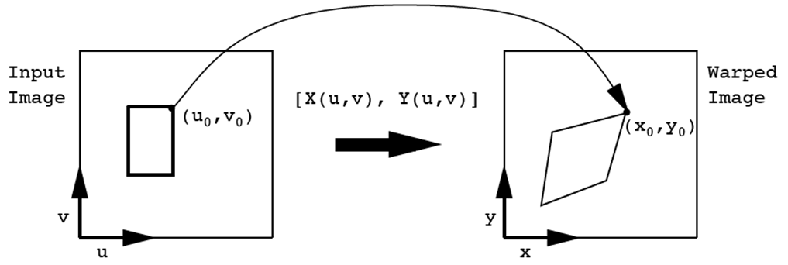
Forward Mapping: [ X(), Y() ]
If the image was continuous and the forward map: [X(), Y()] is relatively smooth (no discontinuities)
Then for each old image pixel (u, v) we can paint new pixel (x, y) using the same color

Slide 7
Forward Map
Digital image are NOT continuous
They consist of a finite number of samples = pixels
Allowing the following algorithm to perform a mapping
original image’s
pixel color
at (u, v)
( x , y )

Slide 8
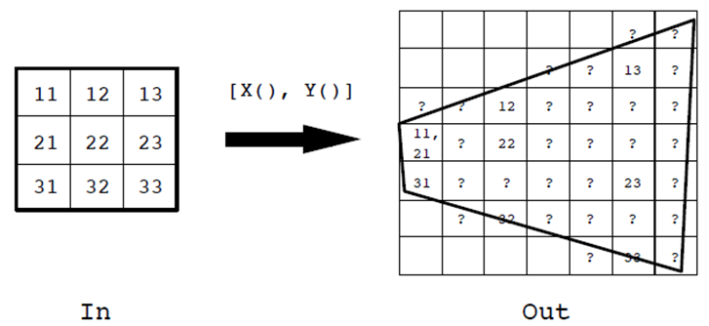
Problem with Forward Map
With loss of “continuous/infinite” points
one-to-on mapping cannot happen
forward map leaves holes and folds
? = hole in new image
= fold in new image
scaled up
on this side
scaled down
on this side

Slide 9
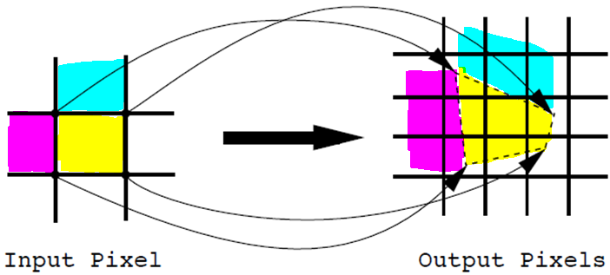
Searching for a Solution
[ X(), Y() ]
Could try weighting average of some kind
to mix colors, to fill holes and fix folds…

Slide 10
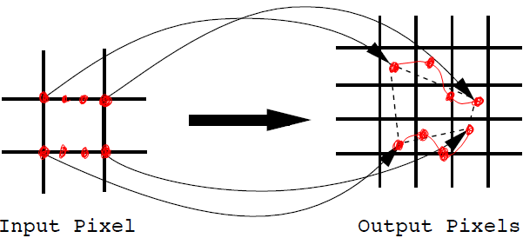
Still Searching…
If map is to curvy lines/edges that averaging becomes more difficult
not very “pixel-to-pixel”
[ X(), Y() ]
Must be an easier way…

Slide 11
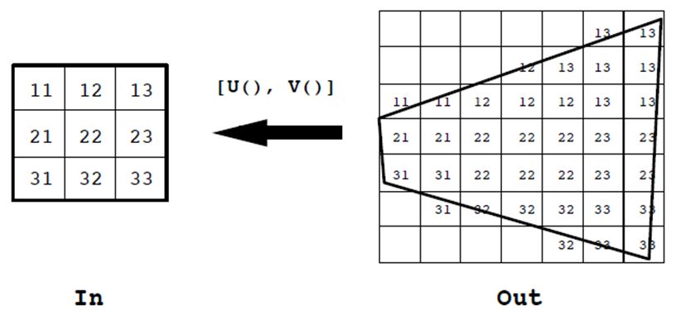
Inverse Map Solution
Invert the problem
Look at each output pixel and determine what input pixel(s) map to it
instead of sending each input pixel to an output pixel
No holes or folds !!!

Slide 12
Inverse Map: [ U(), V() ]
Recall the forward map:
Invert the mapping functions X() and Y()
or in matrix form:

Slide 13
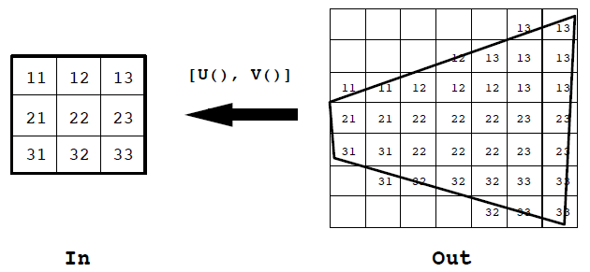
Inverse Mapping Algorithm
( u , v )
The inverse map provides a complete covering

Slide 14
Forward vs Inverse Maps
Forward Map:
( x , y )
Inverse Map:
( u , v )

Slide 15
Inverse Supports Clipping Too!
Warping and clipping
all together, same time

Slide 16
Inverse Supports Clipping Too!
A forward map would map this pixel to the new image
and require it to be cleared off later

Slide 17
Affine Map
A geometric transformation that maps points and parallel lines to points and parallel lines
General form of an affine map:
a_{ij} are coefficient constants

Slide 18
Affine Maps: Matrix Form
in matrix form looks like:

Slide 19
What about Infinity?
Euclidean/Cartesian space cannot handle points at infinity → cannot describe projective space
The railroad tracks become narrower
as they meet the horizon
→ parallel lines intersect at infinity
Projective space allows for this effect
AND
It is easy to transform points
to and from Cartesian space
into and out of Projective space
…
Image from: http://www.songho.ca/math/homogeneous/homogeneous.html

Slide 20
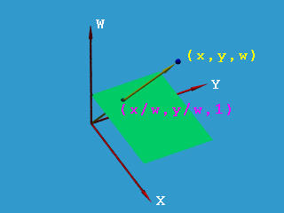
Homogeneous Coordinate System
Every (Cartesian) point has an identical third coordinate
NOTE: Conversion from Cartesian coordinates to Homogeneous coordinates is unique
however,
Conversion from Homogeneous coordinates to Cartesian is NOT unique
Image from: http://www.cs.mtu.edu/~shene/COURSES/cs3621/NOTES/geometry/homo-coor.html
Notes:
A good paper (among many other options)
on homogeneous coordinate systems might be found at:
http://www.mat.ucsb.edu/594cm/2010/Week1/homog-coords.pdf

Slide 21
Homogeneous Coordinate System
Every (Cartesian) point has an identical third coordinate
( u, v, 1)
( x, y )
Affine
will focus on the plane defined by
w = 1
Image will be (u, v, 1)
with u and v the pixel coordinates
NOTE: Conversion from Cartesian coordinates to Homogeneous coordinates is unique
however,
Conversion from Homogeneous coordinates to Cartesian is NOT unique
Image from: http://www.cs.mtu.edu/~shene/COURSES/cs3621/NOTES/geometry/homo-coor.html

Slide 22
Matrix Translation
Given homogeneous coordinates (u, v, 1)
Find Cartesian coordinates (x, y)
Explicitly, x then would be calculated as:
AGAIN:
Conversion from Homogeneous coordinates to Cartesian is NOT unique
coeffs a_{ij} will describe how we want to warp an image,
Example: a₁₃ is a translation distance for x

Slide 23
Points to Remember
Homogeneous Coordinates
allow affine transformations to be easily represented by matrix multiplications
Affine Maps
always have an inverse
can be represented in matrix form (via homogeneous coords)

Slide 24
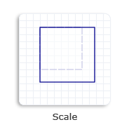
Scale: an affine map transform
scale(x, y) = ( a₁₁u, a₂₂v )
$$\left[\begin{matrix}x \\ y \\ 1\end{matrix}\right]=\left[\begin{matrix}a_{11}u \\ a_{22}v \\ 1\end{matrix}\right]=\left[\begin{matrix}a_{11} & 0 & 0 \\ 0 & a_{22} & 0 \\ 0 & 0 & 1\end{matrix}\right]\left[\begin{matrix}u \\ v \\ 1\end{matrix}\right]$$

Slide 25
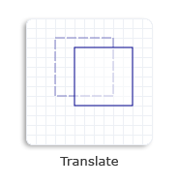
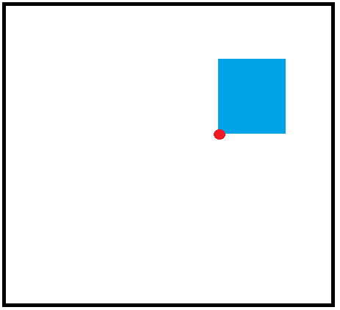
Translate: an affine map transform
translate (x, y) = ( u + a₁₃, v + a₂₃ )
$$\left[\begin{matrix}x \\ y \\ 1\end{matrix}\right]=\left[\begin{matrix}u+a_{13} \\ v+a_{23} \\ 1\end{matrix}\right]=\left[\begin{matrix}1 & 0 & a_{13} \\ 0 & 1 & a_{23} \\ 0 & 0 & 1\end{matrix}\right]\left[\begin{matrix}u \\ v \\ 1\end{matrix}\right]$$
(a₁₃, a₂₃)
(0, 0)

Slide 26
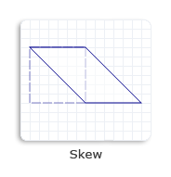
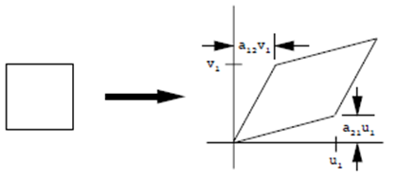
Shear: an affine map transform
shear (x, y) = ( u + a₁₂v, a₂₁u + v)
$$\left[\begin{matrix}x \\ y \\ 1\end{matrix}\right]=\left[\begin{matrix}u+a_{12}v \\ a_{21}u+v \\ 1\end{matrix}\right]=\left[\begin{matrix}1 & a_{12} & 0 \\ a_{21} & 1 & 0 \\ 0 & 0 & 1\end{matrix}\right]\left[\begin{matrix}u \\ v \\ 1\end{matrix}\right]$$
a₁₂v
a₂₁u

Slide 27
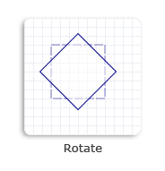
Rotate: an affine map transform
rotate (x, y) = ($u \cos{θ}−v \sin{θ}$, $u \sin{θ}+v\cos{θ}$)
$$\left[\begin{matrix}x \\ y \\ 1\end{matrix}\right]=\left[\begin{matrix}u \cos{θ}−v \sin{θ} \\ u \sin{θ}+v\cos{θ} \\ 1\end{matrix}\right]=\left[\begin{matrix}\cos{θ} & −\sin{θ} & 0 \\ \sin{θ} & \cos{θ} & 0 \\ 0 & 0 & 1\end{matrix}\right]\left[\begin{matrix}u \\ v \\ 1\end{matrix}\right]$$
$$θ$$
(0, 0)
(0, 0)
NOTE: rotation is around (0,0)… which might not achieve the expected result

Slide 28
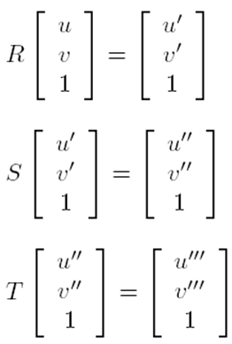
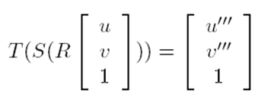
Composing Affine Warps
R is a rotation
S is a scale
T is a translation
First do a rotation, followed by a scale, then a translation
Denote this as:
By associative property can also denote it as:

Slide 29
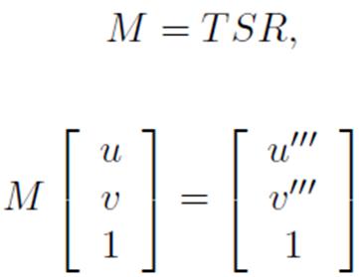
Composing Affine Warps
All translations, scales, and rotations can be done using one matrix
Yields ONE SIMPLE representation
Important: order of operations when creating the matrix does matter, be careful
i.e. operations are NOT commutative

Slide 30
Example

Slide 31
T and S Commutative ?
What is ST ?
$$ST=\left[\begin{matrix}1/2 & 0 & 0 \\ 0 & 1/2 & 0 \\ 0 & 0 & 1\end{matrix}\right]\left[\begin{matrix}1 & 0 & 1/4 \\ 0 & 1 & 1/4 \\ 0 & 0 & 1\end{matrix}\right]=$$
$$\left[\begin{matrix}1/2 & 0 & 1/8 \\ 0 & 1/2 & 1/8 \\ 0 & 0 & 1\end{matrix}\right]$$
NOT commutative !

Slide 32
Summary: Warps
Warps are cool
Homogeneous coordinates are cool
Can represent affine warps in one “matrix way”
Affine warps are awesome
Can combine warps into one matrix
BUT order matters

Slide 33
Questions?
Beyond D2L
Examples and information can be found online at:
http://docdingle.com/teaching/cs.html
Continue to more stuff as needed

Slide 34
Extra Reference Stuff Follows

Slide 35
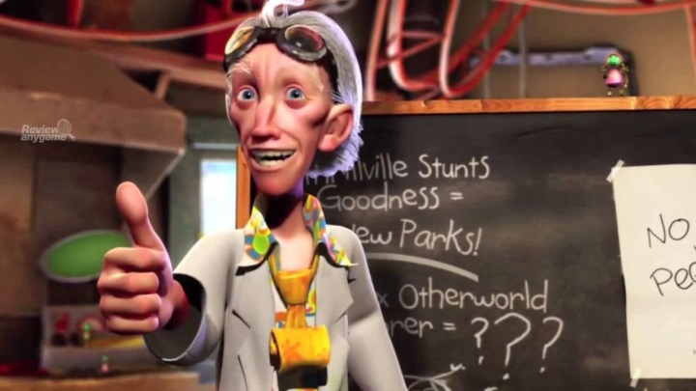
Credits
Much of the content derived/based on slides for use with the book:
Digital Image Processing, Gonzalez and Woods
Some layout and presentation style derived/based on presentations by
Donald House, Texas A&M University, 1999
Bernd Girod, Stanford University, 2007
Shreekanth Mandayam, Rowan University, 2009
Igor Aizenberg, TAMUT, 2013
Xin Li, WVU, 2014
George Wolberg, City College of New York, 2015
Yao Wang and Zhu Liu, NYU-Poly, 2015
Sinisa Todorovic, Oregon State, 2015

