Slide 1
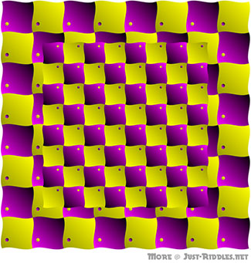
Affine and Perspective Warping (Geometric Transforms)
Image Processing
Brent M. Dingle, Ph.D. 2015
Game Design and Development Program
Mathematics, Statistics and Computer Science
University of Wisconsin - Stout
Material in this presentation is largely based on/derived from
presentation(s) and book: The Digital Image by Dr. Donald House at Texas A&M University

Slide 2
Lecture Objectives
Previously
Image Warping (Geometric Transforms)
Today
Projective Warps
Affine Warping (review)
Perspective Warping

Slide 3
Outline
Projective Warps
Affine Review
Perspective Warping
Concluding Remarks

Slide 4
Affine Map
A geometric transformation that maps points and parallel lines to points and parallel lines
General form of an affine map:
a_{ij} are coefficient constants

Slide 5
Affine Maps: Matrix Form
in matrix form looks like:

Slide 6
Homogeneous Coordinate System
Given homogeneous coordinates (u, v, 1)
Find Cartesian coordinates (x, y)
Explicitly, x then would be calculated as:
AGAIN:
Conversion from Homogeneous coordinates to Cartesian is NOT unique
coeffs a_{ij} will describe how we want to warp an image,
Example: a₁₃ is a translation distance for x

Slide 7
Points to Remember
Homogeneous Coordinates
allow affine transformations to be easily represented by matrix multiplications
Affine Maps
always have an inverse
can be represented in matrix form (via homogeneous coords)

Slide 8
Scale: an affine map transform
scale(x, y) = ( a₁₁u, a₂₂v )
$$\left[\begin{matrix}a_{11} & 0 & 0 \\ 0 & a_{22} & 0 \\ 0 & 0 & 1\end{matrix}\right]\left[\begin{matrix}u \\ v \\ 1\end{matrix}\right]=\left[\begin{matrix}a_{11}u \\ a_{22}v \\ 1\end{matrix}\right]$$

Slide 9
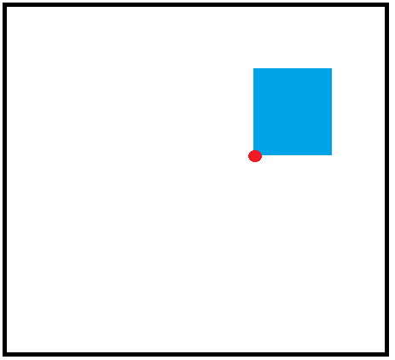
Translate: an affine map transform
translate (x, y) = ( u + a₁₃, v + a₂₃ )
$$\left[\begin{matrix}1 & 0 & a_{13} \\ 0 & 1 & a_{23} \\ 0 & 0 & 1\end{matrix}\right]\left[\begin{matrix}u \\ v \\ 1\end{matrix}\right]=\left[\begin{matrix}u+a_{13} \\ v+a_{23} \\ 1\end{matrix}\right]$$
(a₁₃, a₂₃)
(0, 0)

Slide 10
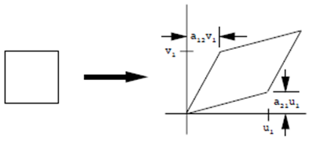
Shear: an affine map transform
shear (x, y) = ( u + a₁₂v, a₂₁u + v)
$$\left[\begin{matrix}1 & a_{12} & 0 \\ a_{21} & 1 & 0 \\ 0 & 0 & 1\end{matrix}\right]\left[\begin{matrix}u \\ v \\ 1\end{matrix}\right]=\left[\begin{matrix}u+a_{12}v \\ a_{21}u+v \\ 1\end{matrix}\right]$$
a₁₂v
a₂₁u

Slide 11
Rotate: an affine map transform
rotate (x, y) = ($u \cos{θ}−v \sin{θ}$ , v sin $θ$)
$$\left[\begin{matrix}\cos{θ} & −\sin{θ} & 0 \\ \sin{θ} & \cos{θ} & 0 \\ 0 & 0 & 1\end{matrix}\right]\left[\begin{matrix}u \\ v \\ 1\end{matrix}\right]=\left[\begin{matrix}u \cos{θ}−v \sin{θ} \\ u \sin{θ}+v\cos{θ} \\ 1\end{matrix}\right]$$
$$θ$$

Slide 12
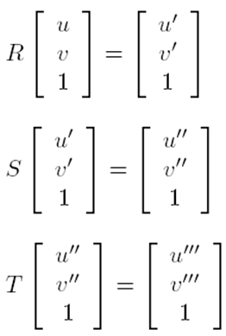
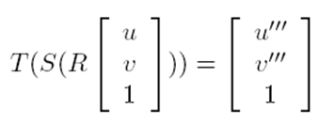
Composing Affine Warps
R is a rotation
S is a scale
T is a translation
First do a rotation, followed by a scale, then a translation
Denote this as:
By associative property can also denote it as:

Slide 13
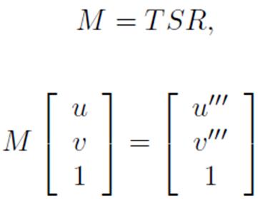
Composing Affine Warps
All translations, scales, and rotations can be done using one matrix
Yields ONE SIMPLE representation
Important: order of operations when creating the matrix does matter, be careful
i.e. operations are NOT commutative

Slide 14
Example

Slide 15
T and S Commutative ?
What is ST ?
$$ST=\left[\begin{matrix}1/2 & 0 & 0 \\ 0 & 1/2 & 0 \\ 0 & 0 & 1\end{matrix}\right]\left[\begin{matrix}1 & 0 & 1/4 \\ 0 & 1 & 1/4 \\ 0 & 0 & 1\end{matrix}\right]=$$
$$\left[\begin{matrix}1/2 & 0 & 1/8 \\ 0 & 1/2 & 1/8 \\ 0 & 0 & 1\end{matrix}\right]$$
NOT commutative !

Slide 16
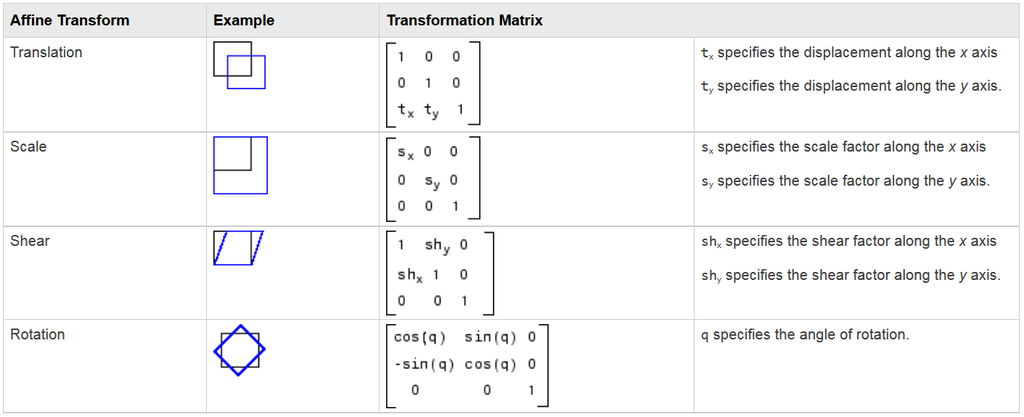
Affine Summary: ROW vector form
Each matrix
here is the
transpose
of what was
just presented
Table from: http://www.mathworks.com/help/images/performing-general-2-d-spatial-transformations.html
IMPORTANT:
Know what your abstraction is.
We have been using column vector:
$$\left[\begin{matrix}u \\ v \\ 1\end{matrix}\right]$$
Others, as above,
may expect row vector:
$$\left[\begin{matrix}u & v & 1\end{matrix}\right]$$

Slide 17
Outline
Projective Warps
Affine Review
Perspective Warping
NOT affine
Subset of Projective Mapping
Concluding remarks

Slide 18
Perspective Warps: Non-Affine Transform
Perspective warps are NOT affine
Not all parallel lines stay parallel
But lines do stay lines
And provides a 3D feeling
vanishing point
foreshortening
horizontal lines
stay parallel
bottom
looks longer
-- gives illusion of depth
Aside: Perspective Warping will be seen to be a ‘subset’ of Projective Transforms
--- just as scale, translate, rotate, shear, are ‘subsets’ of general affine

Slide 19
Perspective Transform: Step 1
Matrix Multiply
Third coordinate, w, of result is no longer 1
$$\left[\begin{matrix}1 & 0 & 0 \\ 0 & 1 & 0 \\ a_{31} & a_{32} & 1\end{matrix}\right]\left[\begin{matrix}u \\ v \\ 1\end{matrix}\right]=\left[\begin{matrix}u \\ v \\ a_{31}u+a_{32}v+1\end{matrix}\right]$$
= w

Slide 20
Perspective Transform: Part 2
Restore points to homogeneous coordinates
with w = 1
divide each vector by its own w coordinate
$$\frac{1}{w}\left[\begin{matrix}u \\ v \\ w\end{matrix}\right]=\left[\begin{matrix}u/w \\ v/w \\ 1\end{matrix}\right]$$
NOTE: w is different for each point
Notes:
By dividing w out of each point
we are taking all the points back to the w = 1 plane
This maintains colinearity, thus making this a feature perspective transform
In other words – perspective transforms preserve straight lines

Slide 21
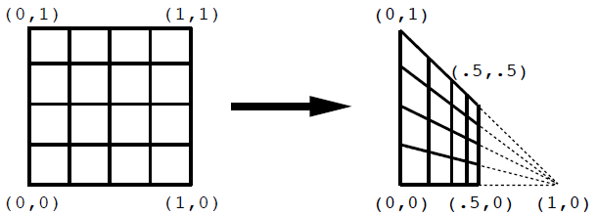
Example
$$\left(\frac{0.25}{0.25+1},\frac{1}{0.25+1} \right)$$
$$\left(\frac{0.5}{0.5+1},\frac{1}{0.5+1} \right)$$
forward map
$$\left(0.5,0.5 \right)$$
vanishing point
at infinity
$$\lim_{u→∞}{\frac{u}{u+1}=1}$$
$$\lim_{u→∞}{\frac{v}{u+1}=0}$$

Slide 22
Perspective Warp ⊆ Projective Map
Perspective Warping is a ‘type’ of Projective Transform
just as scale, translate, rotate, shear, are ‘types’ of general affine transforms

Slide 23
Projective Map: General Equation
$$x=\frac{a_{11}u+a_{12}v+a_{13}}{a_{31}u+a_{32}v+a_{33}}$$
$$\left[\begin{matrix}a_{11} & a_{12} & a_{13} \\ a_{21} & a_{22} & a_{33} \\ a_{31} & a_{32} & a_{33}\end{matrix}\right]\left[\begin{matrix}u \\ v \\ 1\end{matrix}\right]=\left[\begin{matrix}\frac{a_{11}u+a_{12}v+a_{13}}{a_{31}u+a_{32}v+a_{33}} \\ \frac{a_{21}u+a_{22}v+a_{23}}{a_{31}u+a_{32}v+a_{33}} \\ 1\end{matrix}\right]$$
$$y=\frac{a_{21}u+a_{22}v+a_{23}}{a_{31}u+a_{32}v+a_{33}}$$
Notes:
Perspective as described here is a ‘subset’ of projective transforms
Idea is to simplify the behavior to easily understood and illustrated behaviors
--- just as scale, translate, rotate, shear, are separated from general affine
Projective transform preserves collinearity, concurrency, order of contact

Slide 24
Projective Back to Perspective
$$x=\frac{a_{11}u+a_{12}v+a_{13}}{a_{31}u+a_{32}v+a_{33}}$$
$$\left[\begin{matrix}a_{11} & a_{12} & a_{13} \\ a_{21} & a_{22} & a_{33} \\ a_{31} & a_{32} & a_{33}\end{matrix}\right]\left[\begin{matrix}u \\ v \\ 1\end{matrix}\right]=\left[\begin{matrix}\frac{a_{11}u+a_{12}v+a_{13}}{a_{31}u+a_{32}v+a_{33}} \\ \frac{a_{21}u+a_{22}v+a_{23}}{a_{31}u+a_{32}v+a_{33}} \\ 1\end{matrix}\right]$$
$$\left[\begin{matrix}a_{11} & a_{12} & a_{13} \\ a_{21} & a_{22} & a_{33} \\ a_{31} & a_{32} & a_{33}\end{matrix}\right]\left[\begin{matrix}u \\ v \\ 1\end{matrix}\right]=\left[\begin{matrix}\frac{a_{11}u+a_{12}v+a_{13}}{a_{31}u+a_{32}v+a_{33}} \\ \frac{a_{21}u+a_{22}v+a_{23}}{a_{31}u+a_{32}v+a_{33}} \\ 1\end{matrix}\right]$$
$$y=\frac{a_{21}u+a_{22}v+a_{23}}{a_{31}u+a_{32}v+a_{33}}$$
For the perspective case (just described) most of the coefficients becomes 0 or 1
$$\left[\begin{matrix}1 & 0 & 0 \\ 0 & 1 & 0 \\ a_{31} & a_{32} & 1\end{matrix}\right]\left[\begin{matrix}u \\ v \\ 1\end{matrix}\right]=\left[\begin{matrix}\frac{u}{a_{31}u+a_{32}v+1} \\ \frac{v}{a_{31}u+a_{32}v+1} \\ 1\end{matrix}\right]$$
Notes:
Perspective as described here is a ‘subset’ of projective transforms by others
Idea is to simplify the behavior to easily understood and illustrated behaviors
--- just as scale, translate, rotate, shear, are separated from general affine
Projective transform preserves collinearity, concurrency, order of contact

Slide 25
Projective Back to Perspective
And we separated the process into TWO steps
$$\left[\begin{matrix}1 & 0 & 0 \\ 0 & 1 & 0 \\ a_{31} & a_{32} & 1\end{matrix}\right]\left[\begin{matrix}u \\ v \\ 1\end{matrix}\right]=\left[\begin{matrix}u \\ v \\ a_{31}u+a_{32}v+1\end{matrix}\right]=\left[\begin{matrix}\frac{u}{a_{31}u+a_{32}v+1} \\ \frac{v}{a_{31}u+a_{32}v+1} \\ 1\end{matrix}\right]$$
step 1
step 2

Slide 26
Summary: Affine and Perspective Warps
Warps are cool
Affine warps are awesome
Can combine warps into one matrix
BUT order matters
Perspective warps rock
Are NOT affine
Use same matrix idea as affine
Are a type of projective map

Slide 27
Outline
Projective Warps
Affine Review
Perspective Warping
Concluding Remarks

Slide 28
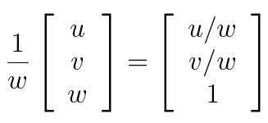
Projective Warps
Projective Warps are Affine, Perspective or Composite of the two
Affine is Perspective with w = 1
$$\frac{1}{a_{31}u+a_{32}v+1}\left[\begin{matrix}u \\ v \\ a_{31}u+a_{32}v+1\end{matrix}\right]=\left[\begin{matrix}\frac{u}{a_{31}u+a_{32}v+1} \\ \frac{v}{a_{31}u+a_{32}v+1} \\ 1\end{matrix}\right]$$
Affine cases:
w = 1 → a31 and a32 = 0

Slide 29
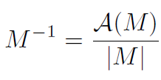
Inverse Map
The general formula for an inverse of a matrix mapping, M is
where |M| is the determinant of the matrix M
and A(M) is the adjoint of M

Slide 30
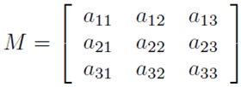
Inverse map of Projective Warp

Slide 31
Summary of Warps and Process
As an exercise it may be useful to closely follow the next few slides
Walk through some examples by hand and by code

Slide 32
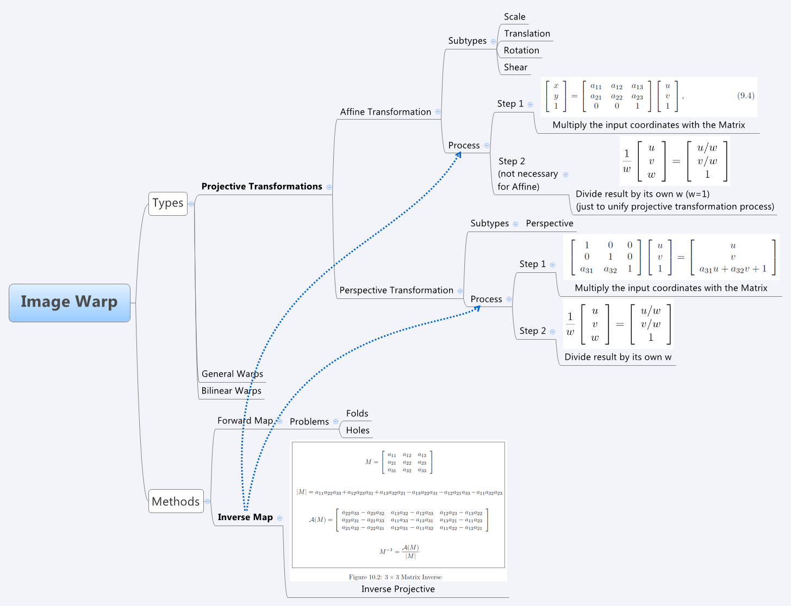
Image from Book/Slides: The Digital Image
by Donald House, Texas A&M University
Notes:
Image from Book/Slides: The Digital Image
by Donald House, Texas A&M University

Slide 33
Step 1: Build Transformation Matrix M
A composite transformation matrix is easily constructed from a series of more simple transformations
Initialize M to the identity matrix
Then for each simpler transform, T, pre-multiply the matrix M by T
Replacing M by the product TM
M ⬅ TM
$$M=\left[\begin{matrix}1 & 0 & 0 \\ 0 & 1 & 0 \\ 0 & 0 & 1\end{matrix}\right]$$

Slide 34
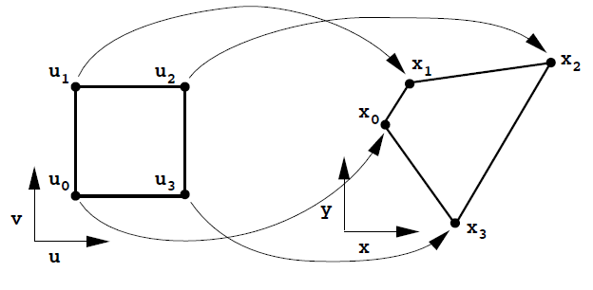
Step 2: (Think) Forward Map the corners
$$\left[\begin{matrix}x_{i} \\ y_{i} \\ 1\end{matrix}\right]=M\left[\begin{matrix}u_{i} \\ v_{i} \\ 1\end{matrix}\right]=\left[\begin{matrix}a_{11} & a_{12} & a_{13} \\ a_{21} & a_{22} & a_{33} \\ a_{31} & a_{32} & a_{33}\end{matrix}\right]\left[\begin{matrix}u_{i} \\ v_{i} \\ 1\end{matrix}\right]$$
$$x_{i}=\frac{a_{11}u_{i}+a_{12}v_{i}+a_{13}}{a_{31}u_{i}+a_{32}v_{i}+a_{33}}$$
$$y_{i}=\frac{a_{21}u_{i}+a_{22}v_{i}+a_{23}}{a_{31}u_{i}+a_{32}v_{i}+a_{33}}$$
ASIDE:
This is a good debug check to make sure matrix is correct
See if the corners via forward map go where you expect

Slide 35
Step 3: Find the Inverse Transform
$\left[\begin{matrix}x_{i} \\ y_{i} \\ 1\end{matrix}\right]=M\left[\begin{matrix}u_{i} \\ v_{i} \\ 1\end{matrix}\right]$→ $M^{−1} \left[\begin{matrix}x_{i} \\ y_{i} \\ 1\end{matrix}\right]=\left[\begin{matrix}u_{i} \\ v_{i} \\ 1\end{matrix}\right]$

Slide 36
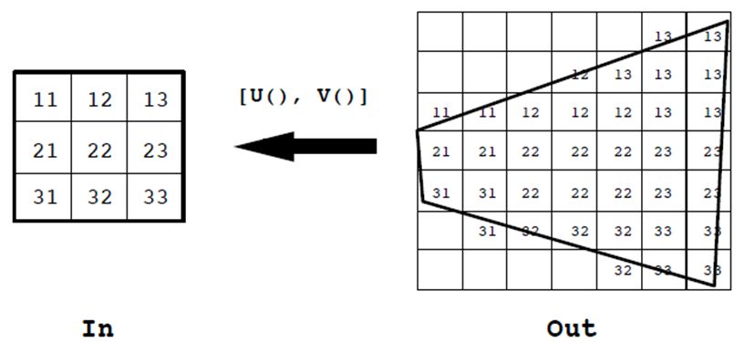
Step 4: Apply the Inverse Transform
Loop through the output image pixel by pixel
Identify the input image pixel each is mapped to
and assign each the corresponding color
$$\left[\begin{matrix}U(x_{i},y_{i}) \\ V(x_{i},y_{i}) \\ 1\end{matrix}\right]=M^{−1} \left[\begin{matrix}x_{i} \\ y_{i} \\ 1\end{matrix}\right]$$

Slide 37
Questions?
Beyond D2L
Examples and information can be found online at:
http://docdingle.com/teaching/cs.html
Continue to more stuff as needed

Slide 38
Extra Reference Stuff Follows

Slide 39
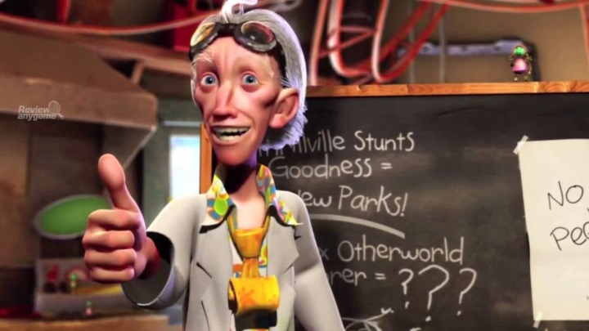
Credits
Much of the content derived/based on slides for use with the book:
Digital Image Processing, Gonzalez and Woods
Some layout and presentation style derived/based on presentations by
Donald House, Texas A&M University, 1999
Bernd Girod, Stanford University, 2007
Shreekanth Mandayam, Rowan University, 2009
Igor Aizenberg, TAMUT, 2013
Xin Li, WVU, 2014
George Wolberg, City College of New York, 2015
Yao Wang and Zhu Liu, NYU-Poly, 2015
Sinisa Todorovic, Oregon State, 2015

