Slide 1

Digital Image Processing
Feature Based Morphing Using Lines
Brent M. Dingle, Ph.D. 2015
Game Design and Development Program
Mathematics, Statistics and Computer Science
University of Wisconsin - Stout
Material in this presentation is largely based on/derived from
presentation(s) and book: The Digital Image by Dr. Donald House at Texas A&M University

Slide 2
Lecture Objectives
Previously
  Interpolation
  Warping
  Morphing
Today
  Feature Based Morphs
    Details of using line pairs

Slide 3
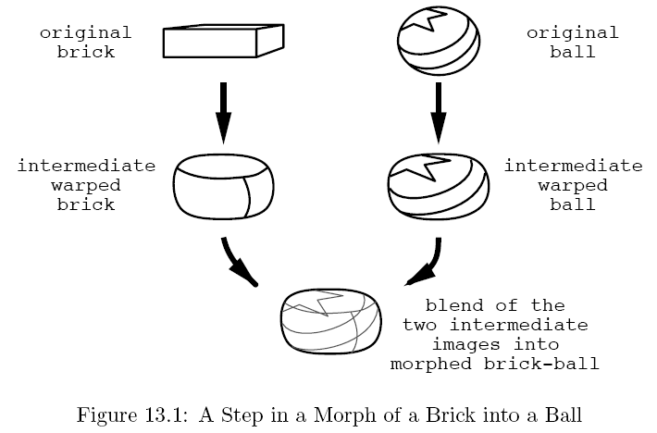
Morphing
A smooth transition from one shape and coloring to another
An image morph involves
  warping both images to some intermediate shape such that they can be superimposed on each other
  blending the two images together to produce a third image

Slide 4
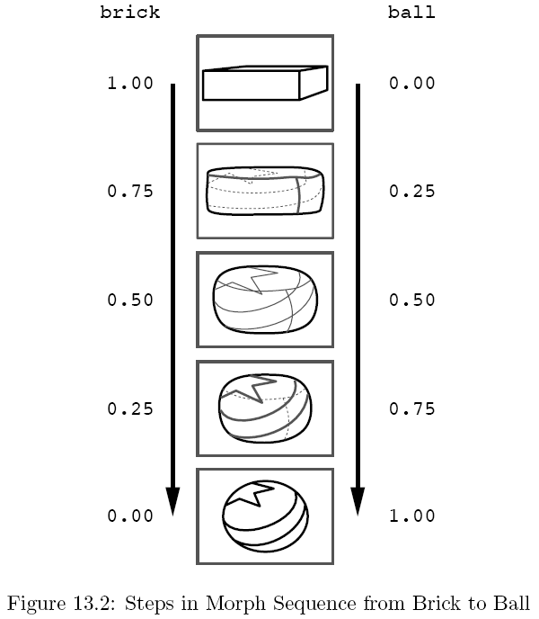
Sample Steps
Blend is controlled by giving more strength to the original image that is closer to the deformed shape

Slide 5
Feature-based Image Metamorphosis
Concept:
  Morph one image into another using an inverse map by specifying corresponding features in both images using directed lines
Beier, T & Neely, S. (1992). Feature-based image metamorphosis
Computer Graphics 26 (2): 35-42. doi: 10.1145/133994.134003
-- Identify features via line-pairs

Slide 6
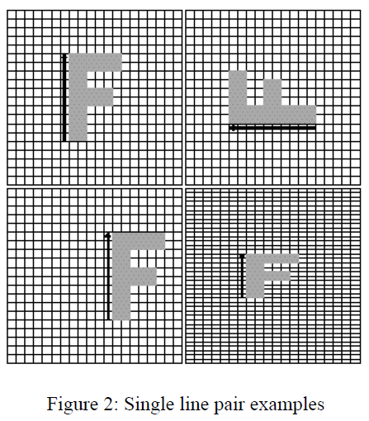
3 Examples: Each Using One Pair of Lines
original
image
rotated
translated
scaled
(non-uniformly)

Slide 7
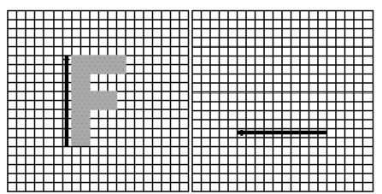
Transform via 1 pair of lines
Given a line pair: PQ and P’Q’
  Determine which pixel X’ in the source image do we sample for the X pixel in the destination image
?
X’
Q’
X
P’
P
Q

Slide 8
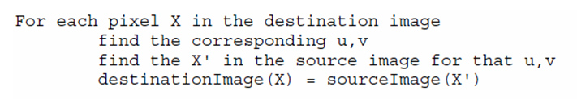
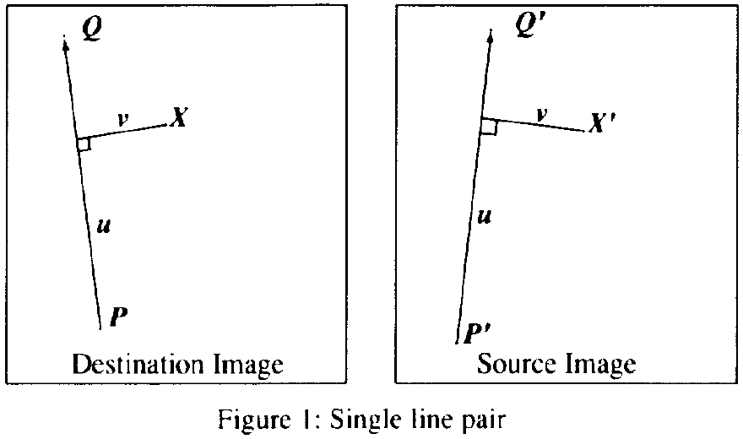
Transform via 1 pair of lines
Solution Design
First:
Calculate parameters u and v
Find v
Find u

Slide 9
Transform via 1 pair of lines
Solution Design
First:
Calculate parameters u and v
Use v
Then
Use u, v to get X’
Use u

Slide 10
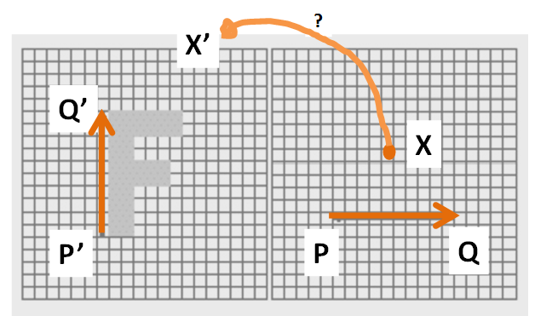
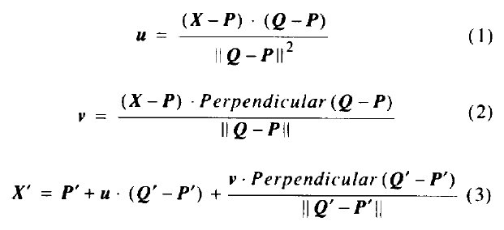
Implementation
walk-thru of this follows

Slide 11
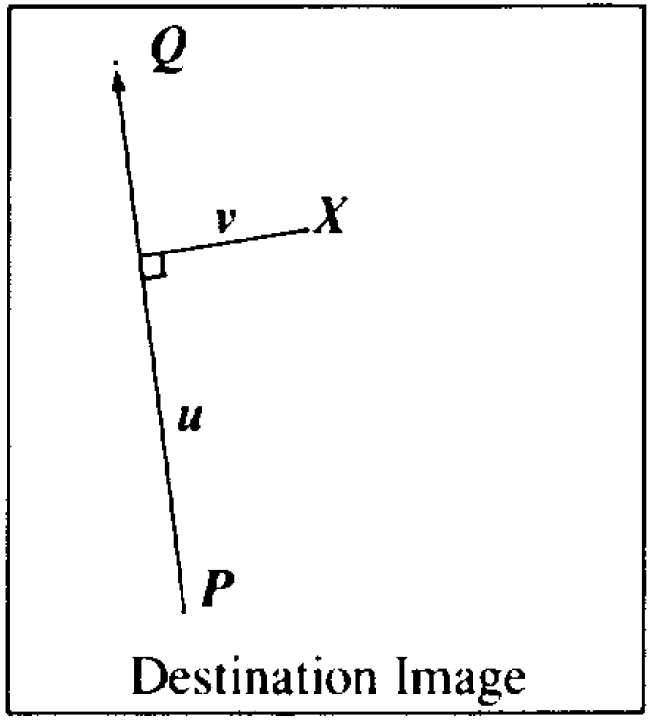
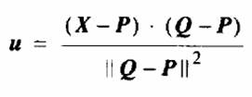
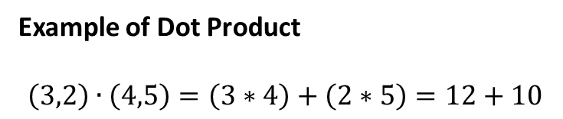
Walk-Thru
dot product and L2 norm
Example of Dot Product
$$\left(3,2\right)∙\left(4,5\right)=\left(3∗4\right)+\left(2∗5\right)=12+10$$
L2 norm
is the length/magnitude of the vector

Slide 12
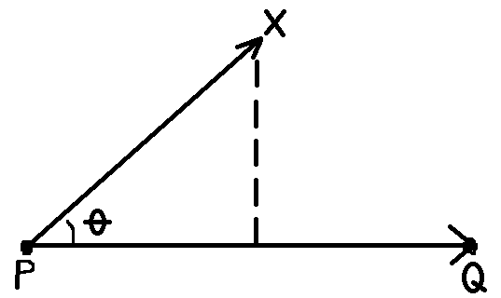

Walk-Thru
dot product and L2 norm
In words:
u is the position along the line PQ
u is a fraction
like a time parameter
u = 0 → P
u = 1 → Q
u gives position of X
projected onto line PQ
u = $\frac{\left|PX\right||PQ|cosθ}{\left|PQ\right||PQ|}$

Slide 13
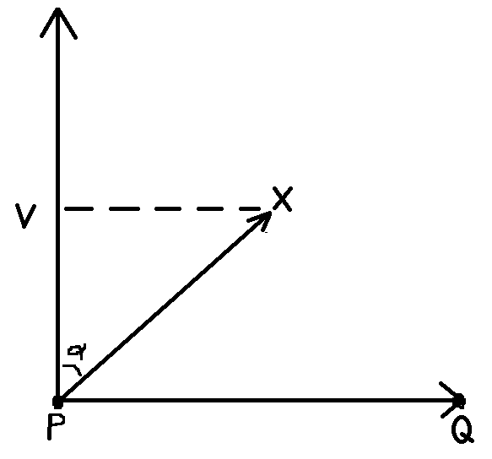

Walk-Thru
perpendicular(Q – P)
Perpendicular()
returns the vector perpendicular to,
and the same length as, the input vector

Slide 14

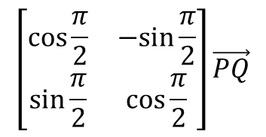
Aside Example: Application of Transforms
perpendicular(Q – P)
Calculation of Perpendicular(PQ)
assume P is (0, 0) and Q at (x, y)
$$\left[\begin{matrix}\cos{\frac{π}{2}} & −sin{\frac{π}{2}} \\ \sin{\frac{π}{2}} & \cos{\frac{π}{2}}\end{matrix}\right]\vec{PQ}$$
=
$$\left[\begin{matrix}0 & −1 \\ 1 & 0\end{matrix}\right]\left[\begin{matrix}x \\ y\end{matrix}\right]=\left[\begin{matrix}−y \\ x\end{matrix}\right]$$

Slide 15

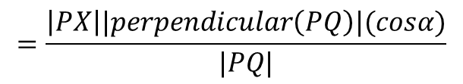
Walk-Thru
perpendicular(Q – P)
$$=\frac{\left|PX\right||perpendicular\left(PQ\right)|(cosα)}{|PQ|}$$
$$=\left|PX\right|(cosα)$$
v is NOT normalized = distance in pixels from the PQ line
Notes:
u is a ratio/fraction because it is referencing the PQ length
v is absolute length because it doesn’t have a reference to compare

Slide 16

Walk-Thru
Using u and v, we now compute X’

Slide 17
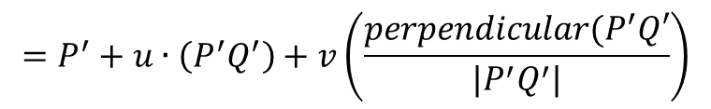
Walk-Thru
Using u and v, we now compute X’
$$=P^{′}+u∙\left(P^{′}Q^{′}\right)+v\left(\frac{perpendicular(P^{′}Q′}{|P^{′}Q^{′}|}\right)$$
note: this is a unit vector

Slide 18
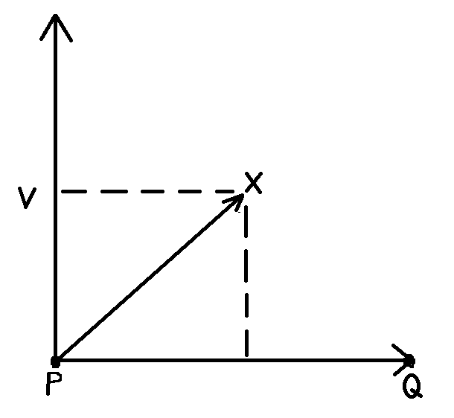
Walk-Thru
Using u and v, we now compute X’
$$=P^{′}+u∙\left(P^{′}Q^{′}\right)+v\left(\frac{perpendicular(P^{′}Q′}{|P^{′}Q^{′}|}\right)$$
note: this is a unit vector
u
inverse map

Slide 19
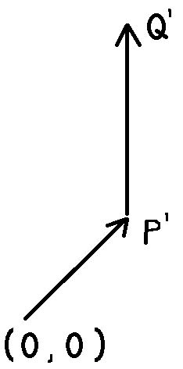
Walk-Thru
Using u and v, we now compute X’
$$=P^{′}+u∙\left(P^{′}Q^{′}\right)+v\left(\frac{perpendicular(P^{′}Q′}{|P^{′}Q^{′}|}\right)$$
1
note: this is a unit vector
1
u
inverse map

Slide 20
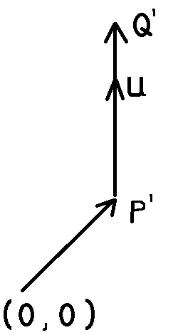
Walk-Thru
Using u and v, we now compute X’
$$=P^{′}+u∙\left(P^{′}Q^{′}\right)+v\left(\frac{perpendicular(P^{′}Q′}{|P^{′}Q^{′}|}\right)$$
2
note: this is a unit vector
2
u
inverse map

Slide 21
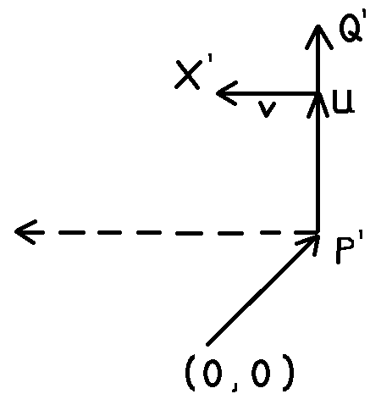
Walk-Thru
Using u and v, we now compute X’
$$=P^{′}+u∙\left(P^{′}Q^{′}\right)+v\left(\frac{perpendicular(P^{′}Q′}{|P^{′}Q^{′}|}\right)$$
3
3
u
inverse map

Slide 22
Finished: Transform with 1 Line Pair

Slide 23
Results: Each Using One Pair of Lines
original
image
rotated
translated
scaled
(non-uniformly)
Notes:
Not all affine warps are possible
Examples: uniform scale and shear
Uniform scale can be achieved if change algorithm so: v_new = v*u

Slide 24
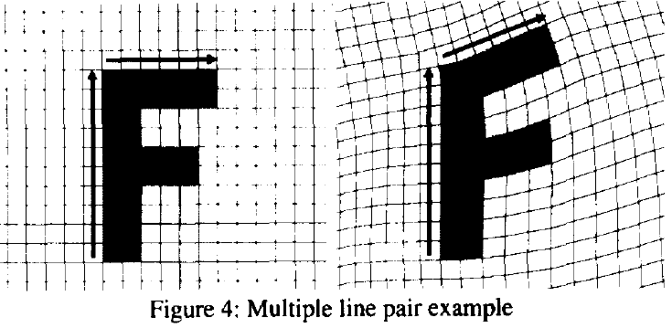
Transform with Multiple Line Pairs
More complex and makes use of fields of influence from each line to identify which pixel X’ in the source image that must be sampled for each pixel X in the destination image
?

Slide 25
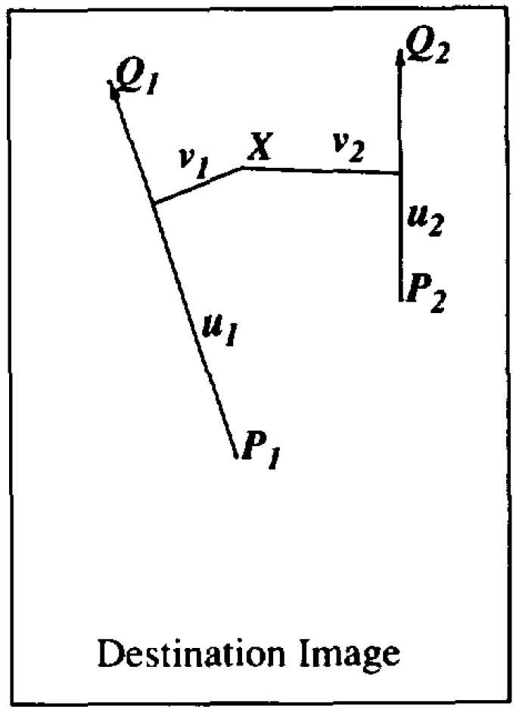
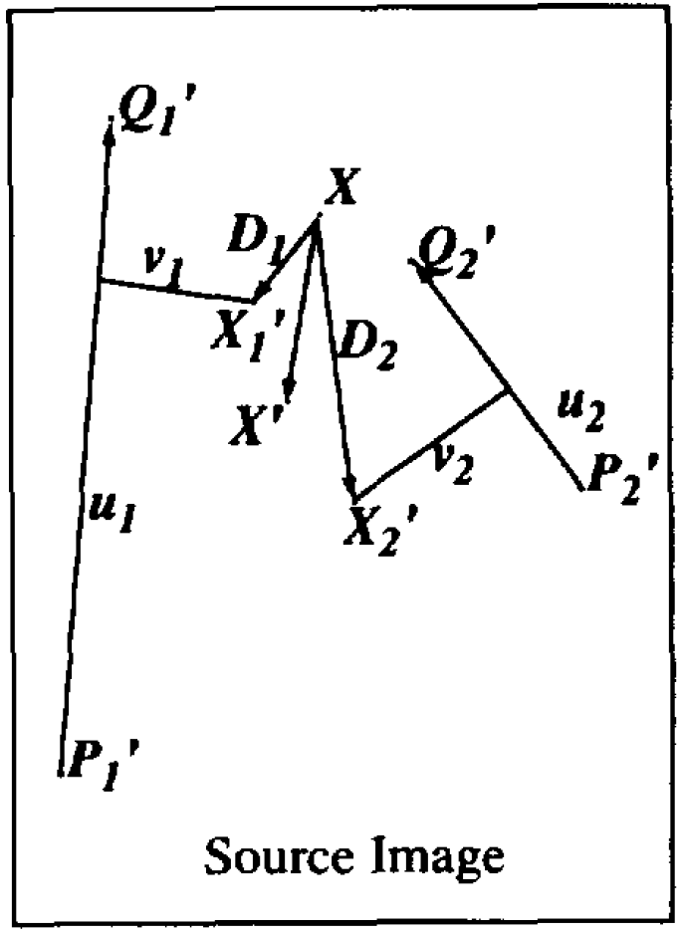
Transform with Multiple Line Pairs
X’_{i} are obtained by
single line pairs

Slide 26
Transform with Multiple Line Pairs
X’_{i} are obtained by
single line pairs
D_{i} = X’_{i} – X
displacement

Slide 27
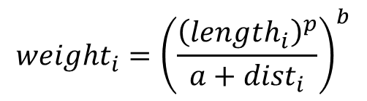
Transform with Multiple Line Pairs
X’_{i} are obtained by
single line pairs
length₂
D_{i} = X’_{i} – X
displacement
dist₁
dist₂
length₁
$${weight}_{i}={\left(\frac{{\left({length}_{i}\right)}^{p}}{a+{dist}_{i}}\right)}^{b}$$
a, p, and b
are constants that can be used
to change the relative effect
of the lines

Slide 28
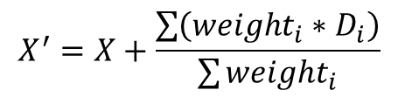
Transform with Multiple Line Pairs
X’_{i} are obtained by
single line pairs
length₂
D_{i} = X’_{i} – X
displacement
dist₁
dist₂
length₁
$${weight}_{i}={\left(\frac{{\left({length}_{i}\right)}^{p}}{a+{dist}_{i}}\right)}^{b}$$
a, p, and b
are constants that can be used
to change the relative effect
of the lines
$$X^{′}=X+\frac{\sum{\left({weight}_{i}∗D_{i}\right)}}{\sum{{weight}_{i}}}$$

Slide 29
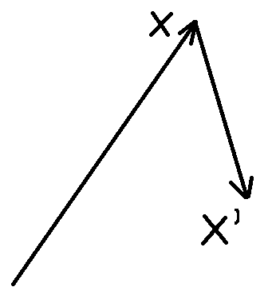
Transform with Multiple Line Pairs
X’_{i} are obtained by
single line pairs
length₂
D_{i} = X’_{i} – X
displacement
dist₁
dist₂
length₁
$${weight}_{i}={\left(\frac{{\left({length}_{i}\right)}^{p}}{a+{dist}_{i}}\right)}^{b}$$
a, p, and b
are constants that can be used
to change the relative effect
of the lines
$$X^{′}=X+\frac{\sum{\left({weight}_{i}∗D_{i}\right)}}{\sum{{weight}_{i}}}$$
1
1

Slide 30
Transform with Multiple Line Pairs
X’_{i} are obtained by
single line pairs
length₂
D_{i} = X’_{i} – X
displacement
dist₁
dist₂
length₁
$${weight}_{i}={\left(\frac{{\left({length}_{i}\right)}^{p}}{a+{dist}_{i}}\right)}^{b}$$
a, p, and b
are constants that can be used
to change the relative effect
of the lines
$$X^{′}=X+\frac{\sum{\left({weight}_{i}∗D_{i}\right)}}{\sum{{weight}_{i}}}$$
2
plus the weighted sum of D_{i}
(displacement)
2
Notes:
Note the 1 line pair is a special case of the multiple line pairs
(equations are consistent)

Slide 31
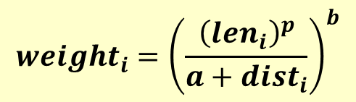
Constant Details
$${weight}_{i}={\left(\frac{{\left({len}_{i}\right)}^{p}}{a+{dist}_{i}}\right)}^{b}$$
len₂
a – adjust the influence of distance; when a is larger, distance has smaller influence. When a is close to 0, pixels on a line go exactly to corresponding line as the line’s influence is infinite.
b – adjust the influence of length/distance ratio; when b is larger, longer and nearer line has larger influence. When b is 0, all lines have the same influence on each pixel.
p – adjust the influence of length; when p is larger, longer lines have greater influence than shorter lines. When p is 0, different lengths have the same influence.
dist₁
dist₂
len₁
a+dist_{i} → 0 then weight_{i} →∞
a, p, and b are constants that can be used to change the relative effect of the lines

Slide 32
Constant Details
$${weight}_{i}={\left(\frac{{\left({len}_{i}\right)}^{p}}{a+{dist}_{i}}\right)}^{b}$$
len₂
a – adjust the influence of distance; when a is larger, distance has smaller influence. When a is close to 0, pixels on a line go exactly to corresponding line as the line’s influence is infinite.
b – adjust the influence of length/distance ratio; when b is larger, longer and nearer line has larger influence. When b is 0, all lines have the same influence on each pixel.
p – adjust the influence of length; when p is larger, longer lines have greater influence than shorter lines. When p is 0, different lengths have the same influence.
dist₁
dist₂
len₁
a, p, and b are constants that can be used to change the relative effect of the lines

Slide 33
Constant Details
$${weight}_{i}={\left(\frac{{\left({len}_{i}\right)}^{p}}{a+{dist}_{i}}\right)}^{b}$$
len₂
a – adjust the influence of distance; when a is larger, distance has smaller influence. When a is close to 0, pixels on a line go exactly to corresponding line as the line’s influence is infinite.
b – adjust the influence of length/distance ratio; when b is larger, longer and nearer line has larger influence. When b is 0, all lines have the same influence on each pixel.
p – adjust the influence of length; when p is larger, longer lines have greater influence than shorter lines. When p is 0, different lengths have the same influence.
dist₁
dist₂
len₁
a, p, and b are constants that can be used to change the relative effect of the lines

Slide 34
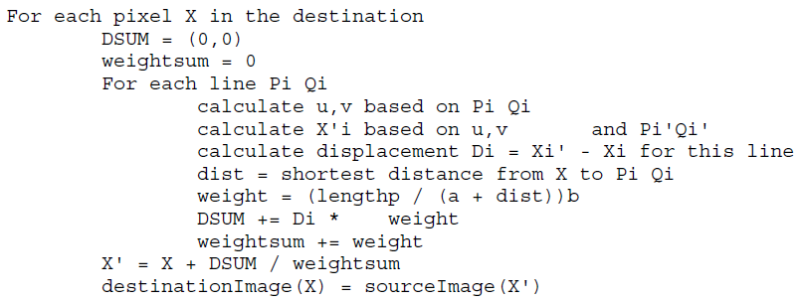

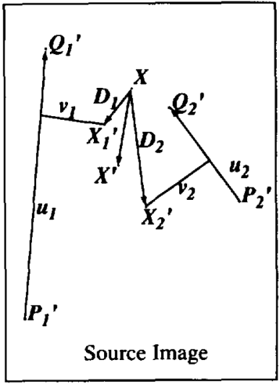
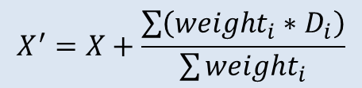
Pseudocode: Multiple Line Pairs
$$X^{′}=X+\frac{\sum{\left({weight}_{i}∗D_{i}\right)}}{\sum{{weight}_{i}}}$$

Slide 35
Results with Multiple Line Pairs

Slide 36
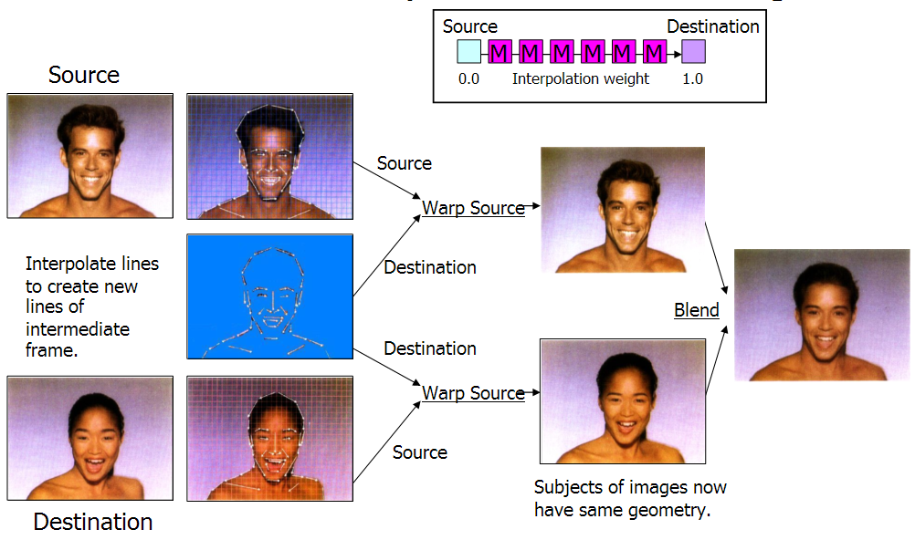
Morphing Between 2 Still Images
this is what we just
talked about doing
Image source: http://www.cs.mcgill.ca/~kaleigh/graphics/graphics767/beierneely_talk/frame.htm
Notes:
Each pixel is warped based on ALL line pairs
--- going from source image lines to intermediate frame lines
--- both source and destination image are warped to intermediate, as shown, then blended

Slide 37
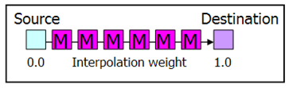
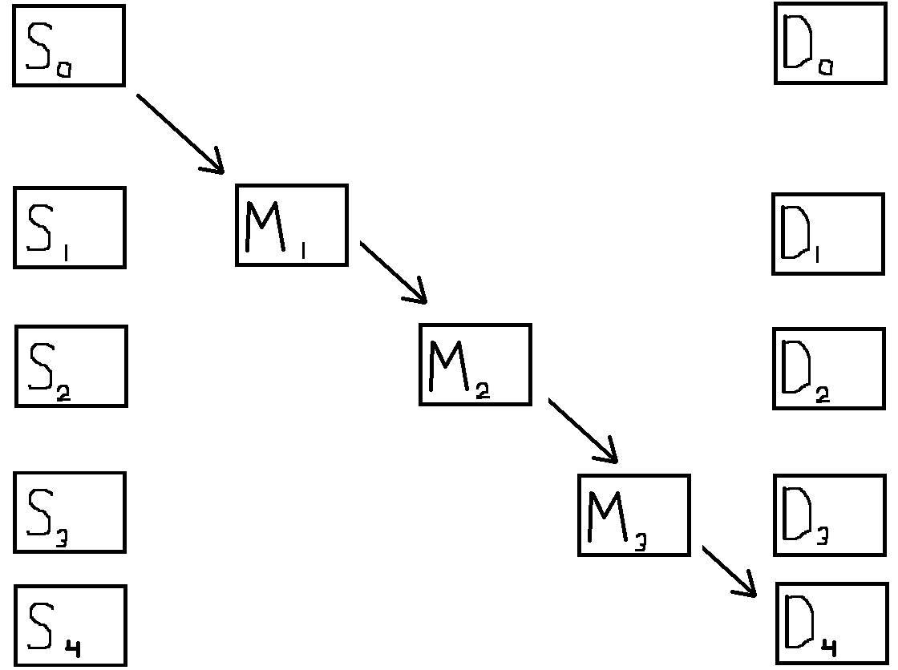

Animated Sequences
Specify lines on
keyframes and
interpolate lines
on other frames
Example:
S_{1.5}, D_{1.5}
would be
interpolated
between Q₁, P₁
and Q₂, P₂.
Q₁ and P₁ are interpolated
Q’
Q₁
Q
P’
P₁
P
Note:
Interpolation can be
1. on the end points of line pairs
OR
2. on the center, orientation and length of line pairs
Notes:
Note:
Interpolation can be
1. on the end points of line pairs
OR
2. on the center, orientation and length of line pairs

Slide 38
Questions?
Beyond D2L
  Examples and information
  can be found online at:
    http://docdingle.com/teaching/cs.html
    Continue to more stuff as needed

Slide 39
Extra Reference Stuff Follows

Slide 40
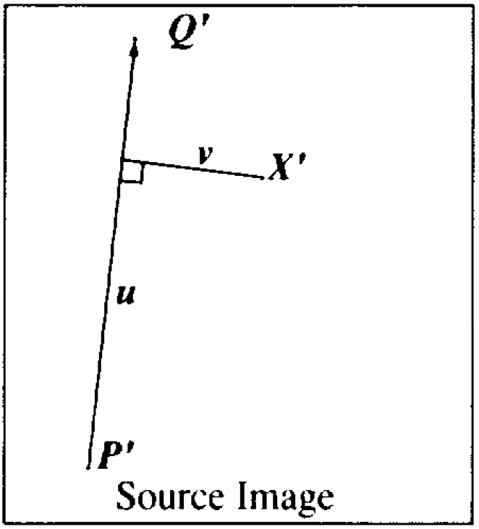

Slide 43
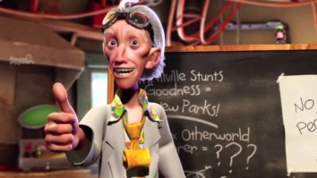
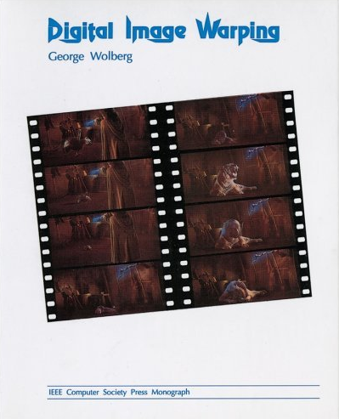
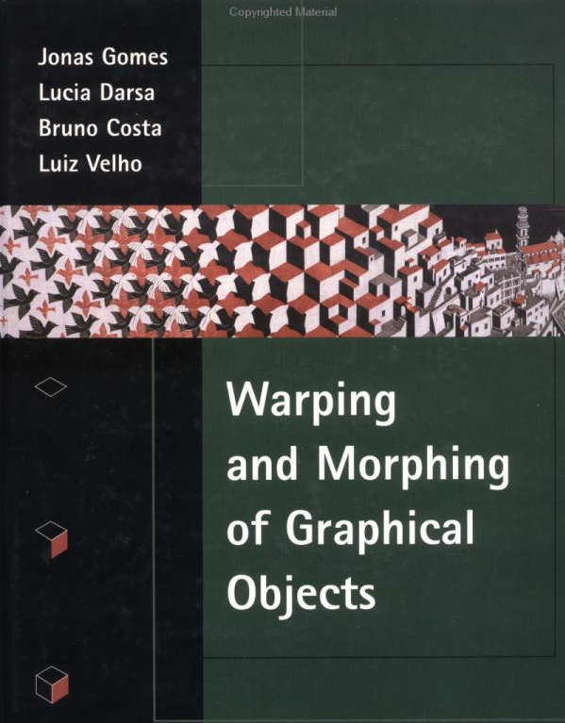
Credits
Much of the content derived/based on slides
for use with the book:
  Digital Image Processing, Gonzalez and Woods
Some layout and presentation style derived/based
on presentations by
  Donald House, Texas A&M University, 1999
  Bernd Girod, Stanford University, 2007
  Shreekanth Mandayam, Rowan University, 2009
  Igor Aizenberg, TAMUT, 2013
  Xin Li, WVU, 2014
  George Wolberg, City College of New York, 2015
  Yao Wang and Zhu Liu, NYU-Poly, 2015
  Sinisa Todorovic, Oregon State, 2015

