Slide 1
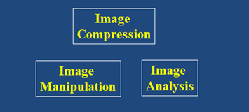
Digital Image Processing
Image Compression
Caution:
The PDF version of this
presentation will appear
to have errors due to heavy
use of animations
Brent M. Dingle, Ph.D. 2015
Game Design and Development Program
Mathematics, Statistics and Computer Science
University of Wisconsin - Stout
Material in this presentation is largely based on/derived from
presentation(s) and book: The Digital Image by Dr. Donald House at Texas A&M University

Slide 2
Lecture Objectives
Previously
Filtering
Interpolation
Warping
Morphing
Today
Image Compression
Image Manipulation
and Enhancement

Slide 3
Definition: File Compression
Compression: the process of encoding information in fewer bits
Wasting space is bad, so compression is good
Image Compression
Redundant information in images
Identical colors
Smooth variation in light intensity
Repeating texture

Slide 4
Identical Colors
Mondrian’s Composition 1930

Slide 5
Smooth Variation in Light Intensity
Digital rendering using Autodesk VIZ.
(Image Credit: Alejandro Vazquez.)

Slide 6
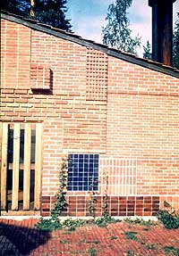
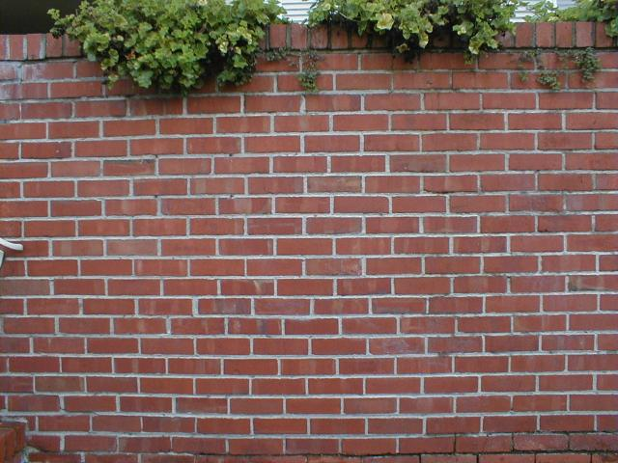
Repeating Texture
Alvar Aalto Summer House 1953

Slide 7
What is Compression Really?
Works because of data redundancy
Temporal
In 1D data, 1D signals, Audio…
Spatial
correlation between neighboring pixels or data items
Spectral
correlation between color or luminescence components
uses the frequency domain to exploit relationships between frequency of change in data
Psycho-visual
exploits perceptual properties of the human (visual) system

Slide 8
Two General Types
Lossless Compression
data is compressed and can be uncompressed without loss of detail or information
bit-preserving
reversible
Lossy Compression
purpose is to obtain the best possible fidelity for a given bit-rate
or minimizing the bit-rate to achieve a given fidelity measure
Video and audio commonly use lossy compression
because humans have limited perception of finer details

Slide 9
Two Types
Lossless compression often involves some form of entropy encoding
based in information theoretic techniques
see next slide for visual
Lossy compression uses source encoding techniques that may involve transform encoding, differential encoding or vector quanatization
see next slide for visual

Slide 10
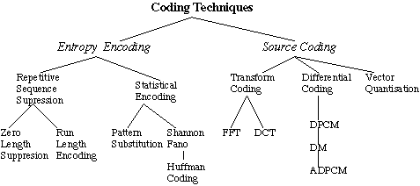
Compression Methods

Slide 11
Compression Methods
next up

Slide 12
Simple Lossless Compression
Simple Repetition Suppression
If a sequence contains a series of N successive tokens
Then they can be replaced with a single token and a count of the number of times the token repeats
This does require a flag to denote when the repeated token appears
Example
123444444444
can be denoted
123f9
where f is the flag for four

Slide 13
Run-length Encoding (RLE)
RLE is often applied to images
It is a small component used in JPEG compression
Conceptually
sequences of image elements X₁, X₂,…,X_{n} are mapped to pairs (c₁, L₁), (c₂, L₂),…,(c_{n}, L_{n})
where c_{i} represent the image intensity or color
and L_{i} the length of the i^{th} run of pixels

Slide 14
Run-Length Encoding (RLE): lossless
Scanline: 2 2 2 2 2 2 2 3 4 1 1 1
Run-length encoding ( 7 2) (1 3) (1 4) (3 1)
12 values
8 values

Slide 15
Run-Length Encoding (RLE): lossless
Scanline: 2 2 2 2 2 2 2 3 4 1 1 1
Run-length encoding ( 7 2) (1 3) (1 4) (3 1)
12 values
run of
repeating values
8 values
repeat count
pixel value
25% reduction of memory use

Slide 16
RLE: worst case
Scanline: 1 2 3 4 5 6 7 8
Run-length encoding: (1 1)(1 2)(1 3)(1 4)(1 5)(1 6)(1 7)
8 values
16 values
doubles space

Slide 17
RLE: Improving
Scanline: 5 5 5 5 5 5 5 3 4 1 1 1
Run-length encoding ( 7 5) (2 3 4)(3 1)
need to flag this as meaning “not repeating”
(7 2) → 5 5 5 5 5 5 5
the flag indicates
that 2 explicitly given
values follow
(2 3 4) → 3 4
(3 1) → 1 1 1
Using this improvement
The worst case then only adds 1 extra value

Slide 18
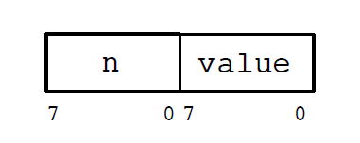
How to flag the repeat/no repeat?
SGI Iris RGB Run-length Encoding Scheme

Slide 19
Compression Methods
next up

Slide 20
Compression: Pattern Substitution
Pattern Substitution, lossless
Simple form of statistical encoding
Concept
Substitute a frequently repeating pattern with a shorter code
the shorter code(s) may be predefined by the algorithm being used or dynamically created

Slide 21
Table Lookup
Table Lookup can be viewed as a Pattern Substitution Method
Example
Allow full range of colors (24 bit, RGB)
Image only uses 256 (or less) unique colors (8 bits)
Create a table of which colors are used
Use 8 bits for each color instead of 24 bits
Conceptually how older BMPs worked
color depth <= 8 bits

Slide 22
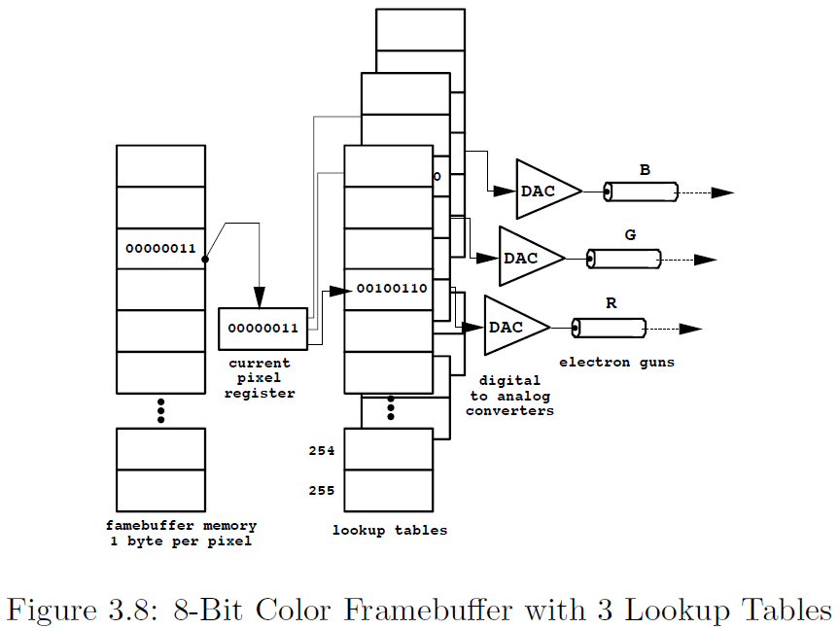
Table Lookup: GIF
Graphics Interchange File Format (GIF)
uses table lookups → Color LookUp Table (CLUT)

Slide 23
GIF Compression with Color LookUp Table (CLUT)
Example
Image Size = 1000x1000
256 colors
Each color 24 bit (RGB)
without CLUT
1000*1000*24 bits
with CLUT
1000*1000*8 bit (index data)
+ 3*256*8bit (table data)
Use about 2/3 the space
(when image size is “big”)

Slide 24
Compression: Pattern Substitution
Table lookups work
But Pattern Substitution typically is more dynamic
Counts occurrence of tokens
Sorts (say descending order)
Assign highest counts shortest codes

Slide 25
Compression Methods
next up

Slide 26
Lossless Compression: Entropy Encoding
Lossless compression often involves some form of entropy encoding and are based in information theoretic techniques
Aside:
Claude Shannon is considered the father of information theory

Slide 27
Shannon-Fano Algorithm
Technique proposed in Shannon’s 1948 article. introducing the field of Information Theory:
A Mathematical Theory of Communication
Shannon, C.E. (July 1948). "A Mathematical Theory of Communication". Bell System Technical Journal 27: 379–423.
Method Attributed to Robert Fano, as published in a technical report
The transmission of information
Fano, R.M. (1949). "The transmission of information". Technical Report No. 65 (Cambridge (Mass.), USA: Research Laboratory of Electronics at MIT).

Slide 28
Example: Shannon-Fano Algorithm
Symbol | A | B | C | D | E
Count | 15 | 7 | 6 | 6 | 5

Slide 29
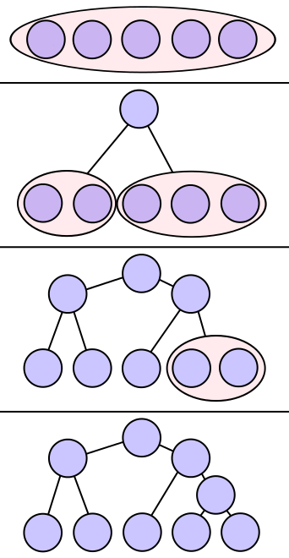
Example: Shannon-Fano Algorithm
Symbol | E | B | A | D | C
Count | 15 | 7 | 6 | 6 | 5
Step 1: Sort the symbols by frequency/probability
As shown: E B A D C

Slide 30
Example: Shannon-Fano Algorithm
Symbol | E | B | A | D | C
Count | 15 | 7 | 6 | 6 | 5
Step 1: Sort the symbols by frequency/probability
As shown: E B A D C
Step 2: Recursively divide into 2 parts
Each with about same number of counts
Dividing between B and A
results in 22 on the left and 17 on the right
-- minimizing difference totals between groups
E B A D C
This division means E and B codes start with 0
and A D and C codes start with 1

Slide 31
Example: Shannon-Fano Algorithm
Symbol | E | B | A | D | C
Count | 15 | 7 | 6 | 6 | 5
Step 1: Sort the symbols by frequency/probability
As shown: E B A D C
Step 2: Recursively divide into 2 parts
Each with about same number of counts
Dividing between B and A
results in 22 on the left and 17 on the right
-- minimizing difference totals between groups
E B A D C
This division means E and B codes start with 0
and A D and C codes start with 1
E and B are then divided (15:7)
A is divided from D and C (6:11)
E B A D C
So E is leaf with code 00,
B is a leaf with code 01
A is a leaf with code 10
D and C need divided again

Slide 32
Example: Shannon-Fano Algorithm
Symbol | E | B | A | D | C
Count | 15 | 7 | 6 | 6 | 5
Step 1: Sort the symbols by frequency/probability
As shown: E B A D C
Step 2: Recursively divide into 2 parts
Each with about same number of counts
So E is leaf with code 00,
B is a leaf with code 01
A is a leaf with code 10
D and C need divided again
E B A D C
Divide D and C (6:5)
E B A D C
D becomes a leaf with code 110
C becomes a leaf with code 111
E B A D C

Slide 33
Example: Shannon-Fano Algorithm
Symbol | E | B | A | D | C
Count | 15 | 7 | 6 | 6 | 5
Step 1: Sort the symbols by frequency/probability
As shown: E B A D C
Step 2: Recursively divide into 2 parts
Each with about same number of counts
Final Encoding:
E B A D C
Symbol | E | B | A | D | C
Count | 00 | 01 | 10 | 110 | 111
E B A D C
E B A D C

Slide 34
Compression Methods
next up

Slide 35
Quick Summary: Huffman Algorithm
Encoding Summary
Step 1: Initialization
Put all nodes in an OPEN list (keep it sorted at all times)
Step 2: While OPEN list has more than 1 node
Step 2a: From OPEN pick 2 nodes having the lowest frequency/probability
Create a parent node for them
Step 2b: Assign the sum of the frequencies of the selected node
to their newly created parent
Step 2c: Assign code 0 to the left branch
Assign code 1 to the right branch
Remove the selected children from OPEN
(note the newly created parent node remains in OPEN)

Slide 36
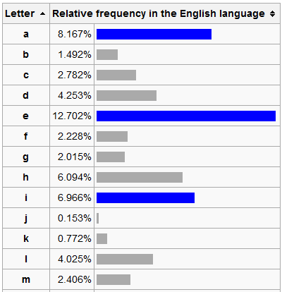
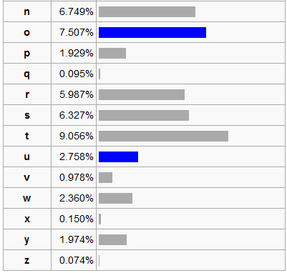
Observation
Some characters in the English alphabet occur more frequently than others
The table below is based on Robert Lewand's Cryptological Mathematics

Slide 37
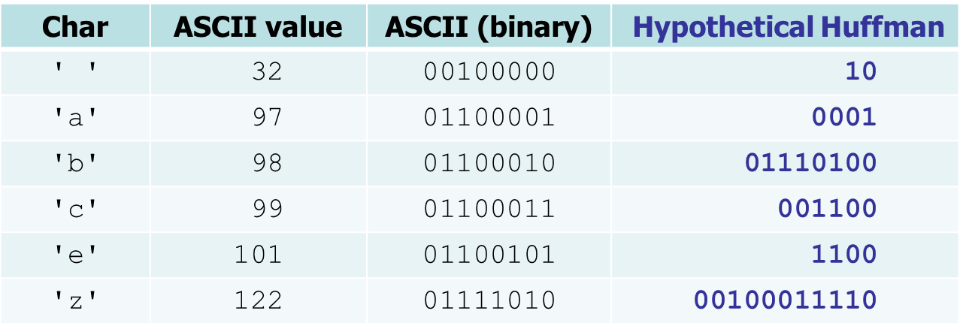
Huffman Encoding (English Letters)
Huffman encoding: Uses variable lengths for different characters to take advantage of their relative frequencies
Some characters occur more often than others
If those characters use < 8 bits each, the file will be smaller
Other characters may need > 8 bits
but that’s ok → they don’t show up often

Slide 38
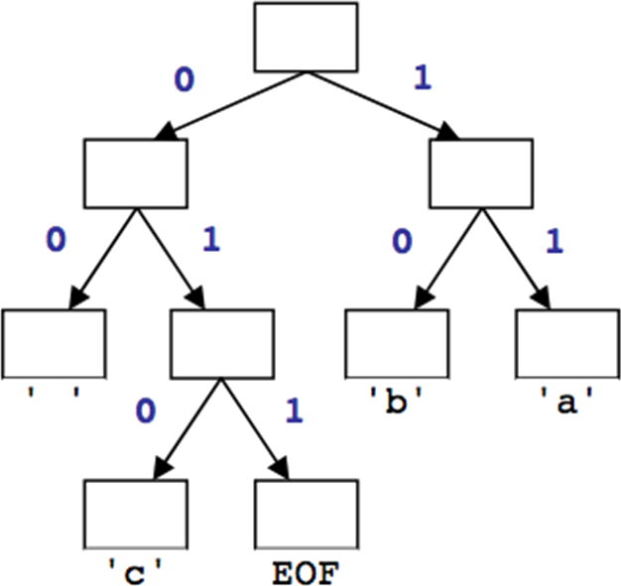
Huffman’s Algorithm
The idea: Create a “Huffman Tree” that will tell us a good binary representation for each character
Left means 0
Right means 1
Example 'b‘ is 10
More frequent characters will be higher in the tree (have a shorter binary value).
To build this tree, we must do a few steps first
Count occurrences of each unique character in the file to compress
Use a priority queue to order them from least to most frequent
Make a tree and use it

Slide 39
Huffman Compression – Overview
Step 1
Count characters (frequency of characters in the message)
Step 2
Create a Priority Queue
Step 3
Build a Huffman Tree
Step 4
Traverse the Tree to find the Character to Binary Mapping
Step 5
Use the mapping to encode the message

Slide 40
Step 1: Count Characters
Example message (input file) contents: ab ab cab
counts: { ' ' = 2, 'b'=3, 'a' =3, 'c' =1, EOF=1 }
File size currently = 10 bytes = 80 bits
file ends with an invisible EOF character
byte | 1 | 2 | 3 | 4 | 5 | 6 | 7 | 8 | 9 | 10
char | 'a' | 'b' | ' ' | 'a' | 'b' | ' ' | 'c' | 'a' | 'b' | EOF
ASCII | 97 | 98 | 32 | 97 | 98 | 32 | 99 | 97 | 98 | 256
binary | 01100001 | 01100010 | 00100000 | 01100001 | 01100010 | 00100000 | 01100011 | 01100001 | 01100010 | N/A

Slide 41
Step 2: Create a Priority Queue
Each node of the PQ is a tree
The root of the tree is the ‘key’
The other internal nodes hold ‘subkeys’
The leaves hold the character values
Insert each into the PQ using the PQ’s function
insertItem(count, character)
The PQ should organize them into ascending order
So the smallest value is highest priority
We will use an example with the PQ implemented as an ordered list
But the PQ could be implemented in whatever way works best
could be a minheap, unordered list, or ‘other’

Slide 42
Step 2: PQ Creation, An Illustration
From step 1 we have
counts: { ' ' = 2, 'b'=3, 'a'=3, 'c'=1, EOF=1 }
Make these into trees
Add the trees to a Priority Queue
Assume PQ is implemented as a sorted list

Slide 43
Step 2: PQ Creation, An Illustration
From step 1 we have
counts: { ' ' = 2, 'b'=3, 'a'=3, 'c'=1, EOF=1 }
Make these into trees
Add the trees to a Priority Queue
Assume PQ is implemented as a sorted list
2
3
3
1
1
' '
b
a
c
EOF

Slide 44
Step 2: PQ Creation, An Illustration
From step 1 we have
counts: { ' ' = 2, 'b'=3, 'a'=3, 'c'=1, EOF=1 }
Make these into trees
Add the trees to a Priority Queue
Assume PQ is implemented as a sorted list
Recall: Each Insert is an O(n) operation
This is done n times. So this is O(n²)
3
2
1
3
1
b
' '
EOF
a
c

Slide 45
Step 3: Build the Huffman Tree
Aside: All nodes should be in the PQ
While PQ.size() > 1
Remove the two highest priority (rarest) nodes
Removal done using PQ’s removeMin() function
Combine the two nodes into a single node
So the new node is a tree with
root has key value = sum of keys of nodes being combined
left subtree is the first removed node
right subtree is the second removed node
Insert the combined node back into the PQ
end While
Remove the one node from the PQ
This is the Huffman Tree
Example next slide

Slide 46
Step 3a: Building Huffman Tree, Illus.
Remove the two highest priority (rarest) nodes
1
1
2
3
3
c
EOF
' '
b
a

Slide 47
Step 3b: Building Huffman Tree, Illus.
Combine the two nodes into a single node
2
3
3
' '
b
a
2
1
1
c
EOF

Slide 48
Step 3c: Building Huffman Tree, Illus.
Insert the combined node back into the PQ
2
3
3
' '
b
a
2
1
1
c
EOF

Slide 49
Step 3d: Building Huffman Tree, Illus.
PQ has 4 nodes still, so repeat
2
2
3
3
' '
b
a
1
1
c
EOF

Slide 50
Step 3a: Building Huffman Tree, Illus.
Remove the two highest priority (rarest) nodes
2
2
3
3
' '
b
a
1
1
c
EOF

Slide 51
Step 3b: Building Huffman Tree, Illus.
Combine the two nodes into a single node
3
3
b
a
4
2
2
' '
1
1
c
EOF

Slide 52
Step 3c: Building Huffman Tree, Illus.
Insert the combined node back into the PQ
3
3
b
a
4
2
2
' '
1
1
c
EOF

Slide 53
Step 3d: Building Huffman Tree, Illus.
3 nodes remain in PQ, repeat again
3
3
4
b
a
2
2
' '
1
1
c
EOF

Slide 54
Step 3a: Building Huffman Tree, Illus.
Remove the two highest priority (rarest) nodes
3
3
4
b
a
2
2
' '
1
1
c
EOF

Slide 55
Step 3b: Building Huffman Tree, Illus.
Combine the two nodes into a single node
4
6
2
2
3
3
' '
b
a
1
1
c
EOF

Slide 56
Step 3c: Building Huffman Tree, Illus.
Insert the combined node back into the PQ
4
6
2
2
3
3
' '
b
a
1
1
c
EOF

Slide 57
Step 3d: Building Huffman Tree, Illus.
2 nodes still in PQ, repeat one more time
4
6
2
2
3
3
' '
b
a
1
1
c
EOF

Slide 58
Step 3a: Building Huffman Tree, Illus.
Remove the two highest priority (rarest) nodes
4
6
2
2
3
3
' '
b
a
1
1
c
EOF

Slide 59
Step 3b: Building Huffman Tree, Illus.
Combine the two nodes into a single node
10
4
6
2
2
3
3
' '
b
a
1
1
c
EOF

Slide 60
Step 3c: Building Huffman Tree, Illus.
Insert the combined node back into the PQ
10
4
6
2
2
3
3
' '
b
a
1
1
c
EOF

Slide 61
Step 3d: Building Huffman Tree, Illus.
Only 1 node remains in the PQ, so while loop ends
10
4
6
2
2
3
3
' '
b
a
1
1
c
EOF

Slide 62
Step 3: Building Huffman Tree, Illus.
Huffman tree is complete
10
4
6
2
2
3
3
' '
b
a
1
1
c
EOF

Slide 63
Step 4: Traverse Tree to Find the Character to Binary Mapping
' ' =
'c' =
EOF =
'b' =
'a' =
Recall
Left is 0
Right is 1
10
4
6
2
2
3
3
' '
b
a
1
1
c
EOF

Slide 64
Step 4: Traverse Tree to Find the Character to Binary Mapping
' ' =
'c' =
EOF =
'b' =
'a' =
00
Recall
Left is 0
Right is 1
10
0
4
6
0
2
2
3
3
' '
b
a
1
1
c
EOF

Slide 65
Step 4: Traverse Tree to Find the Character to Binary Mapping
' ' =
'c' =
EOF =
'b' =
'a' =
00
010
Recall
Left is 0
Right is 1
10
0
4
6
1
2
2
3
3
0
' '
b
a
1
1
c
EOF

Slide 66
Step 4: Traverse Tree to Find the Character to Binary Mapping
' ' =
'c' =
EOF =
'b' =
'a' =
00
010
Recall
Left is 0
Right is 1
10
011
0
4
6
1
2
2
3
3
1
' '
b
a
1
1
c
EOF

Slide 67
Step 4: Traverse Tree to Find the Character to Binary Mapping
' ' =
'c' =
EOF =
'b' =
'a' =
00
010
Recall
Left is 0
Right is 1
10
011
1
10
4
6
0
2
2
3
3
' '
b
a
1
1
c
EOF

Slide 68
Step 4: Traverse Tree to Find the Character to Binary Mapping
' ' =
'c' =
EOF =
'b' =
'a' =
00
010
Recall
Left is 0
Right is 1
10
011
1
10
11
4
6
1
2
2
3
3
' '
b
a
1
1
c
EOF

Slide 69
Step 5: Encode the Message
file ends with an invisible EOF character
' ' = 00
'c' = 010
EOF = 011
'b' = 10
'a' = 11
Example message (input file) contents: ab ab cab
10
4
6
2
2
3
3
' '
b
a
1
1
c
EOF

Slide 70
Challenge: Encode the Message
' ' = 00
'c' = 010
EOF = 011
'b' = 10
'a' = 11
Example message (input file) contents: ab ab cab
file ends with an invisible EOF character

Slide 71
Step 5: Encode the Message
file ends with an invisible EOF character
' ' = 00
'c' = 010
EOF = 011
'b' = 10
'a' = 11
Example message (input file) contents: ab ab cab
11

Slide 72
Step 5: Encode the Message
file ends with an invisible EOF character
' ' = 00
'c' = 010
EOF = 011
'b' = 10
'a' = 11
Example message (input file) contents: ab ab cab
1110

Slide 73
Step 5: Encode the Message
file ends with an invisible EOF character
' ' = 00
'c' = 010
EOF = 011
'b' = 10
'a' = 11
Example message (input file) contents: ab ab cab
111000

Slide 74
Step 5: Encode the Message
file ends with an invisible EOF character
' ' = 00
'c' = 010
EOF = 011
'b' = 10
'a' = 11
Example message (input file) contents: ab ab cab
11100011

Slide 75
Step 5: Encode the Message
file ends with an invisible EOF character
' ' = 00
'c' = 010
EOF = 011
'b' = 10
'a' = 11
Example message (input file) contents: ab ab cab
1110001110

Slide 76
Step 5: Encode the Message
file ends with an invisible EOF character
' ' = 00
'c' = 010
EOF = 011
'b' = 10
'a' = 11
Example message (input file) contents: ab ab cab
111000111000

Slide 77
Step 5: Encode the Message
file ends with an invisible EOF character
' ' = 00
'c' = 010
EOF = 011
'b' = 10
'a' = 11
Example message (input file) contents: ab ab cab
111000111000010

Slide 78
Step 5: Encode the Message
file ends with an invisible EOF character
' ' = 00
'c' = 010
EOF = 011
'b' = 10
'a' = 11
Example message (input file) contents: ab ab cab
11100011100001011

Slide 79
Step 5: Encode the Message
file ends with an invisible EOF character
' ' = 00
'c' = 010
EOF = 011
'b' = 10
'a' = 11
Example message (input file) contents: ab ab cab
1110001110000101110

Slide 80
Step 5: Encode the Message
file ends with an invisible EOF character
' ' = 00
'c' = 010
EOF = 011
'b' = 10
'a' = 11
Example message (input file) contents: ab ab cab
1110001110000101110011

Slide 81
Step 5: Encode the Message
file ends with an invisible EOF character
' ' = 00
'c' = 010
EOF = 011
'b' = 10
'a' = 11
Example message (input file) contents: ab ab cab
1110001110000101110011
Count the bits used = 22 bits
versus the 80
previously needed
File is almost ¼ the size
lots of savings

Slide 82
Decompression
From the previous tree shown we now have the message characters encoded as:
Which compresses to bytes 3 like so:
How to decompress?
Hint: Lookup table is not the best answer, what is the first symbol?... 1=? or is it 11? or 111? or 1110? or…
char | 'a' | 'b' | ' ' | 'a' | 'b' | ' ' | 'c' | 'a' | 'b' | EOF
binary | 11 | 10 | 00 | 11 | 10 | 00 | 010 | 11 | 10 | 011
byte | 1 | 2 | 3
char | a b a | b c a | b EOF
binary | 11 10 00 11 | 10 00 010 1 | 1 10 011

Slide 83
Decompression via Tree
The tree is known to the recipient of the message
So use it
To identify symbols we will Apply the Prefix Property
No encoding A is the prefix of another encoding B
Never will have x→011 and y→011100110

Slide 84
Decompression via Tree
Apply the Prefix Property
No encoding A is the prefix of another encoding B
Never will have x→011 and y→011100110
the Algorithm
Read each bit one at a time from the input
If the bit is 0 go left in the tree
Else if the bit is 1 go right
If you reach a leaf node
output the character at that leaf
and go back to the tree root

Slide 85
Decompressing Example
Say the encrypted message was:
1011010001101011011
note: this is NOT the same message as the encryption just done (but the tree the is same)
10
4
6
Read each bit one at a time
If it is 0 go left
If it is 1 go right
If you reach a leaf, output the character there and go back to the tree root
2
2
3
3
' '
b
a
1
1
c
EOF

Slide 86
Class Activity: Decompressing Example
Say the encrypted message was:
1011010001101011011
note: this is NOT the same message as the encryption just done (but the tree the is same)
10
4
6
Read each bit one at a time
If it is 0 go left
If it is 1 go right
If you reach a leaf, output the character there and go back to the tree root
2
2
3
3
' '
b
a
1
1
Pause for students to complete
c
EOF

Slide 87
Decompressing Example
Say the encrypted message was:
1011010001101011011
10
1
4
6
Read each bit one at a time
If it is 0 go left
If it is 1 go right
If you reach a leaf, output the character there and go back to the tree root
2
2
3
3
' '
b
a
1
1
c
EOF

Slide 88
Decompressing Example
Say the encrypted message was:
1011010001101011011
10
b
1
4
6
0
Read each bit one at a time
If it is 0 go left
If it is 1 go right
If you reach a leaf, output the character there and go back to the tree root
2
2
3
3
' '
b
a
1
1
c
EOF

Slide 89
Decompressing Example
Say the encrypted message was:
1011010001101011011
10
b
1
4
6
Read each bit one at a time
If it is 0 go left
If it is 1 go right
If you reach a leaf, output the character there and go back to the tree root
2
2
3
3
' '
b
a
1
1
c
EOF

Slide 90
Decompressing Example
Say the encrypted message was:
1011010001101011011
10
b
a
1
4
6
1
Read each bit one at a time
If it is 0 go left
If it is 1 go right
If you reach a leaf, output the character there and go back to the tree root
2
2
3
3
' '
b
a
1
1
c
EOF

Slide 91
Decompressing Example
Say the encrypted message was:
1011010001101011011
10
b
a
0
4
6
Read each bit one at a time
If it is 0 go left
If it is 1 go right
If you reach a leaf, output the character there and go back to the tree root
2
2
3
3
' '
b
a
1
1
c
EOF

Slide 92
Decompressing Example
Say the encrypted message was:
1011010001101011011
10
b
a
0
4
6
1
Read each bit one at a time
If it is 0 go left
If it is 1 go right
If you reach a leaf, output the character there and go back to the tree root
2
2
3
3
' '
b
a
1
1
c
EOF

Slide 93
Decompressing Example
Say the encrypted message was:
1011010001101011011
10
b
a
c
0
4
6
1
Read each bit one at a time
If it is 0 go left
If it is 1 go right
If you reach a leaf, output the character there and go back to the tree root
2
2
3
3
0
' '
b
a
1
1
c
EOF

Slide 94
Decompressing Example
Say the encrypted message was:
1011010001101011011
10
b
a
c
0
4
6
Read each bit one at a time
If it is 0 go left
If it is 1 go right
If you reach a leaf, output the character there and go back to the tree root
2
2
3
3
' '
b
a
1
1
c
EOF

Slide 95
Decompressing Example
Say the encrypted message was:
1011010001101011011
10
b
a
c
0
4
6
0
Read each bit one at a time
If it is 0 go left
If it is 1 go right
If you reach a leaf, output the character there and go back to the tree root
2
2
3
3
' '
b
a
1
1
c
EOF

Slide 96
Decompressing Example
Say the encrypted message was:
1011010001101011011
10
b
a
c
1
4
6
Read each bit one at a time
If it is 0 go left
If it is 1 go right
If you reach a leaf, output the character there and go back to the tree root
2
2
3
3
' '
b
a
1
1
c
EOF

Slide 97
Decompressing Example
Say the encrypted message was:
1011010001101011011
10
b
a
c
a
1
4
6
Read each bit one at a time
If it is 0 go left
If it is 1 go right
If you reach a leaf, output the character there and go back to the tree root
1
2
2
3
3
' '
b
a
1
1
c
EOF

Slide 98
Decompressing Example
Say the encrypted message was:
1011010001101011011
10
b
a
c
a
0
4
6
Read each bit one at a time
If it is 0 go left
If it is 1 go right
If you reach a leaf, output the character there and go back to the tree root
2
2
3
3
' '
b
a
1
1
c
EOF

Slide 99
Decompressing Example
Say the encrypted message was:
1011010001101011011
10
b
a
c
a
0
4
6
Read each bit one at a time
If it is 0 go left
If it is 1 go right
If you reach a leaf, output the character there and go back to the tree root
1
2
2
3
3
' '
b
a
1
1
c
EOF

Slide 100
Decompressing Example
Say the encrypted message was:
1011010001101011011
10
b
a
c
a
c
0
4
6
Read each bit one at a time
If it is 0 go left
If it is 1 go right
If you reach a leaf, output the character there and go back to the tree root
1
2
2
3
3
0
' '
b
a
1
1
c
EOF

Slide 101
Decompressing Example
Say the encrypted message was:
1011010001101011011
10
b
b
c
a
c
a
1
a
c
4
6
Read each bit one at a time
If it is 0 go left
If it is 1 go right
If you reach a leaf, output the character there and go back to the tree root
2
2
3
3
' '
b
a
1
1
c
EOF

Slide 102
Decompressing Example
Say the encrypted message was:
1011010001101011011
10
b
a
c
a
c
a
1
4
6
Read each bit one at a time
If it is 0 go left
If it is 1 go right
If you reach a leaf, output the character there and go back to the tree root
1
2
2
3
3
' '
b
a
1
1
c
EOF

Slide 103
Decompressing Example
Say the encrypted message was:
1011010001101011011
10
b
a
c
a
c
a
0
4
6
Read each bit one at a time
If it is 0 go left
If it is 1 go right
If you reach a leaf, output the character there and go back to the tree root
2
2
3
3
' '
b
a
1
1
c
EOF

Slide 104
Decompressing Example
Say the encrypted message was:
1011010001101011011
10
b
a
c
a
c
a
0
4
6
1
Read each bit one at a time
If it is 0 go left
If it is 1 go right
If you reach a leaf, output the character there and go back to the tree root
2
2
3
3
' '
b
a
1
1
c
EOF

Slide 105
Decompressing Example
Say the encrypted message was:
1011010001101011011
10
b
a
c
a
c
a
EOF
0
4
6
1
Read each bit one at a time
If it is 0 go left
If it is 1 go right
If you reach a leaf, output the character there and go back to the tree root
2
2
3
3
1
' '
b
a
1
1
c
EOF

Slide 106
Decompressing Example
Say the encrypted message was:
1011010001101011011
10
b
a
c
a
c
a
EOF
4
6
And the file is now decoded
Read each bit one at a time
If it is 0 go left
If it is 1 go right
If you reach a leaf, output the character there and go back to the tree root
2
2
3
3
' '
b
a
1
1
c
EOF

Slide 107
Compression Methods
up next: ONE MORE EXAMPLE

Slide 108
Lempel-Ziv-Welch (LZW) Compression
Lossless
Has a table
Does not store the table

Slide 109
LZW Compression
Discovers and remembers patterns of colors
Stores the patterns in a table
BUT only table indices are stored in the file
LZW table entries can grow arbitrarily long,
So one table index can stand for a long string of data in the file
BUT again the table itself never needs to be stored in the file

Slide 110
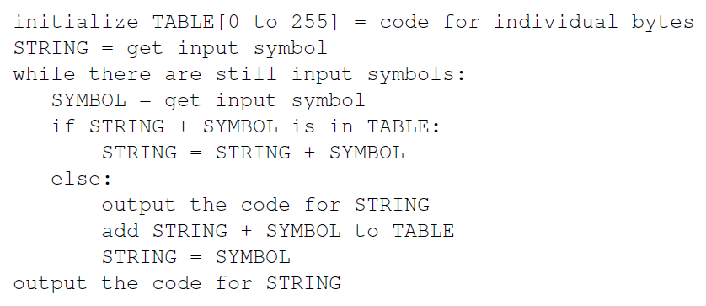
LZW Encoder: Pseudocode
RGB = 3 bytes
but idea stays same
From Chapter 3 of
MIT 6.02 DRAFT Lecture Notes, Feb 13, 2012

Slide 111
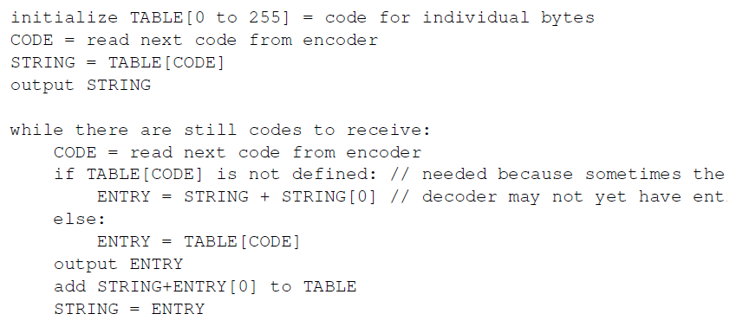
LZW Decoder: Pseudocode
RGB = 3 bytes
but idea stays same
ry
From Chapter 3 of
MIT 6.02 DRAFT Lecture Notes, Feb 13, 2012

Slide 112
LZW Compression: Quick Look
w = NIL;
while ( read a character k )
{
if (wk exists in the dictionary)
w = wk;
else
add wk to the dictionary
output the code for w
w = k
}
NOTE:
character k
or pixel p
Idea is same

Slide 113
LZW DEcompression: Quick Look
read a character k
output k
w = k
while (read a character k)
{
entry = dictionary entry for k
output entry
add w+entry[0] to dictionary
w = entry
}
Note:
read k means
k could be a character
or k could be a code

Slide 114
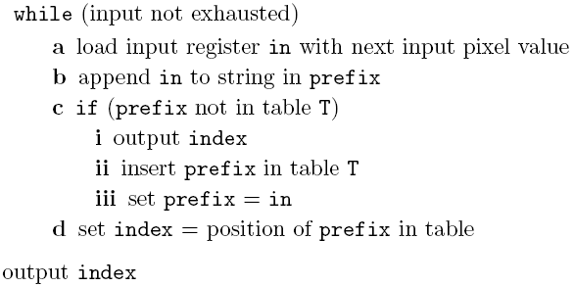
LZW Encoding
Input: ABABABA
Output: 0146

Slide 115
Questions?
Beyond D2L
Examples and information can be found online at:
http://docdingle.com/teaching/cs.html
Continue to more stuff as needed

Slide 116
Extra Reference Stuff Follows

Slide 118
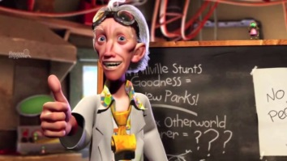
Credits
Much of the content derived/based on slides for use with the book:
Digital Image Processing, Gonzalez and Woods
Some layout and presentation style derived/based on presentations by
Donald House, Texas A&M University, 1999
Bernd Girod, Stanford University, 2007
Shreekanth Mandayam, Rowan University, 2009
Igor Aizenberg, TAMUT, 2013
Xin Li, WVU, 2014
George Wolberg, City College of New York, 2015
Yao Wang and Zhu Liu, NYU-Poly, 2015
Sinisa Todorovic, Oregon State, 2015

