Slide 1

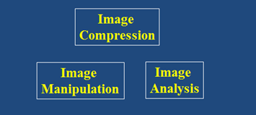


Digital Image Processing
Edge Detection
Brent M. Dingle, Ph.D. 2015
Game Design and Development Program
Mathematics, Statistics and Computer Science
University of Wisconsin - Stout
Material in this presentation is largely based on/derived from
presentations by: Sventlana Lazebnik, and Noah Snavely

Slide 2
Lecture Objectives
Previously
  Filtering
  Interpolation
  Warping
  Morphing
  Compression
Today
  Edge Detection
Image Manipulation
and Enhancement
Image Compression
Image Analysis

Slide 3

Recall: Digital Image Processing
Digital Image Processing (DIP)
  Is computer manipulation of pictures, or images, that have been converted into numeric form
  Typical operations include
    Image Compression
    Image Warping
    Contrast Enhancement
    Blur Removal
    Feature Extraction
    Pattern Recognition

Slide 4
Image Processing Goals
Digital image processing is
a subclass of signal processing
specifically concerned with picture images
  Goals
    To improve image quality for
      human perception (subjective)
      computer interpretation (objective)
    Develop methods and applications
      to compress images
      to provide efficient storage and transmission
Your projects
should relate
to these goals

Slide 5
Related Fields
Computer Graphics
Computer Vision
Artificial Intelligence
… others…

Slide 6
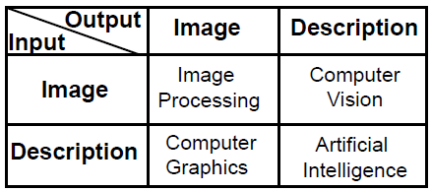
Distinction Between Fields
Image processing is not just image-in/image-out
But it does work to distinguish relational aspects of some fields

Slide 7
Related Fields
Image Processing
Image-In / Image Out
Image
Low
Level
Texture mapping
Antialiasing
Noise reduction
Contrast enhancement
Filtering
Computer Graphics
Computer Vision
Mid
Level
Extract Attributes
Edge Detection
Segmentation
Description In
Image Out
Image In
Features Out
High
Level
Object Recognition
Cognitive Functions
Scene Description
Features In
Description Out
AI

Slide 8
Image Analysis: Edge Detection
Edge Detection
  Relates to filtering
  Used in various types of image analysis
  Useful in other fields
    Such as Computer Vision

Slide 9

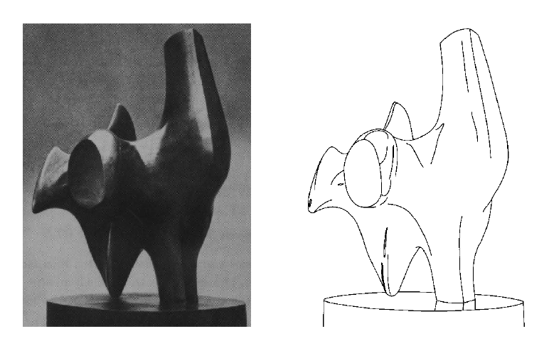
Edge Detection
Goal: Identify sudden changes (discontinuities) in an image
  Much of the ‘shape’ information of the image can be realized in the edges
Ideal Result: an artist’s line drawing
  aside: who can use knowledge beyond a single image
contour line drawing image from: https://www.youtube.com/watch?v=Eu9sUWLfGng

Slide 10
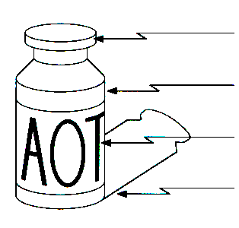
What Makes an Edge?
surface normal discontinuity
depth discontinuity
surface color discontinuity
illumination discontinuity
Edges are “caused” by various discontinuities
image source: Steve Seitz

Slide 11
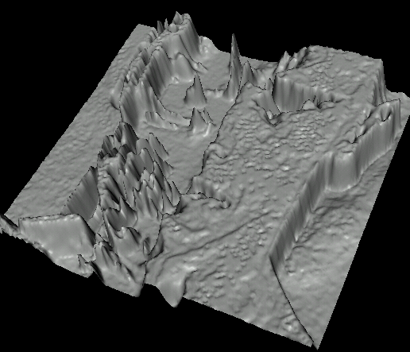

Discontinuity --> Sharp Change

Slide 12

Edge Characterization
An edge is a place of rapid change in the image intensity function
intensity function
(along horizontal scanline)
image
first derivative
edges correspond to
extrema of derivative
Images from: Svetlana Lazebnik

Slide 13
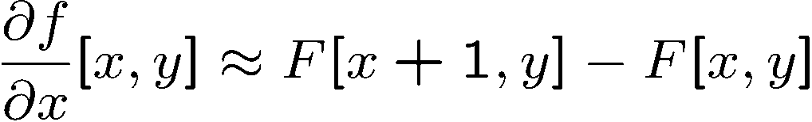


Image Derivatives
How can we differentiate a digital image F(x, y)?
Option 1:
  Reconstruct a continuous image, f, then compute its derivative
Option 2:
  Take a discrete derivative (finite difference, convolution)
In other notation:
approximate
-1 | 1
i.e. the convolution:

Slide 14
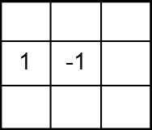
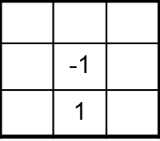




Image Derivatives
How can we differentiate a digital image F(x, y)?
Option 1:
  Reconstruct a continuous image, f, then compute its derivative
Option 2:
  Take a discrete derivative (finite difference, convolution)
How can this be implemented as a linear filter?
:
:

Slide 15
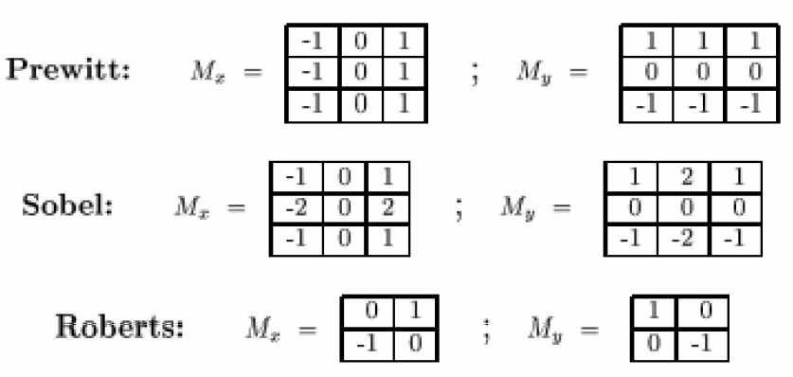
Finite Difference Filters
Other filters for approximating differentiation exist:
source: K. Grauman

Slide 16
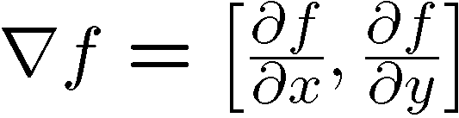



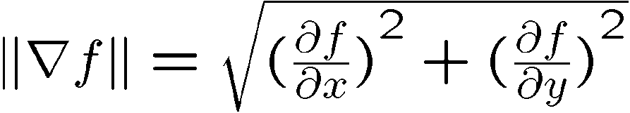
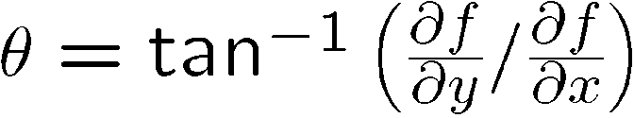
Image Gradient
The gradient of an image:
The gradient points in the direction of the most rapid change (increase) in intensity
The edge strength is given by the magnitude of the gradient:
The gradient direction is given by:
This is perpendicular to the direction of the edge
source: Steve Seitz

Slide 17
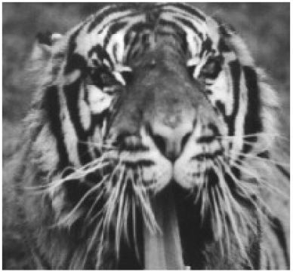
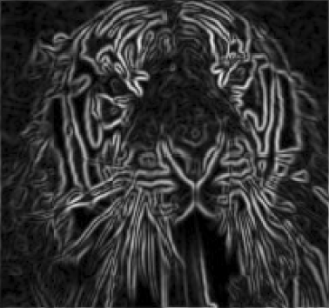
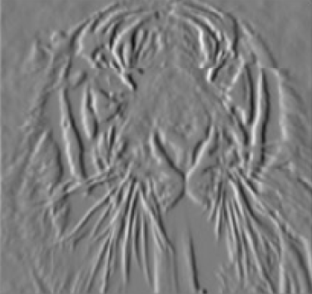
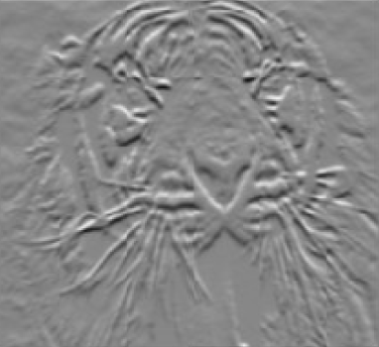
Example: Finite Differences
lines in the y-direction
lines in the x-direction
Source: S Lazebnik

Slide 18

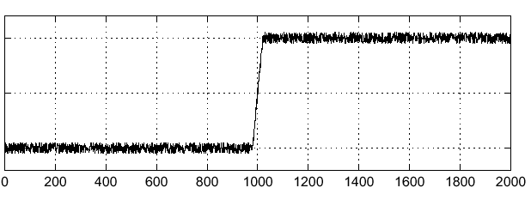

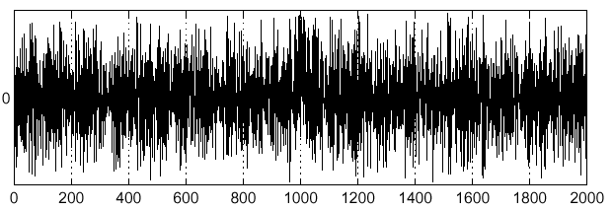
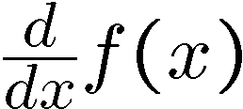
Effects of Noise
Consider a single row or column of the image
Plot the intensity as a function of position gives a signal:
Noisy input image
Where is the Edge?
source: S. Seitz

Slide 19
Effects of Noise
Finite difference filters respond strongly to noise
  Image noise results in pixels that look different from their neighbors
  The “larger” the noise then the stronger the response
Solution?
  Smoothing the image
  Forces pixels different from their nhbrs to look more like their nhbrs
    i.e. Removes “largeness” of the difference
source: D. Forsyth

Slide 20
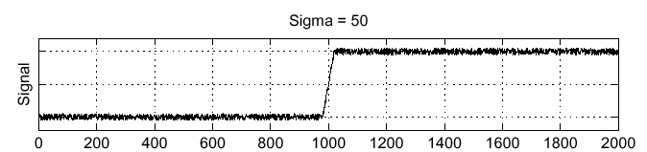
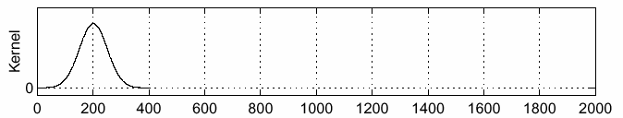
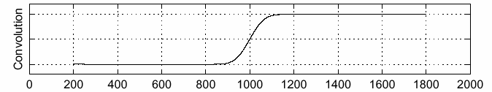
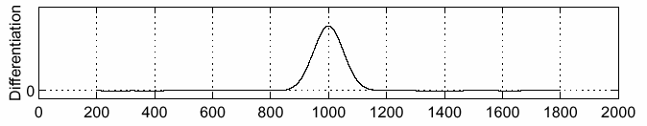
Smoothing First
To find edges: look for peaks in
f
g
f * g
source: S. Seitz

Slide 21
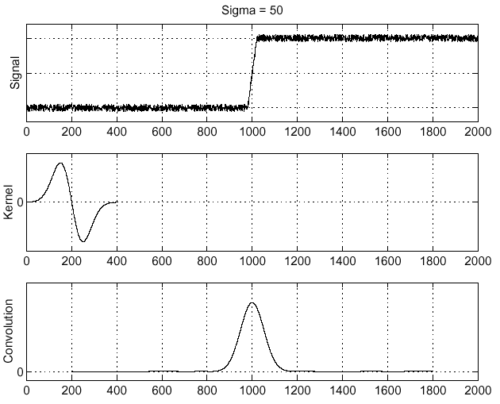
Associative Property of Convolution
Differentiation is convolution,
and convolution is associative:
This saves us one operation:
f
source: S. Seitz

Slide 22
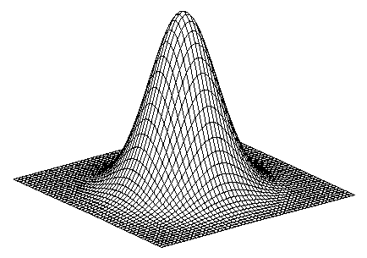
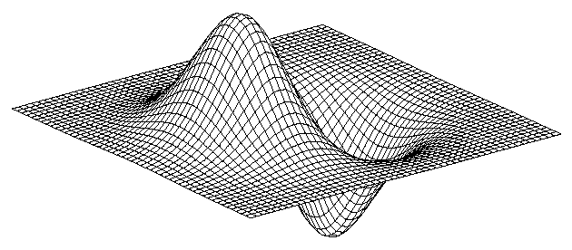
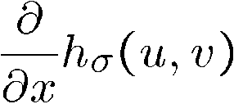
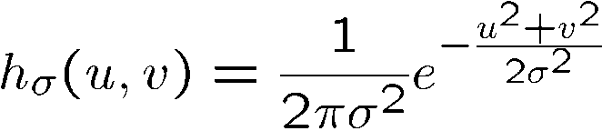
2D Edge Detection Filter
* [1 -1] =
Derivative of Gaussian (x)
Gaussian
Notes:
A good/commonly used 2nd derivative filter is the Laplacian

Slide 23
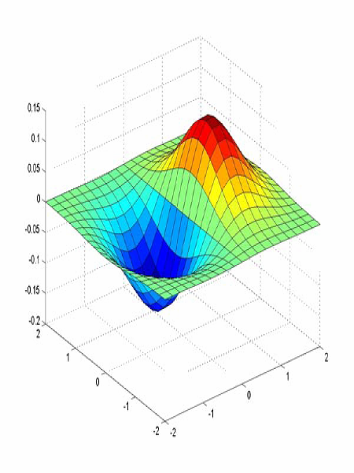
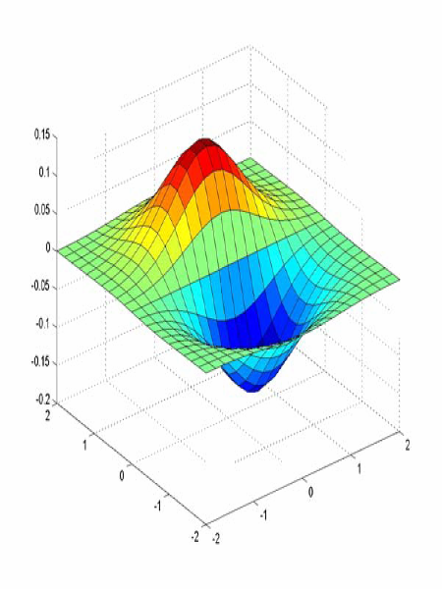
Derivative of Gaussian Filter
x-direction
y-direction
Which finds horizontal/vertical edges? --- try it and find out!

Slide 24
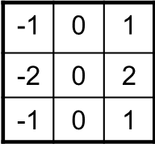
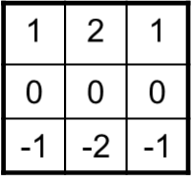



Options: Sobel Operator
Remember there are options for approximating the derivative of the Gaussian
  Prewitt, Sobel, Roberts (back a few slides), results vary
For illustration consider the Sobel Operator
Most “standard” definition of the Sobel operator omit the 1/8 term
This terms does not matter so much with regard to edge detection
But it IS needed to calculate the correct gradient value

Slide 25
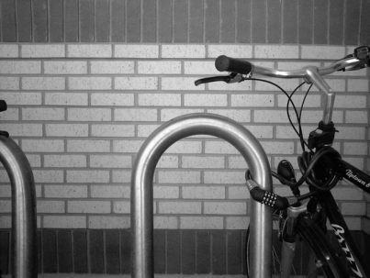
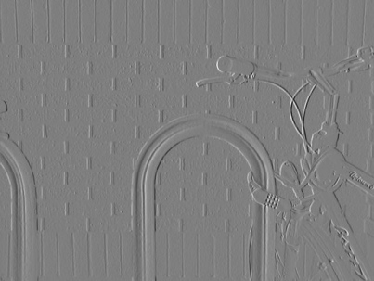
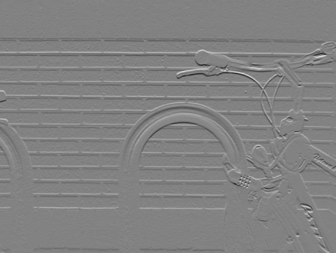
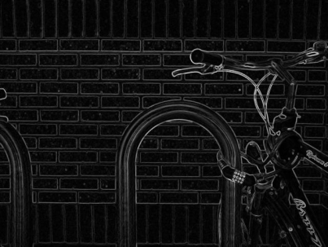

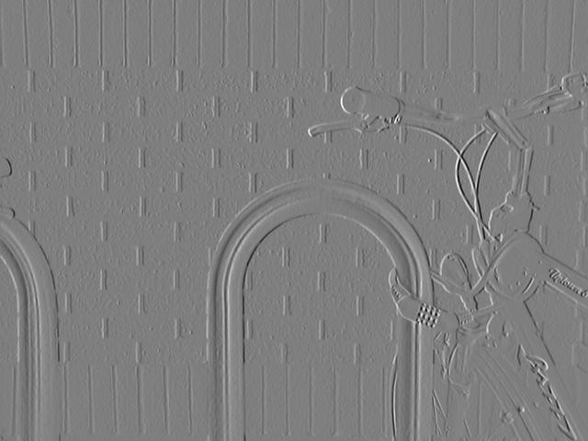
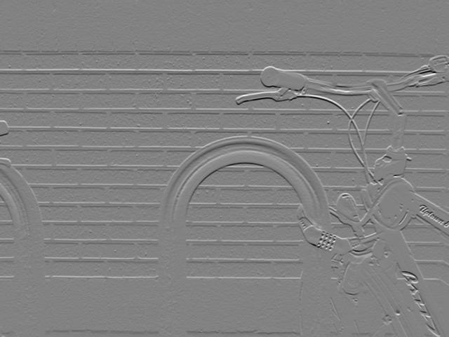
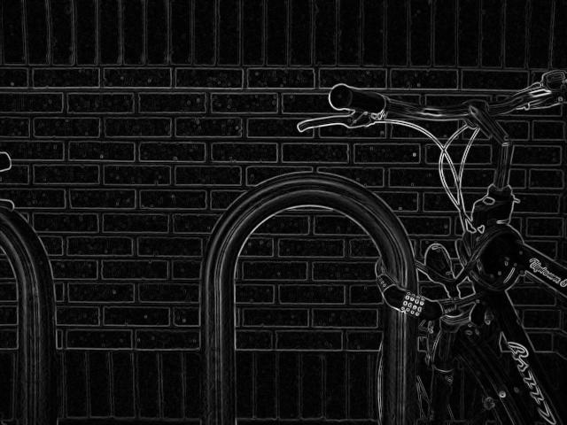
Example: Sobel Operator
Source: Wikipedia

Slide 26
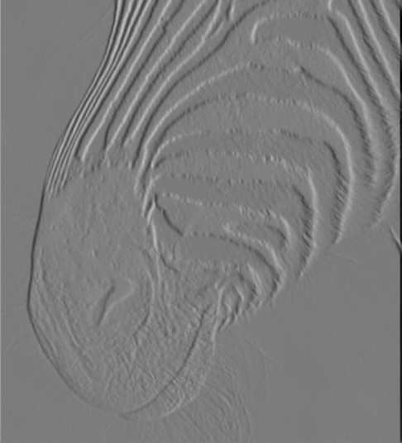
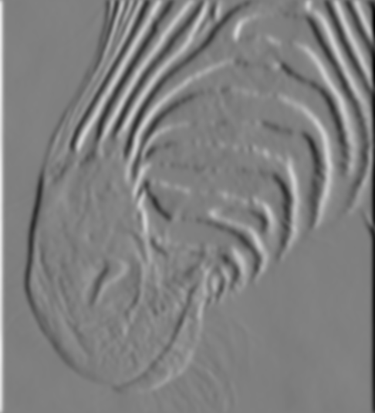
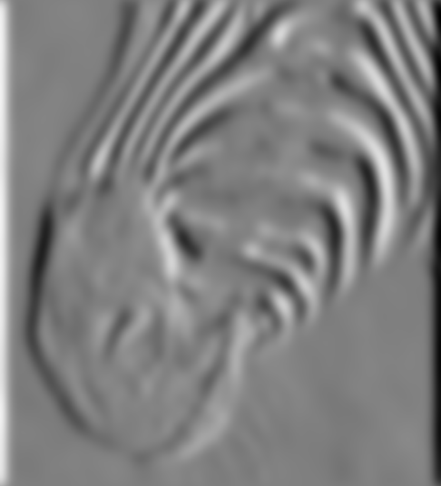
Also Consider: Scale of Gaussian’ Filter
Scale of Gaussian Derivative Filter
1 pixel
3 pixels
7 pixels
Smoothed derivative removes noise
BUT blurs the edges
AND finds edges at different ‘scales.’
source: D. Forsyth

Slide 27
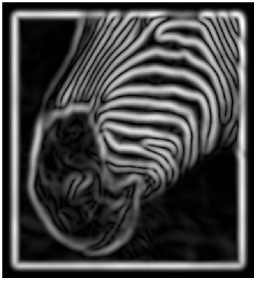
Implementation Issues
The gradient magnitude is large along a thick trail or ridge
  How do we identify actual edge points?
  How do we link the edge points to form curves?

Slide 28

Example: Lena
Original Image

Slide 29

Finding Edges
Gradient Magnitude

Slide 30

Finding Edges
where is the edge?

Slide 31

Non-Maximum Suppression
Check if pixel is a local maximum along gradient direction
  q is a maximum if the value is larger than those at both p and r
    note: p and r values would be interpolated values
source: D. Forsyth

Slide 32
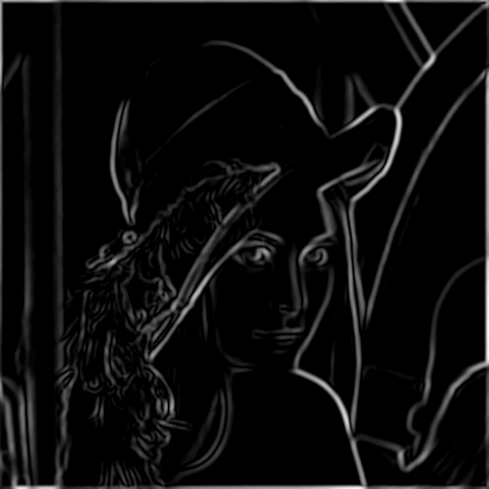
Finding Edges
Thresholding

Slide 33

Finding Edges
Thinning
(non-maximum suppression)

Slide 34
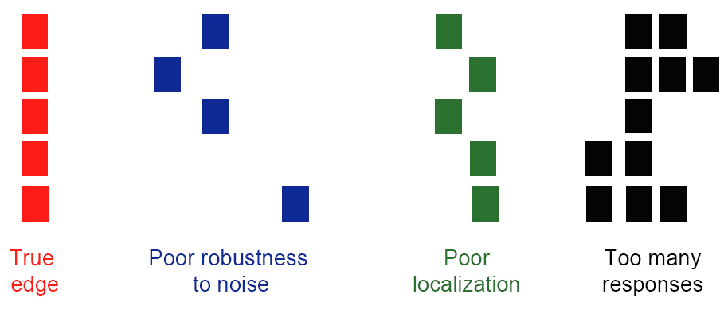
Designing an Edge Detector
Criteria for an ‘optimal’ edge detector
  Good Detection
    Minimizes the probability of false positives and false negatives
  Good Localization
    The detected edges must be as close as possible to the true edges
  Single Response
    Returns only one point for each true edge point
      Minimize the number of local maxima around the true edge
source: L. Fei-Fei

Slide 35
Canny Edge Detector
Originated in 1986
  J. Canny, A Computational Approach To Edge Detection, IEEE Trans. Pattern Analysis and Machine Intelligence, 8:679-714, 1986.
Still widely used today
Depends on several parameters
    σ : width (size of kernel) of the Gaussian blur
    high and low threshold

Slide 36

Canny Edge Detector
Filter image with derivative of Gaussian
Find magnitude and orientation of gradient
Apply non-maximum suppression
Linking and thresholding (hysteresis)
  Define 2 thresholds: low and high
  Use the high threshold to start edge curves and the low threshold to continue them
source: L. Fei-Fei, D. Lowe

Slide 37
Edge Linking
Assume the marked point is an edge point
Construct the tangent to the edge curve
  which is normal to the gradient at that point
Use this to predict the next points
  either r or s as shown
source: D. Forsyth

Slide 38
Hysteresis Thresholding
Use a high threshold to start edge curves and a low threshold to continue them
source: S. Seitz

Slide 39
Example: Hysteresis Thresholding
original image
high threshold
(strong edges)
low threshold
(weak edges)
hysteresis threshold
source: L. Fei-Fei

Slide 40





Effect of σ (size of kernel)
original
Canny with
Canny with
Large σ detects large scale edges
Small σ detects small (finer) scale edges
source: S. Seitz

Slide 41
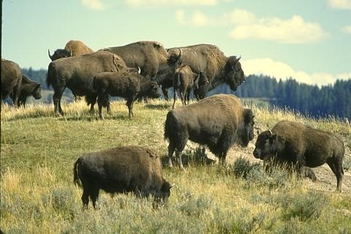
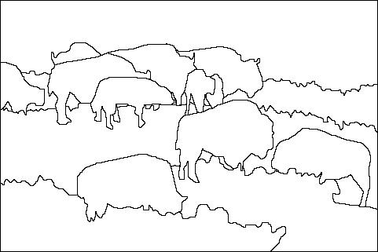

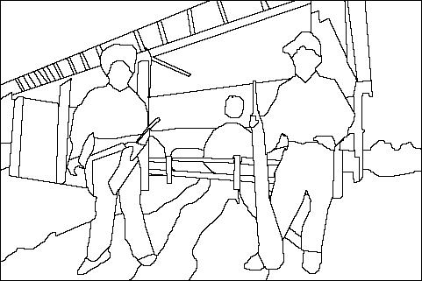
Edge Detection is Just the Beginning
image
segmentation

Slide 42
Questions?
Beyond D2L
  Examples and information
  can be found online at:
    http://docdingle.com/teaching/cs.html
    Continue to more stuff as needed

Slide 43
Extra Reference Stuff Follows

Slide 44

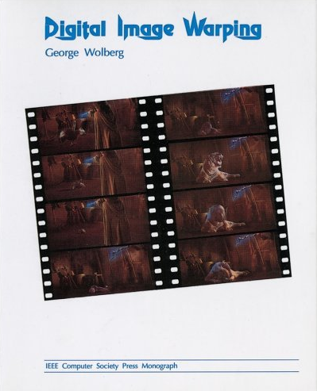

Credits
Much of the content derived/based on slides
for use with the book:
  Digital Image Processing, Gonzalez and Woods
Some layout and presentation style derived/based
on presentations by
  Donald House, Texas A&M University, 1999
  Sventlana Lazebnik, UNC, 2010
  Noah Snavely, Cornell University, 2012
  Xin Li, WVU, 2014
  George Wolberg, City College of New York, 2015
  Yao Wang and Zhu Liu, NYU-Poly, 2015

