Slide 1
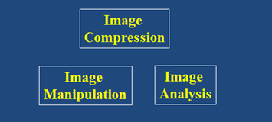
Digital Image Processing
Edge Detection: Smart Scissors
DRAFT
Brent M. Dingle, Ph.D. 2015
Game Design and Development Program
Mathematics, Statistics and Computer Science
University of Wisconsin - Stout
Material in this presentation is largely based on/derived from
presentations by: Noah Snavely

Slide 2
Lecture Objectives
Previously
Filtering
Interpolation
Warping
Morphing
Compression
Edge Detection
Today
Intelligent Scissors
Image Manipulation
and Enhancement
Image Compression
Image Analysis

Slide 3
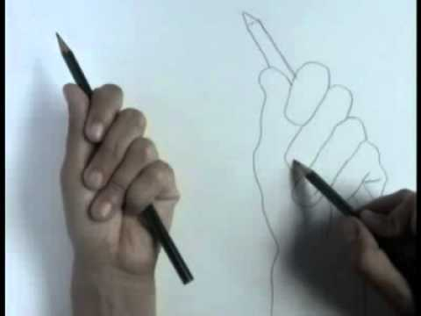
Recall: Edge Detection
Goal: Identify sudden changes (discontinuities) in an image
Much of the ‘shape’ information of the image can be realized in the edges
Ideal Result: an artist’s line drawing
aside: who can use knowledge beyond a single image
contour line drawing image from: https://www.youtube.com/watch?v=Eu9sUWLfGng

Slide 4
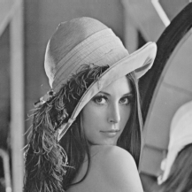
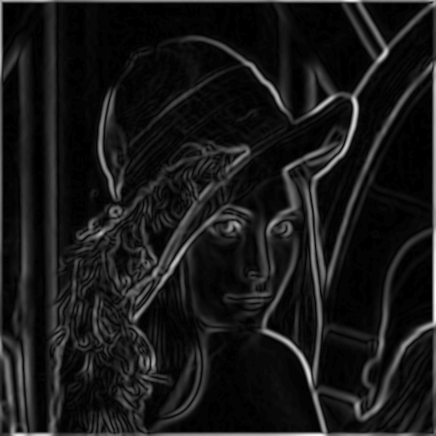
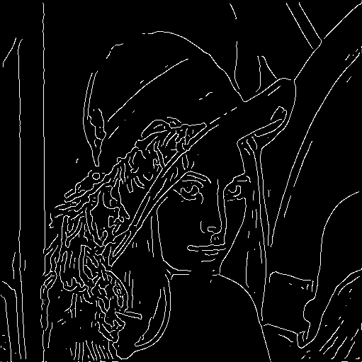
Recall: Canny Edge Detector
Filter image with derivative of Gaussian
Find magnitude and orientation of gradient
Apply non-maximum suppression
Linking and thresholding (hysteresis)
Define 2 thresholds: low and high
Use the high threshold to start edge curves and the low threshold to continue them
source: L. Fei-Fei, D. Lowe

Slide 5
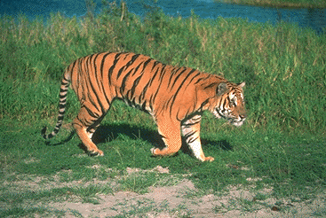
Extracting Objects
How can the tiger be extracted from the image?
Difficult to do manually
Difficult to do automatically (but possible)
Easier to do semi-automatically
source: Noah Snavely

Slide 6
Paper to Read/Reference
Intelligent Scissors, Mortensen et. al, SIGGRAPH 1995
source: Noah Snavely

Slide 7
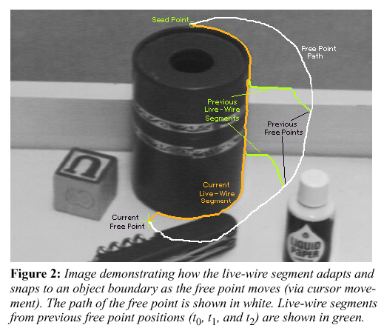
Intelligent Scissors
source: Noah Snavely

Slide 8
Intelligent Scissors
Question
How do we find a path from seed to mouse that follows an object boundary as closely as possible?
Answer
Define a path that stays as close as possible to edges
source: Noah Snavely

Slide 9
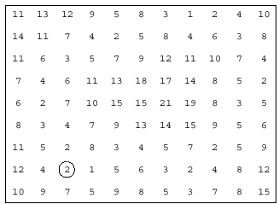
Intelligent Scissors
Basic Idea
Define edge score for each pixel
assign edge pixels a low score
Find lowest cost path from seed to mouse
mouse
seed
source: Noah Snavely

Slide 10
Let’s look at this more closely
Treat the image as a graph
q
c
p
Graph
node for every pixel p
link between every adjacent pair of pixels, p,q
cost c for each link
Note: each link has a cost
this is a little different than the figure before where each pixel had a cost
source: Noah Snavely

Slide 11
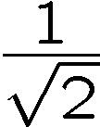
Defining the costs
s
q
c
p
r
Want to hug image edges: how to define cost of a link?
good (low-cost) links follow the intensity edge
want intensity to change rapidly to the link
c – |intensity of r – intensity of s|
source: Noah Snavely

Slide 12
Defining the costs
s
q
c
p
r
c can be computed using a cross-correlation filter
assume it is centered at p
source: Noah Snavely

Slide 13
Defining the costs
s
q
c
1
1
 | 1
 |  | -1
p
r
w
-1
-1
c can be computed using a cross-correlation filter
assume it is centered at p
A couple more modifications
Scale the filter response by length of link c. Why?
Make c positive
Set c = (max-|filter response|*length)
where max = maximum |filter response|*length over all pixels in the image
source: Noah Snavely

Slide 14
Dijkstra’s shortest path algorithm
9
link cost
4
5
1
0
3
3
2
3
Algorithm
init node costs to , set p = seed point, cost(p) = 0
expand p as follows:
for each of p’s neighbors q that are not expanded
set cost(q) = min( cost(p) + c_{pq}, cost(q) )
source: Noah Snavely

Slide 15
Dijkstra’s shortest path algorithm
4
9
5
9
4
5
1
1
1
1
0
3
3
3
3
2
3
2
3
Algorithm
init node costs to , set p = seed point, cost(p) = 0
expand p as follows:
for each of p’s neighbors q that are not expanded
set cost(q) = min( cost(p) + c_{pq}, cost(q) )
if q’s cost changed, make q point back to p
put q on the ACTIVE list (if not already there)
source: Noah Snavely

Slide 16
Dijkstra’s shortest path algorithm
4
9
5
2
9
3
5
4
5
1
2
1
1
0
3
3
3
3
3
3
4
2
3
2
3
Algorithm
init node costs to , set p = seed point, cost(p) = 0
expand p as follows:
for each of p’s neighbors q that are not expanded
set cost(q) = min( cost(p) + c_{pq}, cost(q) )
if q’s cost changed, make q point back to p
put q on the ACTIVE list (if not already there)
set r = node with minimum cost on the ACTIVE list
repeat Step 2 for p = r
source: Noah Snavely

Slide 17
Dijkstra’s shortest path algorithm
4
3
6
5
2
9
3
5
4
5
3
1
2
1
1
0
3
3
3
3
3
3
4
2
4
3
2
3
Algorithm
init node costs to , set p = seed point, cost(p) = 0
expand p as follows:
for each of p’s neighbors q that are not expanded
set cost(q) = min( cost(p) + c_{pq}, cost(q) )
if q’s cost changed, make q point back to p
put q on the ACTIVE list (if not already there)
set r = node with minimum cost on the ACTIVE list
repeat Step 2 for p = r
source: Noah Snavely

Slide 18
Dijkstra’s shortest path algorithm
Properties
It computes the minimum cost path from the seed to every node in the graph. This set of minimum paths is represented as a tree
Running time, with N pixels:
O(N²) time if you use an active list
O(N log N) if you use an active priority queue (heap)
takes fraction of a second for a typical (640x480) image
Once this tree is computed once, we can extract the optimal path from any point to the seed in O(N) time.
it runs in real time as the mouse moves
What happens when the user specifies a new seed?
source: Noah Snavely

Slide 19
Questions?
Beyond D2L
Examples and information can be found online at:
http://docdingle.com/teaching/cs.html
Continue to more stuff as needed

Slide 20
Extra Reference Stuff Follows

Slide 21
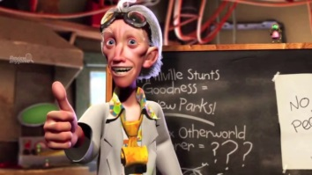
Credits
Much of the content derived/based on slides for use with the book:
Digital Image Processing, Gonzalez and Woods
Some layout and presentation style derived/based on presentations by
Donald House, Texas A&M University, 1999
Sventlana Lazebnik, UNC, 2010
Noah Snavely, Cornell University, 2012
Xin Li, WVU, 2014
George Wolberg, City College of New York, 2015
Yao Wang and Zhu Liu, NYU-Poly, 2015

