Slide 1
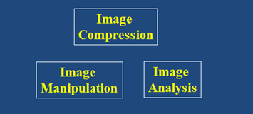
Digital Image Processing
Stereo Images
DRAFT
Brent M. Dingle, Ph.D. 2015
Game Design and Development Program
Mathematics, Statistics and Computer Science
University of Wisconsin - Stout
Material in this presentation is largely based on/derived from
presentations by: Sventlana Lazebnik, and Noah Snavely

Slide 2
Lecture Objectives
Previously
Image Manipulation and Enhancement
Filtering
Interpolation
Warping
Morphing
Image Compression
Image Analysis
Edge Detection
Smart Scissors
Today
Stereo Images

Slide 3
Stereo Images, Relation
Stereo Image Processing
Builds from previous topics
Requires methods derived from image manipulation and enhancement
Relates to feature detection and extraction
Relates to human stereoscopic vision
Useful in navigating 3D environments
i.e. computer vision for robots

Slide 4
Public Library, Stereoscopic Looking Room, Chicago, by Phillips, 1923
slide by: Noah Snavely

Slide 5
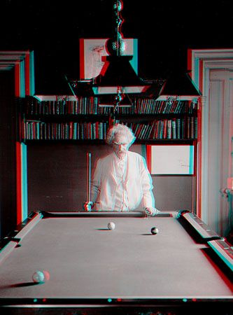
Mark Twain at Pool Table", no date, UCR Museum of Photography
slide by: Noah Snavely

Slide 6
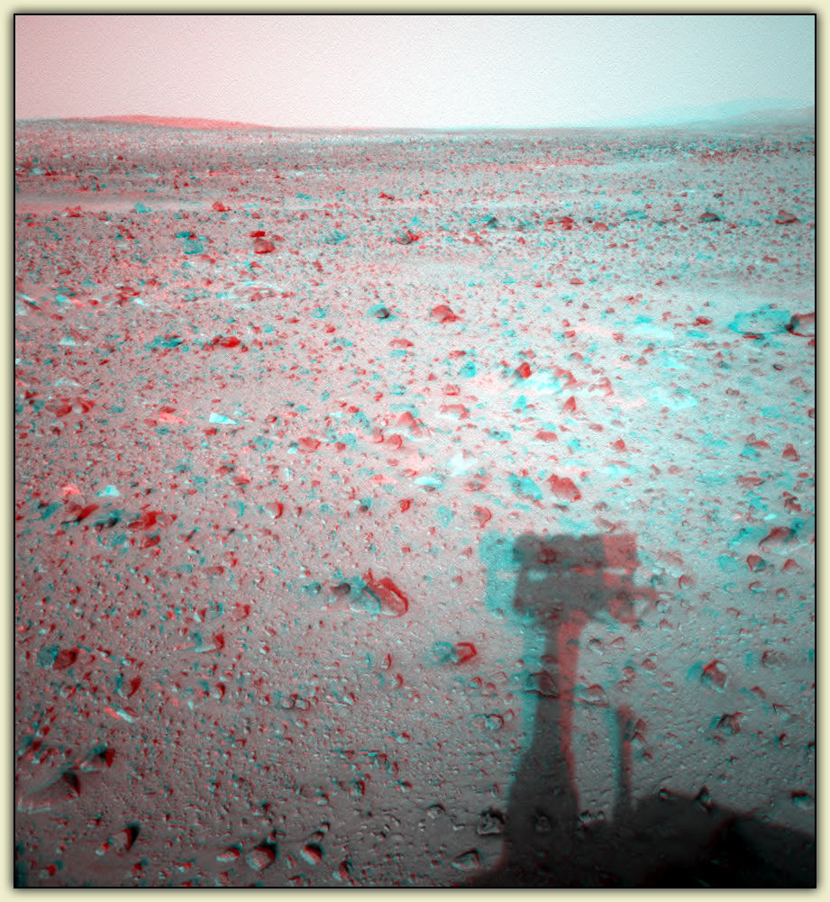
slide by: Noah Snavely

Slide 7
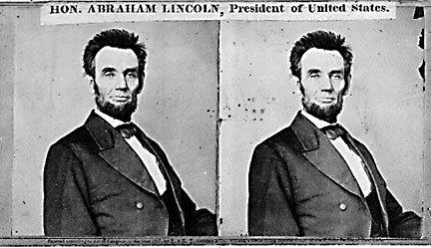
slide by: Noah Snavely

Slide 8
Stereo Image Goal
Given 2 images from different viewpoints
Compute the depth of each point in the image
Suggested Method
Perform the computation based on how much each pixel moves between the two images

Slide 9
Epipolar Geometry
x2 – x1 = the disparity of pixel (x1, y1)
Two images captured by a purely horizontal translating camera
(rectified stereo pair)
epipolar lines
(x₁, y₁)
(x₂, y₁)

Slide 10
Simple Stereo Algorithm
For each epipolar line
For each pixel in the ‘left’ image
Compare it with every pixel in the same epipolar line of the ‘right’ image
Select the pixel with minimum cost match
Possible improvement: use matching windows instead of pixels

Slide 11
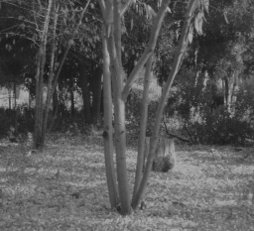
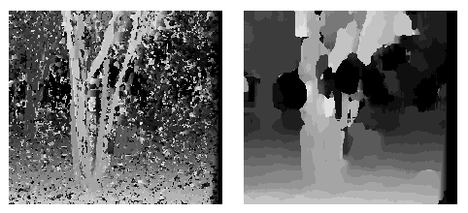
Window size
W = 3
W = 20
Effect of window size
Better results with adaptive window
T. Kanade and M. Okutomi, A Stereo Matching Algorithm with an Adaptive Window: Theory and Experiment,, Proc. International Conference on Robotics and Automation, 1991.
D. Scharstein and R. Szeliski. Stereo matching with nonlinear diffusion. International Journal of Computer Vision, 28(2):155-174, July 1998
Smaller window
more detail
more noise
Larger window
less noise
more detail
slide by: Noah Snavely
Notes:
smaller window: more detail, more noise
bigger window: less noise, more detail

Slide 12
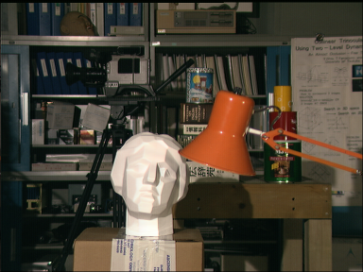
Stereo results
Data from University of Tsukuba
Similar results on other images without ground truth
Scene
Ground truth
slide by: Noah Snavely

Slide 13
Results with window search
Window-based matching
(best window size)
Ground truth
slide by: Noah Snavely

Slide 14
Better methods exist...
State of the art method
Boykov et al., Fast Approximate Energy Minimization via Graph Cuts,
International Conference on Computer Vision, September 1999.
Ground truth
slide by: Noah Snavely

Slide 15
Stereo as Energy Minimization
What defines a good stereo correspondence?
Match quality
Each pixel needs a good match in the other image
Smoothness
Two adjacent pixels in one image should move about the same amount

Slide 16
Stereo as Energy Minimization
Find a disparity map d that minimizes an energy function:
Simple pixel / window matching
=
SSD distance between windows I(x, y) and J(x + d(x,y), y)

Slide 17
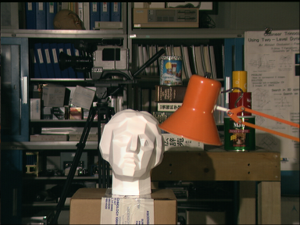
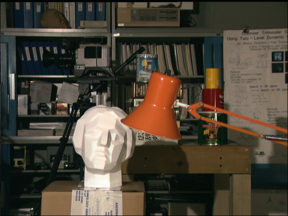
Stereo as energy minimization
I(x, y)
J(x, y)
y = 141
d
x
C(x, y, d); the disparity space image (DSI)
slide by: Noah Snavely

Slide 18
Stereo as energy minimization
y = 141
d
x
Simple pixel / window matching: choose the minimum of each column in the DSI independently:
slide by: Noah Snavely

Slide 19
Stereo as energy minimization
Better objective function
{
{
match cost
smoothness cost
Want each pixel to find a good match in the other image
Adjacent pixels should (usually) move about the same amount
slide by: Noah Snavely

Slide 20
Stereo as energy minimization
match cost:
smoothness cost:
: set of neighboring pixels
4-connected neighborhood
8-connected neighborhood
slide by: Noah Snavely

Slide 21
Smoothness cost
How do we choose V?
L₁ distance
“Potts model”
slide by: Noah Snavely

Slide 22
Dynamic programming
Can minimize this independently per scanline using dynamic programming (DP)
: minimum cost of solution such that d(x,y) = d
slide by: Noah Snavely

Slide 23
Dynamic programming
y = 141
d
x
Finds “smooth” path through DPI from left to right
slide by: Noah Snavely

Slide 24
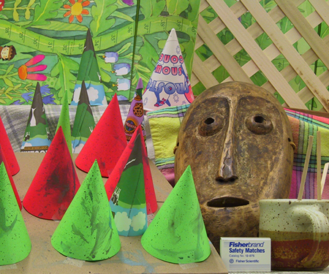
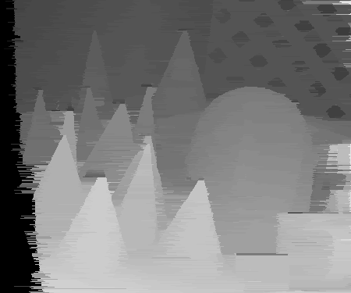
Dynamic Programming
slide by: Noah Snavely

Slide 25
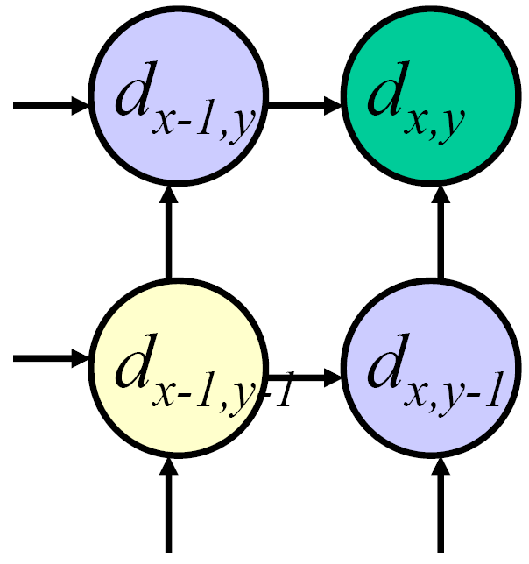
Dynamic programming
Can we apply this trick in 2D as well?
No: d_{x,y-1} and d_{x-1,y} may depend on different values of d_{x-1,y-1}
Slide by: D. Huttenlocher

Slide 26
Stereo as a minimization problem
The 2D problem has many local minima
Gradient descent doesn’t work well
And a large search space
n x m image w/ k disparities has k^{nm} possible solutions
Finding the global minimum is NP-hard in general
Good approximations exist…
slide by: Noah Snavely

Slide 27
Depth From Disparity
X
z
x
x’
f
f
C
baseline
C’
slide by: Noah Snavely

Slide 28
Stereo reconstruction pipeline
Steps
Calibrate cameras
Rectify images
Compute disparity
Estimate depth
Camera calibration errors
Poor image resolution
Occlusions
Violations of brightness constancy (specular reflections)
Large motions
Low-contrast image regions
What will cause errors?
slide by: Noah Snavely

Slide 29
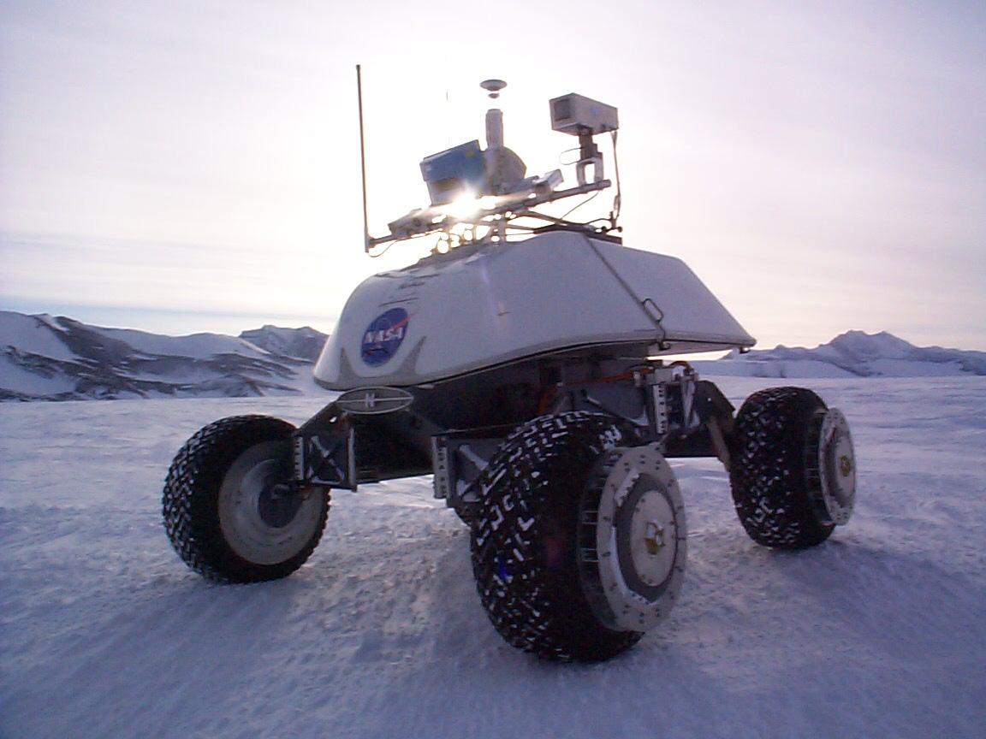
Real-time stereo
Nomad robot searches for meteorites in Antartica
http://www.frc.ri.cmu.edu/projects/meteorobot/index.html
Used for robot navigation (and other tasks)
Several software-based real-time stereo techniques have been developed (most based on simple discrete search)
slide by: Noah Snavely

Slide 30
Questions?
Beyond D2L
Examples and information can be found online at:
http://docdingle.com/teaching/cs.html
Continue to more stuff as needed

Slide 31
Extra Reference Stuff Follows

Slide 32
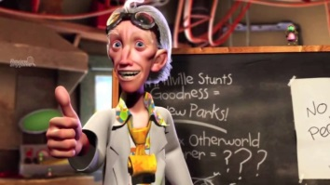
Credits
Much of the content derived/based on slides for use with the book:
Digital Image Processing, Gonzalez and Woods
Some layout and presentation style derived/based on presentations by
Donald House, Texas A&M University, 1999
Sventlana Lazebnik, UNC, 2010
Noah Snavely, Cornell University, 2012
Xin Li, WVU, 2014
George Wolberg, City College of New York, 2015
Yao Wang and Zhu Liu, NYU-Poly, 2015

