Slide 1

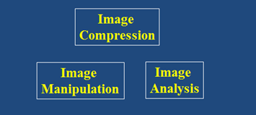


Digital Image Processing
Segmentation
DRAFT
Brent M. Dingle, Ph.D. 2015
Game Design and Development Program
Mathematics, Statistics and Computer Science
University of Wisconsin - Stout
Material in this presentation is largely based on/derived from
presentations by: Sventlana Lazebnik, and Noah Snavely

Slide 2
Lecture Objectives
Previously
  Image Manipulation and Enhancement
    Filtering
    Interpolation
    Warping
    Morphing
  Image Compression
  Image Analysis
    Edge Detection
    Smart Scissors
    Stereo Image Processing
Today
  Segmentation

Slide 3
Segmentation Relation
Segmentation methods touch on and use many previous topics
  Representation Methods
  Manipulation Methods
  Human Perception and Psychology

Slide 4
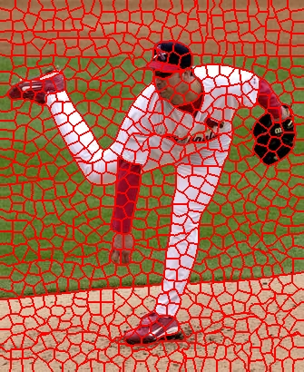
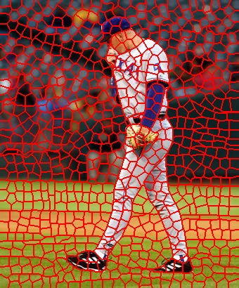
Segmentation Goals
Group similar looking pixels together
for efficiency of additional processing
    Superpixels
      Learning a classification model for segmentation, Ren and Malik, ICCV 2003.

Slide 5
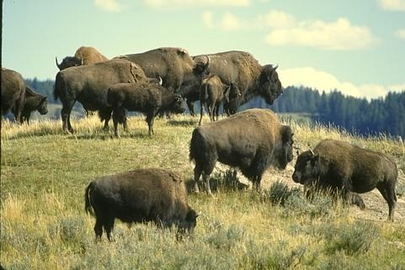
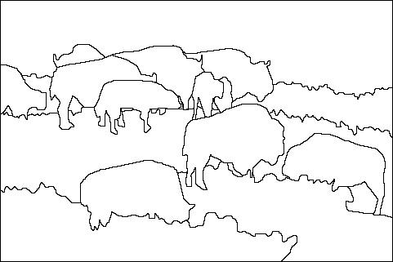
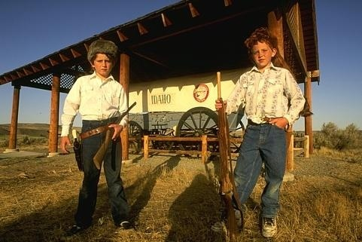
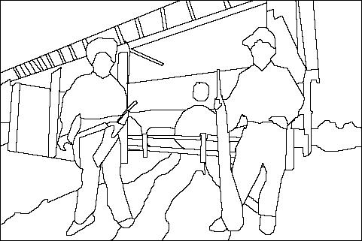
Segmentation Goals
Separate image into coherent objects
    Berkeley segmentation database
      http://www.eecs.berkeley.edu/Research/Projects/CS/vision/grouping/segbench/
image
segmentation

Slide 6
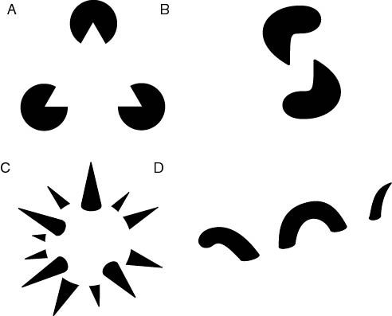
Gestalt Psychology
Human minds ‘group’ things
  Our perception is affected by this behavior
subjective contours
occlusion
familiar configuration
http://en.wikipedia.org/wiki/Gestalt_psychology

Slide 7
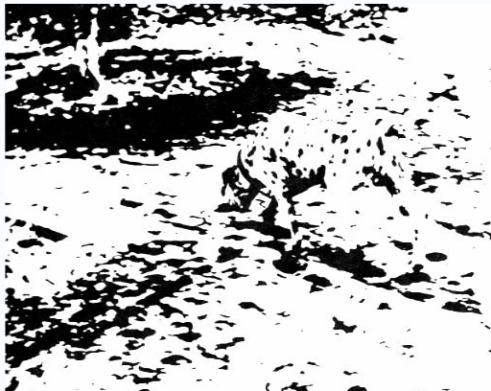
Emergence
Find the dog
http://en.wikipedia.org/wiki/Gestalt_psychology

Slide 8
Gestalt Factors
These factors are intuitively obvious to humans
BUT are difficult to code into a computer

Slide 9
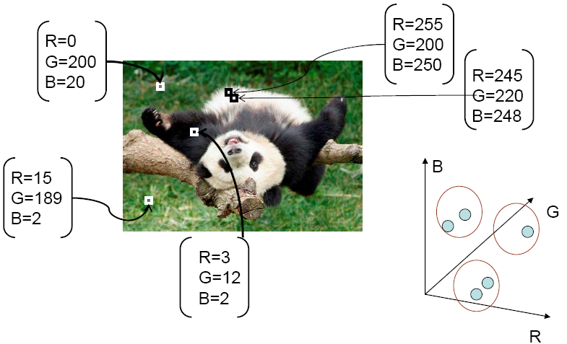
Segmentation via Clustering
Concept:
  Cluster similar pixels/features together
    Color being an obvious choice
source: K. Grauman

Slide 10
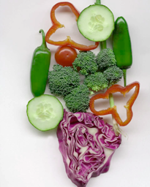
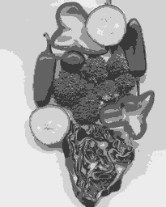
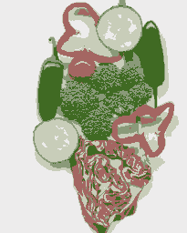
K-Means Clustering
K-means clustering is based on the intensity or color of pixels
  Essentially is a vector quantization of the image attributes (intensity or color)
    Notice the clusters need not be spatially localized
Image
Intensity-based clusters
Color-based clusters
source: S. Lazebnik

Slide 11
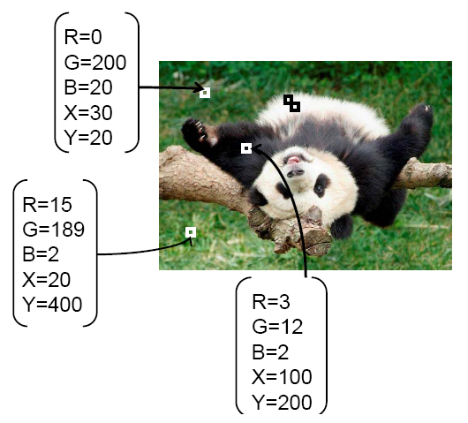
Segmentation via Clustering
  Cluster similar pixels/features together
    Color PLUS LOCATION
source: K. Grauman

Slide 12
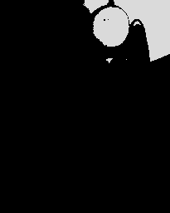
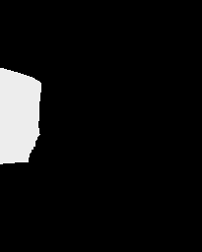

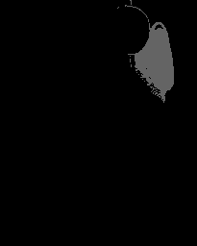

Cluster Color AND Location
Clustering based on (r, g, b, x, y) values leads to greater spatial coherence
source: S. Lazebnik

Slide 13
Summary: K-means Segmentation
Good
  Simple
  Converges to local minimum of the error function
Bad
  Uses lots of memory
  Human picks K
  Sensitive to initialization
  Sensitive to outliers
  Only finds ‘sphere-like’ clusters
source: S. Lazebnik

Slide 14
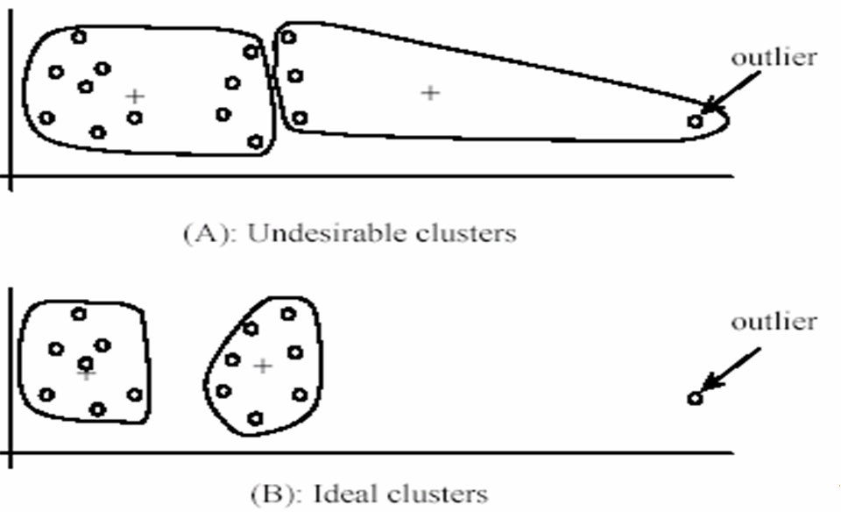
Summary: K-means Segmentation
Good
  Simple
  Converges to local minimum of the error function
Bad
  Uses lots of memory
  Human picks K
  Sensitive to initialization
  Sensitive to outliers
  Only finds ‘sphere-like’ clusters
Good
  Simple
  Converges to local minimum of the error function
Bad
  Uses lots of memory
  Human picks K
  Sensitive to initialization
  Sensitive to outliers
  Only finds ‘sphere-like’ clusters
source: S. Lazebnik

Slide 15
Questions So Far?
Questions on K-Means Segmentation?

Slide 16
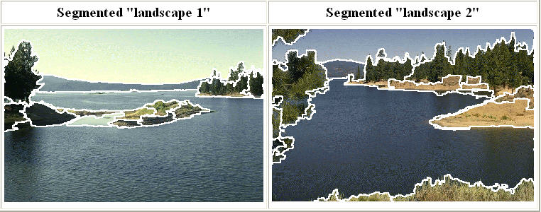
Mean Shift Clustering
An advanced and versatile method of clustering-based segmentation
http://www.caip.rutgers.edu/~comanici/MSPAMI/msPamiResults.html
Mean Shift: A Robust Approach toward Feature Space Analysis,
D. Comaniciu and P. Meer, PAMI 2002.

Slide 17
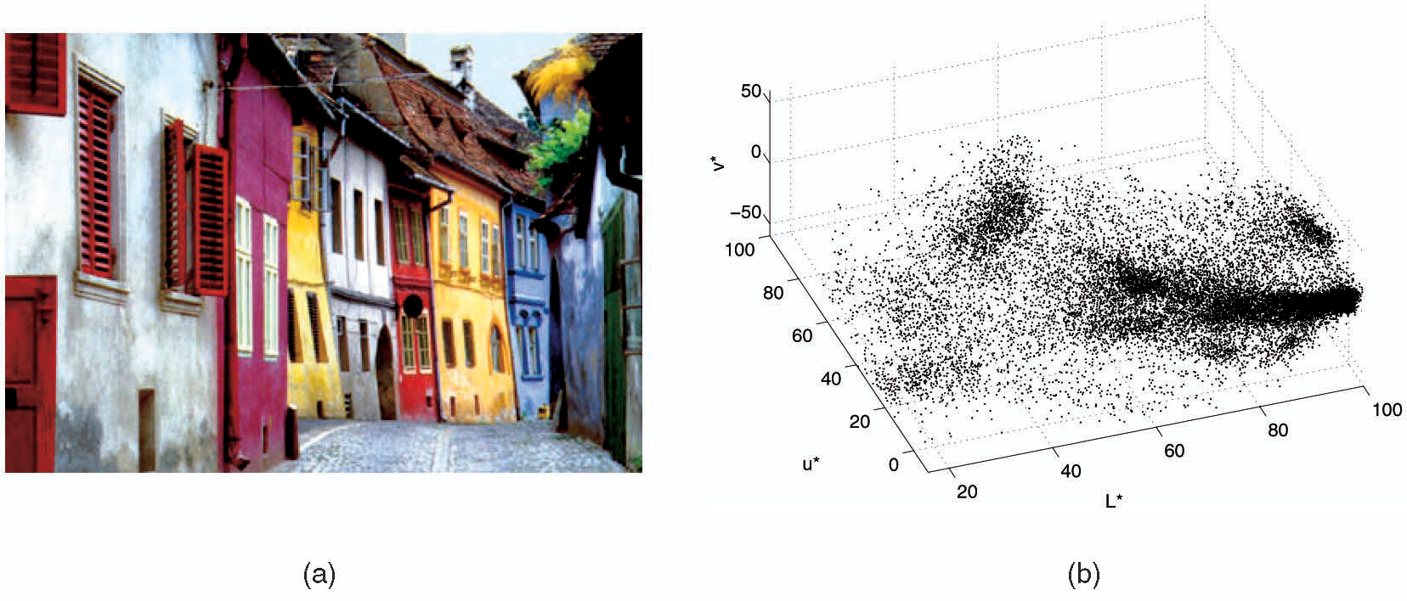
Mean Shift Algorithm
Seeks modes or local maxima of density in the feature space
Feature space
(L*u*v* color values)
image
L = luminance
u and v are spatial coordinates
source: S. Lazebnik

Slide 18
Mean shift
Search
window
Center of
mass
Mean Shift
vector
Slide by Y. Ukrainitz & B. Sarel

Slide 19
Mean shift
Search
window
Center of
mass
Mean Shift
vector
Slide by Y. Ukrainitz & B. Sarel

Slide 20
Mean shift
Search
window
Center of
mass
Mean Shift
vector
Slide by Y. Ukrainitz & B. Sarel

Slide 21
Mean shift
Search
window
Center of
mass
Mean Shift
vector
Slide by Y. Ukrainitz & B. Sarel

Slide 22
Mean shift
Search
window
Center of
mass
Mean Shift
vector
Slide by Y. Ukrainitz & B. Sarel

Slide 23
Mean shift
Search
window
Center of
mass
Mean Shift
vector
Slide by Y. Ukrainitz & B. Sarel

Slide 24
Mean shift
Search
window
Center of
mass
Slide by Y. Ukrainitz & B. Sarel

Slide 25
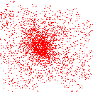
Mean Shift Clustering
Define Cluster as
  all data points in the attraction basin of a mode
Define Attraction Basin as
  the region for which all trajectories lead to the same mode
Slide by Y. Ukrainitz & B. Sarel

Slide 26
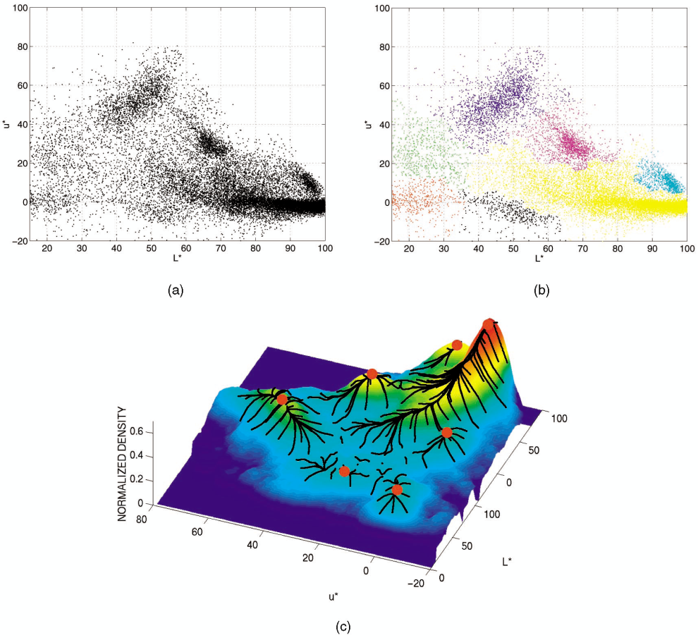
Mean Shift Clustering / Segmentation
Find Features (color, gradients, texture…)
Initialize windows at individual feature points
Perform mean shift for each window until convergence
Merge windows that end near the same ‘peak’ or mode
source: S. Lazebnik

Slide 27
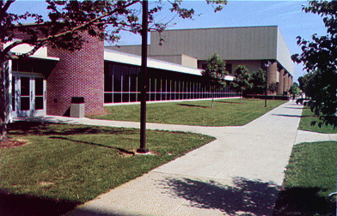
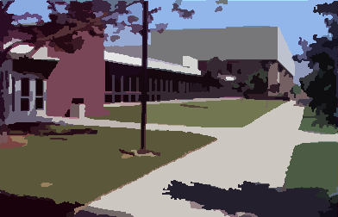
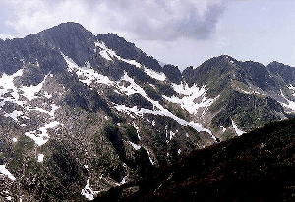
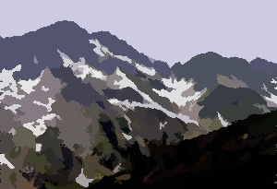
Example: Mean Shift Results
http://www.caip.rutgers.edu/~comanici/MSPAMI/msPamiResults.html

Slide 28
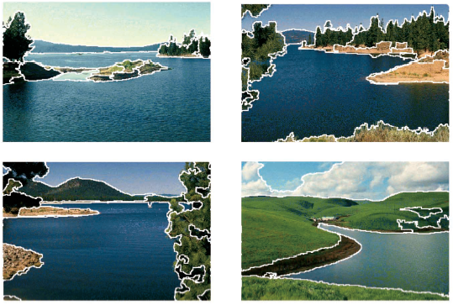
Mean Shift Results (c1)

Slide 29
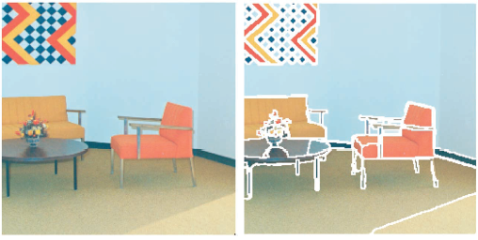
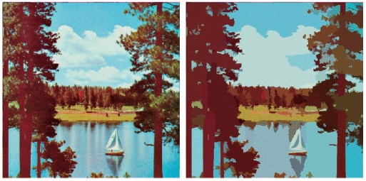
Mean Shift Results (c2)

Slide 30
Summary: Mean Shift
Good
  Does not assume spherical clusters
  Takes a single parameter (window size)
  Finds variable number of nodes
  Robust outliers
Bad
  Output depends on window size
  Computationally expensive
  Does not scale well with dimension of feature space

Slide 31
Questions So Far?
Questions on Mean Shift Clustering/Segmentation?

Slide 32
More Questions?
Beyond D2L
  Examples and information
  can be found online at:
    http://docdingle.com/teaching/cs.html
    Continue to more stuff as needed

Slide 33
Extra Reference Stuff Follows

Slide 34
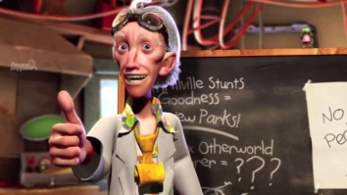
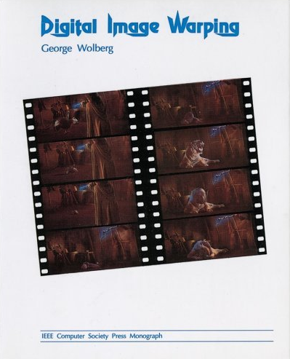
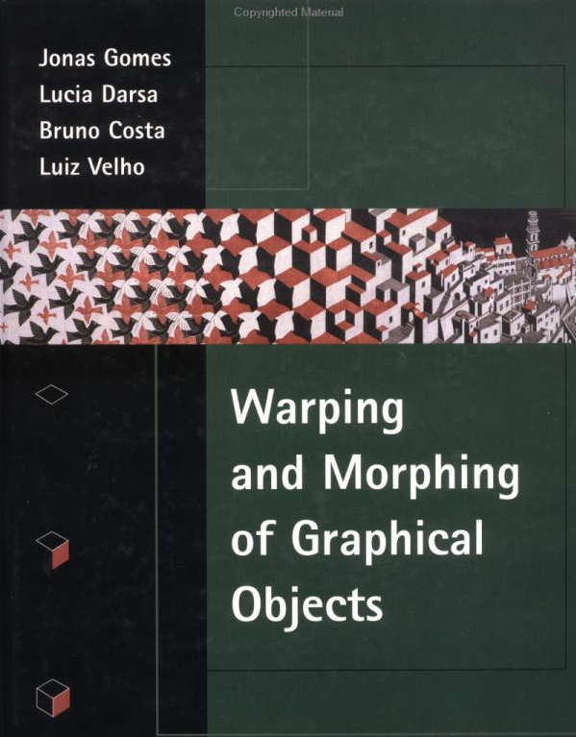
Credits
Much of the content derived/based on slides
for use with the book:
  Digital Image Processing, Gonzalez and Woods
Some layout and presentation style derived/based
on presentations by
  Donald House, Texas A&M University, 1999
  Sventlana Lazebnik, UNC, 2010
  Noah Snavely, Cornell University, 2012
  Xin Li, WVU, 2014
  George Wolberg, City College of New York, 2015
  Yao Wang and Zhu Liu, NYU-Poly, 2015

