Slide 1
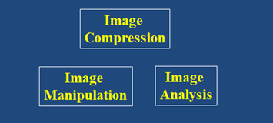
Digital Image Processing
Segmentation via Graphs
DRAFT
Brent M. Dingle, Ph.D. 2015
Game Design and Development Program
Mathematics, Statistics and Computer Science
University of Wisconsin - Stout
Material in this presentation is largely based on/derived from
presentations by: Sventlana Lazebnik, and Noah Snavely

Slide 2
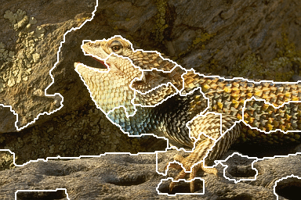
Lecture Objectives
Previously
Image Manipulation and Enhancement
Filtering
Interpolation
Warping
Morphing
Image Compression
Image Analysis
Edge Detection
Smart Scissors
Stereo Image processing
Segmentation
Today
Segmentation - Graph Based
source: Noah Snavely

Slide 3
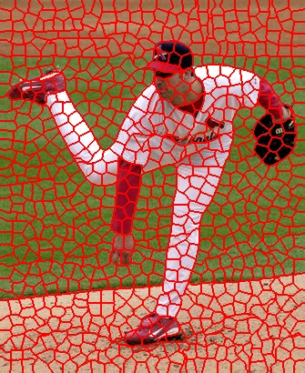
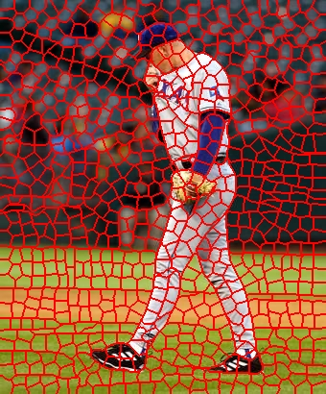
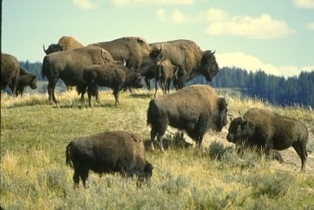
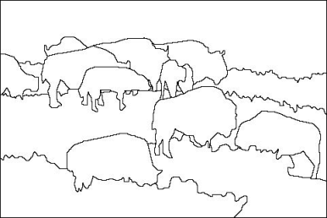
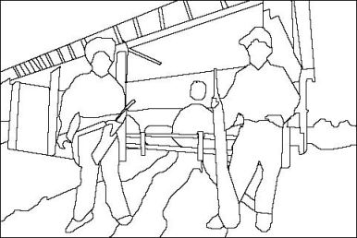
Recall: Image Segmentation
Group similar looking pixels together for efficiency of additional processing
Separate image into coherent objects

Slide 4
Recall: Stereo as a Minimization Prob
{
{
match cost
smoothness cost
Want each pixel to find a good match in the other image
Adjacent pixels should (usually) move about the same amount

Slide 5
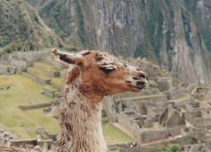
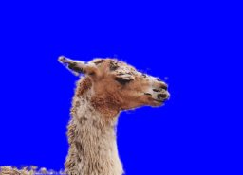
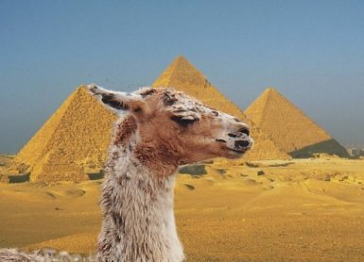
Related: Binary Segmentation
Separate an image into foreground and background
source: Noah Snavely

Slide 6
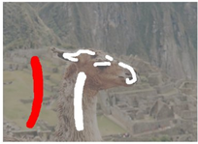
Related: Binary Segmentation
Separate an image into foreground and background
User sketches some strokes on foreground and background
How do we classify the rest of the pixels based on those lines?
source: Noah Snavely

Slide 7
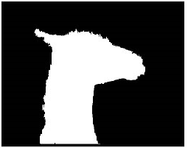
Binary Segmentation as Min Energy
Define a labeling, L:
as an assignment of each pixel with a 0 or 1 label
background or foreground
Problem:
Find the labeling that minimizes
match cost
smoothness cost
Goal: establish a function to measure how
similar a pixel is to the foreground (or background)

Slide 8
: “distance” from pixel to background pixels
{
usually computed by creating a color model from user-labeled pixels
: “distance” from pixel to foreground pixels
source: Noah Snavely

Slide 9
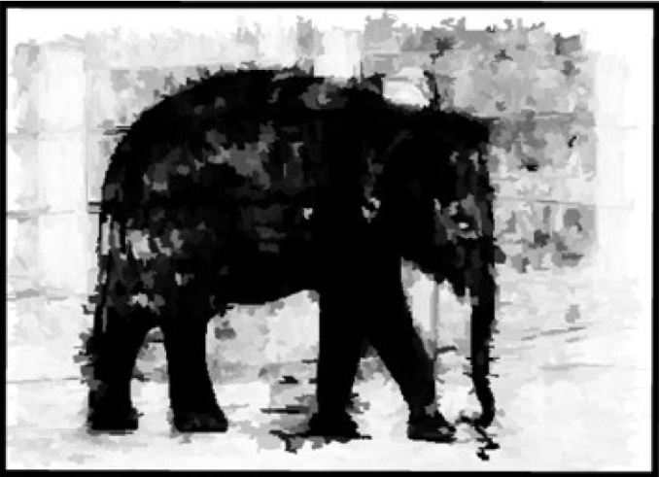
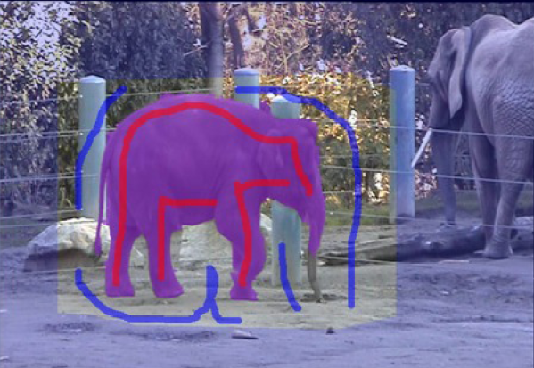
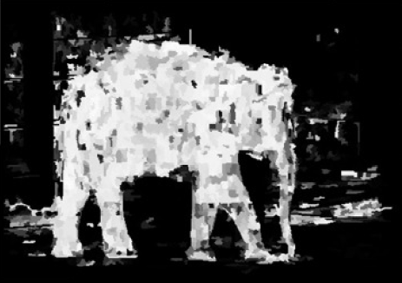
source: Noah Snavely

Slide 10
Neighboring pixels should generally have the same labels
Unless the pixels have very different intensities
: similarity in intensity of p and q
= 10.0
= 0.1
source: Noah Snavely

Slide 11
Solve with max flow / min cut
Once all is in place
We can solve
using max flow / min cut algorithm

Slide 12
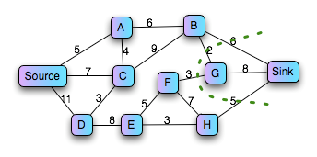
Graph min cut problem
Given a weighted graph G with source and sink nodes (s and t), partition the nodes into two sets, S and T such that the sum of edge weights spanning the partition is minimized
and s S and t T
source: Noah Snavely

Slide 13
Segmentation by min cut
min cut
t
(“background”)
s (“foreground”)
Graph
node for each pixel, link between adjacent pixels
specify a few pixels as foreground and background
create an infinite cost link from each bg pixel to the t node
create an infinite cost link from each fg pixel to the s node
create finite cost links from s and t to each other node
compute min cut that separates s from t
The min-cut max-flow theorem [Ford and Fulkerson 1956]
source: Noah Snavely

Slide 14
Segmentation by min cut
min cut
t
s
The partitions S and T formed by the min cut give the optimal foreground and background segmentation
i.e., the resulting labels minimize

Slide 15
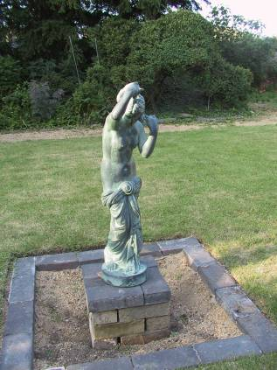
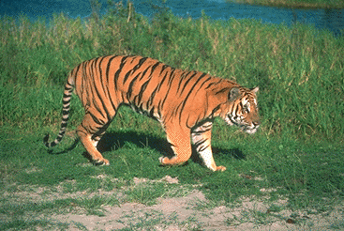
Related / More info
Grabcut
Rother et. al., SIGGRAPH 2004
Intelligent Scissors
Mortensen et. al, SIGGRAPH 1995

Slide 16
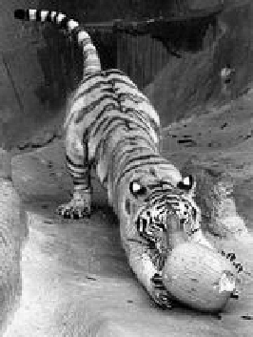
Fully Automatic [Shi and Malik]
q
C_{pq}
c
p
Fully connected graph
Node for every pixel
Edge between every pair of pixels
or every pair of sufficiently close pixels
Each edge is weighted by the similarity (affinity) of the two nodes
Similarity is inversely proportional to difference in color and position

Slide 17
Segmentation by graph partitioning
j
w_{ij}
i
A
B
C
Break Graph into Segments
Delete links that cross between segments
Easiest to break links that have low affinity
similar pixels should be in the same segments
dissimilar pixels should be in different segments
Source: S. Seitz

Slide 18
Measuring affinity
Suppose we represent each pixel by a feature vector x, and define a distance function appropriate for this feature representation
Then we can convert the distance between two feature vectors into an affinity with the help of a generalized Gaussian kernel:

Slide 19
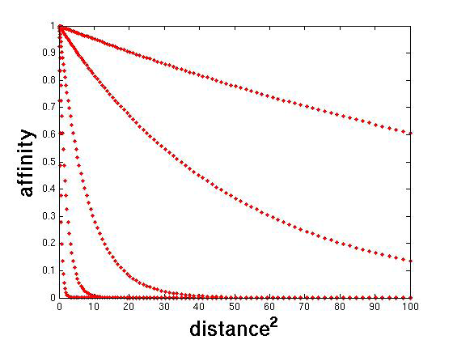
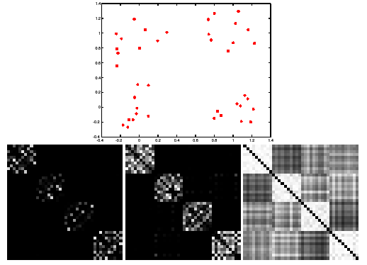
Scale affects affinity
Small σ: group only nearby points
Large σ: group far-away points

Slide 20
Graph cut
B
A
Set of edges whose removal makes a graph disconnected
Cost of a cut: sum of weights of cut edges
Any graph cut gives us a segmentation
Find a minimum cut
Gives us a “good” segmentation
Source: S. Seitz

Slide 21
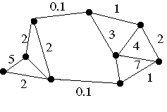
Example: Minimum Cut
We can do segmentation by finding the minimum cut in a graph
Efficient algorithms exist for doing this
Minimum cut example

Slide 22
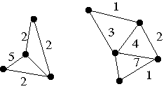
Example: Minimum Cut
We can do segmentation by finding the minimum cut in a graph
Efficient algorithms exist for doing this
Minimum cut example

Slide 23
Normalized cut
Drawback: minimum cut tends to cut off very small, isolated components
Cuts with
lesser weight
than the
ideal cut
Ideal Cut
* Slide from Khurram Hassan-Shafique CAP5415 Computer Vision 2003

Slide 24
Normalized Cuts
B
A
Normalized Cut
a cut penalizes large segments
fix by normalizing for size of segments
volume(A) = sum of costs of all edges that touch A
J. Shi and J. Malik. Normalized cuts and image segmentation. PAMI 2000

Slide 25
Interpretation as a Dynamical System
Treat the links as springs and shake the system
elasticity proportional to cost
vibration “modes” correspond to segments
can compute these by solving an eigenvector problem
http://www.cis.upenn.edu/~jshi/papers/pami_ncut.pdf

Slide 26
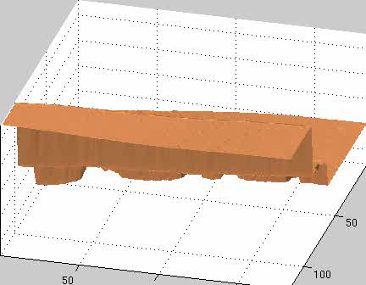
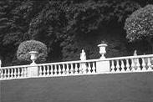
Interpretation as a Dynamical System
Treat the links as springs and shake the system
elasticity proportional to cost
vibration “modes” correspond to segments
can compute these by solving an eigenvector problem
http://www.cis.upenn.edu/~jshi/papers/pami_ncut.pdf

Slide 27
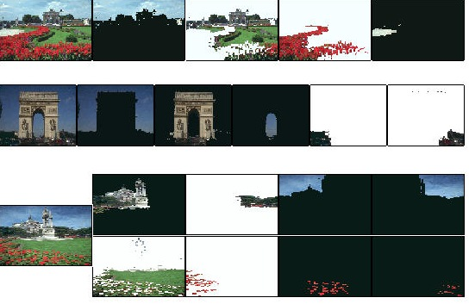
Color Image Segmentation

Slide 28
More Details: Normalized cut
Let W be the adjacency matrix of the graph
Let D be the diagonal matrix with diagonal entries D(i, i) = Σ_{j} W(i, j)
Then the normalized cut cost can be written as where y is an indicator vector whose value should be 1 in the ith position if the ith feature point belongs to A and a negative constant otherwise
J. Shi and J. Malik. Normalized cuts and image segmentation. PAMI 2000

Slide 29
Normalized cut
Finding the exact minimum of the normalized cut cost is NP-complete, but if we relax y to take on arbitrary values, then we can minimize the relaxed cost by solving the generalized eigenvalue problem (D − W)y = λDy
The solution y is given by the generalized eigenvector corresponding to the second smallest eigenvalue
Intutitively, the ith entry of y can be viewed as a “soft” indication of the component membership of the ith feature
Can use 0 or median value of the entries as the splitting point (threshold), or find threshold that minimizes the Ncut cost

Slide 30
Normalized cut algorithm
Represent the image as a weighted graph G = (V,E), compute the weight of each edge, and summarize the information in D and W
Solve (D − W)y = λDy for the eigenvector with the second smallest eigenvalue
Use the entries of the eigenvector to bipartition the graph
To find more than two clusters:
Recursively bipartition the graph
Run k-means clustering on values of several eigenvectors

Slide 31
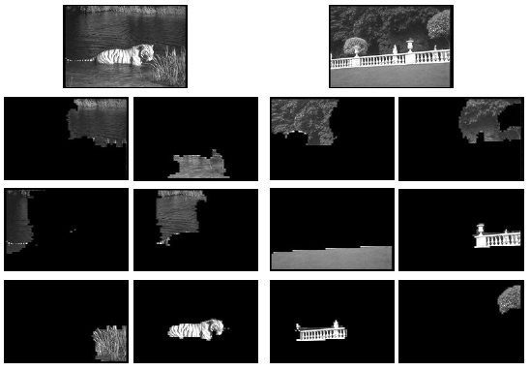
Example result

Slide 32
Questions?
Beyond D2L
Examples and information can be found online at:
http://docdingle.com/teaching/cs.html
Continue to more stuff as needed

Slide 33
Extra Reference Stuff Follows

Slide 34
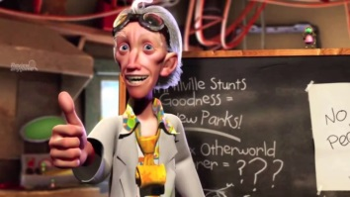
Credits
Much of the content derived/based on slides for use with the book:
Digital Image Processing, Gonzalez and Woods
Some layout and presentation style derived/based on presentations by
Donald House, Texas A&M University, 1999
Sventlana Lazebnik, UNC, 2010
Noah Snavely, Cornell University, 2012
Xin Li, WVU, 2014
George Wolberg, City College of New York, 2015
Yao Wang and Zhu Liu, NYU-Poly, 2015

