Slide 1

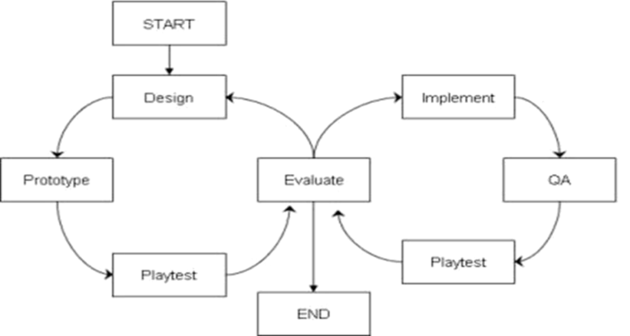
Creating a Game
Iterative Planning and Production
Rapid Prototyping and Mockups
Brent M. Dingle, Ph.D. 2015
Game Design and Development Program
Mathematics, Statistics and Computer Science
University of Wisconsin - Stout
See also references at end of slides (if any)

Slide 2
You Are More
You are more than
  an artist
  a programmer
You are studying to be
  a Game Designer and Developer (GDDer)
What does that mean?

Slide 3
A GDDer Understands
All aspects of design and development
  art
  sound
  programming
  story presentation
  workflow
  management
  advertising
  communication
  …

Slide 4
A GDDer Is
an artist
a programmer
Pretty clear on these two

Slide 5
A GDDer Is
an artist
a programmer
an architect
Architects create blueprints
Games require
  Design Docs
  Prototypes
From blueprints
  consistent (mass) production

Slide 6
A GDDer Is
an artist
a programmer
an architect
a party host
Players are invited into the designer’s “worlds”
  for enjoyment and entertainment

Slide 7
A GDDer Is
an artist
a programmer
an architect
a party host
godlike
Creating worlds
And the physical rules that govern those worlds

Slide 8
A GDDer Is
an artist
a programmer
an architect
a party host
godlike
a lawyer
Create
  and interpret
  and explain
  and defend/enforce
rules that players must follow
    and co-designers and developers must understand

Slide 9
A GDDer Is
an artist
a programmer
an architect
a party host
godlike
a lawyer
an educator
Many games require
  presenting and teaching
    new skills, ideas, concepts, frameworks of thinking
  to players
    and to co-designers/developers

Slide 10
A GDDer Is
an artist
a programmer
an architect
a party host
godlike
a lawyer
an educator
a research scientist
Creating a game
  Uses methods very much like the scientific method
  Requires study and understanding of fields beyond ‘gaming, art, cs…’

Slide 11
Methods and Process
Creating a game involves
  planning and producing
  both should be iterative and cyclic
Why?
Consider some history…

Slide 12
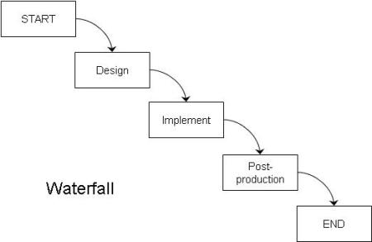
“Old” Process: Waterfall
Design all on
paper
Implement/program it
Test it
Add some “bling”
Ship it
Assumes all things go perfect
  Moves only in one direction
  No way to go back and fix things

Slide 13
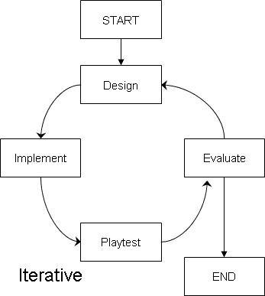
“Newer” Processes are Iterative
Start same as waterfall
  Design
  Implement
  Test
Add an extra phase
  Evaluate
Allows making changes if they are determined to be necessary

Slide 14
Link to Scientific Method
Make an observation
Propose hypothesis
Create Experiment to Test Hypothesis
Perform the Experiment
Evaluate Results
  Repeat as necessary

Slide 15
More = Better
The more iterations done
  The better the game is likely to be

Slide 16
Snag on Video Games
Implementation takes a LONG time
  Programming is slow
    Debugging is slower
  Artwork can be slow
    Finalizing is slower
  Often difficult and time consuming
  to change once in place

Slide 17
Solution on Video Games
Rapidly Prototype things
  Usually on “paper only” first
  Can be “easy digital”
    i.e. little to no programming
For clarity
  for this class
  we often/will call this a mockup

Slide 18
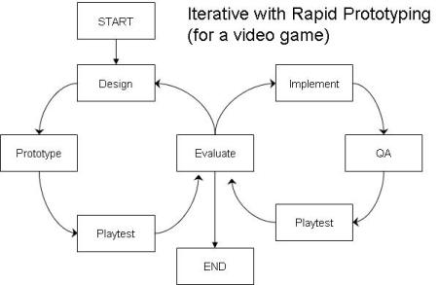
Iterative Rapid Prototyping
More Iterations = Better Game
  Iterate as many times as possible
  Don’t start implementing until the design/planning is well done
    Still possible to go back to design phase after implementation
    But minimizes the likelihood

Slide 19
Risks
Games have many risks
  Design Risk
    Risk game will not be fun and people won’t like it
  Implementation Risk
    Possibility the development team will not be able to build the game
  Market Risk
    Game is great, but people don’t buy it
  …more

Slide 20
Risks Versus Rapid Prototyping
Games have many risks
  Design Risk
    Risk game will not be fun and people won’t like it
  Rapid Prototyping helps reduce Design Risk

Slide 21
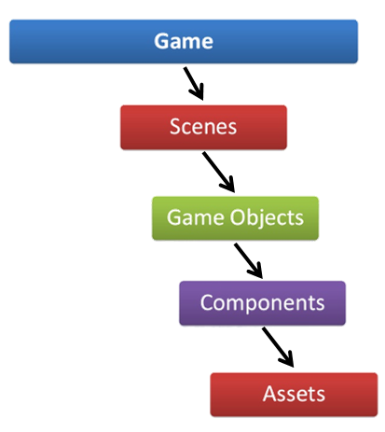
Risks Versus Game Decomposition
Games have many risks
  Design Risk
    Risk game will not be fun and people won’t like it
  Implementation Risk
    Possibility the development team will not be able to build the game
  Market Risk
    Game is great, but people don’t buy it
  …
Later we will see how proper
Game Decomposition can reduce
the Implementation Risk

Slide 22
Also In the Future: Agile Design
Later
  We will take a closer look at agile design
    And how Rapid Prototyping relates

Slide 23
For Now: Take Away
The greater the Design Risk
    the more unknowns you have
    the more untested and unproven rules your have
The more iterations you will need

Slide 24
Risk to Video Games
Video games can have impressive technology
  physics
  graphics
  sounds
  …
Obscuring the “staleness” of the gameplay

Slide 25
Suggestion/Requirement
Take the time to create mockups
  Do the iterations
  Make the planning as solid as it can be
The catch
  Must do so quickly enough to
  have time to implement

Slide 26
End Summary
Great designers do not design great games
  Often the design is bad at the beginning
  iteration and testing makes them become great
Notables
  Have a playable mockup of your game as early in development as possible
    Faster this happens = faster you can test ideas
  With equal amounts of time to create
    Shorter, simpler game will be better than long & complicated
      Simple Reason: Longer games take longer to iterate

Slide 27
Questions?
Beyond D2L
  Examples and information
  can be found online at:
    http://docdingle.com/
    Continue to more stuff as needed

Slide 28
References
Some material in these slides was derived/based on material from:
  Ian Schreiber, Game Design Concepts
  https://gamedesignconcepts.wordpress.com/
  Released under a Creative Commons Attribution 3.0 U.S. License
    http://creativecommons.org/licenses/by/3.0/us/

