Slide 1
Prototyping with a Purpose
Brent M. Dingle 2014
Game Design and Development Program
Mathematics, Statistics and Computer Science
University of Wisconsin - Stout
Some content based on GDC 2006, Gingold and Hecker
Notes:
The trick to these slides is NOT to read them.
A lot of the information is there for later reference. Present a summary of what is on the slides
Relate information to class more

Slide 2
Presentation Outline
Prototyping General Info
Asking Good Questions
How to Decompose a Project
How to Measure a Prototype

Slide 3
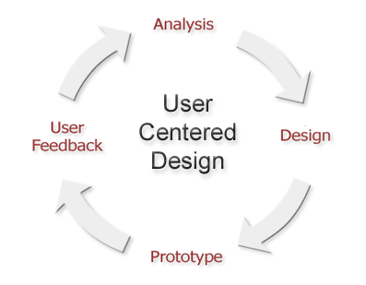
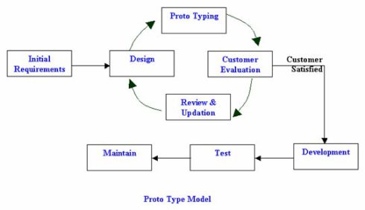
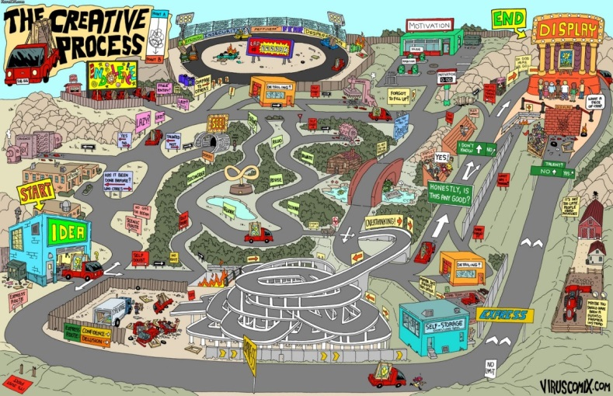
Using Prototyping
Many ways to look at how Prototyping is used
Conceptually the same in every case
Test something, Prove Something…
Learn, Adapt…
Let’s look at it from Game Production

Slide 4
High Level Production Stages
Have an Idea
Discovery
Preproduction
Develop
Sell

Slide 5
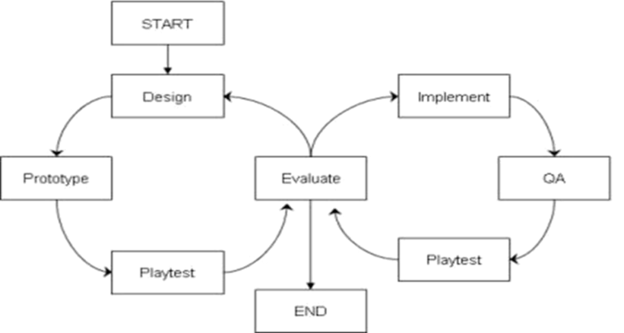
High Level Production Stages
Have an Idea
Discovery
Preproduction
Develop
Sell
Prototyping
is useful and often necessary

Slide 6
Why Prototype?
Most Common: Answer questions
e.g. Will this work?
Also
Discover/uncover the unexpected
downside and upside
Persuade and inspire
YES this will work = PERSUASIVE
Prototype Validates the idea
What if answer is NOT yes,
or not just “yes or no”

Slide 7
Why Prototype?
Most Common: Answer questions
e.g. Will this work?
Also
Discover/uncover the unexpected
downside and upside
Persuade and inspire
NO this will not work = DOWNSIDE
BUT it does do this and this = UPSIDE
So what if we do it like this…

Slide 8
Why Prototype?
Most Common: Answer questions
e.g. Will this work?
Also
Discover/uncover the unexpected
upside and downside
Persuade and inspire
Prototypes do NOT GENERATE ideas
They VALIDATE them
But can generate upsides and suggest ideas

Slide 9
Presentation Outline
Prototyping General Info
Asking Good Questions
How to Decompose a Project
How to Measure a Prototype

Slide 10
Important: Ask a Good Question
How to formulate good questions for prototyping
Focus On
Where do you need understanding?
Target other questions in this area
Let’s consider some examples questions…

Slide 11
Question
Can we make a fun social game between characters?
Is this a good or bad question to use a prototype to answer?

Slide 12
Poor Question
Can we make a fun social game between characters?
Bad!
There is nothing to try and test here.
What idea do you want to try out?

Slide 13
Question
Is the “Leg User Interface concept” user friendly, powerful, and cool?
Is this a good or bad question to use a prototype to answer?

Slide 14
Good Question
Is the Leg UI concept user friendly, powerful, and cool?
Good!
It is testable.
Build it.
Demo it. Ask people about it.
Do they need help? Is it cool? Does it accomplish what we want it to?

Slide 15
Question
Can rolling around a sticky ball be compelling?
Is this a good or bad question to use a prototype to answer?

Slide 16
Good Question
Can rolling around a sticky ball be compelling?
Good!
It is testable.
Build it.
Demo it. Ask people about it.
Do they think it is cool and fun?
And do they keep playing?

Slide 17
Question
Here is the game description document.
Is it going to be fun?
Is this a good or bad question to use a prototype to answer?

Slide 18
Poor Question
Here is the game description document.
Is it going to be fun?
Bad!
It is an idea.
But is very unfocussed.
It basically would require the entire game to be built,
which really is not a prototype.
You must deconstruct/decompose the features.
How do you reduce a large problem into smaller manageable ones?
And stay relevant to the big picture of the project’s idea (it’s vision)?
This is a skill to learn.

Slide 19
Presentation Outline
Prototyping General Info
Asking Good Questions
How to Decompose a Project
How to Measure a Prototype

Slide 20
Decomposition
Examine what you need to know about

Slide 21
Decomposition
Examine what you need to know about
Divide it into smaller pieces

Slide 22
Decomposition
Examine what you need to know about
Divide it into smaller pieces
Make sure the pieces fit together

Slide 23
Decomposition
Examine what you need to know about
Divide it into smaller pieces
Make sure the pieces fit together
Keep track of which pieces depend on others

Slide 24
Decomposition
Examine what you need to know about
Divide it into smaller pieces
Make sure the pieces fit together
Keep track of which pieces depend on others
Know the bounds of your prototype
Decent Size
Large Size
Huge Size
Out of Bounds

Slide 25
Decomposition
Examine what you need to know about
Divide it into smaller pieces
Make sure the pieces fit together
Keep track of which pieces depend on others
Know the bounds of your prototype
Do not overreach
Stay inside the lines of your piece

Slide 26
Presentation Outline
Prototyping General Info
Asking Good Questions
How to Decompose a Project
How to Measure a Prototype

Slide 27
Measuring a Prototype
Metrics
Cheap
Falsifiable
Relevant

Slide 28
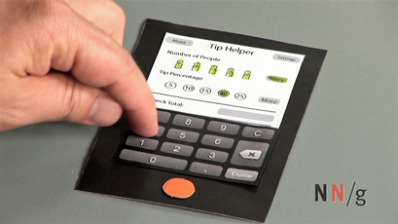
Measuring a Prototype
Metrics
Cheap
Falsifiable
Relevant
Take less effort than the real thing
Cost almost nothing (very little)

Slide 29
Measuring a Prototype
Metrics
Cheap
Agile
Falsifiable
Relevant
Adding suggestions and changes
should be trivial

Slide 30
Measuring a Prototype
Metrics
Cheap
Agile
Light
Falsifiable
Relevant
Typically only one person
working on a prototype at a time
We use teams of two for multiple
educational reasons

Slide 31
Measuring a Prototype
Metrics
Cheap
Agile
Light
Falsifiable
Relevant
You should be looking to prove something.
You should be able to prove
a good idea is good
and a bad idea is bad

Slide 32
Measuring a Prototype
Metrics
Cheap
Agile
Light
Falsifiable
Make a Claim
Relevant
If you cannot explain why or what you want
to achieve by making a prototype,
then you may want to rethink making it
The prototype should be needed to validate or disprove something
Example:
The [blarg] on the right side of the
screen improves [shozbot] more than having
it on the left side of the screen

Slide 33
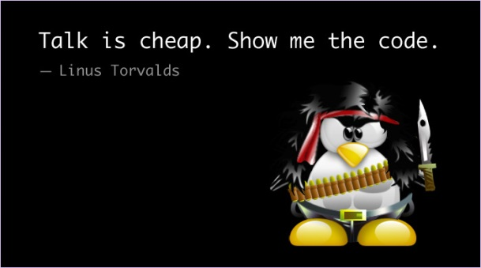
Measuring a Prototype
Metrics
Cheap
Agile
Light
Falsifiable
Make a Claim
Testable
Relevant
How does your prototype TEST your claim?
Will it show something is clearly working or not?
Design the prototype so it obviously shows
success or failure.
This is not a theoretical experiment.
And the results should not be “open”
to much variance in interpretation

Slide 34
Measuring a Prototype
Metrics
Cheap
Agile
Light
Falsifiable
Make a Claim
Testable
Tested
Relevant
Tested by others
NOT just by prototype’s creator(s)
Data collected
Explain why the design is this way
based on the data

Slide 35
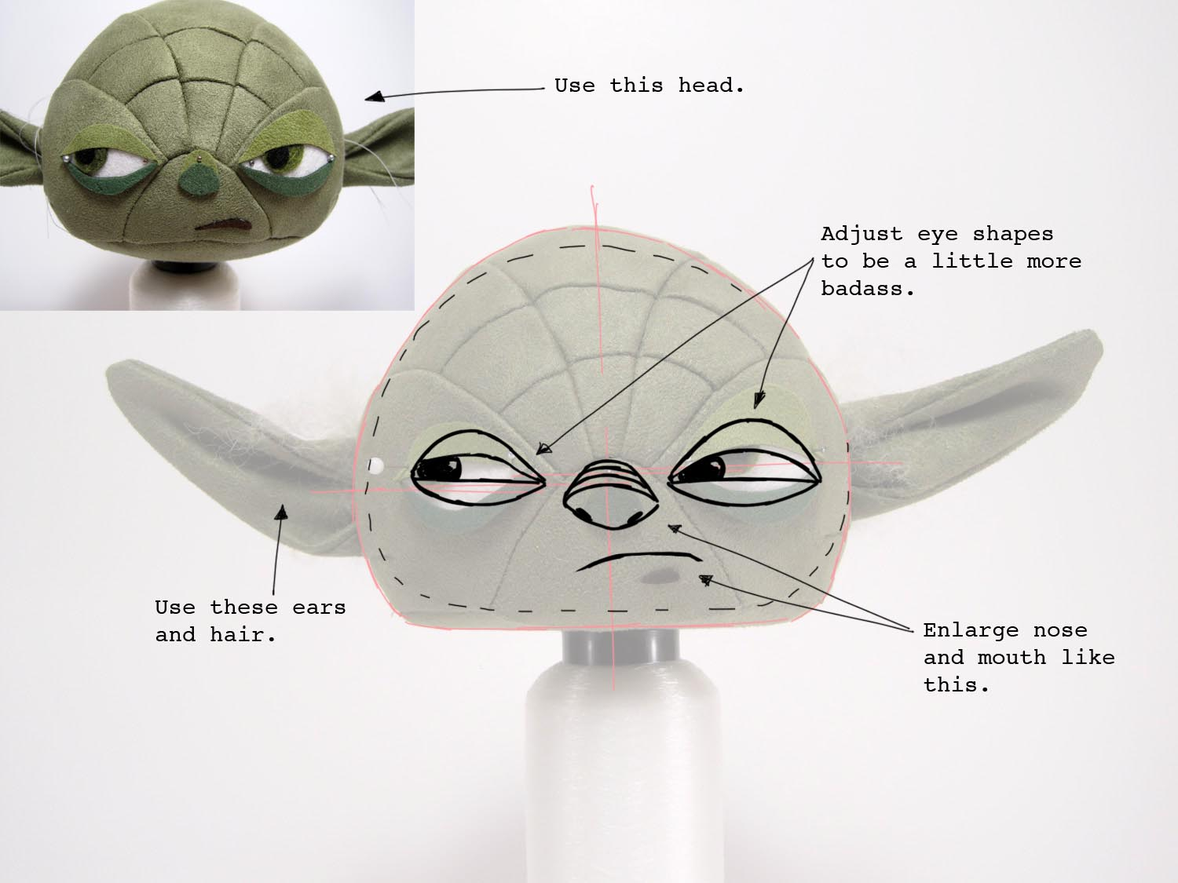
Measuring a Prototype
Metrics
Cheap
Agile
Light
Falsifiable
Make a Claim
Testable
Tested
Learn
Relevant
Identify and Record:
What was learned from the prototype?

Slide 36
Measuring a Prototype
Metrics
Cheap
Agile
Light
Falsifiable
Make a Claim
Testable
Tested
Learn
Relevant
Prototypes must be relevant to the project at hand
Generalizable helps
Prototype becomes incorporated into product
Code or Art can be reused
Design Reuse
Reference point for design/development

Slide 37
Measuring: In The Bonus
Good prototypes do something unexpected and useful
Surprising
Feedback
Upside Downside
Inspiring
Persuasive
Fun
Tangible
Clear
Disruptive

Slide 38
Measuring: In The Bonus
Good prototypes do something unexpected and useful
Surprising
Feedback
Upside Downside
Inspiring
Persuasive
Fun
Tangible
Clear
Disruptive
Good prototypes get lots of feedback
You want people to comment
and not just “yeah good” or “yeah bad”
If you have to beg to get meaningful feedback
Something is off
and it could be something major
that nobody wants to talk about
Like the whole concept stinks
or the prototype is “pointless”

Slide 39
Measuring: In The Bonus
Good prototypes do something unexpected and useful
Surprising
Feedback
Upside Downside
Inspiring
Persuasive
Fun
Tangible
Clear
Disruptive
Good Prototypes
should uncover GOOD and BAD things
If all goes as planned
with no exciting discoveries
or hidden pitfalls
the prototype is likely off in some way
Perhaps the wrong question(s) are being asked

Slide 40
Measuring: In The Bonus
Good prototypes do something unexpected and useful
Surprising
Feedback
Upside Downside
Inspiring
Persuasive
Fun
Tangible
Clear
Disruptive
A prototype should inspire MORE Questions
Revealing more fun stuff
or problems to investigate
WARNING: Eventually the continued exploring
must end (be saved for later).
This hopefully happens when the problems
to investigate are small and the fun is large.
If you are lucky you will always think it ends too soon.
If you are really lucky you will get to go back and
do more (like sequel… oh yeah)

Slide 41
Measuring: In The Bonus
Surprising
Feedback
Upside Downside
Inspiring
Persuasive
Fun
Tangible
Clear
Disruptive
Good Prototypes should Convince people of things

Slide 42
Measuring: In The Bonus
Surprising
Feedback
Upside Downside
Inspiring
Persuasive
Fun
Tangible
Clear
Disruptive
Good Prototypes should Convince people of things
The prototype needs to be
cool, exciting, entertaining, FUN!
That is what the game needs to be too
So in the background the prototype
tests more than just a single question
People must want to see and play
your prototype – just as they would the game
They should be excited about what you are doing
Just like they would the game
Again wanting to be involved, give feedback

Slide 43
Measuring: In The Bonus
Surprising
Feedback
Upside Downside
Inspiring
Persuasive
Fun
Tangible
Clear
Disruptive
Good Prototypes should Convince people of things
Prototypes are not theory.
They should CLEARLY communicate
and make REAL whatever they are getting at
People should look at the prototype and GET IT
The design, the concept, the fun, the interface,
whatever.
Minimal explanation should be required.

Slide 44
Measuring: In The Bonus
Surprising
Feedback
Upside Downside
Inspiring
Persuasive
Fun
Tangible
Clear
Disruptive
Good Prototypes should Convince people of things
Prototypes are not theory.
They should CLEARLY communicate
and make REAL whatever they are getting at
People should look at the prototype and GET IT
The design, the concept, the fun, the interface,
whatever.
Minimal explanation should be required.
Hopefully that is clear

Slide 45
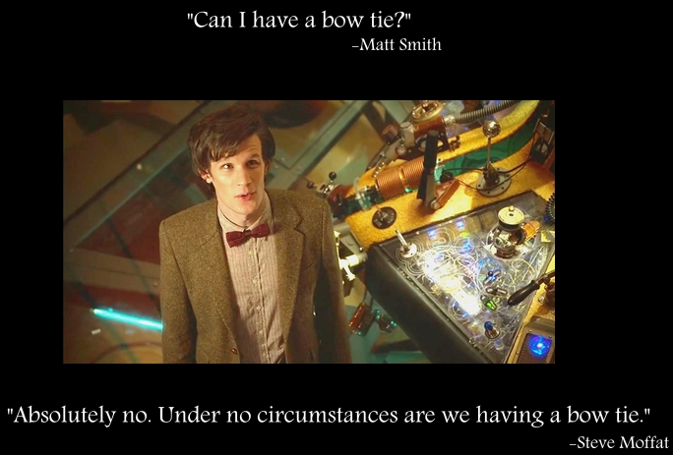
Measuring: In The Bonus
Surprising
Feedback
Upside Downside
Inspiring
Persuasive
Fun
Tangible
Clear
Disruptive
Good Prototypes should Convince people of things
Prototypes should change people’s minds
If nobody is convinced of anything…
Then what is the prototype really doing?

Slide 46
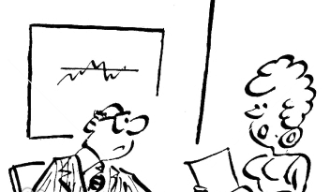
Keeping the Prototype
Prototypes may be labeled “throw away”
However
The results must be kept
to be able to Revisit and Reexamine the results
A good prototype (and its results)
Will be consulted multiple times throughout development
If no one ever revisits it, then perhaps it was not such a useful thing to prototype
The answers it provided were never really in question?
Or the questions were not very useful?
Or it never really answered anything?

Slide 47
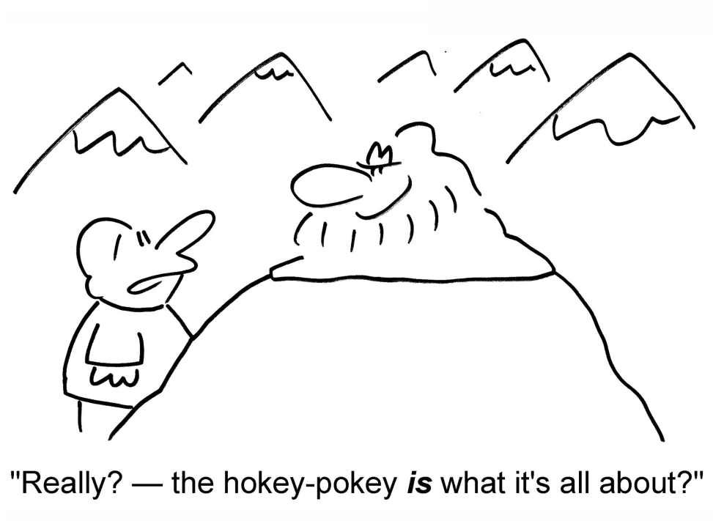
Theoretical Questions?

Slide 48
End

Slide 49
Additional Information/Resource
GDC 2006: Advanced Prototyping Presentation by Chaim Gingold and Chris Hecker

Slide 50
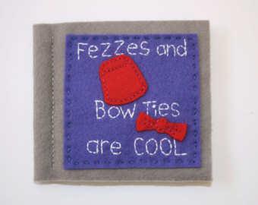
Design Doc versus Prototype
Prototype
Cheap
Interactive
Sexy
Science
Document
Really Cheap
Static
Boring
Faith

