Slide 1



What is a Game?
Brent M. Dingle, Ph.D. 2015
Game Design and Development Program
Mathematics, Statistics and Computer Science
University of Wisconsin - Stout
See also references at end of slides (if any)

Slide 2
A Definition
A Game is
  a play activity with rules that involves conflict
Problem?
  It says nothing about how to design a game

Slide 3
Formal Elements
Perhaps easier to discuss a game in terms of its component parts
  rules
  resources
  actions
  story
  …
These may also be called “formal elements” of a game

Slide 4
How to Find the Parts
Consider options

Slide 5
Definition 1
A game has “ends and means”
  an objective,
  an outcome,
  and a set of rules to get there
        David Parlett

Slide 6
Definition 2
A game is
  an activity involving
    player decisions,
    seeking objectives
    within a “limiting context”
        Clark C. Abt

Slide 7
Definition 3
A game has six properties
  it is “free”
    playing is optional and not obligatory
  separate
    fixed in space and time, in advance
  has an uncertain outcome
  is unproductive
    generates neither goods nor wealth
  is governed by rules
  is “make believe”
    not real life, but a shared separate reality
        Roger Callois

Slide 8
Definition 4
A game is a
  voluntary effort to overcome unnecessary obstacles
        Bernard Suits
    NOTE: this definition implies
      voluntary
      with goals
      and rules
      “unnecessary”
        implying inefficiency caused by rules on purpose

Slide 9
Definition 5
Games have 4 properties
  Closed formal system
    formal meaning defined
  Involve interaction
  Involve conflict
  Offer safety
    as compared to what they might fully represent
        Chris Crawford

Slide 10
Definition 6
Games are a form of art
  which the participants (players)
    make decisions
    to manage resources
    using game tokens
    in the pursuit of a goal
        Greg Costikyan

Slide 11
Definition 7
Games are a system in which
  players engage in
    an artificial conflict
    defined by rules
    that results in a quantifiable outcome
      i.e. there is winning and losing
        book: Rules of Play by Katie Salen and Eric Zimmerman
        which also lists all the above definitions

Slide 12
Common Elements
Games (implicitly) have players
Games are an activity
Games have rules
Games have conflict
Games have goals
Games involve decision making
Games are artificial, safe, outside ordinary life
Games involve no material gain on the part of the players
Games are voluntary
Games have an uncertain outcome
Games are a representation or simulation of something real but are themselves make believe
Games are inefficient
Games have systems
Games are a form of art

Slide 13
Observations on: Goals Part
Object of the game is what?
  Players are trying to do what?
Goals can help tie the parts of a game together
Details Vary
  Some Generic Options
    Capture/Destroy
    Control Territory
    Collection
    Solve (like Clue)
    Chase/Race/Escape
    Build

Slide 14
Observations on: Story Part
Games should have a story
  Narrative of the game
  Theme of the game
  Binds events, goals, objectives, parts together
  Moves player towards the completion of the game
  Options:
    Designer driven
    Emergent based on player choices and actions
    Linear
    Non-Linear

Slide 15
Observations on: Rules Part
Rules and Mechanics of a game
  are tricky
  are subtle
  need details
  must be tested
    using mockups and prototypes
    by ‘real’ players and designers and developers
  can bind parts of the game together
  should create/support player expectations

Slide 16
Observations on System Part
Games have/are Systems
  a set of connected things or parts forming a complex whole
  a set of principles or procedures according to which something is done
  an entire group of parts that work together
A “good” game ties all of its parts together

Slide 17
End Point of Element Parts
Game Design is Designing a System of Elements
  Each element may influence another
  Changing one element may change the entire game
  The combination of elements forms a complex whole
A system may be a system of systems
  a game containing games
The game/system state
is dependent on the state of its elements
  Allows for emergent behavior (from a simple rule set)
  Difficulty in predicting
    Player choices are variable and affect states
mechanics yield system dynamics

Slide 18
Recall
Designing a game is designing a system
Game design and development is iterative
Games can be described as
  the successive layering of constraints
Games have elements

Slide 19
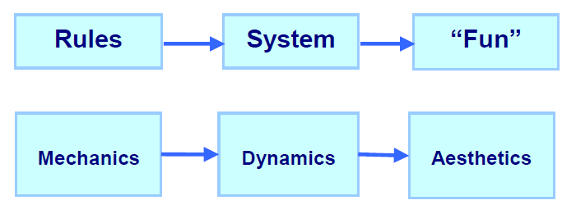
Another Set of Parts
It is possible to look at a game in different ways depending on how you define “parts”
The Mechanics, Dynamics, Aesthetics (MDA) Framework
    Has received a lot of attention from industry professionals
    Shows the designer perspective AND the player perspective
      How each “sees” and relates to the same game parts
    Aids the process of designing and developing a game
              Defined in 2001 by LeBlanc, Hunicke, and Zabek
                http://www.cs.northwestern.edu/~hunicke/MDA.pdf

Slide 20
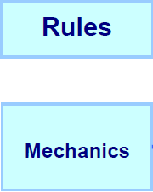
Mechanics = Rules
Mechanics are the rules of the game at the level of data representation and algorithms
These Formal Rules define
  What is allowed (and not allowed)
  How is the game setup
  What actions can players perform
  What goals/objectives can/should/must be achieved
  When does the game end
    Who wins, who loses, what is scored
  How are rules enforced
  …

Slide 21

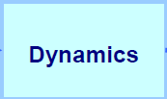
Dynamics = System (in motion)
Dynamics describe the run-time behavior of the mechanics acting on player inputs and each others’ outputs over time
  Describe the “play” of the game
    What strategies/behaviors emerge from the rules
    How do the players interact with the environment and each other

Slide 22

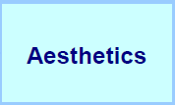
Aesthetics = “Fun”
Aesthetics describes the desired emotional responses evoked in the player when interacting with the game system
  Not the visual elements of the game
  But rather
  the player experience of the game
    enjoyable, fun, frustrating, boring, interesting…
    emotionally or intellectually engaging

Slide 23
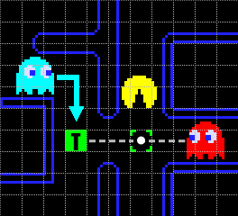
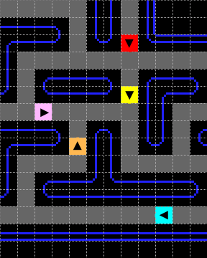
Example: Pac Man Mechanic
Ghost’s pathfinding logic is defined by rules
  Each ghost has a unique seeking mechanic
  Blinky targets the tile player is in
  Inky targets the end of the vector that
    starts at Blinky,
    goes through two tiles in front of player
    is twice as long as distance of that tile to Blinky
http://home.comcast.net/~jpittman2/pacman/pacmandossier.html

Slide 24
Example: Pac Man Dynamic
The rules create a dynamic
  where the player is trapped by Blinky and Inky
http://home.comcast.net/~jpittman2/pacman/pacmandossier.html

Slide 25
Example: Pac Man Dynamic
The enemy dynamics challenge the player
  creating an aesthetic of fun and excitement
http://home.comcast.net/~jpittman2/pacman/pacmandossier.html

Slide 26

Example: Spawn Points
First-Person Shooters often have a “Spawn Point” Mechanic

Slide 27
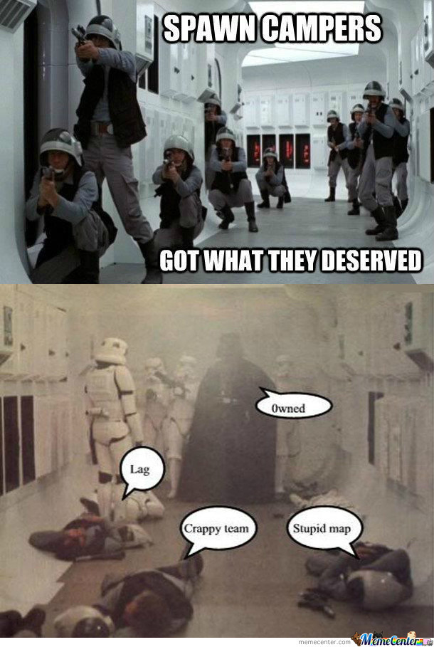
Example: Spawn Points
Leading to the dynamic where a player may sit near a spawn point and take out players as they respawn

Slide 28
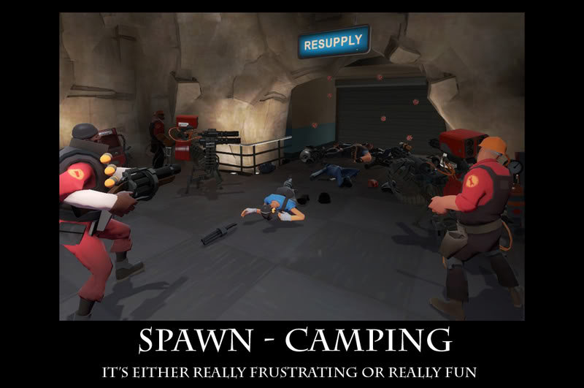
Example: Spawn Points
Leading to the Aesthetic of Player Frustration

Slide 29
Order of Thought
This is the order a Designer will often experience/plan the game
  Designers control the mechanics
  Mechanics generate dynamics
  Dynamics generate aesthetics
Designers often work outward
  design the mechanic to generate the desired aesthetic

Slide 30
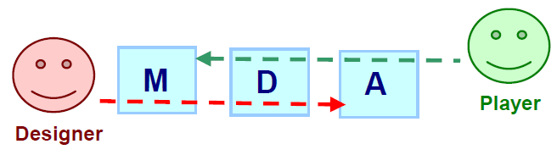
Player View
Players see things in reverse order
  Aesthetics set the tone
  which is created from observed dynamics
  which is controlled by operable mechanics

Slide 31
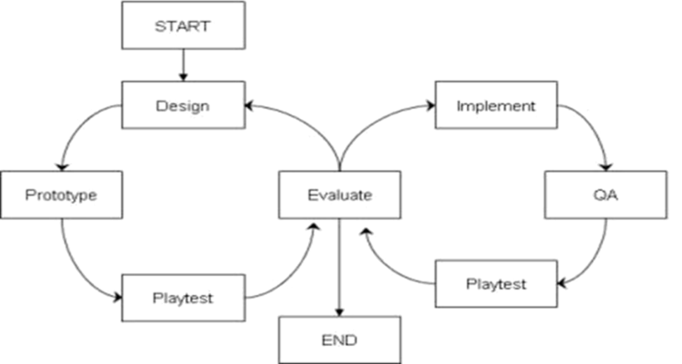
End Summary
Games are composed of elements/parts
Rules are a major part of a game
  Designers create rules
    Rules create gameplay
    Gameplay creates player experience
  A small rule change may have enormous (or no) effect
Play Testing is critical
  Test early ➔ mockups, prototypes
  Test Often
  Evaluate
  Improve
  Iterate, Iterate, Iterate
  From “Success” to “More Success”

Slide 32
Questions?
Beyond D2L
  Examples and information
  can be found online at:
    http://docdingle.com/teaching/gdd450/
    Continue to more stuff as needed

Slide 33
References
Some material in these slides was derived/based on material from:
  Ian Schreiber, Game Design Concepts
    https://gamedesignconcepts.wordpress.com/
    Released under a Creative Commons Attribution 3.0 U.S. License
      http://creativecommons.org/licenses/by/3.0/us/
  Matthew Gallant, Mechanics, Dynamics & Aesthetics
    Blog, August 21, 2009
      http://gangles.ca/2009/08/21/mda/

