Slide 1
Game Design For Development
From Top to Bottom and Back Up
Brent M. Dingle 2015
Game Design and Development Program
Mathematics, Statistics and Computer Science
University of Wisconsin - Stout

Slide 2
Again, Who Are You?
You are
  NOT just an Artist
  NOT just a Programmer
You are learning to
  Design
  AND Develop
  Games
Millions of these
Very few Understand
and Can Do this
NOT JUST GAMES
Process for Games
transfers to design and development
of other things
-- remember this !!!

Slide 3
Emphasis for Today
Designing and Developing a game
  requires understanding many aspects
  of the Design AND Development process
You should be learning
  to think at all levels of the process
When designing a game you should consider
  all aspects of creating and implementing it
    plus all the other things that make a good design

Slide 4
Motivation Summary
Designing a game FOR Development
  requires consideration and understanding of
  all the aspects of creating and implementing it
Lots of people have game Ideas
Some can put their idea into a Design description
Very few see their designs be Developed into real games
Increase your odds
  Design so it is easy to Develop

Slide 5
Design Versus Development
Designing a game is easy
  if you stop at the high level description
  and do not care about the details
      time travel is also easy if done this way
A good design
  takes into consideration the feasibility, measurability, and organization of development

Slide 6
Previously
Designing a game is designing a system
Game design and development is iterative
Games can be described as
  the successive layering of constraints
Games have elements

Slide 7
Another Set of Parts
A game (design)
can be decomposed to parts
that are useful in
planning and measuring
development

Slide 8
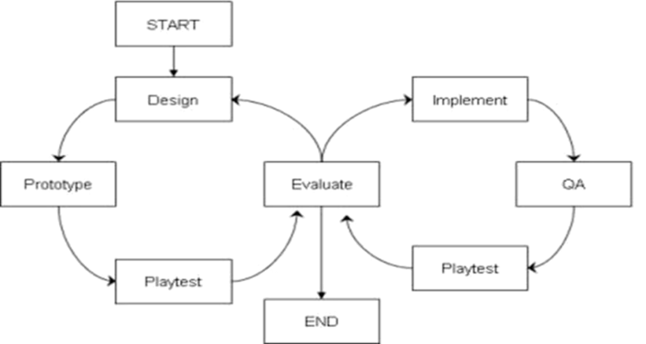
How this Fits
The following is more applicable
to the stages
after mockups and early prototype
iterations
This decomposition
should be considered
  before major programming and artwork development begin
  after a solid game core has been established

Slide 9





Design: Top-Down
Design
  starts at a high level
  and works down
  into the details
This is TOP-DOWN

Slide 10
Development: Bottom-Up
Development
  is often a
  Bottom-Up
  process
Start Small
  Assemble into Big

Slide 11
Design FOR Development
Design is Top-Down
Development is Bottom-Up
If the Design can reduce things into the low level asset requirements
Then Development becomes the process of creating and assembling those assets into the game
  the success of which can be tracked and measured
  there is a clear picture of how and what needs to be developed and by who to achieve the game as designed
    organized chaos

Slide 12
And
So What?
  Design = top-down
  Development = bottom-up
How do we use this information?
Start with the high level design
  Can you decompose it for development?

Slide 13
From the Top
Decompose the game into manageable pieces
  Assets, or game elements,
  that can be assigned to people to create
How?
  Categorize the assets
  Similar to how people skills might be categorized

Slide 14
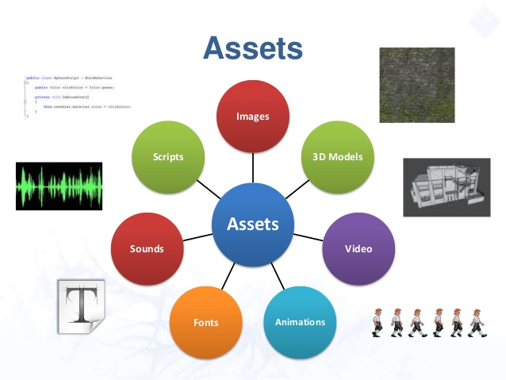
Asset Categories

Slide 15
Asset Categories

Slide 16
Asset Categories

Slide 17
Asset Categories

Slide 18
Asset Categories

Slide 19
Asset Categories

Slide 20
Asset Categories

Slide 21
Asset Categories

Slide 22
Decompose
Have categories of people skills and assets
Now Decompose the game – From the Top

Slide 23
Top Down
Since we have only a high level (top) view
  We start with a TOP-DOWN approach
      Later
      When we have lots of basic pieces/assets
        We may add extra stuff using a Bottom-Up Approach
          Re-using assets already created (crazy isn’t it?)
Reiterating:
Design and Planning go Top-Down
Development and Implementation go Bottom-Up

Slide 24
Asset List Creation – Top Down
From Big to Small
We have a description of a game
Should include scenes/levels/menus/…
Notes:
Start with a “big” picture
Break it into smaller pieces
Then smaller pieces
Then smaller pieces
Until you arrive at a “size” that is manageable,
and can be formed into different bigger things (yet similar in nature and style)

Slide 25
Asset List Creation – Top Down
From Big to Small
We have a description of a game
Should include scenes/levels/menus/…
Decide on a scene to create
Notes:
Start with a “big” picture
Break it into smaller pieces
Then smaller pieces
Then smaller pieces
Until you arrive at a “size” that is manageable,
and can be formed into different bigger things (yet similar in nature and style)

Slide 26
Asset List Creation – Top Down
From Big to Small
We have a description of a game
Should include scenes/levels/menus/…
Decide on a scene to create
Determine what type of objects are
needed to create that scene
Notes:
Start with a “big” picture
Break it into smaller pieces
Then smaller pieces
Then smaller pieces
Until you arrive at a “size” that is manageable,
and can be formed into different bigger things (yet similar in nature and style)

Slide 27
Asset List Creation – Top Down
From Big to Small
We have a description of a game
Should include scenes/levels/menus/…
Decide on a scene to create
Determine what type of objects are
needed to create that scene
Determine what components we need
to make each object in the selected scene
Notes:
Start with a “big” picture
Break it into smaller pieces
Then smaller pieces
Then smaller pieces
Until you arrive at a “size” that is manageable,
and can be formed into different bigger things (yet similar in nature and style)

Slide 28
Asset List Creation – Top Down
From Big to Small
We have a description of a game
Should include scenes/levels/menus/…
Decide on a scene to create
Determine what type of objects are
needed to create that scene
Determine what components we need
to make each object in the selected scene
Determine what assets are needed to
make each of those components
Notes:
Start with a “big” picture
Break it into smaller pieces
Then smaller pieces
Then smaller pieces
Until you arrive at a “size” that is manageable,
and can be formed into different bigger things (yet similar in nature and style)

Slide 29
Asset List Creation – Top Down
From Big to Small
We have a description of a game
Should include scenes/levels/menus/…
Decide on a scene to create
Determine what type of objects are
needed to create that scene
Determine what components we need
to make each object in the selected scene
Determine what assets are needed to
make each of those components
And now we have a list of assets
for ONE scene
Repeat for the other scenes
Notes:
Start with a “big” picture
Break it into smaller pieces
Then smaller pieces
Then smaller pieces
Until you arrive at a “size” that is manageable,
and can be formed into different bigger things (yet similar in nature and style)

Slide 30
Decomposition Process
Decomposing a Game into Scenes is ‘easy’
  Scenes are as in theater → “set the scene”
    A level is a scene (sometimes multiple scenes)
    A secret area is a scene
    A start menu can be a scene
    A pause screen can be a scene
  Objects are also ‘easy’
    Things that are in the scene
    Each thing is made of re-usable components
      Car versus Truck… wheels, doors, headlights, engine

Slide 31
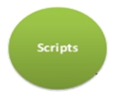
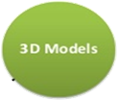
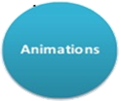



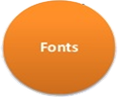
Components Versus Assets
Assets are typed/categorized
  For example:
A component is “composed of”
  a small number of assets
    of the same or different types

Slide 32
Ideal Decomposition
Ideally the
designer would
decompose the entire
game to assets

Slide 33
Reality
Ideally the
designer would
decompose the entire
game to assets
More often Design and Planning
stop at the game object level

Slide 34
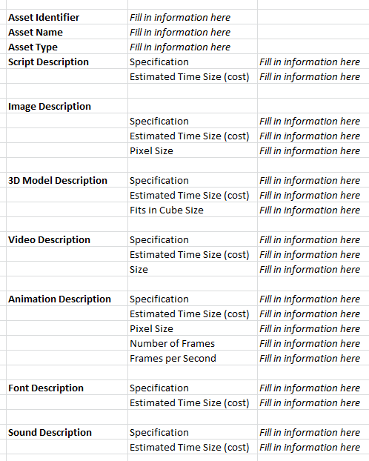
OBJECT Asset Sheets
Design stopping at the object level leads to the use of OBJECT Asset Sheets
Typically these are created by the development team
  One for each object the designer has specified to be in a scene

Slide 35
Object Decomposition Example
Example: PAC-MAN Object
  Script Component
    Asset: Script for user interface motion control
    Asset: Script for collision with walls
      with food and points update
      with ghosts and death (if not powered up)
      …
    …
  Image Component
    Asset: Static Image for marketing
    Asset: Static Image for menus
  Animation Component
    Asset: Image Sequence for Moving
    Asset: Image Sequence for Dying
  Sound Component
    Asset: Sound for moving
    Asset: Sound for eating
    Asset: Sound for dying

Slide 36
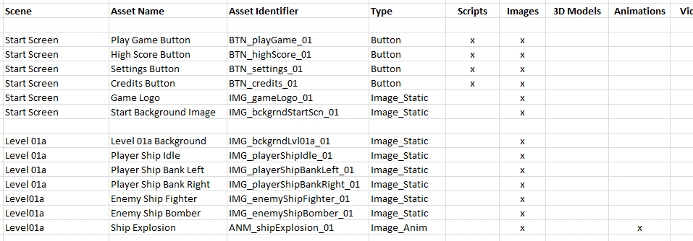
Object Asset Lists
To assist the team in planning tasks
The Team Lead creates Object Asset Lists
Example:
Object Asset Name

Slide 37
(object) Asset Lists
To assist the team in planning tasks
The Team Lead creates Object Asset Lists
Example:
Object Asset Name
Objects
Are Composed of
Assets of Various Types

Slide 38
(object) Asset Lists
To assist the team in planning tasks
The Team Lead creates Object Asset Lists
Example:
What is important about this list?
This ties your Design
through Decomposition
to People Skills
Making it Easier to
Understand, Manage
and Develop
Object Assets
Are Composed of
Assets of Various Types

Slide 39
Object Asset Lists – Just ONE way
You can then use Object Asset Lists to generate Team Task lists
  is Just One Way
  It is not perfect
It illustrates how to
  Link the Architecture and Design of the Game
  to the (late stage) Development of the Game
    never forget about the people aspects
    make the development
    of the design easy to plan and implement

Slide 40
Summary
Designing and Developing a game
  requires understanding many aspects
  of the development process
You should be learning
  to think at all levels of the process
When designing a game you should consider
  all the aspects of creating and implementing it
    plus all the other things that make a good design

Slide 41
Summary
Designing a game FOR Development
  requires consideration and understanding of
  all the aspects of creating and implementing it
Lots of people have game Ideas
Some can put that idea into a Design description
Very few see their designs be Developed into real games
Increase your odds
  Design so it is easy to Develop

Slide 42
Applying This
Your client has a high level game idea
Take it, refine it
  make sure
  it can be quickly decomposed to object level
    if not, revise it until it can be
  additional “to think about/plan for”
    game mechanics/rules
    user interface
    data storage (game saves, game results, player stats)
    clarity of game’s meta-purpose (serious/educational)

Slide 43
The End
Questions?

