Slide 1
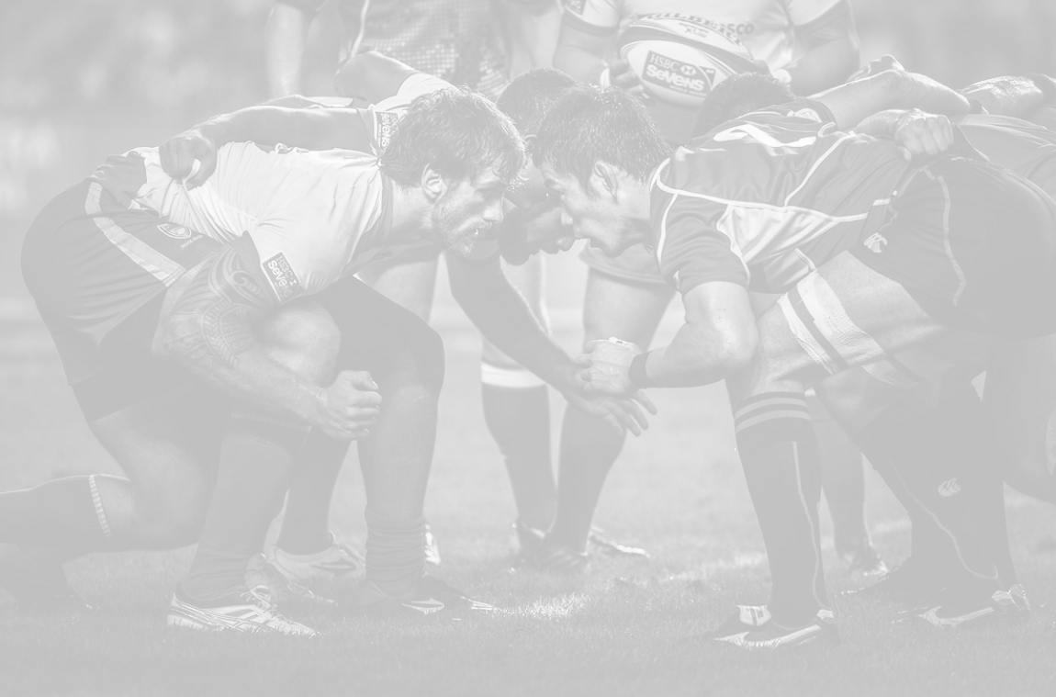
Agile Design and SCRUM
Brent M. Dingle, Ph.D.
“For the last few centuries, … science has been attempting to
break matter down into ever smaller bits, in the pursuit of understanding.
And this works, to some extent...
but putting things back together in order to understand them is harder,
and typically comes later in the development of a scientist
or in the development of science.”
- Nicholas A. Christakis, M.D., Ph.D.

Slide 2
Setup
Agile Design and SCRUM
  There are many books and theories and strategies on this
  Read them if you have time
A simplified overview follows
  Detailed for this course
    Every business manages things the same but different
      This course is no exception

Slide 3
Main Points and Goals of Teamwork
Everyone must work
Communication must exist
Team Progress must be measurable
Individual Progress must be measurable
Everyone is accountable
Deadlines must be met
  Product must be delivered

Slide 4
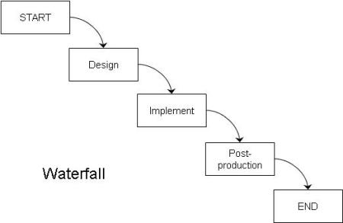
Traditional vs Scrum Comparison
Traditional
Old project management concepts
were not very adaptive
Planning was assumed to be absolutely
correct at the beginning
and nothing would go wrong
Command and Control
Plan what you expect
Enforce the plan, sometimes regardless of changing conditions
Estimate everything up front
Delivery at end (of contract)
Most companies today have
switched to more
AGILE
and adaptive management
and planning strategies…

Slide 5
Traditional vs Scrum Comparison
We will be using a SCRUM
based Agile Design Approach
Traditional
Scrum
Command and Control
Plan what you expect
Enforce the plan, sometimes regardless of changing conditions
Estimate everything up front
Delivery at end (of contract)
Self-directed teams
Learn as we go
Plan for changes
Embrace change to deliver best product
Use Inspect and Adapt
Continuous delivery of working functionality

Slide 6
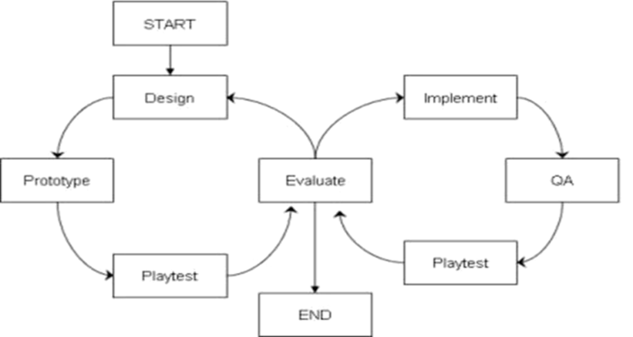
Traditional vs Scrum Comparison
This is consistent with Iterative
and Rapid Prototyping Design
We will be using a SCRUM
based Agile Design Approach
Traditional
Scrum
Command and Control
Plan what you expect
Enforce the plan, sometimes regardless of changing conditions
Estimate everything up front
Delivery at end (of contract)
Self-directed teams
Learn as we go
Plan for changes
Embrace change to deliver best product
Use Inspect and Adapt
Continuous delivery of working functionality

Slide 7
Sprints
Our application of SCRUMs and Agile Design
  Divides time into Sprints
    Typically each sprint is 2 weeks long
Team sizes range from 4 to 8 people
  Depending on enrollment

Slide 8
Simple Summary
Develop from Success to Success
Continually thinking:
What did you get done?
What will you do next?
What is in your way?
starting and completing when?

Slide 9
Early Sprints
First/Early Sprints Should Focus on
  Getting Organized
  Getting reference material and rules in place
  Planning and Testing
  Getting to a mockup of your game quickly
  Determining what needs tested
    and how and when and by who
Plan for iterations

Slide 10
Every Week
Every week (roughly every Sunday night)
each team MUST create a “build”
  It must be “runnable” and testable
    If something prevents the project from running
      Then it is NOT done and should NOT be in the build
      Test everything before committing
This means
  every Monday you have a deliverable product
    features should increase each week

Slide 11
Every Sprint
At the End of Every Sprint
Deliverables are Due
  Presentation/demo/video of the game (in-class)
  Evaluations on other team members
  Begin planning for next Sprint
  Other tasks as needed
    check with instructors each sprint
Continually think:
Presentations should
  Demonstrate what was done/added/improved
    Highlight what each team member contributed for the current sprint
  Indicate what will be done in the next sprint
  Briefly mention anything preventing progress
  Also
    Every team member should speak
    The team should look like a team and act like a team throughout the presentation
What did you get done?
What will you do next?
What is in your way?

Slide 12
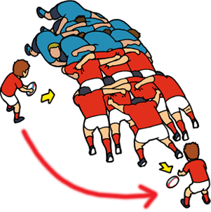
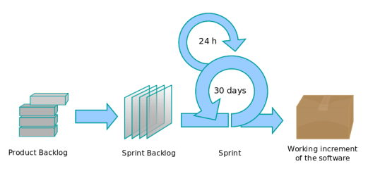

History of Scrum
1986: Scrum was first defined as
  a flexible, holistic product development strategy where a development team works as a unit to reach a common goal
    Hirotaka Takeuchi and Ikujiro Nonaka
    Paper: New New Product Development Game
Scrum is an iterative and incremental agile software development framework for
managing software projects and product
or application development.
Scrum enables the creation of self-organizing teams by encouraging communication between all team members and disciplines in the project.
ASIDE: In rugby football, a scrum refers to the manner of restarting the game after a minor infraction

Slide 13
What is SCRUM
1986: Scrum was first defined as
  a flexible, holistic product development strategy where a development team works as a unit to reach a common goal
    Hirotaka Takeuchi and Ikujiro Nonaka
    Paper: New New Product Development Game
Scrum is an iterative and incremental agile software development framework for
managing software projects and product
or application development.
iterative incremental agile framework managing
development
enables self-organizing teams by communication
Scrum enables the creation of self-organizing teams by encouraging communication between all team members and disciplines in the project.
ASIDE: In rugby football, a scrum refers to the manner of restarting the game after a minor infraction

Slide 14
How to SCRUM
SCRUMs occur every day (every class)
  Short status report of each team member
  Answer 3 questions:
What did you get done? (since the previous scrum)
What will you do next?
What is in your way?
This includes
an ESTIMATE OF WHEN
it will be completed

Slide 15
Scrum Roles
Who are the Participants
  Scrum Team Members (“The Team”)
  Scrum Master
  Product Owner
  Stakeholders / Everyone Else
The Students
Sometimes a Student
The Instructor(s)

Slide 16
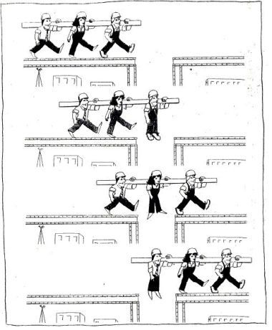
Scrum Roles: Team and Ground Rules
The key to Scrum is operating
as a team
The longer a team is together,
the more effectively it operates
Creating a set of “ground rules”
may help create a more collaborative environment to operate within as a team

Slide 17
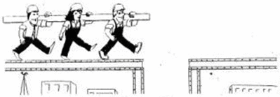
Scrum Roles: Team and Ground Rules
The key to Scrum is
operating as a team
The longer a team is together,
the more effectively it operates
Creating a set of “ground rules”
may help create a more collaborative environment to operate within as a team

Slide 18

Scrum Roles: Scrum Master
Facilitates the Scrum Framework
  Upholds Scrum values and practices
  Oversees the Scrum Meetings
Helps the team be as efficient
as possible
  Works for the Team
  Facilitates continuous improvement
  Helps remove barriers
Enables the team to accomplish Scrum

Slide 19


Scrum Roles: Product Owner
Ultimate responsibility
and authority
  Interface to the customer
  Conveys the vision to the team
  Determines when a feature is done
    implicit link to quality
  Single person, not a committee
  Is available to the team

Slide 20

Framework Overview
Start Here
Move to
the Right
Daily Scrum
Meeting
Potentially
Shippable
(Incremental)
Product
Product
Backlog
24 hours
Sprint
Backlog
1-5 weeks
Sprint
Planning
Part 1
Sprint
Planning
Part 2
Sprint
Review
Sprint
Retrospective

Slide 21

Stories in the Product Backlog
Features and requirements
are tracked as Stories
in the Product Backlog
  Each story must contain
  a description, priority, and estimate
For this course
(most) STORIES = ASSETS
Product Backlog = Master Task List

Slide 22
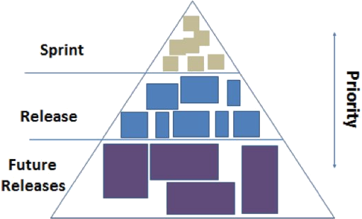
Sprint Planning – Part 1
“The What”
What stories (tasks) are going to be worked on this sprint?

Slide 23
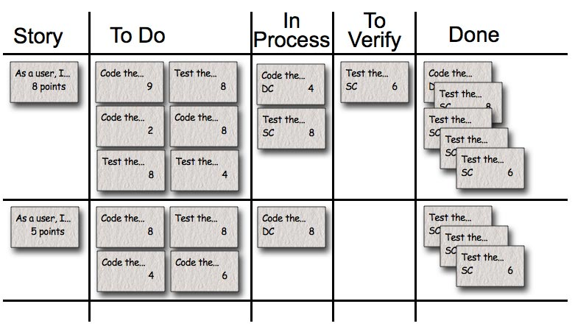

Sprint Planning – Part II
“The How”
Do any of the stories need to be broken into tasks?
If you already decomposed
the game this should
be a simple activity
You now need “volunteers” to work on each task needed for the current sprint

Slide 24

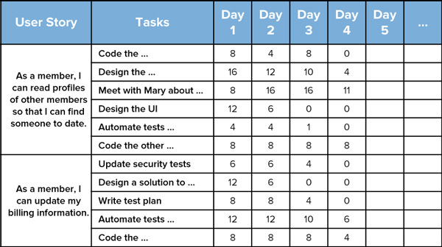
The Daily Scrum
Status your progress to the team
Keep track of
what you have done
what you are doing
and what you will be doing
Remember to Record
Task Progress

Slide 25
Sprint Release
Check stuff into D2L
and
Create a marker point in the version control system

Slide 26
Sprint Review/Demonstration
This is your presentation and demo at the end of each sprint

Slide 27
Sprint Retrospective
For this course
This will usually (but not always) be
the teammate evaluations
The Scrum Team
  Possibly other stakeholders
Purpose
  Evaluate what is and is not working
  Plan ways to improve
  Document lessons learned
  Inspect and Adapt opportunity – for the sake of the Team
Output
  Ways to improve as a team
    May be a change to process
    Can be captured as a Story/Task and added to the product backlog

Slide 28
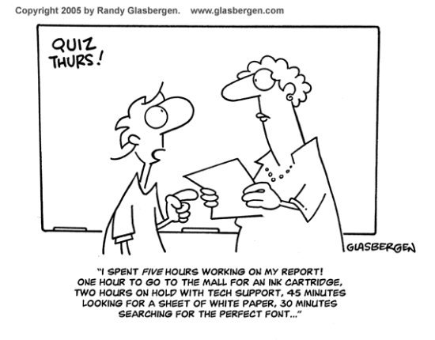


Questions?

