Slide 1
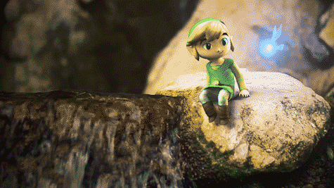
Working Game Title
Game Pitch
by
Your Name
your_email@address.edu
Game Pitch Template, 2015
by Brent M. Dingle, Ph.D.
GDD 450

Slide 2
This Slide is NOT Here
What follows is a template
There are MANY ways to organize this type of presentation
There are many ways to convey the information
Simple outline:
Step 1: Tell them your game is a great idea
Step 2: Show them why/how
Step 3: Summarize to them you have now proven your game is a great idea
Step 4: Tell them they want in on this great opportunity

Slide 3
This Slide is NOT Here
Critical information to include
Game Name
and Your name and contact info
One-Two Liner Marketing Description
Genre, Platform
Description (narrative)
Key/Unique Game Features
Core Gameplay (technical description)
Rules, goals, “win/lose” conditions, points, scoring…
General walk through of game flow
Art Style
Implicit and/or explicit description
Feel of the game’s appearance/nature
Elevator pitch
can summarize all this
This is an extended version
-- it may not need to be

Slide 4
This Slide is NOT Here
More optional information is
User Interface
Usually changes during development, regardless of pitch
Useful to show how the gameplay might work
Sound
While optional for a pitch, it could sell it
Story
Explicit details are not needed
Descriptions usually imply
Extra detail typically not needed for a pitch, but might sell it
Levels
Implicit in game mechanics and flow
Extra detail may be useful
Meta-purpose
May or may not be one, if there is then mention it

Slide 5
This Slide is NOT Here
More optional information is
Schedule, Personnel, Tools, Asset Requirements
Good to have to handle questions (may not need explicit inclusion in pitch)
May give a feel of how things will work and can be done
Useful in proving the game idea is reasonable and can be successfully implemented
Comparison to existing ‘competition’
Useful in QUICKLY establishing feel general idea of game
BUT might make it seem like just another knockoff
HIGH RISK if your unique points are difficult to see or poorly explained
May help establish feasibility of successful completion
But there are other ways to accomplish that
May be required if you have limited time (or a dense/slow audience)
Other items
Unique points should be explained and sold
They might not fit into the typical description or may need more emphasis

Slide 6
This Slide is NOT Here
In sum of what MUST be included
Cover the critical stuff
How and how detailed is up to you
The optional stuff
You know your game idea
You likely are the only one who knows it
You must decide what will sell it
Knowing your audience helps
What they like
What they want to achieve

Slide 7
This Slide is NOT Here
Advice:
Say what must be said as clearly and succinctly as possible, say no more
You WANT questions
Lead the audience to ask them
Be ready to answer them
Even the ones you did not want

Slide 8
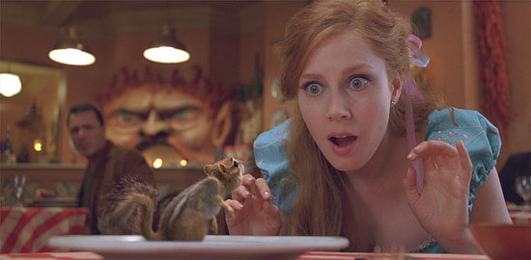
Working Game Title
The Introduction and/or Marketing tagline goes here. This is the catchy line or two that attracts attention and really makes the reader want to find out more!
Genre: Perhaps a genre?
Platform: PC, iOS, Wii, Xbox…

Slide 9
Working Game Title Description (narrative)
Description:
Describe the game to the reader as if they are the player.
Do this from the second-person perspective (you).
This description should be very exciting and thrilling.
You will find it can then be a mesmerizing and imagination capturing storyline for your game. It should tell of grand adventure and daring deeds. Detailing how you will experience all the adrenaline and spine tingling sensations that can be imagined as you explore and do great and magnificent things. It might start with words like:
It was a dark and stormy night, you were out by the… when… You now find yourself…
This description should be a single paragraph.
Remember the visual aspects too
Use them well throughout the presentation

Slide 10
Working Game Title Key Game Features
Key Game Features
Create a list
List the unique and interesting aspects of your game
Sell your game
Be descriptive. Look at as many examples as you can
Keep it brief
Keep the list around 5 points, never more than 10
Use visual enhancements
Images may complement these bullet points nicely
Define your game
These points are the what, how, and why your game should be made
Summarize your items
Each bullet might be a topic word or two, followed by a description

Slide 11
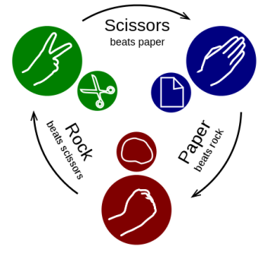
Working Game Title Game Play Description
Game Mechanics: Core Gameplay and Game Flow
In a paragraph or less describe the essence of the game.
These will be words from which the design grows. This is a more technical (non-narrative) description.
Game flow may be illustrated with a diagram or words or both.
Trace the flow of gameplay with a description of player activity. Focus on the progression of challenges and entertainment. Be specific about what the player does.
Do not describe the GUI (do that elsewhere if at all)
Describe what the player can and will typically do.
The game flow activity should be an extension from the core gameplay.
Having an explicit description of the game’s rules is also valuable
What can the player do? What is the nature of the game’s environment? What does it do?

Slide 12
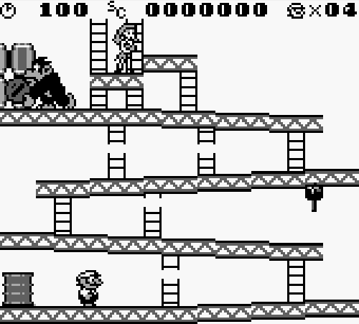
Working Game Title Gameplay (good to have)
Within ‘gameplay’ include:
Points/Scoring
What are the players trying to accomplish? How will they know they succeeded?
Is it score based? How is the player scored? What achievements do players get as they play?
End Game
How does the game end? How does the player win? How does the player lose? Can the game be played again? Why would it be played a second time?
A “sketch” prototype might be useful in establishing this and other gameplay aspects
A video showing the prototype being played could be useful
If comments were made as it played through
Or if gameplay basics were discussed prior to playing it

Slide 13
This Slide is NOT Here
Add detail as needed, things such as:
Game Mechanics
Additional details for clarity or demonstration of FUN/unique
Core Gameplay and Game Flow
User Interface
Art and Sound
Story
Levels
Meta-Purpose
Schedule and Planning
Personnel
Tools
Asset Requirements
Emphasize the UNIQUE and FUN parts of your game
Show how and why they are so
Make the FEEL of your game clear and obvious

Slide 14
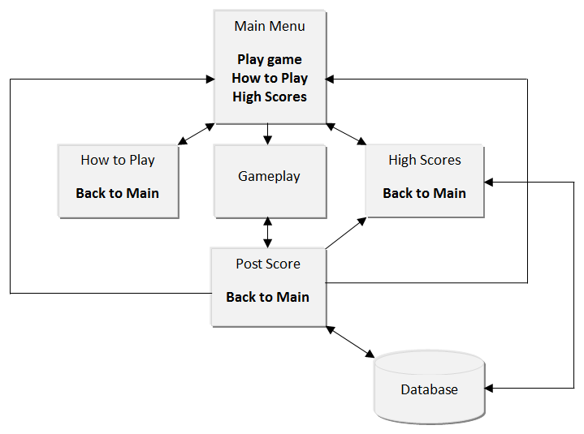
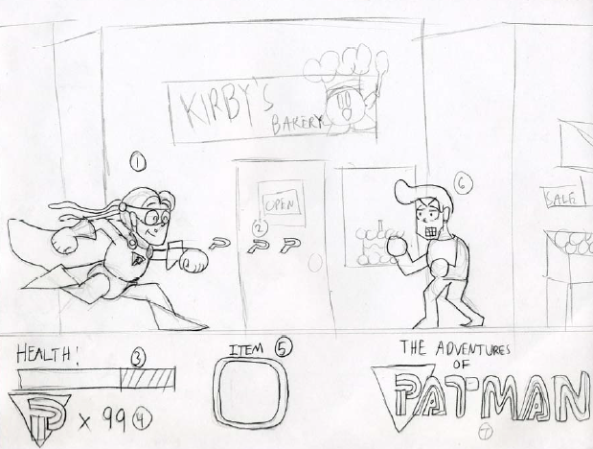
Working Game Title Optional Extra Information As Needed
User Interface
You may provide a flowchart to demonstrate how the player will navigate through various screens.
You may use mock-up sketches to illustrate your main gameplay screen and the information it will convey to the player.

Slide 15
Working Game Title Optional Extra Information As Needed
Art and Sound
Art style can be described in words or implied by included artwork.
The use of sound in your game will require words (voice acting, sound effects, music).
If sound is going to be a major component of your game then describe/show how it will be.
Discussion of cut scenes, or other video playback within the game, may also be useful.

Slide 16
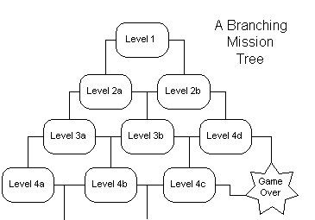
Working Game Title Optional Extra Information As Needed
Levels
What are levels in your game?
How does the player go through them?
Is a specific order required?
What, if any, level defines the “end?”
How does the player get there?

Slide 17
Working Game Title Optional Extra Information As Needed
Meta-Purpose
Does the game have educational or training aspects to it?
Does the game test a new interface?
Does the game trick players into accomplishing something that is beyond the explicit game?
A meta-purpose may offer a new context to re-task or reuse an old or previously implemented game setup
i.e. A “new spin” on an old idea

Slide 18
Working Game Title Optional Extra Information As Needed
Schedule, Personnel, Tools, and Asset Requirements
What is needed to make this game?
How long will it take?
How much will it cost?
Will support tools need to be created?
e.g. level design tool
How many people (of what skillsets) will this require?
Can/will the game make money? How? Why?

Slide 19
Working Game Title Optional Extra Information As Needed
Story
A synopsis of your game’s story is good to have.
This is implied greatly from the above descriptions.
Additional details may be explicitly mentioned
BE BRIEF
Leave room for adaptation.
Story provides context for how the player got to where the game starts and how they will win or lose or forever play the game.

Slide 20
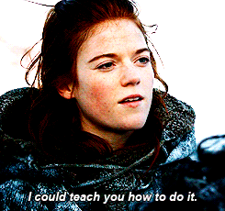
Working Game Title Optional Extra Information As Needed
In the end
Sell your game
Convey the idea and feel

Slide 21
Working Game Title Summary
Summary
This game will be AWESOME
It has many opportunities
It has AMAZING gameplay
I look forward to working with all of you!
This class will be GREAT!

Slide 22
The End

